Slide 1
NU CIF Project
University of Nebraska – Omaha Capstone
Talon Flynn, Amber Makovicka, Neil Thorne, Jackson Urrutia

Slide 2
Overview
Introduction
Cybersecurity Threat Landscape
What is CIF, and why is it relevant?
Research Questions
Methodology
Demo
Findings
Notes:
Why overview?
The direction of our project has changed slightly
Due to gaining a better understanding of the requirements from the stakeholder and strategizing how best to tackle the problem
It has also been a bit since we talked about the project, so we figured a quick recap wouldn’t hurt

Slide 3
Overview – Threat Landscape The Cost of Cybercrime Study by Accenture Security
2017
$11.7 million average total cyber crime costs per company in study
2018
$13.0 million average total cyber crime costs per company in study
Notes:
Kelly Bissell, Ryan Lasalle, Floris Van Den Dool, and Josh Kennedy-White. 2018. Gaining Ground on the Cyber Attacker: 2018 State of Cyber Resilence. (April 2018). Retrieved February 23, 2020 from https://www.accenture.com/in-en/insights/security/2018-state-of-cyber-resilience-index

Slide 4
Overview – Threat Landscape Global Application & Network Security Report Study by Radware
Average $1.1 million cost per cyber attack
Equifax
$430 million
$600 million Projected
Yahoo!
$1.3 billion
Sold to Verizon $350 million below initial offer
Notes:
Ezra, Y. B., Pariente, N., Zilberman, B., & Smith, D. (n.d.). Global Application & Network Security Report (pp. 1–64). Radware.

Slide 5
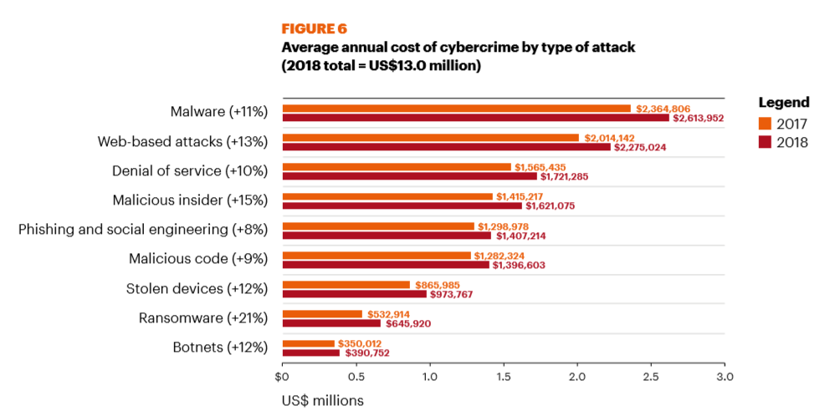
Overview – Threat Landscape The Cost of Cybercrime Study by Accenture Security
Notes:
Kelly Bissell, Ryan Lasalle, Floris Van Den Dool, and Josh Kennedy-White. 2018. Gaining Ground on the Cyber Attacker: 2018 State of Cyber Resilence. (April 2018). Retrieved February 23, 2020 from https://www.accenture.com/in-en/insights/security/2018-state-of-cyber-resilience-index

Slide 6
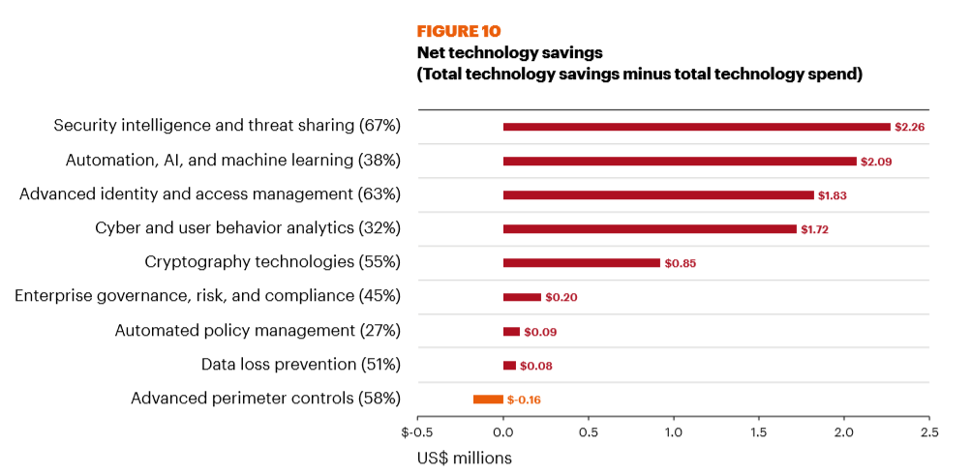
Overview – Threat Landscape The Cost of CyberCrime Study by Accenture Security
Notes:
Security intelligence and threat sharing has the highest cost savings. 67% respondents use it, average 2.26 million savings
Kelly Bissell, Ryan Lasalle, Floris Van Den Dool, and Josh Kennedy-White. 2018. Gaining Ground on the Cyber Attacker: 2018 State of Cyber Resilence. (April 2018). Retrieved February 23, 2020 from https://www.accenture.com/in-en/insights/security/2018-state-of-cyber-resilience-index

Slide 7
Collective Intelligence Framework (CIF)
Developed by REN-ISAC (Information Sharing Network for Higher Education)
Server that pushes/pulls threat feeds to/from internal database
Indicators: IPv4, IPv6, Email, URL, FQDN
Tags: botnet, exploit, hijacked, malware, phishing, scanner, search, suspicious, bruteforce, whitelist, uce, darknet, dns
Confidence Levels

Slide 8
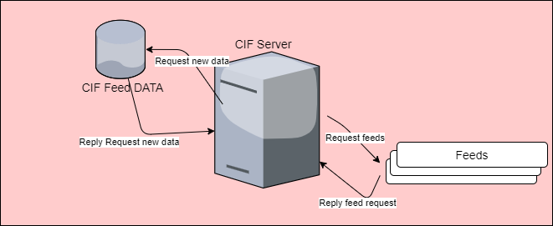
Collective Intelligence Framework (CIF)

Slide 9
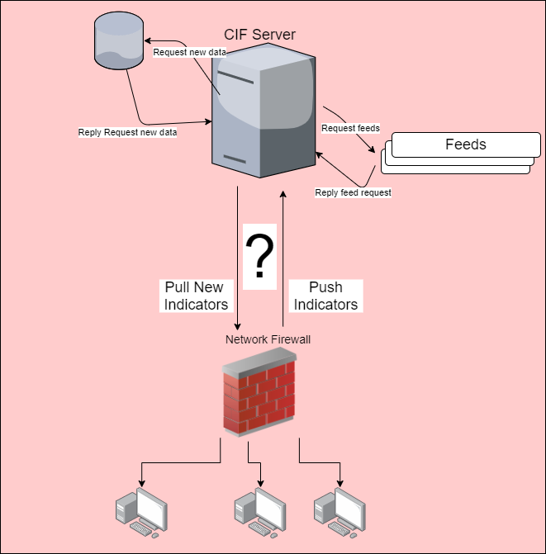
Implementing CIF Into Security Infrastructure

Slide 10
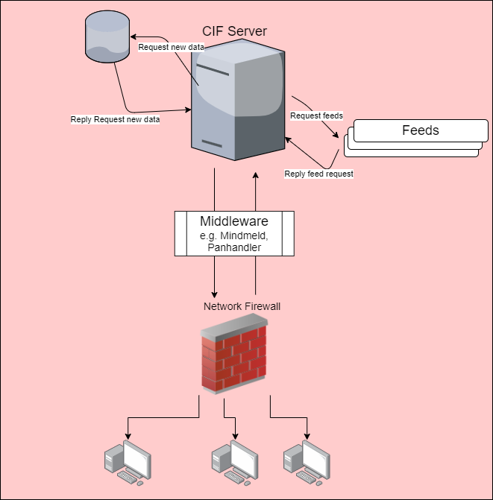
Implementing CIF Into Security Infrastructure

Slide 11

Implementing CIF Into Security Infrastructure

Slide 12
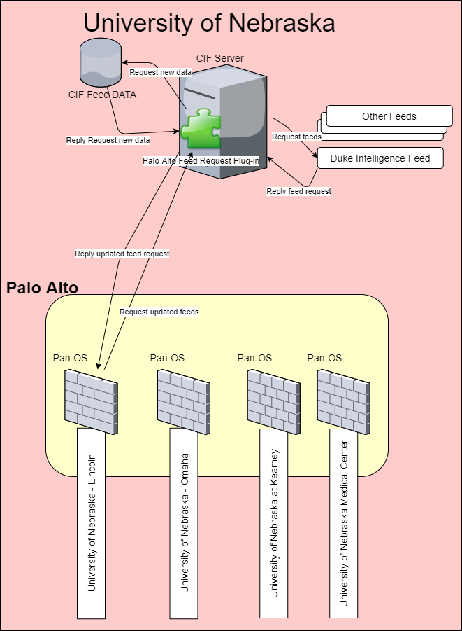
Implementing CIF Into Security Infrastructure: UN

Slide 13
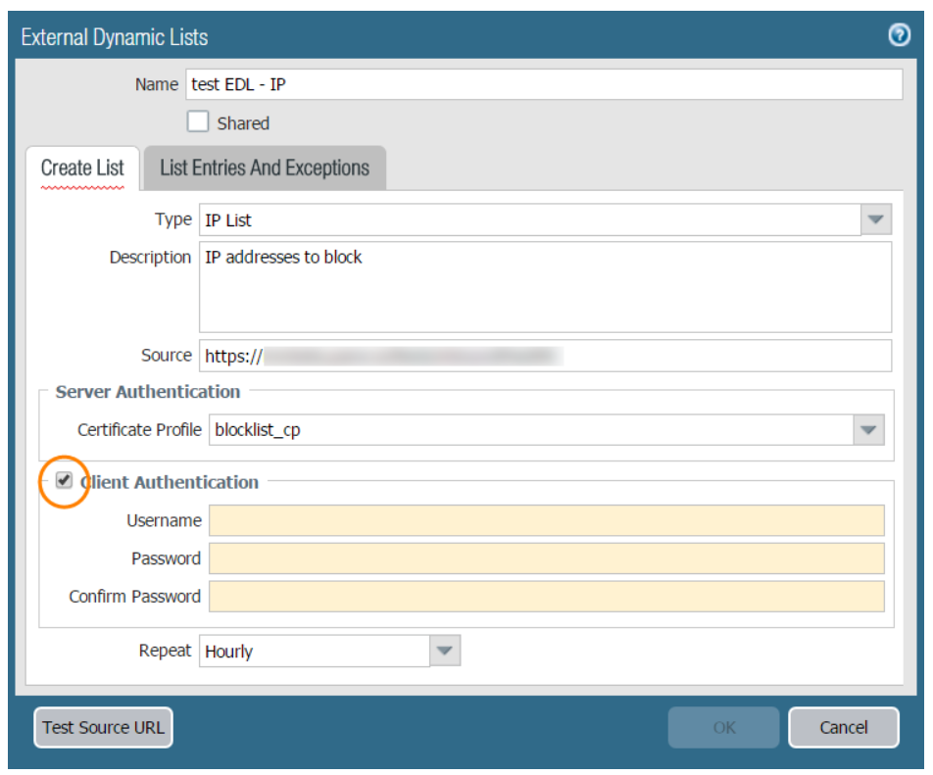
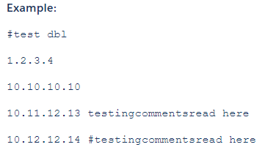
Palo Alto Constraints
External Block Lists: 5,000 maximum each
Maximum total for UN’s Palo Alto: 150,000
Cannot process token in header
Format:
99.11.22.33
11.22.33.44
…
First 5,000 IPs
123.11.22.33/palo/?page_num=1
123.11.22.33/palo/?page_num=2
99.11.22.33
11.22.33.44
…
Second 5,000 IPs

Slide 14
Research Question(s)
To what extent does the timeliness of threat intelligence gathering, aggregation, and sharing affect risk profile reduction within a university enterprise setting?
If there are security efficacy outcomes, what are the costs?

Slide 15
Methodology
Pull 7-day report of blocked IPs from current CIF setup.
Implement Solution
Pull 7-day report of blocked IPs from new CIF setup

Slide 16
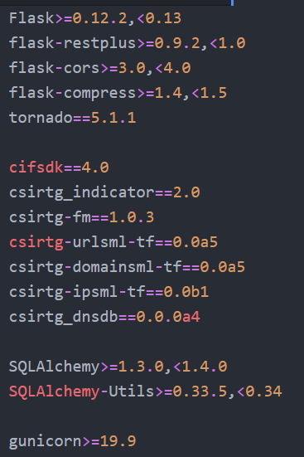
requirements.txt
Flask Web App Framework
CIF-related Packages

Slide 17
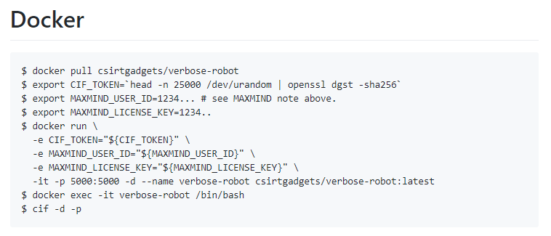
Setup CIF Test Environment
Instructions from CIFv4 Wiki

Slide 18
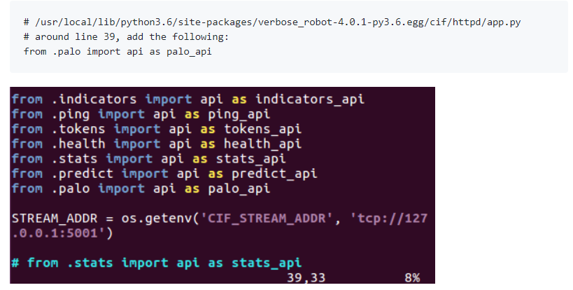
Palo Endpoint Setup

Slide 19
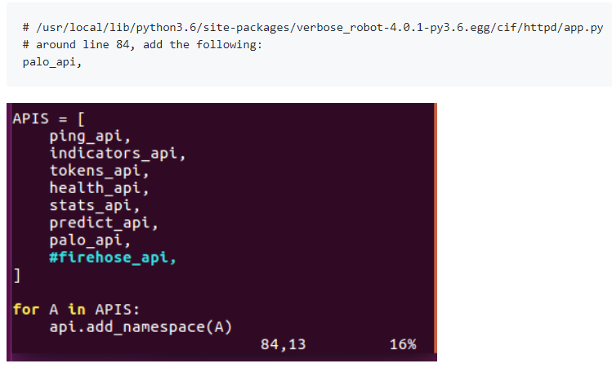
Palo Endpoint Setup

Slide 20
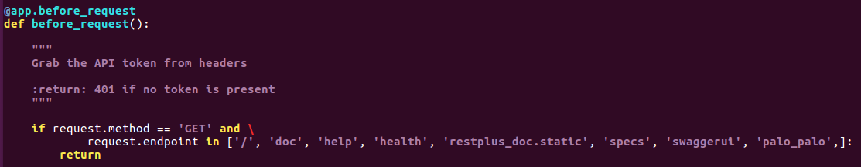
Palo Endpoint Setup
# /user/local/lib/pypthon3.6/site-packages/verbose_robot-4.0.1-py3.6.egg/cif/httpd/app.py
# Around #238 add to prevent need for authorization token

Slide 21
Palo Endpoint
# /user/local/lib/pypthon3.6/site-packages/verbose_robot-4.0.1-py3.6.egg/cif/httpd/palo.py
Parameter input sanitization
Grabs all IP address and sorts them by ID
Implements paging mechanism
Writes IPs to file and returns file to client

Slide 22
Palo Endpoint Versions
Version 1:
curl command inside our endpoint executed another endpoint
Version 2:
Implicit parameter via Flask variable rule:
E.g. /palo/1
Writing file to disk
Version 3:
StringIO
Explicit parameter: /palo/?page_num=1

Slide 23
Demo

Slide 24
Test Results and Findings
To what extent does the timeliness of threat intelligence gathering, aggregation, and sharing affect risk profile reduction within a university enterprise setting?
If there are security efficacy outcomes, what are the costs?
Examined 2.5hrs of network traffic
Theoretical analysis: applied the previous day’s newly added IP blocklist to the next day’s network traffic

Slide 25
Test Results and Findings
59 unique IP addresses added from previous day’s CIF server
44 of these IP addresses referenced in 2.5hrs sample of network traffic
375,683 Total Packets
162 Malicious Packets
95 considered “Blocked” had a 15minute strategy been implemented

Slide 26
Test Results and Findings: Limitations
2.5 hour sample of data NOT representative of all network traffic
Known malicious IPs in sample NOT representative of all malicious traffic

Slide 27
Closing Thoughts
To what extent does the timeliness of threat intelligence gathering, aggregation, and sharing affect risk profile reduction within a university enterprise setting?
Answer: Analysis based on theoretical model suggests a 57% reduction of known malicious traffic (view finding with caution)
If there are security efficacy outcomes, what are the costs?
CIF is an open source project
Basic setup can be conducted in around an hour

