Slide 1
NU CIF Project
University of Nebraska – Omaha Capstone
Taylor Flynn, Amber Makovicka, Neil Thorne, Jackson Urrutia

Slide 2
Milestone 2 Overview
Brief Overview
Research Question(s)
Methodology
Requirements
Current Status
Notes:
Why overview?
The direction of our project has changed slightly
Due to gaining a better understanding of the requirements from the stakeholder and strategizing how best to tackle the problem
It has also been a bit since we talked about the project, so we figured a quick recap wouldn’t hurt

Slide 3
Overview – Threat Landscape The Cost of CyberCrime Study by Accenture Security
2017
130 security breaches
$11.7 million average cyber crime costs
2018
145 security breaches
$13.0 million average cyber crime costs
Notes:
Kelly Bissell, Ryan Lasalle, Floris Van Den Dool, and Josh Kennedy-White. 2018. Gaining Ground on the Cyber Attacker: 2018 State of Cyber Resilence. (April 2018). Retrieved February 23, 2020 from https://www.accenture.com/in-en/insights/security/2018-state-of-cyber-resilience-index

Slide 4
Overview – Threat Landscape Global Application & Network Security Report Study by Radware
Average $1.1 million cost per cyber attack
Equifax
$430 million
$600 million projected
Yahoo!
$1.3 billion
Sold to Verizon $350 million below initial offer
Notes:
Ezra, Y. B., Pariente, N., Zilberman, B., & Smith, D. (n.d.). Global Application & Network Security Report (pp. 1–64). Radware.

Slide 5
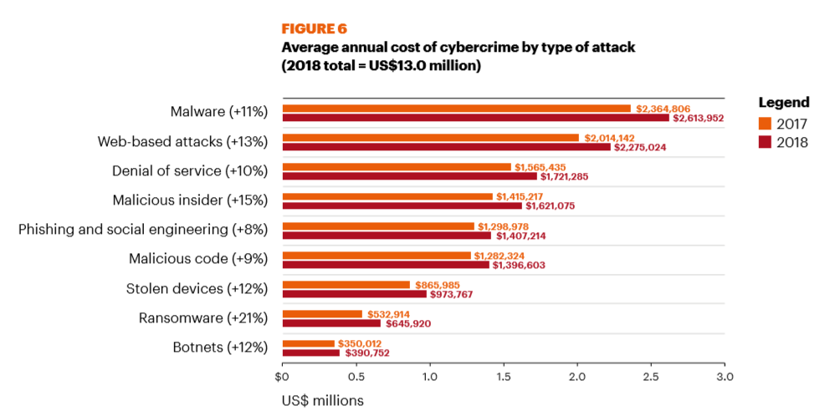
Overview – Threat Landscape The Cost of CyberCrime Study by Accenture Security
Notes:
Kelly Bissell, Ryan Lasalle, Floris Van Den Dool, and Josh Kennedy-White. 2018. Gaining Ground on the Cyber Attacker: 2018 State of Cyber Resilence. (April 2018). Retrieved February 23, 2020 from https://www.accenture.com/in-en/insights/security/2018-state-of-cyber-resilience-index

Slide 6
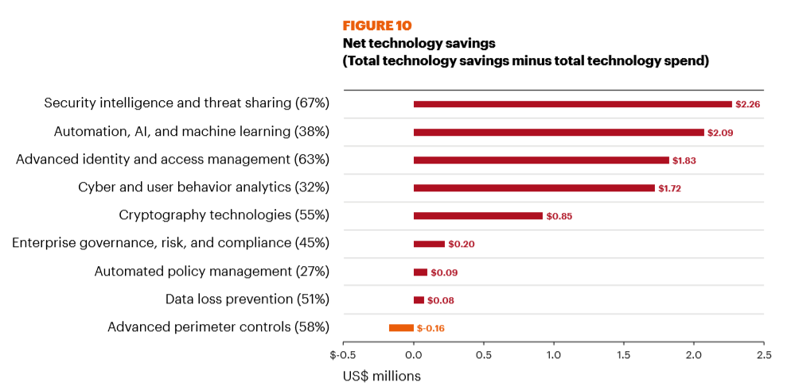
Overview – Threat Landscape The Cost of CyberCrime Study by Accenture Security
Notes:
Security intelligence and threat sharing has the highest cost savings. 67% respondents use it, average 2.26 million savings
Kelly Bissell, Ryan Lasalle, Floris Van Den Dool, and Josh Kennedy-White. 2018. Gaining Ground on the Cyber Attacker: 2018 State of Cyber Resilence. (April 2018). Retrieved February 23, 2020 from https://www.accenture.com/in-en/insights/security/2018-state-of-cyber-resilience-index

Slide 7
Collective Intelligence Framework (CIF)
Developed by REN-ISAC (Information Sharing Network for Higher Education)
Server that pushes/pulls threat feeds to/from internal database
Indicators: IPv4, IPv6, Email, URL, FQDN
Tags: botnet, exploit, hijacked, malware, phishing, scanner, search, suspicious, bruteforce, whitelist, uce, darknet, dns
Confidence Levels

Slide 8
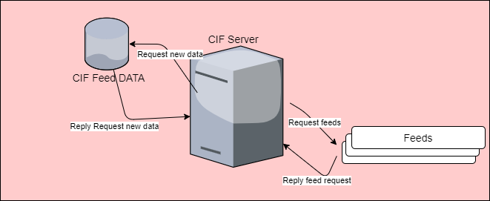
Collective Intelligence Framework (CIF)

Slide 9
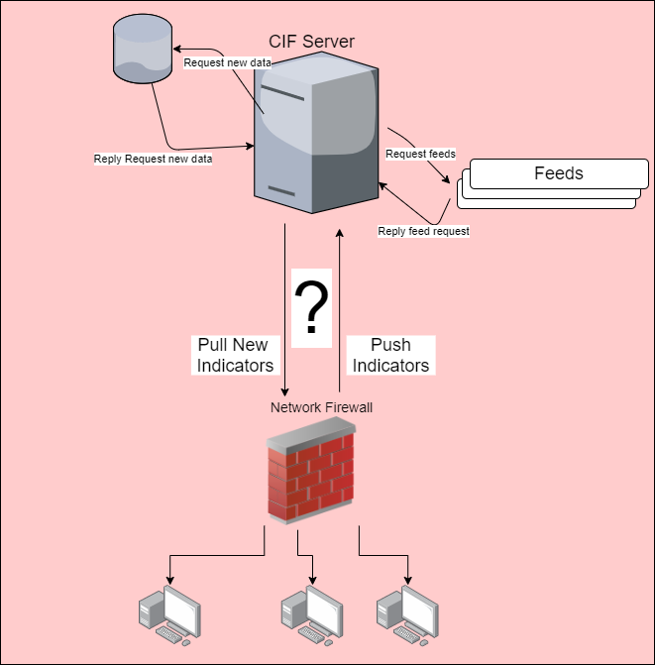
Implementing CIF Into Security Infrastructure

Slide 10
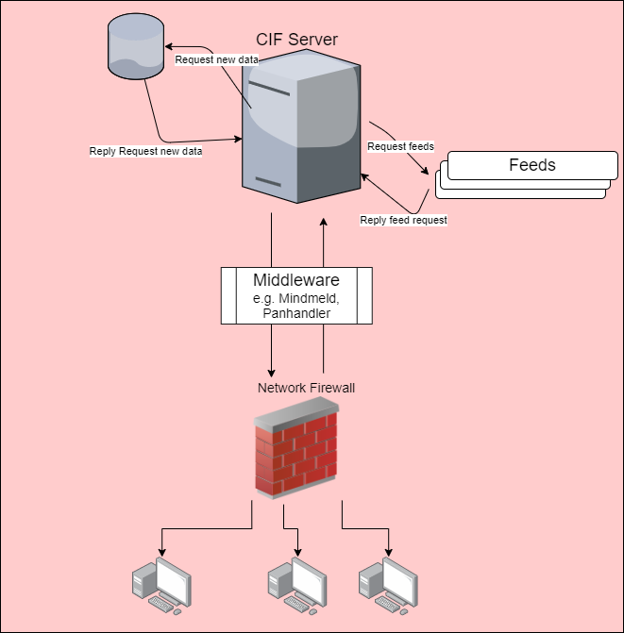
Implementing CIF Into Security Infrastructure

Slide 11

Implementing CIF Into Security Infrastructure

Slide 12
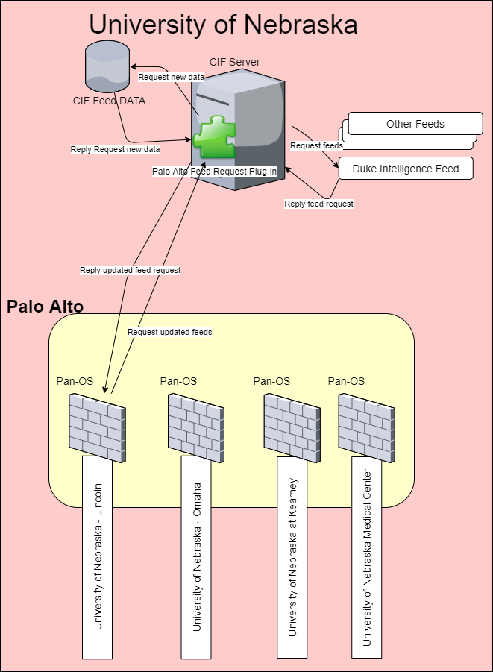
Implementing CIF Into Security Infrastructure: UN

Slide 13
Research Question(s)
To what extent does the timeliness of threat intelligence gathering, aggregation, and sharing affect risk profile reduction within a university enterprise setting?
If there are security efficacy outcomes, what are the costs?

Slide 14
Methodology
Pull report of IPs being blocked by Current CIF over 7-day period
Measure traffic
Implement Solution
Pull report of IPs being blocked by CIF over 7-day period
Measure traffic

Slide 15
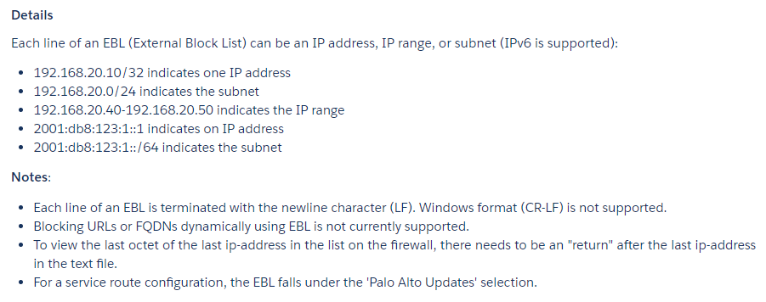
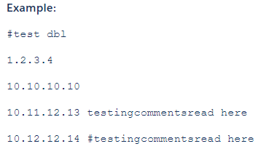
Palo Alto Requirements
https://knowledgebase.paloaltonetworks.com/KCSArticleDetail?id=kA10g000000ClVYCA0

Slide 16
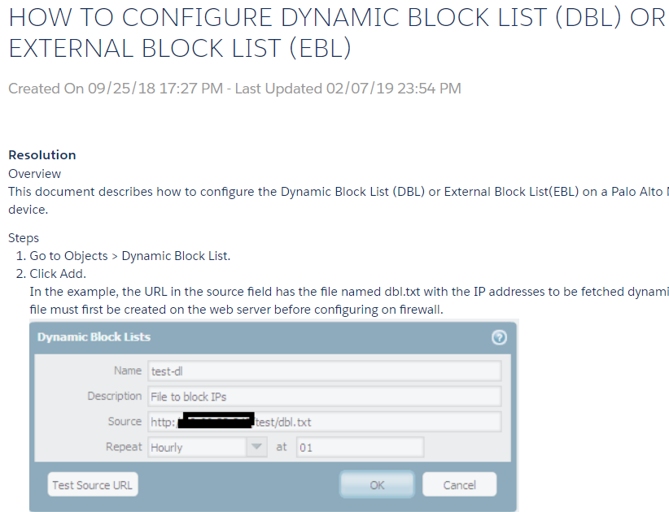
Palo Alto Requirements
https://knowledgebase.paloaltonetworks.com/KCSArticleDetail?id=kA10g000000ClFOCA0

Slide 17
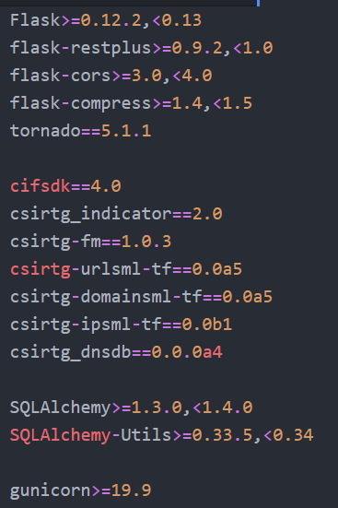
Requirements
Python Knowledge
Flask Web App Framework
CIF-related Packages

Slide 18
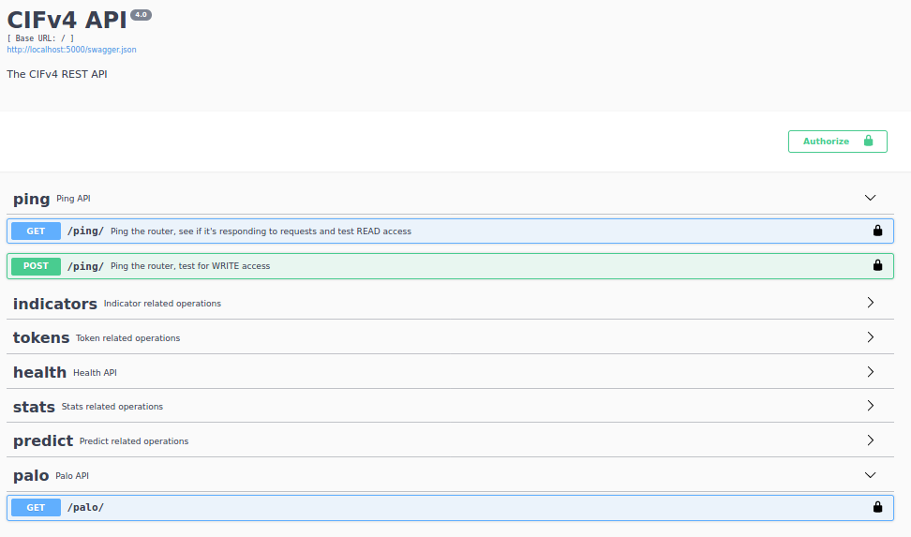
Current Status

Slide 19
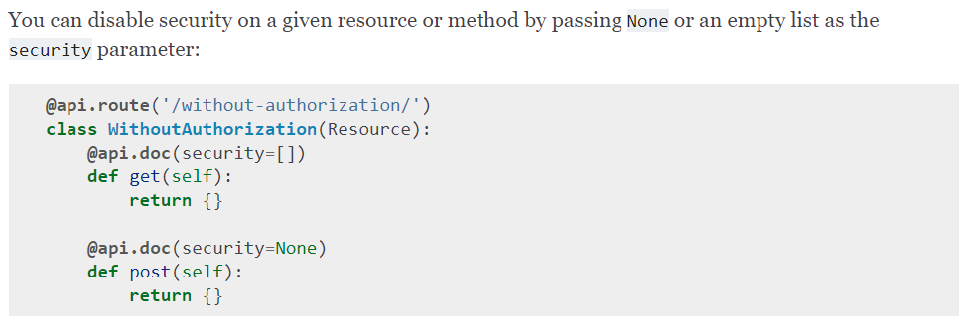
Current Status
https://flask-restplus.readthedocs.io/en/stable/swagger.html#documenting-authorizations

Slide 20
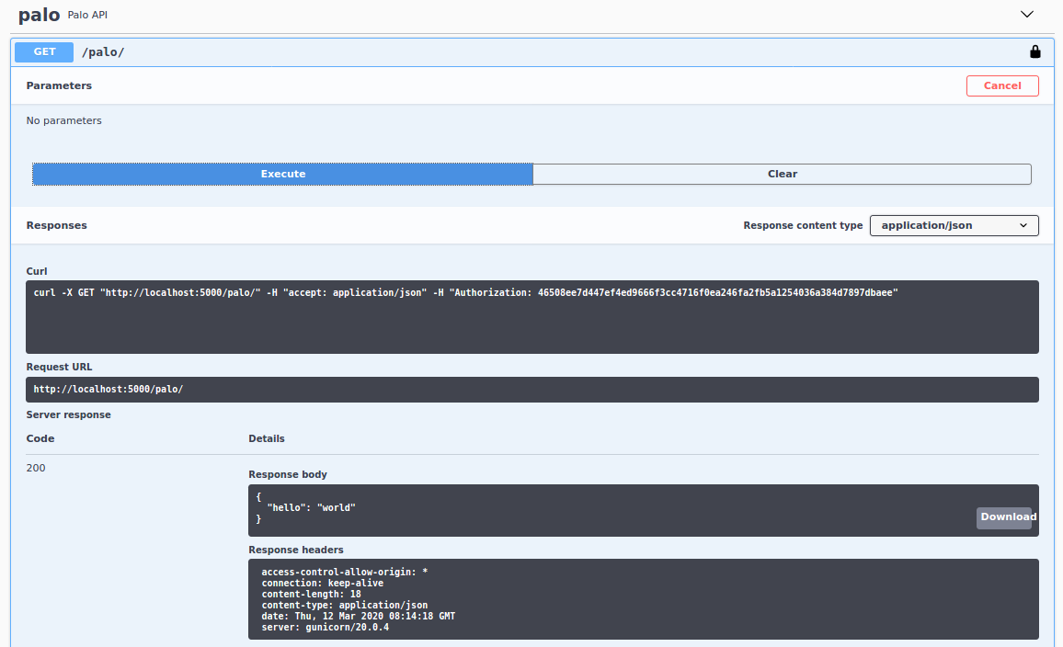
Current Status

Slide 21
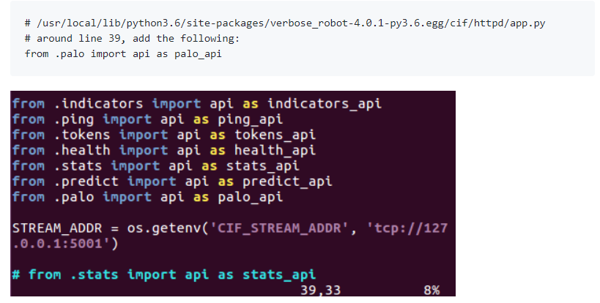
Current Status - Details

Slide 22
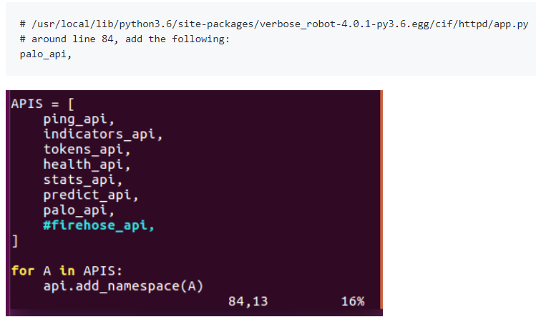
Current Status - Details

Slide 23
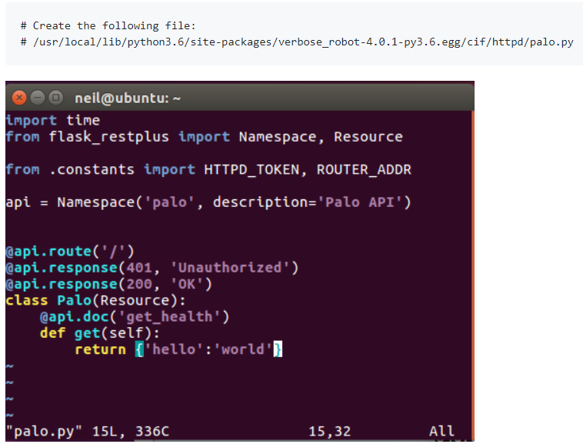
Current Status - Details

Slide 24
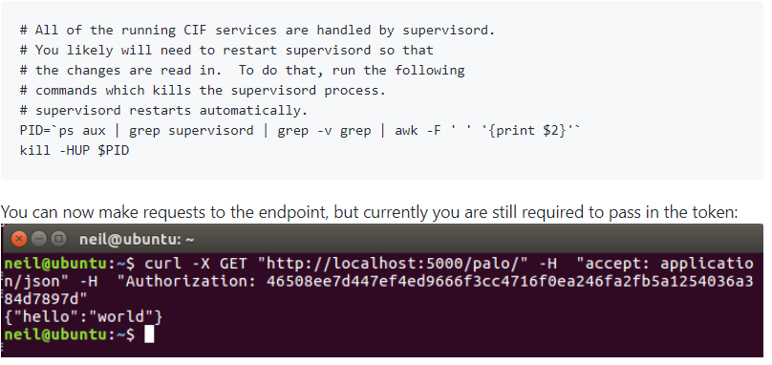
Current Status - Details
cron_restart.sh
(referenced in Dockerfile)

Slide 25
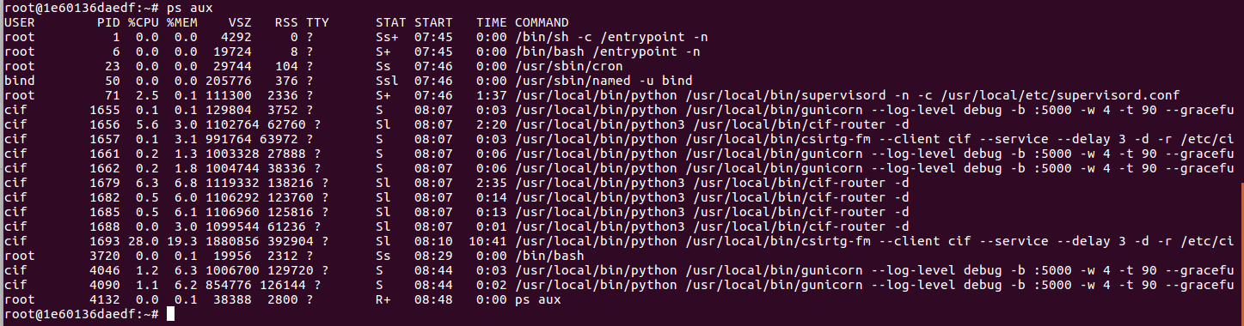
Current Status – Boot Up

Slide 26
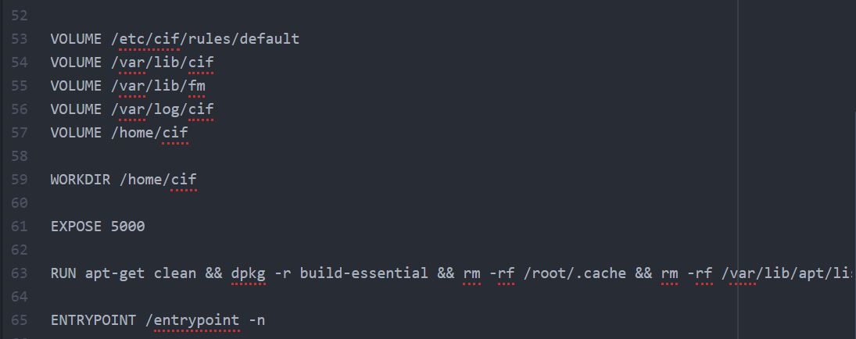
Current Status – Boot Up
Tail end of the Dockerfile

Slide 27
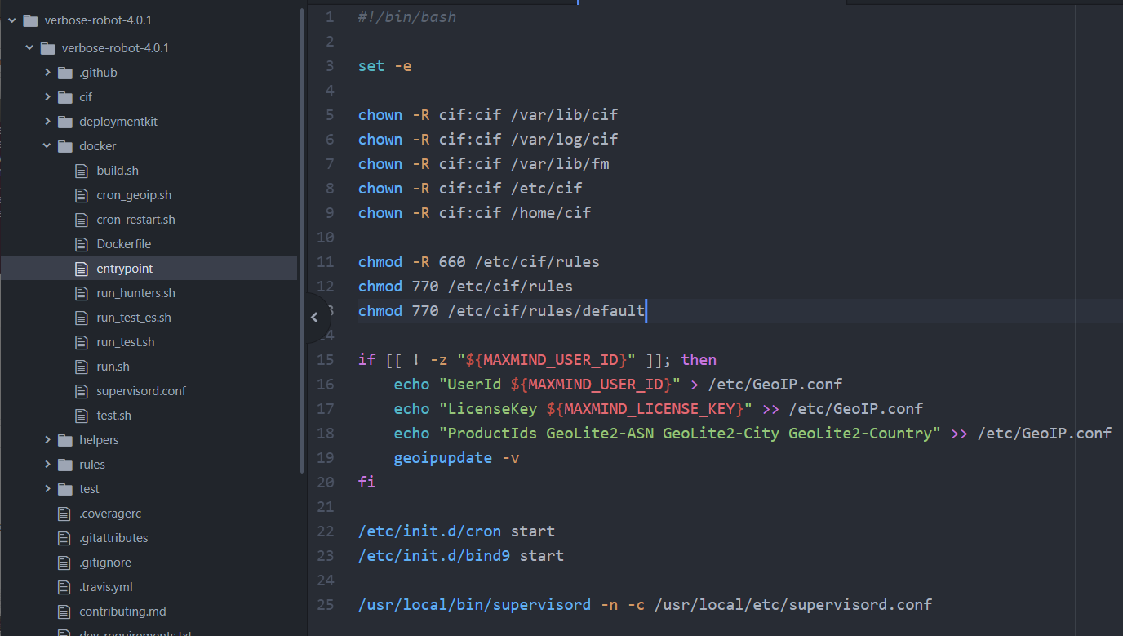
Current Status – Boot Up

Slide 28
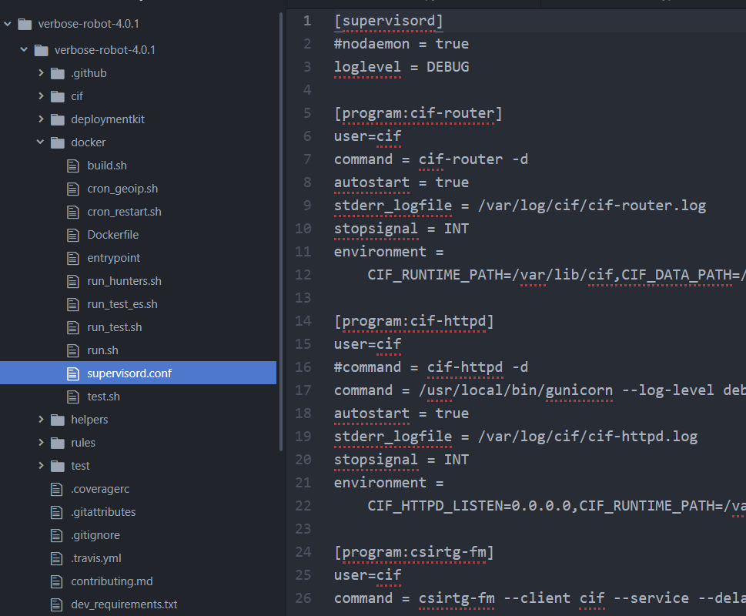
Current Status – Boot Up

