Slide 1

Bi-Directional Reflectance Distribution Functions (BRDF’s)
Matthew McCrory

Slide 2
What is a BRDF?
Must know something about light and how it interacts with matter
When light interacts with matter:
  Complicated light-matter dynamic occurs
  Dependent on characteristics of both the light and the matter
  Example, sandpaper vs. a mirror

Slide 3
What is a BRDF?
Typical light-matter interaction scenario:
Reflected Light
Incoming Light
Scattering and Emission
Internal Reflection
Absorption
Transmitted Light
3 types of interaction: transmission, reflection, and absorbtion
Light incident at surface = reflected + absorbed + transmitted
BRDF describes how much light is reflected

Slide 4
What is a BRDF?
Viewer/light position dependency (incoming/outgoing rays of light)
  Example – Shiny plastic teapot with point light
Different wavelengths (colors) of light may be absorbed, reflected, transmitted differently
Positional variance – light interacts differently with different regions of a surface, e.g. wood
BRDF must capture this view and light dependent nature of reflected light

Slide 5


What is a BRDF?
In functional notation:
Or
For position invariant BRDF’s

Slide 6
Differential Solid Angles
More appropriate to speak of light in terms of quantity of light arriving at or passing through a certain area of space
Light doesn’t come from a single direction
  More appropriate to consider a small region of directions
Incoming light direction
w_{i}
Normal
Small area
Neighborhood of directions
Small surface element

Slide 7
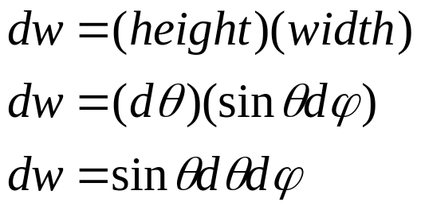
Differential Solid Angles
sinθ
sphere of radius 1
dθ
θ
φ
dφ
Patch formed at intersection of pyramid and unit sphere
Differential Solid Angle defined as surface area of path

Slide 8
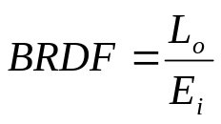
Definition of a BRDF
Given:
  Incoming light direction w_{i}, and an outgoing reflected direction w_{o}, each defined relative to a small surface element
BRDF defined as:
  the ratio of the quantity of reflected light in direction w_{o}, to the amount of light that reaches the surface from direction w_{i}.
light source
n
w_{i}
θ_{i}
Differential solid angle dw_{i}
Small surface element

Slide 9

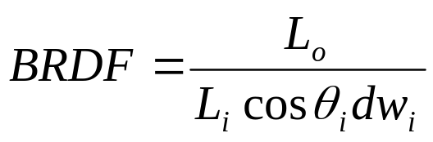
Definition of a BRDF
Light arriving from direction w_{i} proportional to the amount arriving at the differential solid angle.
Given light source L_{i}, total light arriving through the region is L_{i}*dw
Incoming light must be projected onto surface element. Accomplished by modulating by (= N.w_{i})
BRDF given by:

Slide 10
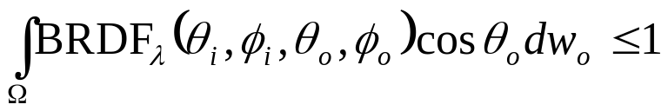
Classes and Properties of BRDF’s
2 classes
  Isotropic
  Anistropic
2 important properties
  Reciprocity
  Conservation of energy
=
Reflected light
Incoming light
Surface

Slide 11
The BRDF Lighting Equation
Goal:
  Define a general lighting equation that expresses how to use BRDF’s for computing the illumination produced at a surface point
Light arrives from > 1 point
Incoming light
E
Outgoing light
Surface

Slide 12
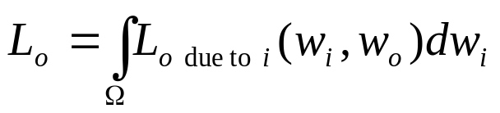
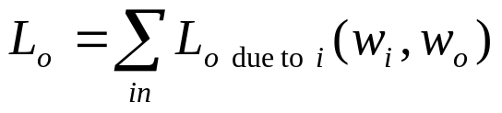
The BRDF Lighting Equation
Amount of light reflected in outgoing direction is the integral of the amount of light reflected in the outgoing direction from each incoming direction
More convenient to think discreetly

Slide 13


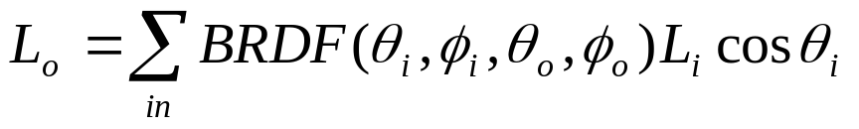
The BRDF Lighting Equation
For each incoming direction, the amount of reflected light in the outgoing direction is defined in terms of the BRDF.
Given:
  L_{i} is the light intensity from direction w_{i}. E_{i} is the amount of light arriving from direction w_{i}:
E_{i} must take into account surface area intensity instead of differential solid angle

Slide 14

The BRDF Lighting Equation
Finally! The general BRDF lighting equation for a single point light source is:
For multiple light sources, each light must be used in the equation and the sum is the amount of outgoing light

Slide 15
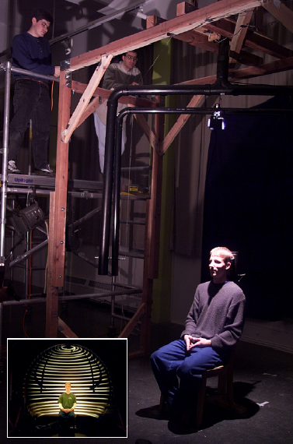
Analytical Models and Acquired BRDF Data
How can we compute BRDFs for use in the general BRDF lighting equation?
  Evaluate mathematical functions derived from analytical models
  Resample BRDF data acquired by empirical measurements of real-world surfaces

Slide 16

Some Examples
From the National Institute of Standards and Technology
Course and fine metallic paint on vases

Slide 17
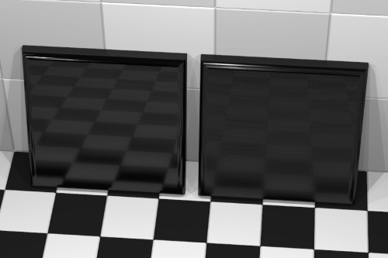
Some Examples
Two tiles rendered using BRDFs obtained from the measured surface topology of actual tile samples

Slide 18
Improvements on BRDF
BRDF assumes light enters and leaves a surface at the same point, which isn’t true in real life
Light scatters beneath a surface and leaves at different places than where it entered
Bi-direction Scattering Surface Reflection Distribution Functions (BSSRDFs) account for just that

Slide 19


Comparison
BRDF vs BSSRDF

Slide 20

Real-time BRDF
Some hardware vendors like Nvidia are making BRDF lighting doable in real-time

Slide 21
That’s it!
Questions?

