Slide 1

Pitfalls of Object Oriented
Programming - Revisited
Tony Albrecht
Riot Games
@TonyAlbrecht
Notes:
This is the talk presented at the Tehran Game Conference, July 2017

Slide 2

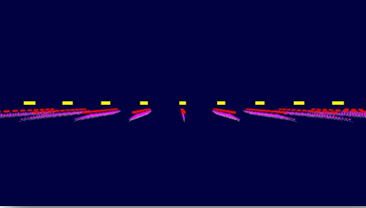
Pitfalls of Object Oriented Programming - 2009
Investigated the performance of a simple OO scenetree.
Ran on PlayStation 3.
Used Sony tools for profiling.
PS3 had a limited CPU.
Original: http://overbyte.com.au/misc/Pitfalls2009.pdf
Notes:
Recap: 2009 talk. PS3 based. 11,000 objects,
HW more limited : LHS penalties, no OoO execution, branch prediction was crude, cache misses expensive (No L3)
Unless you’re talking SPU - L1 access, dual pipeline SIMD instruction

Slide 3
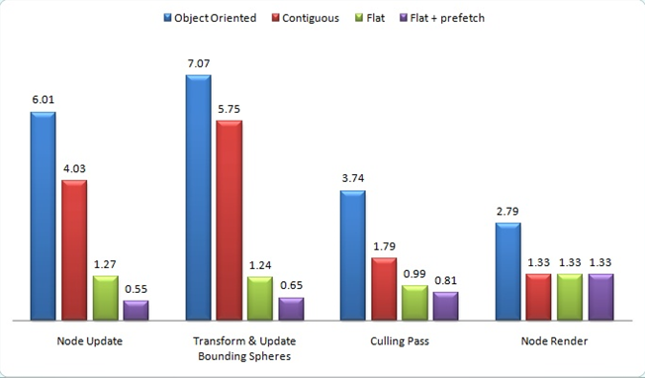
Pitfalls 2009
Start: 19.2ms
Data reorg: 12.9ms
Linear traversal: 4.8ms
Prefetching: 3.3ms
Notes:
Reorg the data 19.6ms -> 12.9ms
Change processing from hierarchical to linear (in levels) 12.9ms -> 4.8ms
Prefetching 4.8ms -> 3.3ms
Showed a dramatic improvement in performance with some simple modifications to data, data layout and code.

Slide 4
8 years later...
Do we still need to care about data as much?
What about branching?
Prefetching?
Virtuals?
Can’t the compiler optimise it?

Slide 5

The compiler will not tidy your room!
The compiler will not tidy your room!
Notes:
The compiler won’t move your data around.
It will reorganise the execution order of your code and data accesses to a certain extent
Most programmers write bad code, so hardware designers make more and more complex systems to try to make bad code run fast.
Out of order execution
Branch prediction
Caches
Additional cores

Slide 6

“The most amazing achievement of the computer software industry is its continuing cancellation of the steady and staggering gains made by the computer hardware industry.”
-Henry Petroski
Notes:
Basically, computer HW is steadily improving, and as it improves, programmers take liberties with it. They can write worse and worse code and the computer will still run it reasonably well. Or, they just buy faster hardware.

Slide 7
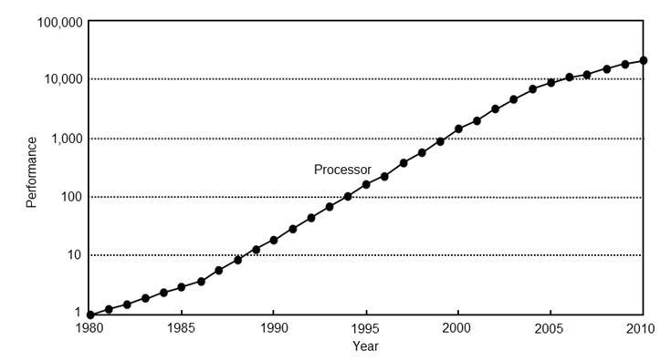
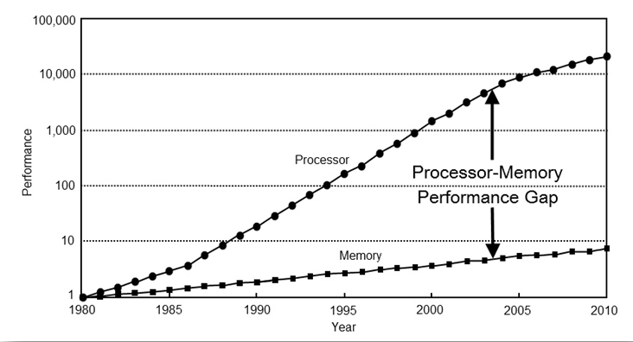
Random Memory Accesses are slow
Computer architecture: a quantitative approach
By John L. Hennessy, David A. Patterson, Andrea C. Arpaci-Dusseau
Notes:
Processor speed has increased at 60% per year, memory at around 10% Memory speed has increased 10-fold, processor speed 10,000 fold. 3 orders of magnitude difference
This is why we have caches - small amounts of high speed, expensive memory.

Slide 8
Caches
Number of levels, types and speeds depend on your platform:
L1 ~ cycles
L2 ~ 10s to 100s of cycles
L3 ~ 100s to thousands of cycles
Fairly dumb - they store data for access until evicted.
CPUs will try to predict where the next access will be.
Notes:
Hardware prefetch
Adjacent cache line prefetch
HW is getting smarter
Thoroughly recommend you read up on caches and how they work and are used.

Slide 9

How does the CPU prefetch?
Linearly.
Uniform stride/direction.
Multiple streams can be active at once.
But only a limited number of them.
A smart programmer will take advantage of this.
Notes:
Programmers can and should constrain data access.
The Compiler will not reorganise your data for you (although it can change the order that some data is read and written in)

Slide 10
So, memory access is slow?
If what I’m saying is true, we should be able to observe and measure it.
Then, as we change code and data, we can measure the changes in performance.
This is not an ideological argument. This is science.
Notes:
This is not an ideological argument. This is science.

Slide 11

DO
Notes:
I built a test. The control. Then I measured its performance.
Then modified it and measured it again, comparing it against the control. And kept doing this until I ran out of time and documented it here.

Slide 12
Performance measurement?
Profilers
Instrumented
Sampling
Special
Notes:
How do we measure performance?
What are the different types of profilers?

Slide 13
A quick note on units:
Never use Frames Per Second to measure performance.
FPS is a relative measurement.
For example: How much faster is “20fps faster”?
That depends...
60fps -> 80fps = 4.16ms improvement per frame
20fps -> 40fps = 25ms improvement per frame
Notes:
20fps faster depends on the original frame rate.

Slide 14
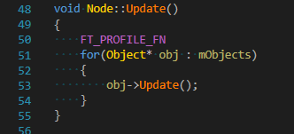
Instrumented profiling
Manually mark up sections to profile
Record unique ID
Start time
End time
Visualise it
Notes:
I use a simple macro that records the start and end times with a pointer to the name of the function.
Simple to use, compiles out for release, very low level of intrusion
You can add in more data to record there (memory etc) but that increases its impact - this should be as lean as possible.

Slide 15
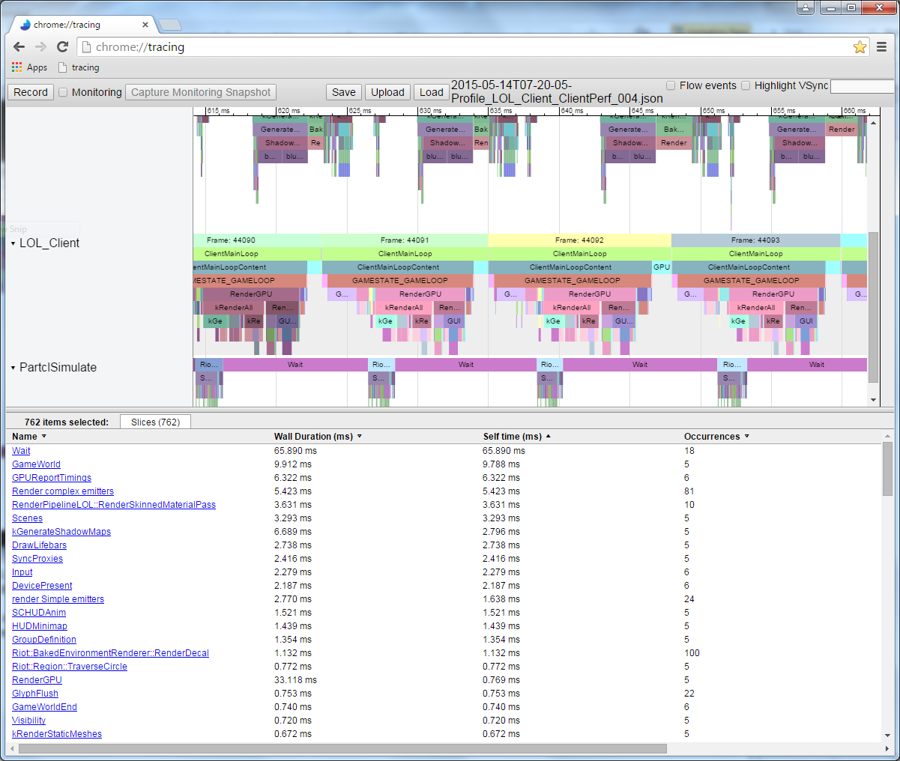
Visualisation
Notes:
Not just for JS and webpages.
Export instrumented scope information to a json file, read it in with chrome://tracing

Slide 16
Instrumented Profilers
Pros
Fantastic for detecting spikes
Provides a visual sense of performance characteristics
Top-down view
Cons
Intrusive
Won’t tell you which lines are slow
Examples:
RAD Game Tool’s Telemetry
Write your own - visualise with chrome://tracing
Use mine (when I release it)

Slide 17
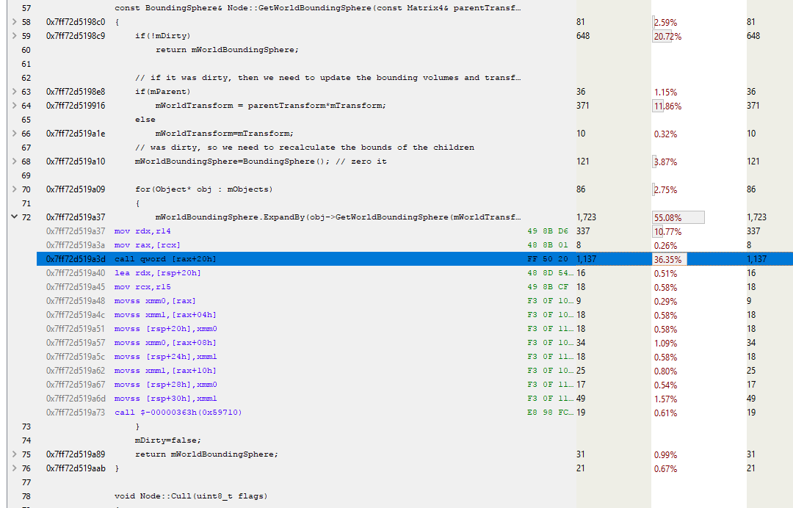
Sampling profilers
Rapidly sample the Program Counter and store the stack.
Then reassembles the samples by stack.
Slow functions will get hit more often - basic probability.
Slow lines will be hit more often.
Bottom up profiling
Sampling profilers:
Intel’s Vtune
AMD’s CodeXL
Very Sleepy
Notes:
CodeXL example

Slide 18
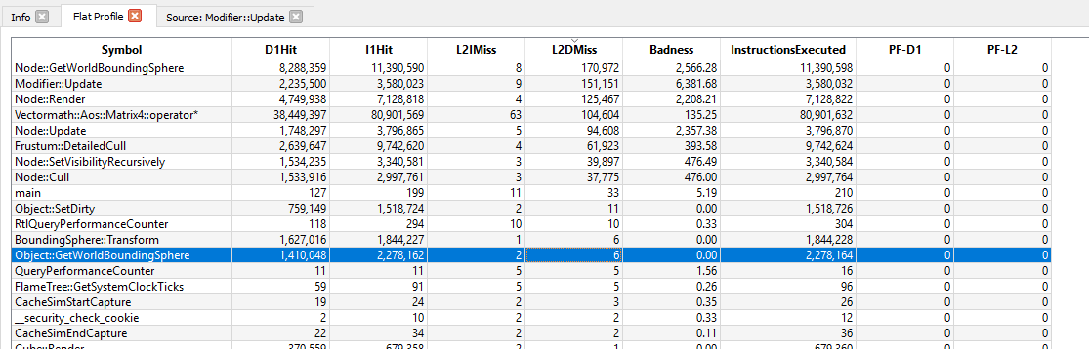
Specialised Profilers
Extract particular information from a process
CPU specific perf counters
AMD/Intel profilers
CacheSim
https://github.com/InsomniacGames/ig-cachesim
Notes:
Didn’t use Cache Sim as it’s written for a different CPU than I was using. Could modify it (and may do)

Slide 19
When optimising
You want a deterministic test case (if possible)
Otherwise, be aware of iterative variation
Run test case multiple times and compare
USE THE COMPILER OPTIONS!!
Learn what the different compiler options do.
Experiment and Profile!
Notes:
Mention working for a client who needed code optimised. I changed one option in the optimisation settings for the compiler and gained a 30% improvement in perf.

Slide 20

Measuring performance is not enough
You need to know *why* something is slow.
When you know why, then you can address it.
For that, you must understand your hardware.
(left as an exercise for the reader) http://www.agner.org/optimize/microarchitecture.pdf
Notes:
Whether console/PC/mobile, you need to know what the HW can do. Ignore at your peril.
PC: http://www.agner.org/optimize/microarchitecture.pdf

Slide 21
The Test Case
Basically the same code as the 2009 Pitfalls talk, but with more. 55,000 objects instead of 11,000.
Animates, culls and renders a scenetree.
FREE 3rd party libs/applications:
dear imgui: https://github.com/ocornut/imgui
Vectormath from Bullet: http://bulletphysics.org/
Chrome Tracing for perf vis: chrome://tracing
CodeXL:http://gpuopen.com/compute-product/codexl/

Slide 22
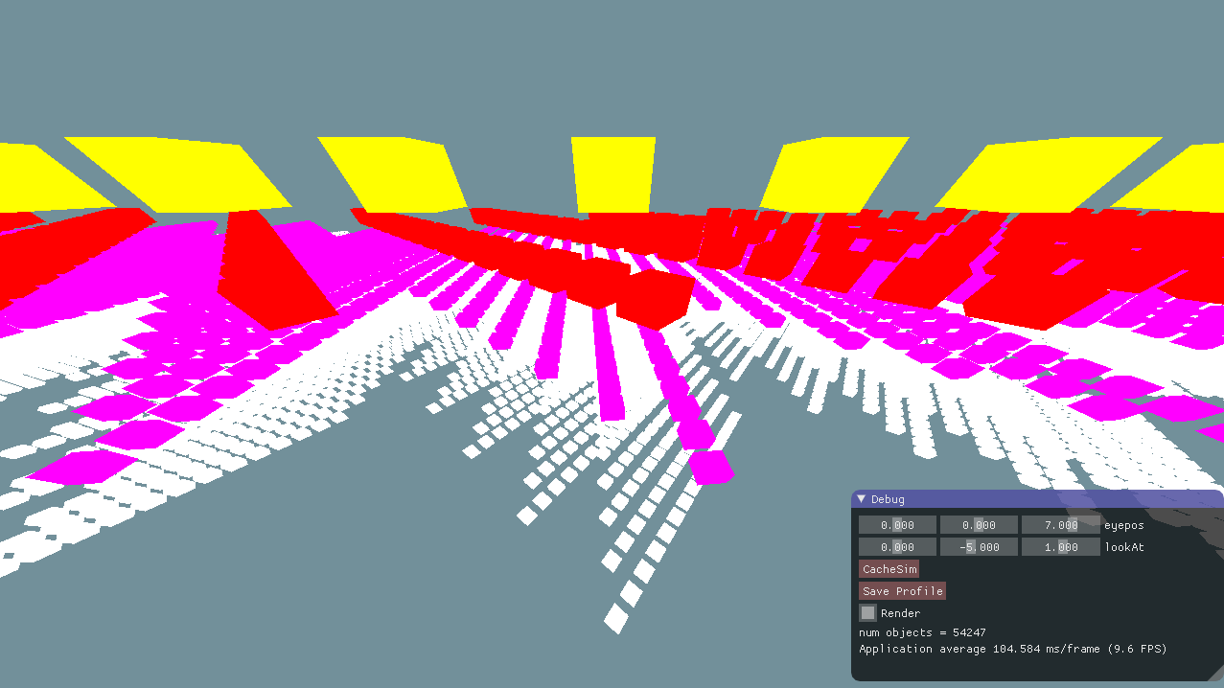
Notes:
Replace this with a version which has a lighting shader applied to it.

Slide 23
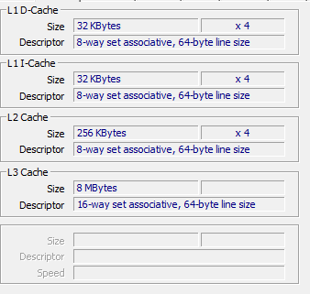
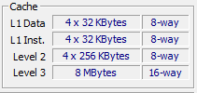
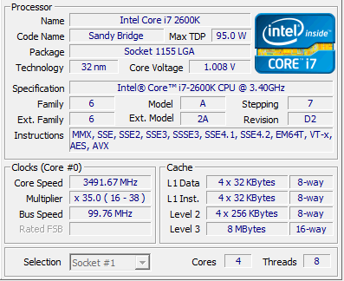
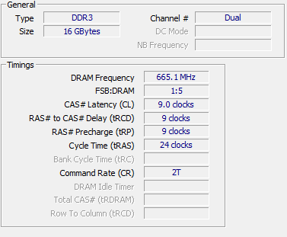
Hardware Used
Notes:
Will be looking at the same experiment on an i7 2600k (Sandy Bridge) - 4 cores, 2 threads per core. DDR3 mem
Cache line is the granularity that data is stored in the cache. 64bytes in this case
I recommend reading up on caches and how they work (and CPUs for that matter). It will help your programming

Slide 24
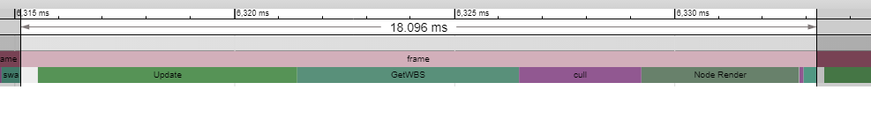
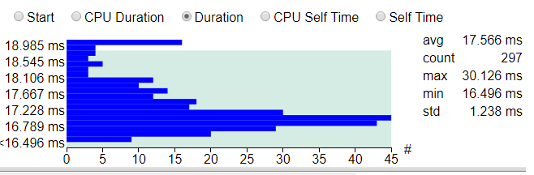
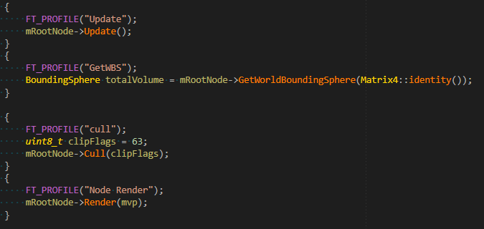
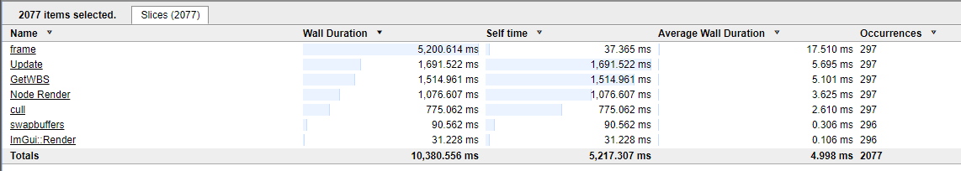
Here’s a single instrumented frame
Notes:
Show trace view - talk about function layout
Show table view. Wall vs self vs average. Talk about averages
Show distribution - this is important. If you don’t have a nice gaussian cluster of times then you may need to drill down a little deeper to see what different is happening in some frames.
They should be fairly consistent

Slide 25
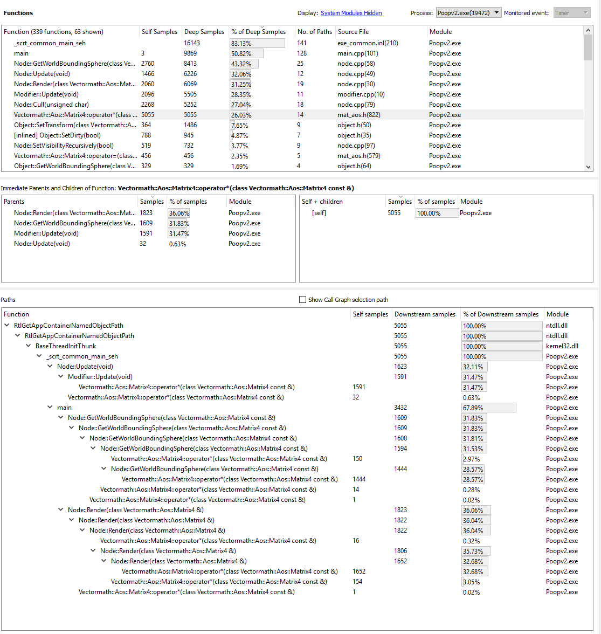
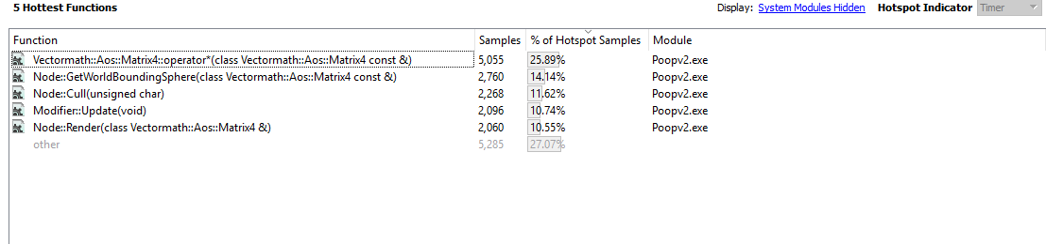
Sampling profiler

Slide 26
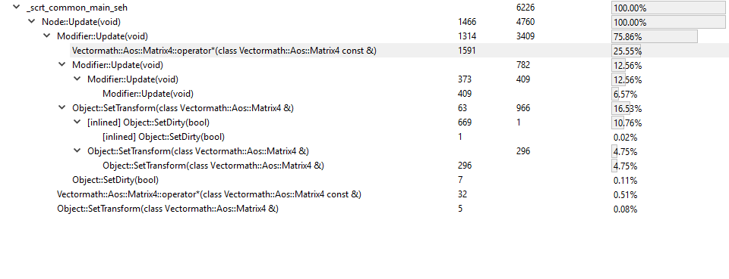
Notes:
We know from the instrumented profiling that Node::Update is slow.
From the sampling profiler, we can see why - matrix multiply in Modifier ::update() as well as elsewhere (it shows up as the hottest function)
That makes intuitive sense - matrix multiplication is doing a lot of work - we would expect that to be slow.
Let’s have a look at it...

Slide 27
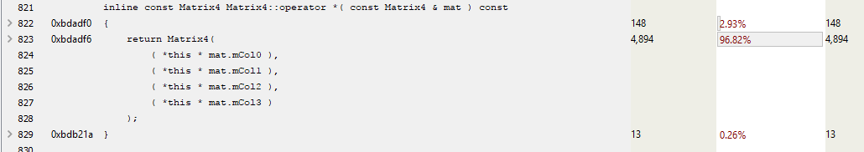
inline const Matrix4 Matrix4::operator *()
Notes:
Note the 96% of hits on the return. Not much use is it?
Lets drill down a little deeper

Slide 28
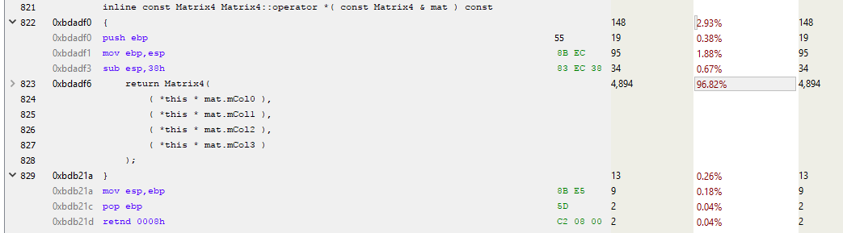
Notes:
Function prolog and epilog

Slide 29
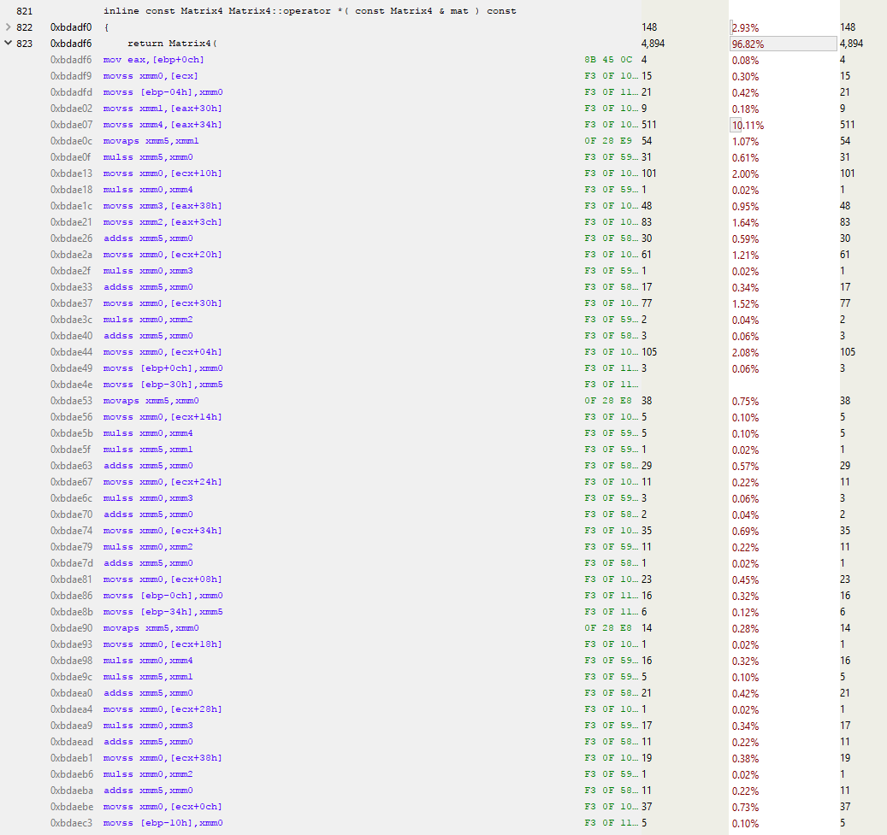
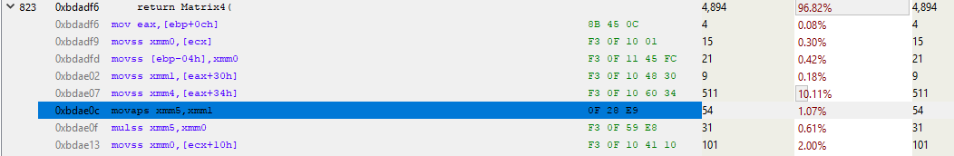
Notes:
The asm for this is 4.5 screens high - can’t show it all to you. Over 1 kilobyte of code - around 250 to 300 instructions.
So, where is the bottleneck?
Movss is move or merge scalar single precision fp value from [ecx] to xmm1 - a 128 bit register
Movaps move aligned packed single precision fp values (4 of them)
Mulss single precision scalar multiply
But, 511 samples on a movss? Why?

Slide 30
Cache miss!
An L3 cache miss is of the order of a few 100 cycles. (200-300?)
A hit is around 40 cycles
Average instruction takes 1 to 14 cycles (atomics can be 30+cycles)
And they can pipeline…
An L3 Cache miss is equivalent to potentially 100s of instructions.
Notes:
These samples are here because this instruction takes a long time.
An L3 cache miss is in the order of a few 100 cycles (2 or 3 hundred)
An L3 cache hit is ~40 cycles (at best)

Slide 31
Let’s take a step back...
Be careful not to get caught up in micro-optimisation.
Take the time to understand the big picture.
Algorithmic optimisations can provide dramatic performance boosts.
For this example, let’s assume that it’s algorithmically perfect
It’s not.
Notes:
If you’re anything like me, you’ll be tempted to jump in right away. “I know why that instruction is slow!”, and then you optimise it only to find out later that you could have just called this function less often.
We’re not talking BigO notation. That is useful to understand but it s theoretical limit which ignores HW limitations

Slide 32
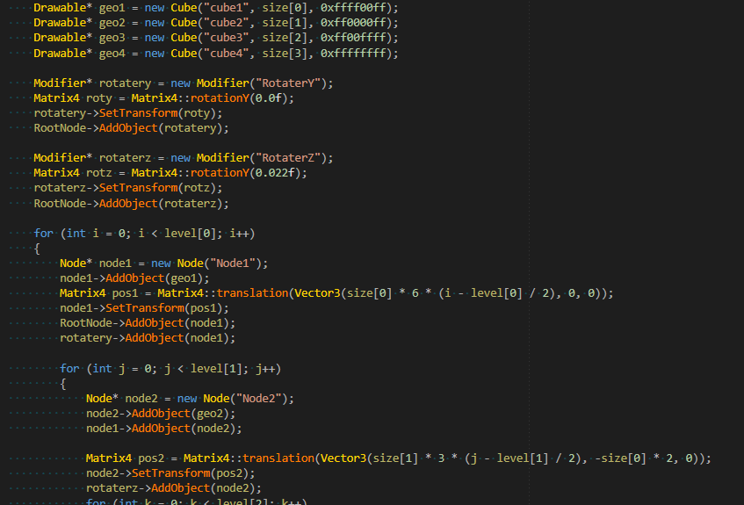
What code are we dealing with?
Notes:
Build some geometry which is shared
Build some modifiers which rotate objects

Slide 33
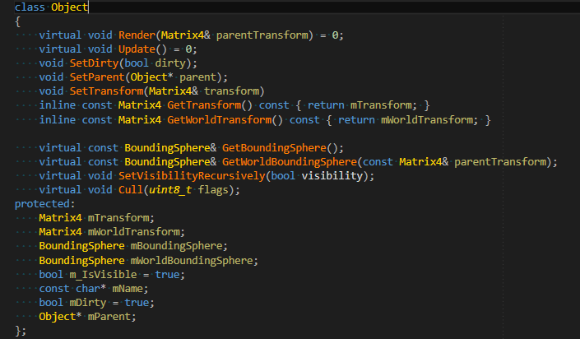
Object Class
Notes:
Accessors, a little functionality
Everything inherits from this - We build a scenetree of Objects.

Slide 34
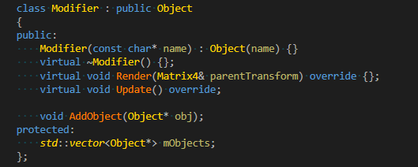
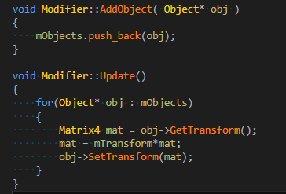
Modifiers
Hold a vector of Objects
And a Matrix4
Call Update() to multiply all its Objects by its transform.

Slide 35
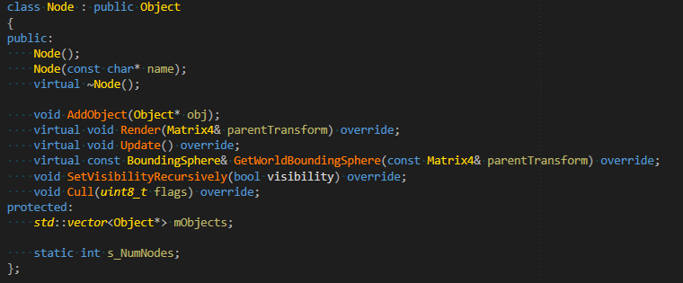
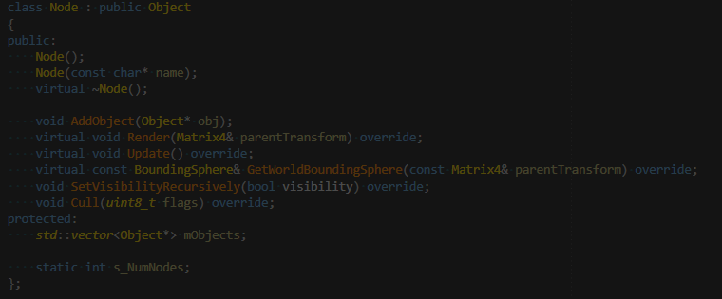
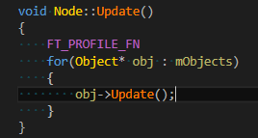
Nodes

Slide 36
Back to the Cache miss
Why is Matrix4::operator*() the bottleneck?
Where Object is
Notes:
Describe what’s going on here. Each object’s mTransform is being *copied*, multiplied and then stored back.
Let’s look at the memory layout of the object

Slide 37
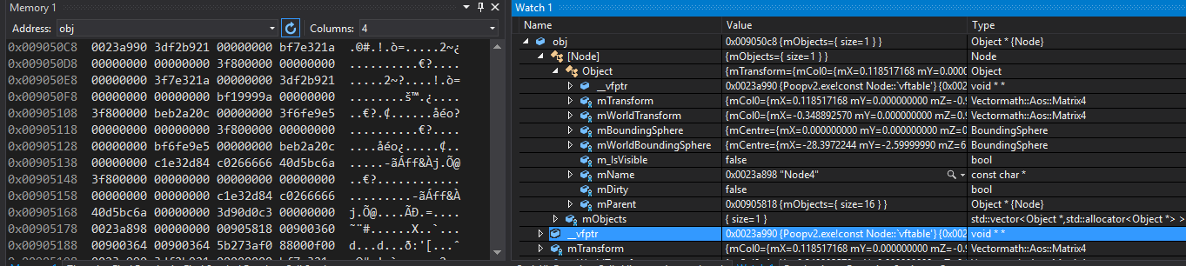
Memory layout for Nodes
Node size = 200 bytes Object size = 188 bytes
Notes:
sizeof(std::vector) is 12 bytes
_Myfirst, _Mylast, _Myend pointers.
In this case, loading the matrix is across 2 cache lines. Since our memory allocation is arbitrary (OS dependent - 8 byte aligned in this case), each matrix access is between 1 and 2 cache lines
Note the bools - they are each taking up 4 bytes, so we’re wasting 6 bytes of space. A good rule of thumb is to place the largest objects at the start, smallest at the end. If you need to, you can rearrange data for temporal coherence within a class (if you’re not breaking things out)
Note the packing between inheritance levels as well.
SetTransform() actually sets the mDirty flg as well, so it will hit 3 cache lines, in a row

Slide 38
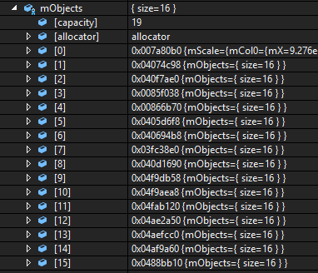
Modifer::Update()
Iterates through all its objects.
Which are scattered throughout memory.
Notes:
Iterates through all it’s objects (remember, the matrices are part of the object, so are offset from the addresses shown above.
So we’ll have a cache miss grabbing the object, then another miss grabbing the mTransform

Slide 39
How do we remove this bottleneck?
Do less.
Use less memory.
Minimise load stalls by making memory access contiguous.
Or, use prefetching to tell the CPU where the upcoming data will be.
Tricky. Pointer chasing, pre-emptive loads, messy code...
Better off working with the HW.
Notes:
https://software.intel.com/sites/default/files/managed/9e/bc/64-ia-32-architectures-optimization-manual.pdf

Slide 40

How do we fix it?
Force homogeneous, temporally coherent data to be contiguous
Memory Pool Managers
Overload new
“Don’t be clever, be clear”
Notes:
You can always overload the new and transparently allocate into pools, but I prefer to be obviously explicit so the next coder who comes along knows exactly what I’m doing and why.

Slide 41

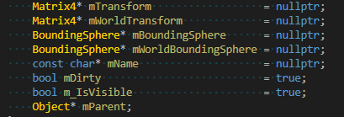

A simple allocator
sizeof(Node) = 44, sizeof(Object) = 32 (was 200 and 188)
Notes:
Managers return that type from a linear array. Subsequent allocs will return adjacent objects.
The other thing I did was, make all the allocations aligned to a user specified boundary. In this case, 16 bytes.
More bad packing in here. 2 bytes before mParent.

Slide 42
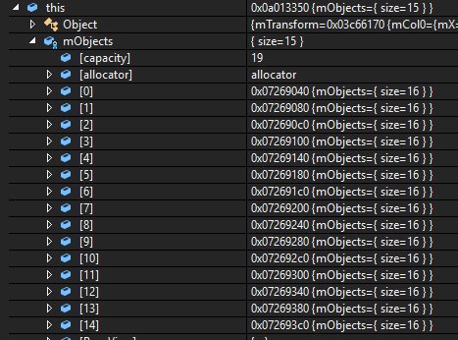
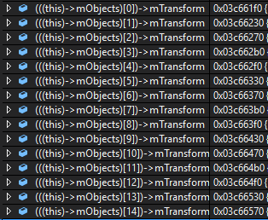
Let’s look at the memory layout now
Notes:
Maybe remove this. I hacked the allocators to enforce contiguous allocation like we see above, but that isn’t the order that the nodes/objects are traversed, so this is actually slower than just letting the Managers allocate linearly in the order that we traverse!
Lovely, but now the transforms are no longer part of the object

Slide 43
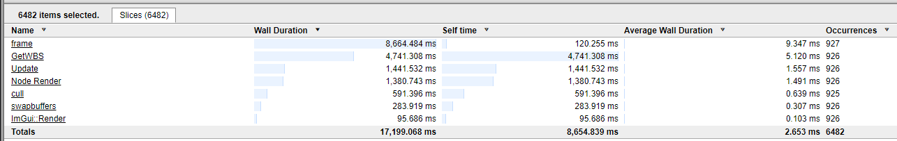
Now, measure performance...
Previously…
Now…
Notes:
Do this one quickly, jump to the money shot and then discuss relative performance in the solide after that.

Slide 44
17.5ms -> 9.5ms
No functional code changes.
Notes:
Lets take a closer look at that data...

Slide 45
Now, measure performance...
Previously…
Now…
Notes:
Update reduced from 5.69ms to 1.55ms
Get WBS hasn’t changed at all (as it deals with bounding spheres, not anything we’ve modified.
Node Render drops from 3.6 to 1.49

Slide 46
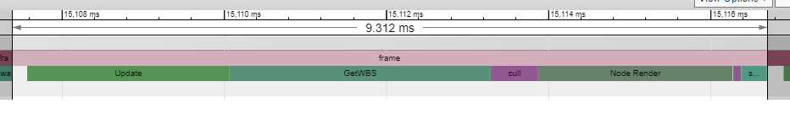
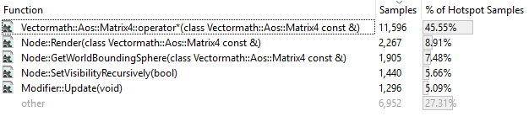
Where are the bottlenecks now?
Previous
New
Notes:
Instrumented profiling doesn’t give us much help - everything has scaled down equally. <click>
Looking at the sampling profile, the Matrix4 multiply is still the slowest part.
In fact, it is now taking up 45% of the time compared to 25% previously <show old data>
This is because there is less time spent in the rest of the code - we’ve optimised it. Matrix multiply now takes relatively more time.
Let’s look at the ASM samples <click>

Slide 47
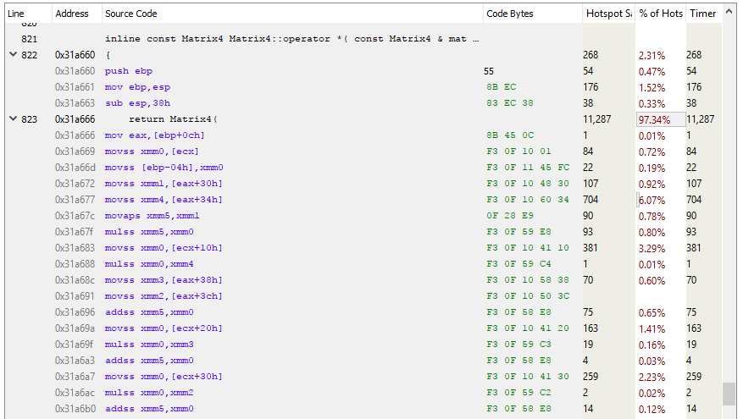
A closer look at Matrix4 multiply
Where is my SIMD?
Notes:
There is still a cache miss here, but it’s down to 6% instead of 10%
This code is most probably instruction bound.
Its also not inlining (prolly too large)
Note that all the instructions here are scalar. It’s dealing with single floats.
But I asked the compiler to give me SIMD code <click> - the compiler didn’t optimise it for us into SIMD (possibly because it doesn’t know the we are guaranteeing that the matrices are 16byte aligned.
But we, the programmer know that. So let’s force the maths lib to use SSE

Slide 48

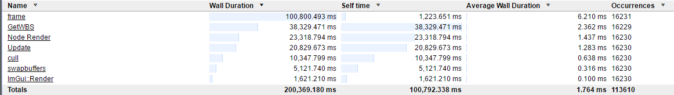
Recompile and profile with SIMD
9.5ms -> 6.2ms
Notes:
Modifier::Update() has gone from 1.6ms down to 1.3ms
GetWBS has dropped from 5.1 down to 2.3

Slide 49
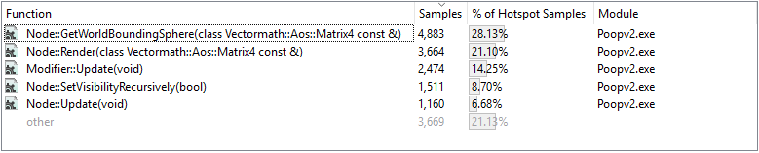
Sampling profile
Matrix multiply has disappeared!
It’s now small enough to be inlined.
Notes:
And Modifier::Update() has drop to #3

Slide 50
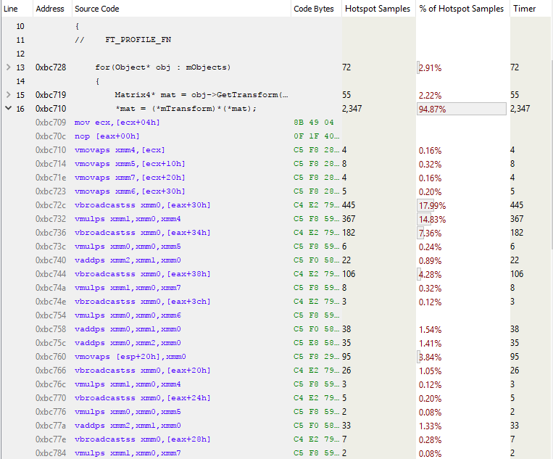
Modifier::Update()
Notes:
First note all the different instructions!
And from 1,060 bytes down to approx 350 bytes
Highlighted area is primarily due to cache misses (still)
Vbroadcastss takes a float and sticks it in all 4 slots in the 128bit register.
First highlighted line is stalling on the load from eax+30h
Second it stalling on xmm4 (the load from ecx) probably
Third is stalling on the line above finishing (reuse of xmm0)
We could improve performance here by inspecting the memory usage patterns, but since this function is now #3, lets look elsewhere first.

Slide 51
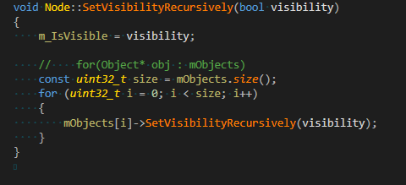

Virtual function overhead
This was a big issue on PS3.
Let’s look at SetVisibilityRecursively()
Notes:
SetVisR is a small virtual function which doesn’t do much. So we can isolate the vfunction overhead easily.

Slide 52
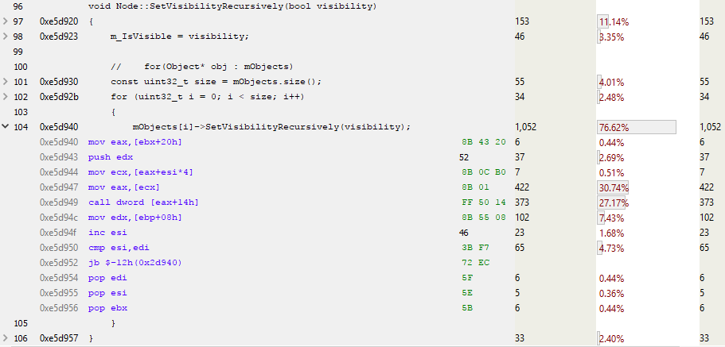
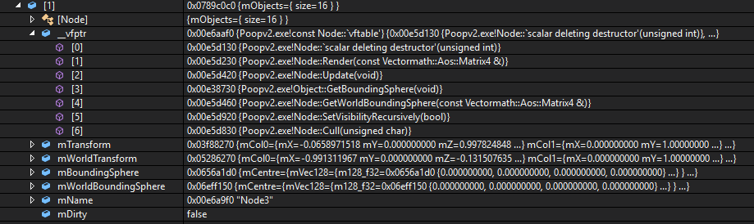
Notes:
Esi is the counter
Call dword [eax + 14h] is jumping to eax + 20bytes -> 20 bytes is the 5th virtual function which is SetVis

Slide 53
De-inheriting everything
Decoupled Node from Object
Changed code to addNode and addObject etc
Nodes looped over Objects and Nodes separately
No virtuals!
How fast?
6.2ms -> 7.6ms

Slide 54
Ah, wat?
Suspect better branch prediction.
From asm - not much worse than function call overhead.
Extra code for looping over nodes and objects broke cache coherence.
Worthy of further inspection.
“Assume nothing, test everything”

Slide 55

Notes:
I assumed at least a slight change in performance when removing virtuals.
But it’s good when you get something wrong, because that means you’ve learnt something

Slide 56
Prefetching?
Prefetching is complicated
Hard to get significant perf improvements
The HW does a pretty good job if you keep your access patterns simple
Notes:
Prefetching is complicated - I’ve not had a significant improvement in performance that warrants the added code complexity.

Slide 57
Summary
17.5ms -> 6.2ms
No functional changes
Memory layout (9.5ms)
SIMD use
Could go even faster
2009 talk reduced everything to flat arrays
But, at the cost of flexibility and readability.
Notes:
With no functional changes, we’ve optimised from 17.5ms down to 6.2ms

Slide 58
Optimisation Process
Understand your problem.
Is there a better algorithm?
Can you call it less (or in a different thread)?
Understand your data access patterns.
Optimise for temporal coherence.
Side effect: Easier to parallelise!
Then, instruction level optimisation.
Notes:
You can’t optimise it if you don’t understand it. Don’t micro-optimise straight away. Profile and understand your bottlenecks
Are we solving this problem in the best way? Problems change over time and old solutions may no longer be appropriate.
Do you have to do this every frame? Can we do it in parallel?
Biggest

Slide 59
Obfuscation by Optimisation
When optimising, aim for simplicity.
Simple code is easy to understand, easy to maintain.
Weigh up costs of complex, highly optimised code - it can be brittle and costly to maintain. Will often be throw away, but can be necessary.

Slide 60
So, is OO bad?
Encapsulation by
logic/function vs
data
OO used with foresight
Fast
Simple
Maintainable
OO used without care
Slow
Complex
Unmaintainable
Unoptimisable.
Notes:
Encap by function - often necessary to allow abstraction of complex systems. But can be very hard to optimise and maintain..
If your data is spread all around memory, your code will run slow.
Instead of optimising by stuffing everything into objects, think about how the data is used and transformed. Build objects around that.

Slide 61
The Language is not your platform
You are not building something to run in C++
You are building something to run on some hardware.
Your language is an abstraction of the HW.
If you need it to run fast, build with the HW in mind.

Slide 62
END پایان
Notes:
Questions?

