Slide 1

ATTRITION DATASET ANALYSIS
EMPLOYEE TURNOVER

Slide 2

Business Objective
In today’s competitive job market, employee attrition is one of the most pressing issues businesses face.
Employee turnover is costly.
Each time an employee leaves, they take a significant portion of their knowledge and expertise with them.
Knowledge transfer takes up additional resources.
A model using different classifiers that would help an organization predict employee turnover given some attributes pro-actively helps solving such a costly matter.

Slide 3
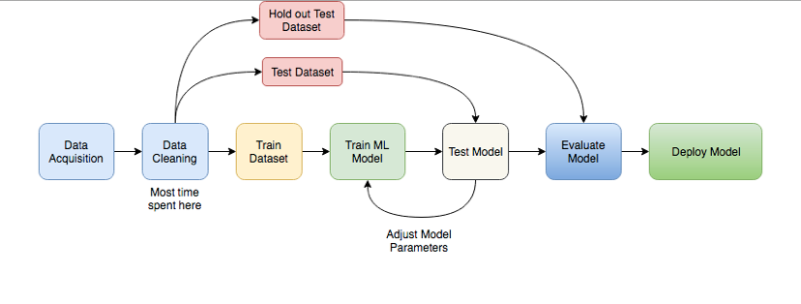
FLOW OF THE PROJECT

Slide 4
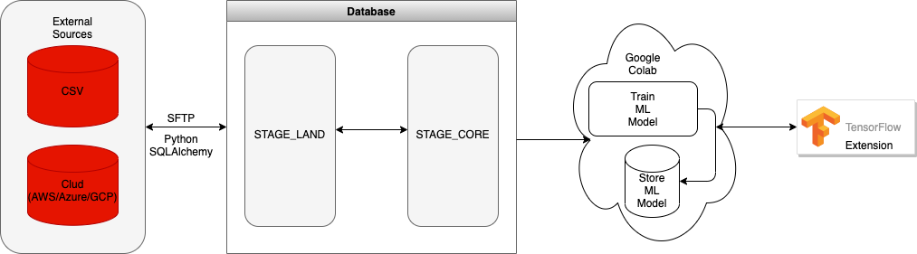
Data Flow Diagram

Slide 5
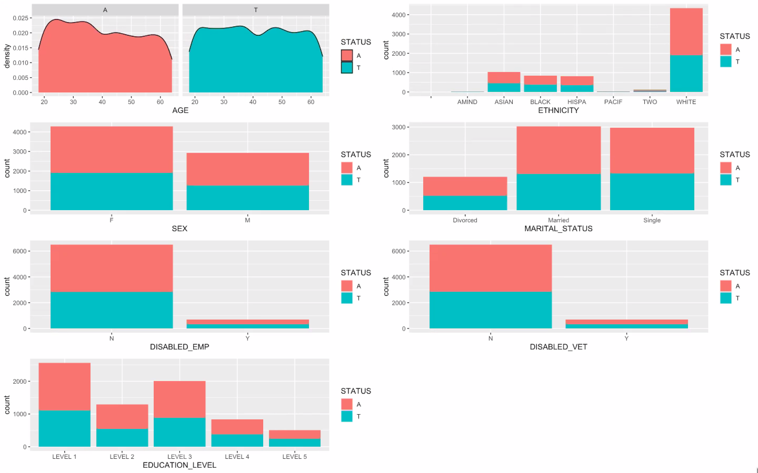
DATA ANALYSIS
Employee Personal Demographics - Numerical and categorical variables
Attrition rate is higher for:
Younger employees with 25-35 age group.
Female employees.
Disabled employees.
Employees with education level between 1-3.
White Employees.
Not divorced (Married/Single)
Not a disabled Veteran.

Slide 6
TensorFlow in Production
TensorFlow Serving:
Tf.keras is a high-level API to build and train models in TensorFlow.
Train and Evaluate custom models.
Save Models as a protobuf file in cloud directory. Versions can be managed.
Deploy using TensorFlow Extension.
Start running TensorFlow Serving:
rest_api_port: The port used for REST requests.
model_name: This is the URL of REST requests. It can be anything.
model_base_path: Path to the directory where model is saved.
Send predict request as a POST request to the saved model

Slide 7
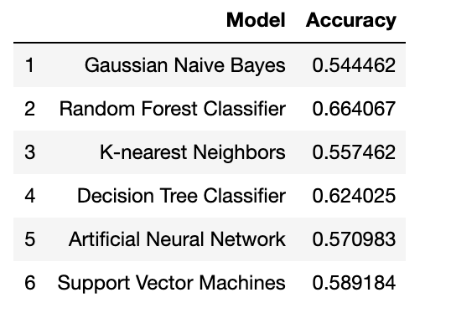
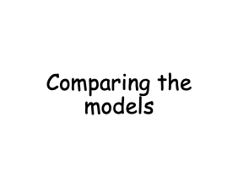
Best accuracy is achieved using Random Forest Classifier.

Slide 8

In the comparison of all the approaches used for testing on the Employee Attrition dataset, The Random Forest, has offered the highest accuracy for the data.
The choice of detection algorithm heavily depends on the dataset itself. The Gaussian Naïve Bayes approach fails to compete with Random Forest and Decision Tree and hence would not a suitable choice for the task.
Apart from all the supervised learning approaches a lot of unsupervised learning algorithms such as the k means clustering and Self-organizing maps can be tested and can prove to be more efficient.

Slide 9
THANK YOU!
Questions?

