Slide 1
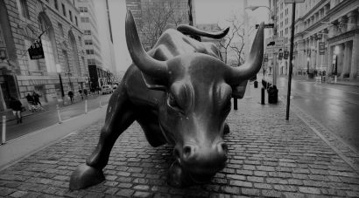
TICKER TALK
BY :
DEEP CHITRODA
NEIL SHARMA
ANKIT TALAVIYA
RAJAT VERMA
CS 546
Section B
Group 18

Slide 2
WHY ?
Currently most applications don’t provide the functionality to purchase and access insights to stocks.
The forum section is often misused on such services to spread false information

Slide 3
TICKER TALK
Notes:
“sell the bear’s skin before one has caught the bear” (sort of like counting your chickens before they hatch, but with a lot more gore).

Slide 4
What is it?
It is a platform bringing traders and their core insights at one place
Users can poll for the stocks as per their prediction
Other users will have an option to view these poll results for a particular stock

Slide 5
Features
Watch List
Polling
Prediction by Poll Results
Stock Trading
Order History

Slide 6



Watch List
Can add or remove stocks to watch list
To track the status of favorite stocks
Only authorized user can access
Search stock Login Add to watchList

Slide 7

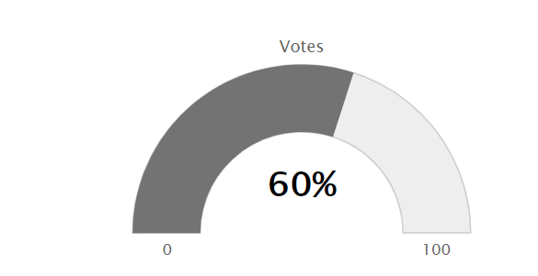
Polling
Can predict by Upvoting or Downvoting a Stock price
Poll only once for one stock at a time
Only authorized user can poll
Search stock Login Poll Result

Slide 8
Poll result indice
What does that Indicate?
Poll result specific to a stock is an indicator of public opinion on the value of stock
If Poll index is less than 50%, prediction says price will drop
If Poll index is more than 50%, more population believes that the price will raise.
Poll Result

Slide 9
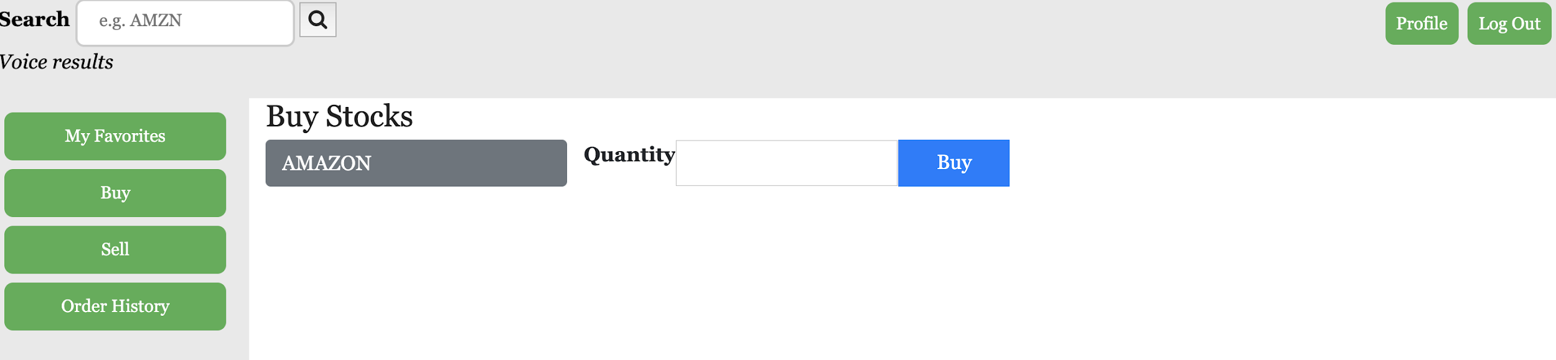
Stock Trading
Only authorized users has the access to buy/sell the stocks
User can buy and sell stocks
User has to select the stock from the list before buying/selling

Slide 10
Stock Trading (cont.)
User should have the sufficient balance in his account to buy a particular stocks
User can purchase up to the limit of stocks available with the company
User can only sell the stock that he has purchased

Slide 11

Order History
Users can view all transactions in his account
Currently purchased stocks in the user’s account are also visible

Slide 12
Extra Features
Incorporate data changing at regular intervals (live data)
Generate charts based on profit loss data
Expert Opinion
Making App accessible to visually impaired people

Slide 13
SWOT Analysis
Strength
Provide polling and Trade in one place
Speech-Control
Easy to use
Weakness
Polling is not 100% reliable
Opportunities
Development of Mobile Application
Add payment gateway feature for real time trade
Threats
User can sign up without identity verification
Security

Slide 14
Thank You
Any Questions ?

