Slide 1
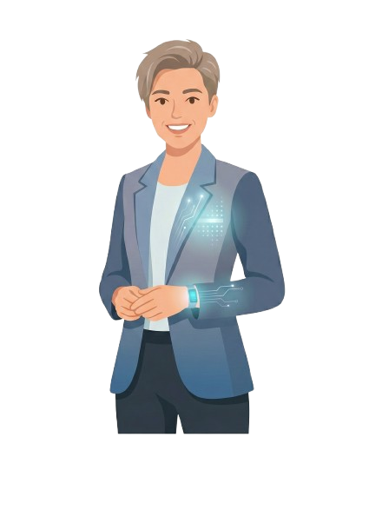

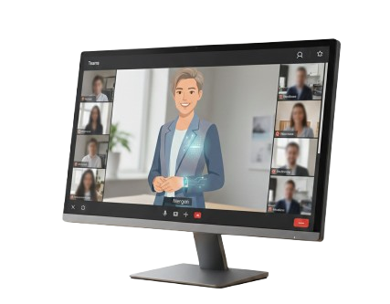
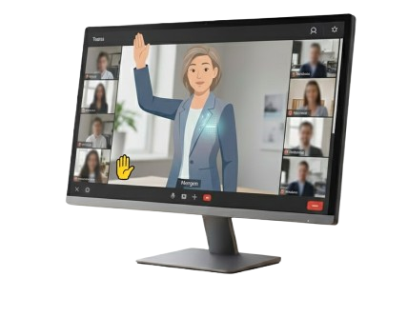
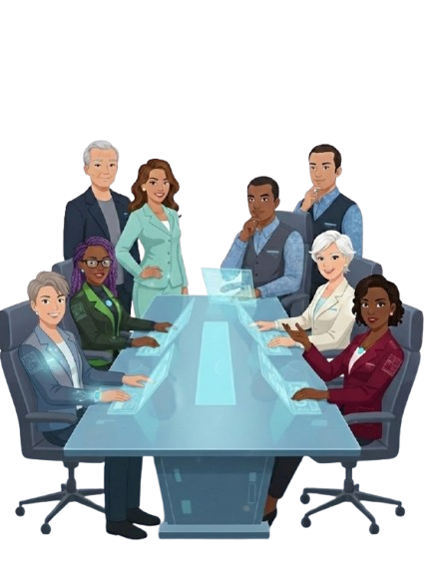
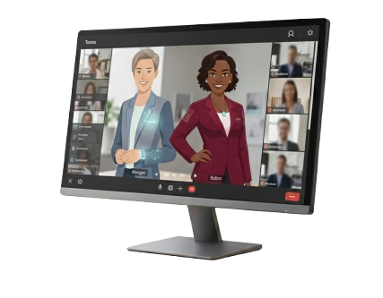
#1 Bringing Morgan to Life
Morgan
Build Morgan using a Microsoft-first approach while remaining open to non-Microsoft components where they add clear value. Engage Microsoft to test feasibility, but plan for Slalom engineering and Foundry teams to prototype and iterate quickly toward a usable MVP.
Virtual Board Member
Purpose: an AI-powered “eighth board member” that joins CAB meetings to provide a consistent new voice, filling gaps in the board’s diversity of perspective and enriching the overall discussion. AI is simply the enabler - the aim is a broader, more insightful conversation.
#2 The Passive Participant
Morgan joins the CAB meeting as a passive, fixed-persona board member. It listens continuously and responds only when invited, offering a consistent new viewpoint that fills diversity gaps and enriches discussion without interrupting the flow.
Ambition: To evolve Morgan from a passive, fixed-persona participant into a capable contributor that can surface patterns and enrich discussion, with a longer-term horizon of introducing multiple tailored agents and, potentially, a multi-agent shadow board.
#3 The Reactive Contributor
Morgan evolves to gently signal when it has identified a meaningful pattern, contradiction, or missed connection — for example through a subtle visual cue. It still does not interrupt, but can raise its “virtual hand” to offer timely insight when appropriate.
#5 Virtual Shadow Board
(North Star)
#4 Morgan and Friends
Ahead of each meeting, a set of AI agents runs a simulated board discussion of the agenda, debating topics, surfacing insights, and producing recommendations. The CAB reviews this output as a provocation to compare perspectives and reveal gaps.
Introduce additional AI agents, each with distinct, fixed personas (e.g., Gen Z, nearing retirement, public-sector viewpoint). The CAB can direct questions to specific agents to access different perspectives in real time.

Slide 2



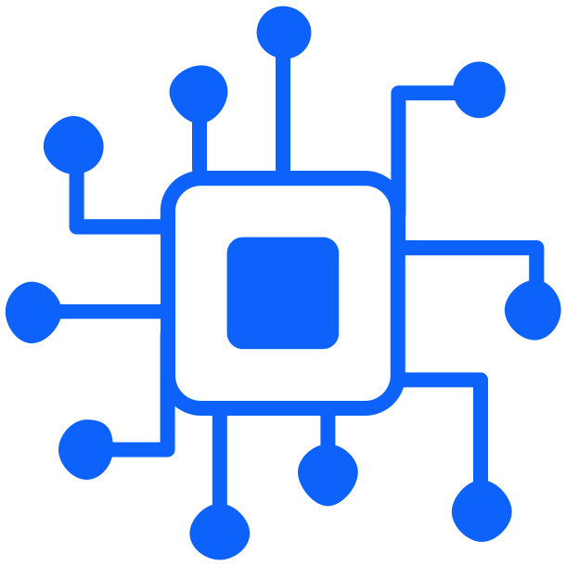



Morgan | Next Steps
The immediate focus is to validate how we could technically deliver Morgan, align on the right build path, and shape a small, testable prototype. By firming up feasibility, personas, and meeting participation mechanics, we can quickly confirm what’s realistic and move into controlled experimentation with confidence.
Draft Concept
Prepare the one-pager summarising ambition and phases.
Tech Sounding
Richard to validate feasibility with Microsoft contacts.
Foundry Check
Assess whether this is a viable build route.
Persona Design
Define initial personas and behavioural boundaries.
Teams Feasibility
Confirm how an AI agent can join and listen in Teams.
Prototype Plan
Outline scope and approach for a Phase 1 MVP.

Slide 3
NW 0912 - Superseded
Morgan
Step 1
Bringing Morgan to Life
Virtual Board Member
Purpose: an AI-powered “eighth board member” that joins CAB meetings to provide a consistent new voice, filling gaps in the board’s diversity of perspective and enriching the overall discussion. AI is simply the enabler - the aim is a broader, more insightful conversation.
The approach is to build Morgan on a Microsoft-first stack. We will engage Microsoft as an alliance partner to validate feasibility and architectural options, while also considering Slalom’s own engineering and Foundry teams for design and prototyping. The aim is to iterate quickly, close technical gaps, and establish a practical model for human–AI teaming to showcase to the CAB.
Ambition: To evolve Morgan from a passive, fixed-persona participant into a capable contributor that can surface patterns and enrich discussion, with a longer-term horizon of introducing multiple tailored agents and, potentially, a multi-agent shadow board.
Step 2
The Passive Participant
Morgan would join the meeting as a passive participant, listening continuously and responding only when directly asked. It would operate with a clear, predefined persona — such as a Gen Z voice, a sustainability lens, or a constructive challenger — and provide structured challenge and alternative viewpoints to enrich the discussion without interrupting the natural flow of the conversation.
Step 3
Virtual Shadow Board
Before each CAB meeting, multiple Morgan personas would run a simulated discussion on the agenda, debating key topics, producing recommendations, flagging risks, and raising challenge questions. The output is then shared in the final 10–20 minutes of the real session to prompt comparison, expose gaps, and strengthen the board’s discussion.

