Slide 1
R on Microsoft SQL Server
CinDay R Users Group
May 22, 2018

Slide 2
Outline
What does it mean to run R?
Choosing platform
SQL, SQL Server in a business context
SQL basics, why it makes sense for R
Overview
“Production” and products
How-to of running R on SQL server
Setup / detective work
Demo
Tips
Pros/Cons

Slide 3
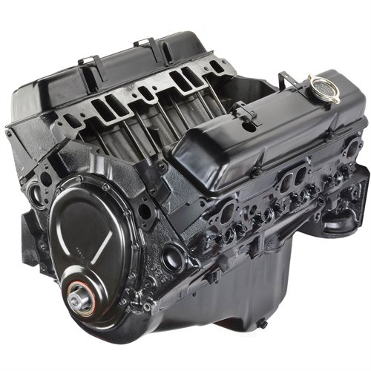
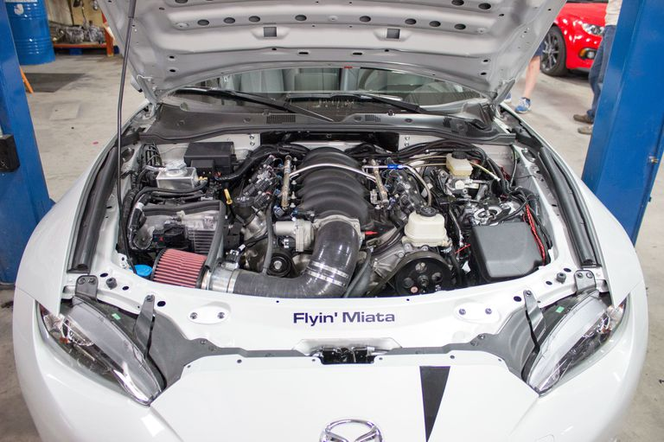
R = standard analytics engine?
Platform choices is not a technical limitation. R runs on many systems.
SAS, Python, Julia, Mathematica, SAP, PowerBI … now SQL Server
Different tasks benefit from different platforms
Data sourcing, ETL
Creating models
Scoring
Output

Slide 4
What is SQL?
Structured Query Language
Provides rough structure for Extract-Transform-Load by relating data columns and rows from different tables
Specific software that runs SQL
Oracle, Microsoft SQL Server, and MySQL keep floating between the top three spaces for relational databases
“SQL Server” usually refers specifically to Microsoft SQL server

Slide 5
What is SQL Server?
(Microsoft) SQL Server is well-developed
Runs locally and on cloud services
Fast
Capable and integrated
Microsoft commitment to R
Bought RevolutionR in 2015
Microsoft R Server
Azure ML backbone is R
Microsoft wants R to run natively on everything!
+
=
SQL Server 2016 runs R
Python runs on SQL Server 2017

Slide 6
Integration questions
LinearDigressions.com : Analytical Maturity article (5 areas)
Are Data organized for business purposes?
Relevance, access, comprehensive, high-quality
Does the Culture value and use data?
“Gut feel” vs “prove it”
People and Processes
Effective access: Are data science methods shared, understood, and impactful?
Software (Platform)
Are data storage and processing workflows flexible, capable, and long-term?
Do they work between IT, DBA, business, and analytics as a mature workflow?
Science and Methods
Everything else: calculations, models, test/control, the techie stuff

Slide 7
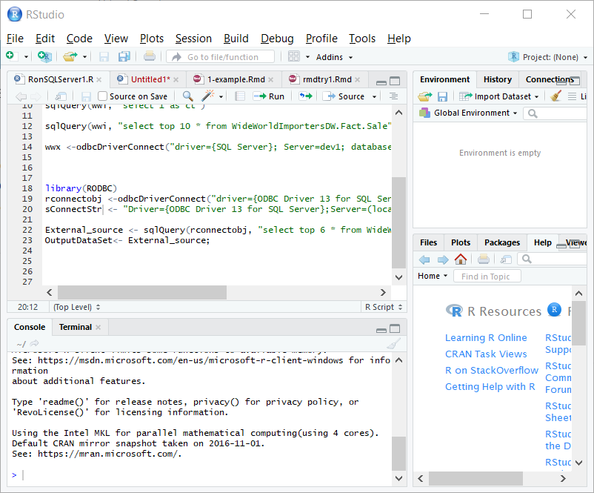
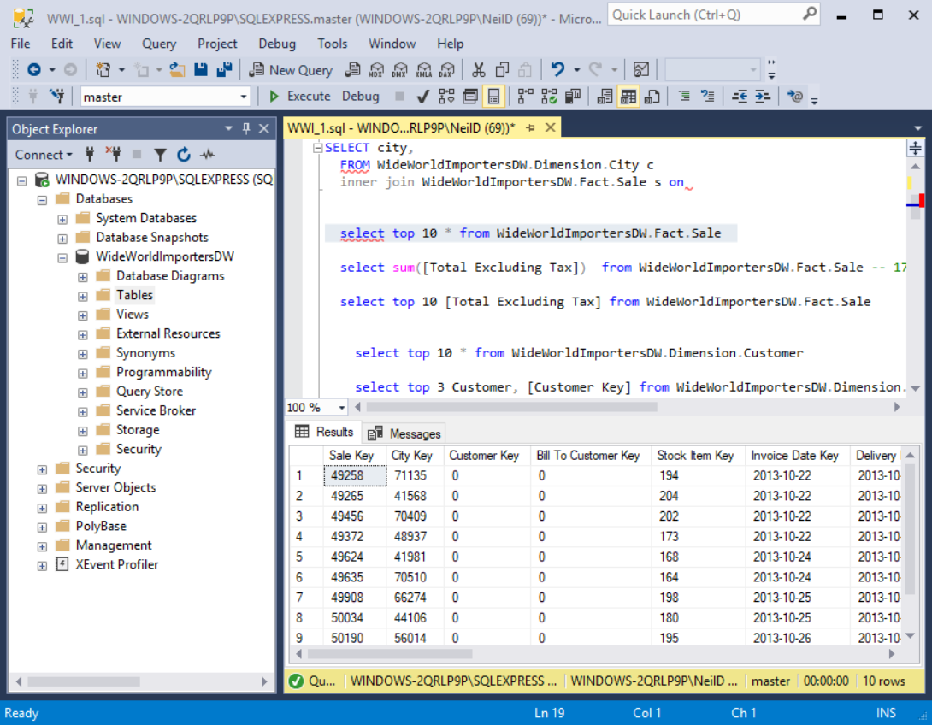
Platform is a choice
How to match task to platform?
Ad-hoc? Sharing? Production? Aggregation?
“What do you gain from moving your code out of RStudio?”

Slide 8


Model production -> data products: Can our platform help us be more useful?
SILOS
VS
INTEGRATION
“I live in the server room.”
“Can I present this to shareholders?”

Slide 9
What does the SQL Server platform excel at?
“Production” means that it is an important job and can get run often
R widely used for production -- it’s mature and well-documented
BUT, R is infrequently used for CS training and in IT
R needs to integrate with existing Microsoft products, if your company is included toward Microsoft

Slide 10
Specific benefits to R on SQL Server
Convenience of SQL Stored Procedures
SQL Stored Procedures are a simple and intuitive system
Automation/Scheduling (this may be the biggest help!)
IT is already using it
Bigger machines than your laptop (speed)
To share the process with people who don’t know R
Follows current permissions, so no extra IT burden
No need to move data (or at least not far)
No source is closer to your data
Ability to execute scripts even when remote

Slide 11
What do I need?
SQL Server 2016 or 2017 (64 bit only)
That’s it. You just need to enable it.
R Services(In-Database) needs to be installed
SP_CONFIGURE 'external scripts enabled', 1 GO RECONFIGURE GO
Set up permissions
Alter role db_rrerole add member UserName
It installs automatically with Microsoft R Server (MRS; it’s otherwise a paid system)
Multi-threading, memory chunking, etc.

Slide 12
Suggested workflow
RStudio: fully explicit script – no environment assumptions
Know what libraries you are using
matrix::as.matrix(x)
SQL Script: Encapsulate R script into a stored procedure
Error checking, code review (& etc.) all follow existing developer framework
Work with DB/IT groups to structure the stored procedure output
Use SQL server tools to schedule the stored procedure
Create error checking that is readable throughout the organization
Who notices when a category changes or gets deleted?

Slide 13
Language basics
T-SQL performs DB commands: you don’t have to learn it
Fill in this frame. Retain it a Stored Procedure.
EXECUTE sp_execute_external_script
@language = N'R'
, @script = N'
CODE GOES HERE
'

Slide 14
Tip: Inputs and outputs
The official method is to use stdin and stdout, with each referencing a single table on the SQL Server
You also get stderror, which delivers all warnings and explicitly printed output
Get used to using print() a lot
The easiest way to connect is by installing RODBC and creating an ODBC connection like the session is taking place on an outside server
It’s also the easiest to test, because the session will then be the same on both the server and a local session

Slide 15
Demo: Figure out your R session environment
EXECUTE sp_execute_external_script
@language = N'R'
, @script = N'
getwd()
'
R.Version(),
installed.packages(),
install.packages("stringr")

Slide 16
Tips: Installing packages
Your server will not likely have the outside connection you need to get to CRAN/MRAN
EXECUTE sp_execute_external_script
@language = N'R'
, @script = N'
print(install.packages(‘‘magrittr‘‘ ))
‘
Instead, find your getwd() on the server drive, download the package .zip from CRAN and use a local install that references that server space
print(install.packages(‘‘~/magrittr.zip‘‘, repos= NULL))
Fails
Works

Slide 17

Tips: Permissions
Need to have the service installed
The R session needs to have permissions installed (to mirror the user, ideally)
Look out: You can do stupid things
You may be able to use all available memory

Slide 18
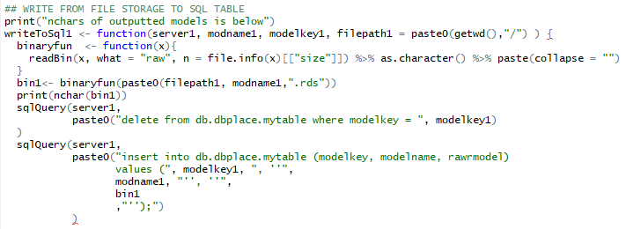
Tips: What to do with your new R object? Store RDS objects as a varbinary table entry
With this, you have full access to all objects in your session
They can be made permanent
They can be referenced later (this allows versioning)

Slide 19
Tips: Tuning code and processes
''
There are extremely limited packages installed
installed.packages() to check
Single-quotes have to doubled up or it closes the script!
Find ' and replace with ''
Bringing in lots of data:
You are not limited to single input -- there are streaming (rows per read) and parallel parameters within the external script arguments
This is done even more simply by using ODBC references

Slide 20
Quick note: A different technique entirely: RevoR-enabled contexts
RevoScaleR is a very different system. It’s a presentation on its own!
Can use RevoScaleR and switch file and compute contexts
Pros:
Can use any data source type
Hadoop; Azure
Microsoft has done the hard work of optimizing the system to them
Unlimited memory resources through chunking
Can be fast
Has decent support and upgrades through Microsoft
Cons:
You have to develop/understand RevoScaleR (Rclient for local)
It is different from Base R and Tidyverse R (decent, but less, support)

Slide 21
Overall: Other limitations
Have to “step back” from new tools to Base R (+ RevoScaleR)
Can only install some packages (and the permissions are iffy)
C++ based programs may be impossible
Probably the case for rjava, devtools, etc.
Output is more difficult than in RStudio
There are creative possibilities, but they require work

Slide 22
Overall: Benefits are in the process
Software (from the Analytic Maturity article)
Data storage and processing workflows are flexible, capable, and long-term
Processes can be run by IT, DBA, and analytics depts
Data flows allow productionizing
IT/DB collaboration
Scrutiny: stricter/more formal coding standards
Versioning/testing/failing well
Is it worth the effort?....

Slide 23
It’s a big push toward integration
SILOS
VS
INTEGRATION

Slide 24
Questions

