Slide 2
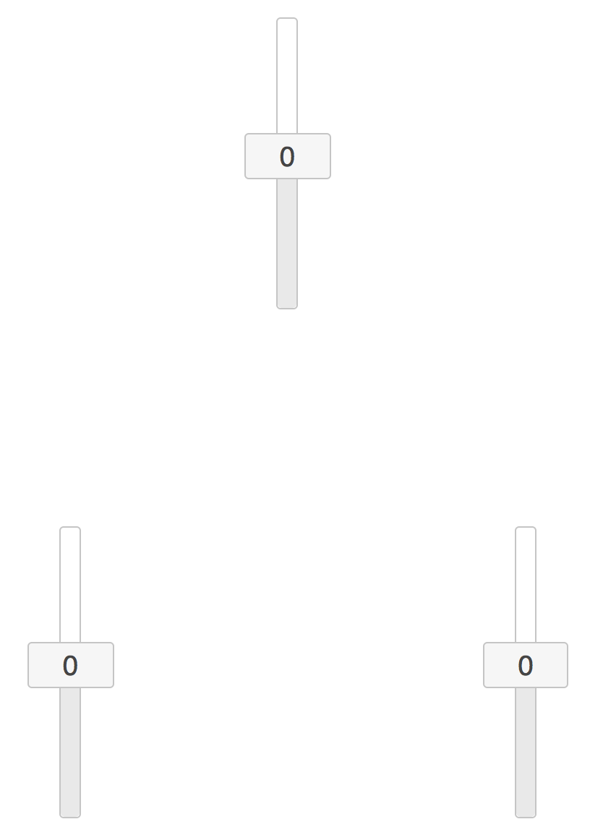

Slide 8
Huge arrows

