Slide 1
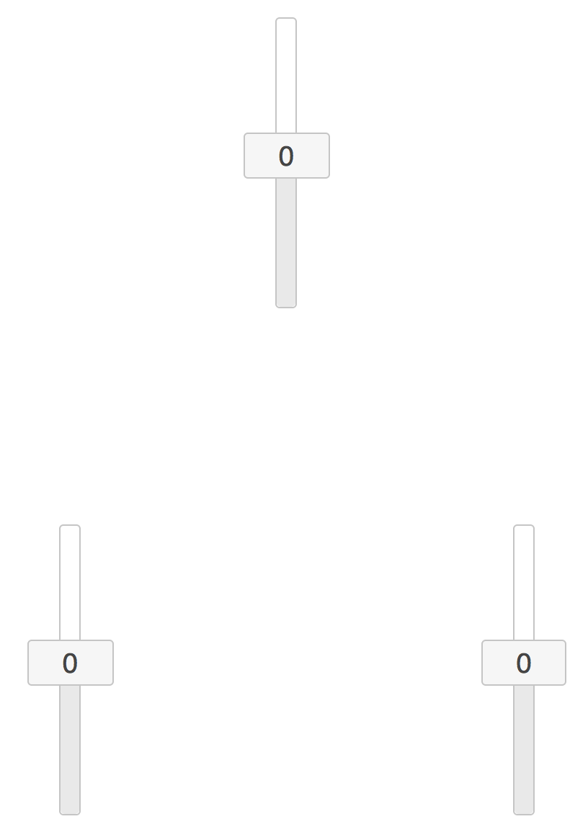
Components

Slide 2
Potential causal
relationships

Slide 10
Huge arrows

