Slide 1
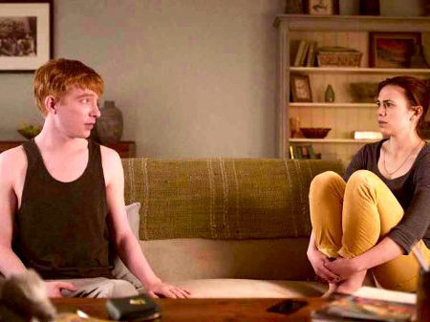
CASE 1: A man who is living with a robot of his dead wife dies. What happens to the man’s property? What happens to the robot?

Slide 2
CASE 2: A man creates a robot of his dead wife (with whom he had a child). A few years later the man also dies. Does the robot have any custody rights in the child?

Slide 3
CASE 3: A robot is created of a dead painter. He continues to paint; when he sells the work, the proceeds go to his wife, who controls their finances (though he’s fine with this). Someone else copies his painting and sells it. When accused of copyright infringement, he claims that a robot cannot own a copyright.

Slide 4
CASE 4: A robot of someone’s dead mother murders someone. Who is responsible?

Slide 5
CASE 5: A woman creates a robot of her dead husband, who was emotionally and physically abusive. She repeatedly is in the hospital for injuries from the robot. The hospital informs the police. What should they do? Who is responsible?

Slide 6
CASE 6: A man makes a robot of his dead wife. Later it is discovered that they had had an abusive relationship and now he is horribly mistreating the robot. Can anything be done?

Slide 7
CASE 7: The robotics company maintains records of everything said and done by a robot so that they can make sure they aren’t liable for misdeeds etc. Is this an invasion of privacy?

Slide 8
CASE 8: Because the robots are so expensive, the robotics company does not get enough users to be profitable, and goes bankrupt. There is no one to continue to support the robots, and eventually they all stop working. The robots essentially die (again). Can their users sue the company? For what?

Slide 9
CASE 9: A man wants to create a robot of his dead child. He and his wife are divorced. She strongly objects.

Slide 10
CASE 10: Someone wants a robot made of a dead friend that they had no formal relationship with. Are there any regulations around this?

Slide 11
CASE 11: Someone makes a robot of their dead spouse and then a few years later decide they hate them. They want a “divorce.”

Slide 12
CASE 12: Someone makes a robot of their dead spouse and then a few years later the robot falls in love with someone else. The robot wants a divorce.

Slide 13
CASE 13: Someone “steals” a robot, keeps them prisoner. Should they be charged with property theft or kidnapping?

Slide 14
CASE 14: A woman creates a robot of her soldier husband who was presumed dead in a warzone. He was actually a prisoner of war, and years later returns. What happens to any rights conferred upon the robot?

Slide 15
For more information about this exercise, see https://medium.com/@cfiesler/the-black-mirror-writers-room-teaching-technology-ethics-through-speculation-f1a9e2deccf4

