Slide 1
Lecture 1
INTRODUCTION TO COMPUTER VISION
ACQUIRING IMAGES
Emanuele Trucco
School of Computing
University of Dundee
e.trucco@dundee.ac.uk
Ref textbook: Trucco, Verri, “Introductory techniques for 3-D computer vision”,Prentice-Hall, 1998
Plus papers/handouts for specific lectures

Slide 2
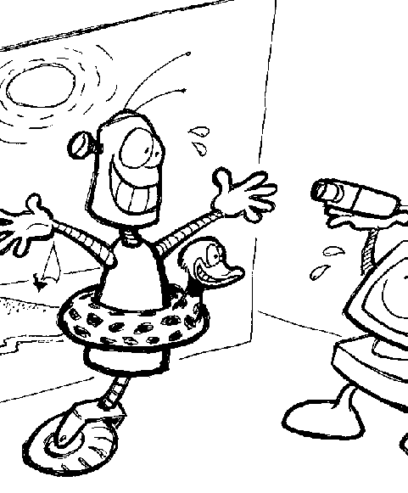
CONTENTS
1.1. Structure of the course
1.2. Introduction:
computer vision and
related disciplines
1.3. Img acquisition basics:
optics, radiometry, geom.
1.4. Projection models:
perspective and more
1.5. Projective formulation
1.6. Lecture summary

Slide 3
AC42001 Research Frontiers
Emanuele Trucco, February 2008
Weeks 6-10
UNIT PLAN
EYES OF THE ROBOTS
HUMAN MOTION ANALYSIS
RETINAL IMAGE ANALYSIS (RIA)
INTRO
SOME THEORY
PAPER DISCUSSION
INTRO
SOME THEORY
PAPER DISCUSSION
Human modeling and motion capture
CLASSIFICATION FOR RIA
Context-based landmark location
Evaluation methods in biomedical informatics
IMAGE FEATURES
CONTEXT-BASED RIA
STEREO
HUMAN BODY MODELS
TESTING AND VALIDATION IN CLINICAL CONTEXTS
Case-based learning exercise
Case-based learning exercise
OPTIMIZATION
Incl code examples (PSO MATLAB)

Slide 4
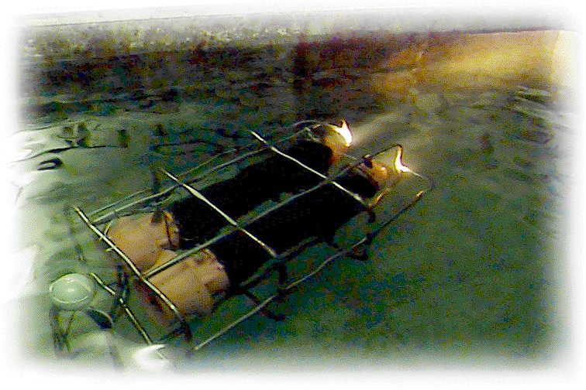
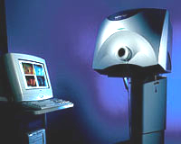
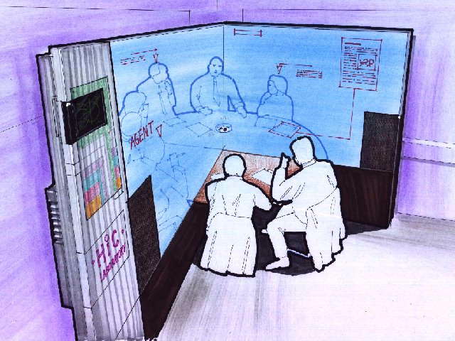
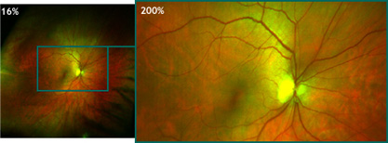
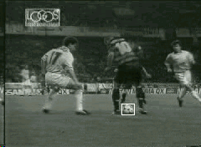
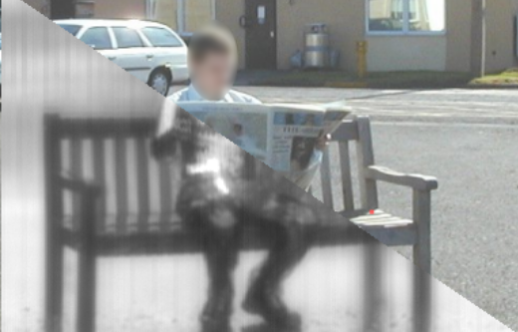
1.2. COMPUTER VISION AND RELATED FIELDS
Textbook: Chapter 1
Target problem of CV: computing properties of the 3D world from images or videos.
Impacts hardware and software! Here, emphasis on algorithms.
Huge number of applications!

Slide 5
RELATED DISCIPLINES
IMPORTANT! definitions are not rigid; disciplines intersect.
c
IMAGE PROCESSING: compute image properties or image-image transformations, e.g., feature extraction, noise attenuation, enhancement, restoration.
www.eurasip.org, European Society for Signal Processing; IAPR; IEEE Sig Proc Soc
PATTERN RECOGNITION: recognise and classify targets given digital images.
www.iapr.org, Int. Association for Pattern Recognition (IAPR)
PHOTOGRAMMETRY: obtaining accurate measurements from non-contact imaging.
www.isprs.org, Int. Society for Photogrammetry and Remote Sensing

Slide 6
WHERE CAN I READ ABOUT CV?
MAJOR INTERNATIONAL JOURNALS
Int Journ of Computer Vision
Computer Vision and Image Understanding
IEEE Trans on Pattern Analysis and Machine Intelligence
Image and Vision Computing
MAJOR INTERNATIONAL CONFERENCES
IEEE ICCV, Int Conf on Computer Vision
IEEE CVPR, Int Conf on Comp Vis. and Pattern Recogn.
CV work published also in applied publications, e.g., graphics, robotics, automation, comms, medical

Slide 7
1.3. IMAGE ACQUISITION
Textbook: Chapter 2
PROBLEM DEFINITION: where do digital video and images come from?
Digital images are 2-D arrays of numbers
Such numbers encode lots of info about the world
Info encoded via the image formation process
Img Acquis concentrates on creating digital images (rest of book on making encoded info explicit)

Slide 8
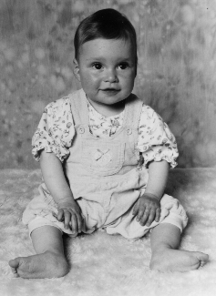
➔ IMAGES ARE ARRAYS OF NUMBERS
117 125 133 127 130 133 121
134 133 138 132 134 130 133
146 147 138 140 125 134 124
144 141 136 130 120 108 88
pixel values

Slide 9
➔ SCENE, IMAGES, AND CAMERA
FRAME MEMORY IMG
CCD IMAGE
FRAME GRABBER
CAMERA
3-D SCENE (WORLD)
HOST COMPUTER

Slide 10
IMAGE FORMATION INGREDIENTS
Geometric parameters
Where on the image does a scene point appear?
- optics type, params (e.g., focal length)
- projection type
- camera position and orientation in space
Radiometric parameters
  What is the intensity/colour of a given pixel?
- illumination (type, intensity, direction)
- reflectance properties of scene surfaces
- sensor behaviour (e.g., % incoming energy lost)

Slide 11
➔ BASIC ELEMENTS OF IMAGING DEVICE
IMAGE PLANE
OPTICS
OPTICAL AXIS
APERTURE

Slide 12
OPTICS: KEY CONCEPTS (TEXTBOOK SECTION 2.2.2)
FOCUS
Point in focus = All rays coming from a scene point converge into a single image point.
If not, circle of confusion (point is out of focus)
HOW CAN ALL POINTS BE IN FOCUS SIMULTANEOUSLY?
If in focus at distance d , not in focus at d+δ !
- pinhole aperture: only one ray per scene point enters
- optical system composed of several lenses
f1
f2
IN FOCUS
(thin lens)
OUT OF FOCUS
(thin lens)

Slide 13
OPTICS: KEY CONCEPTS (cont’d)
EXPOSURE TIME
Time needed to allow enough light through to form an image.
The smaller the aperture, the longer the ET.
(Obviously, pinhole aperture a problem!)
FIELD OF VIEW
Angular measure of portion of 3-D space seen by camera.

Slide 14
➔ BASIC RADIOMETRY (TEXTBOOK SECTION 2.2.3)
LIGHT SOURCE
CCD ARRAY
I
OPTICS
p
n
E(p)
L(P,d)
I
d
P
SURFACE
Irradiance = power of light, per unit area, incident on a given point
Radiance = emitted power of light, per unit area, leaving a given point in a given direction

Slide 15

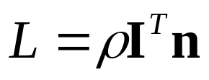
MODELLING SURFACE REFLECTANCE
PROBLEM DEFINITION: What is the relation between irradance and radiance for a given surface?
I.e., how much light does a surface point, P, emit in a given direction, n, when hit by a ray of light coming from
direction ?
LAMBERTIAN REFLECTANCE
The simplest model, frequently adopted in CV:
where:
ρ = albedo, value specific for material
I and n, see figure page 14
Other models, see further readings

Slide 16
FUNDAMENTAL EQUATION OF RADIOMETRIC IMAGE FORMATION
PROBLEM DEFINITION: What is the relation between scene radiance, L(P), and image irradiance, E(p), for a given surface point?
F
Assuming:
1. Scene point P projects to image point p
2. thin lens
3. finite aperture
4. no energy losses in optics, i.e., E = L
then …

Slide 17
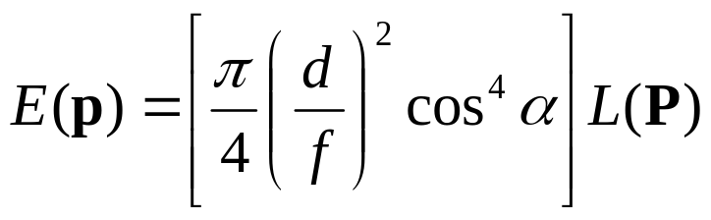
RADIOMETRIC IMAGE FORMATION (cont’d)
δO
P
θ
ΔΩ
δΩ₀
d
α
O
δΩ_{I}
δI
p
Z
f
Derivation and details: textbook, pp. 23-26
E(p) decreases moving away from the image centre, but normally main variation due to irradiance gradient (cos⁴α falls slower than cosα + optics compensation) .
F-number = f/d ; the smaller, the brighter the optics

Slide 18
1.4. GEOMETRIC CAMERA MODELS
PROBLEM DEFINITION: Given the co-ordinates of a scene point, P, in some 3-D reference frame, what are the image co-ordinates of its projection, p ?
To answer, we need a mathematical model of the geometric projection implemented by the camera, often called simply a camera model.
THINGS TO NOTICE IN PROB DEF ABOVE:
- Which 3-D ref frame? Various possibilities ...
- Digital camera introduces pixelisation

Slide 19
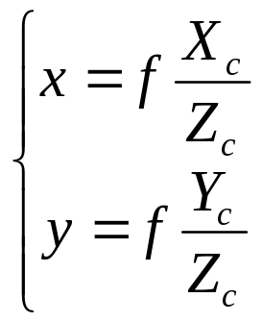
➔ PINHOLE (PERSPECTIVE) CAMERA
Yc
Xc
IMAGE
PLANE
CAMERA
FRAME
P
O
p
f
o
OPTICAL
AXIS
π
Zc
All co-ords in camera reference frame [mm]
p = [x,y,f]^{T}, P = [X,Y,Z]^{T}
f = focal length [what is its effect?]
O = center of projection
o = principal point, or image center
r
NOTICE
1. Abstraction only! Optics collapsed in a single point!
2. Camera ref. frame (3-D) rigidly attached to camera
3. Not yet a digital camera model! No pixels!

Slide 20
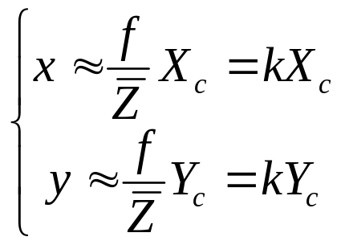
INTERMEZZO: WEAK PERSPECTIVE CAMERA
If stand-off distance much larger than scene depth, then the WPC model applies:
SCENE DEPTH
CAMERA REF FRAME
Zc
STAND-OFF DISTANCE
IN PRACTICE:
- Mathematically, simpler (linear) equations
- Visually, perspective distortion lost (same Z for all points)
- Consequently, cannot recover depth, Z, from image, as projection is now invariant to Z !
➔ Distances and depth measured along Z axis only; not Euclidean distances!!

Slide 21
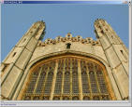

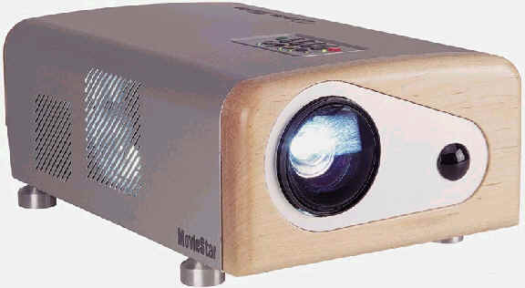
WEAK PERSPECTIVE VISUALLY
FULL PERSPECTIVE: depth makes a difference.
Parallel lines in scene converge (to vanishing points)
WEAK PERSPECTIVE (scaled orthographic): Z-induced distortion is lost. Parallel lines in scene remain parallel.

Slide 22
MODELLING DIGITAL IMAGE ACQUISITION
Effects generated by digital sensor (CCD) and frame store:
1. Image co-ordinates are integer
2. Pixels (and images) are, in general, not square
As CCD dimensions in pixel may be different from frame store dimensions, one considers equivalent pixels belonging to an ideal image directly stored in the computer :
How to model this mathematically?
DIGITAL IMAGE
(equivalent pixels)
IDEAL ACQUISITION SYSTEM

Slide 23
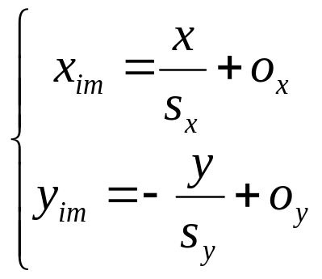
MODELLING A DIGITAL VISION SYSTEM (2)
Y
X
X_{im}
CAMERA
FRAME
IMAGE
FRAME
P
O
p
f
o
OPTICAL
AXIS
π
From camera ref frame [mm] to image ref frame [pixel]
x, y as per Page 19
Z
Y_{im}
Image reference frame:
- o = [o_{x},o_{y}]^{T} image center [pixel]
- s_{x}, s_{y} : x and y pixel size [mm/pixel]
- x_{im}, y_{im} integer image co-ords [pixel]
- IRF defined on the image plane  2-D co-ords!
- IRF defined by 4 intrinsic parameters: s_{x}, s_{y} , o_{x}, o_{y}

Slide 24

WHERE IS THE CAMERA?
To answer, we need an independent world reference frame!
We have already:
- scene to image-plane projection in 3-D camera co-ords (P. 19)
- 3-D camera co-ords to 2-D image co-ords (P. 23)
Must add: world co-ords to camera co-ords:
Y
X_{im}
X
IMAGE
FRAME
CAMERA
FRAME
P
O
P_{c} = P in camera co-ords (p 19)
P_{w} = P in world co-ords
R, T = specify world-to-camera transformation
Z_{im}
p
o
R, T
f
OPTICAL
AXIS
π
WORLD FRAME
Z
Y_{im}
Y_{im}
X_{im}
The 6 degrees of freedom of R and T are called the extrinsic parameters

Slide 25
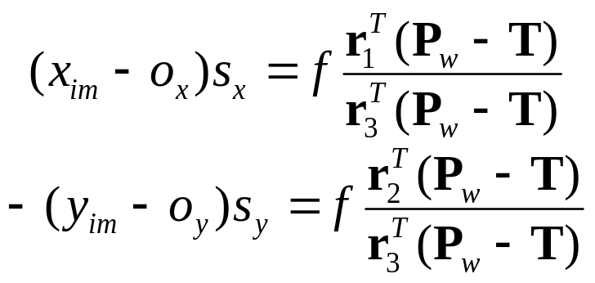
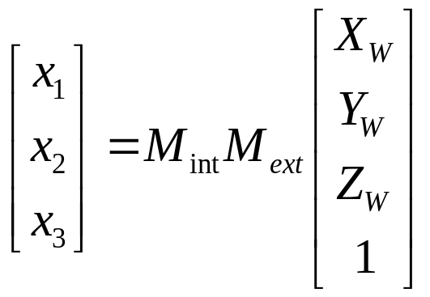
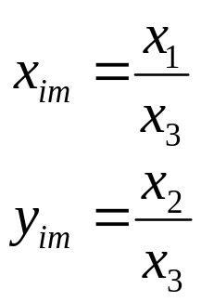
BRINGING IT ALL TOGETHER
Let’s combine:
- scene to image plane in camera co-ords (P. 19)
- camera to image co-ords (P. 23)
- world to camera co-ords transformation (P. 24)
r_{k} = k-th row of R
NOTICE: camera co-ords disappeared!
and finally:
Solution to the target problem (P. 18)

Slide 26
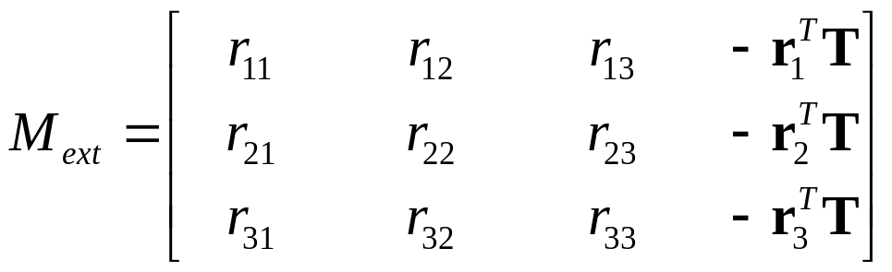
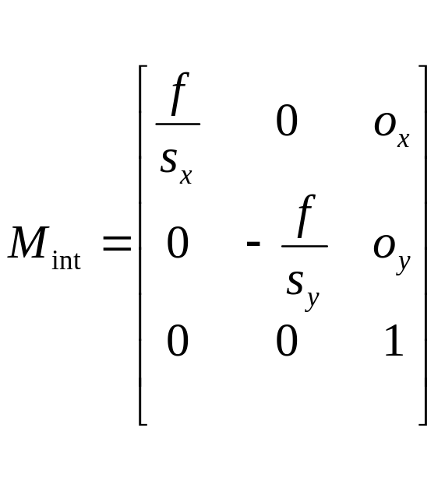



THE PROJECTION MATRIX
Perspective projection matrix
= projective (tilda) image co-ordinates

Slide 27
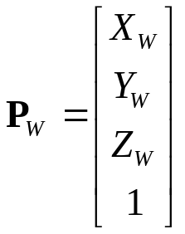
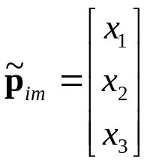
COMMENTS: GEOMETRIC PROJECTION MODEL
1. Camera co-ords inaccessible directly, hence sensible to drop them from model
2. Linear model using homogeneous co-ords for world points and projective co-ords for image points, i.e.,
3. Model separates nicely internal camera parameters (M_{int}) from camera position and orientation (M_{ext})
4. Projective co-ords defined up to an arbitrary factor, so M has really only 11 degrees of freedom

Slide 28


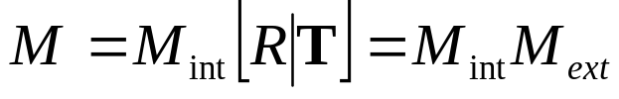
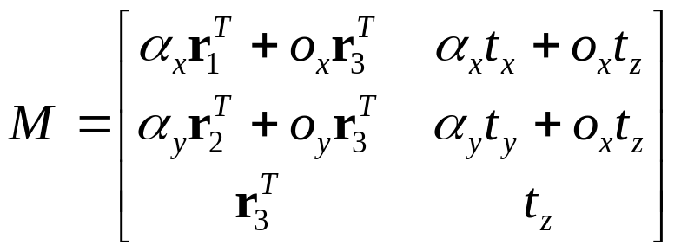

1.5. FULL PROJECTIVE FORMULATION*
In projective co-ords, points are only directions, so that:
with κ an arbitrary factor.
Assuming , we obtain a very similar form for M :
(1)
The PPM becomes:
(2)
Where are the focal lenghts in pixels.

Slide 29
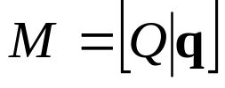

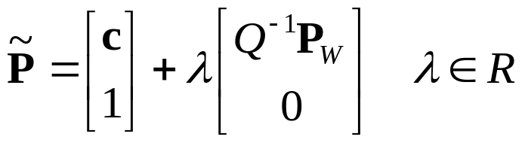
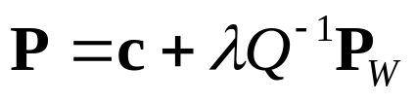
USEFUL FACTS*
The quantity κ can be regarded as the distance of P_{W} from the image plane, i.e., the Z co-ord of P_{W} (follows from Eq. (1) and (2) )
M has full rank, i.e., rank(M ) = 3 . Its kernel defines the optical center, the only point for which the proj is not defined, i.e.,
If we let , then
The optical ray passing through P_{W} and c is
(projective co-ords)
(Cartesian co-ords)

Slide 30
1.6. LECTURE 1: TAKE-HOME MESSAGES
Image formation involves geometry (where does a scene point appear on the image?) and radiometry (how bright, what colour will a pixel be?)
Even simplified optics (finite aperture, focal length) implies non-uniform light distribution
Lambertian reflectance assumed frequently for simplicity
Geometric camera models in computer vision assume equivalent pixels and pin-hole cameras
Most general projection is perspective, which simplifies to affine camera or weak perspective under appropriate conditions

Slide 31
SOME REFERENCES*
General books on CV (in addition to our textbook)
- Forsyth and Ponce, Computer Vision, Prentice Hall, 2003
Wide coverage, spanning most CV areas.
Geometry
- Hartley and Zisserman, Multiple View Geometry, Cambridge Univ Press, 2000
The definitive book on geometric computer vision.
Optics and radiometry
- Born and Wolf, Principles of Optics, 6th edition, 1993
Classics never die. All the optical physics you need, and more.
- Luong, Fua, Leclerc, The radiometry of multiple images, IEEE Trans PAMI 24(1), 2002. A recent view on radiometry and identification of radiometric models
Useful links
- Fisher (ed.) Cvonline, on-line compendium of CV, homepages.inf.ed.ac.uk/rbf/Cvonline
- The Computer Vision home page, www2.cs.cmu.edu/afs/cs/project/cil/ftp/html/vision.html

