Slide 1
NYC Parking Violations Analysis
Using PySpark, HDFS, and MapReduce
By: [Your Name]

Slide 2
Project Overview
• Analyzed 7M+ NYC parking violations
• Used PySpark and Hadoop MapReduce for processing
• Stored data in HDFS for scalability
• Extracted insights on ticket trends, common car makes, and locations

Slide 3
Technologies Used
• Google Cloud Platform (GCP) - Hosted and processed large datasets
• Hadoop Distributed File System (HDFS) - Stored big data efficiently
• PySpark & MapReduce - Distributed processing
• Bash Scripting - Automated data retrieval and processing
• JSON & Pandas - Data parsing and manipulation

Slide 4
Data Collection & Storage
• Data Source: NYC Open Data API
• Retrieved 7M+ rows using Bash scripts
• Stored in JSON format and uploaded to HDFS
• Used HDFS to manage and distribute large datasets efficiently

Slide 5
How MapReduce Works
• Mapper extracts key features from raw data
• Shuffle & Sort groups data by key (e.g., hour, location)
• Reducer aggregates and counts occurrences
• Optimized for large-scale batch processing

Slide 6
Key Findings & Insights
✅ 9 AM is the most common ticket time (614,149 tickets)
✅ 2021 Toyota is the most ticketed car (65,721 tickets)
✅ NY County has the highest violations (1,453,362 tickets)
✅ Gray (GY) is the most ticketed vehicle color (1,347,195 tickets)

Slide 7
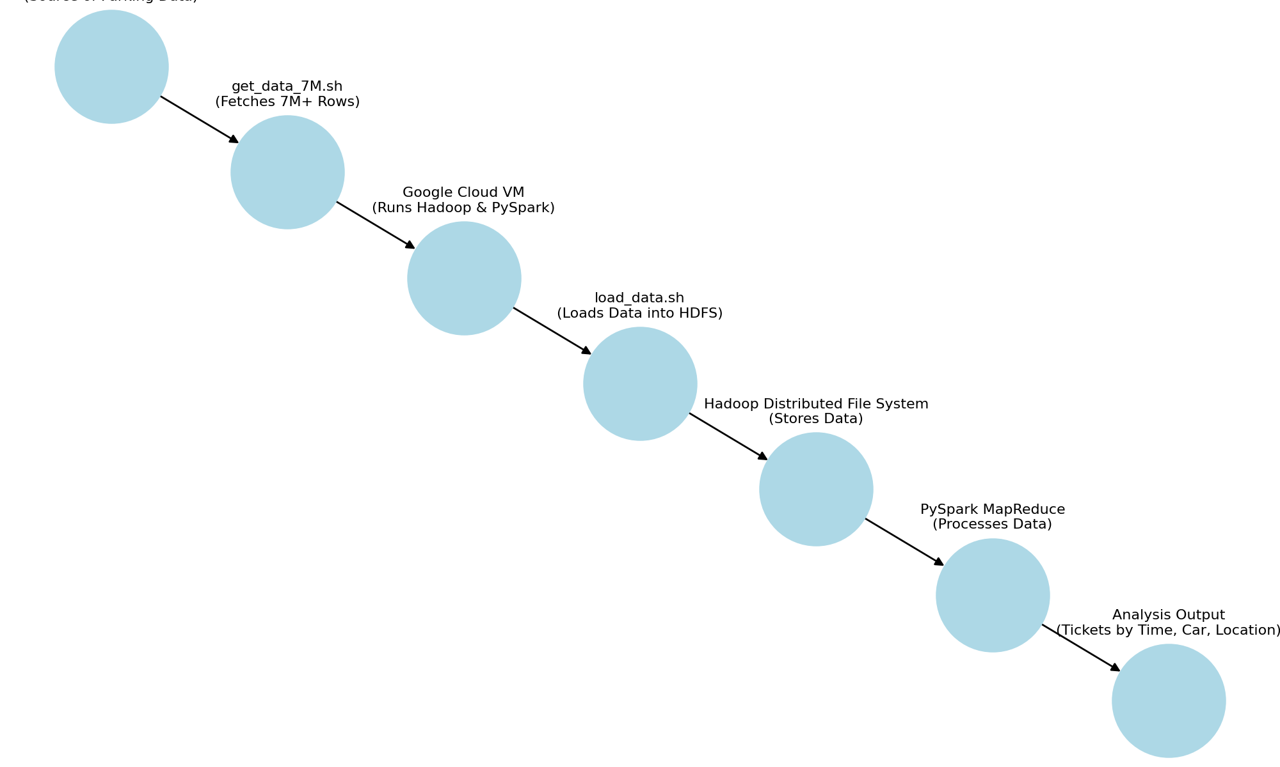
Project Architecture Diagram

Slide 8
How to Run This Project
1️⃣ Start an SSH session on GCP:
ssh your-username@your-gcp-instance
2️⃣ Upload data to HDFS:
hdfs dfs -copyFromLocal data.json /p1/input/
3️⃣ Run MapReduce Jobs:
python mapper.py | sort | python reducer.py
4️⃣ View results in output logs

Slide 9
Why This Project is Relevant for Fetch Rewards
🔹 Demonstrates Big Data processing skills
🔹 Shows ability to analyze transactional datasets
🔹 Uses cloud-based infrastructure similar to Fetch Rewards
🔹 Experience in real-time data aggregation and analytics

Slide 10
Future Improvements & Next Steps
✔ Optimize performance using SparkSQL
✔ Automate pipeline with Apache Airflow
✔ Expand dataset for more insights
✔ Create a visualization dashboard using Tableau or Power BI

Slide 11
Contact & Links
📧 your.email@example.com
🔗 LinkedIn: linkedin.com/in/yourprofile
🐙 GitHub: github.com/yourusername
📜 Project Repo: github.com/yourusername/nyc-parking-analysis

