Slide 1
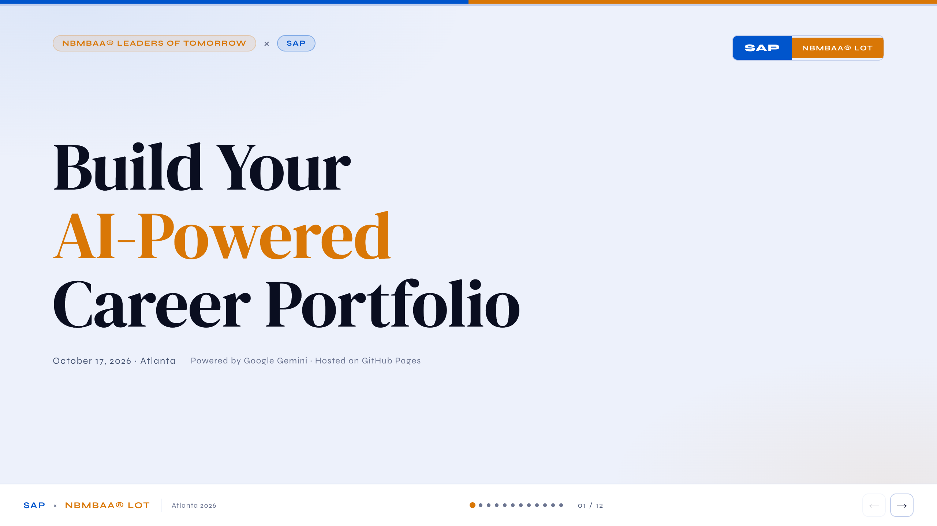
Notes:
[NEIL] Hey everyone - we're Neil and India from SAP. We have 30 minutes and we're going to use all of it. By the time we're done, every one of you will have a real AI-generated portfolio page - the kind you can link to on a college application or LinkedIn. No coding experience, no software to install, nothing to pay for. Two free tools. Let's go.

Slide 2
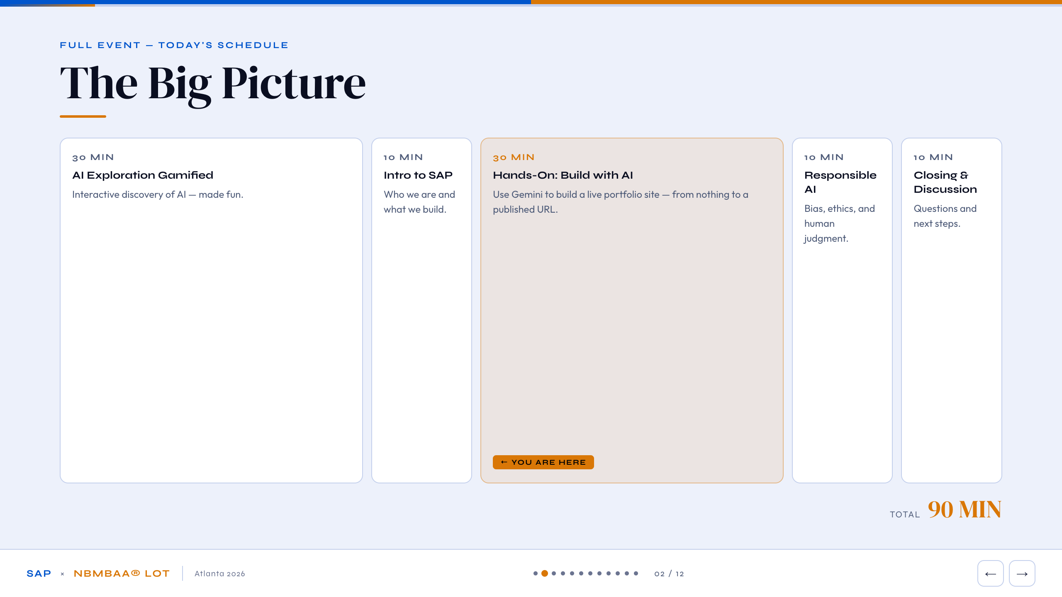
Notes:
[NEIL or INDIA] Quick map of the morning. You've already done the first two blocks. We're the orange one - the hands-on build. After us: a responsible AI segment, then closing. Our 30 minutes. Everything we're doing is built on two free tools: Google Gemini for the AI, and GitHub to host the website. You've probably heard of both. You're about to use them together to build something real.

Slide 3
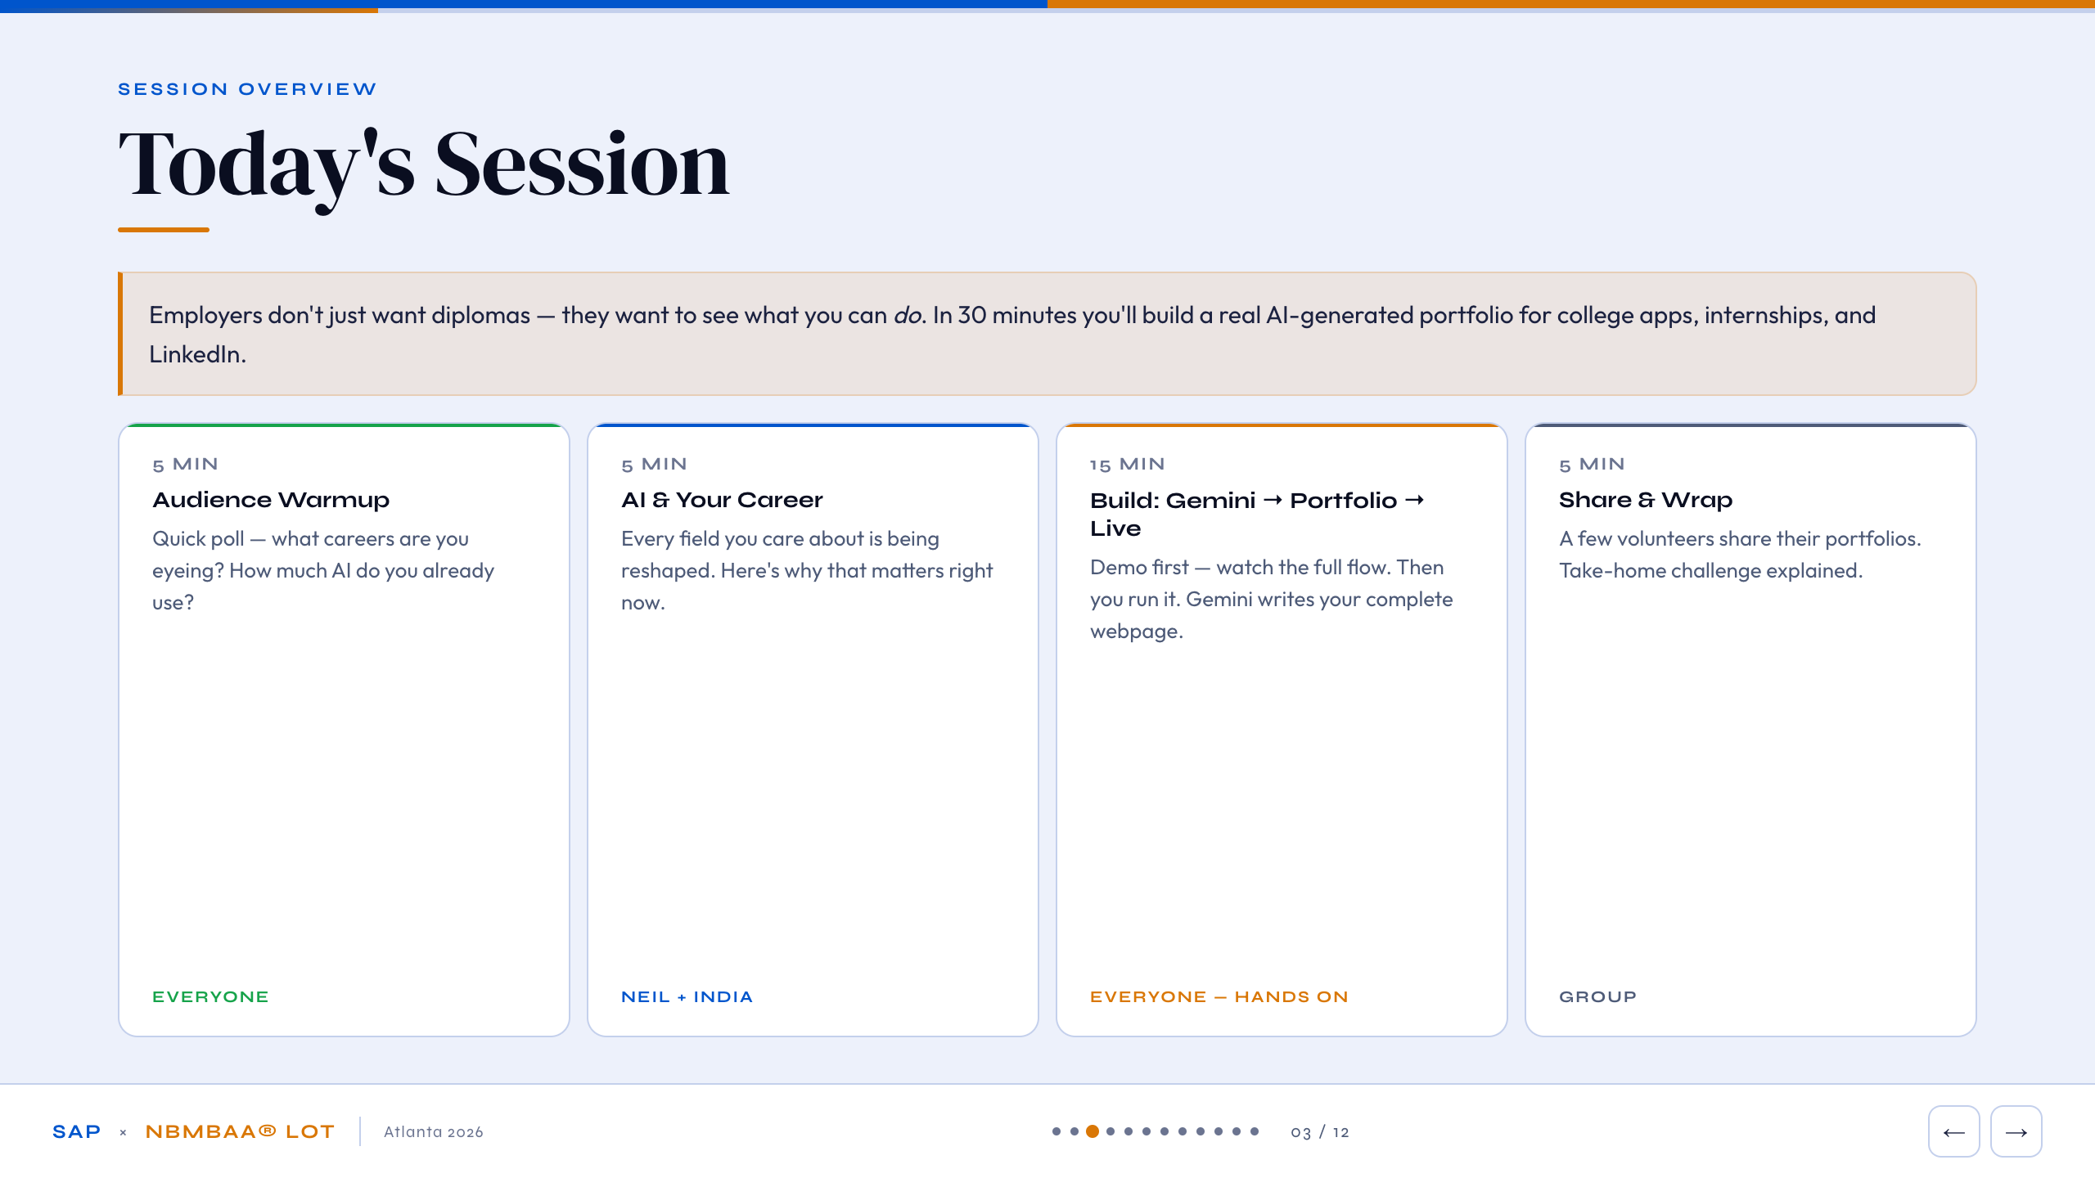
Notes:
[INDIA] Here's our 30 minutes. Five minutes warming up, five on AI and careers, fifteen minutes building - that's the main event - and five minutes to share. The key idea on this slide: employers don't care that you went to school. They want to see what you built. A portfolio page with your actual name, skills, and career thinking stands out from every other applicant who just submits a transcript.

Slide 4
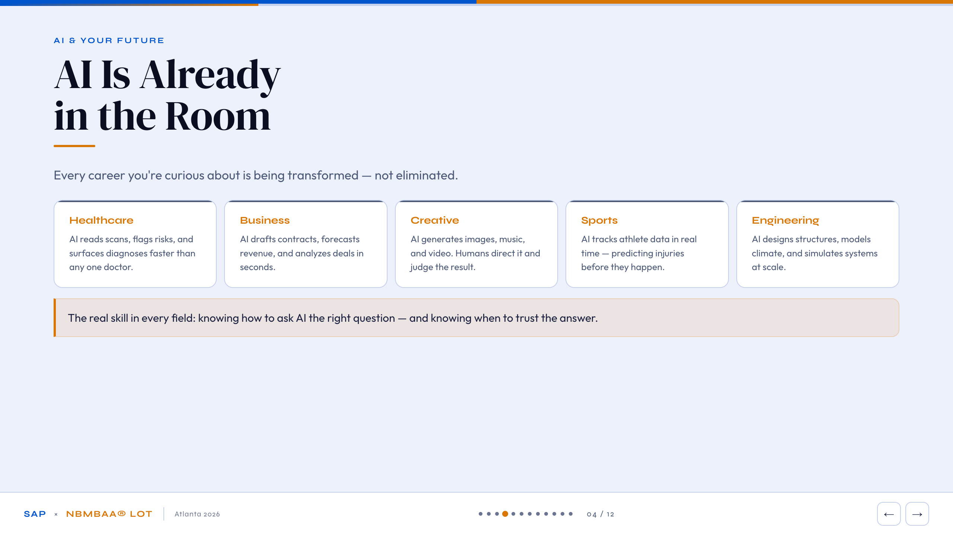
Notes:
[NEIL] Show of hands - who's thinking about healthcare? Business? Creative work? Sports? Engineering? [pause] Here's what's true for every one of those fields: AI is already in them. AI reads medical scans faster than any one doctor. AI writes contracts and runs financial models in seconds. AI generates music, images, video. AI tracks athlete performance in real time and predicts injuries before they happen. AI designs physical structures and simulates climate systems. This isn't a future thing - it's happening now. The students who learn to work WITH AI, not just use it, will have a real edge. That's what we're showing you today.

Slide 5
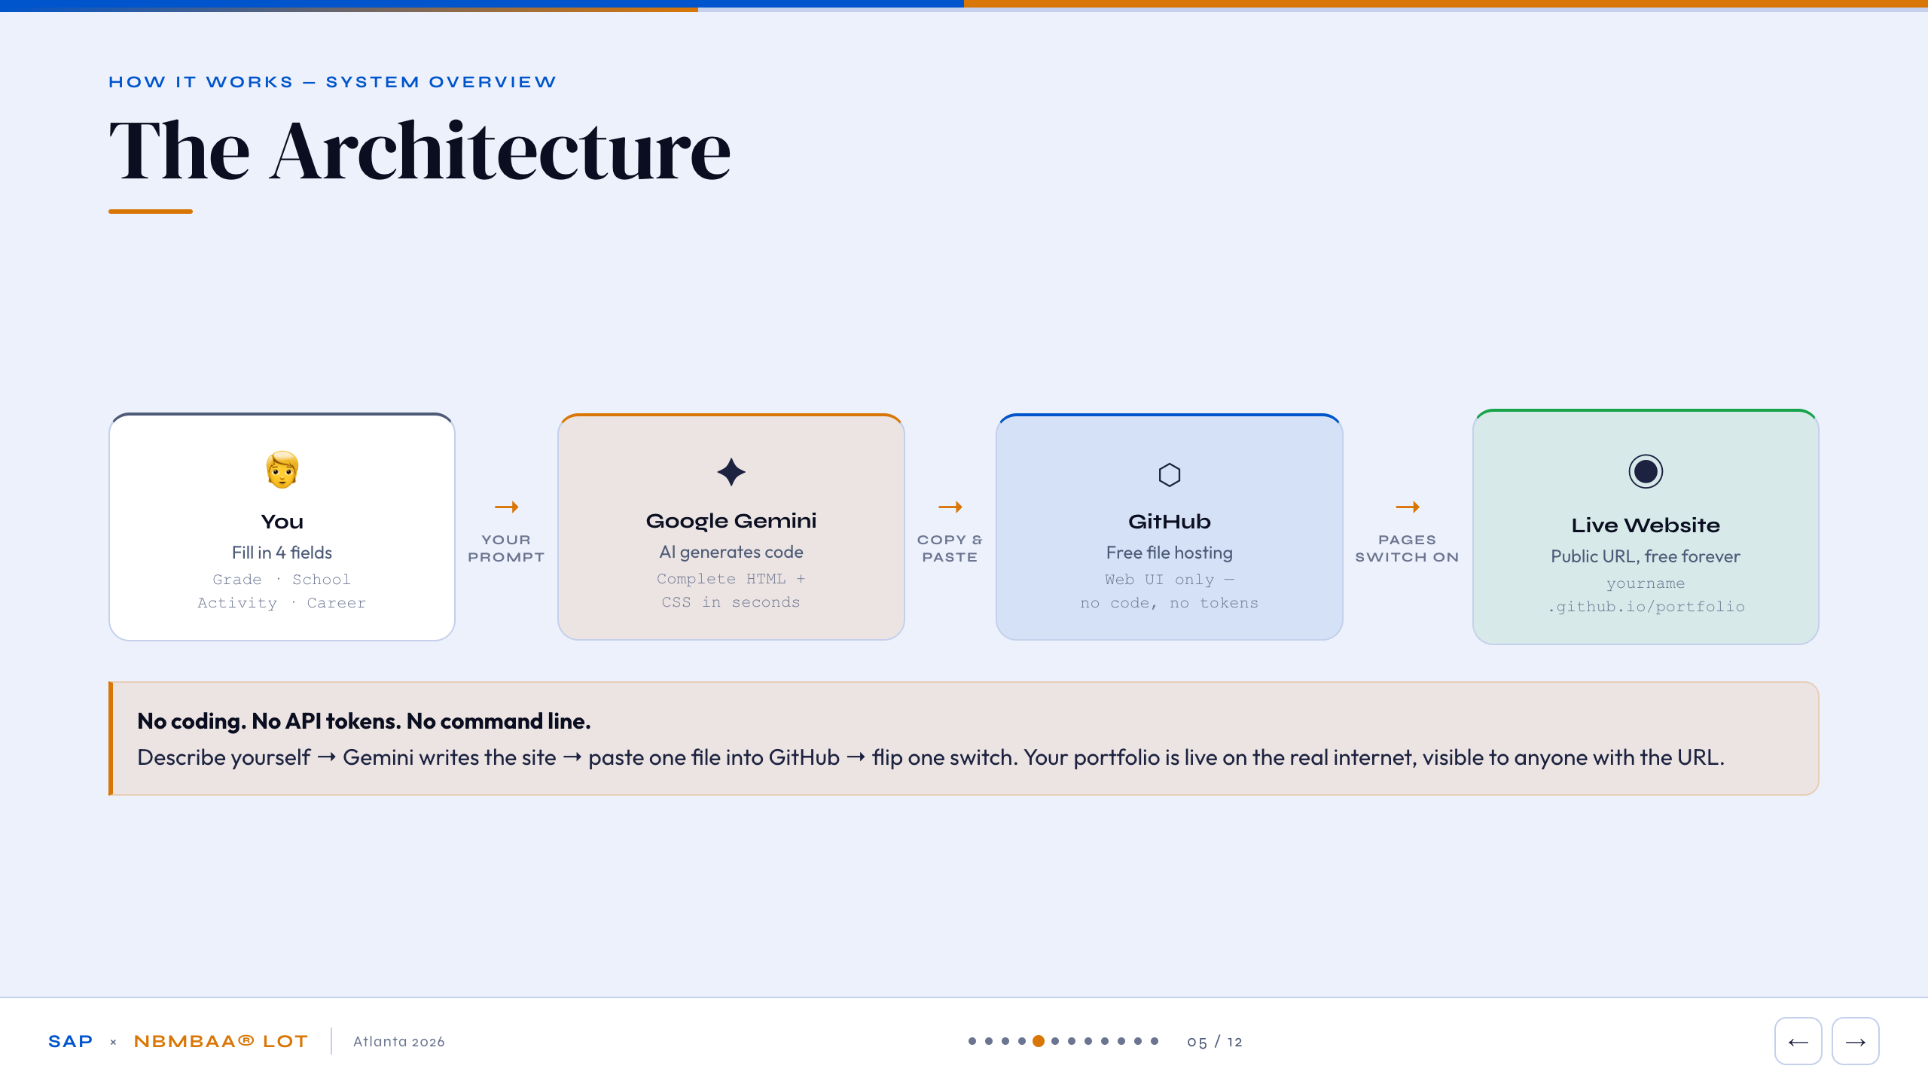
Notes:
[NEIL] Before we touch anything, here's exactly what's about to happen. Four steps. You fill in four things about yourself - your grade, school, one activity, and a career you're curious about. That goes into Google Gemini as a prompt. Gemini reads it and writes a complete website - not just text, the actual code for a real webpage. Then you paste that code into GitHub, a free file-hosting service used by millions of developers. Flip one switch to turn on GitHub Pages, and your portfolio is live at a real URL. No coding. No command line. No credit card. That's the whole system.

Slide 6
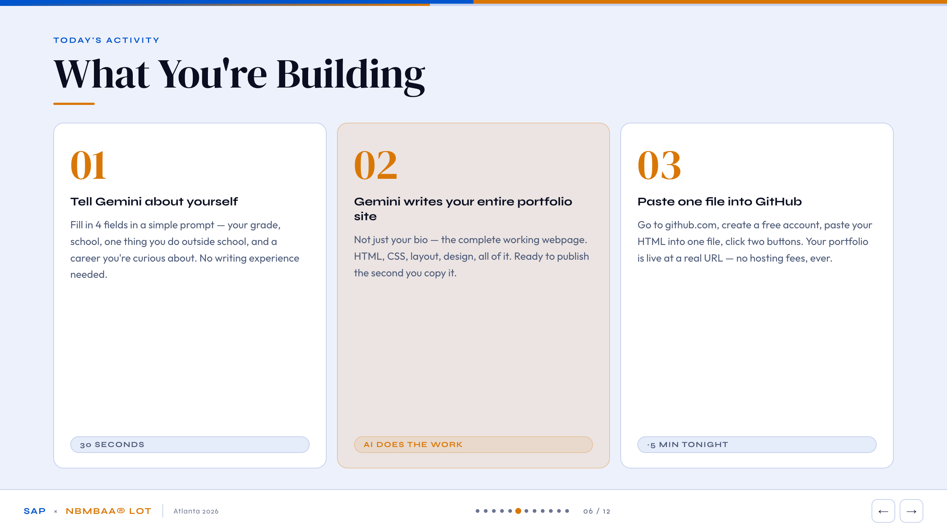
Notes:
[INDIA] Here's what you're walking away with. Step one: four fields, 30 seconds. Step two - this is the part people usually don't believe until they see it - Gemini writes the ENTIRE website for you. Not just your bio. The HTML, the CSS, the layout, the design - a fully working webpage, ready to publish. Step three: tonight, paste one file into GitHub and your portfolio is live at a real URL. Free. No expiration. Yours to share anywhere.

Slide 7
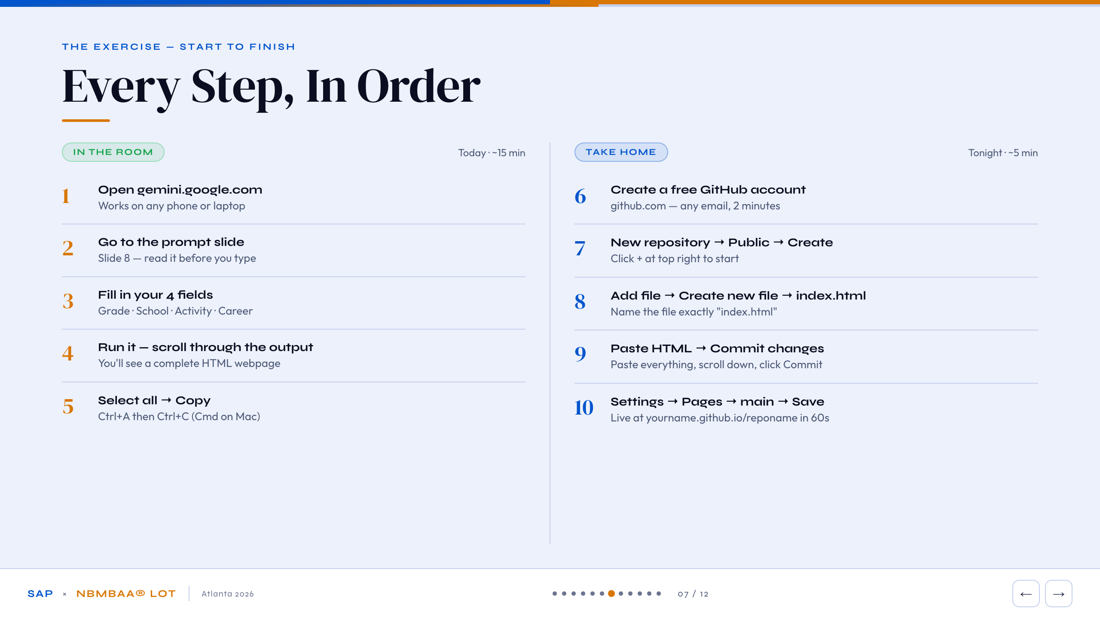
Notes:
[NEIL] Let's walk through all ten steps before we do them so nothing surprises you. Left column is what we're doing right now - five steps, about 15 minutes. Open Gemini, use the prompt on slide 8, fill in your four fields, run it, copy the output. Right column is tonight - five more steps, about 5 minutes. Create a free GitHub account, make a new public repo, create a file called index.html, paste your HTML, and turn on Pages. We'll walk through the right column again at the end. For now - let's start on the left.

Slide 8
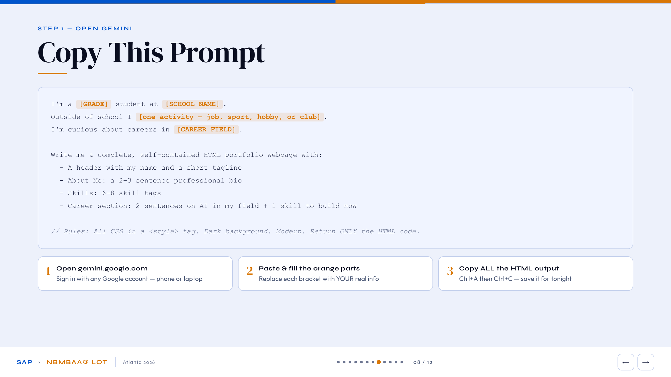
Notes:
[INDIA] This is the prompt. See the orange brackets? Those are the four things you fill in. Your grade - like '10th grade'. Your school name. One activity - a job, a sport, a club, anything you do outside school. And a career field you're curious about. That's it. Fill in the four orange parts, paste the whole thing into gemini.google.com, hit Enter. The last line is key - it tells Gemini to return ONLY the HTML code, so you get a clean file you can paste straight into GitHub with nothing to edit. [Point at slide] Read it once, then fill in your own info. Don't overthink it.

Slide 9
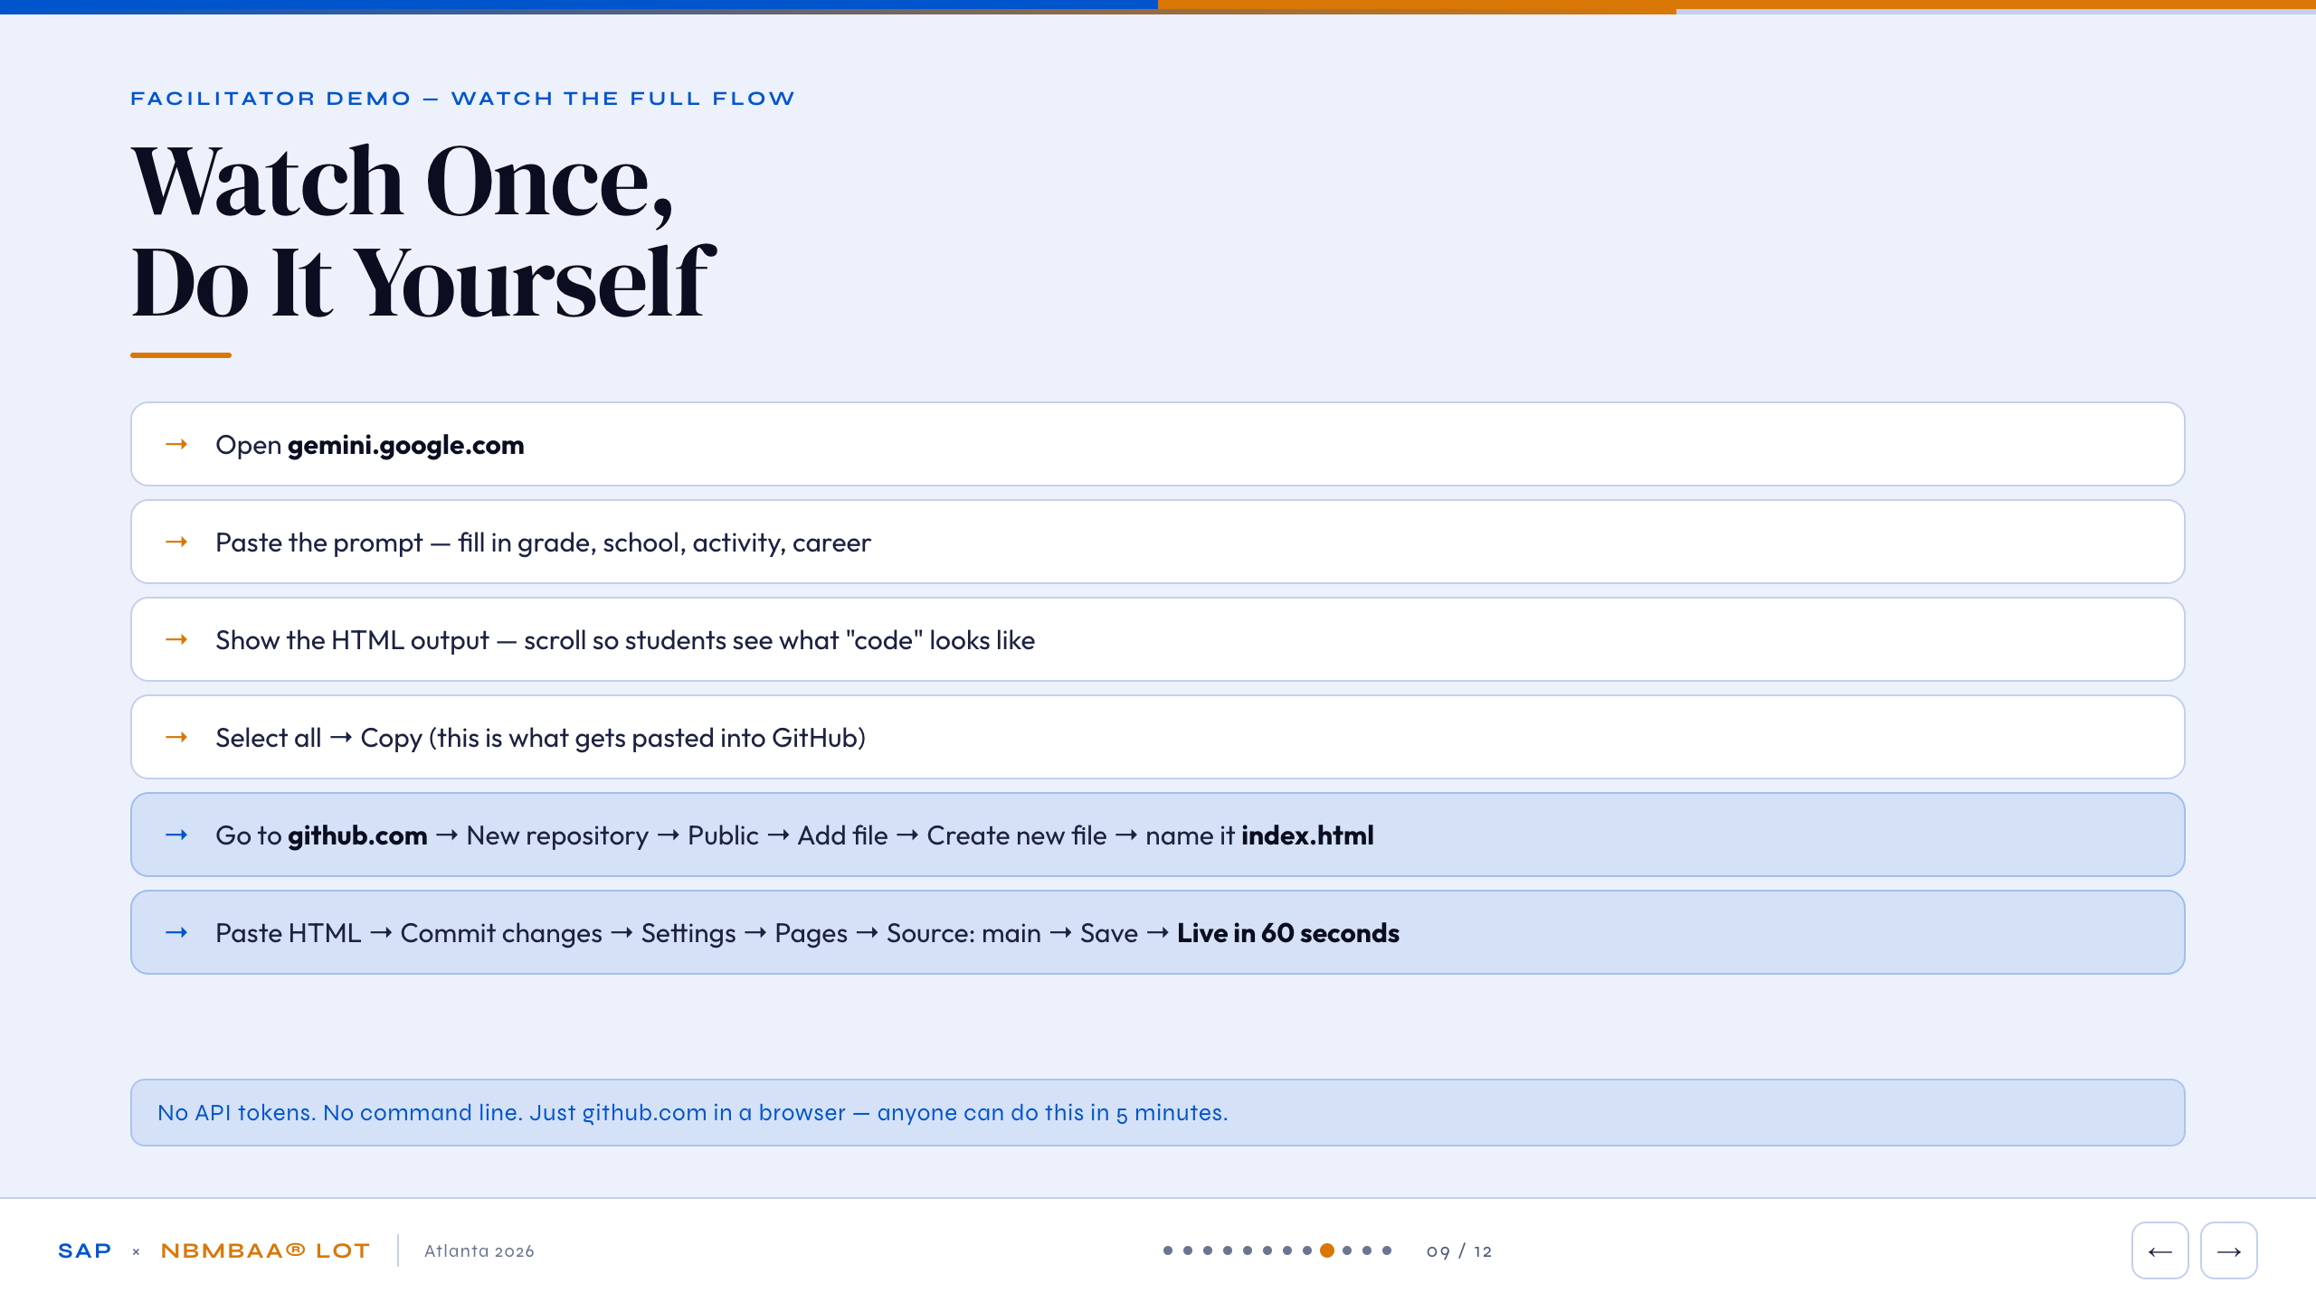
Notes:
[NEIL - LIVE DEMO] Watch this once - I'll run the full flow live so you see every step before you try it.
GEMINI STEPS:
- Open gemini.google.com in the browser
- Paste the prompt with real info filled in (your grade/school/activity/career)
- Scroll the HTML output - say: 'See this? A complete webpage. Gemini wrote it in about 10 seconds.'
- Select all (Ctrl+A), Copy (Ctrl+C)
GITHUB STEPS:
- Go to github.com - say: 'Just a website, no software to install'
- Click + > New repository > name it 'portfolio' > Public > Create repository
- Add file > Create new file > type 'index.html'
- Paste the HTML > scroll down > Commit changes
- Settings > Pages > Source: main > Save
- Wait ~60 seconds, show the live URL
Say: 'That's a real website. Anyone with that URL can see it. Now you do it.'

Slide 10
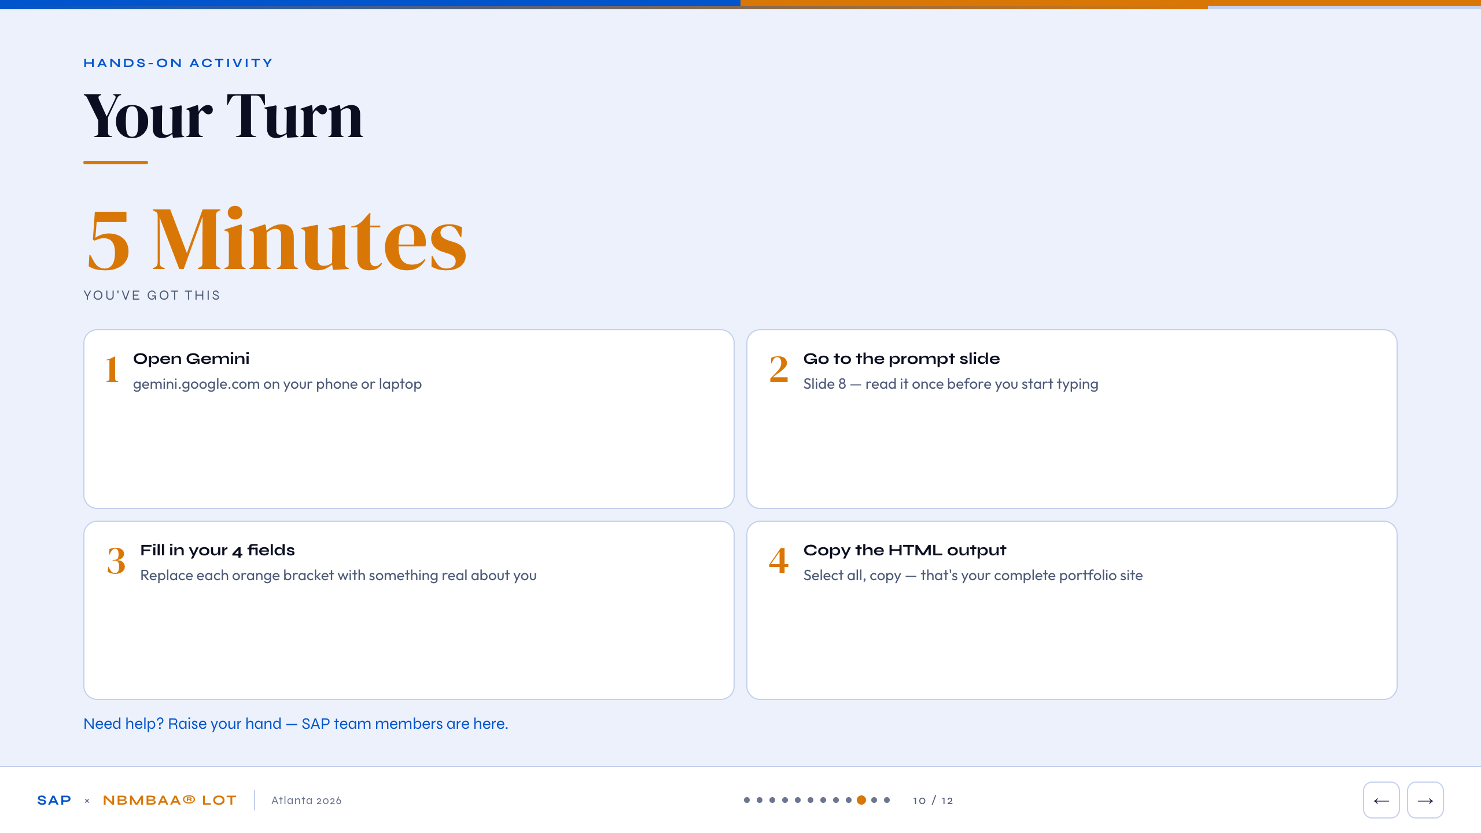
Notes:
[INDIA] Five minutes. Open Gemini on your phone or laptop - gemini.google.com. Go to slide 8 for the prompt, fill in your four fields with real info, run it, and copy all the HTML output. That's everything you need to do right now. Stuck anywhere? Raise your hand - we have SAP team members in the room. Don't worry about it being perfect; you can always regenerate with different info later.
[NEIL - while students work] Finished early? Go back into Gemini and try a different career field - see how the portfolio changes. Or make the prompt more specific: add your GPA, a specific club role, a company you want to work for.

Slide 11
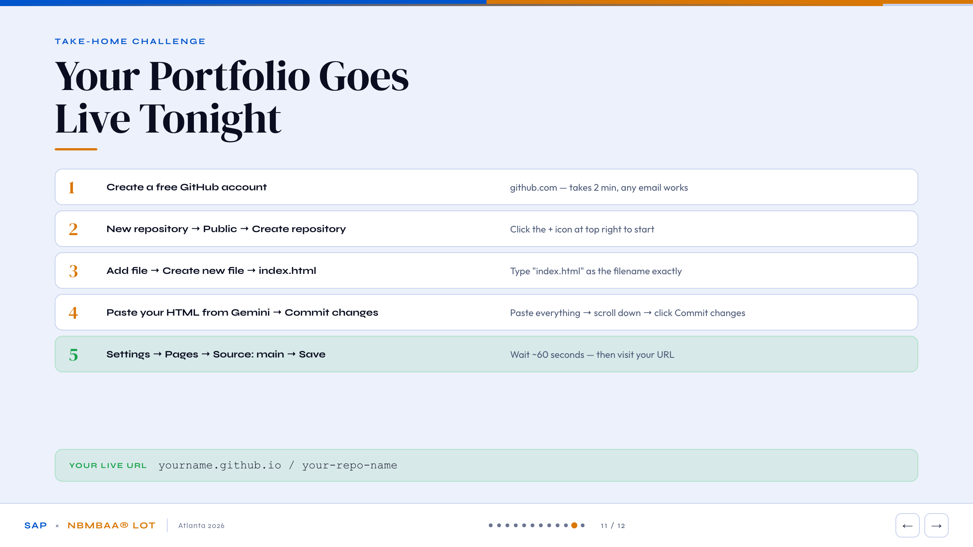
Notes:
[NEIL] You've got the HTML - the hard part is done. Tonight, five steps to get it live. One: create a free GitHub account at github.com. Any email, two minutes. Two: click the plus sign at top right, new repository, make it Public, Create. Three: Add file, Create new file, name it exactly 'index.html' - lowercase, spelling matters. Four: paste your entire HTML from Gemini, scroll to the bottom, Commit changes. Five: Settings, then Pages, set Source to 'main', Save. Wait about 60 seconds. Your URL appears - yourname.github.io/your-repo-name. Screenshot it. Put it on your college apps, your LinkedIn, your email signature. It's yours and it's free forever.

Slide 12
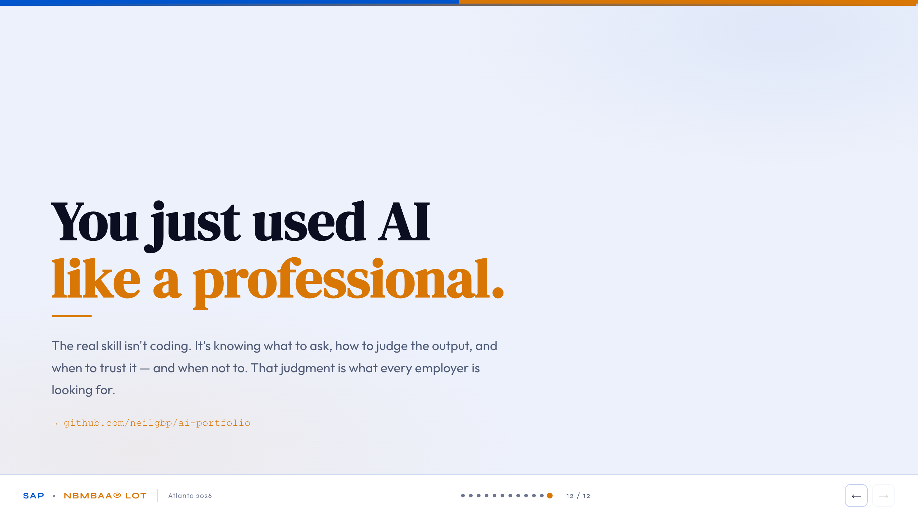
Notes:
[INDIA] What you just did isn't a party trick. You gave an AI the right instructions, it produced professional output, and you can deploy it to the real internet. That's the same workflow a product manager, a marketing director, a healthcare analyst, or a startup founder uses today. The skill employers pay for isn't knowing how to code - it's knowing what to ask, how to judge what comes back, and when to trust it versus question it. You just practiced that.
[NEIL] Everything from today is at github.com/neilgbp/ai-portfolio - the prompts, the deployment steps, all of it. Free. Grab it. Want to connect on LinkedIn or have questions later? Find us. You've got this. Go build something.

