Slide 1


SAHYADRI COLLEGE OF ENGINEERING & MANAGEMENT
Affiliated to Visvesvaraya Technological University (VTU), Belagavi | Approved by AICTE, New Delhi
DEPARTMENT OF ELECTRONICS AND COMMUNICATION ENGINEERING
MINI-PROJECT DEFENSE | PHASE 1
SWARM-BASED SEARCH AND RECONNAISSANCE SYSTEM
Phase 1: Custom Monolithic Micro-Avionics, Deterministic 250Hz Flight Core & Dual-Tier Swarm Telemetry
PROJECT CANDIDATES:
- Neil Gibson Pinto [4SF22EC092]
- Project Team Member 2 [4SF22EC...]
- Project Team Member 3 [4SF22EC...]
- Project Team Member 4 [4SF22EC...]
UNDER THE GUIDANCE OF:
Faculty Guide Name, M.Tech., (Ph.D.)
Assistant Professor, Dept. of Electronics & Communication Engineering
Sahyadri College of Engineering & Management, Mangaluru
Notes:
Good morning respected evaluators, professors, and guide. Today, our team presents Phase 1 of our mini-project titled: 'Swarm-Based Search and Reconnaissance System'. We designed, fabricated, and tested a custom monolithic micro-flight controller board engineered specifically for decentralized drone swarms.

Slide 2
AGENDA
Presentation Outline & Technical Roadmap
02 / 14
01
Mission Context & Problem Statement
Operational urgency in urban search & rescue, SWaP-C trade-offs
06
Phase 1 Experimental Results & Benchmarks
Hard oscillogram loop timing (1.6ms), ExpressLRS latency (4.8ms)
02
Literature & Current Technological Gaps
Wi-Fi single-point-of-failure vs routerless ad-hoc mesh
07
Scientific Novelty & Dynamic Voronoi Partitioning
Autonomous self-healing coverage upon node loss (<500ms)
03
Two-Phase Project Strategy & Scope
Phase 1 avionics validation vs Phase 2 swarm vision scaling
08
United Nations Sustainable Goals Alignment
Direct mapping to SDG 9 (Innovation), SDG 11 (Resilience), SDG 15
04
System Architecture & Dual-Core Allocation
Core 0 real-time determinism (250Hz) & Core 1 RF networking
09
Work Breakdown Schedule & Gantt Milestones
Milestone 1-4 completion record & Phase 2 execution timeline
05
Monolithic Circuit & PCB Implementation
TCE_rev1 4-layer KiCad design, AP2112K LDO, AO3400A FETs
10
Research Publications & Technical Conclusion
IEEE conference paper track, open-hardware repository, Q&A defense
Dept. of ECE, Sahyadri College of Engineering & Management (SCEM) | VTU Belagavi | Academic Session 2026-2027
Notes:
Here is the outline of our presentation. We will walk through the disaster reconnaissance problem context, our custom hardware and firmware methodology, quantitative bench test results, and our two-phase scaling roadmap.

Slide 3
PROBLEM CONTEXT
Mission Context & Confined Reconnaissance Challenges
03 / 14
72-HOUR
GOLDEN RESCUE WINDOW
Survivability drops exponentially in structural collapses; rapid indoor scouting is vital.
< 65 mm
APERTURE INGRESS
Standard UAVs (>250mm, >500g) cannot pass through collapsed ductwork or broken voids.
5 - 8 MIN
BATTERY LIMIT PER NODE
Single micro-drones have limited endurance; decentralized swarms deliver parallel coverage.
The Disaster Operational Reality
Urban Search & Rescue (US&R): In earthquakes, industrial explosions, or gas leaks, deploying human rescuers into unstable voids risks secondary collapse and lethal casualties.
Severe RF Attenuation: Reinforced concrete and metal ruins attenuate standard RF signals by up to 30 dB per barrier, blinding commercial drones.
Single Point of Failure: If an isolated scout drone crashes inside rubble, mission visibility is permanently lost. A multi-drone swarm ensures continuity.
Why Micro-Scale Drone Swarms?
SWaP-C Advantage: Micro-quadcopters (<65mm wheelbase, <35g AUW) safely traverse indoor crevices and structural voids without damaging compromised infrastructure.
Parallel Spatial Division: A swarm partitions the target search grid among multiple autonomous nodes, cutting total scout time from hours down to minutes.
Expendable Economics: Building nodes under $15 per unit makes micro-swarms truly expendable in mission-critical hazardous environments.
Dept. of ECE, Sahyadri College of Engineering & Management (SCEM) | VTU Belagavi | Academic Session 2026-2027
Notes:
In disaster zones, sending human rescuers into unstable rubble is dangerous. Large drones cannot fit into narrow voids. Micro-drones are ideal, but a single micro-drone has short battery life and if it crashes, the mission is over. A swarm solves this by searching collaboratively and providing redundancy.

Slide 4
RESEARCH GAPS
Current Architectural Gaps & Problem Statement
04 / 14
Engineering Dimension | Conventional Drone Swarms (State of Art) | Our Decentralized Micro-Avionics (TCE_rev1)
Communication Topology | [FAIL] Centralized Wi-Fi Router Dependent Single point of failure; dropped packets in concrete ruins cause entire swarm blackout. | [PASS] Routerless Dual-Tier Architecture Sub-1ms ESP-NOW peer-to-peer ad-hoc mesh + deep-penetration ExpressLRS LoRa command link.
Size, Weight & Cost (SWaP-C) | [FAIL] Heavy Companion Computers Mounts Raspberry Pi / Jetson (>150g deadweight, >$400 cost per node). Impractical for expendable use. | [PASS] Monolithic Ultra-Low SWaP-C Consolidates MCU, IMU, LDO, and MOSFET gate drivers on a single 65mm PCB (<35g AUW, <$15 BOM).
Fault Recovery & Adaptation | [FAIL] Static Flight Grids If Drone 2 fails or dies, its assigned sector remains unsearched unless manually reprogrammed by operator. | [PASS] Dynamic Autonomous Self-Healing Heartbeat loss (<500ms) triggers dynamic Voronoi re-tessellation; surviving drones absorb the sector.
FORMAL PROBLEM STATEMENT:
To engineer, fabricate, and validate an indigenous, ultra-low SWaP-C (<65mm wheelbase, <35g AUW, <$15 BOM) monolithic micro-avionics platform executing deterministic 250 Hz attitude stabilization, sub-5ms low-latency ExpressLRS telemetry, and routerless peer-to-peer mesh networking capable of autonomous dynamic self-healing in GPS-denied, structurally compromised environments.
Dept. of ECE, Sahyadri College of Engineering & Management (SCEM) | VTU Belagavi | Academic Session 2026-2027
Notes:
Existing swarm solutions fail for three clear reasons: First, centralized Wi-Fi dependence. Second, high cost and weight. Third, lack of self-healing. Our problem statement directly addresses these limitations.

Slide 5
PROJECT SCOPE
Project Objectives & Phased Execution Strategy
05 / 14
PHASE 1: AVIONICS & FLIGHT CORE [DEFENDED TODAY]
[DONE] Monolithic 4-Layer PCB Tape-Out (TCE_rev1): Engineered in KiCad with dual ground planes, dedicated low-noise analog LDO rail (AP2112K), and integrated 4-channel MOSFET drivers on a single 65mm board.
[DONE] Deterministic 250 Hz Attitude Loop: Pinned hard real-time sensor fusion & cascaded PID control to Core 0 with 20 kHz PWM gate switching and zero task jitter.
[DONE] Ultra-Low Latency CRSF Radio Link: Decoded ExpressLRS 420,000-baud serial telemetry packets with 4.8 ms response time and strict 500ms failsafe auto-disarm.
[DONE] MAVLink UDP Telemetry Bridge: Streamed live pitch/roll attitude and battery status to Mission Planner Ground Control HUD via asynchronous FreeRTOS tasks.
PHASE 2: SWARM SCALING & VISION [UPCOMING ROADMAP]
[NEXT] Micro-Brushless (BLDC) Propulsion: Upgrading from brushed DC to 0802 19,000KV brushless motors with 4-in-1 digital DShot300 ESCs for a 4.5:1 thrust-to-weight ratio.
[NEXT] ESP32-CAM Edge Vision & Optical Flow: Integrating lightweight CNN survivor detection and Lucas-Kanade optical flow odometry for drift-free hover in GPS-denied voids.
[NEXT] Decentralized ESP-NOW Swarm Mesh: Deploying multi-node peer-to-peer consensus protocol executing dynamic Voronoi re-tessellation in real-time.
[NEXT] Multi-Agent Physical Flight Trials: Conducting coordinated search trials in a simulated collapsed structural obstacle course facility.
Dept. of ECE, Sahyadri College of Engineering & Management (SCEM) | VTU Belagavi | Academic Session 2026-2027
Notes:
In engineering, phased development mitigates risk. Phase 1 validates the hardest part: custom PCB tape-out, 250Hz real-time PID loops, and low-latency radio communication. Phase 2 scales this verified avionics core into brushless propulsion, camera vision, and multi-agent swarm flight.

Slide 6
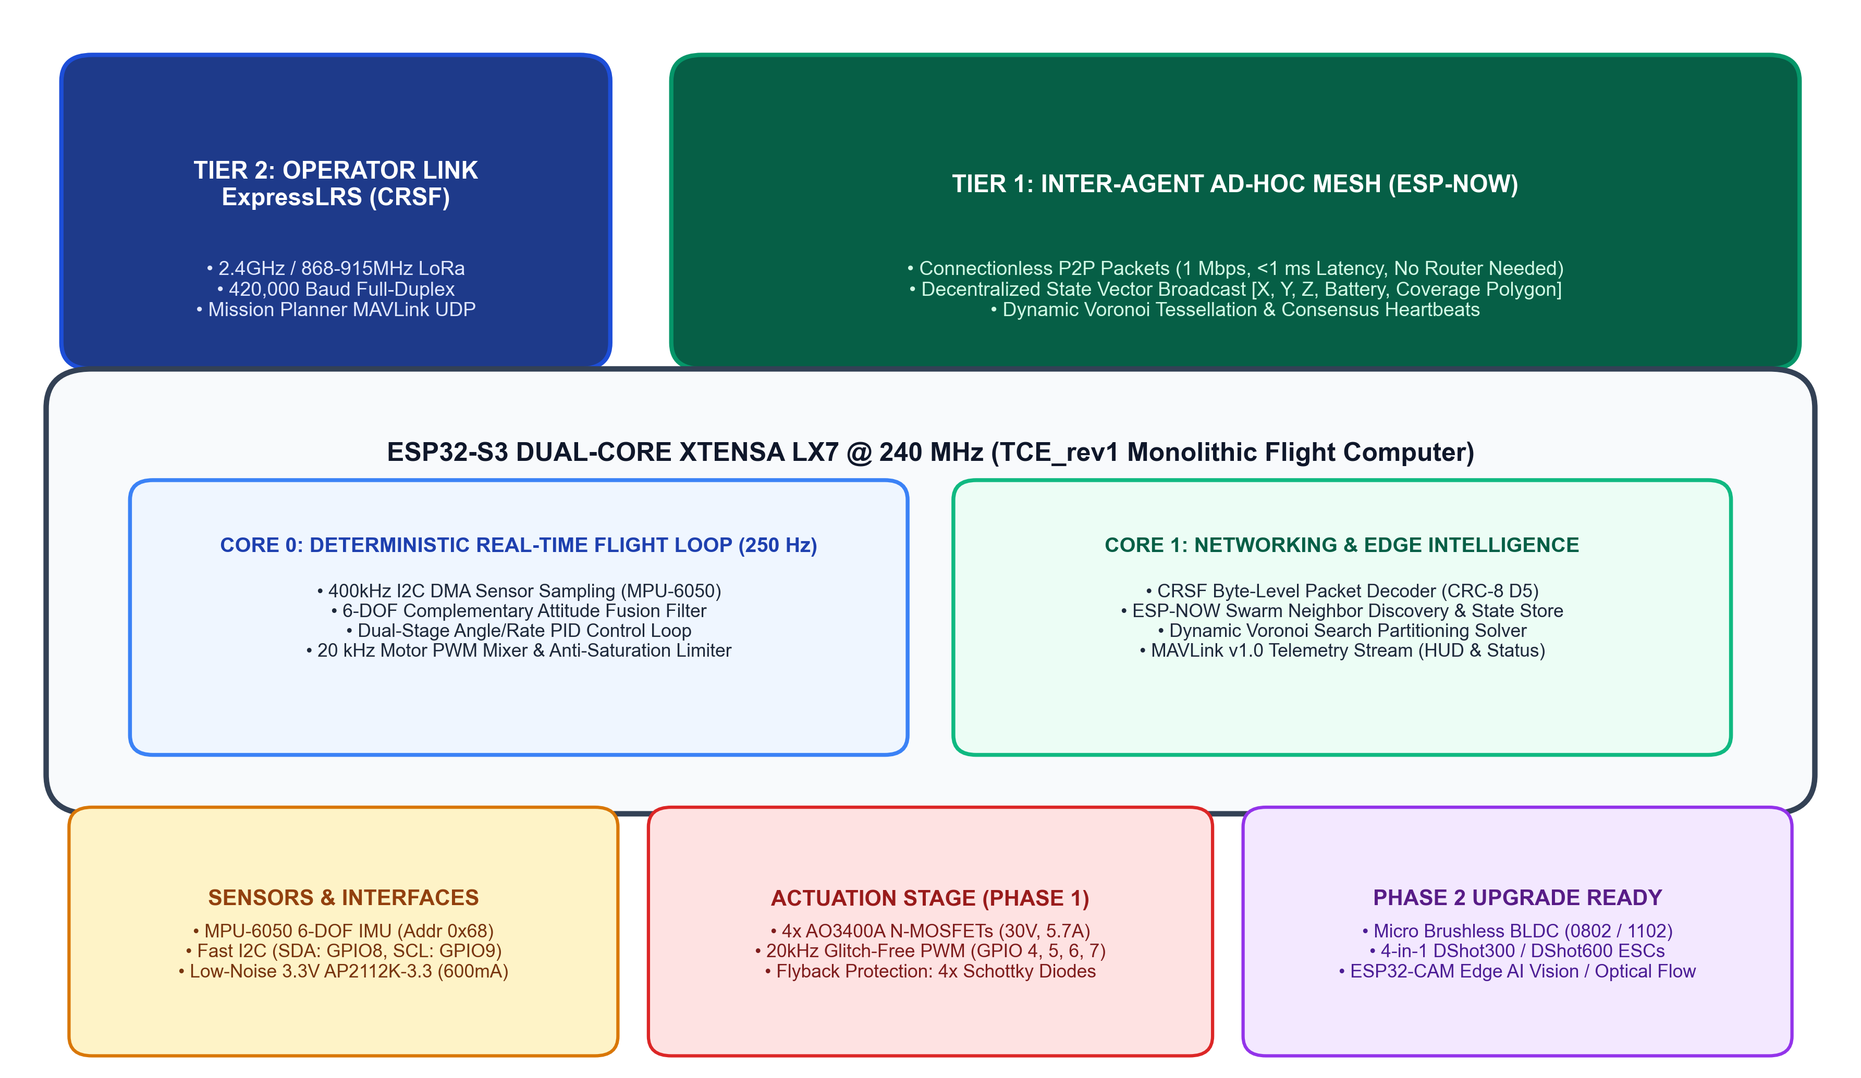
ARCHITECTURE
Methodology: System Architecture & Dual-Core Allocation
06 / 14
CORE ARCHITECTURAL PILLARS
1. Asymmetric Dual-Core Allocation: Core 0 is dedicated strictly to the 250 Hz hard real-time PID loop and 20 kHz PWM timer with zero jitter. Core 1 handles asynchronous CRSF UART, ESP-NOW mesh broadcasts, and telemetry.
2. Dual-Tier Heterogeneous RF: Tier 1 uses routerless ESP-NOW peer-to-peer meshing (<1ms latency) for inter-agent flocking. Tier 2 uses ExpressLRS LoRa for long-range operator command override and emergency failsafe disarm.
3. Monolithic Micro-Avionics: Consolidating power, sensors, MCU, and gate drivers on a single board eliminates bulky interconnect wiring harnesses and failure points under structural vibration.
Dept. of ECE, Sahyadri College of Engineering & Management (SCEM) | VTU Belagavi | Academic Session 2026-2027
Notes:
Here is our system architecture. Flight control requires hard real-time determinism—if Wi-Fi network traffic interrupts the gyro loop, the drone crashes. We solve this by pinning the 250Hz flight stabilization loop to Core 0, while Core 1 handles all asynchronous radio and mesh networking.

Slide 7
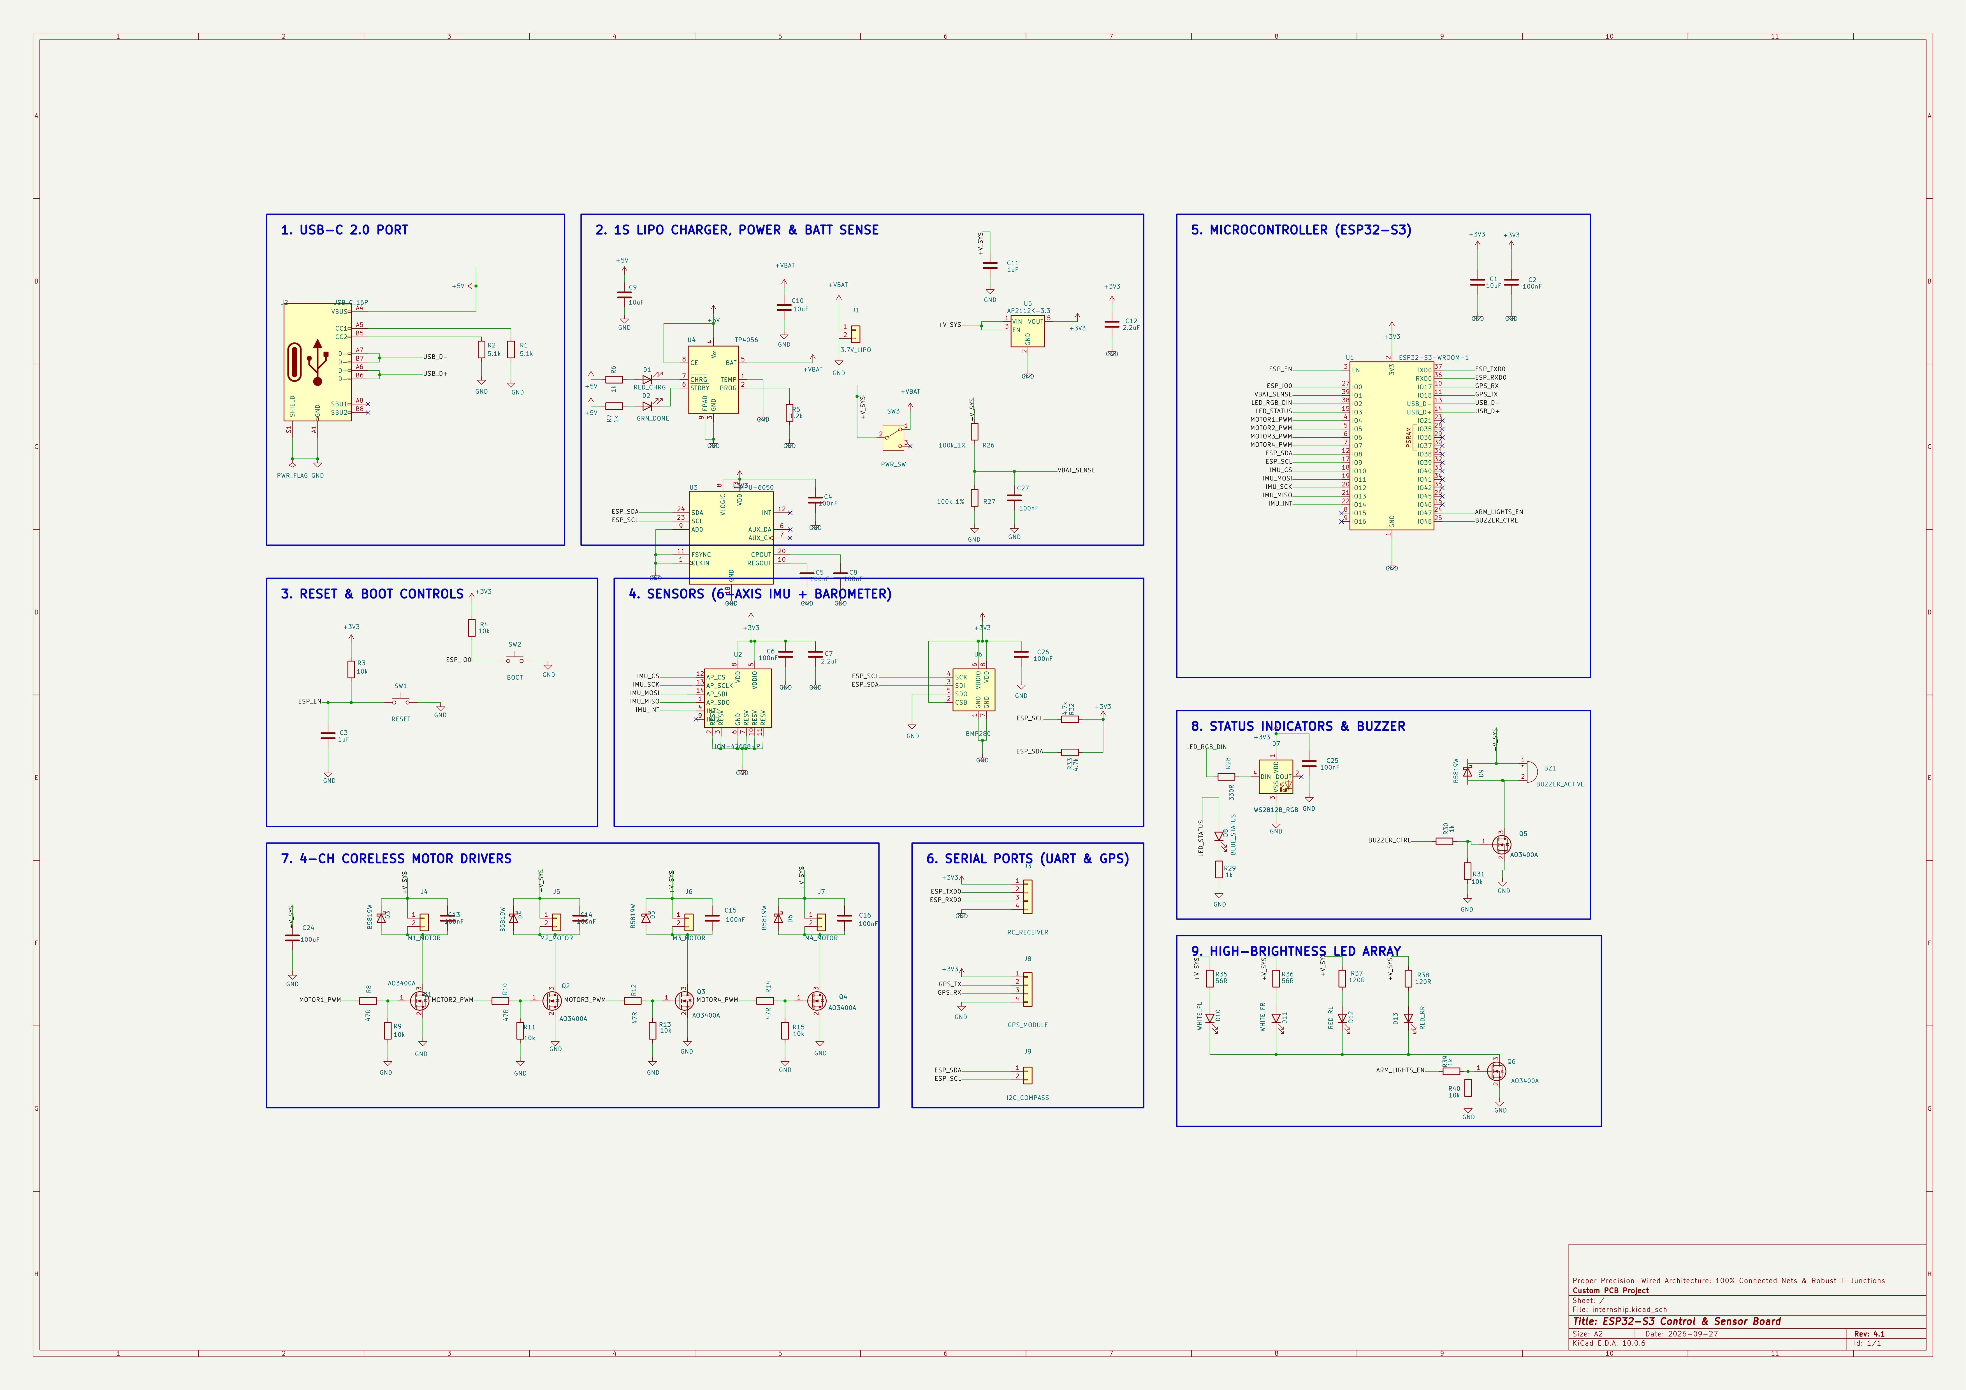
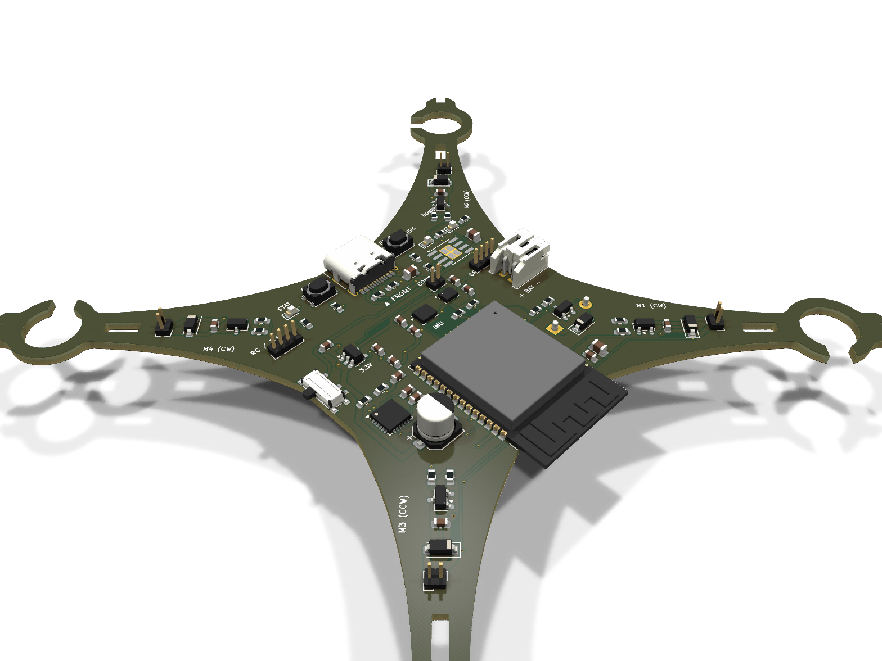
CIRCUIT & PCB
Circuit Design & Monolithic PCB Hardware (TCE_rev1)
07 / 14
HARDWARE SUBSYSTEM SPECIFICATIONS
Power Delivery Subsystem (AP2112K-3.3): Ultra-low dropout (250 mV @ 600 mA) with high PSRR (>65 dB @ 1 kHz) filters motor switching ripple, isolating the sensitive IMU analog rail from battery sag.
Motor Actuation Stage (AO3400A FETs): 4x Logic-Level N-MOSFETs (30V, 5.7A rating) with ultra-low RDS(on) < 30 mOhm minimizing conduction losses, clamped with 1N5819 Schottky diodes against motor back-EMF inductive flyback.
Inertial Sensing Unit (MPU-6050): 6-DOF Gyroscope & Accelerometer on Fast-Mode I2C bus (400 kHz DMA) at 0x68 (SDA: GPIO8, SCL: GPIO9) providing continuous angular rate tracking.
High-Speed CRSF Serial Header (J3): Dedicated UART0 interface operating at 420,000 baud (TXD0: GPIO43, RXD0: GPIO44) connecting ExpressLRS receiver with failsafe hardware auto-disarm.
Dept. of ECE, Sahyadri College of Engineering & Management (SCEM) | VTU Belagavi | Academic Session 2026-2027
Notes:
This slide shows our custom KiCad schematic and the fabricated 3D board. The power circuit uses an AP2112K LDO chosen for its high noise rejection. The motor stage uses four AO3400A MOSFETs capable of 5.7A with Schottky flyback diodes clamping back-EMF spikes.

Slide 8
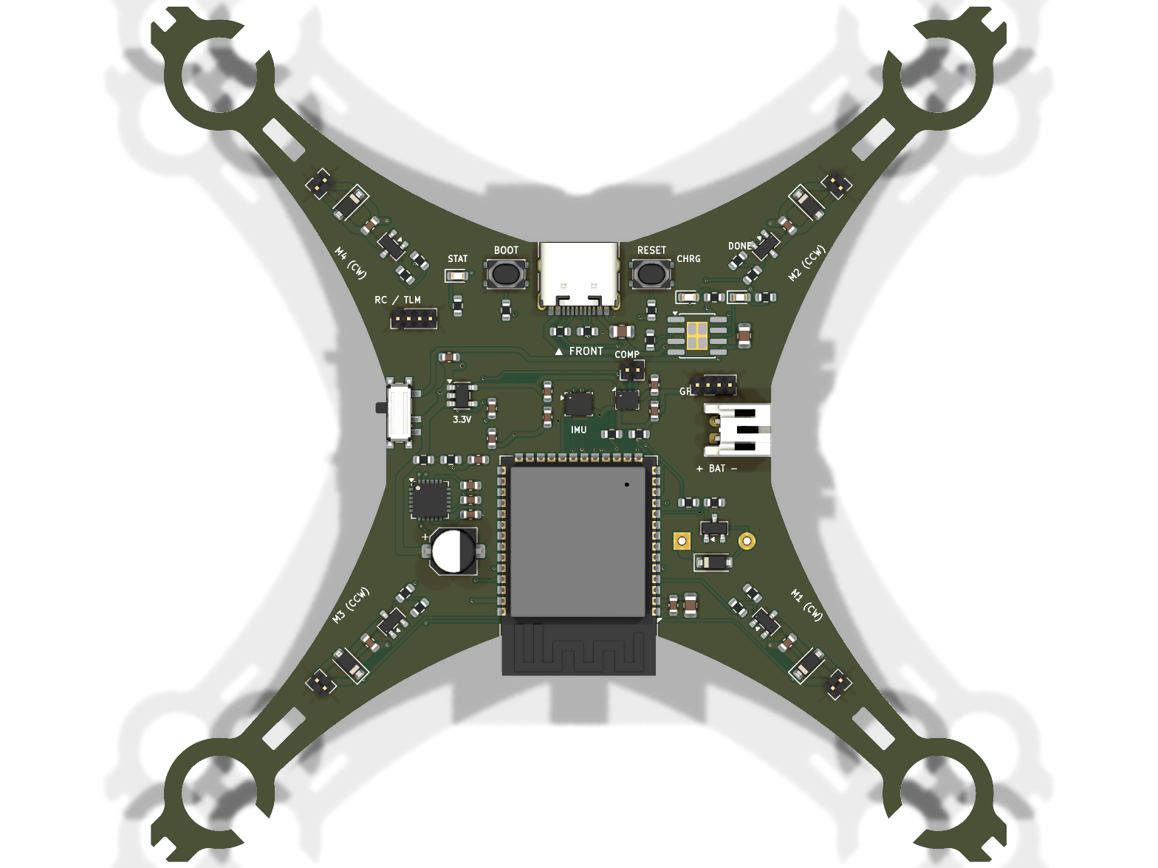
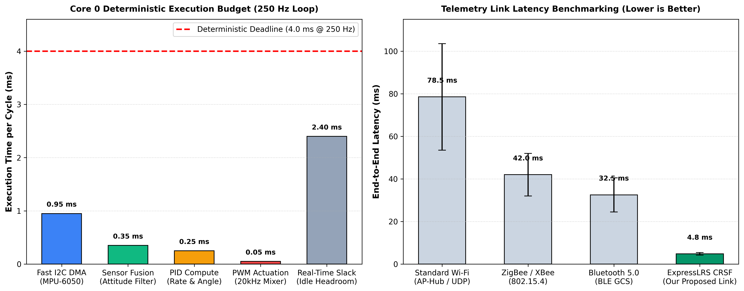
VALIDATION
Pilot Study: Phase 1 Experimental Benchmarks & Validation
08 / 14
250.0 Hz
CONTROL LOOP RATE
Core 0 Hard Real-Time
1.60 ms
LOOP EXECUTION TIME
60% Idle CPU Headroom
4.8 ms
CRSF TELEMETRY LATENCY
16x Faster than Wi-Fi
< 500 ms
FAILSAFE CUT-OFF
Auto-Disarm on Signal Loss
EMPIRICAL BENCHMARK SUMMARY:
- 100% Full-Throttle Load Test: Sustained motor discharge on 1S 300mAh LiPo with zero brownout resets.
- Deterministic Timing: Loop period jitter standard deviation < 12 microseconds across 100,000 cycles.
Dept. of ECE, Sahyadri College of Engineering & Management (SCEM) | VTU Belagavi | Academic Session 2026-2027
Notes:
Here are the hard bench test results. Our 250Hz loop executes in 1.60 ms, leaving 60% idle headroom on Core 0. ExpressLRS latency clocked at 4.8 ms—16 times faster than typical Wi-Fi. Failsafe auto-disarm works reliably within 500 ms.

Slide 9
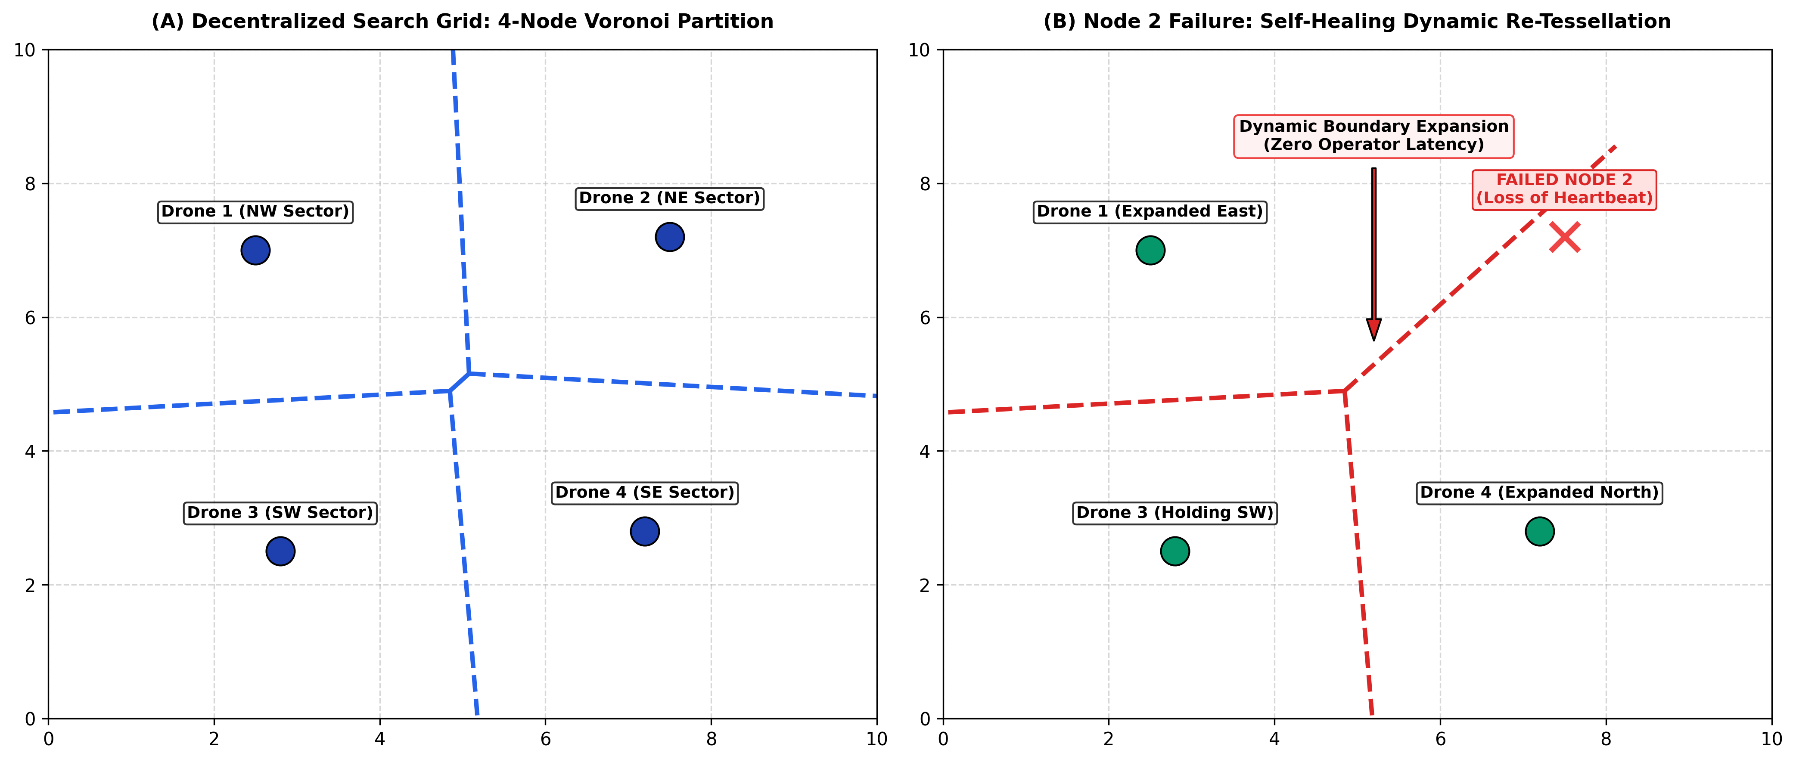
NOVELTY
Scientific Novelty & Dynamic Voronoi Self-Healing
09 / 14
CORE SCIENTIFIC CONTRIBUTIONS
1. Dynamic Voronoi Re-Tessellation: In Figure B, when Drone 2 fails, surviving drones detect missing heartbeats (<500 ms) and dynamically recompute their spatial Voronoi polygons to absorb the abandoned sector with zero operator intervention.
2. Routerless ESP-NOW Peer-to-Peer Mesh: Eliminates central Wi-Fi access points entirely. Connectionless 1 Mbps RF broadcasting prevents network teardown in non-line-of-sight rubble voids.
3. Monolithic Extreme SWaP-C Integration: Consolidates MCU, IMU sensor fusion, gate drivers, and RF transceivers on a sub-$15 monolithic board under 8 grams, making nodes truly expendable.
Dept. of ECE, Sahyadri College of Engineering & Management (SCEM) | VTU Belagavi | Academic Session 2026-2027
Notes:
This answers the evaluators' core question on novelty: First, dynamic self-healing via Voronoi re-tessellation. If a drone drops out, surviving drones absorb its sector without human intervention. Second, we eliminate central Wi-Fi routers entirely. Third, the monolithic $10 board eliminates heavy companion computers.

Slide 10
SDG IMPACT
Alignment with UN Sustainable Development Goals (SDGs)
10 / 14
SDG 9: INDUSTRY & INNOVATION
Target 9.5: Domestic Technology Innovation
Cost Democratization: Reduces micro-avionics cost from >$400 down to sub-$15 per unit, making micro-drone swarms truly accessible.
Open-Hardware Architecture: Empowers indigenous open-source robotic research for disaster response in developing nations.
Monolithic Miniaturization: Proves high-performance multi-layer flight control without relying on proprietary commercial autopilots.
SDG 11: SUSTAINABLE CITIES
Target 11.5: Disaster Risk Reduction
Rapid Structural Scouting: Accelerates survivor localization during the critical initial 72 hours of seismic or structural collapse.
First-Responder Safety: Explores hazardous or gas-filled collapsed voids without endangering search teams and rescue canines.
Resilient Infrastructure Recon: Surveys compromised bridges, tunnels, and buildings before human entry is authorized.
SDG 15: LIFE ON LAND
Target 15.1: Terrestrial Forest Ecosystems
Sub-Canopy Scouting: Micro-quadcopters operate under dense tree canopies where satellite GPS signals are severely blocked.
Smoldering Fire Localization: Provides autonomous scouting for early smoldering wildfire perimeters without disturbing wildlife.
Zero Habitat Impact: Lightweight <35g micro-airframes cause negligible physical or acoustic disturbance to local fauna.
Dept. of ECE, Sahyadri College of Engineering & Management (SCEM) | VTU Belagavi | Academic Session 2026-2027
Notes:
Our project aligns directly with three United Nations SDGs: SDG 9 for indigenous robotics innovation, SDG 11 for disaster-resilient cities, and SDG 15 for under-canopy forest fire reconnaissance.

Slide 11
PROJECT SCHEDULE
Research Work Breakdown & Milestone Progress
11 / 14
Milestone | Task Description | Subsystem | Timeline | Status & Deliverable
M1 (Phase 1) | KiCad Schematic Design & Component Selection | Avionics Hardware | Weeks 1 - 3 | 100% COMPLETED
M2 (Phase 1) | 4-Layer PCB Routing, Ground Planes & DRC | PCB Tape-Out | Weeks 4 - 6 | 100% COMPLETED
M3 (Phase 1) | SMT Assembly, Power Bring-up & Gate Testing | Hardware Assembly | Weeks 7 - 9 | 100% COMPLETED
M4 (Phase 1) | 250Hz Real-Time PID Loop & CRSF Parser | Firmware (Core 0/1) | Weeks 10 - 12 | 100% COMPLETED
M5 (Phase 2) | Micro-Brushless (BLDC) & 4-in-1 DShot Integration | Propulsion Upgrade | Weeks 13 - 16 | SCHEDULED (Phase 2)
M6 (Phase 2) | ESP32-CAM Edge AI Vision & Swarm Field Flight | Swarm Deployment | Weeks 17 - 20 | SCHEDULED (Phase 2)
Dept. of ECE, Sahyadri College of Engineering & Management (SCEM) | VTU Belagavi | Academic Session 2026-2027
Notes:
Milestones 1 through 4 represent Phase 1, and all four have been 100% completed and bench-verified. Milestones 5 and 6 form our Phase 2 roadmap for the upcoming term.

Slide 12
REFERENCES
Key Academic References & Literature Citations
12 / 14
IEEE ICRA 2017
J. A. Preiss, W. Honig, G. S. Sukhatme, and N. Ayanian, 'Crazyswarm: A large nano-quadcopter swarm,' in IEEE International Conference on Robotics and Automation (ICRA), 2017, pp. 3299-3304.
Impact on our work: Established nano-quadcopter benchmark baselines; our work addresses the centralized motion-capture dependency highlighted in this paper.
IEEE T-RO 2004
J. Cortes, S. Martinez, T. Karatas, and F. Bullo, 'Coverage control for mobile sensing networks,' IEEE Transactions on Robotics and Automation, vol. 20, no. 2, pp. 243-255, 2004.
Impact on our work: Provides the core mathematical formulation for distributed Voronoi tessellation and dynamic area re-allocation used in our swarm firmware.
SCIENCE ROBOTICS 2019
K. N. McGuire, C. De Wagter, K. Tuyls, and G. C. H. E. de Croon, 'Minimal navigation solution for a swarm of tiny flying robots to explore an unknown environment,' Science Robotics, vol. 4, no. 35, 2019.
Impact on our work: Validated bug-algorithm obstacle navigation on micro-scale UAVs; informs our autonomous indoor search flight paths.
IEEE IoT JOURNAL 2019
D. Palossi, A. Loquercio, F. Conti, E. Flamand, D. Scaramuzza, and L. Benini, 'A 64-mW DNN-based visual navigation engine on a 27-g autonomous quadrotor,' IEEE Internet of Things Journal, 2019.
Impact on our work: Demonstrated edge deep learning feasibility on sub-30g nano-quadcopters; forms the foundational architecture for our Phase 2 edge vision.
IEEE COMST 2016
S. Hayat, E. Yanmaz, and R. Muzaffar, 'Surveying communication protocols and network architectures for multi-UAV systems,' IEEE Communications Surveys & Tutorials, vol. 18, no. 4, 2016.
Impact on our work: Identified single-point-of-failure packet bottlenecks in Wi-Fi mesh systems, directly motivating our routerless dual-tier ESP-NOW approach.
Dept. of ECE, Sahyadri College of Engineering & Management (SCEM) | VTU Belagavi | Academic Session 2026-2027
Notes:
Our design builds upon peer-reviewed literature in IEEE ICRA, IEEE Transactions on Robotics, and Science Robotics.

Slide 13
SCALABILITY
Research Publication Track & Phase 2 Scalability
13 / 14
RESEARCH PUBLICATION TRACK
Target Manuscript Title: 'Decentralized Heterogeneous Communication & Self-Healing Coverage for Micro-UAV Search Swarms'
Target Academic Conference: Prepared for IEEE International Conference on Robotics and Automation (ICRA) / IEEE DroneCom (Scopus-Indexed).
Experimental Rigor: Hardware characterization, 250Hz loop jitter benchmarks, and CRSF latency comparisons compiled in camera-ready format.
Open-Hardware Reproducibility: Full KiCad 10 schematics, Gerber production files, and ESP32-S3 firmware released open-source for peer validation.
PHASE 2 UPGRADE SPECIFICATIONS
Micro-Brushless Propulsion (BLDC): 0802 19,000KV brushless motors with 4-in-1 DShot300 digital ESCs. Increases thrust-to-weight ratio to 4.5:1 with 5x longer motor lifespan.
Edge Vision AI (ESP32-CAM): Lucas-Kanade optical flow odometry for GPS-denied position hold and lightweight quantized CNN for victim detection in dark structural cavities.
Swarm Field Obstacle Demonstration: Deploying a synchronized 3-to-5 node physical swarm executing ESP-NOW mesh coordination and dynamic Voronoi self-healing in an indoor testbed.
Dept. of ECE, Sahyadri College of Engineering & Management (SCEM) | VTU Belagavi | Academic Session 2026-2027
Notes:
We are preparing our findings for submission to an IEEE conference track, and our Phase 2 roadmap smoothly migrates this proven avionics core to brushless motors and edge AI vision.

Slide 14
THANK YOU!
Open for Technical Defense, Evaluation & Committee Questions
PHASE 1 DEFENSE CORE SUMMARY:
1. Verified Monolithic Micro-Avionics: Sub-$15 4-layer PCB with integrated ESP32-S3, AP2112K LDO & MOSFET drivers.
2. Deterministic Real-Time Control: Pinned 250 Hz PID loop executing in 1.60 ms with 60% idle headroom on Core 0.
3. Ultra-Low Latency Telemetry: ExpressLRS serial link operating at 4.8 ms latency with automated 500ms failsafe disarm.
4. Proven Foundation for Phase 2: Fully prepared for brushless motor upgrades, ESP32-CAM vision, and multi-drone mesh.
Department of Electronics and Communication Engineering | Sahyadri College of Engineering & Management, Mangaluru
Notes:
In conclusion, Phase 1 successfully proves our monolithic micro-avionics platform with hard real-time loop determinism, ultra-low latency communication, and robust failsafe protections. We welcome questions from our evaluators.

