Slide 1
Analytical Toolkit
Especially for Disability in Film

Slide 2
Fries Test
Does a work have more than one disabled character?
Do the disabled characters have their own narrative purpose other than the education and profit of the nondisabled characters?
Is the character’s disability not eradicated either by curing or killing?

Slide 3
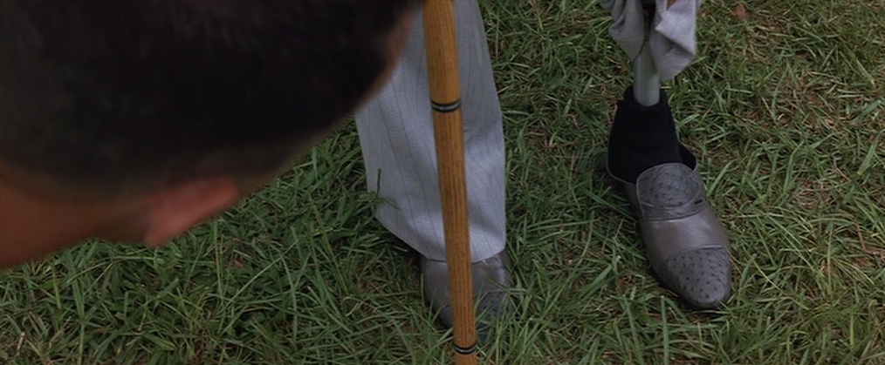

Slide 4
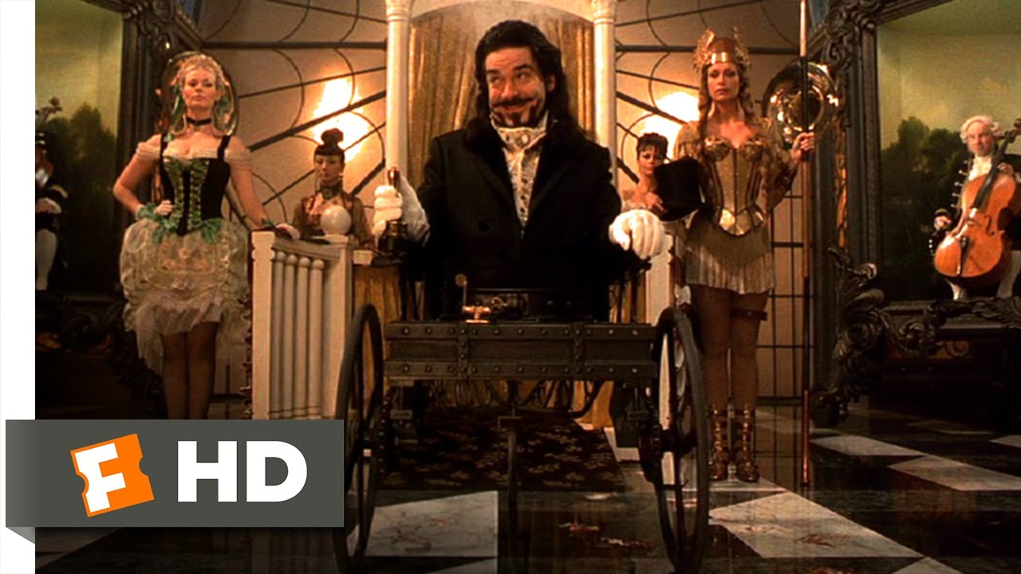
Longmore’s Concepts:
Disability as Punishment
Embittered Disabled
Disabled Resent the Able-Bodied
Compensation
Loss of Essential Humanity
Loss of Self-Control
Spread Effect
Death as Mercy or Punishment
Sexual Deviance or Asexuality
Quayson’s Types:
Moral Test
Alien
Sacred Insight
Normal
Longmore’s Stereotypes:
Criminal / Villain
Monster
Suicidal Disabled
Maladjusted Disabled/
Drama of Adjustment
Super Crip

Slide 5
Typology of SuperCrips
“Regular Supercrip”
“Glorified Supercrip”
“Superpowered Supercrip”

Slide 6
Supercrip Narrative Mechanisms
Superlative Language
Examination of body & Mind
Persistent comparison to nondisabled norm
Appeal to universal, sentimental humanity

Slide 7
Supercrip Narrative Mechanisms
Suppression of negative emotion
Suppression of privilege
Emphasis on personal effort & Attitude
Depoliticization of disability

Slide 8
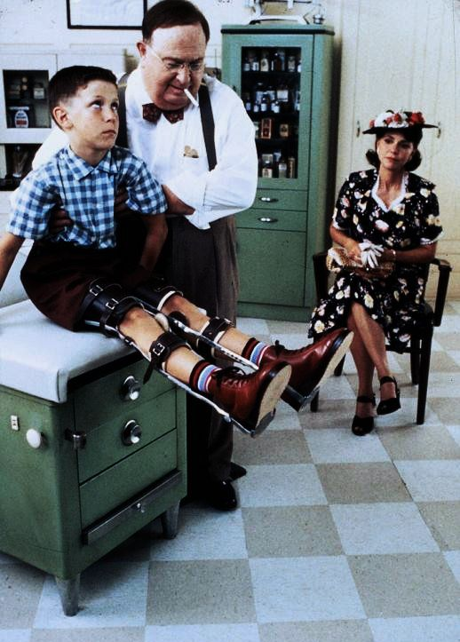
Spread Effect

Slide 9
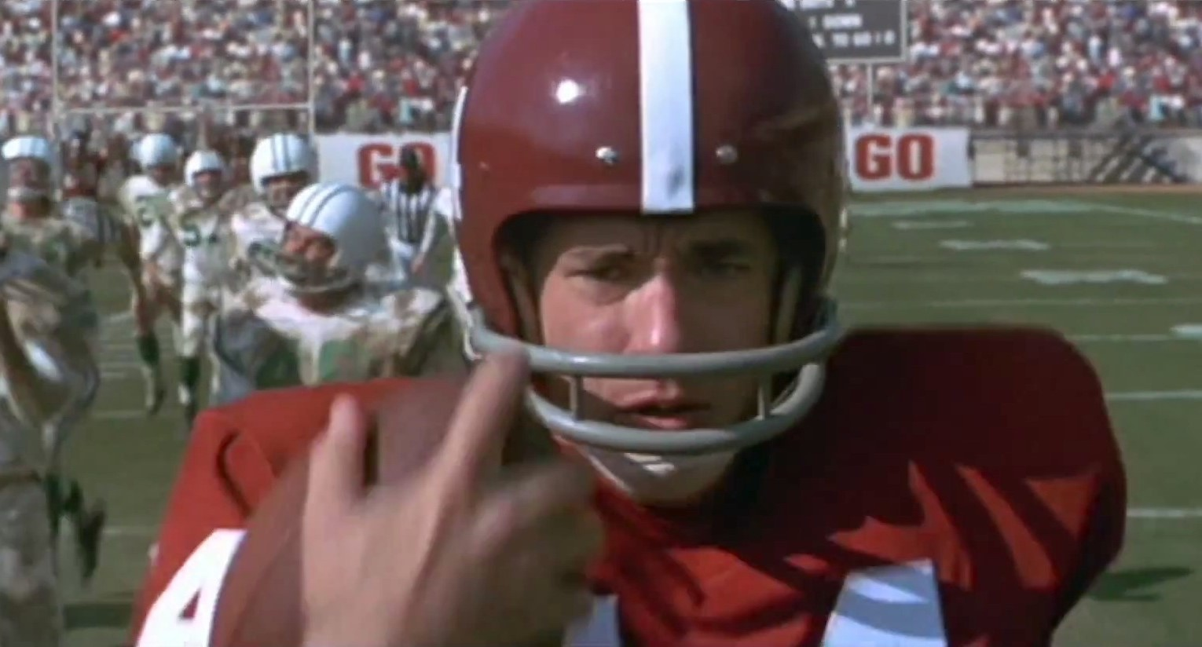
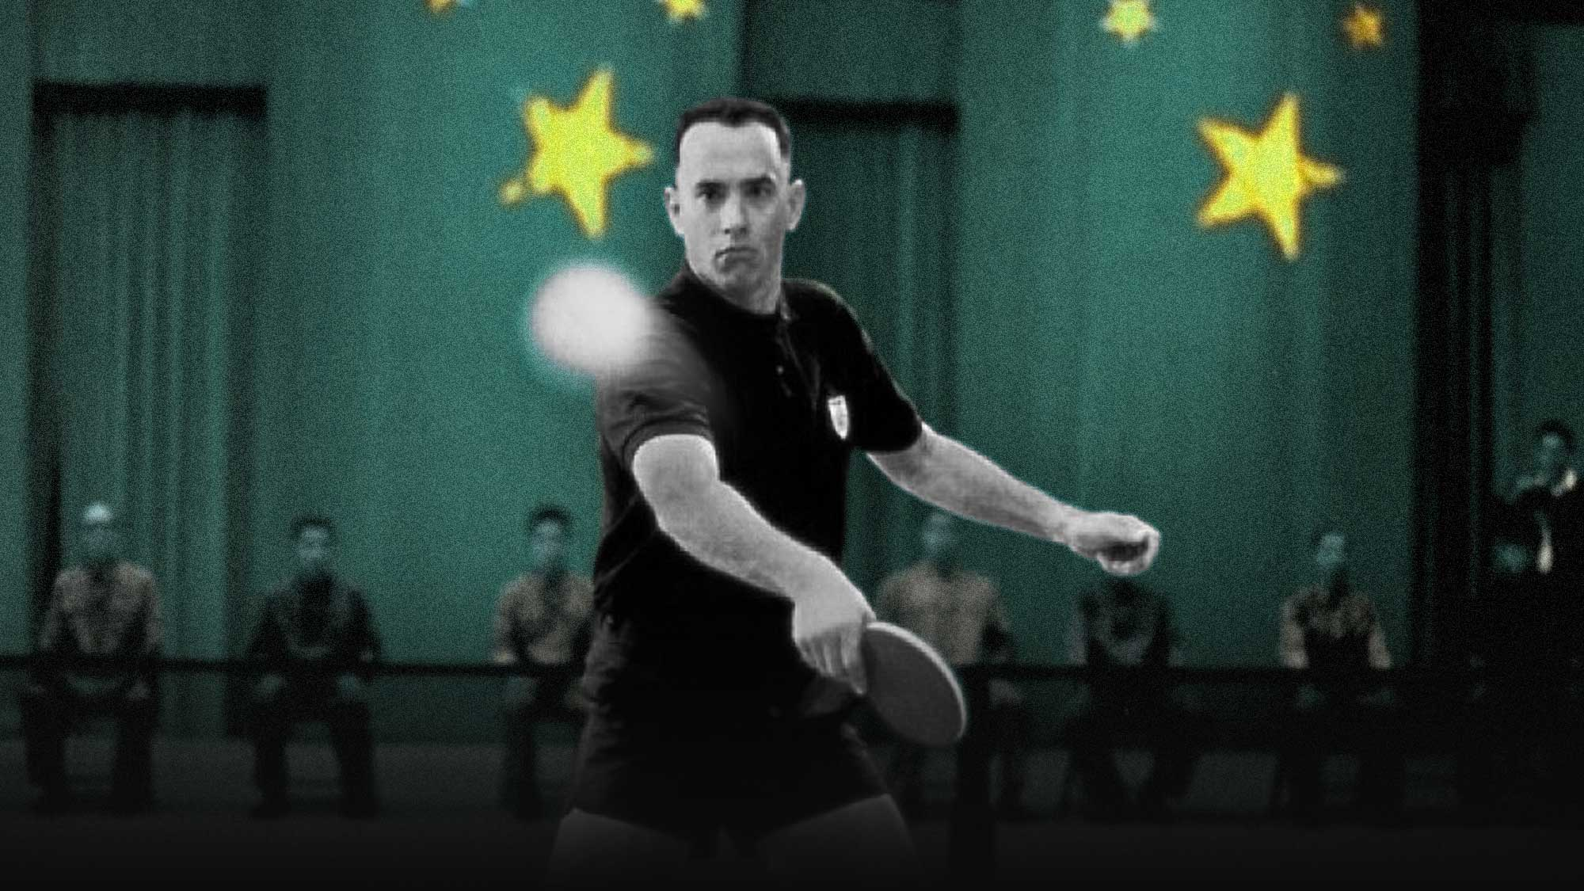
Compensation / Supercrip

Slide 10
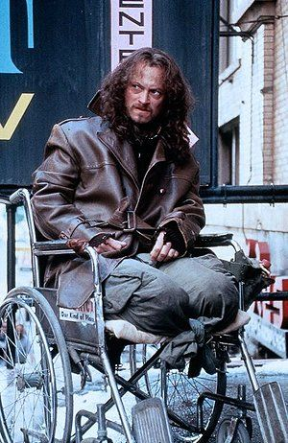
Drama of adjustment
Suicidal Disabled
Embittered Disabled
Disability as Punishment?

Slide 11
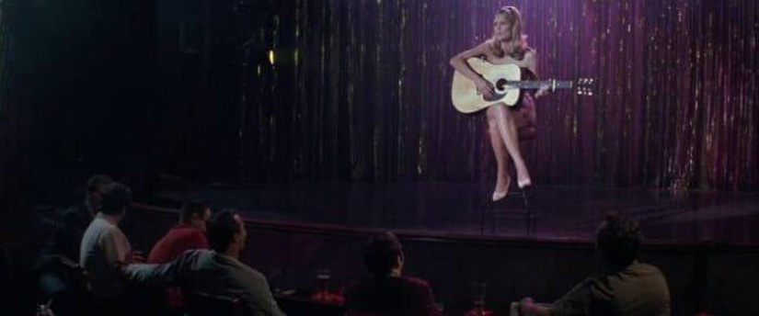
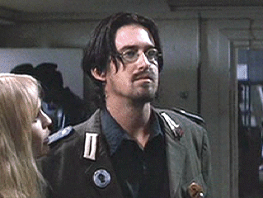
Loss of Self-control

Slide 12
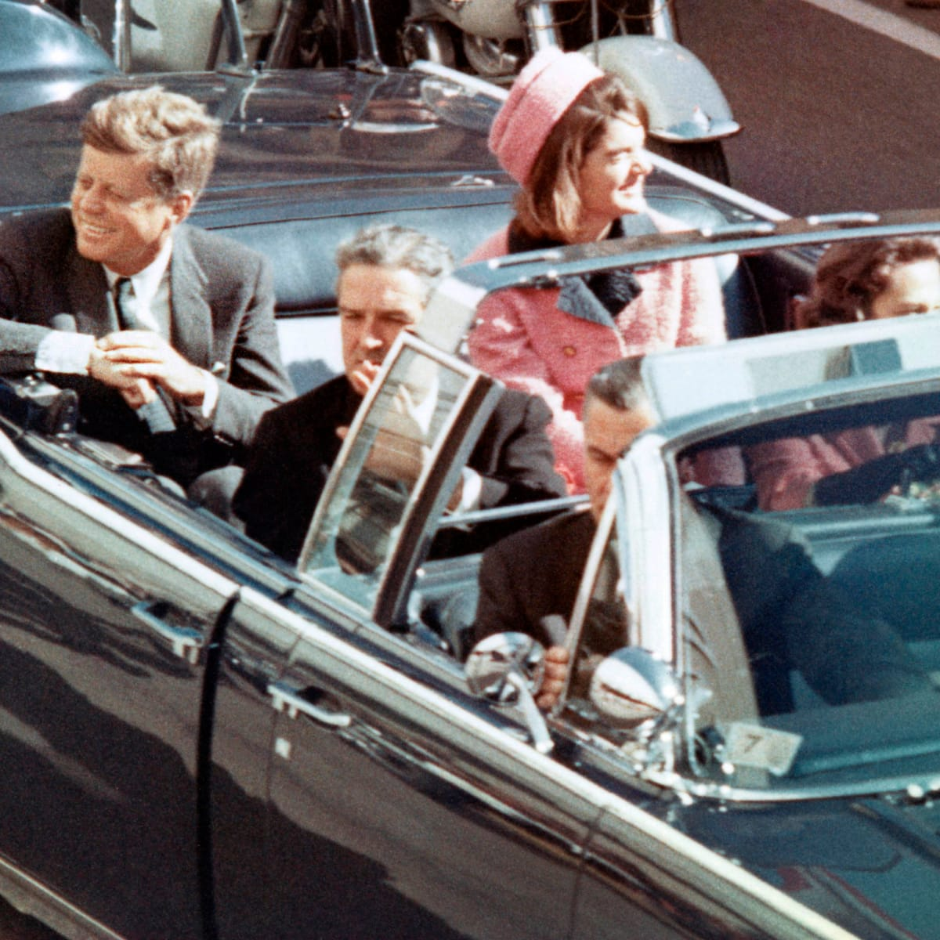
Loss of Self-control
Assassinations or Assassination Attempts
George Wallace
John Kennedy
Robert Kennedy
John Lennon
Gerald Ford
Ronald Reagan
Materiality of Metaphor?

Slide 13
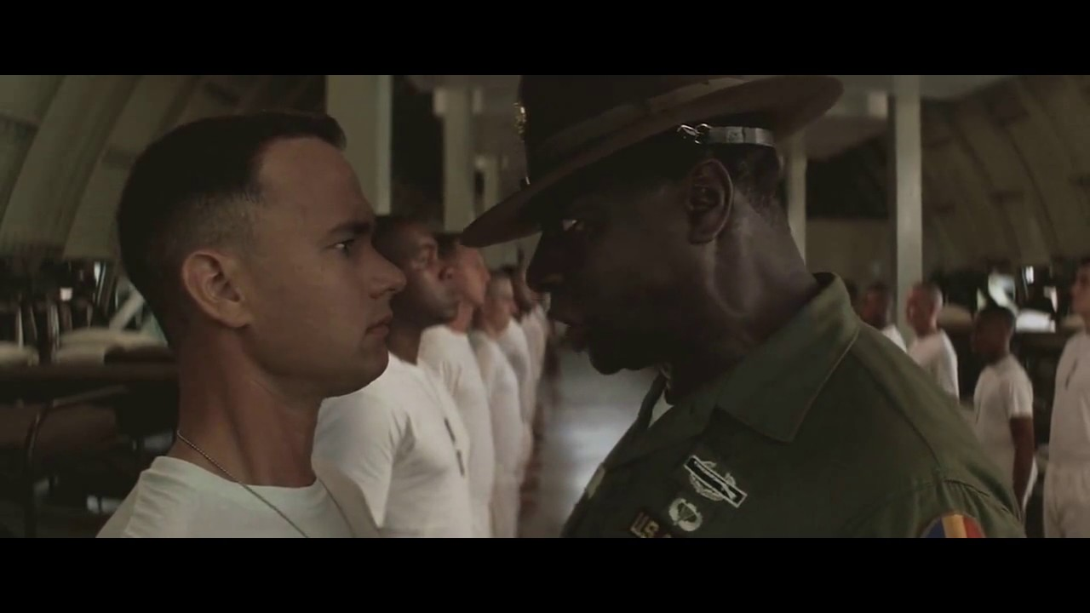
Materiality of Metaphor

Slide 14
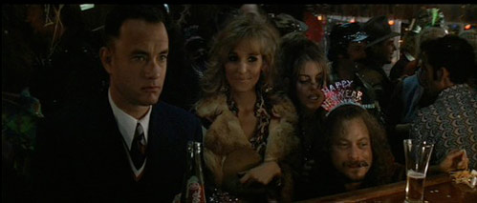
Asexual disabled
“Did You lose your Pecker in the war or something?”

Slide 15
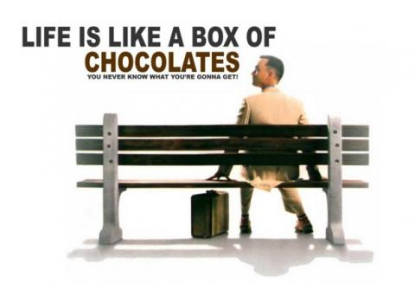
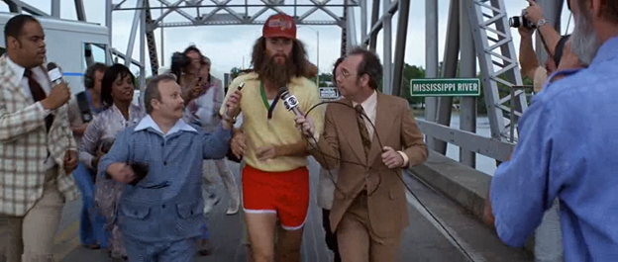
Sacred Insight

Slide 16
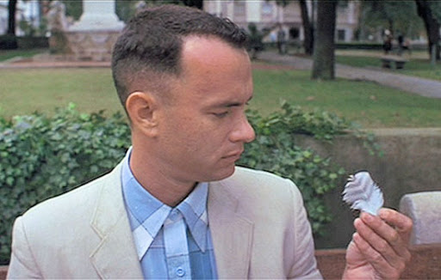
Feather Metaphor
What is the significance?
Is it relevant to disability?

