Slide 1
CAPSTONE PROGRESS REPORT
LLM-enabled Zero-Touch
Kubernetes Service Deployment Platform
Progress Update — 2026/09/22

Slide 2
AGENDA
Today's Agenda
01
System Overview & Goals
What problem this platform solves
02
Full System Architecture
The complete data flow from natural-language input to automated deployment and self-healing
03
Core Foundation Completed (Stability Phase)
Multi-tenant isolation, 3-agent review, Healer self-healing, CI/testing
04
This Week's Progress Highlights
Fuzzy semantic understanding, Google Sign-In, real monitoring, Dashboard, multiple fixes
05
Team Division & Branch Integration
How the branches were integrated and who owned what
06
Testing & Quality Assurance
Automated testing, real-browser verification, risk review docs
07
Known Limitations & Next Steps
Facing our current boundaries honestly, and where we go next
2 / 12

Slide 3
OVERVIEW
System Overview & Goals
Users describe deployment needs in natural language (Chinese or English). The system automatically translates this into a Kubernetes deployment spec, runs it through multi-agent security / cost / performance review plus dry-run validation, then deploys via GitOps — with built-in automatic monitoring and self-healing.
Target users: general users unfamiliar with K8s / Docker / CLI
Core design principle: absolutely beginner-friendly — no silent failures, error messages must say “what to do next”
Not just a “translation layer”: built-in multi-layer protection (review → validate → version control) plus self-remediation
3 / 12

Slide 4
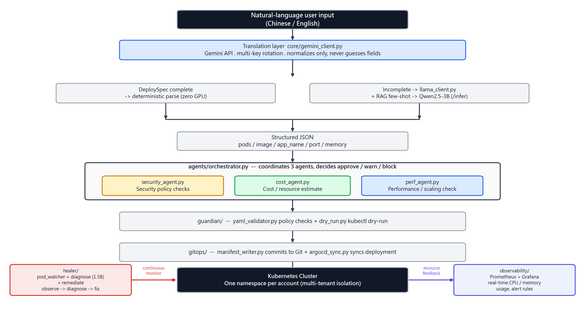
ARCHITECTURE
Full System Architecture
4 / 12

Slide 5
ARCHITECTURE
Module Map & Tech Stack
core/ + llama_client.py
gitops/
Config, Model Server, inference entrypoint (translation layer → deterministic → RAG few-shot → 3B)
Commits to Git, version control, rollback-capable
rag/
healer/
TF-IDF knowledge-base index, used for Q&A and deployment-example few-shot
Pod monitoring, LLM root-cause diagnosis, auto-remediation
agents/
observability/
security_agent / cost_agent / perf_agent + orchestrator coordinated decisions
Prometheus + Grafana, real, live usage and alerting
guardian/
web_demo.py
YAML validation, security policy, kubectl dry-run
Flask Web Dashboard, the single current user entry point
5 / 12

Slide 6
FOUNDATION
Core Foundation Completed (Stability Phase)
Completed progressively since 09/14 — the foundation every later feature builds on
Multi-tenant isolation
Three-layer protection chain
One real K8s namespace per account; end-to-end verified accounts can't see each other's resources
orchestrator (decide) → guardian (validate) → gitops (version control) — if any layer blocks, nothing deploys
Healer auto-remediation
Malicious-behavior detection
Background thread scans every 30s; rule-based + LLM root-cause diagnosis + auto-remediation, no manual trigger needed
Gemini judges manipulative intent; repeat offenders get auto-banned and their namespace wiped
Testing & CI
Honest audit culture
213 pytest tests, GitHub Actions auto-run, includes route-layer / multi-tenant isolation regression tests
Repeated full-system audits catching “claimed to work but never wired up” illusions (e.g. hardcoded status flags)
6 / 12

Slide 7
THIS WEEK · 09/16
Fuzzy Semantic Understanding Layer
Lets Chat handle input that's “not clearly said” — not just exact commands
① Reference resolution
“Scale it up to 5” / “that thing I just deployed” — remembers the most recently mentioned resource in the chat
② Fuzzy resource-name matching
Typos, nicknames or categories only — difflib + category detection finds the most likely target
③ Missing deploy fields: guess or ask?
When image/app_name have zero clues, it proactively asks instead of silently defaulting to nginx:latest
④ Proactive clarification on low confidence
Previously only destructive operations had this gate; now extended to general queries and deploy intents too
Real browser end-to-end testing caught and fixed a real bug: an exact resource-name match was misjudged as “ambiguous” because of its own Pod's name prefix
7 / 12

Slide 8
THIS WEEK · 09/16
Google Sign-In
Added as a second login method, coexisting with the existing password system, with zero impact on existing accounts
Manually implemented the 3 OAuth2 endpoints (authorize → token → userinfo) using the project's existing requests library — no new dependency added
CSRF state verification: a random value is generated before login and checked again on callback
Email must be verified (email_verified) before login is allowed
Never auto-merges accounts — a name collision always gets a suffix and becomes a new account, preventing account takeover
18 new tests covering state mismatch, unverified email, banned accounts, and other security scenarios
Security Design Highlights
Why can't accounts auto-merge?
Knowing only someone's username/email would let anyone log in
with their own Google account and gain that person's K8s namespace access
Existing accounts are looked up by google_sub
(Google's stable ID), not by matching the email string
8 / 12

Slide 9
THIS WEEK · 09/15, 09/20
Real Monitoring Stack + Dashboard
Actually deployed kube-prometheus-stack
Audit found observability/ had been dead code since the day it was written — the cluster never actually had Prometheus installed
Fixed two more “claimed to work but never wired up” gaps found along the way (PrometheusRule label, cAdvisor filter condition)
New Dashboard page
Lets users see how much cluster headroom is left before they deploy
Adopts Kubecost's allocation = max(usage, requests) concept, closer to reality than requests alone
A real bug caught in the process
Cost estimation reused the single-container formula; when
the total for 0 deployments is genuinely 0, Python's or
misread it as “not filled in,” producing a phantom monthly
cost. Fixed, with a regression test added.
An extra environment issue resolved
Local Prometheus was unreachable for a while (Docker
Desktop/WSL2 network freeze); root-caused and resolved.
Dashboard now shows real usage correctly.
9 / 12

Slide 10
THIS WEEK · 09/19-09/20
Fixes for Issues Actually Found & Experience Polish
Reported Issue
Root Cause
Resolution
Default prompt cards did nothing when clicked
onclick attribute's double quotes canceled each other out (a string-escaping oversight)
Fixed + verified with Playwright
Traditional Chinese occasionally showed Simplified characters
opencc was listed in requirements.txt but never actually installed
Fixed + character-by-character scan verified
Markdown syntax wasn't rendered
AI replies were dropped straight into innerHTML with no conversion
Added a lightweight renderMarkdown()
Loading animation felt out of place
Restyled to a radial rotating-tick pattern matching a reference image
Applied consistently site-wide
Switching language didn't affect the Dashboard
The toggle button only existed in the Chat page's own header
Moved to the shared global status bar
10 / 12

Slide 11
Thank You
Q & A
LLM-enabled Zero-Touch Kubernetes Service Deployment Platform
Full record: see CHANGELOG.md, docs/security_review.md

