Slide 1
Genero User Interface
Dynamic User Interface - DUI
Neil J Martin
neilm@4js.com
Genero BDL 3.10
Genero Studio 3.10
January 2018

Slide 2
Goals
Describe and manipulate the first layer of the new Dynamic User Interface
Create Action Defaults
Use Presentation Styles
Create XML files for a ToolBar or TopMenu
Create a Start Menu
Use MDI Windows
Load XML files dynamically at runtime

Slide 3
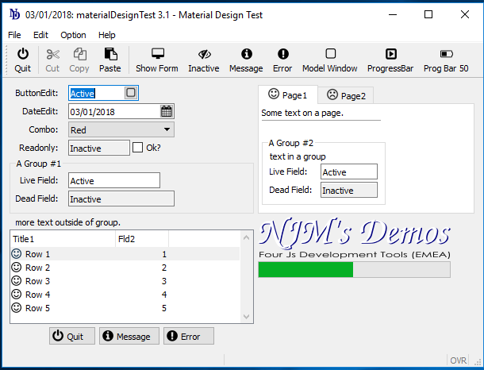
DUI – Top Level
The first layer of the Dynamic User Interface.
Windows and Forms
Presentation Styles
Statusbar
Ring Menus
Actions
Toolbars
Top Menus
Start Menus

Slide 4
DUI – Concepts
Windows are created from programs as independent resizable windows.
Windows define a display context and layout for sub-elements like forms, menus, message and error lines, …
A window can contain only one Form at a time.
You can apply independent window styles to each window.
You can use the Window class to manipulate window objects.
The Form class can be used to handle forms.

Slide 5
DUI – Concepts
Windows are graphical objects that react in the same way as the default behavior of the Client environment.
For example, in GDC for Windows, a user can close the current window by pressing Alt-F4.
This will send a cancellation ACTION to the DVM.
It is up to the program to manage it with:
ON ACTION close
There is also:
OPTION ON TERMINATE SIGNAL

Slide 6
Presentation Styles

Slide 7
DUI – Presentation Styles
Presentation Styles are provided to centralize attributes related to the appearance of user interface elements.
Elements in the AUI that reference a Style attribute will automatically get the attribute values defined in that style.
Elements in the AUI that don’t reference a style will use the global default style.
Presentation styles are defined in a unique file with the extension .4st. Genero provides a default style file, $FGLDIR/lib/default.4st.
You can create your own style file to replace default.4st.

Slide 8
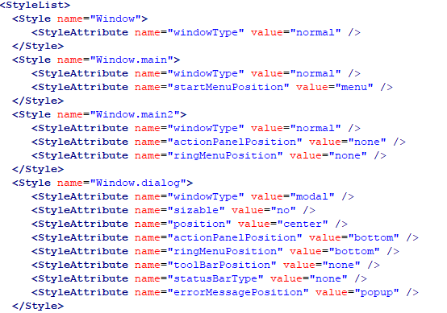
DUI – Presentation Styles - Example .4st file

Slide 9
DUI – Presentation Styles - Syntax
<StyleList>
<Style name=“style-identifier" >
<StyleAttribute name="attribute-name" value="attribute-value“ />
[...]
</Style>
[...]
</StyleList>
style-identifier is the name of the style referenced by graphical objects with the Style attribute.
attribute-name defines the name of the graphical object attribute.
attribute-value defines the value to be assigned to attribute-name.

Slide 10
DUI – Presentation Styles
Styles can be defined at several levels:
<Style name="*">
Global; applied automatically to all elements
<Style name="element-type">
Global; applied automatically to the named element type (Window, Edit, Combobox, …)
<Style name=".any-name">
Specific; applied to any element types that have the Style attribute set to this Style name.
<Style name="element-type.any-name">
Specific; applied only to elements of the given type that have the Style attribute set to this Style name.

Slide 11
DUI – Presentation Styles - Defaults
Dialog : for typical modal windows like winmessage or winquestion
Naked : No Menu, no Action Buttons
Main : Start Application Window, ideal to display a StartMenu
If you don’t specify a STYLE, there is a default Style defined as ‘Window’.

Slide 12
DUI – Presentation Styles - Defaults
Use the attribute STYLE to specify the style to be applied.
Example (using a Window style):
In the .per file:
…
OPEN WINDOW w1 WITH FORM “start_form"
ATTRIBUTE (STYLE = “main")
…
LAYOUT ( TEXT=“Customer Query”, STYLE=“newstyle” )
…

Slide 13
DUI – Presentation Styles - Defaults
You can set the statusBarType attribute in the 4st style file for Windows to control the display of statusbar area.
Values of statusBarType can be:
none = No statusbar
default = The default status bar, same as panels2
panels1 = 1 panel, 1:comment/error/message
panels2 = 2 panels, 1:comment, 2:error/message
panels3 = 2 panels, 1:error/message, 2:comment
lines1 = 2 lines, 1:comment, 2:error/message
lines2 = 2 lines, 1:comment/message, 2:error
…

Slide 14
DUI – Presentation Styles - Example
  <Style name="Window.statusbar">
  <StyleAttribute name="statusBarType" value="lines2" />
  </Style>

Slide 15
DUI – Presentation Styles - Example
Call the following method in your program to use your style file instead of $FGLDIR/lib/default.4st:
Style files have an extension .4st and are searched for in the FGLRESOURCEPATH
Use one of your styles in the application:
Or the recommended way, on a form:
CALL ui.Interface.loadStyles(“mystylefile")
OPEN WINDOW w1 WITH FORM “order_form"
ATTRIBUTE (STYLE = “mystyle")
LAYOUT ( TEXT=“Customer Query”, STYLE=“mystyle” )

Slide 16
Do Chapter 3 - Exercise 1

Slide 17
The MENU statement

Slide 18
DUI – Menu
Menu items are action views tied to the actions defined by the current interactive statement, which can be: DIALOG, MENU, INPUT, INPUT ARRAY, DISPLAY ARRAY or CONSTRUCT.
When a user selects a Menu item, the program receives an action event corresponding to the program trigger the item is bound to.
A Menu item is disabled automatically if that action is not available (for example, when a ring menu option is hidden).
Since Menus are part of the Abstract User Interface, you can manipulate them dynamically at runtime.

Slide 19
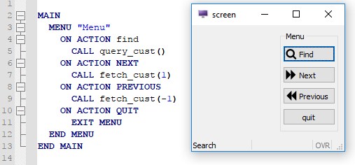
DUI – Ring Menu
By default, Ring Menu buttons are generated in the application window for the actions listed in the MENU statement of your program code.
The menu buttons display in a specific area of the window, depending on the client software and current style applied ( Action Panel ).

Slide 20
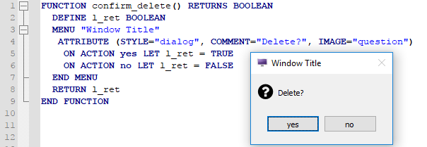
DUI – Ring Menu
A Ring menu can also have styles applied to it to change how it’s rendered, for example it can appear as a dialog window:

Slide 21
DUI – Ring Menu
Some considerations:
By default the Ring Menu items appear on the ringMenu Panal. This panels position can be set in the styles file ( .4st ).
The ringMenu’s panel position can be set to ‘none’ meaning it will not be visible.
An ON IDLE idle-seconds clause defines a set of instructions that must be executed after idle-seconds of inactivity.

Slide 22
Actions

Slide 23
DUI – Actions
The ON ACTION clause in your program executes a set of instructions.
Can be used in DIALOG, MENU, INPUT, INPUT ARRAY, CONSTRUCT and DISPLAY ARRAY statements.
ON ACTION creates a default Action View in the application window, allowing the user to trigger the action.
You can define specific Action Views (like Topmenus or Toolbars in the form) and bind them to Actions using the “name” attribute.
Example: a Toolbar item with the name ‘quit' is bound to the Action having the name ‘quit'.
If you define a specific Action View, that Action will not appear on the Action Panel.

Slide 24
DUI – Actions - Syntax
  -- In a dialog
  INPUT ARRAY custarr WITHOUT DEFAULTS FROM sr_cust.*
  ON ACTION print
  CALL PrintRecord(custarr[arr_curr()].*)
  ON ACTION help
  CALL ShowHelp()
  END INPUT
  -- .per button definition (action view)
  ATTRIBUTES
  BUTTON b1 : print, TEXT = "Print Record";
  END

Slide 25
DUI – Actions
A list of Predefined Action Names is provided with the language.
For example:
INPUT / INPUT ARRAY / CONSTRUCT has predefined actions of ‘accept’ and ‘cancel’.
DISPLAY / INPUT ARRAY has predefined actions, ‘nextrow’ and ‘prevrow’, to bind action views for navigation.
The 'help' predefined action starts the help viewer for HELP clauses in dialog instructions.
INPUT BY NAME .... HELP 12423 <-- Creates action 'help'

Slide 26
DUI – Actions – Attribute Definitions
Define default attributes for graphical objects associated with actions (action views).
Centralize the decoration (appearance) of action views.
Can be defined in the form specification file (Action Defaults section) or in an external actions default file.
An external action defaults file is an XML file with the extension .4ad. Genero provides a default file, $FGLDIR/lib/default.4ad.
You can create your own action defaults file to replace default.4ad.

Slide 27
DUI – Actions – Attribute Definitions - Syntax
<ActionDefaultList>
<ActionDefault name="action-name" [ attribute="value" [...] ] /> [...]
</ActionDefaultList>
Example:
<ActionDefaultList>
<ActionDefault name="print" text="Print" image="printer“ comment="Print" />
<ActionDefault name="modify" text="Update"comment="Update the record" />
</ActionDefaultList>

Slide 28
DUI – Actions – Attributes
name: The name of action - Important: This is case sensitve!
acceleratorName: defines the primary accelerator key for an action.
acceleratorName2-4: additional accelerator keys for an action.
comment: defines tooltip hint for the user about the action.
contextMenu: defines whether a context menu option must be displayed for an action.
defaultView: default view (a button) must be displayed for a given action.
image: defines the image resource to be displayed for the action.
text: defines the label associated to the action.
validate: defines the data validation level for a given action.
Mobile Only:
disclosuseIndicator: drill-down decoration to an action.
rowbound: defines if the action is related to the row context of a record list.

Slide 29
DUI – Actions – Precedence
higher
Attribute specified in the form for an element that is an action view (buttons, toolbar buttons, and topmenu options, for example)
Attribute specified for the action in the Action Defaults section of the form
Attribute specified for the action in a user-defined action defaults file (filename.4ad) or in the Genero-provided action defaults file (default.4ad)
lower

Slide 30
DUI – Actions – Loading the .4ad
Specify a custom Action Defaults file in your program with the following Method:
CALL ui.Interface.loadActionDefaults("mydefaults")

Slide 31
Do Chapter 3 - Exercise 2

Slide 32
Toolbars

Slide 33
DUI – Toolbars
A Toolbar is a view providing buttons that can trigger events in an interactive instruction.
The Toolbar items (buttons) are enabled in accordance with the actions defined by the current interactive instruction, which can be DIALOG, MENU, INPUT, INPUT ARRAY, DISPLAY ARRAY or CONSTRUCT.

Slide 34
DUI – Toolbars
A Toolbar can be defined in a form’s TOOLBAR section; in this case the menu is available for that specific form only.
A TOOLBAR can also be:
Defined in a .4tb file.
Created from scratch in the 4gl with UI methods.
In these cases, the TOOLBAR is available to different forms.

Slide 35
DUI – Toolbar – Definition
In the Form Specification File(.per):
TOOLBAR
ITEM quit (TEXT="Quit", IMAGE="quit")
SEPARATOR
ITEM find
ITEM previous
ITEM next
SEPARATOR
ITEM help
END
In an XML file (standard.4tb):
<ToolBar>
<ToolBarItem name="quit" text="Quit" image="quit" />
<ToolBarSeparator/>
<ToolBarItem name=“query" text="Query" image="search" />
<ToolBarItem name=“add" text="Append" image="add" />
<ToolBarItem name=“delete" text="Delete" image="delete" />
<ToolBarItem name=“modify" text="Modify" image="change" />
<ToolBarSeparator/>
<ToolBarItem name="f1" text="Help" image="list" />
</ToolBar>

Slide 36
DUI – Toolbar – Definition
Node | Attribute | Type | Description
Toolbar | buttonTextHidden | INTEGER | Defines if the texts of toolbar buttons must appear by default
ToolbarItem | Name | STRING | Defines the action corresponding to the toolbar button.
ToolbarItem | Text | STRING | Defines the text to be displayed in the toolbar button.
ToolbarItem | Comment | STRING | Defines the message to be shown as tooltip when the user selects a toolbar button.
ToolbarItem | Image | STRING | Defines the icon to be used in the toolbar button.
ToolbarItem | hidden | INTEGER | Indicates if the item is hidden
ToolbarSeparator | hidden | INTEGER | Indicates if the separator is hidden

Slide 37
DUI – Toolbar – Loading
  You can define a Toolbar in an XML file and load it at runtime using the utility method provided by the Interface built-in class:
CALL ui.Interface.loadToolbar("standard")
Or you can use the utility method provided by the Form built-in class:
NOTE: This method does require you to get the form object first!
DEFINE myform ui.form
…
CALL myform.loadToolbar("standard")

Slide 38
DUI – Toolbar – Summary
Some considerations:
The DOM tag names are case sensitive, Toolbar is different from ToolBar.
When binding to an action, make sure that you are using the right value in the name attribute.
When binding to a key, make sure the name attribute value is in lowercase eg: "f5".
Make sure the image specified is accessible to the Genero Client.

Slide 39
Do Chapter 3 - Exercise 3

Slide 40
TopMenus

Slide 41
DUI – TopMenu
A Top Menu is a view for actions presented as a typical pull-down menu that can trigger events.
Menu options are bound to the actions specified in the program by ON ACTION clauses.
The Top Menu items (buttons) are enabled in accordance with the actions defined by the current interactive statement in your program, which can be DIALOG, MENU, INPUT, INPUT ARRAY, DISPLAY ARRAY or CONSTRUCT.

Slide 42
DUI – TopMenu - Defining
A Top Menu can be defined in a form’s TOPMENU section; in this case the menu will be available for the specific form only.
Defined in a .4tm file and loaded using a ui.Form object method of loadTopMenu() or loaded at a user interface level using ui.Interface.loadTopMenu()
Created from scratch in the 4gl with UI methods.
Those last two method mean the TopMenu is re-usable in other forms.

Slide 43
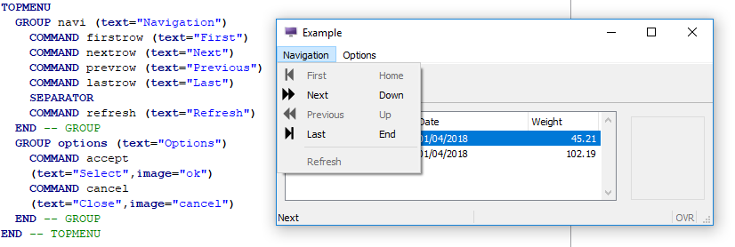
DUI – TopMenu - .per Syntax
TOPMENU
group
[...]
[END]
where group is:
GROUP group-identifier ( group-attribute [,...] )
{ command
| group
| SEPARATOR
} [...]
END
where command is:
COMMAND command-identifier ( item-attribute [,...] )

Slide 44
DUI – TopMenu - .4tm - XML Syntax
<TopMenu [ topmenu-attribute="value" [...] ] >
group
[...]
</TopMenu>
Where group is:
<TopMenuGroup group-attribute="value" [...]>
{ <TopMenuSeparator/>
| <TopMenuCommand command-attribute="value" [...] />
| group
} [...]
</TopMenuGroup>
Example:
<TopMenu>
<TopMenuGroup text="File" >
<TopMenuCommand name="clear" text="Clear" image="new" />
<TopMenuSeparator/>
<TopMenuCommand name="quit" text="Quit“ />
</TopMenuGroup>
<TopMenuGroup text="Edit" >
<TopMenuCommand name="editcut" />
<TopMenuCommand name="editcopy" />
<TopMenuCommand name="editpaste” />
</TopMenuGroup>
</TopMenu>

Slide 45
DUI – TopMenu - .4tm - XML Syntax
Node | Attribute | Type | Description
TopMenuGroup | text | STRING | Defines the text to be displayed in the pull-down menu group
TopMenuGroup | comment | STRING | Defines the message to be shown for this element
TopMenuGroup | image | STRING | Defines the icon to be used in the pull-down menu group
TopMenuGroup | hidden | INTEGER | Indicates if the group is hidden

Slide 46
DUI – TopMenu - .4tm - XML Syntax
Node | Attribute | Type | Description
TopMenuCommand | name | STRING | Defines the action corresponding to the topmenu command
TopMenuCommand | text | STRING | Defines the text to be displayed in the pull-down menu option
TopMenuCommand | comment | STRING | Defines the message to be shown for this element
TopMenuCommand | image | STRING | Defines the icon to be used in the pull-down menu option
TopMenuCommand | hidden | INTEGER | Indicates if the command is hidden
TopMenuSeparator | hidden | INTEGER | Indicates if the separator is hidden

Slide 47
DUI – TopMenu – Loading
  If you defined a TopMenu in an XML file you can load it at runtime using the utility method provided by the Interface built-in class:
CALL ui.Interface.loadTopMenu("standard")
Or you can use the utility method provided by the Form built-in class:
CALL ui.Window.getForm().loadToolbar("standard")

Slide 48
DUI – TopMenu - Summary
You can define an XML file to create your TopMenu.
The DOM tag names are case sensitive; Topmenu is different from TopMenu.
A TopMenu is part of a form definition (the TopMenu node must be created under the Form node).
A TopMenu command is bound to an action node of the current interactive instruction if its name attribute corresponds to an action node name.

Slide 49
Do Chapter 3 - Exercise 4

Slide 50
StartMenu

Slide 51
DUI – StartMenu
A Start Menu defines a tree of commands that start programs on the application server where the runtime system executes.
We recommend that you create a specific BDL program dedicated for running the Start Menu. This program must create (or load) a Start Menu and then perform an interactive instruction (eg. DISPLAY ARRAY or a MENU in the SCREEN window)
A program can only have one Start Menu.
The Start Menu window should use the style 'main'.

Slide 52
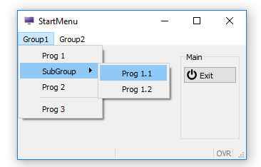
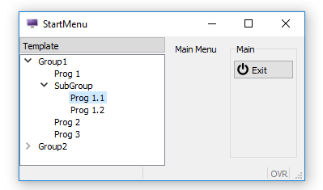
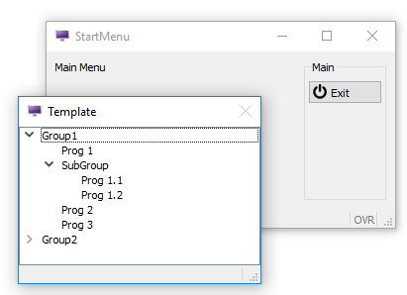
DUI – StartMenu
A StartMenu can be one of three styles:
Menu, Tree or Poptree.

Slide 53
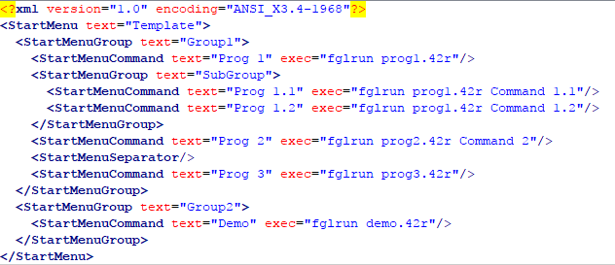
DUI – StartMenu – XML Syntax
<StartMenu [ startmenu-attribute="value" [...] ] >
group
[...]
</StartMenu>
where startmenu-group is:
<StartMenuGroup group-attribute="value" [...]>
{ <StartMenuSeparator/>
| <StartMenuCommand command-attribute="value" [...] />
| group
} [...]
</StartMenuGroup>

Slide 54
DUI – StartMenu – XML Syntax
Node | Attribute | Type | Description
StartMenu | text | STRING | Defines the text to be displayed as title.
StartMenuGroup | text | STRING | Defines the text to be displayed for this group.
StartMenuGroup | image | STRING | Defines the icon to be used for this group.
StartMenuGroup | disabled | INTEGER | Indicates if the group is disabled (grayed out, cannot be selected.)
StartMenuCommand | exec | STRING | Defines the command to be executed when the user selects this command.
StartMenuCommand | text | STRING | Defines the text to be displayed for this command.
StartMenuCommand | Image | STRING | Defines the icon to be used for this command.
StartMenuCommand | disabled | INTEGER | Indicates if the group is disabled (grayed out, cannot be selected.)

Slide 55
DUI – StartMenu – Loading
You can use the utility method provided by the Interface built-in class.
"app_menu" is a file with an extension .4sm located in the FGLRESOURCEPATH.
CALL ui.Interface.loadStartMenu("app_menu")

Slide 56
DUI – StartMenu – Summary
You can define an XML file to create your start Menu.
The DOM tag names are case sensitive; Startmenu is different from StartMenu.
You can apply different decorations for a StartMenu : Menu | tree | poptree (see Window Style attributes).
Since the Start Menu is part of the Abstract User Interface, you can manipulate it at runtime.

Slide 57
Do Chapter 3 - Exercise 5

Slide 58
MDI

Slide 59
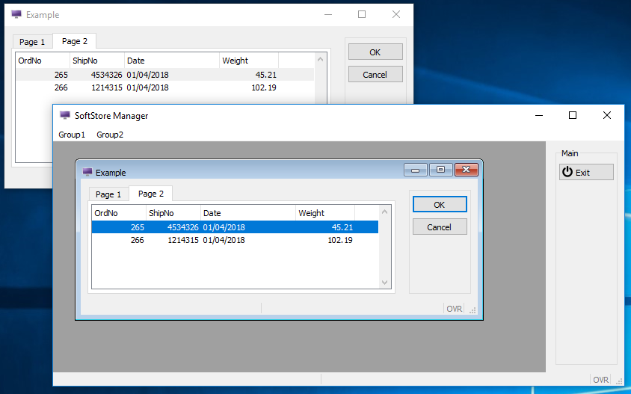
DUI – SDI vs MDI

Slide 60
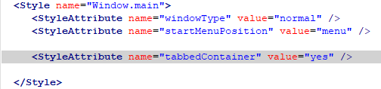
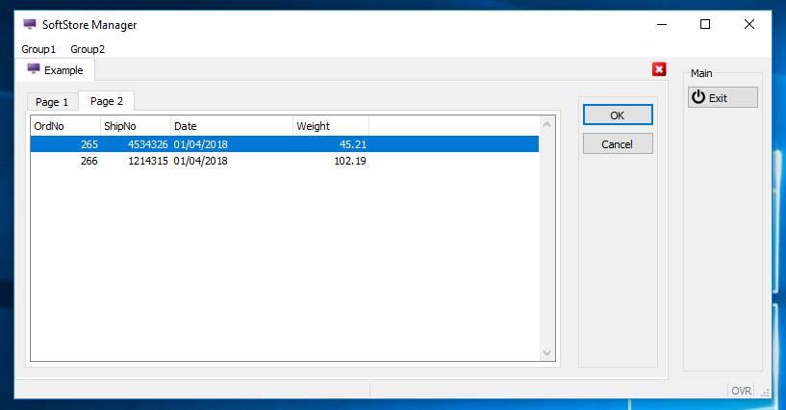
DUI – MDI – Tabbed Container

Slide 61
DUI – MDI
In BDL, Multiple Document Interface is also referred to as WCI: Window Container Interface.
WCI makes sense when the application programs have a main window that is the root for other windows opened temporarily (typically, modal windows to pick a record in a list).
WCI configuration is done dynamically at the beginning of programs, by using some methods of the ui.Interface built-in class.
The WCI container program is a separate BDL program of a special type, in which the default SCREEN window is used as an MDI container.

Slide 62
DUI – MDI
The WCI container program must indicate that its type is special (setType), and must identify itself (setName):
WCI children programs must attach to a parent container by giving the name of the container program:
  MAIN
  CALL ui.Interface.setName("parent1")
  CALL ui.Interface.setType("container")
  CALL ui.Interface.setText("SoftStore Manager")
  CALL ui.Interface.loadStartMenu("mystartmenu")
  …
MAIN
CALL ui.Interface.setName("custapp")
CALL ui.Interface.setType("child")
CALL ui.Interface.setContainer("parent1")
…

Slide 63
DUI – MDI - Summary
The only style applied to the container is Window.main.
The Toolbar is unique for the container, however the StartMenu and TopMenu are not.
If a child program is started, but the parent container is not, the client shows an error message and the program stops with a runtime error.
If a container program is run twice, the client shows an error message and the program stops with a runtime error.
When the parent container program is stopped, it’s child applications are terminated.

Slide 64
DUI – Summary
All these objects can be created and manipulated in Genero:
  Windows and Forms
  Presentation Styles
  Statusbar
  Ring Menus
  Actions
  Toolbars
  Top Menus
  Start Menus
  Multiple Document Interface (MDI/WCI)

Slide 65
Q&A

