Slide 1
Genero User Interface
Course Overview
Neil J Martin
neilm@4js.com
Genero BDL 3.10
Genero Studio 3.10
January 2018

Slide 2
Goals
  Define key Genero terms and concepts
  Describe the Genero product suite
  Describe the Genero architecture
  Identify the usage of XML and DOM within Genero
January 2018

Slide 3
Meaning
The name ‘Genero’ is derived from the Latin verb ‘to create’ or ‘to produce’.
Genero - a product designed to improve creativity and productivity
January 2018

Slide 4
Goals
Genero was developed with two main goals:
  Support different display devices with the same source code.
  Provide an abstract definition of the user interface that can be manipulated at runtime as a tree of user interface objects.
January 2018

Slide 5
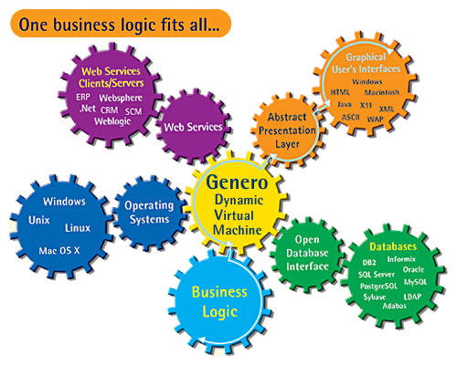
Overview
January 2018

Slide 6
Terms & Acronyms
Dynamic Virtual Machine (DVM) - Application/Runtime server, automatically manages and optimizes communication between clients and runtime system where the Business Logic and Design Logic are processed
Open Database Interface (ODI) - Part of the DVM, provides concurrent access to a broad range of databases
Abstract User Interface (AUI) - XML-based logical model of the user interface, which can be rendered at runtime to specific platforms
Dynamic User Interface (DUI) - DOM tree model of the AUI that can be modified at runtime
January 2018

Slide 7
Components
Genero Compiler / Runtime – FGL
Core language compiler and runtime environment
Genero Web Services – GWS (supplied with the FGL package)
Communicate in real time with applications across heterogeneous environments using open standards based (XML, SOAP, WSDL …).
Genero Application Server – GAS
Launch application and web services via a web server from a browser or the GDC.
Genero Studio – GST ( bundled with other Genero conponents )
Integrated graphical set of tools designed to fast-track application development
January 2018

Slide 8
Components
Genero Desktop Client – GDC
Desktop Client, One product fits Windows, Mac OS X, Linux.
Genero Browser Client – GBC (supplied with the FGL package)
Modern web client using ( HTML5, JS, SASS, NODE )
Genero Mobile Android – GMA
Run application natively on Android devices
Genero Mobile iOS – GMI
Run Genero application natively on iPhone/iPad
Genero Reporting Engine– GRE
Turn XML data into high level reports with multiple output choices.
January 2018

Slide 9
Genero Architecture
A
S
C
I
I
/
W
I
N
D
O
W
S
/
L
I
N
U
X
/
M
A
C
Informix
Web
Services
Oracle
IBM DB2
SQL Server
O
D
I
D
U
I
DVM
PostgreSQL
MariaDB
MySQL
B
R
O
W
S
E
R
S
SQLlite
Business
Logic
M
O
B
I
L
YOU
January 2018

Slide 10
Genero Architecture
4GL based development language
Modify layouts dynamically
W
I
N
D
O
W
S
Web
Services
O
D
I
D
U
I
DVM
Total separation of business logic from presentation logic
Configure display layouts dynamically at runtime
H
T
M
L
Business
Logic
W
M
L
YOU

Slide 11
Genero Architecture
One compilation fits all OSes & databases
A
S
C
I
I
W
I
N
D
O
W
S
Informix
Web
Services
Oracle
X
1
1
IBM DB2
SQL Server
O
D
I
D
U
I
DVM
PostgreSQL
Sybase
MySQL
XML based Abstract Presentation Layer
H
T
M
L
LDAP
Business
Logic
W
M
L
YOU

Slide 12
Genero Deployment
GDC (SSH Tunnel)
GDC, GJC
Firewall
Firewall
Application Server
Firewall
Web Server
WAP, I-mode
Browsers: GWC or GDCAX (ActiveX)
GDC (Windows, Mac, X11, ActiveX), ASCII, GJC (Java)
Database Servers

Slide 13
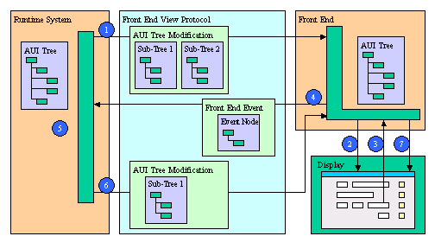
Genero Protocol

Slide 14
Genero Protocol
Initialization phase:
The Runtime System sends the initial AUI Tree.
The Client builds the Graphical User Interface in accordance with the AUI Tree.

Slide 15
Genero Protocol
When the user performs some interaction, the Client sends Client Events corresponding to the modifications made by the user.
The Client waits for a user interaction (mouse click, keyboard typing).

Slide 16
Genero Protocol
When these commands are received, the Client modifies its version of the AUI Tree and updates the Graphical User Interface; then it waits for new user interactions (step 3).
The Client Events are analyzed and validated by the runtime system.
The Runtime System sends back the result of the Client requests, in the form of AUI Tree Modification Commands.

Slide 17
XML
XML = eXtensible Markup Language
  A meta-language that allows the design of a markup language, used for the easy interchange of data over the internet.
  XML is simply tagged text - it does not do anything on its own.
  XML tags are not predefined. Tags are defined by the designer.
  Genero can read, write, and interpret XML documents.

Slide 18
XML
Tags
Elements (root, child)
<Form name="sampleform" width="23" height="4">
<Grid width="23" height="4">
<Label name="label1" width="20" text="Hello"
posY="1" posX="2" gridWidth="20"/>
<Label name="label2" width="20" text="Dolly"
posY="2" posX="2" gridWidth="20"/>
...
</Grid>
</Form>

Slide 19
XML → DOM
Document Object Model
  The DOM is an internal tree representation of an XML document.
  The DOM tree resides in memory.
An XML document with the extension .42f is automatically generated when a Genero form definition file (.per) is compiled.
The internal representation of this XML document is our AUI DOM tree.

Slide 20
Summary
Genero is
A N-tier architecture
Supports different display devices with the same source code
One compilation fits all OSes and databases
Enables dynamic local & global display layout modifications
Uses XML and DOM tree to represent the user interface
Includes built-in classes to manipulate the user interface elements of the DOM tree

Slide 21
Q&A

