Slide 1
Genero User Interface
Desktop Clients
Neil J Martin
neilm@4js.com
Genero BDL 3.10
Genero Studio 3.10
January 2018

Slide 2
Clients
The two main GUI clients for Genero are:
Genero Desktop Client – GDC
A thin client application for a native look-n-feel on Windows, Mac and Linux desktops.
Genero Browser Client – GBC
A client for running in a modern browser.

Slide 3
GDC
The Genero Desktop Client is a graphical front end to the Genero Runtime System. GDC must be installed and running on the client computer (Windows, Linux, or Mac desktops).
GDC supports connections to the Runtime System using http, https or ssh(1 or 2).
You can create shortcuts to connect to servers and run applications
You can set up and play back log files.

Slide 4
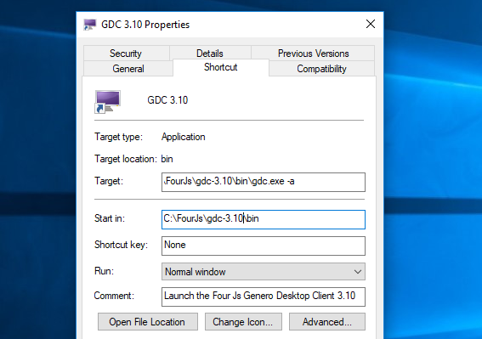
GDC - Modes
User mode & Admin mode
By default, GDC starts in user mode.
By adding –a or –admin, GDC starts in administration mode.
To create shortcuts or modify options, start GDC in administration mode.

Slide 5
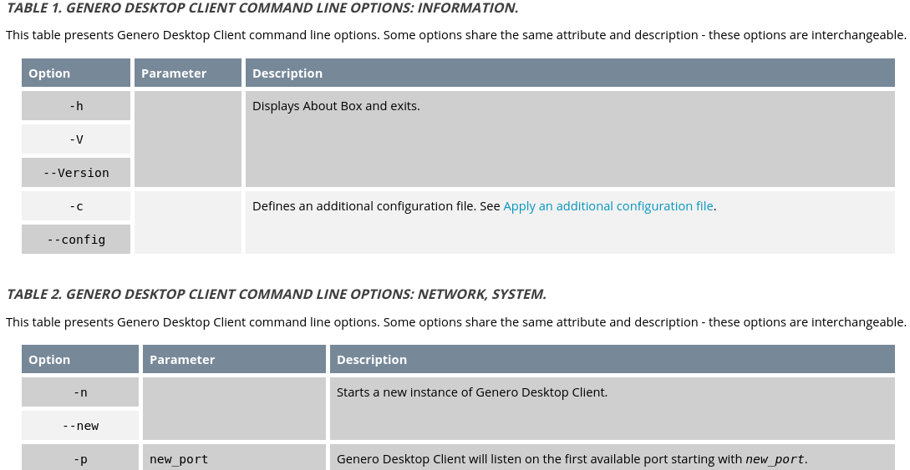
GDC – Command Line Arguments – See Manual

Slide 6
GDC – Stored Settings
Some graphical settings are stored by GDC.
Windows:
Settings are stored into the registry under \HKEY_CURRENT_USER\Software\Four J's Development Tools\GDC
Unix and MacOS:
An internal system is used to store data.

Slide 7
GDC – Stored Settings
Stored Settings:
Position of the upper left corner of the top-level window
State of the top-level window (Maximized, …)
StartMenu section width if the StartMenu is defined as a tree
Table width
Initial number of rows of a table when displayed the first time
Number of columns of a table when the window is closed
Number of rows of a table when the window is closed
Column and the direction used to sort the table
Width of each column
Number of columns and their order in the table
Text linked to these columns and its visible attribute
Height and width of textedit fields

Slide 8
GDC – Stored Settings
Some features of the GDC are defined as “local actions”:
Actions dependent on the DVM, but concerning local behavior, like the navigation in a table.
Completely local actions, such as cut, copy, or paste.
Local actions follow the same rules as Runtime System actions, but they are created by the Desktop Client instead of the Runtime System.
A local action may send events or information to the Runtime System.
NOTE : Local Actions are a deprecated feature and are only supported by the GDC front-end for backward compatibility. Avoid binding action views with the action names listed in the next table. Avoid also changing the action defaults attributes such as accelerators, for these actions.

Slide 9
GDC – Stored Settings
Name | ShortCut | Definition
editcopy | Ctrl-c | Copies the selected text into the clipboard
editcut | Ctrl-x | Moves the selected text into the clipboard
editpast | Ctrl-v | Pastes the content of the clipboard into the current field
nextfield | Tab | Moves the focus to the next field
prevfield | Shift-Tab | Moves the focus to the previous field
firstrow | Home | Moves the focus to the first row
prevpage | Page Up | Moves one page back
prevrow | Key Up | Moves one row back
nextrow | Key Down | Moves one row forward
nextpage | Page Down | Moves one page forward
lastrow | End | Moves the focus to the last row
interrupt |  | Sends interrupt to the DVM

Slide 10
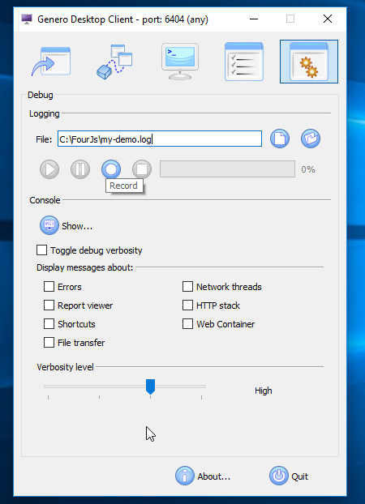
GDC – Logs
You can record and playback logs of the AUI protocol. This is especially useful for logging a support case that relates to a UI specific issue.

Slide 11
GDC – Summary
GDC can be installed on the client as a graphical front end to the Runtime System
GDC supports connections to the Runtime System using http, https or ssh(1 or 2).
Some user interactions with the GDC are local actions.
Some graphical settings are stored by the GDC.
The GDC can record and playback logs.
You can start the GDC with various flags.
  You must start the GDC with the –a flag to create log files and shortcuts.

Slide 12
GBC – Summary
The GBC is installed on the server and is supplied as part of the Runtime System
The GAS is used to run the GBC in a browser
The GBC can be customized either with just simple theme changes for completely changed by extending and replacing the HTML/JS/SASS for various widgets.

Slide 13
Q&A

