Slide 1
Genero User Interface
Forms
Neil J Martin
neilm@4js.com
Genero BDL 3.10
Genero Studio 3.10
January 2018

Slide 2
Goals
  Learn all the elements of a form file.
  Use the LAYOUT section to design a form.
    Lay out the form with containers and layout tags
    Add form items such as combo boxes, buttons and radio groups.
  Compile the form definition file ( .per ).
  Read and interpret a compiled form file (.42f ).

Slide 3
Elements of a Genero Form
Container – a formatted screen region or a container for other containers (Grid, Folder, Table, groupboxes, etc.)
Form field – an area where users can view and/or edit data
Widgets – the decoration for the form field (Edit, ButtonEdit, ComboBox, RadioGroup, etc )
Action View – a form item that can trigger a program action (Button, Topmenu, Toolbar, etc.)
Label – text displaying static information

Slide 4
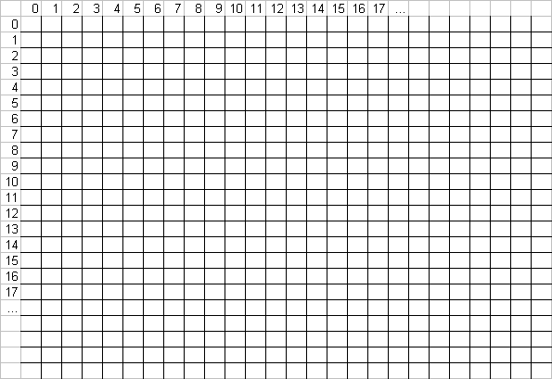
Genero Forms – Legacy / Ascii Terminal
A common fixed form (not sizeable, with fixed font) would be represented as a grid with fixed sized cells:

Slide 5

Genero Forms – Modern
Genero forms are sizeable and can include proportional fonts and graphical objects of different sizes.
Each cell has its own size
Default size is about 2 pixels
The cell takes the size of its content or of the larger cell in the same column.
An object can use one or more cells, depending on its definition

Slide 6

Genero Forms – Layouting Rules
Adding a Combo box with a width of 5 cells will enlarge these cells to the combo box size.
The last cell is kept for the combo box button.
Cells around the combo box are automatically retained to provide a margin.

Slide 7
Genero Forms – Creating a Form
Three ways to define application screens:
  Write text-based form definition files with a suffix of .per
  Use the drag-and-drop graphical Form Designer in Genero Studio
  Dynamically at runtime

Slide 8
Genero Forms – Definition File ( .per )
The .per file consists of a set of defined sections, which must appear in the following order in the file:
  SCHEMA
  ACTION DEFAULTS
  TOPMENU
  TOOLBAR
  LAYOUT
  TABLES
  ATTRIBUTES
  INSTRUCTIONS
Only LAYOUT is required, the rest are optional depending on the features of the form.

Slide 9
Genero Forms – Definition File ( .per )
SCHEMA Section
  Defines the database schema on which the form is based.
    You can define fields on the form in terms of the schema tables and columns.
    The Schema must be defined in a database schema file.
  Optional; defaults to FORMONLY if omitted.
Syntax:
SCHEMA ( string | FORMONLY )

Slide 10
Genero Forms – Definition File ( .per )
LAYOUT Section
  The LAYOUT section defines the abstract layout of the elements of the form.
  This section is a tree of layout nodes, used to define graphical elements.
  Mandatory
Syntax:
LAYOUT [ ( attribute [ = value ] [,…] ) ]
root-layout-container
[…]
[END]

Slide 11
Genero Forms – Definition File ( .per )
ATTRIBUTES section
  Describes the properties of elements in the LAYOUT section
  Mandatory
Syntax:
ATTRIBUTES
[item-type] item-tag = field-name [ , attribute-list ] ;
[item-type] item-tag : item-name [ , attribute-list ] ;
…
END

Slide 12
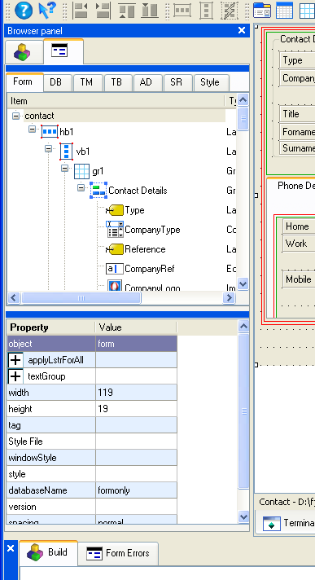
Genero Forms – Studio Form Designer ( .4fd )
In Genero Studio Form Designer all sections and widget attributes are shown and can be updated in the browser panel.
The browser panel is located by default on the left side of Genero Studio screen.

Slide 13
Genero Forms – Containers
Containers are blocks holding other containers or defining a formatted screen region.
  They are nested to create the visual layout of the form area of the user interface.
  The END keyword defines the end of the list of children inside a container.
HBOX
VBOX
GROUP
FOLDER
PAGE
GRID
SCROLLGRID
TABLE

Slide 14
Genero Form – .per Example
LAYOUT ( text = "Customer Orders" )
  VBOX
  GROUP ( text = "Customer Details" )
  GRID
  {
  Name: [f001 ]
  Phone: [f002 ]
  Address: [f003 ]
  }
  END --GRID
  END --GROUP
  TABLE
  {
  OrdNo Date Ship date Weight
  [c01 |c02 |c03 |c04 ]
  [c01 |c02 |c03 |c04 ]
  [c01 |c02 |c03 |c04 ]
  }
  END --TABLE
  END --VBOX
  END --LAYOUT

Slide 15
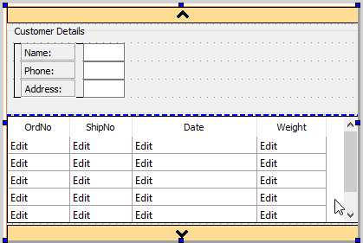
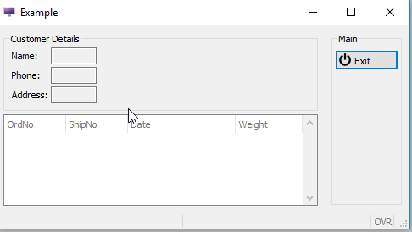
Genero Forms – GST Layout Example
VBox
Group Box
Grid
Table

Slide 16
Genero Forms – Containers
Containers have a set of supported attributes that can be applied in the .per definition for presentation and behavior.
Example:
  GROUP (TEXT = "Customer Details", HIDDEN)
The documentation lists the valid attributes for each container, and includes an Attributes List.

Slide 17


Genero Forms – Containers
VBOX (Vertical Box)
  Displays the elements defined within the container vertically from top to bottom.
HBOX (Horizontal Box)
  Displays the elements defined within the container horizontally from left to right.
Syntax:
  VBOX [ ( attribute [ = value ] ) ]
  layout-container
  [...]
  END

Slide 18


Genero Forms – Containers
A GROUP container can be used to display a titled box (usually called a groupbox)
around contained elements.
Syntax:
  GROUP [ ( attribute [ = value ] ) ]
  layout-container
  [...]
  END
Where layout-container can be:
  VBOX, HBOX, GROUP, FOLDER, GRID, TABLE

Slide 19

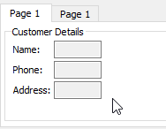
Genero Forms – Containers
A FOLDER container can be used to display PAGE containers as folder tabs.
Syntax:
  FOLDER [ ( attribute [ = value ] ) ]
  PAGE
  layout-container
  [...]
  END
  [...]
  END
Where layout-container can be:
  VBOX, HBOX, GROUP, FOLDER, GRID, SCROLLGRID, TABLE
PAGE containers can include other containers such as GROUP and GRID

Slide 20


Genero Forms – Containers
The GRID container declares a formatted text block, encased in braces “{…}”, defining the
dimensions and the relative positions of the logical elements of a screen. Form fields are
normally defined here.
Syntax:
  GRID [ ( attribute [ = value ] ) ]
  {
  { text | item-tag | layout-tag }
  [...]
  }
  END

Slide 21

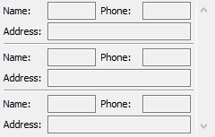
Genero Forms – Containers
SCROLLGRID is similar to the GRID container, except that you can
repeat the screen elements on
Several "record rows" in order to
design a multiple-record view, which
will appear with a scrollbar.
Syntax:
  SCROLLGRID [ ( attribute [ = value ] ) ]
  {
  row-template
  [...]
  }
  END
where row-template is a text block containing:
{ text | item-tag | h-line }
[...]

Slide 22
Genero Forms - Containers
Do Chapter 2 - Exercise 1

Slide 23

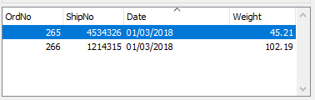
Genero Forms – Containers - Tables
The TABLE container defines the presentation of a list of records.
The first line of a table-area
can be text defining the
column titles.
The second line must be field item tags that define the columns receiving data.
Syntax:
  TABLE [ ( attribute [ = value ] ) ]
  {
  [ title [...] ]
  [identifier [|...] ]
  }
  END

Slide 24
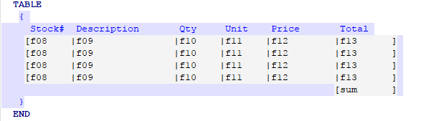
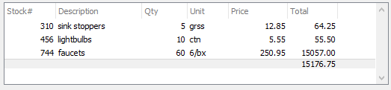
Genero Forms – Containers - Tables
A Table can also have a summary line for either automatically calculated values or program calculated.

Slide 25
Genero Forms - Tables
Do Chapter 2 - Exercise 2

Slide 26
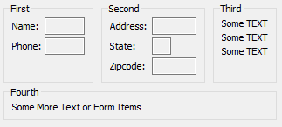
Genero Forms – Layout Tag
Layout tags define layout regions within a GRID or SCROLLGRID container.
G - Groupbox layout tag gives same presentation as a GROUP container.
T - Table layout tag gives same presentation as the TABLE.
S - ScrollGrid layout tag resulting in the
same presentation as the SCROLLGRID.
GRID
{
<G "First" ><G "Second" ><G "Third" >
Name: [f001 ] Address: [f003 ] Some TEXT
Phone: [f002 ] State: [a0] Some TEXT
Zipcode: [f010 ] Some TEXT
< >< >< >
<G "Fourth" >
Some More Text or Form Items
< >
}
END --GRID

Slide 27


Genero Forms – Spaces
An HBox Tag defines the position and size in a GRID of a horizontal box containing several form items.
Syntax:
[ element [...] ]
Where element can be:
{ identifier [-] | string-list } [:...]
Where string-list is:
{ string-literal | spacer } [...]

Slide 28
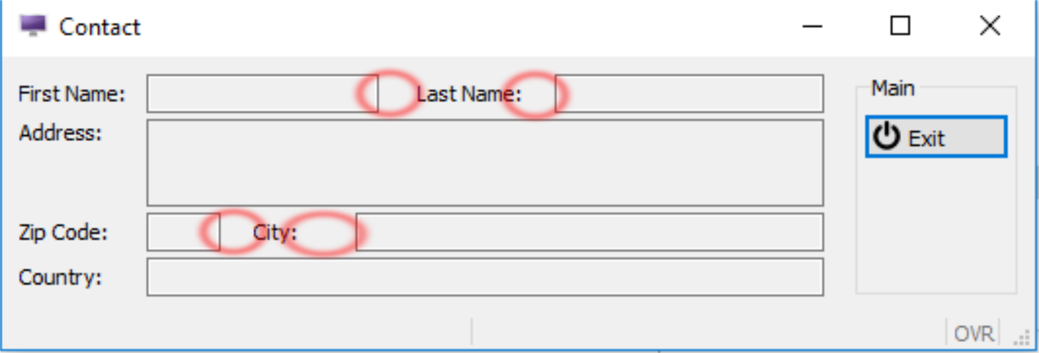
Genero Forms – Solving Misaligned Elements
GRID
{
First Name: [fldfname ] Last Name: [fldlname ]
Address: [fldaddress ]
[ ]
[ ]
Zip Code: [fldzip ] City: [fldcity ]
Country: [fldcountry ]
}
END --GRID

Slide 29
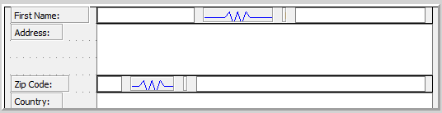
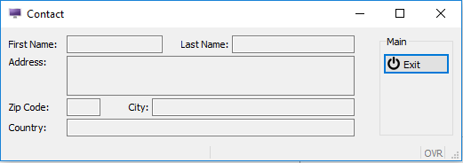
Genero Forms – Containers
GRID
{
First Name: [fldfname : :"Last Name:":fldlname ]
Address: [fldaddress ]
[ ]
[ ]
Zip Code: [fldzip : :"City:":fldcity ]
Country: [fldcountry ]
}
END --GRID
Spacers:
When the window is drawn, the length will change within the spacer, not within the whole line.

Slide 30
Genero Forms – Layout Tags
Do Chapter 2 - Exercise 3

Slide 31
Genero Forms – Form Elements - .per File.
LAYOUT ( text = "Customer orders" )
VBOX
GROUP ( text = "Customer details" )
GRID
{
Name: [f001 ]
Phone: [f002 ]
Address: [f003 ]
}
END --GRID
END --GROUP
TABLE
{
OrdNo Date Ship date Weight
[c01 |c02 |c03 |c04 ]
[c01 |c02 |c03 |c04 ]
[c01 |c02 |c03 |c04 ]
}
END --TABLE
END --VBOX
END --LAYOUT
Text labels
Form Fields
Pipe symbol used to make items appear next to each other

Slide 32
Genero Forms – Form Elements - .4fd File
Text labels
Form Fields
Table
Widget

Slide 33
Genero Forms – Form Elements
Form elements have a set of supported attributes that can be applied in the .per definition for presentation and behavior.
The Genero documentation lists the valid attributes for all the form elements, and contains an Attributes List.

Slide 34
Genero Forms – Form Elements - The Widgets
EDIT
BUTTON
BUTTONEDIT
CANVAS
COMBOBOX
CHECKBOX
DATEEDIT
DATETIMEEDIT
GROUP
IMAGE
LABEL
PROGRESSBAR
RADIOGROUP
SCROLLGRID
SLIDER
SPINEDIT
TABLE
TEXTEDIT
TIMEEDIT

Slide 35


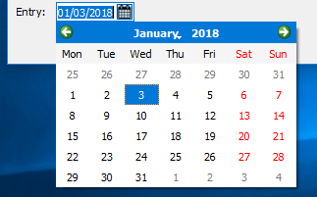
Genero Forms – The Widgets
A EDIT item is a common edit field.
EDIT item-tag = field-name[,attribute-list];
A BUTTONEDIT defines an edit field with a push button that can trigger an action.
BUTTONEDIT f001 = customer.state,REQUIRED,
IMAGE="smiley",ACTION=zoom;
A DateEdit defines an edit box with a button that opens a calendar.
DATEEDIT item-tag =
field-name
[,attribute-list];

Slide 36
Genero Forms – Widgets
The ProgressBar item type defines a horizontal bar with a progress indicator.
PROGRESSBAR r1 = FORMONLY.r1 TYPE INTEGER,
VALUEMIN=0, VALUEMAX=100;
The SLIDER item type defines a horizontal or vertical slider.
SLIDER f01 = workstate.duration,
VALUEMIN=0, VALUEMAX=5,
STEP=1;

Slide 37

Genero Forms – Widgets
A CHECKBOX defines a boolean entry with a box and a text label.
CheckBox check1= formonly.check1,
valueChecked=”Y”,
valueUnchecked=”N”,
text=”Confirm”
A RADIOGROUP defines a set of radio buttons.
RadioGroup r1 = formonly.r1,
items=((0,"Leo"),(1,"Rene"), (2,"Peter"),(3,"Horst")),
ORIENTATION=HORIZONTAL;

Slide 38

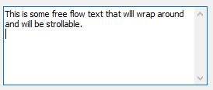
Genero Forms – Widgets
The COMBOBOX item type defines a line-edit with a drop-down list of values.
COMBOBOX cb = FORMONLY.l_colours,
ITEMS=((1,"Red"),(2,"Green"), (3,"Blue"));
The TEXTEDIT form item type defines a multi-line edit form field.
TEXTEDIT f1 = customer.comments,STRETCH=BOTH;

Slide 39
Genero Forms – Widgets
An IMAGE item defines an area in which you can display an image from a pixel-map file.
Form Field Images – for images that change often.
IMAGE f01 = contact.picture,
HEIGHT=400 PIXELS,
WIDTH=200 PIXELS,
STRETCH=BOTH;
Static Images – for images that do not change.
IMAGE f01 : logo, IMAGE="fjs.gif",
STRETCH=BOTH;

Slide 40
Genero Forms – Widgets
The LABEL form item defines a simple text area to display read-only data. There are two types, and each has unique syntax:
Form Field Labels - for labels that have a value that changes often, such as data retrieved from a database.
LABEL custid = customer.customer_id;
Static Labels - for labels that have a value that does not change.
LABEL lab1 : copyright,
TEXT = "2003 ABC COMPANY";

Slide 41
Genero Forms – Widgets
A BUTTON is an action view, not associated with database columns and therefore using the static notation.
BUTTON btn1 : help, TEXT="Click me", IMAGE="question“;
A CANVAS item defines an area in which you can draw shapes.
CANVAS cvs1 : canvasarea1;

Slide 42
Genero Forms - Widgets
Do Chapter 2 - Exercise 4

Slide 43
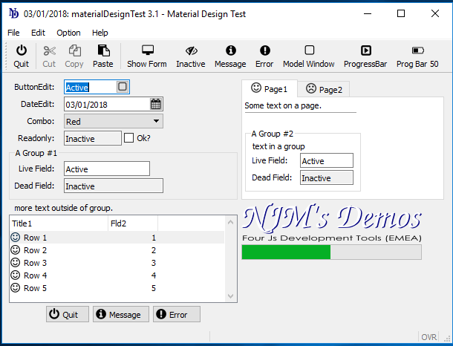
Genero Forms – Additional Form Elements
Topmenus and Toolbars are views for actions that can trigger events in your code.
Top menu
Toolbar

Slide 44
Genero Forms – Additional Form Elements
ACTION DEFAULTS
TOPMENU
TOOLBAR
ACTION DEFAULTS
ACTION action_id ( action_attribute [,…] )
[…]
END

Slide 45
Genero Forms – Compiling
Form definitions in text files (.per files) can be compiled from the command line using the tool fglform:
fglform custform.per
Genero Studio has menu options and icons that allow you to validate or compile form definitions.
The resulting runtime form file is an XML file with a .42f extension.

Slide 46
Genero Forms – Summary
A form definition file is used to design the form area of a Genero program.
The definition file is translated into an XML document and loaded into the AUI at runtime.
The LAYOUT section in the file manages the layout of the form.
Form items are used within GRID, SCROLLGRID and TABLE containers to provide fields for static and database-driven values.
Containers and form items have specific attributes.
TopMenus and Toolbars can be defined.
The Action Defaults section can be used to centralize the definition of attributes for action views.

Slide 47
Genero Forms
Do Chapter 2 - Exercise 5

Slide 48
Q&A

