Slide 1
Genero User Interface
Programming the AUI
Neil J Martin
neilm@4js.com
Genero BDL 3.10
Genero Studio 3.10
January 2018

Slide 2
Goals
You will learn to:
Find the node for the current window.
Dump all the attributes of a node.
Use several methods for finding a node.
Use these techniques to programmatically add new elements to a form.

Slide 3
The AUI
Abstract User Interface is:
A conceptual “meta” user interface
Logical rather than Real
Common interface to all target interfaces
Styles provide a transformation layer to Real interface

Slide 4
The AUI → DOM → XML
Why use XML for Abstract User Interface?
GUIs are typically defined as hierarchical object trees.
XML is ideal for describing hierarchical object trees.
DOM is an internal (memory) representation of XML document.
XML and DOM are open industry standards defined by W3C.
Simple standard APIs can be used for navigating and manipulating a DOM object tree.

Slide 5
The AUI → DOM → XML
Why use XML for Abstract User Interface?
GUIs are typically defined as hierarchical object trees.
XML is ideal for describing hierarchical object trees.
DOM is an internal (memory) representation of XML document.
XML and DOM are open industry standards defined by W3C.
Simple standard APIs can be used for navigating and manipulating a DOM object tree.

Slide 6
The AUI → DOM → XML
How does XML relate to an object?
An XML document is a tree of Nodes
A Node represents an Object or Event
Screen elements are Objects
A Node may have Attributes
Nodes have a unique i-node identifier
SomeObjects are instances ofClasses eg: Form, Combobox
An XML tag may be a Class or Attribute
Objects may be a Container for Attributes or other Objects
Recursive and hierarchical

Slide 7
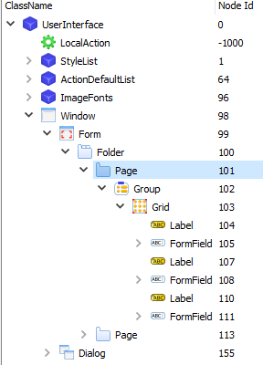
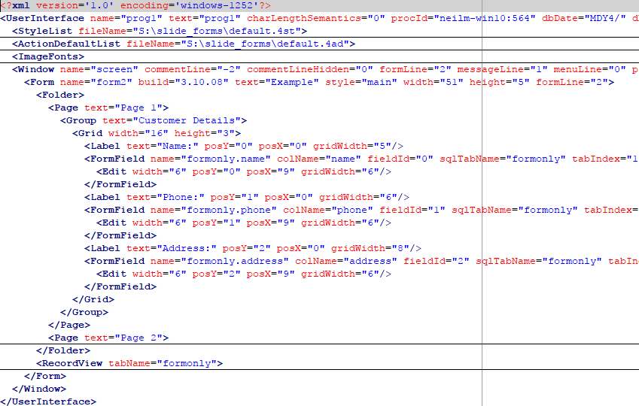
The AUI → DOM → XML

Slide 8
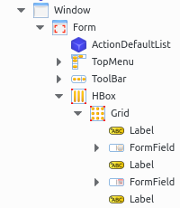
The AUI → DOM → XML
What standard UI Elements are defined from XML documents?
Styles (.4st)
Start Menus (.4sm)
Toolbars (.4tb)
Topmenus (.4tm)
Forms (.42f)
BUT - Any part of the UI can defined from an XML document

Slide 9
The AUI → DOM → XML
What is the relationship between Forms and XML?
A Form is part of the User Interface (UI)
A compiled Form (.42f) is an XML document
An XML document can be loaded to the User Interface or as a subtree of the User Interface
The User Interface can also be saved as an XML document

Slide 10
The Programming the AUI
ui.Interface - Provides an interface to the AUI tree
ui.Window - Provides an interface to the window objects
ui.Form - Provides an interface to forms used in the program
ui.ComboBox – Provides an interface to ComboBox objects
ui.Dialog – Provides an interface to interactive instructions in the program.
om.DomDocument - Provides methods to manipulate a data tree, using DOM standards
om.DomNode - Provides methods to manipulate a node of a data tree, using DOM standards
om.NodeList - Holds a list of DomNode objects created from a selection method

Slide 11
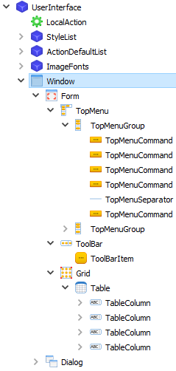
The Programming the AUI
How do you find the DomNode for the current window?
FUNCTION getCurrentWindowNode()
DEFINE l_win ui.Window
LET l_win = ui.Window.getCurrent()
RETURN l_win.getNode()
END FUNCTION

Slide 12
The Programming the AUI
An example function to display all the attributes of a node.
FUNCTION Dump_Node(l_node om.DomNode)
DEFINE l_idx INTEGER
DISPLAY l_node.getTagName(), ": ", l_node.getID() USING "<<&"
FOR l_idx = 1 TO l_node.getAttributesCount() -- Print each attribute
DISPLAY
l_node.getAttributeName(l_idx), "=",
l_node.getAttributeValue(l_idx)
END FOR
END FUNCTION

Slide 13
The Programming the AUI
There are several methods that can be used to select a DomNode:
Recursive Descent
ui.Window.findNode()
om.DomNode.SelectByTagName()
om.DomNode.SelectByPath()

Slide 14
The Programming the AUI – Finding Nodes
ui.Window.findNode()
DEFINE n om.DomNode,
w ui.Window
LET w = ui.Window.getCurrent()
LET n = w.findNode(“Label”, "customer_id")
IF n IS NOT NULL THEN
CALL n.setAttribute(“color", “Red”)
END IF
ui.Window.selectByTagName()
DEFINE l_node om.DomNode,
l_list om.NodeList,
l_str STRING,
l_idx INTEGER
LET l_list = l_node.selectByTagName(“Label")
-- Upshift all labels
FOR l_idx = 1 TO l_list.getLength()
LET l_node = l_list.item(l_idx)
LET l_str = l_node.getAttribute(“text”)
CALL l_node.setAttribute(“text", l_str.toUpperCase())
END FOR

Slide 15
The Programming the AUI – Finding Nodes
ui.Window.selectByPath()
DEFINE l_node om.DomNode,
l_list om.NodeList,
l_idx INTEGER
LET l_list = l_node.selectByPath(”//Window[@name=’giftcert’]”)
-- Change the windows text.
FOR l_idx = 1 TO l_list.getLength()
LET l_node = l_list.item(l_idx)
CALL l_node.setAttribute(“text”, “Gift Cert Demo”)
END FOR

Slide 16
The Programming the AUI – XPath
XPath uses pattern expressions to identify nodes in an XML tree and is a W3C Standard
om.DomNode.SelectByPath() uses a subset of XPath expressions
Pattern | Description
/ | Represents an absolute path to the required element.
// | All elements in the document which fulfill following criteria are selected.
* | Selects all elements located by preceding path
[@attrib=‘value’] | Selects elements that have attributes matching a value

Slide 17
The Programming the AUI – Finding Nodes
Finding a Vbox / HBox
FUNCTION find_vbox(l_form om.DomNode)
DEFINE l_box om.DomNode
LET l_box = l_form.getFirstChild()
WHILE l_box IS NOT NULL
IF l_box.getTagName() MATCHES “[VH]Box" THEN
EXIT WHILE
END IF
LET l_box = l_box.getNext()
END WHILE
RETURN l_box
END FUNCTION

Slide 18
The Programming the AUI – Finding Nodes
Programmatically add an Element to a form
FUNCTION add_label(d_box om.DomNode)
DEFINE l_node om.DomNode
LET l_node = l_box.createChild("Label")
CALL l_node.setAttribute("posX", 1)
CALL l_node.setAttribute("posY", 0)
CALL l_node.setAttribute("width", 10)
CALL l_node.setAttribute("text", "Hello World")
CALL l_node.setAttribute("color", "magenta")
END FUNCTION

Slide 19
Q&A

