Slide 1
Genero User Interface
Summary
Neil J Martin
neilm@4js.com
Genero BDL 3.10
Genero Studio 3.10
January 2018

Slide 2
Chapter 1 - Overview
Key Genero terms and concepts
The Genero product suite
The Genero architecture
Usage of XML and DOM within Genero

Slide 3
Chapter 2 - GDC
Genero Desktop Client (GDC)
How it can be used
Configuring

Slide 4
Chapter 3 - Forms
Read and interpret a compiled form file.
Use the LAYOUT section to design a form.
Use containers and layout tags.
Add form items such as combo boxes.
Discover the attributes that can be used with Widgets.
See TOPMENU, ACTION DEFAULTS and TOOLBAR sections.

Slide 5
Chapter 4 - DUI
Describe and manipulate the first layer of the Dynamic User Interface
Use Presentation Styles
Create Action Defaults
Create XML files for a ToolBar or TopMenu
Create a Start Menu
Use MDI Windows
Load XML files dynamically at runtime

Slide 6
Chapter 5 – Classes
Define the packages containing the Genero built-in classes
base
om
ui
Use the built-in classes and their methods in your programs

Slide 7
Chapter 6 – Programming the AUI
Find the node for the current window
Dump all the attributes of a node
Use several methods for finding a node
Use these techniques to programmatically add new elements to a form

Slide 8
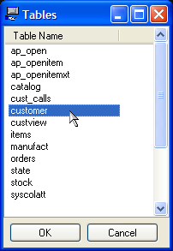
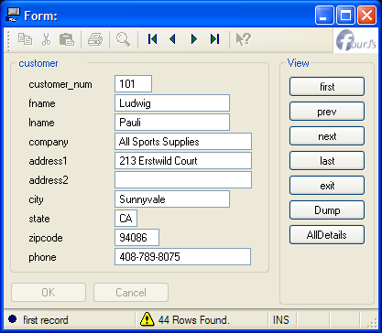
Conclusion
Programming the AUI provides the capability to create completely dynamic user interface, WITHOUT any forms.
Note: screenshots from Alpha version of Genero!

Slide 9
Q&A

