Slide 1



World-Wide
Developer Conference
Genero Browser Client - Customization
Neil J Martin
JW Marriott Cancùn Spa & Resort
September 26-29, 2017
Notes:
Company doing well FY16 very good year+10% EBIT 18%
Our job – anticipate your needs
Consumer IT
Mobile apps
Mobile Enterprise Apps
Web site becomes Web app
Web apps & Mobile apps converge
SAGE 10€/month, Why ? Xero eating their lunch!
Security
Cloud

Slide 2
Intro – It's all about me
Neil Martin - neilm@4js.com
I work from the UK office.
My Roles are support / training / consultancy / development.
Currently also working on Genero Cloud.
My background is in developing 4gl applications, I have been using 4gl ( InformixRDS / Four Js BDL / Genero ) for over 25 years!
I do NOT consider myself a Web Developer!

Slide 3
Overview - About the session
Goals of this session
Run GBC default with default demos
Setup the GBC dev environment
Run the GBC dev build with default demos
Create custom build folder for the custom GBC files
Setup GeneroStudio to build GBC
A test Application
Colors and Theme
Headers and Footers
Packaging and deploy GBC
More GBC customizations

Slide 4
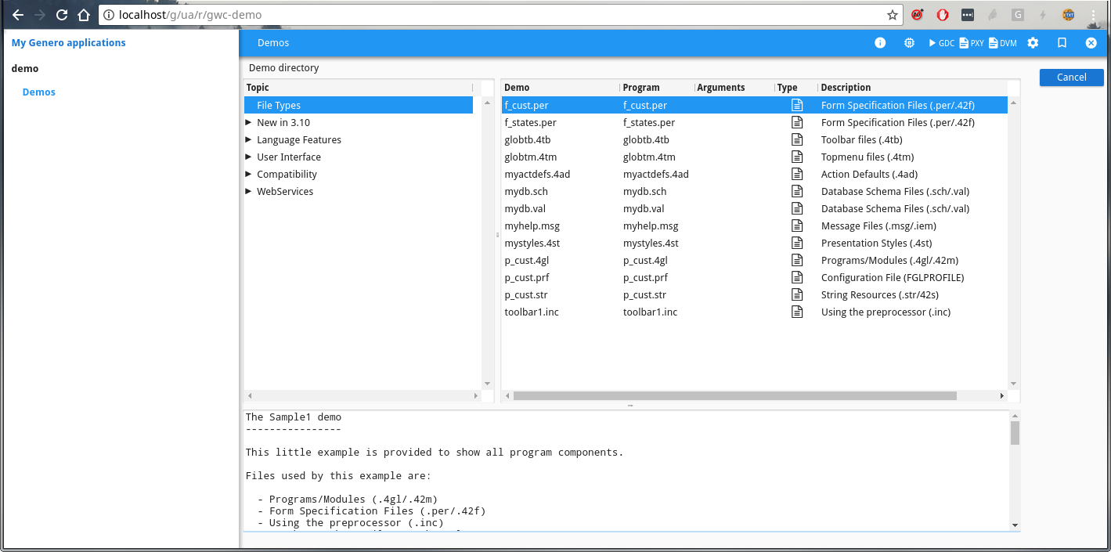
GBC Default Test
Basic sanity test
Before we start, let’s make sure the current default GBC is working and we can run the default Genero demos!

Slide 5
Setup the GBC Dev Environment
Tools of the trade
The GBC uses various standard web development tools, these need to be installed in your development environment so you can build the GBC Runtime from the Project sources.
$ sudo yum install git unzip nodejs
$ wget https://nodejs.org/dist/v6.11.3/node-v6.11.3-linux-x64.tar.xz
$ tar xvJf node-v6.11.3-linux-x64.tar.xz
$ export PATH=node-v6.11.3-linux-x64/bin:$PATH
$ sudo npm install -g grunt-cli

Slide 6
Setup the GBC Dev Environment
Our first build
Once the require packages are installed you need to set up the GBC project folder
$ unzip fjs-gbc-1.00.39-build201709041139-project.zip
$ cd gbc-1.00.39/
$ npm install
$ grunt
When complete you should have the ‘default’ custom GBC built.

Slide 7
Setup the GBC Dev Environment
Configure for running
Before you can test the ‘default’ custom GBC you need to make sure the GAS can find it.
There are a couple of ways to tell the GAS how to find your custom GBC.
One method is a symbolic link in $FGLDIR/web_utilities/gbc
$ ln -s $HOME/gbc-1.00.39/dist/customization/default $FGLDIR/web_utilities/gbc/mydef
Another method is to modify the as.xcf for the "res.path.gbc.user".

Slide 8
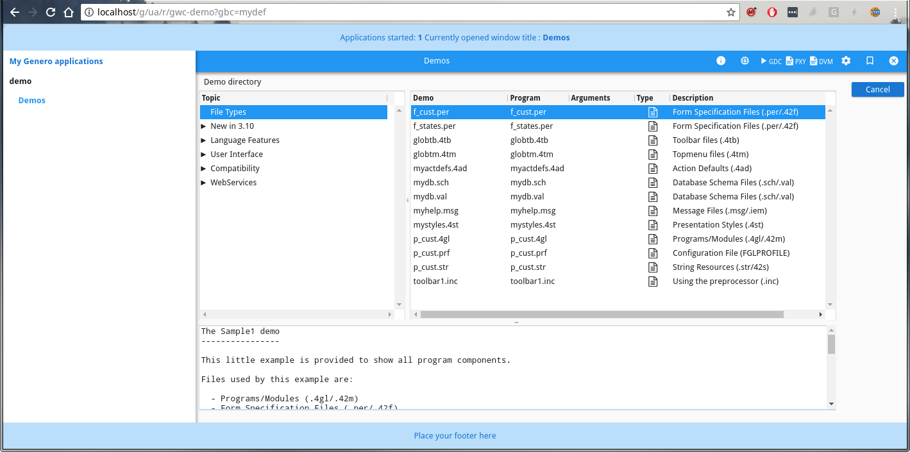
GBC ‘Default’ Custom Run
The results of all that effort
Test the ‘default’ custom GBC:
http://<server>/gas/ua/r/gwc-demo?gbc=mydef )

Slide 9
First Customization
First a new build
I recommend testing your application with the default Custom GBC build before doing any customizations.
Next, setup your own sources folder like this:
Create a new folder in your sources location for your custom GBC files. ( so they are part of your Source Code Control )
Create a link in the GBC customization build folder to this ‘new folder’
Change the custom.json to build that custom folder
Make a small change to the theme file and do your first build
Create a link in $FGLDIR/web_utilities/gbc to this new custom build
Run the new build in your browser.

Slide 10
First Customization
Do the work
$ cd $HOME/gbc-1.00.39/
$ cp -r customization/default $MY_SRC_DIR/mygbc
$ ln -s $MY_SRC_DIR/mygbc/ customization/mygbc
$ vi custom.json
change: "customization": "customization/default"
to this: "customization": "customization/mygbc"
$ grunt ( make sure we can build our new folder )
$ ln -s $HOME/gbc-1.00.39/dist/customization/mygbc $FGLDIR/web_utilities/gbc/mygbc
$ grunt dev ( This will automatically build after any changes )
-> new terminal
$ cd $MY_SRC_DIR/mygbc
$ vi theme.scss.json
do some changes & save them

Slide 11
The ‘default’ Customization
Anatomy of customization
The ‘default’ customization folder contains these sub-folders:
js – JavaScript and template html files.
locales – Localization files for text messages.
resources – Images.
sass – scss files. (syntactically awesome stylesheets!)
and the ‘theme.scss.json’ file.
I suggest removing most of the demo files to leave only the files relating to the header. Ie:
js/MyHeaderBarWidget.js
js/MyHeaderBarWidget.tpl.html
js/MyMainContainerWidget.js
js/MyMainContainerWidget.tpl.html
sass/customization.scss
sass/MyMainContainerWidget.scss

Slide 12
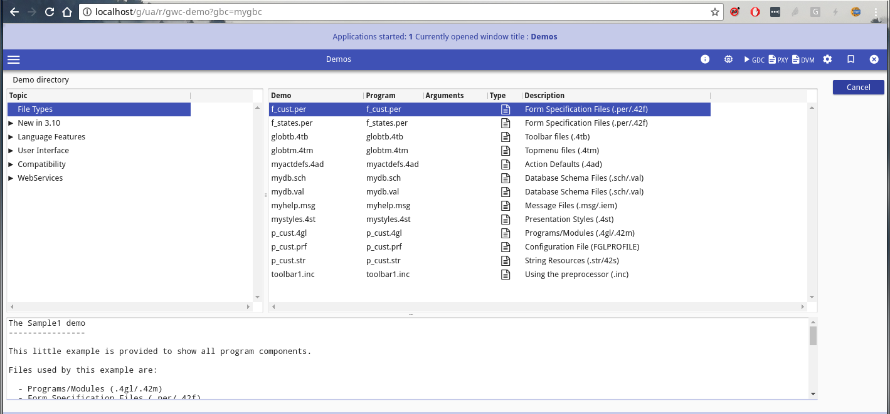
GBC ‘Default’ Custom Run
At last, our own colours!
Test the custom GBC:
http://<server>/gas/ua/r/gwc-demo?gbc=mygbc )

Slide 13
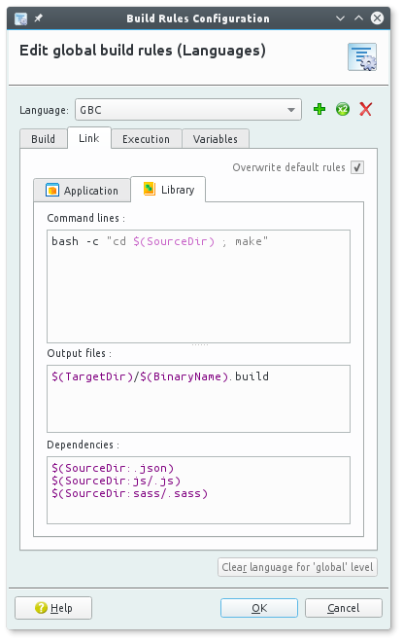
Genero Studio
Custom Builds rules
Genero Studio has many useful features that make it worth spending some time to configure so you can also use it to work on and build your custom GBC.

Slide 14
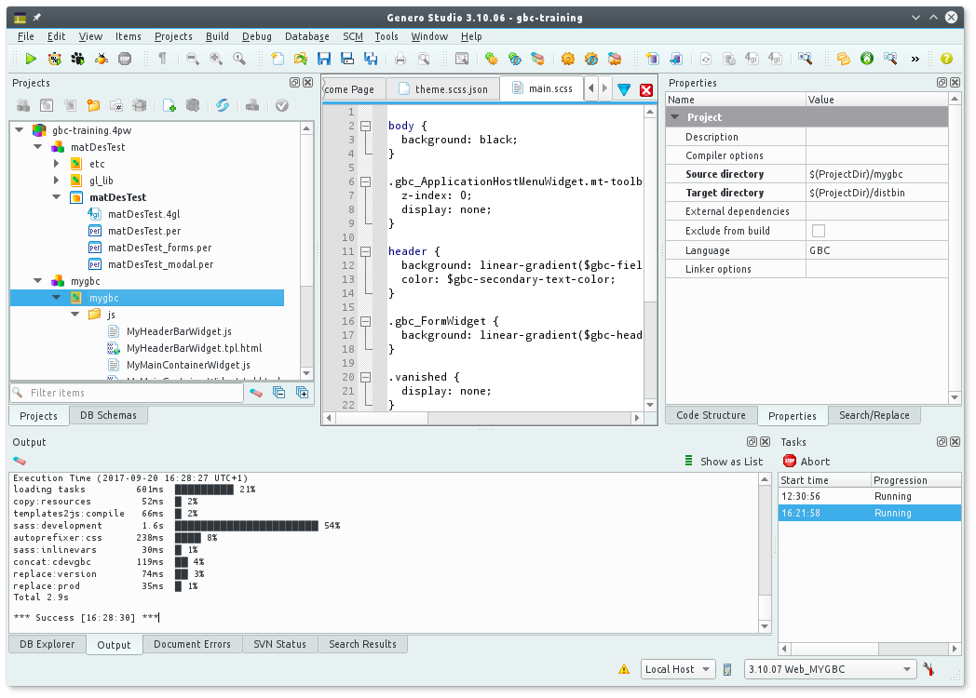
Genero Studio
Custom rules

Slide 15
Test Application
A testing asset
A good idea is to write a small stand-alone test program to run using Custom GBC to see all your changes.
The ‘Test’ program should use all the GUI elements you use in a similar way to your main application, but with the advantage that you don’t have to navigate through various menus and sub programs to get to see any specific UI features you may use.
Another useful feature would be if the program can open and show any of your 42f files.

Slide 16
Colors ( Colours )
All the colours of the rainbow
Coloring the GBC should be done by changing the theme json file. I’d recommend removing most color changes from the .4st file so the GBC can use the theme.
NOTE: The .4st colors will override the GBC theme colors.
The theme file allows us to change the colors for a ‘material design’. See: https://material.io/guidelines/style/color.html#color-color-palette

Slide 17
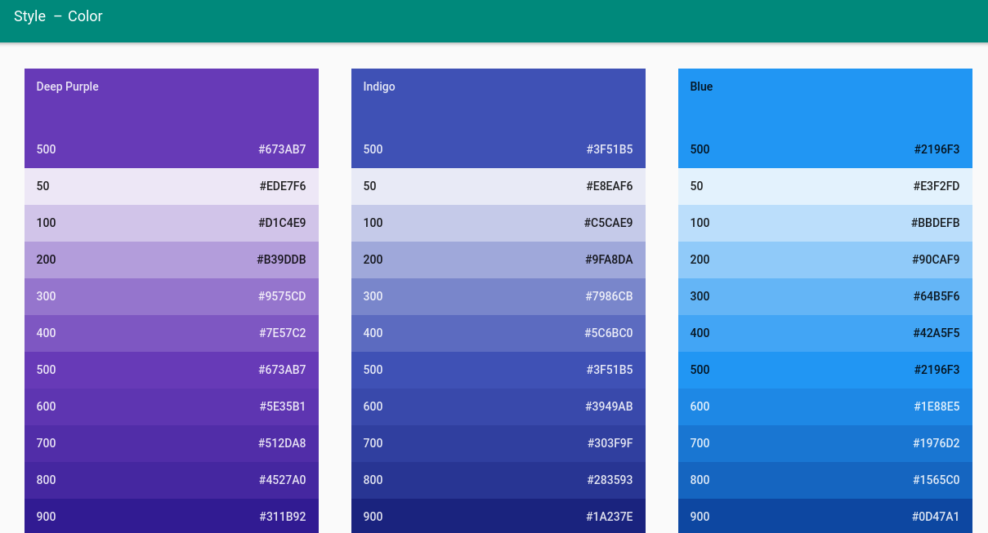
Colors ( Colours )
All the colours of the rainbow

Slide 18
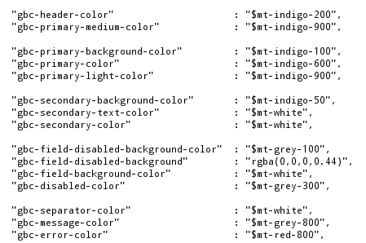
Colors ( Colours )
All the colours of the rainbow
The theme file is a JSON file and allows you to use the ‘Material Design’ color names. After changing this file you must rebuild the GBC using the ‘grunt’ command.

Slide 19
More Than Colors
All the colours of the rainbow and more
You can also override the colors and other styles for any element in the GBC by editing or creating a scss file for that element.
For example, look at the default MyMainContainerWidget.scss
This is controlling the style of the ‘header’ object.
> header {
padding: 1em;
background-color: $gbc-primary-light-color;
color: $gbc-primary-color;
text-align: center;
}

Slide 20
Working with SaSS
Getting Sassy
When you create your .scss files you must add them to the customization.scss file so that included in the build.
@import "MyMainContainerWidget";
@import "MyHeaderBarWidget";
@import "main";
Here I’ve added ‘MyHeaderBarWidget’ and ‘main’ to the customization.scss file.

Slide 21
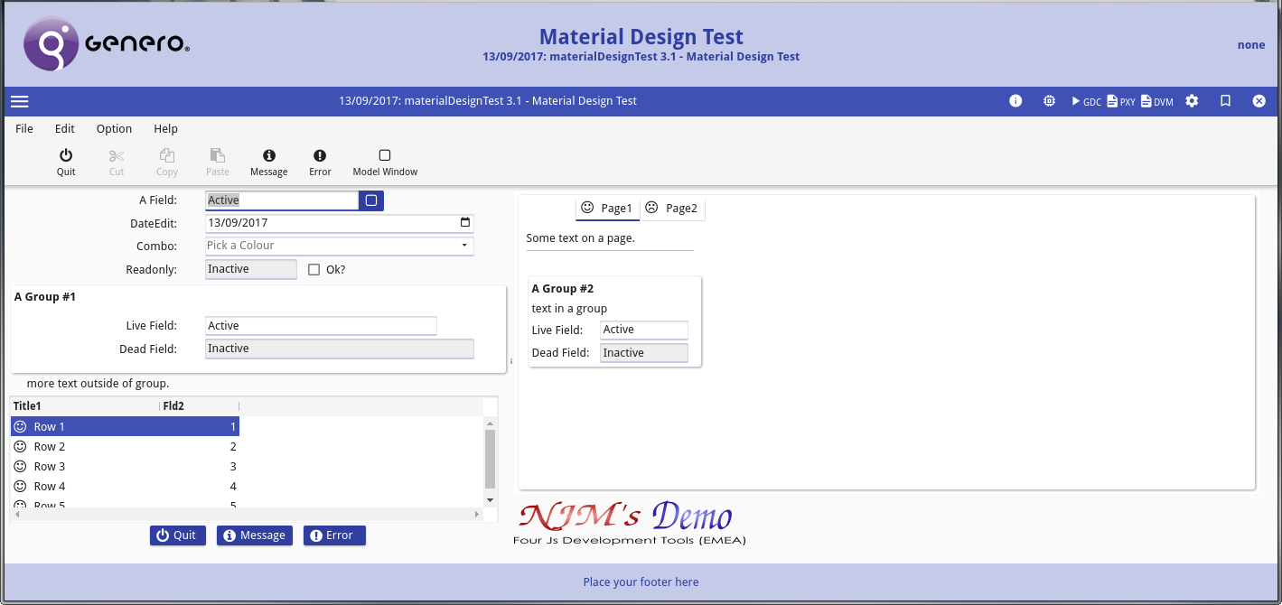
Headers
Getting a head of ourselves
Once we are happy with our basic styles, we can work on the heading by adding a title and logo.

Slide 22
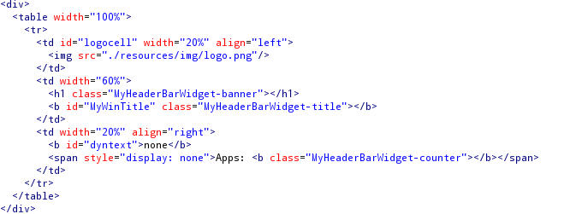
Headers
Getting a head of ourselves
My Code adds a the Application Text into the header as well as the form title.
js/MyHeadingBarWidget.tpl.html:

Slide 23
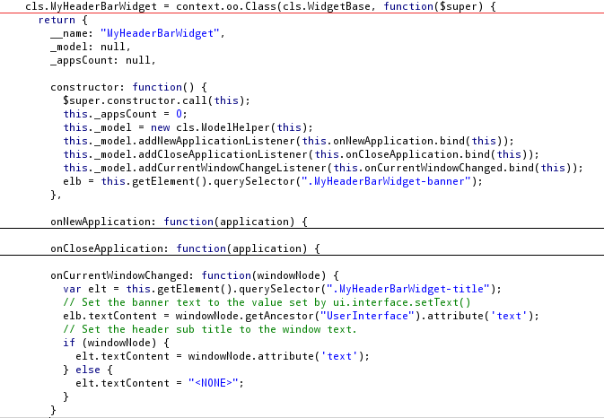
Headers
js/MyHeadingBarWidget.js

Slide 24
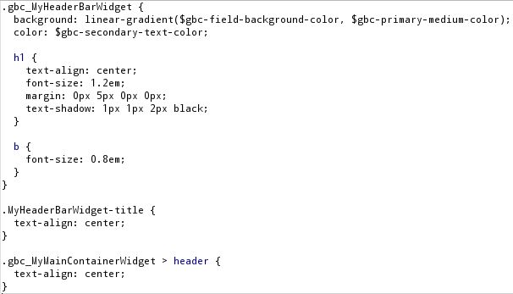
Headers
sass/MyHeadingBarWidget.scss

Slide 25
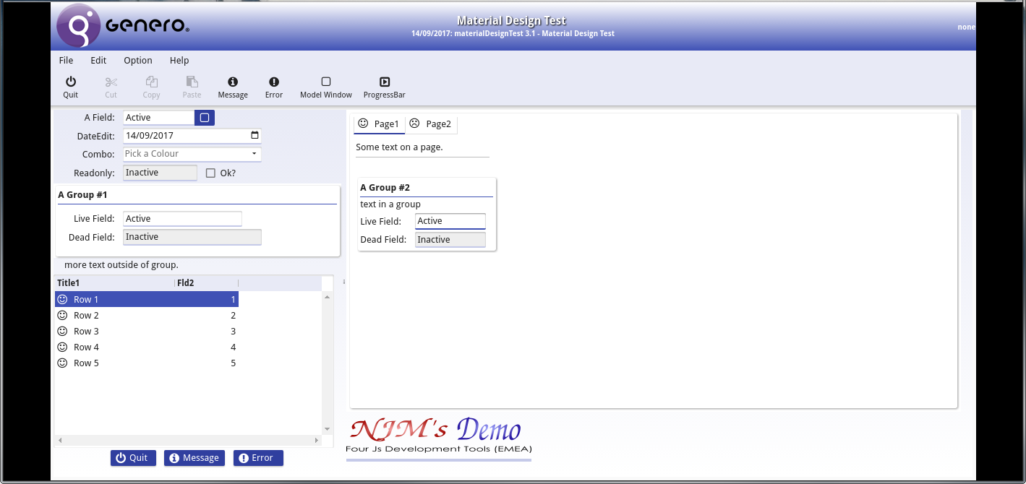
More Customizations
Closer to our goal
Here there are few more subtle changed to the styles to limit the size, change group titles, remove some unwanted spaces

Slide 26
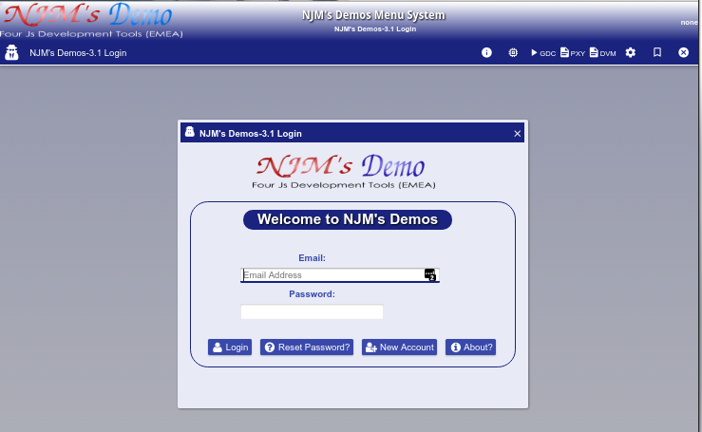
More Customizations
Multiple Themes: Blues
With basic customizations you can achieve a variety of looks.

Slide 27
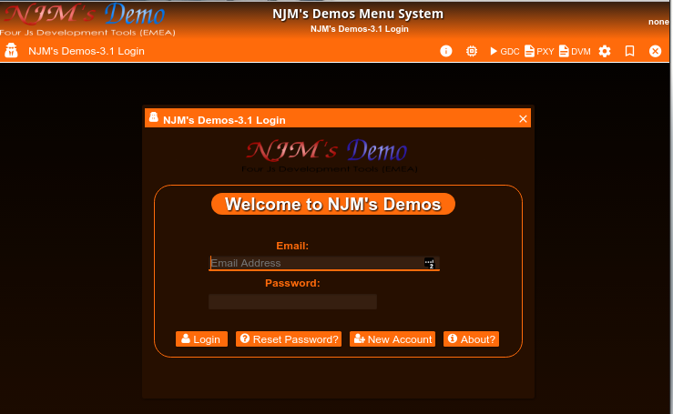
More Customizations
Multiple Themes: Elite
Only the ‘theme’ file is different from the previous slide.

Slide 28
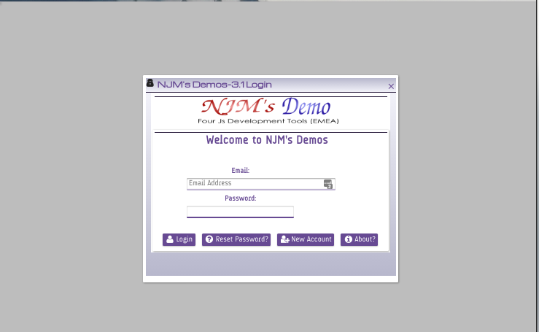
More Customizations
Multiple Themes: Simply Purple
A very simple plain version.

Slide 29
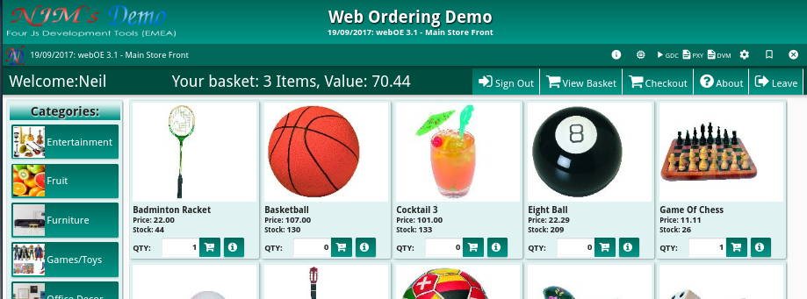
More Advanced Customizations
Custom Toolbar
This screenshot shows a custom ‘ToolBar’ that included a some fields from the form.

Slide 30
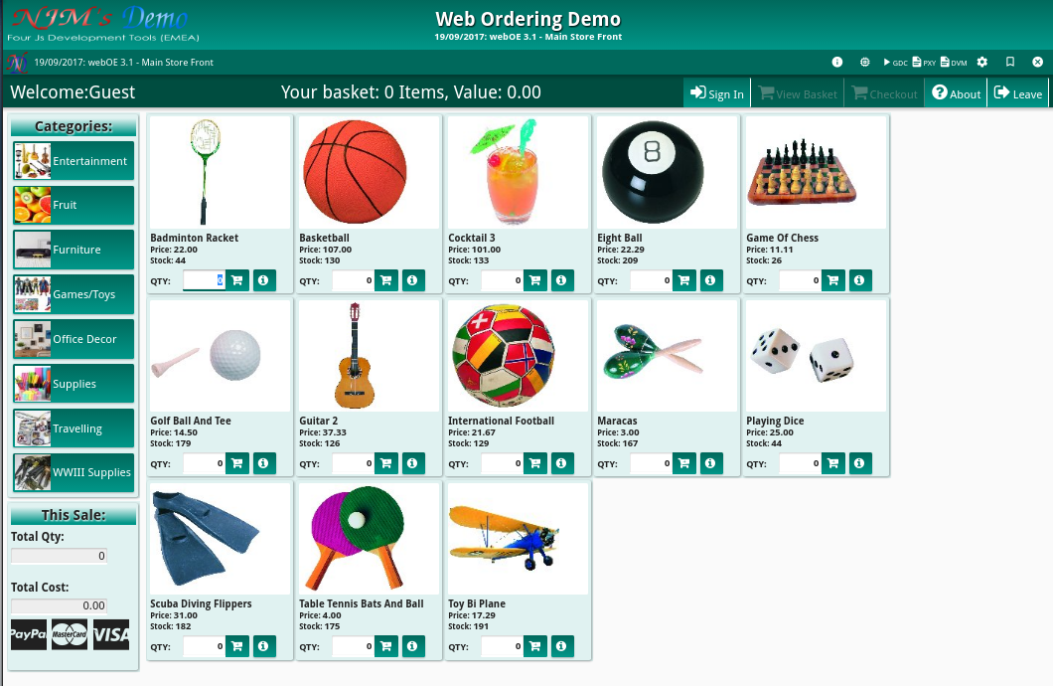
More Advanced Customizations
Paging products
There are couple ways to do a responsive design for listing ‘items’, this example is using JavaScript and a dynamc form layout.

Slide 31
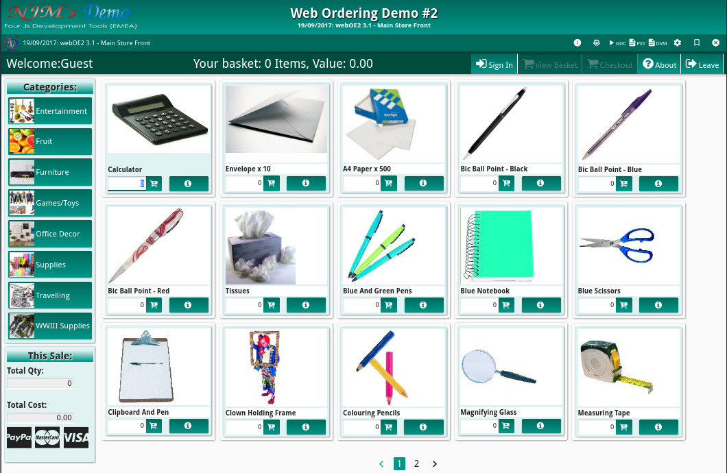
More Advanced Customizations
Paging products
This version is using a ‘simple’ ScrollGrid

