Slide 1
Fractional Brownian Motions in Financial Models and Their Monte Carlo Simulation
Kijima & Tam (2013)
Neil Mascarenhas

Slide 2
Outline
Motivating Fractional Brownian Motion
Methods of Simulating
Finance example

Slide 3
Why Fractional Brownian Motion?

Slide 4
The Problem: Traditional stochastic volatility models can’t capture volatility persistence
Implied volatility smile decays too quickly (geometric decay)
Market data shows much slower decay (hyperbolic) - called long-range dependence
Need a process that retains Gaussian structure but exhibits memory

Slide 5
The Solution: Use Fractional Brownian Motion (fBM) with Hurst exponent $H$
Extends ordinary Brownian motion to capture long memory
When $H>0.5$: persistent (trending) behavior
When $H<0.5$: mean-reverting behavior (anti-persistent, “rougher” than BM)

Slide 6
From Random Walks to Brownian Motion

Slide 7
Random Walk
Start with a simple symmetric random walk:
$S_{n}=\sum_{i=1}^{n}{X_{i}}, X_{i}∼\left\{\begin{matrix}1 & \frac{1}{2} \\ −1 & \frac{1}{2}\end{matrix}\right.$ $B\left(t\right)=\frac{1}{\sqrt{N}}S_{\left[Nt\right]}$
As $N→∞$, by Central Limit Theorem: $B\left(t\right)\overset{d}{→}\text{Standard Brownian Motion}$, i.e. Brownian motion is the scaling limit of a simple random walk.

Slide 8
$B\left(0\right)=0$
Increments are independent: $B\left(t\right)−B\left(s\right)⊥B\left(s\right)$ for $t>s$
Variance: $\text{Var}\left(B\left(t\right)\right)=t$
Self-similar: $B\left(λt\right)\overset{d}{→}\sqrt{λ}B\left(t\right)$

Slide 9
Correlated Random Walk
$$\begin{matrix}S_{n}^{H}=\sum_{i=1}^{n}{X_{i}^{H}}\end{matrix}$$
where $X_{i}^{H}$ are dependent, not independent
Autocorrelation structure:
$$\begin{matrix}γ_{H}\left(k\right)=E\left[X_{1}^{H}⋅X_{1+k}^{H}\right]=\frac{1}{2}\left[{\left(k+1\right)}^{2H}+{\left(k−1\right)}^{2H}−2k^{2H}\right] \\ B^{H}\left(t\right)=\frac{1}{N^{H}}S_{\left[Nt\right]}^{H}\end{matrix}$$

Slide 10
As $N→∞$: $B^{H}\left(t\right)\overset{d}{→}\text{Fractional Brownian Motion with Hurst exponent }H$
Key difference: - $H=0.5$: Standard BM (no correlation) - $H>0.5$: Persistent - positive correlation in increments - $H<0.5$: Mean-reverting - negative correlation in increments

Slide 11
Definition: Fractional Brownian Motion

Slide 12
A Fractional Brownian Motion $B_{H}\left(t\right)$ with Hurst exponent $H∈\left(0,1\right)$ is a continuous, centered Gaussian process with covariance:
$$\begin{matrix}E\left[B_{H}\left(t\right)B_{H}\left(s\right)\right]=\frac{1}{2}\left(t^{2H}+s^{2H}−{\left|t−s\right|}^{2H}\right)\end{matrix}$$
Covariance of increments:
$$\begin{matrix}\text{Cov}\left(X_{i},X_{j}\right)=γ_{H}\left(\left|i−j\right|\right)∼H\left(2H−1\right){\left|i−j\right|}^{2H−2}\text{ as }\left|i−j\right|→∞\end{matrix}$$

Slide 13
Key Properties:
Self-similarity: $B_{H}\left(λt\right)\overset{d}{→}λ^{H}B_{H}\left(t\right)$
Stationary increments: $B_{H}\left(t+s\right)−B_{H}\left(s\right)\overset{d}{→}B_{H}\left(t\right)$
Gaussian structure: Maintains tractability
Variance scaling: $\text{Var}\left(B_{H}\left(t\right)\right)=t^{2H}$
Long-range dependence (only when $H>0.5$)

Slide 14

Blackout - Dan Holdsworth (2010)

Slide 15
Challenges in Analytical Pricing

Slide 16
Why fBM is challenging in finance:
Not a semimartingale unless $H=0.5$
  No standard Itô calculus
  Need Malliavin methods or simulation
Model validation via Monte Carlo
  Estimate $H$, calibrate, test pricing
Need to simulate paths for:
  Risk, volatility, estimation

Slide 17
Simulating fBM for $H>0.5$ (persistent/long-memory case)

Slide 18
Method 1: Hosking Algorithm

Slide 19
Idea: Sequentially sample $Z_{n+1}$ given $Z_{0:n}$. Build fBM by summation.

Slide 20
Hosking Algorithm: Covariance and Conditioning
Autocovariance $γ\left(k\right)$, Toeplitz block:
$$\begin{matrix}Γ^{\left(n\right)}=\{γ\left(i−j\right)\}_{i,j=0}^{n}, Γ^{\left(n+1\right)}=\left(\begin{matrix}1 & c^{\left(n\right)​⊤} \\ c^{\left(n\right)} & Γ^{\left(n\right)}\end{matrix}\right), c_{k}^{\left(n\right)}=γ\left(k+1\right).\end{matrix}$$
Conditional Gaussian:
$$\begin{matrix}μ_{n+1}=E\left[Z_{n+1}​∣​Z_{0:n}\right]=c^{\left(n\right)​⊤}{\left(Γ^{\left(n\right)}\right)}^{−1}Z_{0:n}, \\ σ_{n+1}^{2}=Var\left(Z_{n+1}​∣​Z_{0:n}\right)=1−c^{\left(n\right)​⊤}{\left(Γ^{\left(n\right)}\right)}^{−1}c^{\left(n\right)}.\end{matrix}$$

Slide 21
Hosking/Dieker Recursions (Formulas)
Dieker/Hosking recursions:
$$\begin{matrix}d^{\left(n\right)}={\left(Γ^{\left(n\right)}\right)}^{−1}c^{\left(n\right)} \\ Γ^{{\left(n+1\right)}^{−1}}=\frac{1}{σ_{n}^{2}}\left(\begin{matrix}σ_{n}^{2}Γ^{{\left(n\right)}^{−1}}+F^{\left(n\right)}d^{\left(n\right)}d^{\left(n\right)​⊤}F^{\left(n\right)} & −F^{\left(n\right)}d^{\left(n\right)} \\ −d^{\left(n\right)​⊤}F^{\left(n\right)} & 1\end{matrix}\right)\end{matrix}$$

Slide 22
Hosking/Dieker Recursions (Updates)
With:
$$\begin{matrix}σ_{n+1}^{2}=σ_{n}^{2}−\frac{(γ\left(n+1\right)−τ_{n})^{2}}{σ_{n}^{2}}, \\ τ_{n}=d^{\left(n\right)​⊤}F^{\left(n\right)}c^{\left(n\right)}, ϕ_{n}=\frac{γ\left(n+2\right)−τ_{n}}{σ_{n}^{2}}, \\ d^{\left(n+1\right)}=\left(\begin{matrix}d^{\left(n\right)}−ϕ_{n}F^{\left(n\right)}d^{\left(n\right)} \\ ϕ_{n}\end{matrix}\right).\end{matrix}$$

Slide 23
Intuition and Cost
Intuition: Condition on the past. Update inverse covariance cheaply instead of full inversion.
Cost: $O\left(N^{2}\right)$ time.

Slide 24
Algorithm
Input: Desired sample size $N$, Hurst exponent $H$
Setup:
Compute autocovariance: $γ\left(k\right)=\frac{1}{2}\left[{\left(k+1\right)}^{2H}+{\left(k−1\right)}^{2H}−2k^{2H}\right]$
Build covariance matrix: $Γ^{\left(n\right)}=\{γ\left(\left|i−j\right|\right)\}_{i,j=0}^{n}$

Slide 25
Recursion (for $n=0,1,…,N−1$):
Compute conditional mean: $μ_{n+1}=c^{\left(n\right)′}{\left(Γ^{\left(n\right)}\right)}^{−1}Z_{1:n}$
Compute conditional variance: $σ_{n+1}^{2}=1−c^{\left(n\right)′}{\left(Γ^{\left(n\right)}\right)}^{−1}c^{\left(n\right)}$
Sample: $Z_{n+1}∼N\left(μ_{n+1},σ_{n+1}^{2}\right)$
Accumulate: $B_{H}\left(n+1\right)=\sum_{i=1}^{n+1}{Z_{i}}$

Slide 26
Exact method: captures complete covariance structure
Works for any covariance structure (not just fBM)
Key Flaw: Computational Complexity
Time complexity: $O\left(N^{2}\right)$
  Must invert $N×N$ matrix at each step
  Becomes prohibitive for large $N$ (e.g., $N>10,000$)

Slide 27
Optimization (Dieker, 2002):
Recursively compute inverse without full recalculation: improves constant factor but still $O\left(N^{2}\right)$
Conclusion: Best for small to moderate sample sizes ($N<5000$)

Slide 28
Method 2: Cholesky Decomposition
Overview
Idea: Use matrix decomposition $Γ=LL′$ where $L$ is lower triangular
Sample generation: $Z=LV$ where $V∼N\left(0,I\right)$
Covariance structure preserved: $\text{Cov}\left(Z\right)=LL′=Γ$

Slide 29
Algorithm
Input: Desired sample size $N$, Hurst exponent $H$
Setup: - Build covariance matrix: $Γ^{\left(N\right)}$ with entries $Γ_{i,j}=γ\left(\left|i−j\right|\right)$
Decomposition:
Compute Cholesky decomposition: $Γ^{\left(N\right)}=LL′$
Generate $V∼N\left(0,I_{N}\right)$ (i.i.d. standard normals)
Multiply: $Z=LV$
Accumulate: $B_{H}\left(t\right)=\sum_{i=1}^{t}{Z_{i}}$

Slide 30
Entry formulas for $L$:
$$\begin{matrix}L_{i,i}^{2}=γ\left(0\right)−\sum_{k=0}^{i−1}{L_{i,k}^{2}}\end{matrix}$$
$$\begin{matrix}L_{i,j}=\frac{1}{L_{j,j}}\left(γ\left(i−j\right)−\sum_{k=0}^{j−1}{L_{i,k}}L_{j,k}\right)\end{matrix}$$

Slide 31
Exact method: complete covariance structure
Easy to understand and implement
Time complexity: $O\left(N^{3}\right)$
  Cholesky decomposition itself is $O\left(N^{3}\right)$ (Much worse than Hosking!)

Slide 32
FFT Method Algorithm (Davies-Harte Method)

Slide 33
Any circulant matrix can be decomposed as:
$$\begin{matrix}C=QAQ^{T}\end{matrix}$$
where the Fourier matrix $Q$ has entries:
$$\begin{matrix}{\left(Q\right)}_{j,k}=\frac{1}{\sqrt{2N}}exp\left(2πi\frac{jk}{2N}\right) \text{for }j,k=0,…,2N−1\end{matrix}$$
The matrix $Λ$ is the diagonal matrix with eigenvalues:
$$\begin{matrix}λ_{k}=\sum_{j=0}^{2N−1}{c_{0,j}}exp\left(2πi\frac{jk}{2N}\right) \text{for }j,k=0,…,2N−1\end{matrix}$$

Slide 34
Algorithm: The simulation of the sample path of fGn using the FFT method consists of the following steps:
Compute eigenvalues $\{λ_{k}\}_{k=0,…,2N−1}$ from the circulant covariance matrix by means of FFT. This will reduce the computational time from $O\left(N^{3}\right)$ to $O\left(NlogN\right)$.
Calculate $Q=Q^{T}$ (or $Q=\sqrt{Λ}$ where $Λ$ is diagonal with eigenvalues)
Generate two standard normal random variables: $W_{0}=V_{0}^{\left(1\right)}$ and $W_{N}=V_{N}^{\left(1\right)}$

Slide 35
For $1≤j<N$, generate two standard normal random variables $V_{j}^{\left(1\right)}$ and $V_{j}^{\left(2\right)}$ and let $W_{j}=\frac{1}{\sqrt{2}}\left(V_{j}^{\left(1\right)}+iV_{j}^{\left(2\right)}\right)$ and $W_{2N−j}=\frac{1}{\sqrt{2}}\left(V_{j}^{\left(1\right)}−iV_{j}^{\left(2\right)}\right)$
Compute $Z=QA^{1/2}W$. This can be seen as another Fourier transform of the vector $A^{1/2}W$ such that $Z_{j}=\frac{1}{\sqrt{2N}}\sum_{k=0}^{2N−1}{\sqrt{λ_{k}}}W_{k}exp\left(−2πi\frac{jk}{2N}\right)$

Slide 36
It is identical to carry out FFT on the sequence on the next slide (too big to fit on this slide)

Slide 37
$$w_{j}=\left\{\begin{matrix}\sqrt{λ_{0}} V_{0} & j=0 \\ \frac{1}{\sqrt{2}}\sqrt{λ_{j}} \left(V_{j}^{\left(1\right)}+iV_{j}^{\left(2\right)}\right) & 1≤j<N \\ \sqrt{λ_{N}} V_{N} & j=N \\ \frac{1}{\sqrt{2}}\sqrt{λ_{2N−j}} \left(V_{2N−j}^{\left(1\right)}−iV_{2N−j}^{\left(2\right)}\right) & N<j<2N\end{matrix}\right.$$

Slide 38
Due to the symmetric nature of the sequence, the Fourier sum of $\{w_{j}\}_{j=0}^{2N−1}$ is real. The first $N$ samples have the desired covariance structure. Since the second half of samples $\left(N,…,2N−1\right)$ are not independent of the first $N$ samples, this sample cannot be used.
$$\begin{matrix}B_{H}\left(t\right)=\sum_{i=1}^{t}{Z_{i}}\end{matrix}$$

Slide 39
Exploits circulant structure via FFT (divide-and-conquer)
Diagonal matrix multiplication is $O\left(M\right)$
FFT itself is $O\left(MlogM\right)$
Embedding creates artificial circulant structure
  Original covariance not perfectly preserved at boundaries
  Must check all eigenvalues ${\hat{Λ}}_{k}>0$ for stability

Slide 40
Fix: Increase $M$ (use larger $M=4N$ or more) to fix negative eigenvalues
  Increases memory and computation
Advantages over Hosking & Cholesky:
Time: $O\left(NlogN\right)$ instead of $O\left(N^{2}\right)$ or $O\left(N^{3}\right)$
Fast for large $N$ (practical for $N>10,000$)
Conclusion: Trade-off: slight covariance distortion, but gain massive speed

Slide 41
Approximate Methods

Slide 42
Method 4: Correlated Random Walk

Slide 43
Recall: fBM is limit of scaled correlated random walk:
$$\begin{matrix}B^{H}\left(t\right)=N^{−H}\sum_{i=1}^{\left[Nt\right]}{ϵ_{i}^{H}}\end{matrix}$$
Idea: Use finite aggregation with controlled error
Generate correlated increments directly using central limit theorem

Slide 44
Algorithm
Input: Sample size $N$, Hurst exponent $H$, error tolerance $ϵ_{tol}$
Determine aggregation level
Compute $M\left(N\right)$ from error bound: $ϵ≤0.65D_{H}N^{1−H}/kM$
Choose $k≤1$ and solve for $M$
Generate $M$ correlated sequences For each trajectory $j=1,…,M$:
Sample $U_{k}∼\text{Uniform}\left(0,1\right)$ (i.i.d.)
Compute weight: $μ_{k}^{\left(H\right)}={\left(1−U_{k}\right)}^{1/\left(2−2H\right)}$

Slide 45
Build correlated random walk For each time $t_{i}$:
Generate correlated sequence: $ϵ_{i}={\left(−1\right)}^{\text{Bernoulli}}×μ_{i}$
Accumulate: $X_{t}=\sum_{i=1}^{t}{ϵ_{i}}$
Scale and accumulate
$$\begin{matrix}B_{H}\left(t\right)≈c_{H}′\frac{\sum_{j=1}^{M}{X_{j}^{\left(μ_{j}\right)}}}{M}\end{matrix}$$

Slide 46
Explicit error bound from Berry-Esseen inequality: for sum of i.i.d. variables $S_{n}$,
$$\begin{matrix}\sup_{x}\left|P\left(\frac{S_{n}−ES_{n}}{\sqrt{Var S_{n}}}≤x\right)−Φ\left(x\right)\right|≤\frac{C⋅E{\left|X_{i}\right|}^{3}}{{\left(Var X_{i}\right)}^{3/2}\sqrt{n}}\end{matrix}$$
where $C$ is a constant ($≤0.4748$), and $Φ\left(x\right)$ is the standard normal cdf.
Simple to implement: no matrix operations needed
Covariance not fully captured at each level

Slide 47
Slow for large $N$
Requires choosing parameters $\left(M,k\right)$ based on tolerance
Best for: Theoretical understanding, small-to-moderate $N$, when error control matters

Slide 48
Method 5: Random Midpoint Displacement (RMD)

Slide 49
Hybrid approach: Exact locally, but with bounded conditioning
Idea: Instead of conditioning on all past values, condition on only $m$ left + $n$ right neighbors
Intuition: Far-away values have little influence, exploit locality

Slide 50
Algorithm - Basic RMD(m,n)
Input: Sample size $N$, Hurst exponent $H$, parameters $m,n$ (neighborhood sizes)
Bisection scheme (recursive):
Start with $Z\left(0\right)=0,Z\left(1\right)∼N\left(0,1\right)$
At level $i$, compute midpoints in $2^{i}$ intervals

Slide 51
For position $X_{i,2k+1}$ (odd-indexed in interval $2k$):
$$\begin{matrix}X_{i,2k+1}=μ\left(i,k\right)+σ\left(i,k\right)U_{i,k}\end{matrix}$$
where:
$μ\left(i,k\right)$ = conditional mean on neighboring values
$σ^{2}\left(i,k\right)$ = conditional variance
Neighbors: max($2k−m+1,1$) to $2k$ (left) and $k+1$ to min($k+n,2^{i−1}$) (right)

Slide 52
Matrix inversion for conditional distribution:
$$\begin{matrix}μ\left(i,k\right)=Γ_{12}Γ_{22}^{−1}X_{\text{neighbors}} \\ σ^{2}\left(i,k\right)=Γ_{11}−Γ_{12}Γ_{22}^{−1}Γ_{21}\end{matrix}$$

Slide 53
$O\left(m+n\right)$ matrix inversion per step, not $O\left(N\right)$
Can generate indefinitely without fixed horizon
Truncates far dependencies
  When $m,n$ are small: ignores some correlations
  Need to tune $\left(m,n\right)$ based on $H$
  Loss of long-range dependence near boundaries

Slide 54
On-the-fly version adds complexity
  Algorithm has to manage “enlargement” (doubling time horizon)
  Order of generation matters (bisection vs on-the-fly)
  Harder to implement than FFT
Streaming: Generate one path point at a time (on-the-fly variant)
Accuracy: Near-exact when $m,n$ are large enough
Adaptive: Can adjust parameters based on tolerance

Slide 55
Best for: Streaming applications, when horizon is unknown
Comparison: On-the-fly RMD vs FFT offer similar speed ($O\left(N\right)$ vs $O\left(NlogN\right)$), but RMD more flexible

Slide 56
Method 6: Spectral Method
Overview
Idea: Transform to frequency domain using spectral density of fGn
Spectral density of fractional Gaussian noise:
$$\begin{matrix}f\left(λ\right)=2sin\left(πH\right)Γ\left(2H+1\right)\left(1−cosλ\right){\left|λ\right|}^{−2H−1}+B\left(λ,H\right)\end{matrix}$$
where $B\left(λ,H\right)$ corrects for periodicity effects (complex expression)

Slide 57
Algorithm Outline
Input: Sample size $N$, Hurst exponent $H$
Approximate spectral density
Compute $f\left(λ_{k}\right)$ for frequencies $λ_{k}=πk/l$, $k=0,…,l$
Use Paxson’s robust approximation for $B\left(λ,H\right)$

Slide 58
Frequency-domain sampling Generate coefficients:
$$\begin{matrix}a_{k}=\left\{\begin{matrix}0 & k=0 \\ R_{k}\sqrt{f\left(t_{k}\right)}exp\left(iΦ_{k}\right) & k=1,…,N/2−1 \\ U_{N/2}\sqrt{f\left(t_{N/2}\right)} & k=N/2 \\ a_{k}^{*} & k=N/2+1,…,N−1\end{matrix}\right.\end{matrix}$$
where $R_{k}∼\text{Exp}\left(1\right)$, $Φ_{k}∼\text{Uniform}\left(0,2π\right)$ (independent)

Slide 59
3: Inverse FFT
$$\begin{matrix}Z=\text{IFFT}\left(a\right)\end{matrix}$$
$$\begin{matrix}B_{H}\left(t\right)=∑Z_{i}\end{matrix}$$

Slide 60
Spectral representation theorem: fGn can be reconstructed from spectral density
$O\left(NlogN\right)$
Approximates covariance structure well
Exact form of $B\left(λ,H\right)$ unknown
  Paxson’s approximation: empirical + calibrated
    For $\left|λ\right|>0$,
    $$\begin{matrix}B\left(λ,H\right)≈−2sin\left(πH\right)Γ\left(2H+1\right)\left(\frac{1−cosλ}{{\left|λ\right|}^{2H+1}}\right)\end{matrix}$$
    For computational purposes, set $f\left(λ\right)≈2sin\left(πH\right)Γ\left(2H+1\right)\left(1−cosλ\right){\left|λ\right|}^{−2H−1}$
  Depends on correct parameterization

Slide 61
Only one FFT needed (vs two for Davies-Harte)
  ~4x faster than Davies-Harte FFT
  But requires careful implementation
Empirically validated for wide range of $H$
Best for: Large-scale simulations where speed is critical

Slide 62
Comparison

Slide 63
Method | Type | Time | Accuracy | Flexibility | Best For
Hosking | Exact | O(N^2) | Exact | Fixed horizon | N < 5K, exact needed
Cholesky | Exact | O(N^3) | Exact | Fixed horizon | N < 1K, small samples
FFT (CEM) | Near-exact | O(N log N) | Near-exact | Fixed horizon | N > 5K, standard choice
Corr. RW | Approx | O(N^{2-2H}) | Controlled | On-the-fly | Theory, error control
RMD | Near-exact | O(N) | Bounded | Streaming | Unknown horizon
Spectral | Approx | O(N log N) | Good approx | Fixed horizon | Largest N, speed critical

Slide 64
Numerical Example: fBM Volatility Model

Slide 65
Motivation
fBM finds natural applications in stochastic volatility modeling, where long-memory properties capture realistic market behavior:
Traditional log-normal volatility models assume independence (Markovian)
Real volatility shows persistence: high volatility tends to remain high
fBM with $H>0.5$ captures trending, persistent volatility

Slide 66
Stochastic Volatility Model
Consider the truncated fractional Brownian volatility model:
$$\begin{matrix}\left\{\begin{matrix}σ\left(t\right)=σ_{0}e^{v\left(t\right)} \\ dx\left(t\right)=−kx\left(t\right)dt+vdB_{H}^{\left(t\right)}\end{matrix}\right.\end{matrix}$$
where: - $v$ is the volatility factor of the log-volatility process $v\left(t\right)$
$v\left(t\right)$ is an OU-process driven by truncated fBM
$x\left(0\right)=0$, $k>0$, $\frac{1}{2}<H<1$

Slide 67
Solving the OU-process with integrating factor:
$$\begin{matrix}x\left(t\right)=k\int_{0}^{t}{e^{−k\left(t−s\right)}}dB_{H}^{\left(s\right)}\end{matrix}$$

Slide 68
Continuous Formulation
By applying fractional calculus (formulas from [5]), we reformulate as:
$$\begin{matrix}x\left(t\right)=\int_{0}^{t}{a}\left(t−s\right)dB\left(s\right)\end{matrix}$$
where $B\left(t\right)$ is standard Brownian motion and $a\left(t\right)=\frac{v}{t\left(H+\frac{1}{2}\right)}\int_{0}^{t}{e^{−k\left(t−u\right)}}u^{H−1/2}du=\frac{v}{t\left(H+\frac{1}{2}\right)}\left(t^{α}−ke^{ktu^{α}}\int_{0}^{t}{e^{ku}}u^{α}du\right)$

Slide 69
Discretization
Applying ordinary discretization scheme to equation (54):
$$\begin{matrix}\tilde{x}\left(t_{i}\right)=\sum_{j=1}^{i−1}{a}\left(t_{i}−\frac{j−1}{2}\right)\left(B\left(t_{j}\right)−B\left(t_{j−1}\right)\right)\end{matrix}$$

Slide 70
The coefficient $a\left(⋅\right)$ can be calculated by symbolic packages (MATLAB, Mathematica) as:
A summation involving constant times incomplete gamma function
For OU-process, decomposition via incomplete gamma function
Numerically stable computation possible

Slide 71
Volatility Process Comparison

Slide 72
Sample volatility process $σ\left(t\right)=σ_{0}e^{v\left(t\right)}$ for: $k=1$, $σ_{0}=0.1$, $v=0.3$, $H=0.75$, $T=2$
Figure 2 (OU-based): Fractional-OU driven volatility (red) vs Standard BM (blue)
- More persistent trends (smoother, less mean-reversion)
Figure 3 (FFT-based): Same comparison with improved numerical robustness
- Covariance structure better preserved over entire path

Slide 73
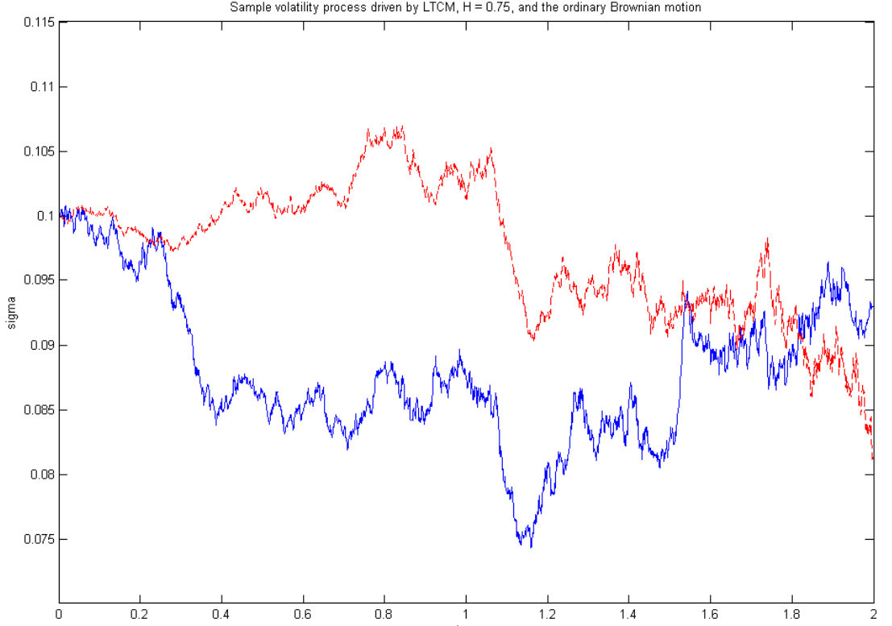
Figure 2

Slide 74
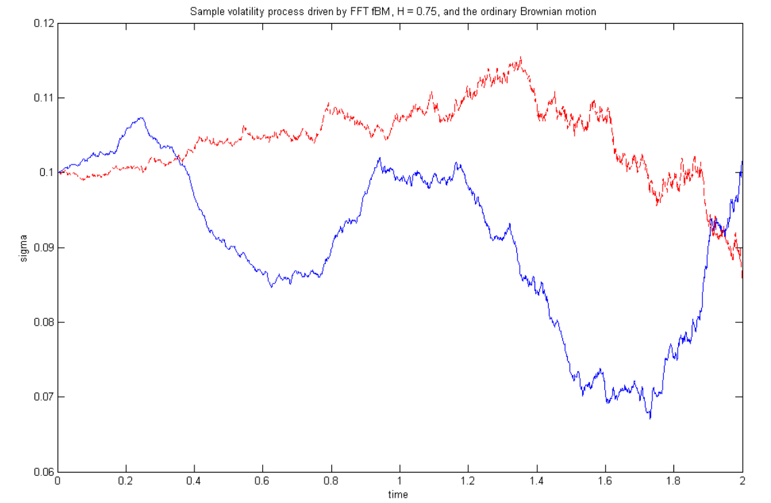
Figure 3

Slide 75
Key Findings
fBM-driven volatility ($H=0.75$) shows significantly more trending behavior than ordinary OU volatility.
Long-memory volatility leads to heavier tails in returns
Traditional VaR models may underestimate risk
Clustering of volatility spikes becomes more pronounced
OU-formulation (Eq. 53-56) theoretically exact but requires special function computation

Slide 76
FFT method (Figure 3) computationally simpler and numerically more stable
Use FFT or Spectral methods for efficient fBM generation in volatility models
Validate against OU discretization on small subsets
Account for long-range dependencies in risk management

Slide 77
References
Primary Reference
Kijima, M. and Tam, C.M. (2013). “Fractional Brownian Motions in Financial Models and Their Monte Carlo Simulation.” In: Theory and Applications of Monte Carlo Simulations. InTech. http://dx.doi.org/10.5772/53568

Slide 78
Full References
[1] Kolmogorov, A.N. (1940). “Wienersche Spiralen und einige andere interessante Kurven im Hilbertschen Raum.” C.R. (Doklady) Acad. URSS (N.S), 26, 115-118.
[2] Mandelbrot, B.B. and Van Ness, J.W. (1968). “Fractional Brownian Motions, Fractional Noises and Applications.” SIAM Review, 10, 422–437.
[3] Mandelbrot, B.B. (1965). “Une classe de processus homothgtiques a soi; Application a la loi climatologique de H. E. Hurst.” C.R. Acad. Sci. Paris, 260, 3274-3277.

Slide 79
[4] Lo, A.W. (1991). “Long-Term Memory in Stock Market Price.” Econometrica, 59, 1279-1313.
[5] Comte, F. and Renault, E. (1996). “Long Memory Continuous Time Models.” J. Econometrics, 73, 101-149.
[6] Comte, F. and Renault, E. (1998). “Long Memory in Continuous-Time Stochastic Volatility Models.” Mathematical Finance, 8, 291-323.

Slide 80
[7] Hull, J. and White, A. (1987). “The Pricing of Options on Assets with Stochastic Volatilities.” Rev. Finan. Studies, 3, 281-300.
[8] Scott, L. (1987). “Option Pricing when the Variance Changes Randomly: Estimation and an Application.” J. Financial and Quant. Anal., 22, 419-438.
[9] Ding, Z., Granger, C.W.J. and Engle, R.F. (1993). “A Long Memory Property of Stock Market Returns and a New Model.” J. Empirical Finance, 1, 83-106.

Slide 81
[10] Crato, N. and de Lima, P. (1994). “Long-Range Dependence in the Conditional Variance of Stock Returns.” Economics Letters, 45, 281-285.
[11] Baillie, R.T., Bollerslev, T. and Mikkelsen, H.O. (1996). “Fractionally Integrated Generalized Autoregressive Conditional Heteroskedasticity.” J. Econometrics, 74, 3-30.
[12] Bollerslev, T. and Mikkelsen, H.O. (1996). “Modeling and Pricing Long Memory in Stock Market Volatility.” J. Econometrics, 73, 151-184.

Slide 82
[13] Jacquier, E., Polson, N.G. and Rossi, P.E. (1994). “Bayesian Analysis of Stochastic Volatility Models.” J. Bus. and Econ. Statistics, 12, 371-417.
[14] Breidt, F.J., Crato, N. and de Lima, P. (1998). “The Detection and Estimation of Long Memory in Stochastic Volatility.” J. Econometrics, 83, 325-348.
[15] Biagini, F., Hu, Y., Øksendal, B. and Zhang T. (2008). Stochastic Calculus for Fractional Brownian Motion and Applications. Springer.

Slide 83
[16] Cont, R. (2007). “Volatility Clustering in Financial Markets: Empirical Facts and Agent-Based Models.” In: Kirman, A. and Teyssiere, G. (ed.), Long Memory in Economics. Springer, 289-310.
[17] Marinucci, D. and Robinson, P.M. (1999). “Alternative Forms of Fractional Brownian Motion.” J. Statistical Planning and Inference, 80, 111-122.
[18] Delbaen, F. and Schachermayer, W. (1994). “A General Version of the Fundamental Theorem of Asset Pricing.” Math. Ann., 300, 463-520.

Slide 84
[19] Rogers, L.C.G. (1997). “Arbitrage with Fractional Brownian Motion.” Mathematical Finance, 7, 95-105.
[20] Cheridito, P. (2003). “Arbitrage in Fractional Brownian Motion Models.” Finance and Stochastics, 7, 533-553.
[21] Comte, F., Coutin, L. and Renault, E. (2012). “Affine Fractional Stochastic Volatility Models.” Annals of Finance, 8, 337-378.

Slide 85
[22] Duffie, D., Pan, R. and Singleton, K. (2000). “Transform Analysis and Asset Pricing for Affine Jump-Diffusion.” Econometrica, 68, 1343-1376.
[23] Fukasawa, M. (2011). “Asymptotic Analysis for Stochastic Volatility: Martingale Expansion.” Finance and Stochastics, 15, 635-654.
[24] Yoshida, N. (2001). “Malliavin Calculus and Martingale Expansion.” Bull. Sci. Math., 125, 431-456.

Slide 86
[25] Dieker, T. (2002). Simulation of Fractional Brownian Motion. Master Thesis, Vrije Universiteit, Amsterdam.
[26] Hosking, J.R.M. (1984). “Modeling Persistence in Hydrological Time Series Using Fractional Differencing.” Water Resources Research, 20, 1898-1908.
[27] Brockwell, P.J. and Davis, R.A. (1987). Time Series: Theory and Methods. Springer, New York.

Slide 87
[28] Davies, R.B. and Harte, D.S. (1987). “Tests for Hurst Effect.” Biometrika, 74, 95-102.
[29] Dietrich, C.R. and Newsam, G.N. (1997). “Fast and Exact Simulation of Stationary Gaussian Processes through Circulant Embedding of the Covariance Matrix.” SIAM J. Sci. Computing, 18, 1088-1107.
[30] Perrin, E., Harba, R., Jennane, R. and Iribarren, I. (2002). “Fast and Exact Synthesis for 1-D Fractional Brownian Motion and Fractional Gaussian Noises.” IEEE Signal Processing Letters, 9, 382-384.

Slide 88
[31] Wood, A.T.A. and Chan, G. (1994). “Simulation of Stationary Gaussian Processes in [0,1]^d.” J. Computational and Graphical Statistics, 3, 409-432.
[32] Enriquez, N. (2004). “A Simple Construction of the Fractional Brownian Motion.” Stochastic Processes and Their Applications, 109, 203-223.
[33] Taqqu, M. (1975). “Weak Convergence to Fractional Brownian Motion and to the Rosenblatt Process.” Z. Wahr. Verw. Gebiete, 31, 287-302.

Slide 89
[34] Norros, I., Mannersalo, P. and Wang, J.L. (1999). “Simulation of Fractional Brownian Motion with Conditionalized Random Midpoint Displacement.” Advances in Performance Analysis, 2, 77-101.
[35] Paxson, V. (1997). “Fast, Approximate Synthesis of Fractional Gaussian Noise for Generating Self-Similar Network Traffic.” Computer Communication Review, 27, 5-18.
[36] Bender, C. (2003). “An S-Transform approach to integration with respect to a Fractional Brownian Motion.” Bernoulli, 9, 955-983.

