Slide 1




Using Quantitative Methodologies to Study Women’s Empowerment
Women’s Empowerment in Development (WED) Lab
Seminar Series

Slide 2



Panelists
Franque Grimard,
McGill University (Facilitator)
Carl Asuncion,
MEDA
Bouba Housseini,
IDRC

Slide 3

Seminar/Webinar Format
Opening presentation by facilitator
Audience Q&A
Break
Expert panel discussion
Audience Q&A
Participants on Zoom can email questions to: kathleen.grantham@mcgill.ca

Slide 4

Dr. Franque Grimard (Facilitator)
Associate Professor, Department of Economics,
McGill University

Slide 5
Using Quantitative Methodologies to Study Women’s Empowerment
Franque Grimard
McGill University

Slide 6
Today’s Presentation
Why measure quantitatively, Why and when use IE ?
Impact Evaluation Principles: Counterfactual
Examples from Progresa
Randomization: RCTs
Discussion
Appendices
Other techniques: RDD, DiD, PSM
Examples
Web links

Slide 7
Principles for Measuring the impact of Programs
This material is based on a recent book on Impact Evaluation:
Gertler, P. J.; Martinez, S., Premand, P., Rawlings, L. B. and Christel M. J. Vermeersch, 2016, Impact Evaluation in Practice: 2nd Edition, The World Bank, Washington DC (www.worldbank.org/ieinpractice).

Slide 8
Monitoring
A continuous process of collecting and analyzing information,
to compare how well a project, program or policy is performing against expected results, and
to inform implementation and program management.

Slide 9
Evaluation
A systematic, objective assessment of an on-going or completed project, program, or policy, its design, implementation and/or results,
to determine the relevance and fulfillment of objectives, development efficiency, effectiveness, impact and sustainability, and
to generate lessons learned to inform the decision making process,
tailored to key questions.

Slide 10
Impact Evaluation
An assessment of the causal effect of a project , program or policy on beneficiaries. Uses a counterfactual…
to estimate what the state of the beneficiaries would have been in the absence of the program (the control or comparison group), compared to the observed state of beneficiaries (the treatment group), and
to determine intermediate or final outcomes attributable to the intervention .

Slide 11
When to use Impact Evaluation?
Evaluate impact when project is:
Innovative
Replicable/scalable
Strategically relevant for reducing poverty
Evaluation will fill knowledge gap
Substantial policy impact
Use impact evaluation within a program to test alternatives and improve programs

Slide 12
MEASURING IMPACT Impact Evaluation Principles for Researchers, Decision and Policy Makers

Slide 13
Our Objective
Estimate the causal effect (impact) of intervention (P) on outcome (Y).
(P) = Program or Treatment
(Y) = Indicator, Measure of Success
Example: What is the effect of a Cash Transfer Program (P) on Household Consumption (Y)?

Slide 14
Causal Inference
What is the impact of (P) on (Y)?
α = (Y | P=1) - (Y | P=0)
Can we all go home?

Slide 15
Problem of Missing Data
α= (Y | P=1) - (Y | P=0)
For a program beneficiary:
we observe
(Y | P=1): Household Consumption (Y) with a cash transfer program (P=1)
but we do not observe
(Y | P=0): Household Consumption (Y) without a cash transfer program (P=0)

Slide 16

Solution ?
Estimate what would have happened to Y in the absence of P.
Counterfactual.
We call this the
The key to a good impact evaluation is
a valid counterfactual!

Slide 17
Estimating impact of P on Y
α= (Y | P=1) - (Y | P=0)
OBSERVE (Y | P=1)
Outcome with treatment
ESTIMATE (Y | P=0)
The Counterfactual
IMPACT = - counterfactual
Outcome with treatment
Intention to Treat (ITT) –Those to whom we wanted to give treatment
Treatment on the Treated (TOT) – Those actually receiving treatment
Use comparison or control group

Slide 18



Example: What is the Impact of…
Giving Maria
additional pocket money
(P)
On Maria’s consumption of candies
(Y)?

Slide 19


The Perfect Clone
Maria
Maria’s Clone
X
6 candies
4 candies
IMPACT=6-4=2 Candies

Slide 20



In reality, use statistics
Treatment
Comparison
X
Average Y=6 candies
Average Y=4 Candies
IMPACT=6-4=2 Candies

Slide 21
Finding good comparison groups
We want to find clones for the Marias in our programs.
The treatment and comparison groups should
have identical characteristics
except for benefiting from the intervention.
With a good comparison group, the only reason for different outcomes between treatments and comparisons is the intervention (P)
In practice, use program eligibility & assignment rules to construct valid counterfactuals
Notes:
For presentation (with animation effects)

Slide 22
Finding good Comparison Groups:
Impact Evaluation Methods Toolbox
Randomization: Assignment or Offering/Promotion
Discontinuity Design
Difference-in-Differences
Matching

Slide 23
Case Study: Progresa
National anti-poverty program in Mexico
Started 1997
5 million beneficiaries by 2004
Eligibility – based on poverty index
Cash Transfers
Conditional on school and health care attendance.

Slide 24
Case Study: Progresa
Rigorous impact evaluation with rich data
506 communities, 24,000 households
Baseline 1997, follow-up 1998
Many outcomes of interest
Here: Consumption per capita
What is the effect of Progresa (P) on Consumption Per Capita (Y)?
If impact is an increase of $20 or more,
then scale up nationally

Slide 25
Case Study: Progresa
How do we find counterfactuals?
1. False counterfactual #1
Before and after
2. False counterfactual #2
Looking at enrollment/eligibility:
enrolled vs non-enrolled

Slide 26
Eligibility and Enrollment
Ineligibles
(Non-Poor)
Eligibles
(Poor)
Not Enrolled
Enrolled
Notes:
For presentation (with animation effects)

Slide 27


False Counterfactual #1
Before & After
Y
A
A-C = 2
C (counterfactual)
IMPACT?
A-B = 4
B
Time
T=0
Baseline
T=1
Endline

Slide 28
Case 1: Before & After
What is the effect of Progresa (P) on consumption (Y)?
(1) Observe only beneficiaries (P=1)
(2) Two observations in time:
Consumption at T=0
and consumption at T=1.
268
A
α = $35
233
B
Time
T=1997
T=1998
IMPACT=A-B= $35

Slide 29
Case 1: Before & After
Consumption (Y)
Outcome with Treatment (After) | 268.7
Counterfactual (Before) | 233.4
Impact (Y | P=1) - (Y | P=0) | 35.3***
Estimated Impact on Consumption (Y)
Linear Regression | 35.27**
Multivariate Linear Regression | 34.28**
:If the effect is statistically significant at the 1% significance level, we label the estimated impact with 2 stars (**).

Slide 30
Case 1: What’s the problem?
Economic Boom:
Real Impact=A-C
A-B is an overestimate
Y
268
A
Impact?
α = $35
Economic Recession:
Real Impact=A-D
A-B is an underestimate
C ?
B
Impact?
233
B
D ?
Time
T=1997
T=1998
Before & After doesn’t control for other time-varying factors!

Slide 31


False Counterfactual #2
Enrolled & Not Enrolled
If we have post-treatment data on
Enrolled: treatment group
Not-enrolled: “comparison” group (counterfactual)
Those ineligible to participate.
Those that choose NOT to participate.
Selection Bias
Reason for not enrolling may be correlated with outcome (Y)
Control for observables.
But not un-observables!
Estimated impact is confounded with other things.

Slide 32
Case 2: Enrolled & Not Enrolled
Consumption (Y)
Outcome with Treatment (Enrolled) | 268
Counterfactual (Not Enrolled) | 290
Impact (Y | P=1) - (Y | P=0) | -22**
Estimated Impact on Consumption (Y)
Linear Regression | -22**
Multivariate Linear Regression | -4.15
Note: If the effect is statistically significant at the 1% significance level, we label the estimated impact with 2 stars (**).

Slide 33
Progresa Policy Recommendation?
Impact on Consumption (Y)
Case 1: Before & After | Linear Regression | 35.27**
 | Multivariate Linear Regression | 34.28**
Case 2: Enrolled & Not Enrolled | Linear Regression | -22**
 | Multivariate Linear Regression | -4.15
Will you recommend scaling up Progresa?
B&A: Are there other time-varying factors that also influence consumption?
E&NE:
Are reasons for enrolling correlated with consumption?
Selection Bias.
If the effect is statistically significant at the 1% significance level, we label the estimated impact with 2 stars (**).

Slide 34
Keep in Mind !
B&A
E&NE
Compare: Same individuals Before and After they receive P.
Compare: Group of individuals Enrolled in a program with group that chooses not to enroll.
Problem: Other things may have happened over time.
Problem: Selection Bias. We don’t know why they are not enrolled.
Both counterfactuals may lead to biased estimates of the impact.

Slide 35





Randomized treatments and comparisons: another way to find a counterfactual
3. Randomize treatment
1. Population
2. Evaluation sample
X
Comparison
Treatment
= Ineligible
External Validity
Internal Validity
= Eligible
Notes:
For presentation (with animation effects)

Slide 36
Unit of Randomization
Choose according to type of program
Individual/Household
School/Health Clinic/catchment area
Block/Village/Community
Ward/District/Region
As a rule of thumb, randomize at the smallest viable unit of implementation.
Keep in mind
Need “sufficiently large” number of units to detect minimum desired impact: Power.
Spillovers/contamination
Operational and survey costs

Slide 37
Progresa: Case 3 :Randomized Assignment
Progresa CCT program
Unit of randomization: Community
506 communities in the evaluation sample
Randomized phase-in
320 treatment communities (14446 households):
First transfers in April 1998.
186 comparison communities (9630 households):
First transfers November 1999

Slide 38

Case 3: Randomized Assignment
T=0
T=1
320
Time
Treatment Communities
186
Comparison Communities
Comparison Period

Slide 39
Case 3: Randomized Assignment
 | Treatment Group (Randomized to treatment) | Counterfactual (Randomized to Comparison) | Impact (Y | P=1) - (Y | P=0)
Baseline (T=0) Consumption (Y) | 233.47 | 233.40 | 0.07
Follow-up (T=1) Consumption (Y) | 268.75 | 239.5 | 29.25**
Estimated Impact on Consumption (Y)
Linear Regression | 29.25**
Multivariate Linear Regression | 29.75**
: If the effect is statistically significant at the 1% significance level, we label the estimated impact with 2 stars (**).

Slide 40
Progresa Policy Recommendation?
Impact of Progresa on Consumption (Y)
Case 1: Before & After | Multivariate Linear Regression | 34.28**
Case 2: Enrolled & Not Enrolled | Linear Regression | -22**
 | Multivariate Linear Regression | -4.15
Case 3: Randomized Assignment | Multivariate Linear Regression | 29.75**
Note: If the effect is statistically significant at the 1% significance level, we label the estimated impact with 2 stars (**).

Slide 41
Keep in Mind
Randomized Assignment
In Randomized Assignment, large enough samples, produces 2 statistically equivalent groups.
Feasible for prospective evaluations with over-subscription/excess demand.
Most pilots and new programs fall into this category.
We have identified the perfect clone.
Randomized
beneficiary
Randomized
comparison

Slide 42
RCTs and Women Empowerment: Some Research funded by IDRC’s GrOW program
Kenya : Access to Daycare and women’s empowerment:
Tanzania: Cash Transfer and Women’s empowerment

Slide 43
But Life is not always a RCT…
Impact evaluation estimates whether there is an effect. Does not explain why there is (or not) an effect. (Glennerster et al. paper)
Ethical issues
Costs
There may be important policy changes that do not lend themselves to randomization
For instance, minimum wage policies, foreign aid, trade, etc
Other methods exist (see appendix 1 for more), but not without problems either.

Slide 44
Quasi-Experimental methods
Wijesiri, M. and F. Grimard 2019 Microfinance programs and women’s empowerment: new evidence from rural middle hills of Nepal, Forthcoming in Business and Development Studies: Issues and Perspectives
data collected from rural women in hill villages in Tanahun district located in the mid-hill region of Nepal from a survey done in collaboration with Nirdhan Utthan Bank Limited (NUBL).
We used the quasi-experimental pipeline design approach proposed by Coleman (1999) to select treatment and control groups

Slide 45
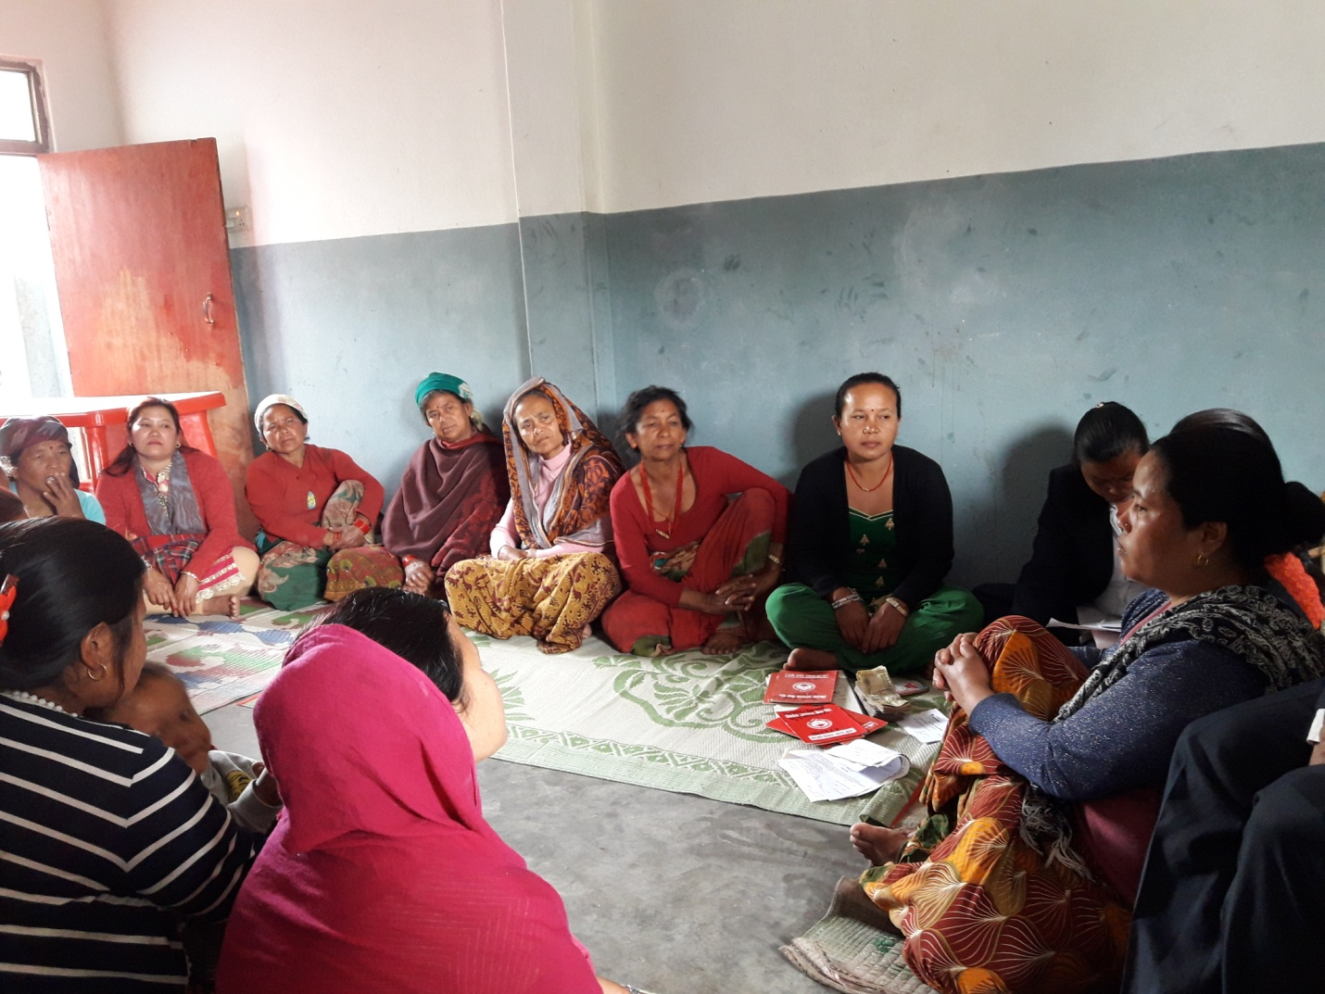
Wijesiri and Grimard (2019), Microfinance programs and women’s empowerment: new evidence from rural middle hills of Nepal,
Women attending a group meeting in Bhimad village, Dulegauda, Tanahun Dstrict, Nepal

Slide 46
Assessing the Impact of the Microfinance…
Our sample strategy consisted of two main steps.
First, we spoke with the NUBL. We obtained a list of treatment and control villages in Tanahun district from the bank.:
The control group consisted of randomly selected villages, pre-identified by the microfinance bank, which would soon receive microfinance support. Women in these villages had been allowed to self-select into the microfinance programs. These women had been organized into groups but no loans had yet been disbursed to them.
The treatment group, on the other hand, consisted of randomly selected villages where the bank has been in operation for at least a five-year period.

Slide 47
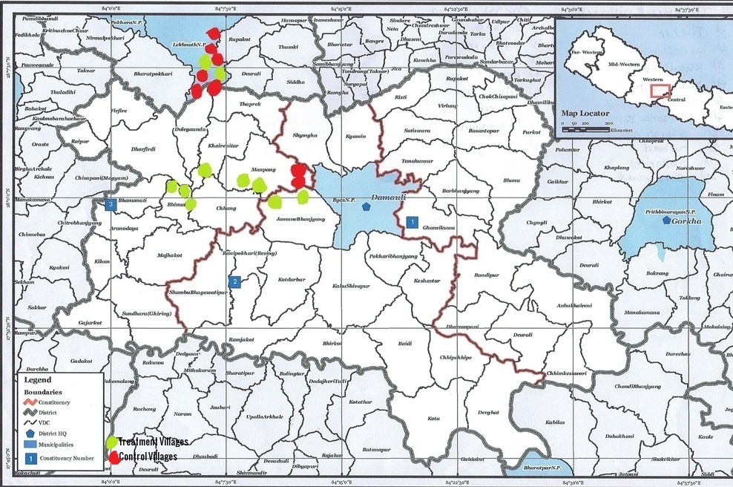

Slide 48
Assessing the Impact of the Microfinance…
In the second step, we randomly drew 10 treatment and 8 control villages from the list of villages provided by the bank.
Care was also taken that the control villages in our sample reflected comparable physical and socio-economic characteristics (availability of infrastructure facilities, level of economic developments, and social and cultural similarities) as the treatment villages. All study villages were approximately 1-2 hours’ walking distance from the closest paved road.
We then surveyed women in both treatment and control villages and we compared their outcomes regarding empowerment

Slide 49
Assessing the Impact of the Microfinance…
Our results show that women’s participation in Nirdhan Bank’s microfinance program has had had a significant positive effect on their financial empowerment with respect to financial indicators such as control of income, independent savings, asset purchases and applying for loans.
On the other hand, our results reveal that access to microfinance did not result in significant impact on in most women’s social empower ment outcomes (for instance women’s household decision-making regarding groceries, their children’s marriage, and women’s role as the household head).

Slide 50
Assessing the Impact of the Microfinance…
How valid are these results?
Internally valid?
Externally valid?
Reproducible?
Scalable?
Not expensive, limited study, but there are trade-offs

Slide 51
Quantitative Approaches used by Practitioners
Oxfam: Rapid Care Analysis, Household Care Survey
https://policy-practice.oxfam.org.uk/publications/rapid-care-analysis-training-modules-620449
Even Oxfam does some impact evaluation:
https://policy-practice.oxfam.org.uk/publications/livelihoods-in-south-sudan-impact-evaluation-of-the-south-sudan-peace-and-prosp-620864
CARE (Power Africa) https://www.carepowerafrica.com
60 million girls NGO

Slide 52
Choosing your IE method(s)
Key information you will need for identifying the right method for your program:
Prospective/Retrospective Evaluation?
Eligibility rules and criteria?
Poverty targeting?
Geographic targeting?
Roll-out plan (pipeline)?
Is the number of eligible units larger than available resources at a given point in time?
Budget and capacity constraints?
Excess demand for program?
Etc.

Slide 53
Choose the best possible design given the operational context:
Best Design
Best comparison group you can find + least operational risk
Have we controlled for everything?
Internal validity
Good comparison group
External validity
Local versus global treatment effect
Evaluation results apply to population we’re interested in
Is the result valid for everyone?

Slide 54
Warning: technique is not a panacea, and is not a substitute for thinking carefully about what it is that you want to estimate
In the case of progresa, here are the various estimates of the returns of the program, according to the estimation methods

Slide 55
Warning: technique is not a panacea, and is not a substitute for thinking carefully about what it is that you want to estimate
In the case of progresa, here are the various estimates of the returns of the program, according to the estimation methods

Slide 56
Remember
“
The objective of impact evaluation is to estimate the causal effect or impact of a program on outcomes of interest.

Slide 57
Remember
To estimate impact, we need to estimate the counterfactual.
what would have happened in the absence of the program and
use comparison or control groups.

Slide 58
Remember
“
Choose the best evaluation method that is feasible in the program’s operational context.

Slide 59
Remember
Be cautious with
internal validity issues
as well as external validity issues

Slide 60
Audience Q&A
Participants on Zoom can email questions to: kathleen.grantham@mcgill.ca

Slide 61
5 minute break

Slide 62
Panelists
Franque Grimard,
McGill University (Facilitator)
Carl Asuncion,
MEDA
Bouba Housseini,
IDRC

Slide 63



1. What type of empirical analysis and results do you use to support your programming and/or funding of research projects? Among the various sources and methods you use, do you also consider impact evaluation? I.e. do you measure results by taking into account a counterfactual? Do you use impact evaluation results from the literature (for instance, 3ieimpact.org) in your programming of projects (MEDA) or in your research financing (IDRC)? Why, why not?
Franque Grimard,
McGill University (Facilitator)
Carl Asuncion,
MEDA
Bouba Housseini,
IDRC

Slide 64
2. What would you need in your operations to integrate some approaches that would look at results compared to a counterfactual? For instance, more budget? More expertise? A requirement by the funder? Do you think this would change what you do and how you do it?
Franque Grimard,
McGill University (Facilitator)
Carl Asuncion,
MEDA
Bouba Housseini,
IDRC

Slide 65
3. In which directions would you like to see researchers, people in the field, policy analysts and funders (either IDRC and/or GAC) to address how one can learn together to assess what works better, both in terms of replicating activities to empower women as well as scaling them up?
Franque Grimard,
McGill University (Facilitator)
Carl Asuncion,
MEDA
Bouba Housseini,
IDRC

Slide 66
Audience Q&A
Participants on Zoom can email questions to: kathleen.grantham@mcgill.ca
Franque Grimard,
McGill University (Facilitator)
Carl Asuncion,
MEDA
Bouba Housseini,
IDRC

Slide 67
Visit the WED Lab website for more information on upcoming seminars and to register:
http://womensempowerment.lab.mcgill.ca

Slide 68

WED Lab Seminar Series
Generously supported by:

Slide 69
References
this working paper by the McGill team in Kenya ;
http://grow.research.mcgill.ca/publications/working-papers/gwp-2017-05.pdf
Rachel Glennerster*, Claire Walsh, Lucia Diaz-Martin , « A practical guide to measuring women’s and girls’ empowerment in impact evaluations », J-PAL
https://www.povertyactionlab.org/sites/default/files/resources/practical-guide-to-measuring-womens-and-girls-empowerment-in-impact-evaluations.pdf
Appendix 1 :
https://www.povertyactionlab.org/sites/default/files/resources/practical-guide-to-measuring-women-and-girls-empowerment-appendix1.pdf
Appendix 2 :
https://www.povertyactionlab.org/sites/default/files/resources/practical-guide-to-measuring-women-and-girls-empowerment-appendix2.pdf
On more general quantitative methods and empowerment
a) Esther Duflo Women Empowerment and Economic Development
Journal of Economic Literature Vol. 50, No. 4 (DECEMBER 2012), pp. 1051-1079
b) this paper on the effect of trade exposure on women's marriage and fertility choices in Brazil :
http://grow.research.mcgill.ca/publications/working-papers/gwp-2018-15.pdf
c) this working paper on unpaid care work and inclusive growth in post-reform China
http://grow.research.mcgill.ca/publications/working-papers/gwp-2017-06.pdf

Slide 70
References
Previous WED Seminars by Prof. Sonia Laszlo
https://womensempowerment.lab.mcgill.ca/seminars/what-we-measure-why-it-matters/
https://womensempowerment.lab.mcgill.ca/seminars/conditional-cash-transfers-womens-empowerment/
Previous WED Seminar by Prof. Rebecca Tiessen
https://womensempowerment.lab.mcgill.ca/seminars/feminist-methodologies-study-womens-empowerment/
Previous WED Seminars by Prof. Kathleen Fallon
https://womensempowerment.lab.mcgill.ca/seminars/social-norms-womens-empowerment/

Slide 71
References
Wijesiri, M. and F. Grimard 2019 Microfinance programs and women’s empowerment: new evidence from rural middle hills of Nepal, Forthcoming in Business and Development Studies: Issues and Perspectives
Meyer, B. 1995, “Natural and Quasi-Experiments in Economics,” Journal of Business and Economic Statistics, 13 (2), pp. 151-161.
Angrist, J. and A. Krueger, “Instrumental Variables and the Search for Identification: From Supply and Demand to Natural Experiments,” Journal of Economic Perspectives, Vol. 15 (4) ,pp. 69-87.
Angrist, J. and A. Krueger, “Empirical Strategies in Labor Economics,” ch. 23 in Ashenfelter and Card, Handbook of Labor Economics, Vol. 3.
Gindling, T. H. and Mossaad, Nadwa and Trejos, Juan Diego, The Consequences of Increased Enforcement of Legal Minimum Wages in a Developing Country: An Evaluation of the Impact of the Campaña Nacional De Salarios Mínimos in Costa Rica. IZA Discussion Paper No. 8253. Available at SSRN: https://ssrn.com/abstract=2460156

Slide 72
References
Material from the Strategic Impact Evaluation Fund:
http://www.worldbank.org/en/programs/sief-trust-fund
Among this,
Gertler, P. J.; Martinez, S., Premand, P., Rawlings, L. B. and Christel M. J. Vermeersch, 2016, Impact Evaluation in Practice: 2nd edition, The World Bank, Washington DC (www.worldbank.org/ieinpractice).
Also, S. R. Khandker , G.B. Koolwal and H.A. Samad, 2010, Handbook on Impact Evaluation Quantitative Methods and Practices, The World Bank, Washington DC

Slide 73
References
Attanasio, Orazio, Adriana Kugler and Costas Meghir. 2011. “Subsidizing Vocational Training for Disadvantaged Youth in Colombia: Evidence from a Randomized Trial.” American Economic Journal: Applied Economics 3(3): 188-220.
Card, David, Pablo Ibarrarán, Ferdinando Regalia, David Rosas-Shady and Yuri Soares. 2011. “The Labor Market Impacts of Youth Training in the Dominican Republic.” Journal of Labor Economics 29(2): 267-300.
Gertler, P. J.; Martinez, S., Premand, P., Rawlings, L. B. and Christel M. J. http://www.3ieimpact.org

Slide 74
Appendix 1: Other Methods to get counterfactuals when randomization not possible
More methods from the toolbox of Impact Evaluation :
1) Regression discontinuity design (RDD)
2) Difference in Differences (Dif-in-Difs or DD)
3) Propensity score matching (PSM)

Slide 75
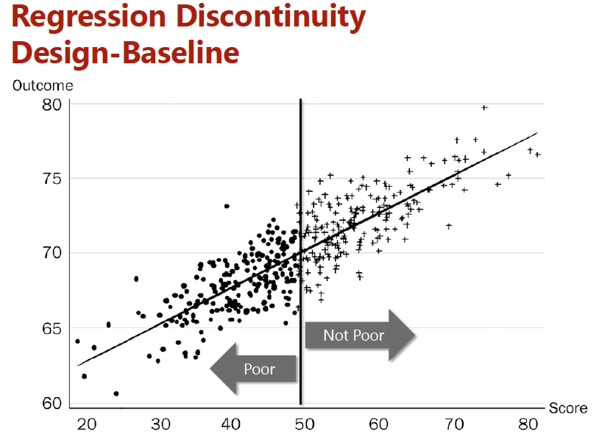
1) Regression discontinuity design Compare households at some break point

Slide 76
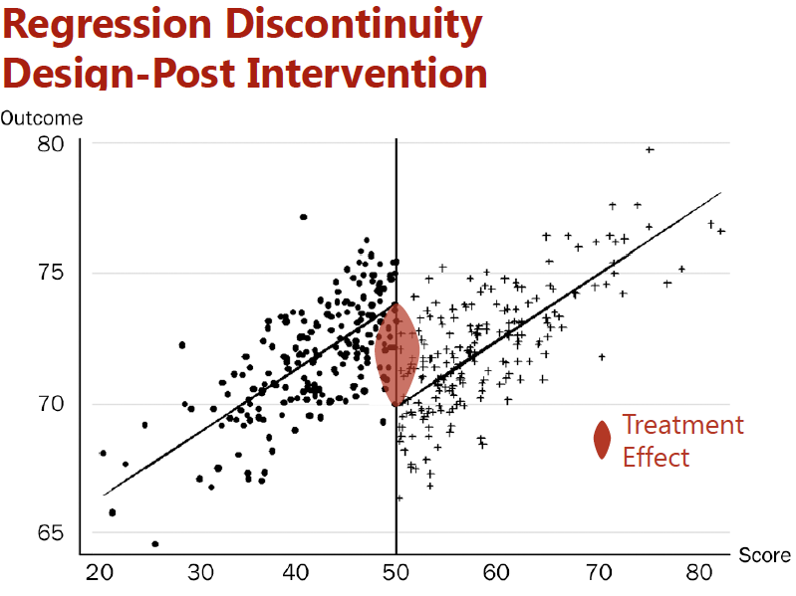
1) Regression discontinuity design Compare households at some break point

Slide 77
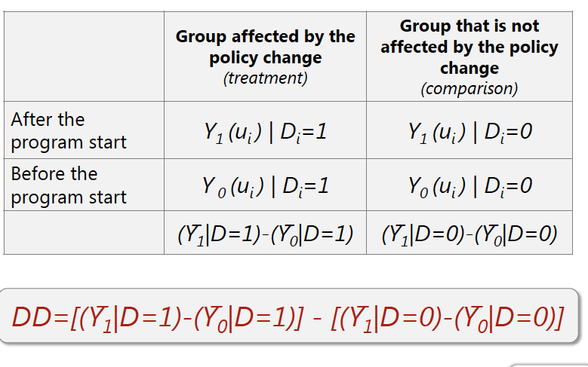
2) Difference in differences (DD) Use of “quasi-natural experiments” to identify the impact of policies

Slide 78
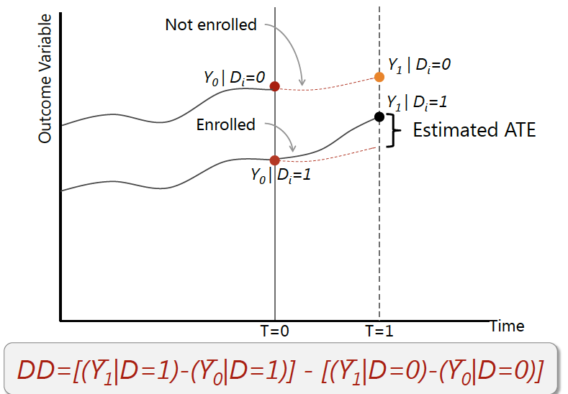
Dif-in-Difs, graphically

Slide 79
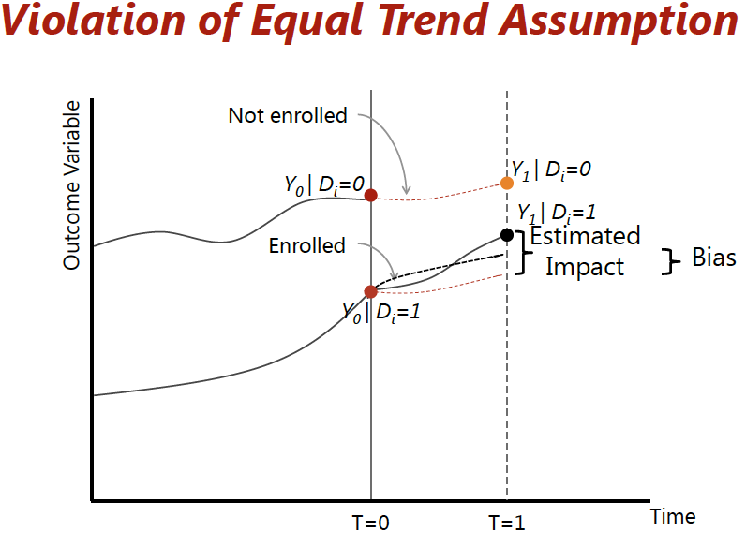
Assumption of equal trend matters

Slide 80
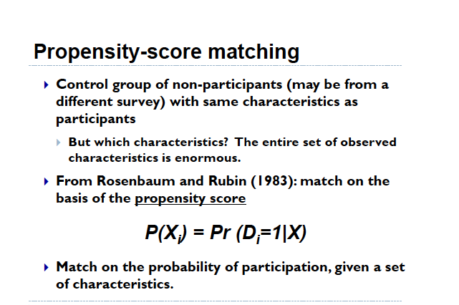
Propensity scores matching

Slide 81
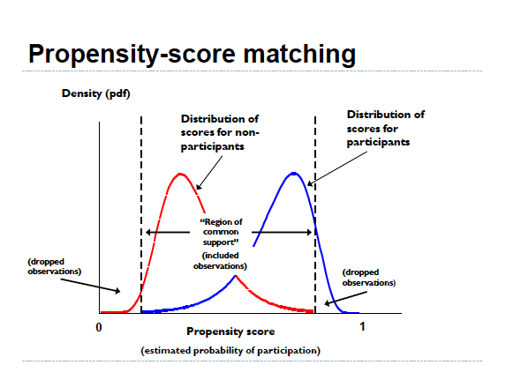

Slide 82
Progresa Policy Recommendation?
Impact of Progresa on Consumption (Y)
Case 1: Before & After | 34.28**
Case 2: Enrolled & Not Enrolled | -4.15
Case 3: Randomized Assignment | 29.75**
Case 4: Discontinuity Design | 30.58**
Case 5: Difference-in-Differences | 25.53**
Case 6: Matching | 7.06+
Note: If the effect is statistically significant at the 1% significance level, we label the estimated impact with 2 stars (**). If significant at 10% level, we label impact with +

Slide 83
Appendix 2 Example of Project using IE with RCT to help with programming: Myanmar: Savings and Cooperatives
The sustainability of financial co-operatives in Myanmar depends on their ability to mobilize deposits. However, there is not an established culture of saving in banks in rural Myanmar.
People do save in the form of gold which is largely thought to appreciate continuously, even though the world prices declined sharply in 2013 and have fluctuated since.

Slide 84
Appendix 2: Example of Savings and Cooperatives in Myanmar
An NGO wants to encourage savings habits through a combination of education, product development, marketing, and incentives
But it does not know which measures may be more effective than others.
What can one do?

Slide 85
Appendix 2: Example of Savings and Cooperatives
Take measurement of outcomes of interest at baseline (i.e. survey the members)
Let the cooperatives administer the various treatments to their members
Then, after, say, two years, take another measurement of outcomes of interest (survey the members, both treated and control ones).
Look at the impact: the difference in the difference of outcomes between the treated and the control members.

Slide 86
Appendix 2 Savings and Cooperatives
Along with this quantitative analysis, be careful to do a qualitative analysis of the various treatments by the cooperatives: try to understand how the cooperatives work with their members, the particular features that members reacted to in interacting with the cooperative staff.
Remember: Impact analysis tells whether there is an impact of not. It does not explain why: This is why one needs to augment the analysis with a qualitative assessment.
But this requires : design of the experiment before starting, time, expertise and funds that projects in the field may not have.

Slide 87
Appendix 3: Some web links
On the Recent Nobel prize:
Those who like: (an example from David MacKenzie from the WB)
https://blogs.worldbank.org/impactevaluations/nobel-prize-development-rcts
Those who hate: (an example from Chelwa and Muller)
https://africasacountry.com/2019/10/the-poverty-of-poor-economics
Perhaps a more balanced one?
https://afinetheorem.wordpress.com/2019/10/17/what-randomization-can-and-cannot-do-the-2019-nobel-prize/

Slide 88
Appendix 3: Some web links
J-PAL’s main website
https://www.povertyactionlab.org
International Initiative for Impact Evaluation
http://www.3ieimpact.org
Some more sceptical views in RCTs:
Naila Kabeer on RCTs
https://oxfamblogs.org/fp2p/naila-kabeer-on-why-randomized-controlled-trials-need-to-include-human-agency/
Even J-PAL:
https://www.poverty-action.org/blog/rcts-backlash

