Slide 1
Definition
Raw, unprocessed data from sources
Clean & standardised data
Business-Ready data
Objective
Traceability & Debugging
(Intermediate Layer)
Prepare Data for Analysis
Provide data for reporting and analytics
Object Type
Tables
Tables
Views
Load Method
Full Load
(Truncate & insert)
Full Load
(Truncate & insert)
None
Data Transformation
None
Data Cleaning
Data Standardisation
Data Normalisation
Derived Columns
Data Enrichment
Data Integration
Data Aggregation
Business Logic & Rules
Data Modelling
None
None
Star Schema
Flat Tables
Aggregated Objects
Target Audience
Data Engineers
Data Analysts
Data Engineers
Data Analysts
Business Users

Slide 2

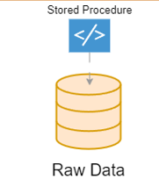

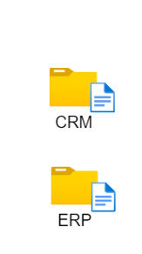
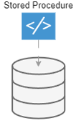
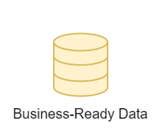
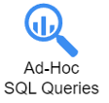
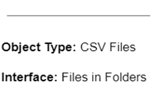

Sources
Data Warehouse
Consume
Run Python Pipeline to enlarge Sales & Customer Datasets

