Slide 1

Applied Text Analytics ( F20/F21AA ) Text Representation Heriot Watt University , Dubai Campus
Dr. Neamat El Gayar

Slide 2
Plan for today
Last Lecture : Course information and walk through text analytics topics
Today:
Lecture on Text processing
Lecture on Document( any text) Representation
Lab 1
Exercise 1
Readings

Slide 3
Text Representation

Slide 4
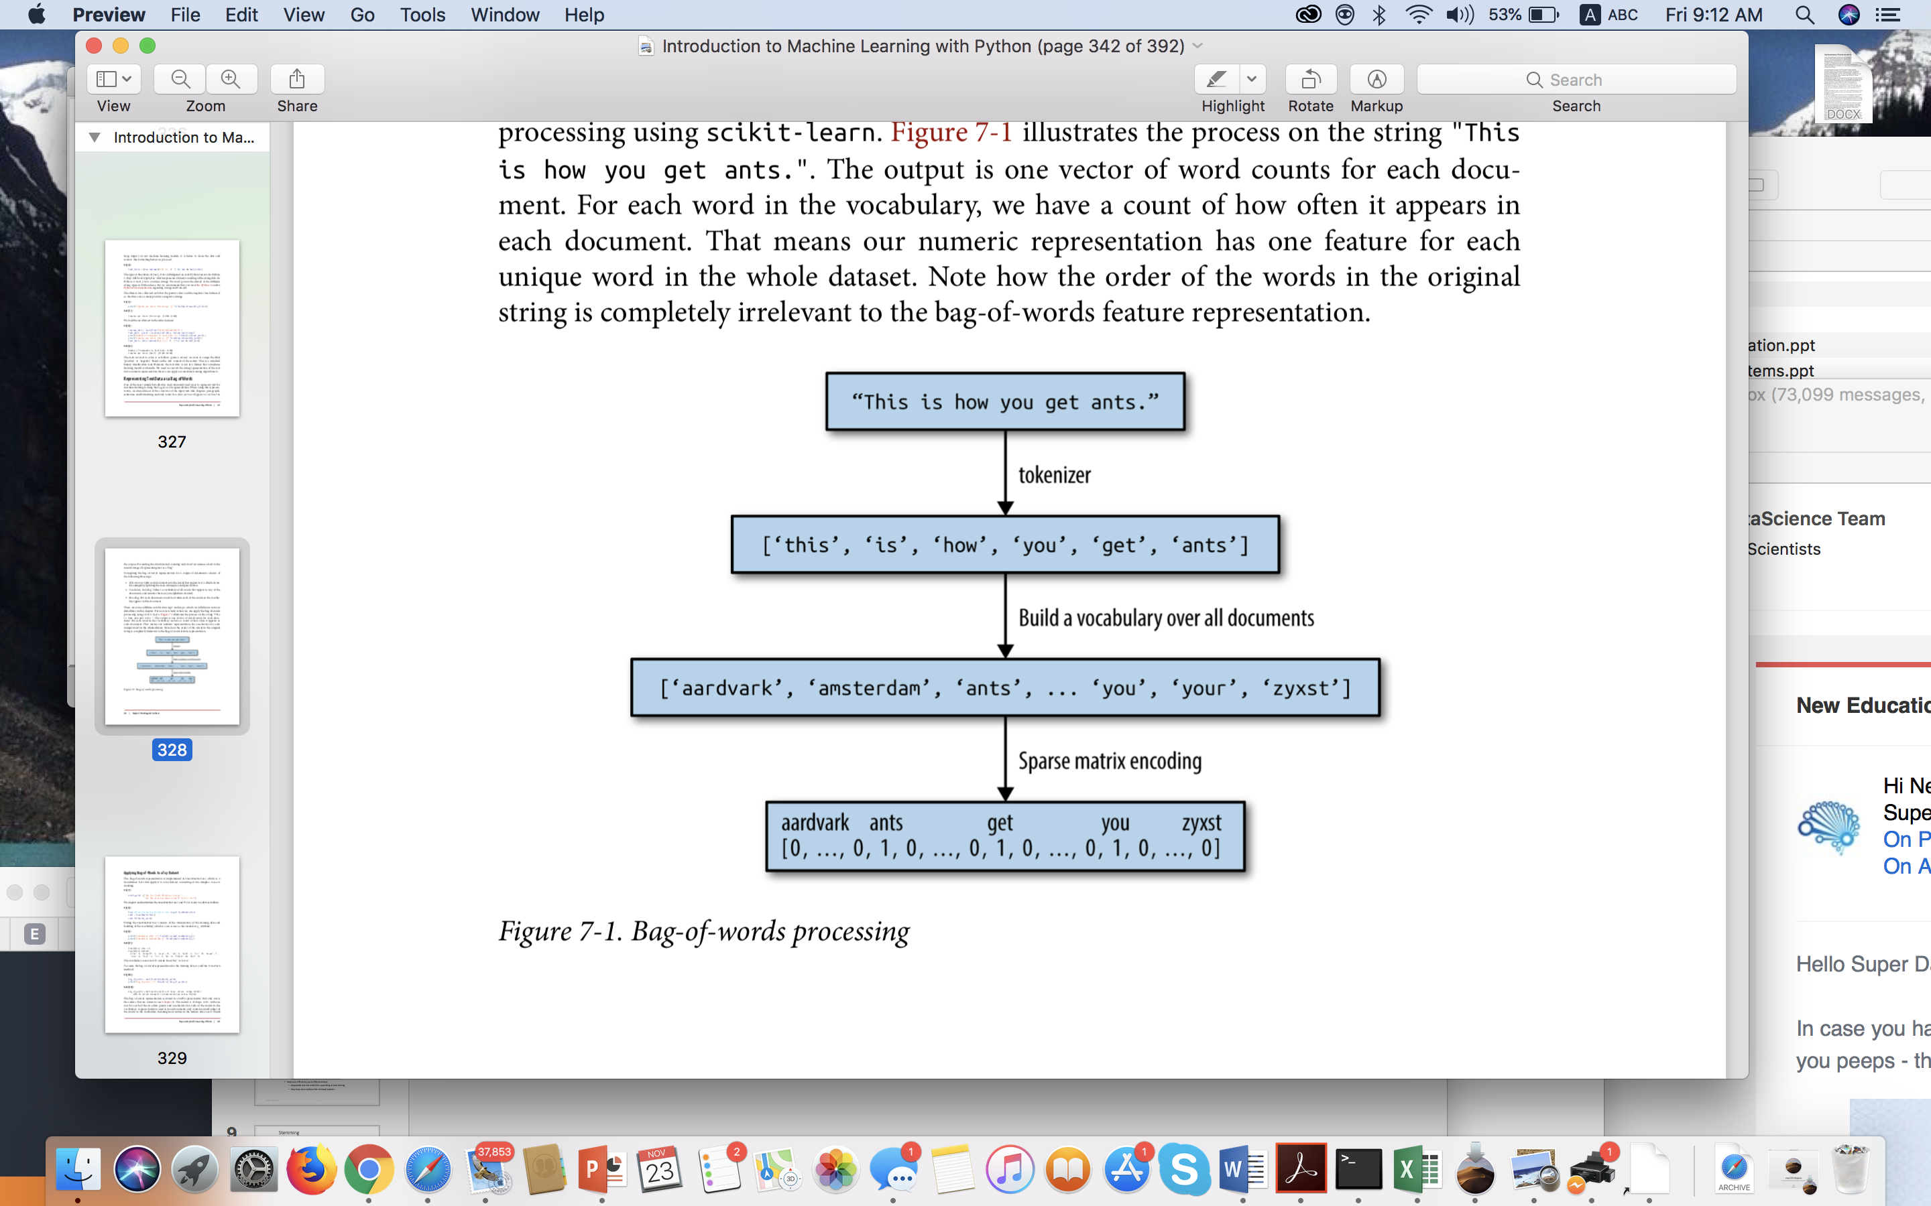
Bag of words example
Most simple but effective and commonly used ways to represent text for machine learning
For applications such as classification, topic-modeling, and recommender systems, this type of representation is sufficient.
Notes:
Words are treated as dimensions with values corresponding to word frequencies
Machine learning models often use the bag-of-words representation
For many applications such as classification, topic-modeling, and recommender systems, this type of representation is sufficient.

Slide 5
Vector space model
Each document is represented as a vector. All documents are projected into the space.
One dimension for every unique term in space(axes)
Cosine similarity
Jaccard Similarity
Finance
D₂
|D₂-D₄|
High-dimensional vector space: 10,000+ dimensions, or even 100,000+
D₄
D₃
Sports
Education
D₅
D₁
Notes:
For text, cosine similarity of tf.idf weighted vectors is typically most effective.
Similar results are obtained with the Jaccard and cosine coefficients
The Jaccard coefficient is especially useful for the case where the Boolean representation of text is used.

Slide 6
Vector space model ( to represent text/document)
Each document is represented as a vector. (weight of term)
Binary vector ( 0 if term occurs , 1 otherwise)
Frequency of each term occurrence: TF
Each term weight is computed based on some variations of TF-IDF scheme.
term frequency–inverse document frequency (tf–idf) method:
Give high weight to any term that appears often in a particular document, but not in many documents in the corpus.
If a word appears often in a particular document, but not in very many documents, it is likely to be very descriptive of the content of that document.
Notes:
Each term weight is computed based on some variations of TF or TF-IDF scheme.
Term Frequency (TF) Scheme: The weight of a term t_{i} in document d_{j} is the number of times that t_{i} appears in d_{j}, denoted by f_{ij}. Normalization may also be applied.

Slide 7
Term frequency TF
Term Frequency: Counts the number of times a word occurred in a document.
Using occurrence frequencies to indicate relative importance of a word in a document.
the term frequency tf_{t,d} of term t in document d is defined as the number of times that t occurs in d.
The term frequency may optionally be normalized.
Notes:
Rescale features by how informative we expect them to be. One of the most common ways to do this is using the term frequency–inverse document frequency (tf–idf) method. The intuition of this method is to give high weight to any term that appears often in a particular document, but not in many documents in the corpus. If a word appears often in a particular document, but not in very many documents, it is likely to be very descriptive of the content of that document.
There are several variants of the tf–idf rescaling scheme, which you can read about on Wikipedia. The tf–idf score for word w in document d as implemented in both the TfidfTransformer and TfidfVectorizer classes is given by:7

Slide 8
TF-IDF
TF= occurrence of a term in document
(considers relative importance of a word in a document)
IDF= Inverse document frequency
(considers how rare the term is among the collection )
”movie" vs. ”Titanic”
DF_{t}= the number of documents that contain t
N is the number of documents in the corpus
Main Idea: If a word appears often in a particular document, but not in other documents, it is likely to be very descriptive of the content of that document.
Notes:
log (N/df_{t}) instead of N/df_{t} to “dampen” the effect of idf.
Log (1)=0 [ not a relevant term as it appears in all documents} dft=N

Slide 9
Inverse Document Frequency (idf)
idf(t) = log [N / df(t)]
N: Number of documents in the corpus
df(t): Number of documents in the corpus that contain a term t
Measures term uniqueness in corpus
”movie" vs. ”Titanic”
Indicates the importance of the term
Classification (discriminatory power)
Notes:
We now define Inverse Document Frequency and look into how we can improve our search algorithm with idf.
idf measures the uniqueness of a term in the corpus. If a term shows up only in 10% of the documents then it is unique. If a term shows up in 90% of the documents then it is not all that unique. It indicates the importance of the term (that appears in 10% of documents) and provides relevance to the search by weighing the rare term higher.
In a corpus of phone reviews, the word "phone" is probably pretty common; in particular it shows up in both good and bad reviews. The term "brick" is probably less common. So it is an important term when it shows up in a query (it discriminates relevant documents better than "phone" does), and potentially is distributed differently in good reviews and bad reviews. IDF reflects the fact that "brick" is potentially an interesting feature of a document.

Slide 10
Document Frequency df
Sec. 6.2.1
Rare terms are more informative than frequent terms
Recall stop words
df_{t} is the document frequency of t: the number of documents that contain t
df_{t} is an inverse measure of the informative-ness of t
df_{t} ≤ N
Notes:
Also empirical finding
N = total number of documents on collection
N/df > 0 so that the log is +ve
We define the idf (inverse document frequency) of t by
We use log (N/df_{t}) instead of N/df_{t} to “dampen” the effect of idf.

Slide 11
idf example, suppose N = 1 million
Sec. 6.2.1
term | df_{t} | idf_{t}
calpurnia | 1
animal | 100
sunday | 1,000
fly | 10,000
under | 100,000
the | 1,000,000
There is one idf value for each term t in a collection.
Notes:
6 4 3 2 1 0
Corpus of a million document
‘the’ useless , idf =0

Slide 12



TF-IDF term weighting scheme (version 1)
The most well-known weighting scheme
TF: still term frequency
IDF: inverse document frequency.
N: total number of docs
df_{i}: the number of docs that t_{i} appears.
The final TF-IDF term weight is:

Slide 13
Version 2: tf-idf weighting
Ch. 6
The tf-idf weight of a term is the product of its tf weight and its idf weight.
Best known weighting scheme in information retrieval
Increases with the number of occurrences within a document
Increases with the rarity of the term in the collection

Slide 14
Binary → count → weight matrix
Sec. 6.3
Each document is now represented by a real-valued vector of tf-idf weights ∈ R^{|V|}

Slide 15
Document Vectorization
Document is represented with a numerical vector
Dimension of the vector = distinct terms in ”corpus”
Method | Function | Description | Comments
Binary “One-hot” | 0 1 | 1 if term occurs 0 otherwise | Can be suitable for shorter documents and NN implementations
Frequency | TF | Counts frequency of terms | Works well for k-means clustering and some probabilistic methods
Term Frequency Inverse Document Frequency | TF-IDF | Weights term by importance across corpus | Originally the gold- standard of Information retrieval
Can use N-gram features
Can be used in combination with PCA for dimensionality reduction
Notes:
Careful when using different types of normalization and pre-processing methods.
What works for one application domain might not work for another
Example: information retrieval settings vrs social network analysis

Slide 16
Exercise 1

Slide 17
Exercise 1 (part 1)
Given 5 different documents in the collection:
D1 = "If it walks like a duck and quacks like a duck, it must be a duck."
D2 = "Beijing Duck is mostly prized for the thin, crispy duck skin with authentic versions of the dish serving mostly the skin."
D3 = "Bugs' ascension to stardom also prompted the Warner animators to recast Daffy Duck as the rabbit's rival, intensely jealous and determined to steal back the spotlight while Bugs remained indifferent to the duck's jealousy, or used it to his advantage. This turned out to be the recipe for the success of the duo."
D4 = "6:25 PM 1/7/2007 blog entry: I found this great recipe for Rabbit Braised in Wine on cookingforengineers.com."
D5 = "Last week Li has shown you how to make the Sechuan duck. Today we'll be making Chinese dumplings (Jiaozi), a popular dish that I had a chance to try last summer in Beijing. There are many recipies for Jiaozi."

Slide 18
Exrecise 1 (part 1)
Compute the term frequencies (TF) in the table below. Assume counting is case insensitive ( i.e.Duck=duck) & stemming is performed ( i.e. recipes= recipe)
Term | TF
 | D1 | D2 | D3 | D4 | D5
beijing
dish
duck
rabbit
recipe

Slide 19
Exercise 1 (part 1)
Calculate the normalized TF* and the IDF for each term. Assume tf-idf= tf’ * log₁₀ (N/dft) ; tf’ is normalized by the maximum occurrence of any term in the document tf’= tf/tf(max in document d)
Term | TF normalized (TF’)* |  |  |  |  | IDF
 | D1 | D2 | D3 | D4 | D5
beijing
dish
duck
rabbit
recipe
Term | TF- IDF
 | D1 | D2 | D3 | D4 | D5
beijing
dish
duck
rabbit
recipe

Slide 20
Exrecise1 (part 1)
You should do all these calculations manually
Python:
In the lab you will experiment with scikit-learn methods for Binary representation, TF representation and TF-Idf representation
Check the following functions and see how you could use them to represent the documents of exercise 1:
from sklearn.preprocessing import Binarizer
Binarize()
from sklearn.feature_extraction.text import CountVectorizer
CountVectorizer()
from sklearn.feature_extraction.text import TfidfVectorizer
TfidfVectorizer()

Slide 21
Take Home Week 2
Install NLTK and experiment with tokenization, stemming and lemmatization
Solve Exercise 1 (part 1)
Readings lec1 &lec2

Slide 22
References
Charu C. Aggarwal. “Machine Learning for Text.” Apple Books
An Introduction to Natural Language Processing, Computational Linguistics, and Speech Recognition, Third Edition draft , Daniel Jurafsky & James H. Martin (Chapter 2).
More technical details on building custom corpus. Chapter 2 Benjamin Bengfort, Rebecca Bilbro, Tony Ojeda. “Applied Text Analysis with Python.” Apple Books.

Slide 23
Lab today
You will experiment with different libraries ( text processing : tokenization and stemming/lemmatization)
You will use Scikit-learn , NLTL & Spacy functions
You will generate your first document representation ( Binary/TF-IdF)
References: Check Lemmatization with Python
Notes:
As we discussed ear‐ lier, the classes CountVectorizer and TfidfVectorizer only implement relatively simple text-processing methods. For more advanced text-processing methods, we recommend the Python packages spacy (a relatively new but very efficient and well- designed package), nltk (a very well-established and complete but somewhat dated library), and gensim (an NLP package with an emphasis on topic modeling).
Historically, IR is about document retrieval, emphasizing document as the basic unit.
Finding documents relevant to user queries
Technically, IR studies the acquisition, organization, storage, retrieval, and distribution of information.

Slide 24
Python Libraries: Text Analytics & NLP
Scikit-learn: Tools for text processing and a large library for machine learning.
NLTK : Most comprehensive toolkit for NLP functions with user interface TextBlob for sentiment analysis
SpaCy library built for performance
Gensim provides good implementations for topic modeling and document similarity.

Slide 25
Thank You

