Slide 1
Azure Resource Manager Deployments
@nepeters

Slide 2
Agenda
- Azure Resource Manager (ARM) Overview
- ARM Deployment Options
- ARM Templates
- ARM Template authoring
- ARM Template deployment
- ARM Template extensibility

Slide 3
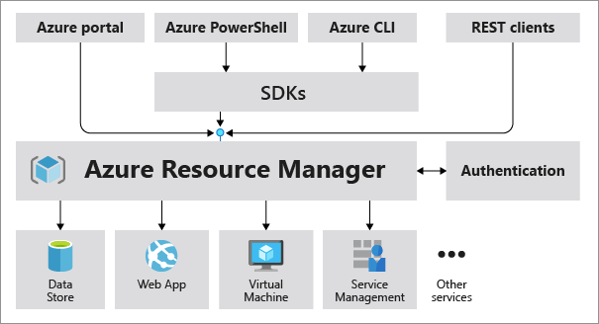
Azure Resource Manager (ARM)
Control plane for creating and managing Azure resource and services.
Resource Provider REST Interface
Swagger
Resource Schema
Control Plane vs. Data Plane
Notes:
Control Pane –
Data Pane -

Slide 4
Demo REST Interfaces

Slide 5
ARM Deployment Options
So that’s cool, but where are the really nice things?
Software Development Kits (SDK)
Azure CLI / Azure PowerShell module
Azure Resource Manager (ARM) Templates
Others (Terraform, Pulumi)

Slide 6
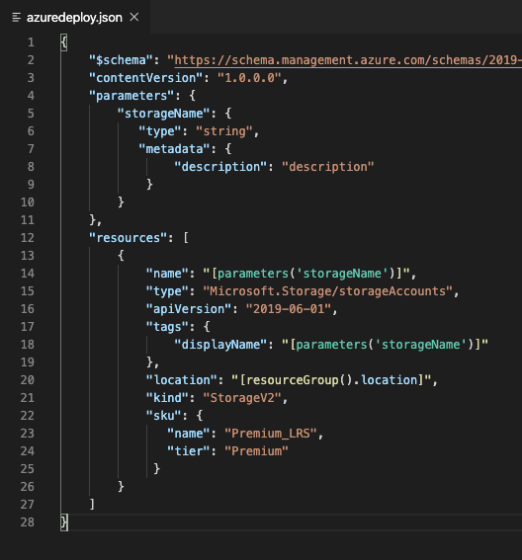
ARM Templates
Declarative deployments *
Idempotent *
Dependency Graph / Parallel
Modular
Extensible
Day 1 resource support
Validation / Testing
Deployment history
And many other things….
Notes:
CI Pipeline integration

Slide 7
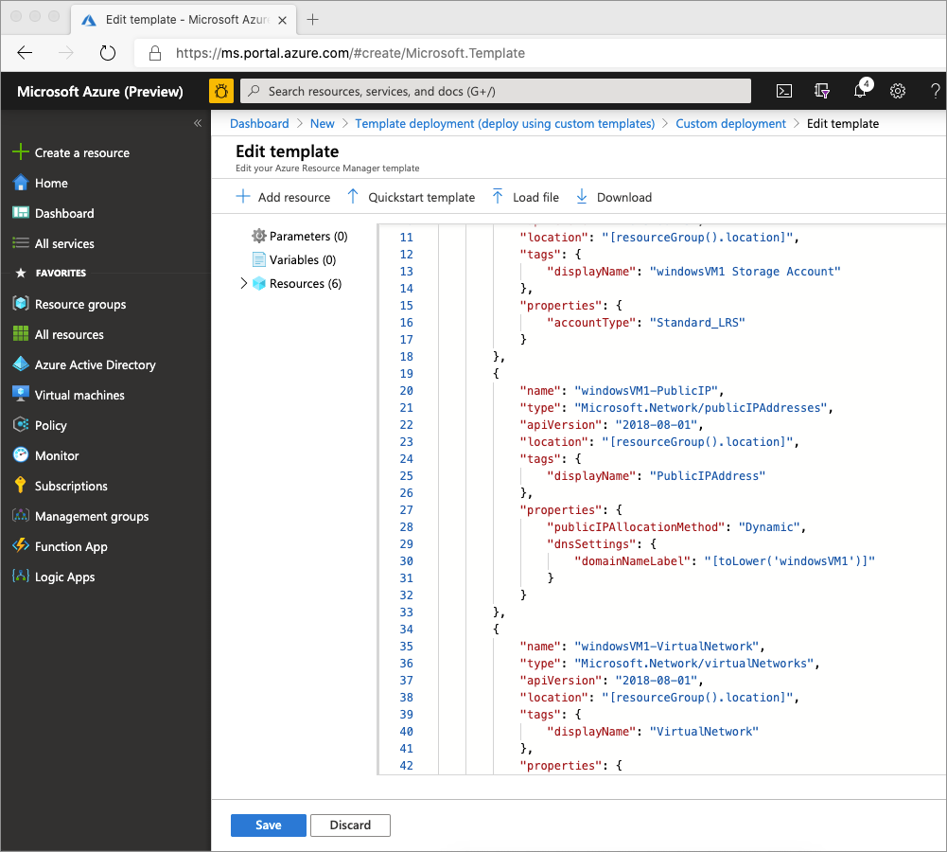
Deployment
Azure CLI
Azure PowerShell
Azure Portal
REST Interface
Other (Terraform)

