Slide 1
Azure Resource Manager Deployments
@nepeters

Slide 2
Agenda
- Azure Resource Manager (ARM) Overview
- ARM Deployment Options
- ARM Templates
- ARM Template authoring
- ARM Template deployment
- ARM Template extensibility

Slide 3
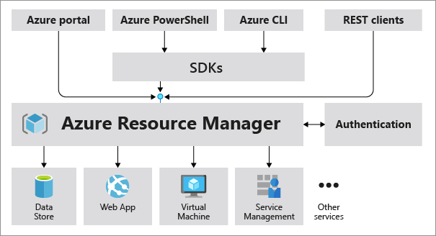
Azure Resource Manager (ARM)
Control plane for creating and managing Azure resource and services.
Resource Provider REST Interface
Swagger
Resource Schema
Control Plane vs. Data Plane
Notes:
Control Pane –
Data Pane -

Slide 4
Demo REST Interfaces

Slide 5
ARM Deployment Options
So that’s cool, but where are the really nice things?
Software Development Kits (SDK)
Azure CLI / Azure PowerShell module
Azure Resource Manager (ARM) Templates
Others (Terraform, Pulumi)

Slide 6
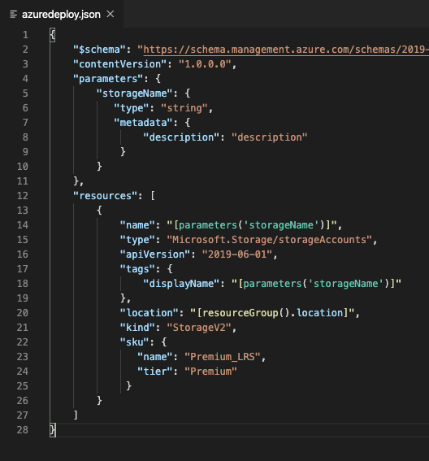
ARM Templates
Declarative deployments *
Idempotent *
Dependency Graph / Parallel
Modular
Extensible
Day 1 resource support
Validation / Testing
Deployment history
And many other things….
Notes:
CI Pipeline integration

Slide 7
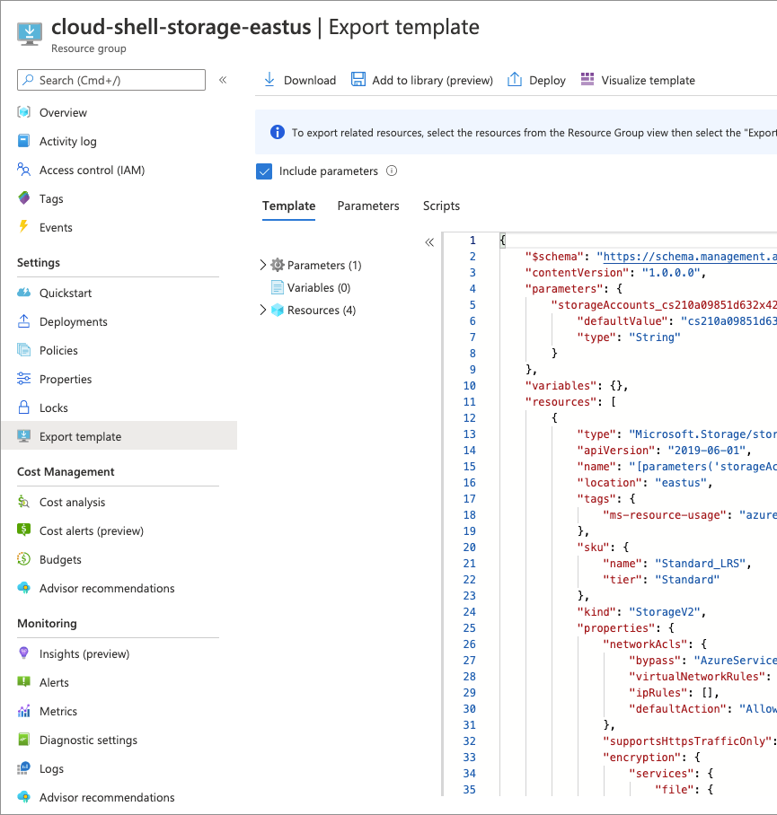
Authoring
Tools and resources
Visual Studio Code Extension
Visual Studio ARM Project
Portal export
ARM QuickStart gallery
Template reference docs

Slide 8
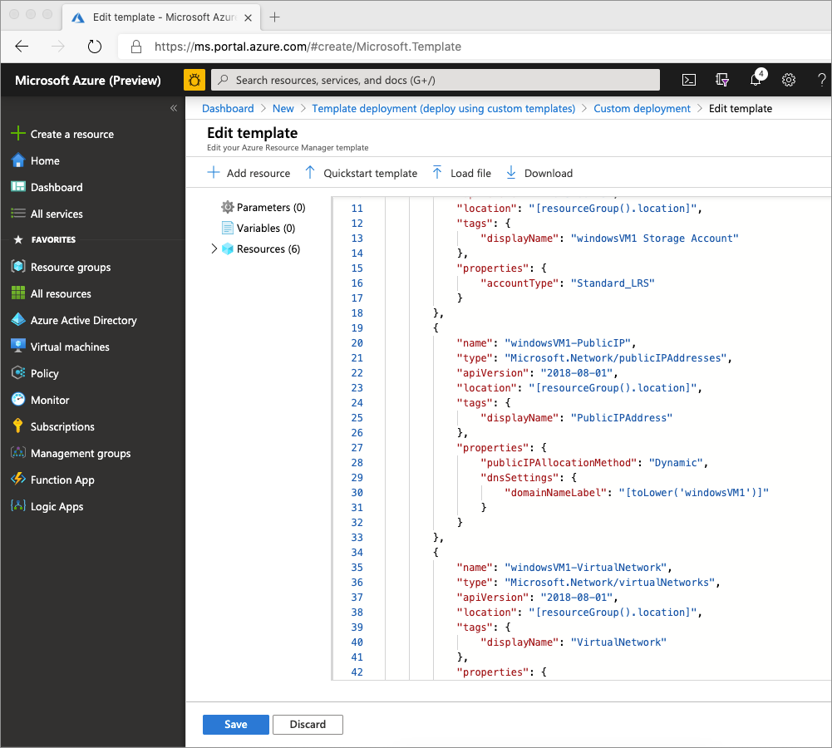
Deployment
Azure CLI
Azure PowerShell
Azure Portal
REST Interface
Other (Terraform)

Slide 9
Demo ARM Templates

Slide 10
ARM What-If
Pre deployment change validation
Preview potential changes before deployment
Azure PowerShell, CLI, and SDK Support
Currently in preview

Slide 11
ARM Template Toolkit
Static code analysis
Validates recommended practices
Extensible
Integrate with CI solutions

Slide 12
Demo What-If and ATT

