Slide 1
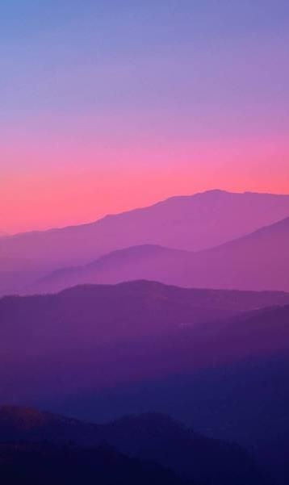

Visit Scotland CodeClan Final Project
Neil Plenderleith

Slide 2
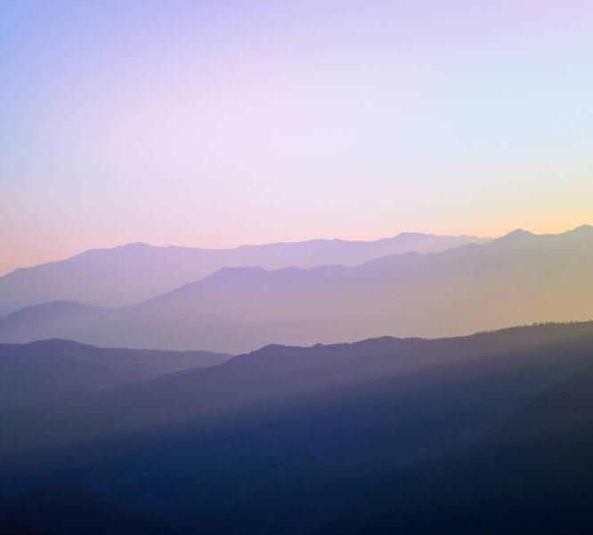
Introduction
Brief: We would like gain more understanding about our tourism data for Scotland.
6 datasets, all presummarised
1 additional dataset - international

Slide 3
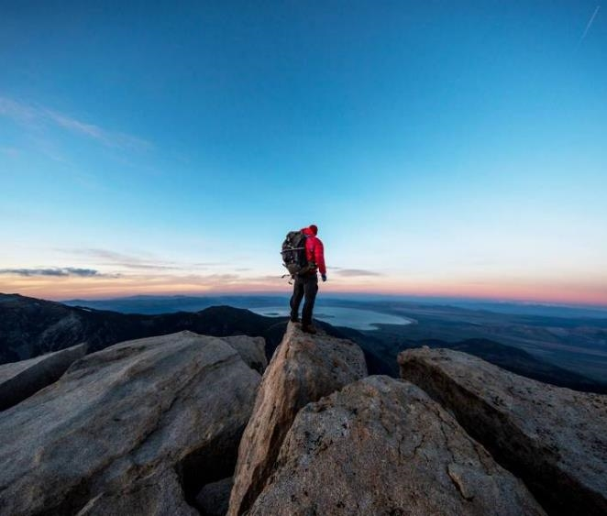
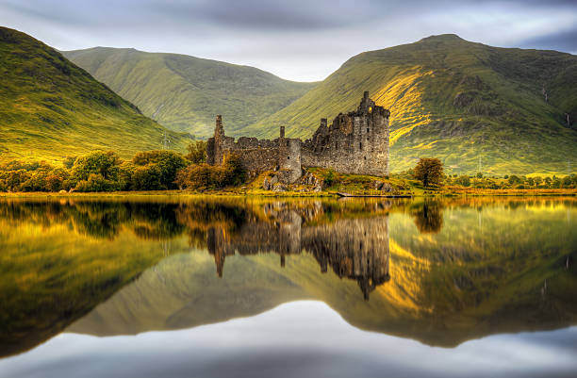
Business Questions
What kind of tourism activity generates the highest income for Scotland?
Which kind of activity generates the most visits to sites?
Is there a particular key demographic of visitors we should be focusing on? Who spends the most? Who visits the most?
What type of locations receive the most visits? What kinds of locations do people spend the most in?
Is there a particular method of travel our visitors arrive by? Some of our locations are remote and not easily accessible by public transport, so this would be good information to have.
When looking at regional tourism, what insights can we gain? Where are our visitors from? How do they differ in the money they spend, nights they spend in Scotland, or number of visits they do?
What type of accommodation is most popular? Is there a difference by location?
How have general tourism rates changed over time?
Is there any way to predict spending and visits for Visit Scotland?
Notes:
Fairly large set of Business Questions.
I will look at 1-7 individually. Question 8 regarding change over time will be dealt with in my answers to questions 1-7.
Question 9 is more about modelling and will be dealt with last. An extra section on additional international data will be also discussed

Slide 4
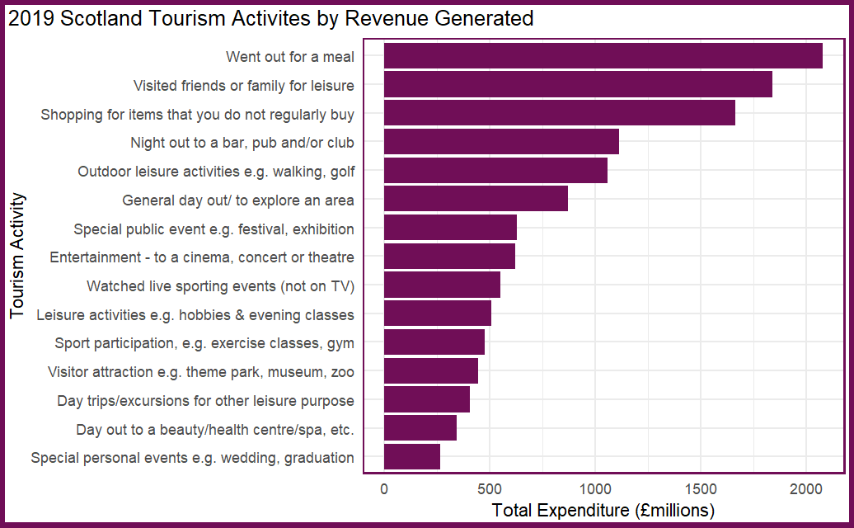
1. What kind of tourism activity generates the highest income for Scotland?
Activity by Revenue
2019 Tourism Activities by Revenue
Appear to be a ‘top 6’
Notes:
I've listed all Tourism activities for 2019 here to get an idea of the overall tourism picture.
I've highlighted the “Top 6” as the most popular. Namely going out for a meal, visiting, shopping, nights out, leisure activities, general day out.
Lets move on to looking at the change of these over time

Slide 5
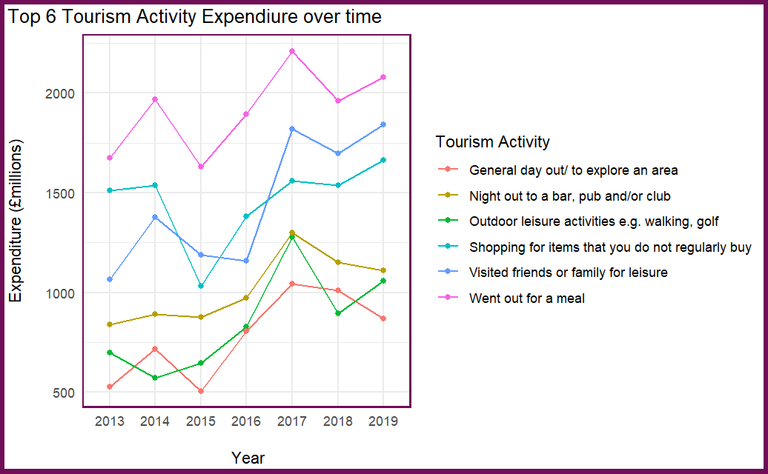
1. What kind of tourism activity generates the highest income for Scotland?
Top 6 Tourism Activities over time
Appear to be a ‘top 6’
Notes:
All of these trend upwards over time.
Massive jump in visiting friends and family 2016 – 2017 of nearly 1 billion pounds in expenditure! In fact most of the activities peak for 2017 .
Will have a look at this later.
Good to Look at unsummarised data, ideally by region to see where this occurred.

Slide 6
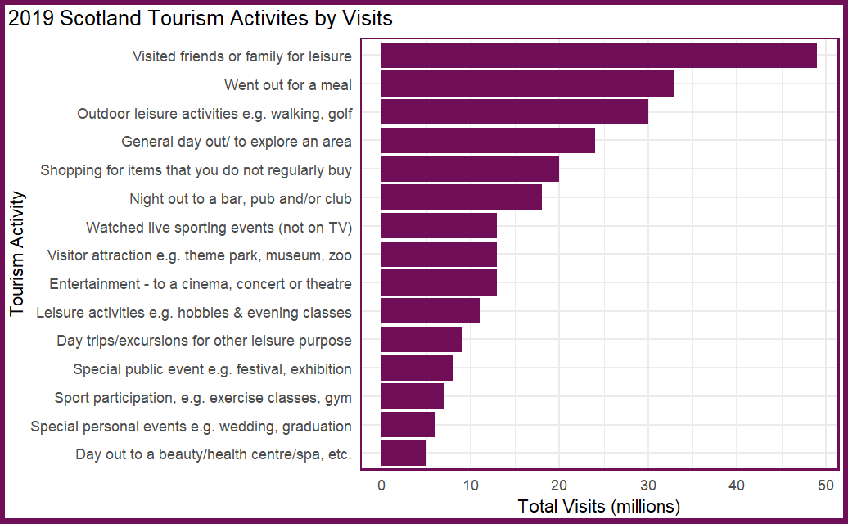
2. Which kind of activity generates the most visits to sites?
Activity by Visits
2019 Tourism Visit Activities
Similar ‘top 6’ to tourism expenditure
Notes:
Q2 . Which kind of activity generates the most visits to sites
Again we have our “top 6” as we saw on the expenditure chart. Shows the correlation between visits and expenditure.
Lets have a look at these over time as well

Slide 7
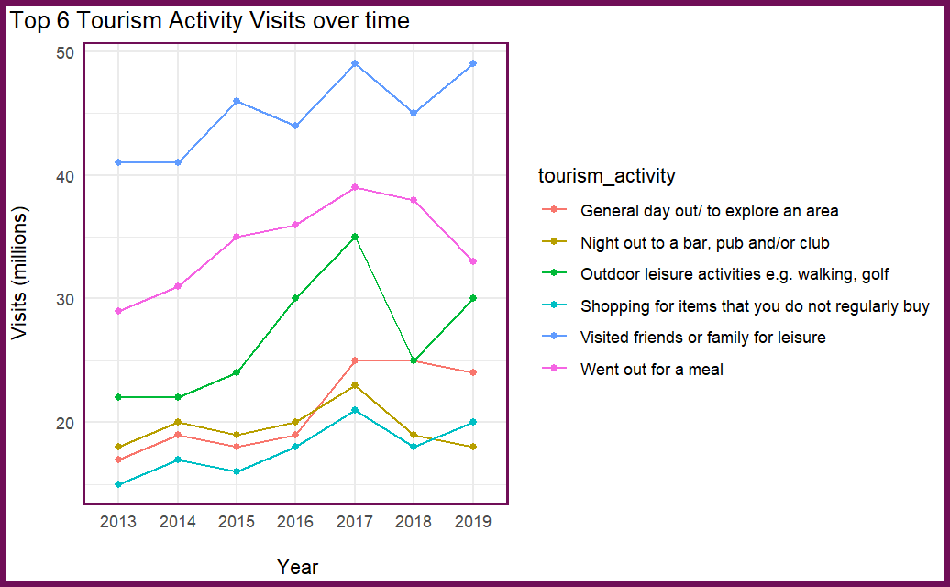
2. Which kind of activity generates the most visits to sites?
Top 6 Tourism Activities over time
Appear to be a ‘top 6’
Notes:
Visits on all but nights out at bars are going up over time so the increase expenditure we saw cant all be associated with inflation.
Big drop (10m!) in Outdoor leaisure activities 2017-2018 despite was the UK’s warmest summer since 2006,
the driest since 2003 and the sunniest since 1995.
Was it too nice a summer?

Slide 8
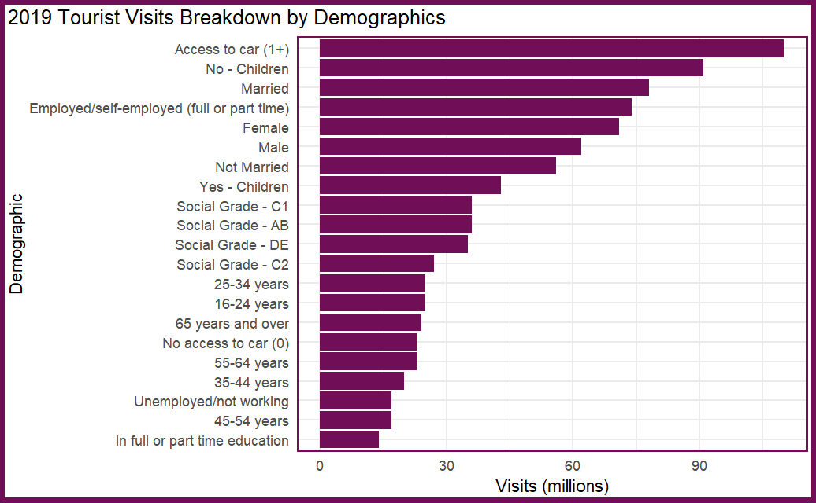
3. Is there a particular key demographic of visitors we should be focusing on?
Who visits the most?
2019 Tourism Visits by Demographic
Access to car, married, employed with no kids – primary market
Age group 45-54, social group C2 (Skilled manual occupations) both under represented
Notes:
Q3. Is there a particular key demographic of visitors we should be focusing on?
Here I have listed all of the demographics so we get a broad picture.
Can see our top 4 – our primary market namely people with a car, no kids, married, employed in some way.
Under represented groups would be 45-54 age bracket and social grade of C2 Skilled manual occupations

Slide 9

3. Is there a particular key demographic of visitors we should be focusing on?
Who spends the most?
2019 Tourism Expenditure by Demographic
Access to car, married, employed with no kids – primary market
Social grade AB overspend compared to other groups
Notes:
Here we have the expenditure graph which is broadly similar to the last - we can see our same top 4 quite clearly
But we can see that social grade AB has moved up perhaps showing more disposable income

Slide 10
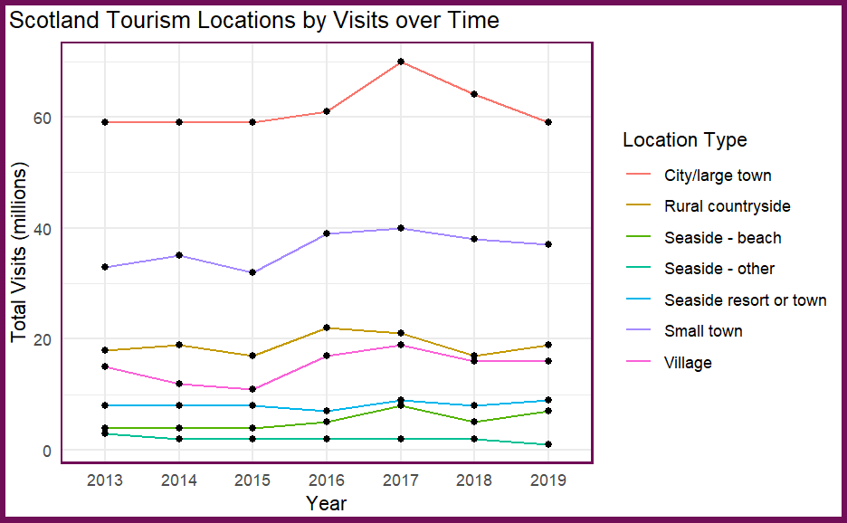
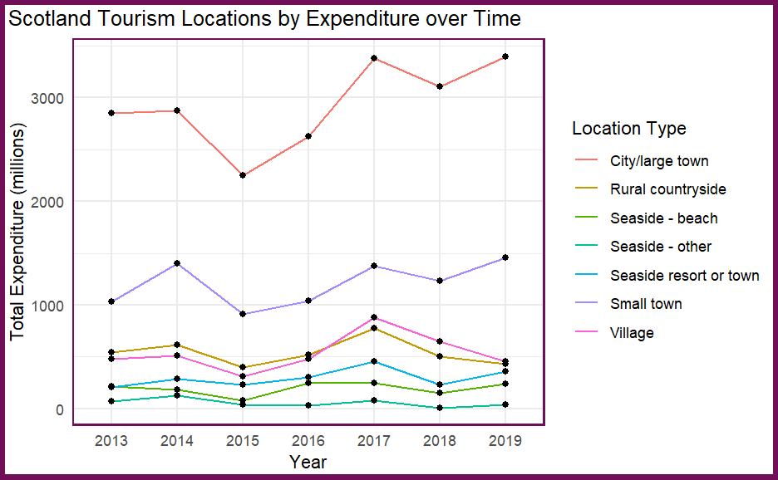

4. What type of locations receive the most visits? What kinds of locations do people spend the most in?
Notes:
4. What type of locations receive the most visits? What kinds of locations do people spend the most in?
We can see the peak in 2017 again.
Rough Guides names Scotland as the world's most beautiful country in 2017 – could this be a reason for the increase in city visits? Nearly a 10m increase? Worth a further look at non summarised data

Slide 11
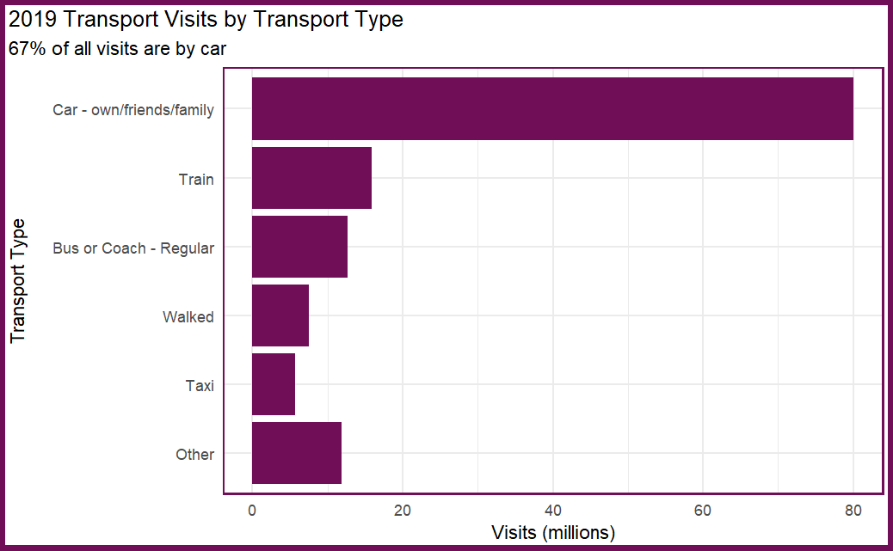
5. Is there a particular method of travel our visitors arrive by?
Tourist Transport
2019 Tourism Visits by Transport Type
Car massively predominant means of transport – 2/3 of all visits.
Don’t need to worry about remote sites!
Grouped “Other” category includes planes, ferries, tube, bike, tram etc.
Notes:
5. Is there a particular method of travel our visitors arrive by?
Car massively predominant means of transport – 2/3 of all visits.
Don’t need to worry about remote sites!
Grouped “Other” category includes planes, ferries, tube, bike, tram etc.

Slide 12
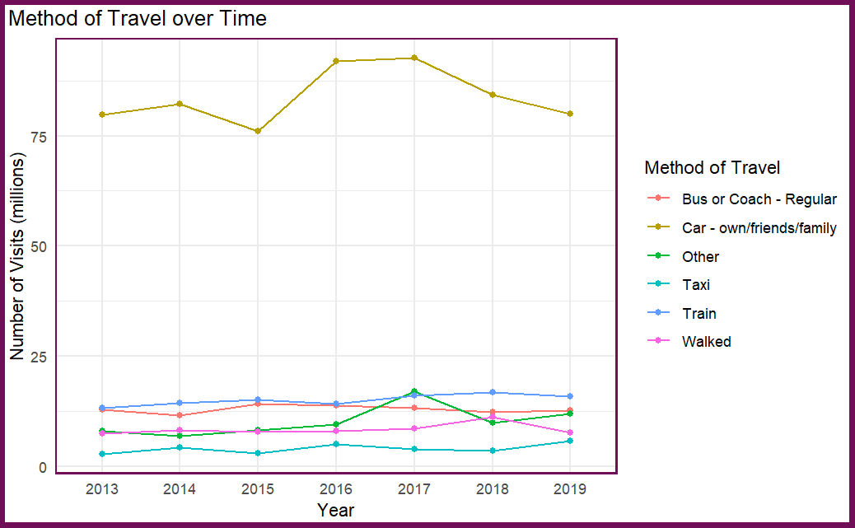
5. Is there a particular method of travel our visitors arrive by?
Tourist Transport over time
Car is King
Little yearly variation
Notes:
Part of the Scottish Governments journey towards net zero by 2045 as a country there is a dilemma here about transport use and carbon neutral commitments.

Slide 13
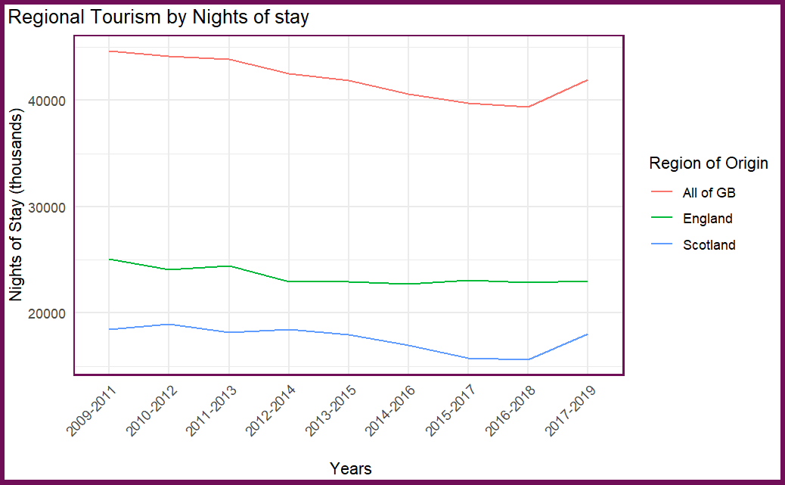
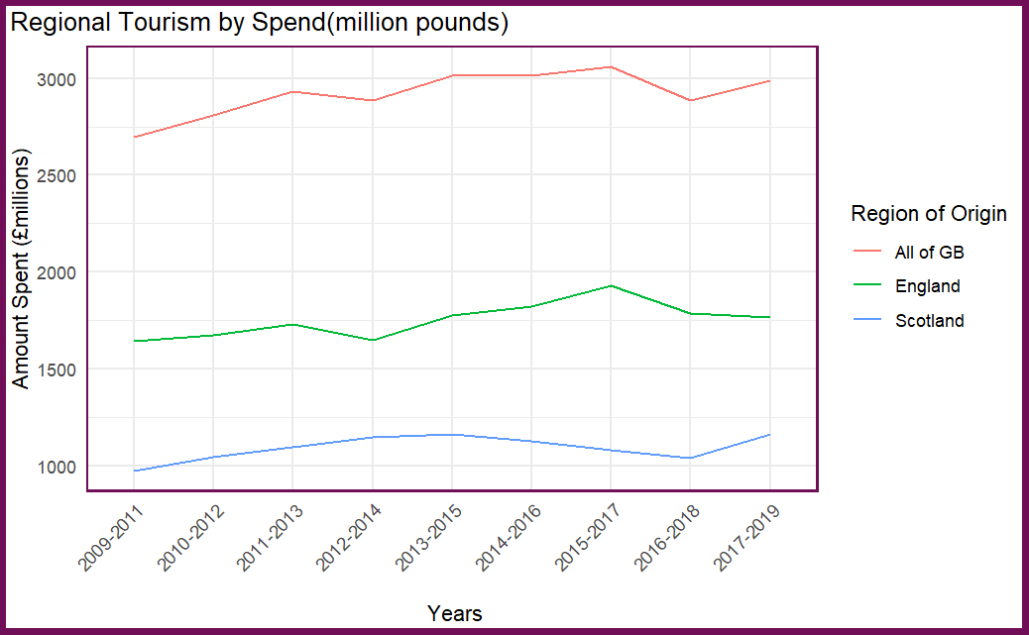
6. When looking at regional tourism, what insights can we gain?
Notes:
6. When looking at regional tourism, what insights can we gain? Where are our visitors from? How do they differ in the money they spend, nights they spend in Scotland, or number of visits they do?
Have not posted number of visits. These are roughly equal between England and Scotland
As you can see English tourists stay longer and spend more. This makes sense, more Scottish visits will be day trips whereas English are more likely to stay overnight.

Slide 14
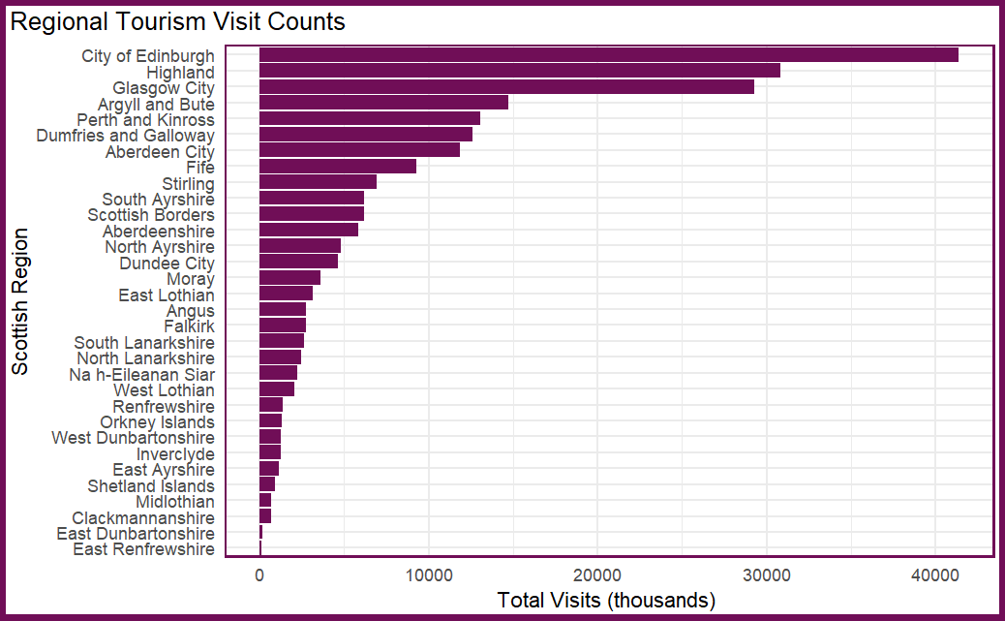
6. When looking at regional tourism, what insights can we gain?
Tourist Visits by Region
Largely skewed towards Cities of Edinburgh and Glasgow
Highland and Argyll largely rural areas also popular
Some regions especially East Ren and East Dumbarton almost zero visits.
Expenditure almost a mirror image of this graph
Notes:
Ie listed here all regions to get the broad picture
Largely skewed towards Cities of Edinburgh and Glasgow
Visit Scotland I know a big part of their events strategy is putting money into big international events such as Glasgows Celtic connections and Edinburghs International Festival.
Highland and Argyll largely rural areas also popular
Some regions especially East Ren and East Dumbarton almost zero visits.
Expenditure almost a mirror image of this graph so ive excluded it.

Slide 15
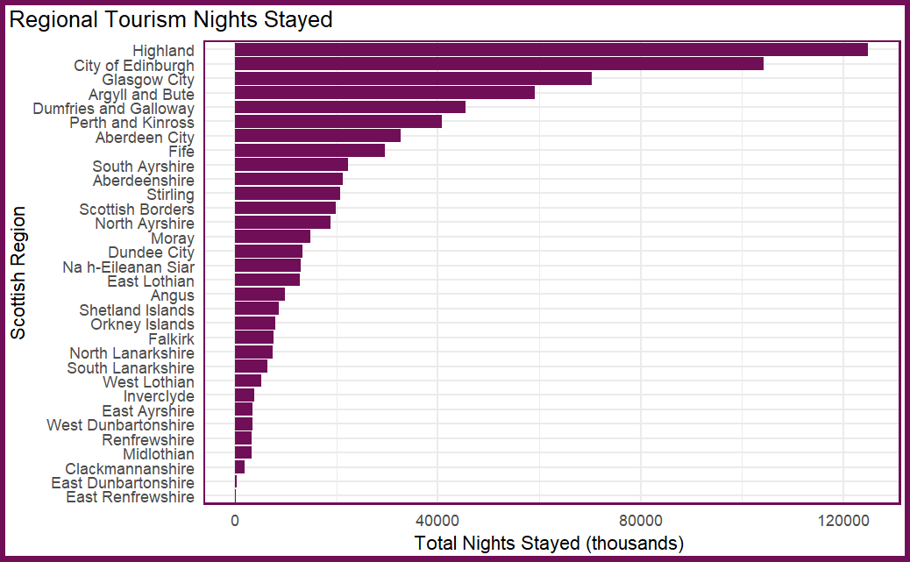
6. When looking at regional tourism, what insights can we gain?
Tourist Nights by Region
For nights stayed, Highland overtakes the cities, Argyll and Bute also moves up
Seems more remote areas invite longer stays from visitors.
Some regions especially East Ren and East Dumbarton almost zero nights stayed.
Notes:
For nights stayed, Highland overtakes the cities, Argyll and Bute also moves up
Seems more remote areas invite longer stays from visitors.
Some regions especially East Ren and East Dumbarton again almost zero nights stayed.

Slide 16
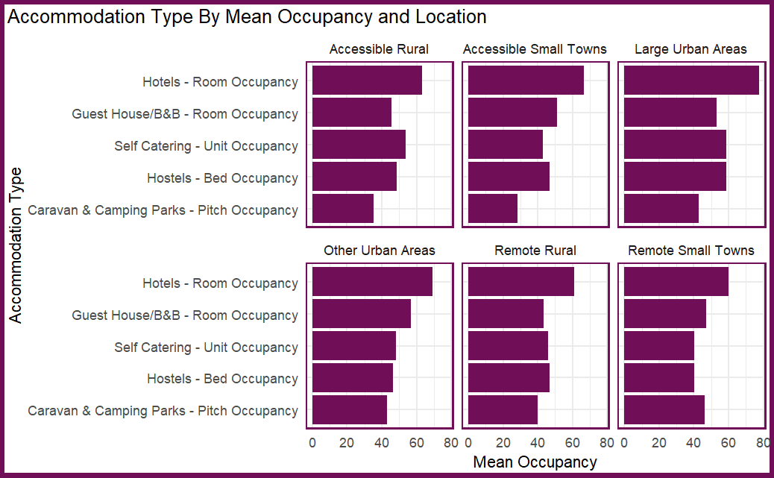
7. What type of accommodation is most popular? Is there a difference by location?
Accommodation by Location and Mean Occupancy
Hotels most popular accommodation across the board.
Other types vary according to location, e.g. the more remote the more popular camping and caravanning.
Notes:
7. What type of accommodation is most popular? Is there a difference by location?
Hotels most popular accommodation across the board.
Other types vary according to location, e.g. the more remote the more popular camping and caravanning.

Slide 17
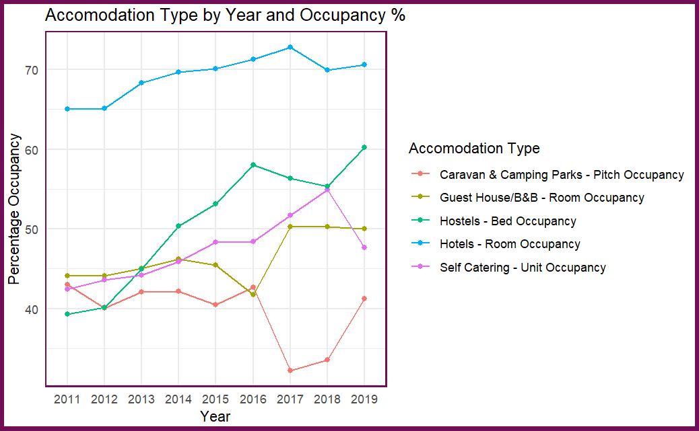
7. What type of accommodation is most popular? Is there a difference by location?
Accommodation by Type and Mean Occupancy over Time
Again all tourism trends are generally upwards for each accommodation type.
Hostel use increase 20% since 2011.
Notes:
Again all tourism types generally trend upwards.
Still have the 2017 spike here – camping and carvanning seeing a massive drop in favour of guest houses and B&Bs
It would be interesting to look at the rise of Air B&B use and if this could be a factor for this spike.
This also raises the question of the rise of second homes as air b&b and the affordability for local residents to won homes.
I know form my experience of staying in Tobermory on the Isle of Mull for 4 years some streets were largely deserted outside of peak tourist times as they were second homes.

Slide 18
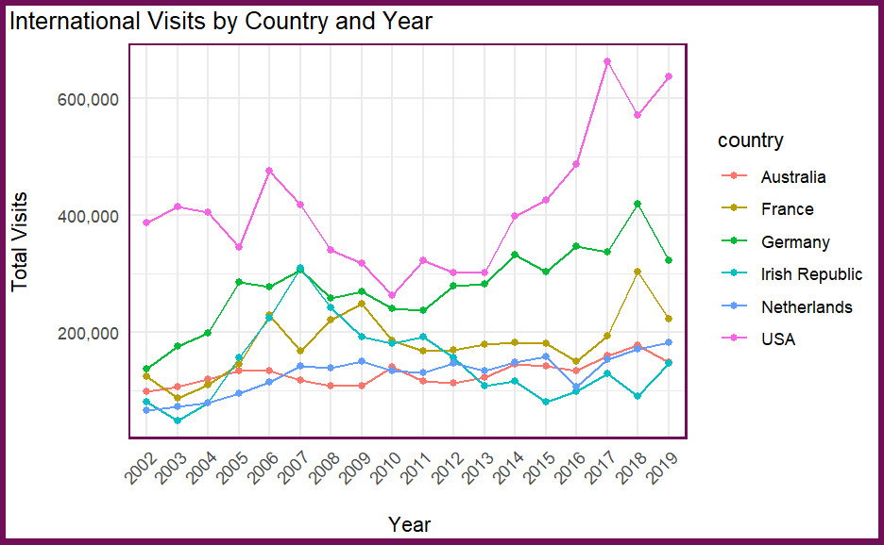
8. Additional International Data
International Visits
American visits have more than doubled in 12 years!
All other nationalities trending upwards but more slowly.
Marketing campaign for Americans be mirrored with other nations?
Notes:
This shows us our additional international visits data. Ive done the top 6 countries.
All figures come from the Great Britain Tourism Survey (GBTS) and represent 3-year annual averages due to small sample sizes on regional level.
You can see that the American visitors have more than doubled since 2010 – Has there been targeted marketing at this.
I know Visit Scotland have concentrated some marketing work on Scottish Clans and the Scottish Diaspora which may explain some of this increase in US visits.
There are no noticeable downward trends from Brexit vote of 2016, perhaps visit Scotland had a targeted campaign in Europe to maintain visits into Scotland.

Slide 19
9. Modelling - Is there any way to predict spending and visits for Visit Scotland?
The summarized data did not lend itself brilliantly to model building
I tried a number of models in python.
Had limited success with Linear Regression with the location dataset – was limited by the number of rows and the model was overfit. Meaning that it would be useless on other data as it was trained ‘too well’ with the meagre data we had.
I had slightly better success with the international dataset and achieved an R2 value of 68, meaning that the model could explain 68% of the data. This was with Lasso regression. Again, not brilliant but it’s a start. Perhaps with more work this could be improved but It may also be the case that its difficult to predict exactly the visitor numbers on a year-by-year basis based on available data.
Notes:
I will look at 1-7 individually. Question 8 regarding change over time will be dealt with in my answers to questions 1-7. Question 9 is more about modelling and will be dealt with last. An extra section on additional international data will be also discussed

Slide 20
Summary
All tourism is generally trending upwards over time in visits, expenditure and nights stayed.
This is particularly apparent in USA visitors which have more than doubled since 2010. Use this marketing campaign in other countries?
2017 was a peak year – this would be worth investigating if Rough Guide rating Scotland worlds most beautiful country had an impact (and trying to get in again!)
Data used was already summarised – it would be useful to apply this analysis on the original data.
COVID is going to wreck all this data – almost starting at zero again regarding trends etc.
Next Steps/Ideas:
Scrape twitter for tweets regarding visit scotland mentions.
Geospatial analysis of regional data.
Better models with un-summarised data.
Review data for accuracy - totals haven't always added up.
Better data collection!
Notes:
I will look at 1-7 individually. Question 8 regarding change over time will be dealt with in my answers to questions 1-7. Question 9 is more about modelling and will be dealt with last. An extra section on additional international data will be also discussed

