Slide 1
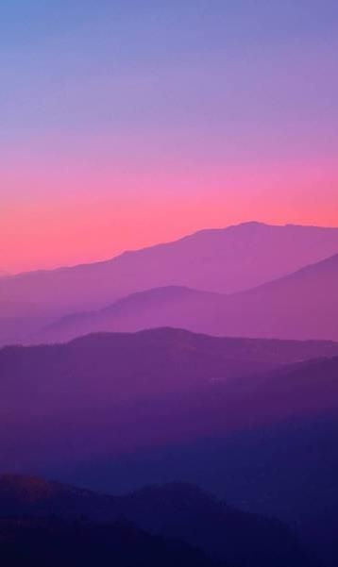

Visit Scotland CodeClan Final Project
Neil Plenderleith

Slide 2
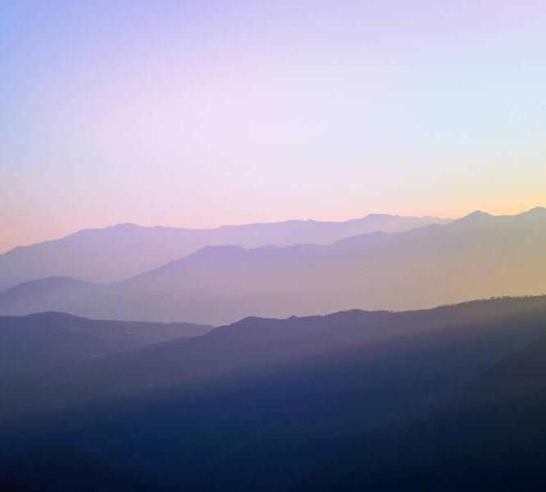
Introduction
We would like gain more understanding about our tourism data for Scotland.

Slide 3
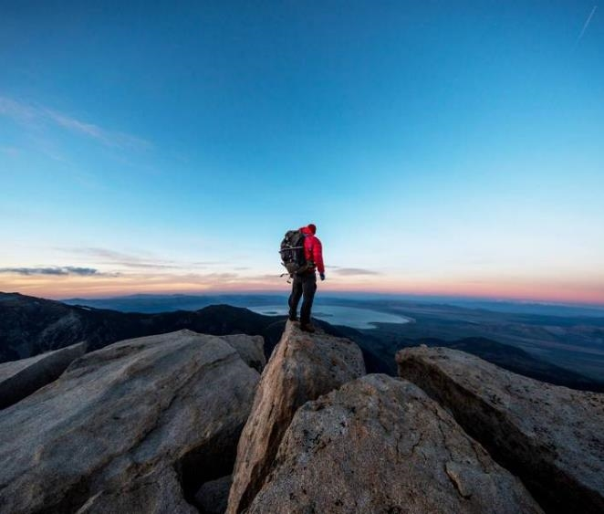
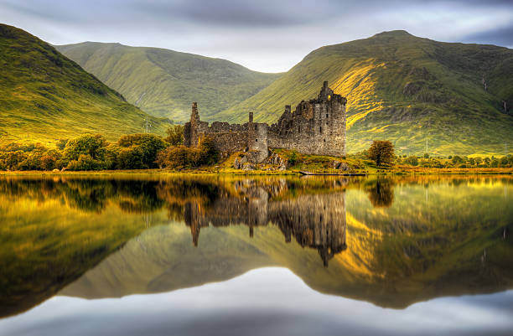
Business Questions
What kind of tourism activity generates the highest income for Scotland?
Which kind of activity generates the most visits to sites?
Is there a particular key demographic of visitors we should be focusing on? Who spends the most? Who visits the most?
What type of locations receive the most visits? What kinds of locations do people spend the most in?
Is there a particular method of travel our visitors arrive by? Some of our locations are remote and not easily accessible by public transport, so this would be good information to have.
When looking at regional tourism, what insights can we gain? Where are our visitors from? How do they differ in the money they spend, nights they spend in Scotland, or number of visits they do?
What type of accommodation is most popular? Is there a difference by location?
How have general tourism rates changed over time?
Is there any way to predict spending and visits for Visit Scotland?
Notes:
Fairly large set of Business Questions hope I have enough time to do them justice.
I will look at 1-7 individually. Question 8 regarding change over time will be dealt with in my answers to questions 1-7.
Question 9 is more about modelling and will be dealt with last. An extra section on additional international data will be also discussed
Quick note – Data is pre-summarized?

Slide 4
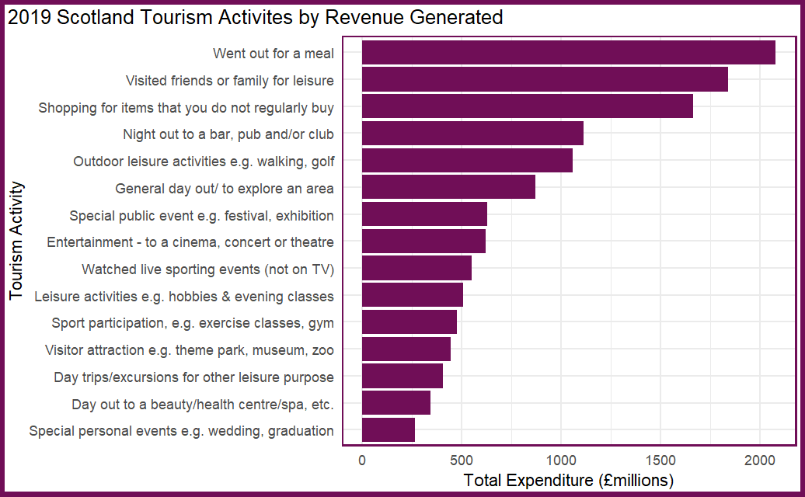
1. What kind of tourism activity generates the highest income for Scotland?
Activity by Revenue
2019 Tourism Activities by Revenue
Appear to be a ‘top 6’

Slide 5
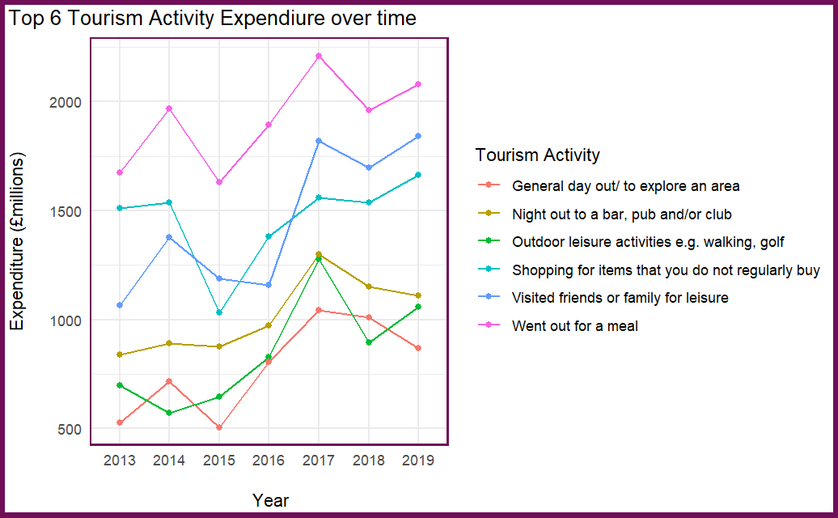
1. What kind of tourism activity generates the highest income for Scotland?
Top 6 Tourism Activities over time
Appear to be a ‘top 6’
Notes:
All of these trend upwards over time. Massive jump in visiting friends and family 2016 – 2017 of approx 1 billion! Look at unsummarised data, ideally by region to see where this occurred.

Slide 6
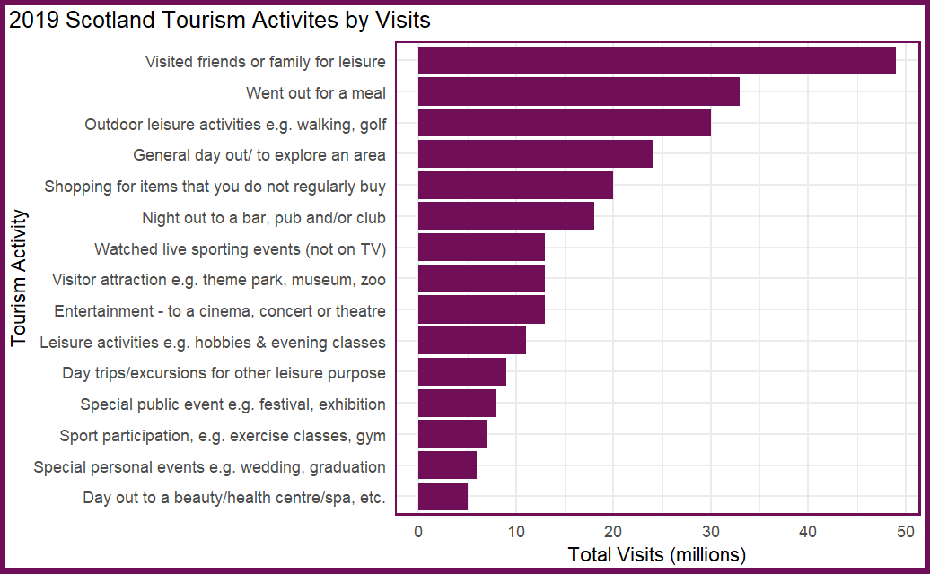
2. Which kind of activity generates the most visits to sites?
Activity by Visits
2019 Tourism Visit Activities
Similar ‘top 6’ to tourism expenditure

Slide 7
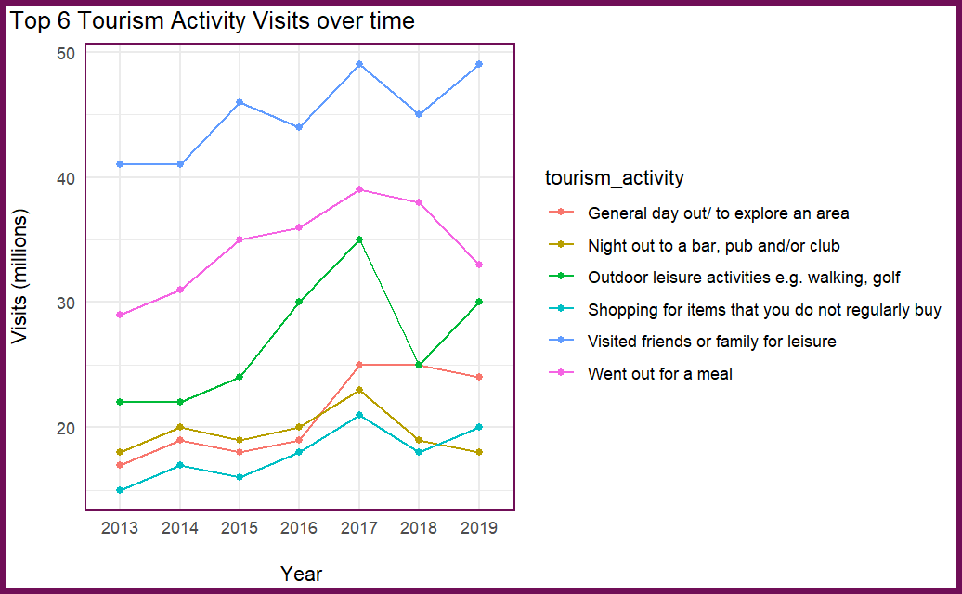
2. Which kind of activity generates the most visits to sites?
Top 6 Tourism Activities over time
Appear to be a ‘top 6’
Notes:
All of these trend upwards over time
Visits on all but nights out at bars are going up over time so the increase expensiture we saw cant all be associated with inflation. Big drop (10m!) in Outdoor leaisure activities 2017-2018 despite was the UK’s warmest summer since 2006,
the driest since 2003 and the sunniest since 1995.Was it too nice a summer? Look at non - summarised data would be good.

Slide 8
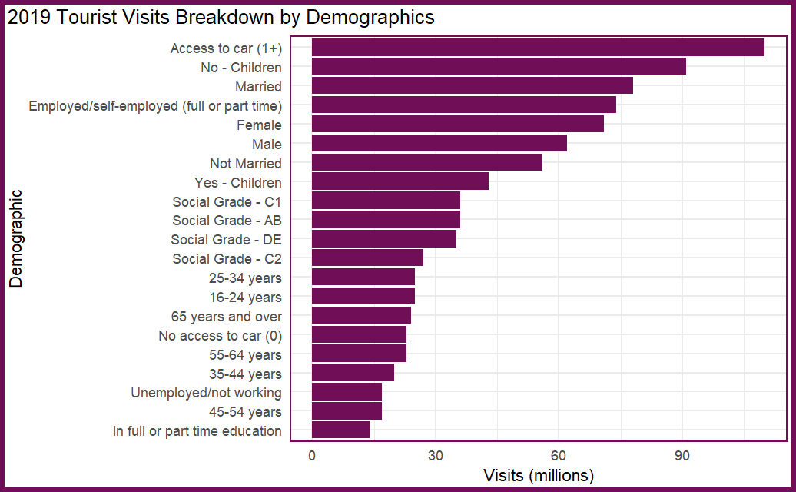
3. Is there a particular key demographic of visitors we should be focusing on?
Who visits the most?
2019 Tourism Visits by Demographic
Access to car, married, employed with no kids – primary market
Age group 45-54, social group C2 both under represented
Notes:
Flipped this round and done visits first.

Slide 9

3. Is there a particular key demographic of visitors we should be focusing on?
Who spends the most?
2019 Tourism Expenditure by Demographic
Access to car, married, employed with no kids – primary market
Social grade AB overspend compared to other groups

Slide 10
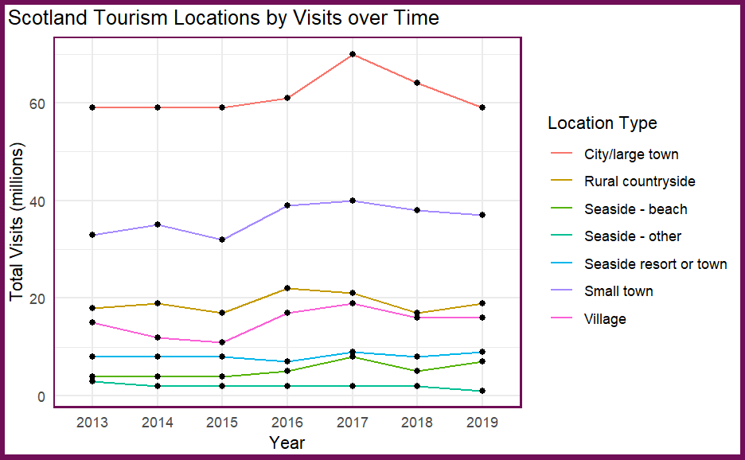
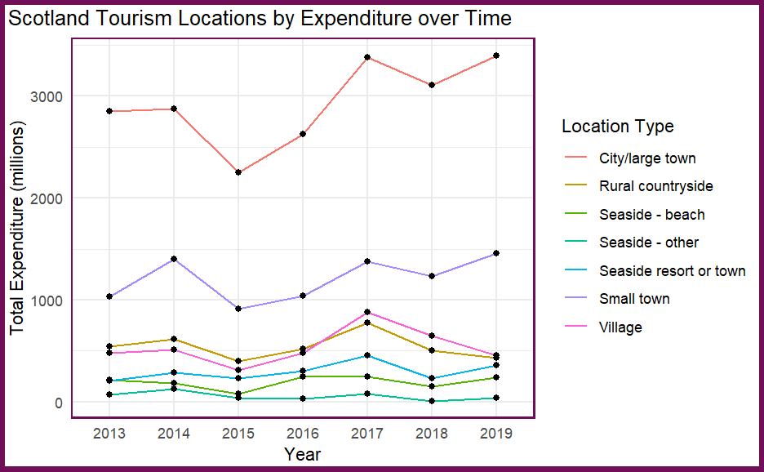

4. What type of locations receive the most visits? What kinds of locations do people spend the most in?
Notes:
Rough Guides names Scotland as the world's most beautiful country in 2017 – could this be a reason for the increase in city visits? Nearly a 10m increase? Worth a further look at non summarised data

Slide 11
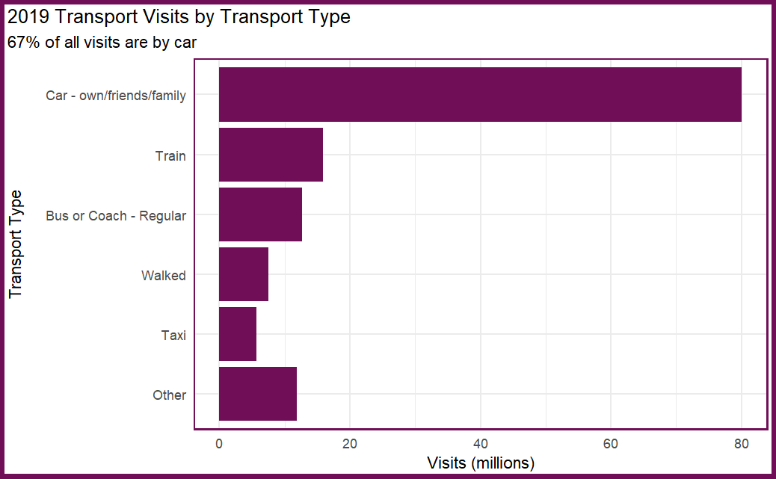
5. Is there a particular method of travel our visitors arrive by?
Tourist Transport
2019 Tourism Visits by Transport Type
Car massively predominant means of transport – 2/3 of all visits.
Don’t need to worry about remote sites!
Grouped “Other” category includes planes, ferries, tube, bike, tram etc.
Notes:
Flipped this round and done visits first.

Slide 12
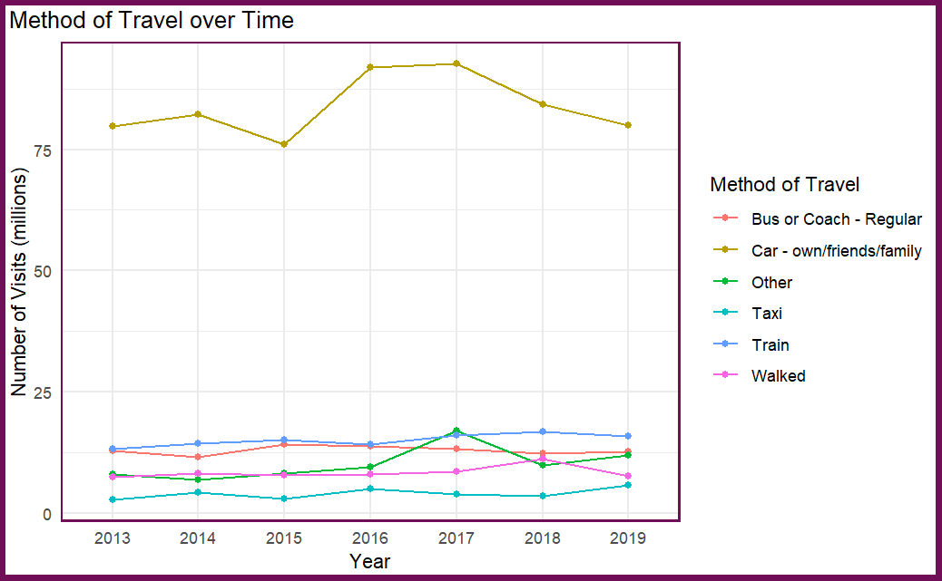
5. Is there a particular method of travel our visitors arrive by?
Tourist Transport over time
Car is King
Little yearly variation
Notes:
Flipped this round and done visits first.

Slide 13
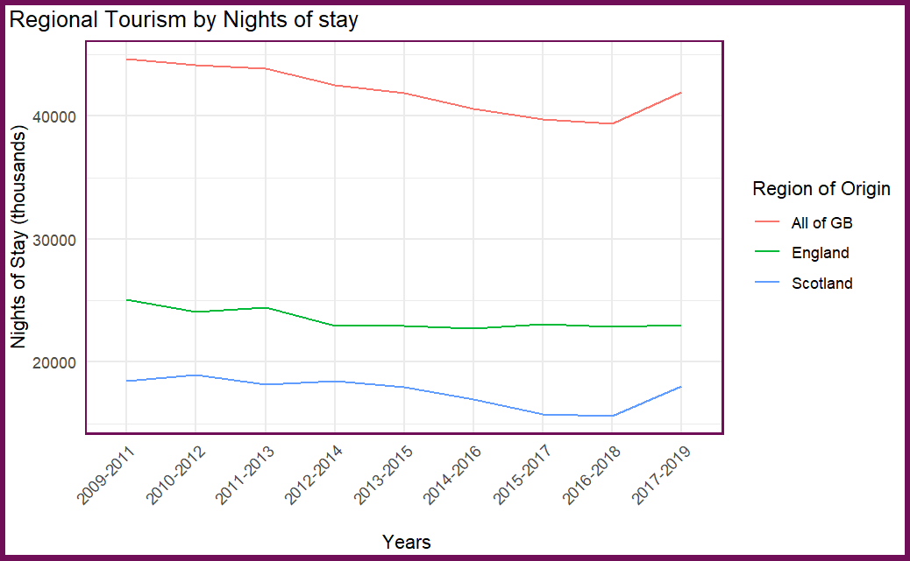
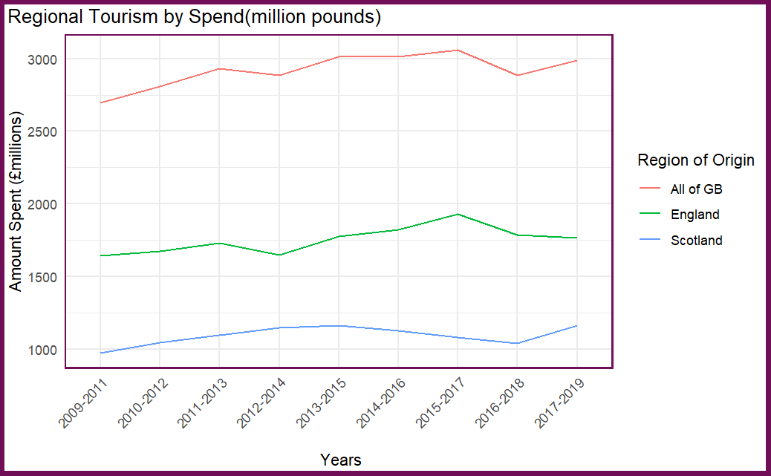
6. When looking at regional tourism, what insights can we gain?
Notes:
Have not posted number of visits. These are roughly equal between England and Scotland
English stay longer and spend more

Slide 14
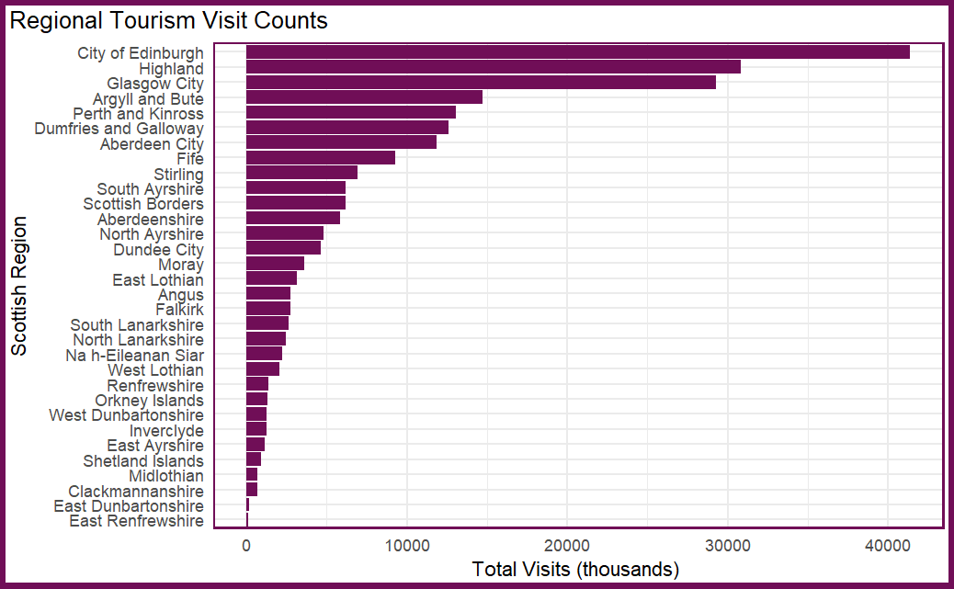
6. When looking at regional tourism, what insights can we gain?
Tourist Visits by Region
Largely skewed towards Cities of Edinburgh and Glasgow
Highland and Argyll largely rural areas also popular
Some regions especially East Ren and East Dumbarton almost zero visits.
Expenditure almost a mirror image of this graph
Notes:
Flipped this round and done visits first.

Slide 15
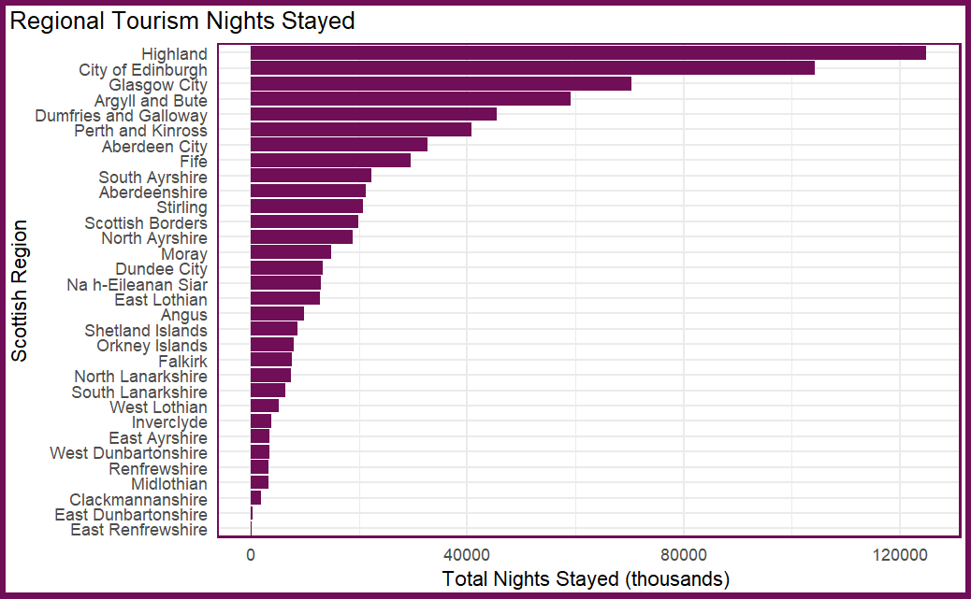
6. When looking at regional tourism, what insights can we gain?
Tourist Nights by Region
For nights stayed, Highland overtakes the cities, Argyll and Bute also moves up
Seems more remote areas invite longer stays from visitors.
Some regions especially East Ren and East Dumbarton almost zero nights stayed.
Notes:
Flipped this round and done visits first.

Slide 16
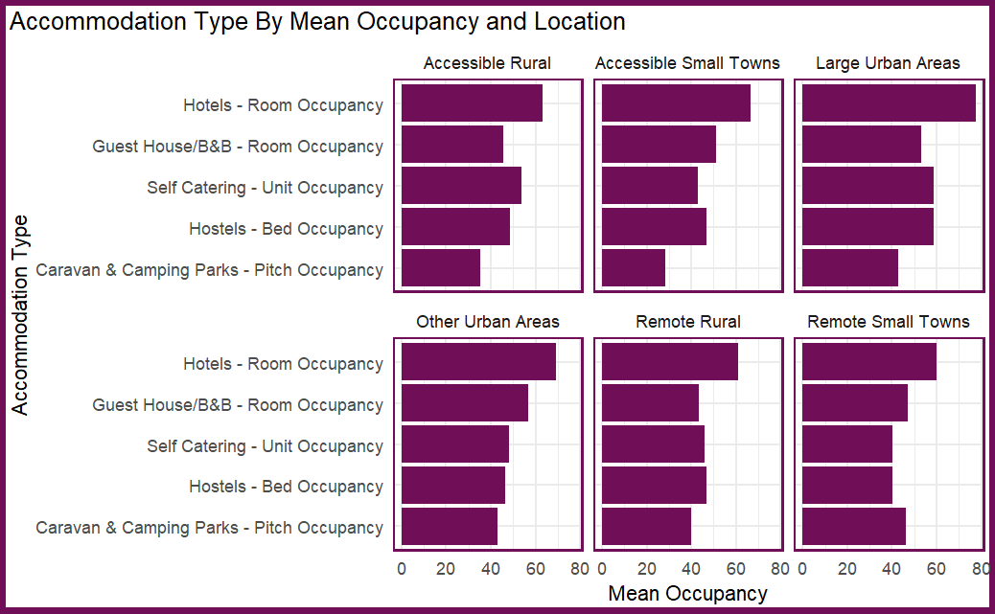
7. What type of accommodation is most popular? Is there a difference by location?
Accommodation by Location and Mean Occupancy
Hotels most popular accommodation across the board.
Other types vary according to location, e.g. the more remote the more popular camping and caravanning.
Notes:
Flipped this round and done visits first.

Slide 17
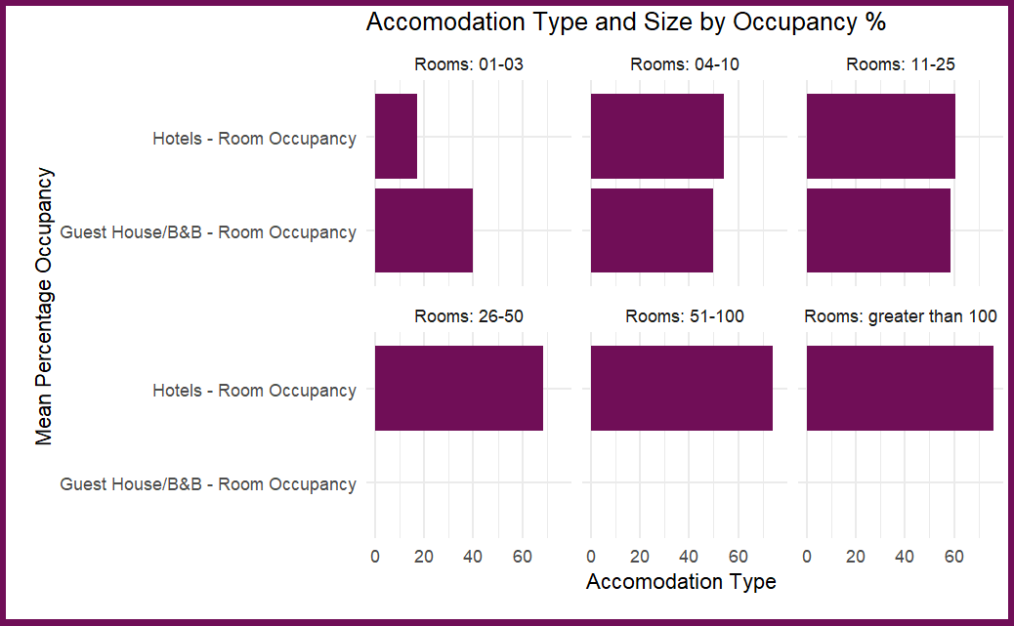
7. What type of accommodation is most popular? Is there a difference by location?
Accommodation by Location and Mean Occupancy
Hotel mean occupancy rises with hotel size.
Guest house and B&B occupany follows same trend
Notes:
Flipped this round and done visits first.

Slide 18
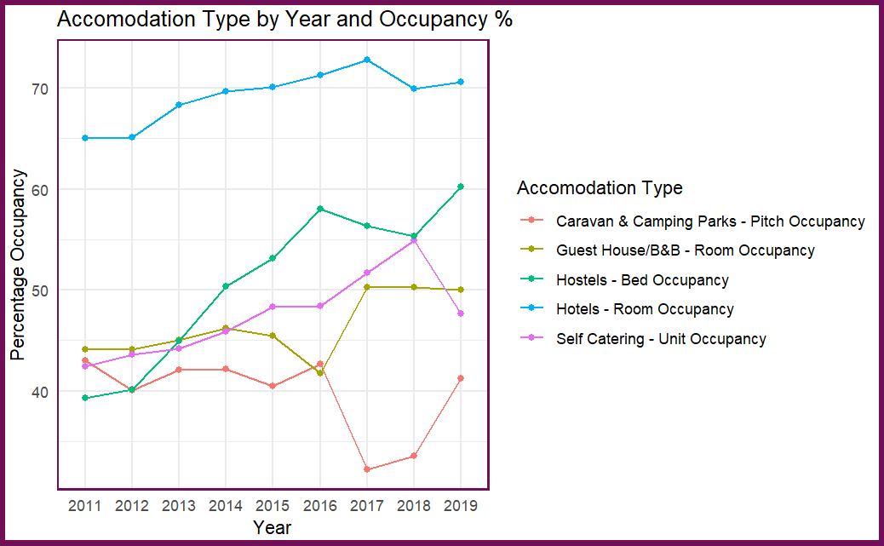
7. What type of accommodation is most popular? Is there a difference by location?
Accommodation by Location and Mean Occupancy
Notes:
Flipped this round and done visits first.

Slide 19
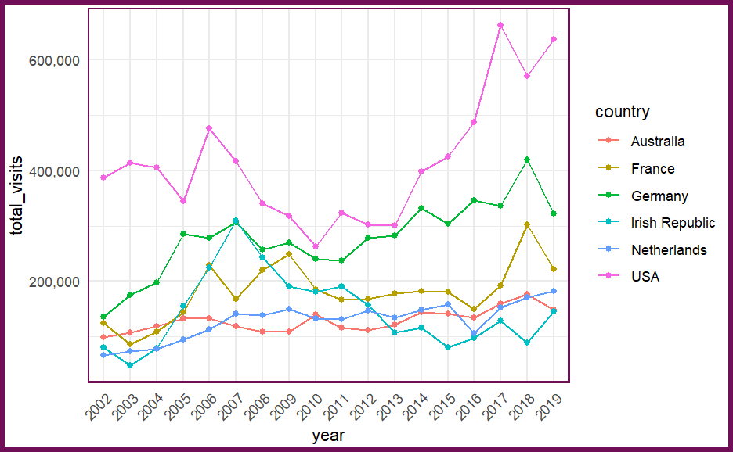
8. Additional International Data
International Visits
American visits have more than doubled in 12 years!
All other nationalities trending upwards but more slowly.
Notes:
Domestic tourism statistics by region and year. All figures come from the Great Britain Tourism Survey (GBTS) and represent 3-year annual averages due to small sample sizes on regional level.

Slide 20
9. Modelling - Is there any way to predict spending and visits for Visit Scotland?
Notes:
I will look at 1-7 individually. Question 8 regarding change over time will be dealt with in my answers to questions 1-7. Question 9 is more about modelling and will be dealt with last. An extra section on additional international data will be also discussed

Slide 21
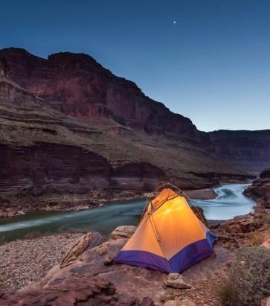
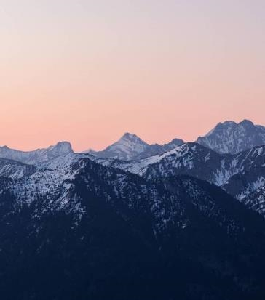
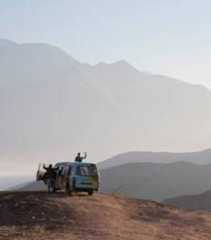
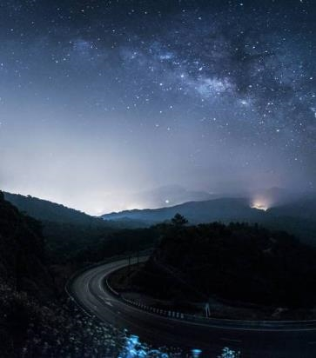
Summary
With PowerPoint, you can create presentations and share your work with others, wherever they are. Type the text you want here to get started. You can also add images, art, and videos on this template. Save to OneDrive and access your presentations from your computer, tablet, or phone.

Slide 22

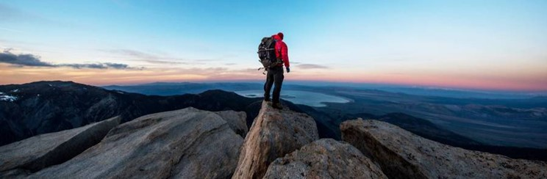
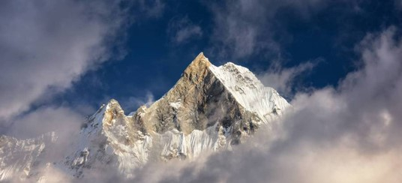
Topic one
Subtitle

Slide 23
Chart

Slide 24
Table
 | Category 1 | Category 2 | Category 3 | Category 4
Item 1 | 4.5 | 2.3 | 1.7 | 5.0
Item 2 | 3.2 | 5.1 | 4.4 | 3.0
Item 3 | 2.1 | 1.7 | 2.5 | 2.8
Item 4 | 4.5 | 2.2 | 1.7 | 7.0

Slide 25
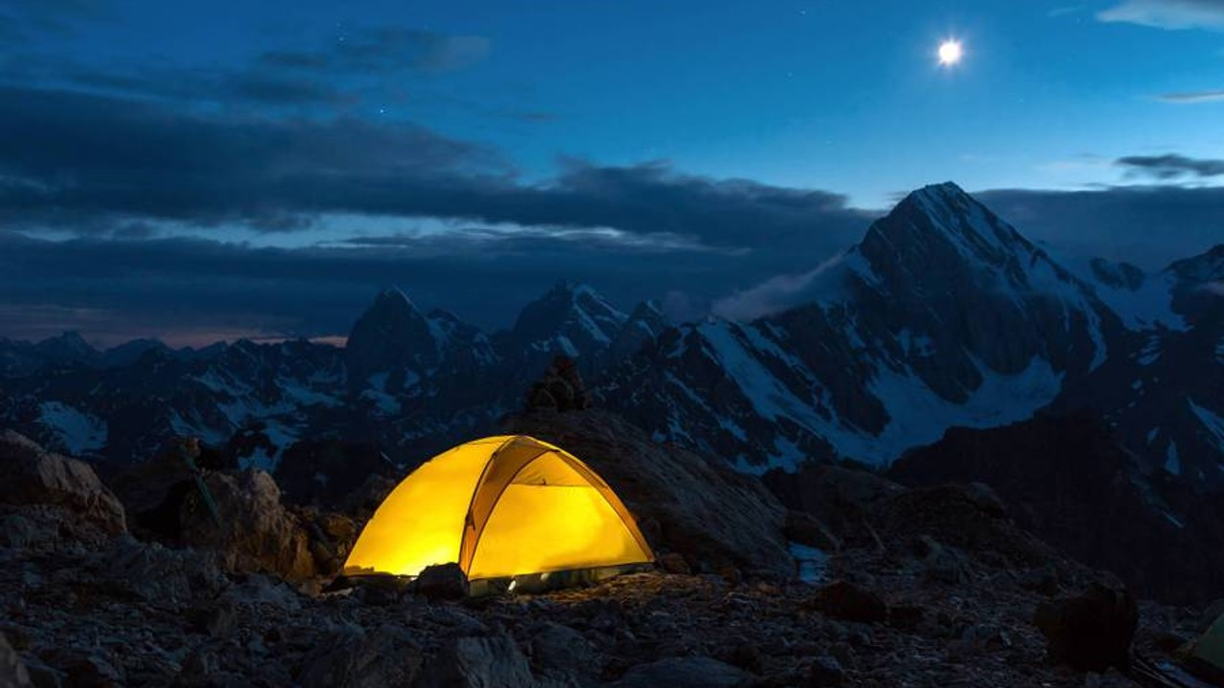
The way to get started is to quit talking and begin doing.
Walt Disney

Slide 26
Team
Name Title
Name Title
Name Title
Name Title

Slide 27
Timeline
Title
To start a presentation, go to the Slide Show tab, and select From Beginning.
Title
To display Presenter view, in Slide Show view, on the control bar at the bottom left select the three dots, and then Show Presenter View.
Title
During your presentation, the speaker notes are visible on your monitor, but aren't visible to the audience.
Title
The Notes pane is a box that appears below each slide. Tap it to add notes.
Title
If you don’t see the Notes pane or it is completely minimized, click Notes on the task bar across the bottom of the PowerPoint window.

Slide 28
Content
Subtitle
Subtitle
Add text, images, art, and videos.
Add transitions, animations, and motion.
Save to OneDrive, to get to your presentations from your computer, tablet, or phone.
Open the Design Ideas pane for instant slide makeovers.
When we have design ideas, we’ll show them to you right there.

Slide 29
Additional content
Subtitle
Subtitle
Subtitle
Add text, images, art, and videos.
Add transitions, animations, and motion.
Save to OneDrive, to get to your presentations from your computer, tablet, or phone.
This PowerPoint theme uses its own unique set of colors, fonts, and effects to create the overall look and feel of these slides.
PowerPoint has tons of themes to give your presentation just the right personality.
Open the Design Ideas pane for instant slide makeovers.
When we have design ideas, we’ll show them to you right there.

Slide 30
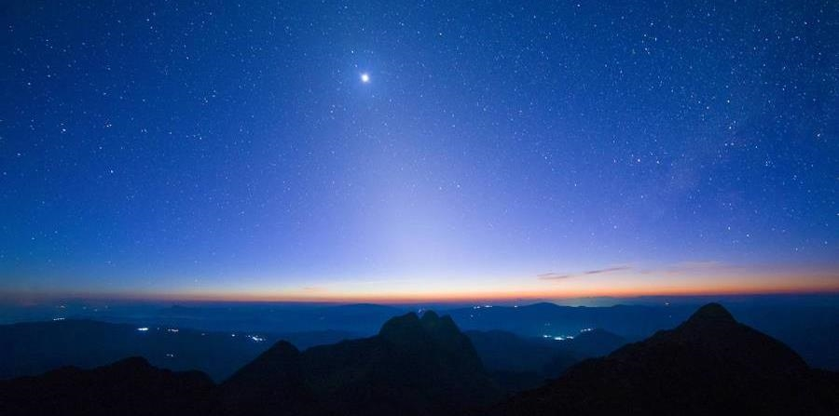
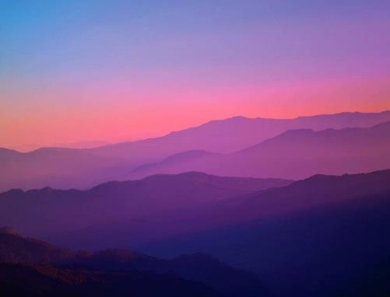
Thank you
Presenter name
Email address
Website

