Slide 1
Creidit card Fraud Detection
By Neil Pradhan

Slide 2
How does the data look like ?
What are types of Credit card Frauds ?
What are these features about ?
What do we focus on when we do ML training
Data Source: Credit Card Fraud Detetion dataset on Kaggle
https://www.kaggle.com/datasets/mlg-ulb/creditcardfraud
Time | Fraud | V1 | V2 | V3 | V4 | V5 | V6 | V7 | V8 | ... | V20 | V21 | V22 | V23 | V24 | V25 | V26 | V27 | V28 | Amount
0 | 1000 | 0 | 1.1646 | 0.2688 | 0.4837 | 1.2669 | -0.6032 | -1.2784 | 0.2192 | -0.2401 | ... | -0.1543 | 0.0689 | 0.1658 | -0.0453 | 0.9155 | 0.5890 | -0.3618 | 0.0066 | 0.0283 | 26.00
1 | 100004 | 0 | -0.8044 | -0.6389 | 2.1726 | 0.3699 | 0.6768 | -0.0729 | -0.8398 | 0.1802 | ... | 0.2084 | -0.0858 | -0.0964 | 0.1114 | 0.5109 | -0.6930 | 0.4495 | -0.0893 | -0.0534 | 7.99
2 | 100004 | 0 | 1.9701 | 0.1128 | -1.6184 | 1.4330 | 0.5694 | -0.6166 | 0.3718 | -0.2556 | ... | -0.3728 | -0.0742 | 0.1108 | -0.0444 | -0.4894 | 0.3921 | -0.5226 | -0.0590 | -0.0814 | 29.70
3 | 10002 | 0 | 1.1253 | 0.0365 | 1.5509 | 1.6339 | -1.1273 | -0.3607 | -0.6802 | 0.0205 | ... | -0.2189 | -0.1959 | -0.1486 | 0.0512 | 0.6324 | 0.3265 | -0.4659 | 0.0417 | 0.0345 | 12.99

Slide 3
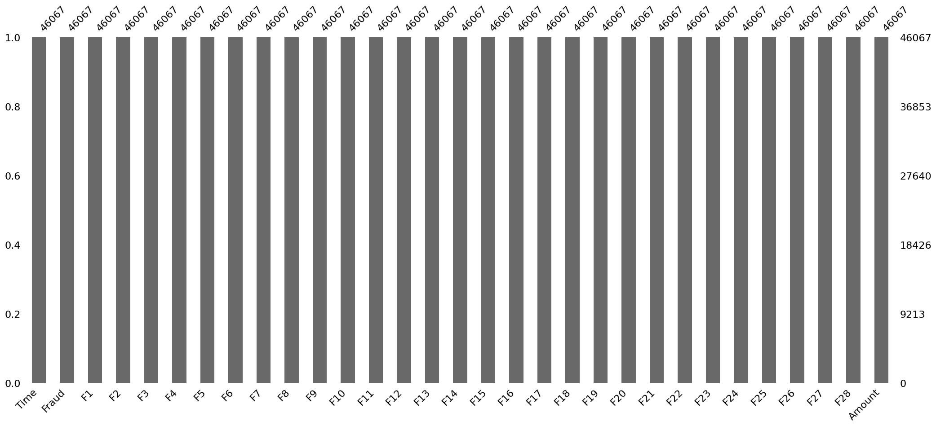
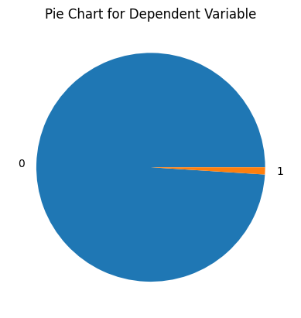
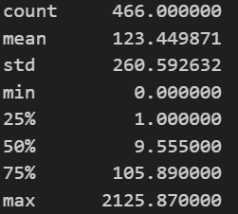
Investigating the Given data
No Missing values
45601 data points are non fraud
466 data points with Fraud
25 rows where Amount is 0.0 [5.3%]
169 rows where Amount is less than and equal to 1.0 [~36.2%]

Slide 4
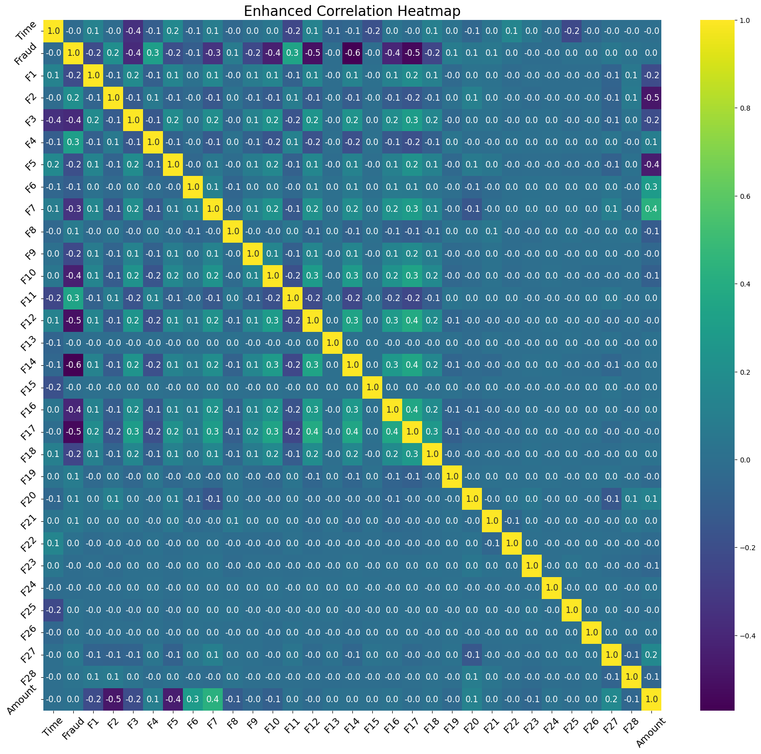
Feature Analysis and Engineering
Linear Correlational Analysis using Heat Map
Notes:
Limitations
Only Measures Linear Relationships:
Correlation Does Not Imply Causation
Sensitive to Outliers:
A few extreme values can significantly affect the correlation coefficient, potentially giving a misleading impression of the strength or direction of the relationship
Difficulty in Interpreting Complex Relationships
Potential Overemphasis on Small Differences:
Requires Bivariate Normality for Accuracy:
For the Pearson correlation coefficient to be a valid measure of association, the data should ideally follow a bivariate normal distribution. This is not always the case in real-world data.
Does Not Account for Confounding Variables:
Correlations shown in a heatmap may be the result of confounding variables that are not included in the heatmap. This can lead to incorrect interpretations if not properly accounted for.
Scale Sensitivity:

Slide 5
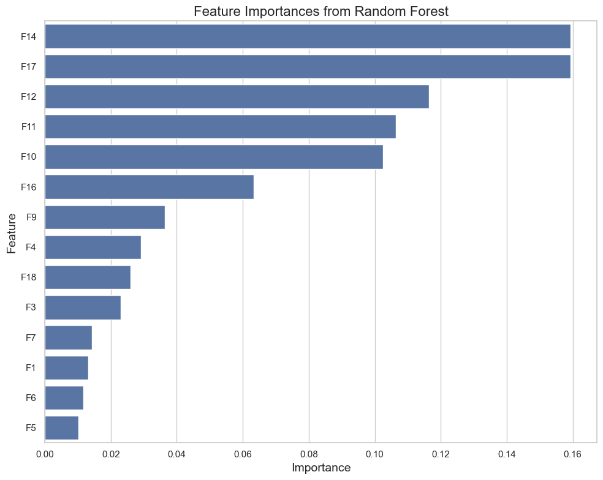
Feature Importance using Random Forest classifier

Slide 6
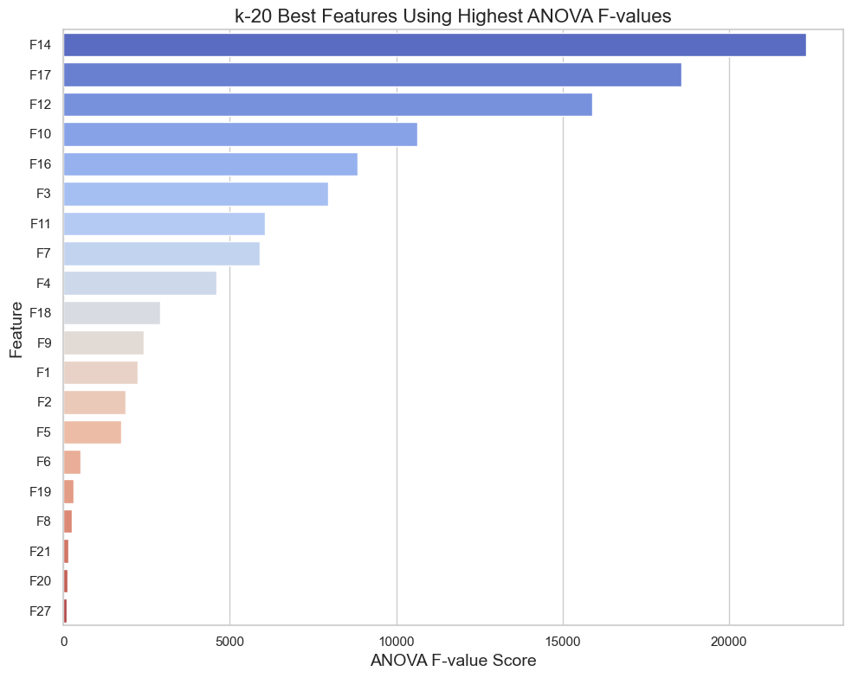
Best Features using highest ANOVA F-values

Slide 7
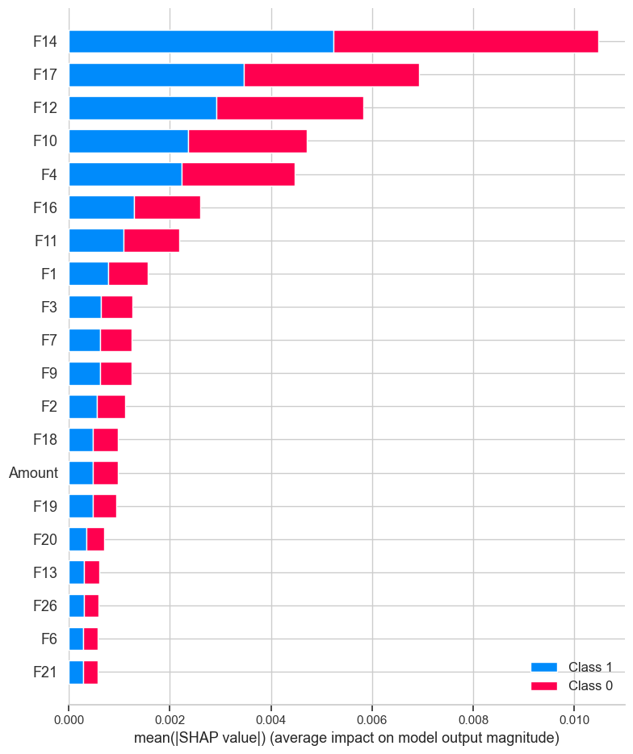
Feature Importance with Shapley

Slide 8
Top 8 Feature selection
F14 and F17 have very high importance in both ANOVA and Random Forest Classifier
F12: High importance in both Random Forest and ANOVA.
F10: Similarly high in both metrics.
F16: Shows significant F value and reasonable importance.
F3: High ANOVA F value and present in Random Forest importances.
F11: Good importance score in Random Forest and presence in ANOVA F values.
F4: Not the highest in ANOVA but has a good importance score in Random Forest.
F9: Similar rank in ANOVA and Random Forest Feature importance
While experimenting with different features spot if duplicates are present in data especially checking if the ‘Fraud’ is 1 or 0 based on selected feature choice for eg rows with same ‘F12’, ‘F17’.. But different value for Fraud or different value of ‘Amount’
Wrote Function to check if duplicated rows with features selected not have different value for Frauds or Amount. [This will help us understand if selected features are enough or not]

Slide 9
Two types of Cost
1. Cost calculated when doing inference or cost to the company or Operational Cost or Economic cost
2. Cost of each sample while training (for example transaction with large amounts should have higher weightage when training algorithms)

Slide 10
Cost Benefit Analysis: Cost for the company
Cost of verifying a Fraud: False Positives
Cost of a transaction that is a Fraud but our Algorithm doesn’t detect it: False Negatives
False Negatives should be much more important that False Positives as even though both have costs, the cost of not detecting a Fraud should be very high in comparison to cost of falsely detecting a Fraud. The weightage should depend on Amount of transaction

Slide 11
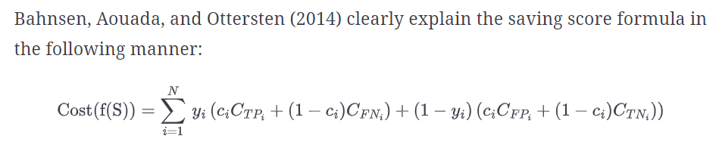
To calculate cost to company: Operational cost or Savings cost
After the Algorithm gives all results, we have True Positive, True Negatives, False Positives and False Negatives
For each row, we find the cost by the above formula
Cost of True Positive = 0, Cost of False Negative = Amount , Cost of False Positive = 1, Cost of True Negative = 0

Slide 12
Penalizing cost to the Algorithm
This is the cost that is used to train the Machine learning algorithm.
Inverse class frequency (penalizing more Fraud cases while training)
Custom heuristic weights
Quantile based weights
Should I Penalize based on Fraud and non-fraud cases or amount of Fraud committed (as in our dataset we have huge standard deviation almost 36% Fraud cases are below 1.0 Amount and 50% percentile of cases are below 9.55 Amount) ?

Slide 13
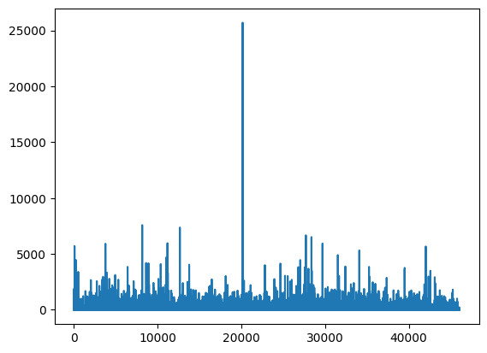
Quantile Based weights
For every row in training dataset check the amount of transaction: factor = 1e-6
In case of Fraud:
If the amount is more than 75th percentile then the sample weight is 10* factor
If the amount is between 50th to 75th percentile then the sample weight is (1.5* factor) and if the amount is less than 50th percentile then the sample weight is (1.05*factor)
In case of non-fraud:
The constant weight is 0.2

Slide 14
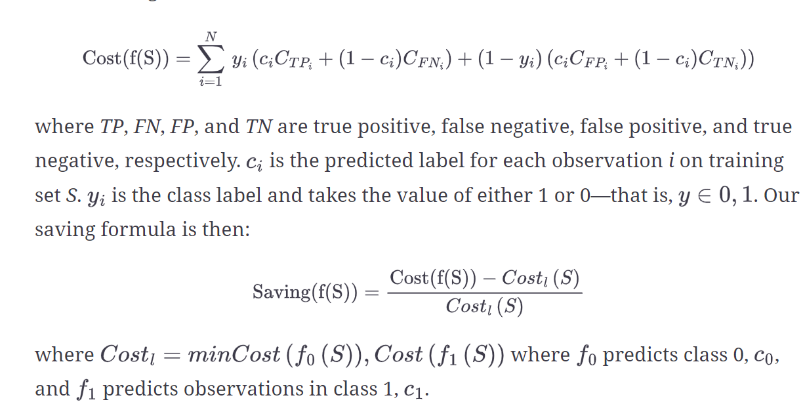
Performance Analysis of Different Supervised learning algorithms
Undersampling of the majority class for Imbalanced datasets
For logistic regression, normalization of the features before training
Classification Algorithm | F1 Score (Normal Model) | F1 Score (Cost sensitive Model) | Cost to Company (Normal Model) | Cost to Company (cost sensitive model) | Reduction in cost to company in %
Logistic Regression | 0.95 | 0.66 | 796 | 116 | 85%
Decision Trees | 0.91 | 0.91 | 1304 | 915 | 29%
Random Forests | 0.94 | 0.95 | 791 | 798 | -0.8%
XG Boost | 0.94 | 0.66 | 785 | 116 | 85.22%

Slide 15
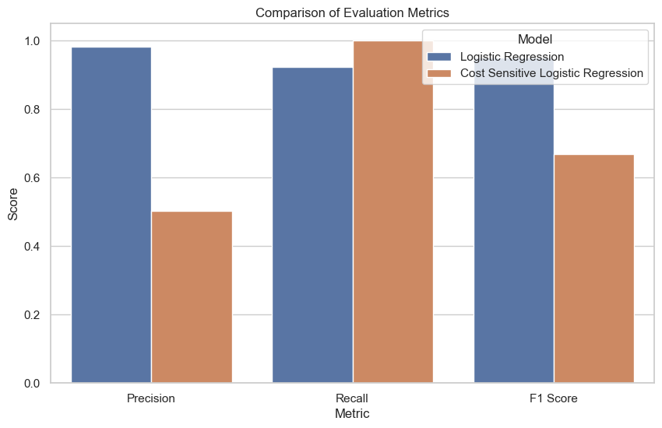
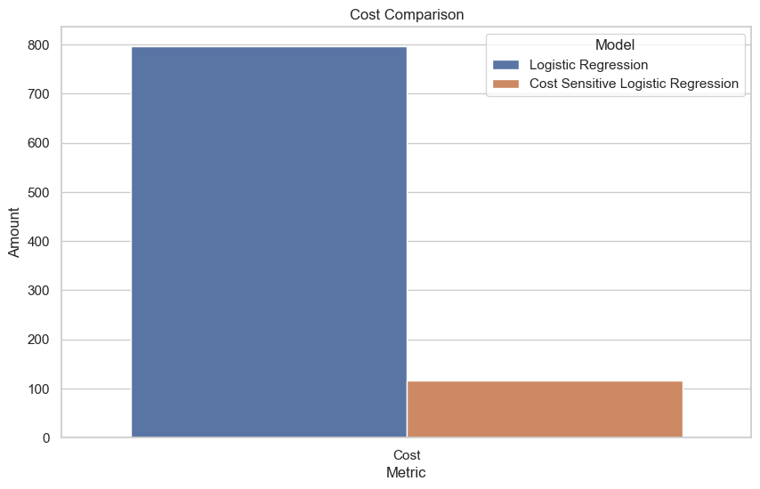
Logistic Regression results on Unseen data

Slide 16
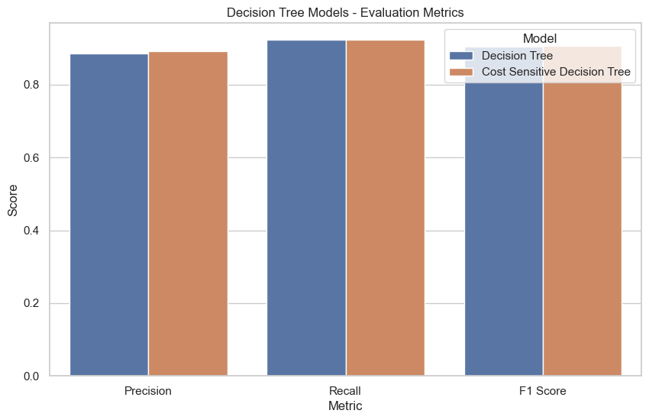
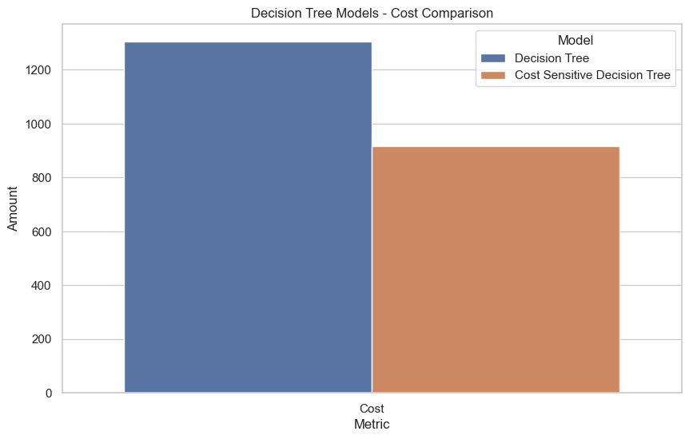
Decision Tree results on unseen data

Slide 17
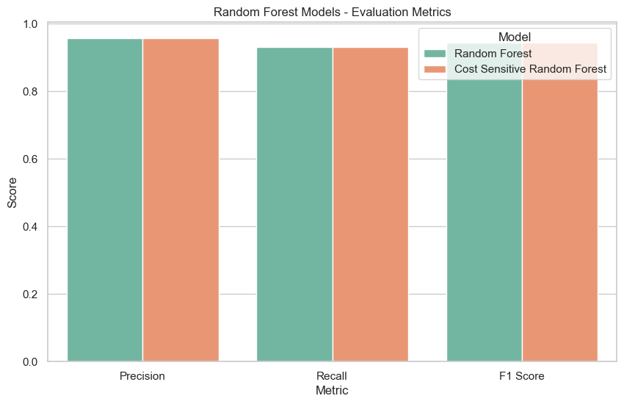
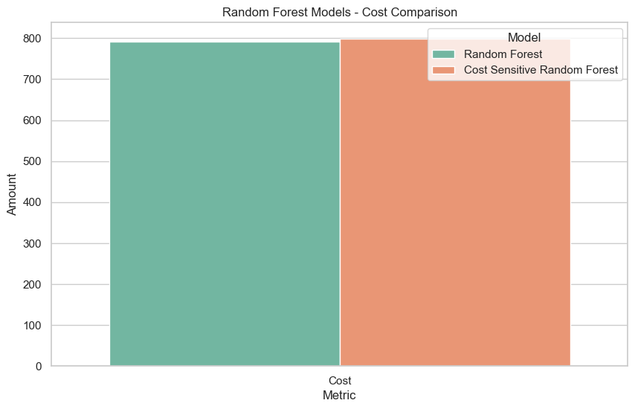
Random Forest Results on unseen data

Slide 18
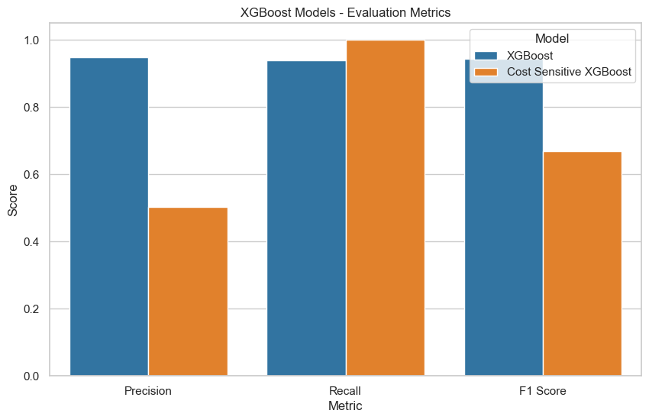
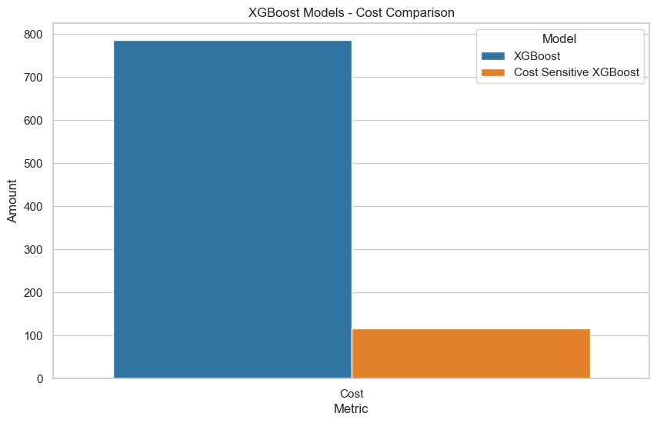
XG Boost results on unseen data

Slide 19
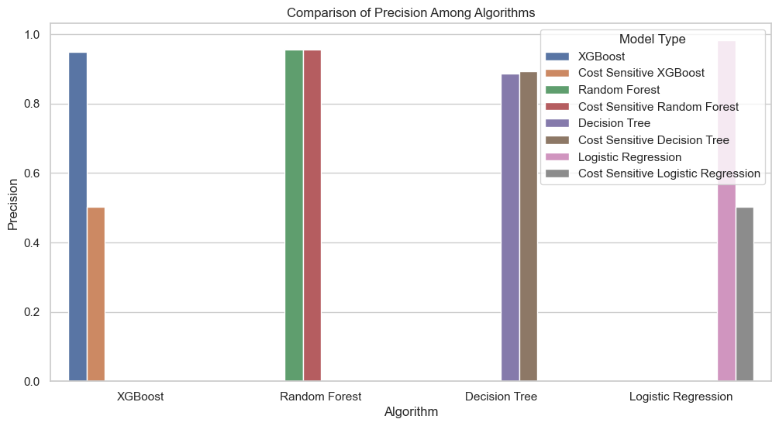
All Algorithms benchmarking

Slide 20
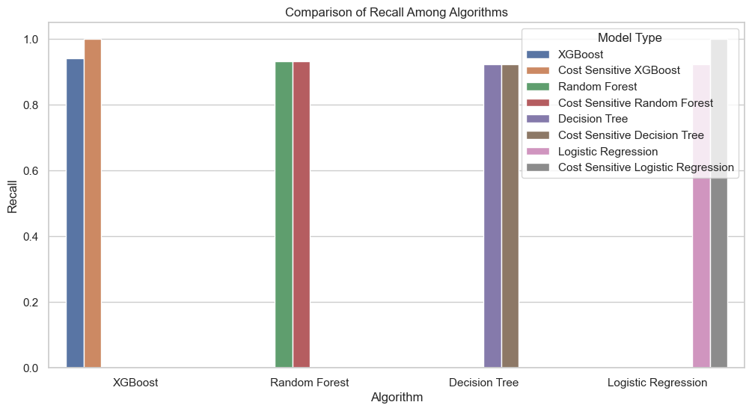

Slide 21
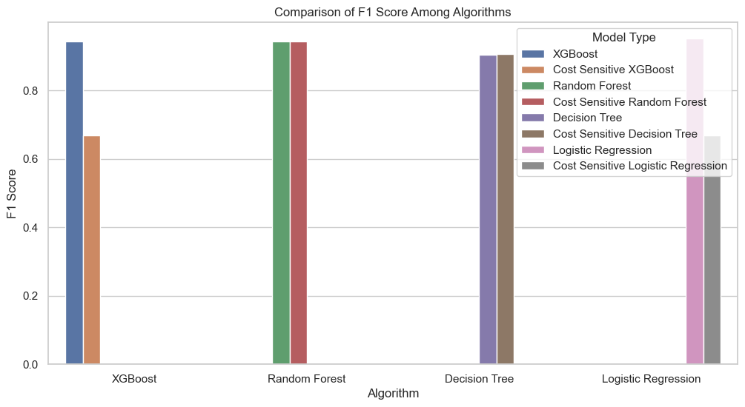

Slide 22
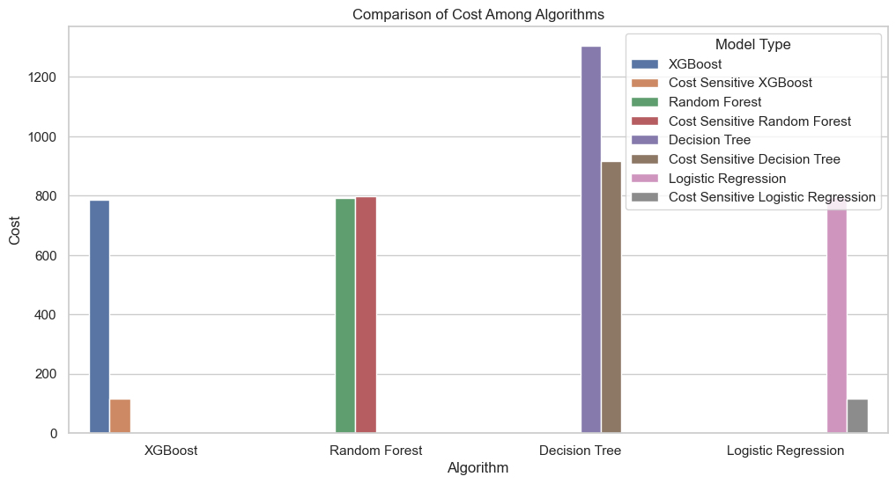

Slide 23
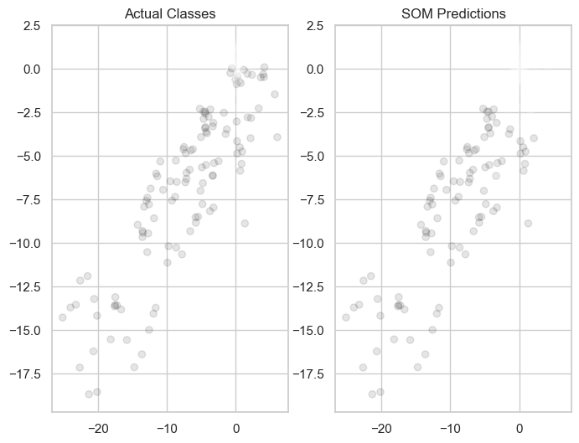
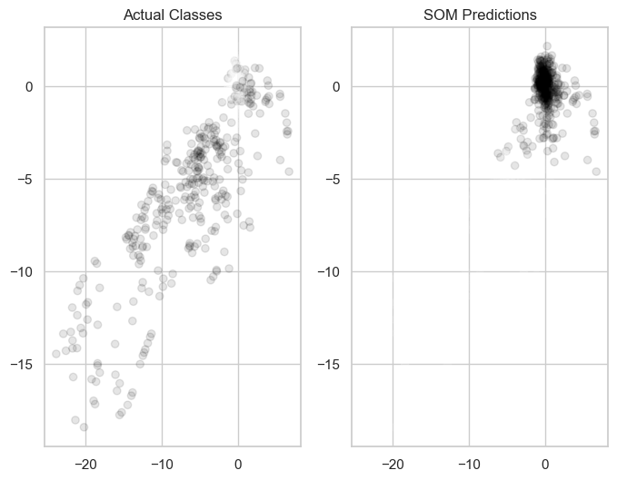
Unsupervised Learning: Self Organised Maps
No assumptions regarding the distribution of variables
Dependent structure among variables
Dealing with nonlinear structure
In the images, we see scatter plot of two Features F17 and F12 there is one bad-example of traing and one good example
Limitations:
Initialization of weights
Computational complexity
Notes:
Limitations:
Parameter Sensitivity: The choice of parameters like grid size, learning rate, and neighborhood function can greatly affect the SOM's performance.
Lack of Universal Best Practice: There is no standard rule for setting these parameters, often requiring trial and error.
Computational Complexity: For large datasets, the training process can be computationally intensive.

Slide 24

Thank you

