Slide 1
A Few Words On Interesting Concepts in Applied Machine Learning
RightHand Robotics
Neil Joshi – 07/15/16

Slide 2
Overview
2 concepts in applied ML
Feature identification and extraction
Computer Vision application – effective corner detection using vector frame/image processing
Automatic feature extraction with Learned Representations
Unsupervised learning clustering application – Deep Learning
Notes:
Over the course of this talk I will present to you 3 concepts / 3 realizations from using mathematical modeling, machine learning to infer understanding from data.
These are 3 topics with realizations that I have found interesting, done in the past. I hope you find them to be interesting as well.
These 3 topics include, feature identification and extraction, learned representations and using using Genetic learning for signal tracking and prediction.
Specifically, read each bullet point.

Slide 3
Effective Corner Detection – vector frame / image processing
Features are regularities or attributes in data useful for describing or explaining the data
Corners – corner detection, corners are useful features for visual data
Effective corner detectors – SUSAN
Works well with grayscale frames/images
What of color visual data?
Color (RGB) pixel encoded 24bits in contrast to grayscale 8bits
Notes:
The first topic and application that I would like to discuss has to do with feature identification / extraction.
Features are regularities in the data, attributes/characteristics that describe or rather explain the data. The features that I want to discuss with you are corners in visual data. Corners may be a useful feature in computer vision, visual data. Just as edges and textures are solid features in image processing, so too are corners.
Now there are effective corner detectors, as the SUSAN, however they are devised for grayscale images visual data. What about color visual data? Here I will present to you a corner detector devised for color frames/images. Premise here is that corner feature extraction is enhanced using color vector image processing. Whereas color pixels (RBG) are encoded with 24bits (3 channels 8bits each), grayscale are encoded with only 8bits. Here all 24bits is used with the SUSAN corner detector.

Slide 4
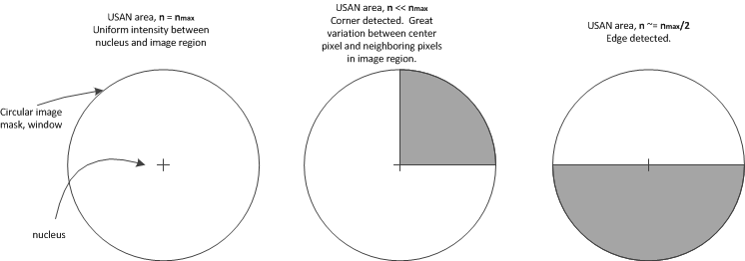
Effective corner detection : color visual data
Use extra information encoded in color images to enhance corner detection
Take SUSAN example:
evaluates intensities, I, between each pixel in image to neighboring pixels within a specified radius (windowing); formulates USAN area
Notes:
So, the premise is to use extra information encoded in color visual data to improve corner detection.
Take the SUSAN example, now the image processing detection method uses a circular mask that is applied to each pixel in an image. The center of the circle is named the nucleus. The intensity of the nucleus is compared to each pixel in circular neighborhood. This forms the USAN area. Here in the circular illustrations we can see differing USAN areas. (left) max area all pixels same intensity, (right) edge detected; area of USAN ~1/2max, (middle) corner detected USAN <<1/2max

Slide 5
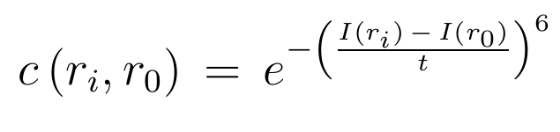
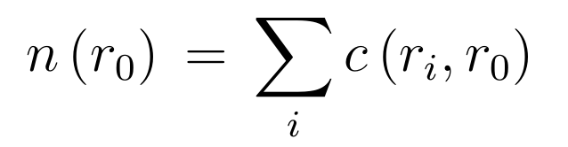
Corner detection - USAN
Define USAN area as, n, r_{o} as pixel center (nucleus), r_{i} pixel value of pixel i, then
Now, for color, use information in all channels, vector image processing (eg. Color image processing using ordered statistics)
Does it work?
Notes:
The USAN area ,n, in the illustrations in the previous, slide, can be formulated with the following. Let n be the USAN area, ro nucleus, ri pixel value of i, then define the intensity comparison between nucleus pixel ro and ri as c. This is simply a count that is either 1 when intensities are similar and 0 otherwise. The USAN is the summation of such counts across every pixel in circular mask.
For color use all 24bits of information as opposed to 8bits grayscale. This is inspired, much like work done with color edge detection, ordered statistics.

Slide 6
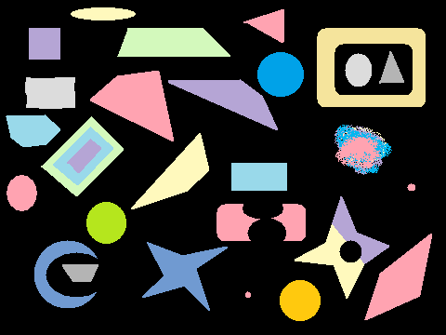
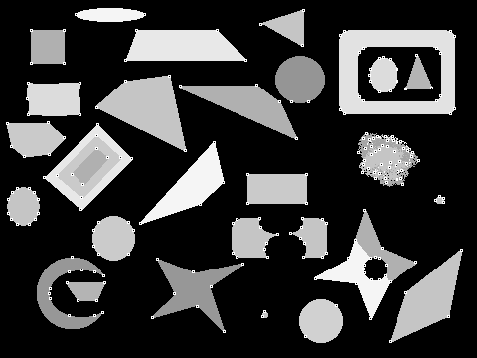

Corner detection – using vector image processing
Test images on shapes, standard USAN corner detector (a), vector corner detector (b)
(a)
(b)
Notes:
Here are images used to test and compare corner detection using SUSAN (grayscale); images in a, and my realization of color vector processing corner detection ; images in (b)

Slide 7
(a)
(b)
(a)
(b)
Notes:
Closer look at same images. Original (top), (a) grayscale, (b) vector color
No major differences. Perhaps this does not work?

Slide 8
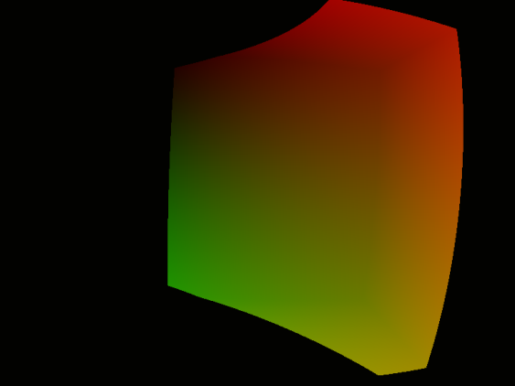
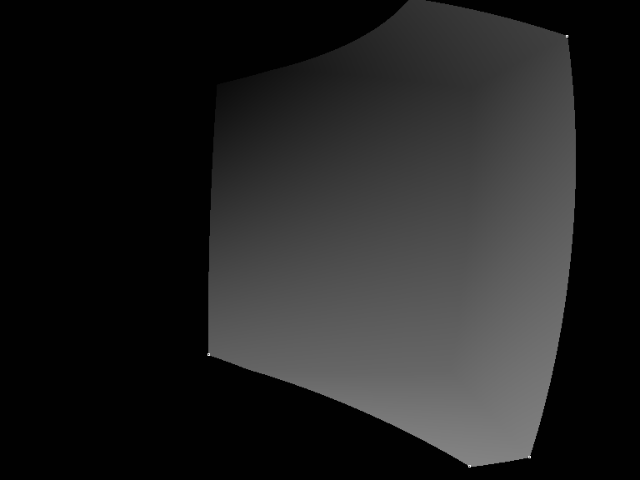


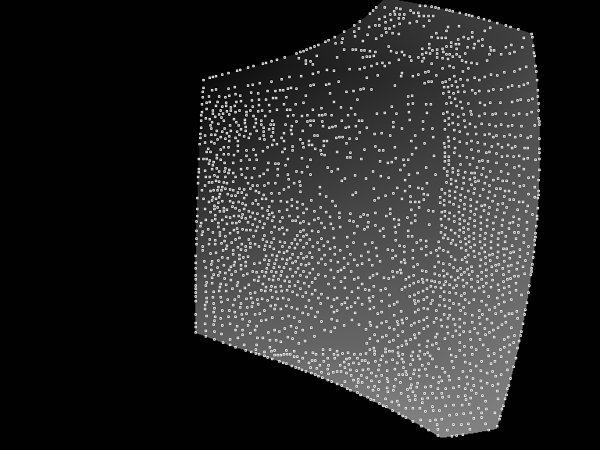
Corner detection – using vector image processing
Test images on shapes, standard USAN corner detector (a), vector corner detector (b)
t = 20
(a)
(b)
t = 1
(a)
(b)
Notes:
Here are comparisons between standard corner detector (a) and color vector corner detector (b) on color gradient image; top images has image intensity threshold, t, defined previously at higher value (less corners detected), bottom images have reduced threshold.

Slide 9
(a)
t = 20
(b)
Notes:
Closer look at images with higher threshold. (a) standard corner detector missing corner, (b) all corners detected. Still…

Slide 10
(a)
t = 1
(b)
Notes:
Here is a good illustration of the color corner detector. At a very low threshold, identifying more corners, the color corner detector (b) clearly uses additional channel information (all 24bits) of encoded pixel information in detecting corners.

Slide 11
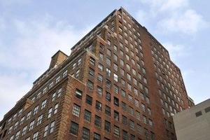
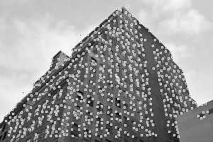
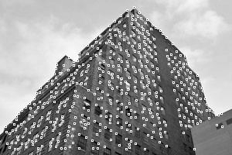
Corner detection – using vector image processing
Test images on shapes, standard USAN corner detector (a), vector corner detector (b)
(a)
(b)
Notes:
A final comparison is with this color image of a building. Focus on the center upper top corner of the building. The standard corner detector is unable to detect this corner, (starts to detect corners in background, cannot distinguish between background and building), whereas the vector color corner detector can.

Slide 12


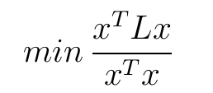
Automatic feature extraction with Learned Representations
Premise to learn good features, regularities in data that explain the data
Previous example, corner detector, is a tailored feature
Transform the input space so regularities are evident?
Spectral methods, PCA, spectral graph cluster
,
,
Notes:
Now I would like to present a method for learned representations. Premise is to identify, extract good features, regularities in data that describe the data. In the previous segment, corners were such features, yet these were tailed, handcrafted features. Can we infer from the data good data representations?
Can we transform the input space such that these regularities, commonalities in the data are evident? We can apply spectral methods, linear transforms such as PCA and Spectral Graph clustering.

Slide 13
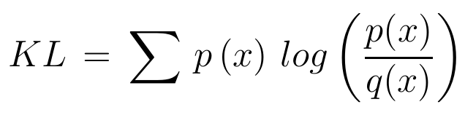
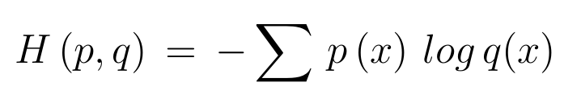
Learned Representations
Infer representation from data – minimize KL divergence between true input distribution and encoded (transformed) distribution
Notes:
These are limited in aspects. How about encoding the data such that the KL divergence between the input distribution and the encoded distribution is minimized, equivalently the cross entropy is minimized. Use to identify, uncover meaningful attributes in the data.

Slide 14
Learned Representations - Autoencoder
Realized with the Autoencoder topology
Notes:
An autoencoder is one such realization. Autoencoder is a neural network topology consisting of input layer, hidden layer and output layer. Input layer are inputs, observable; hidden layer consists of hidden units – it encodes or transforms the input space, transformed space is decoded to the output layer. Connections are fully connected between layers, no lateral connections. Trained with gradient descent; better still stochastic gradient descent.

Slide 15
Learned Representation – Deep Autoencoder
More meaningful features extracted with stacked layers ; aids in training too.
Notes:
Due to difficulties in training, several hidden layers are stacked, providing a mechanism to extract more complex meaningful features from data. Features extracted initially are low level features that combine in upper layers to realize more complex attributes, commonalities in the data.

Slide 16
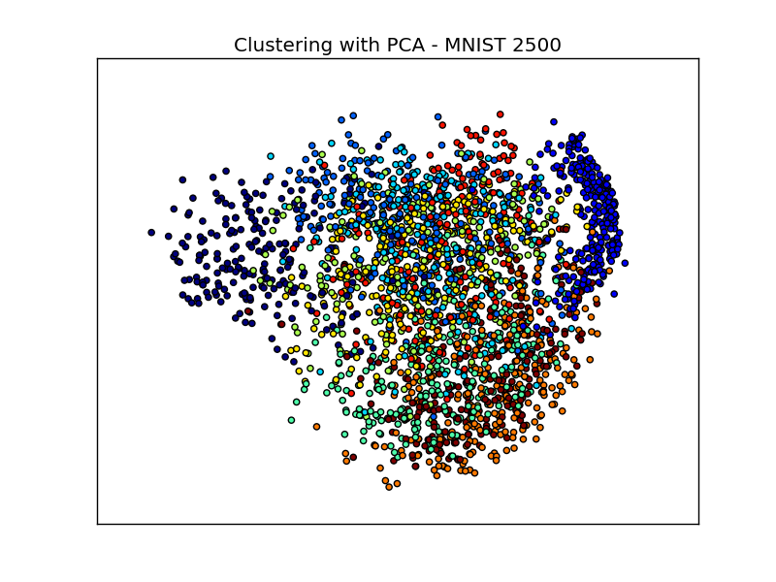
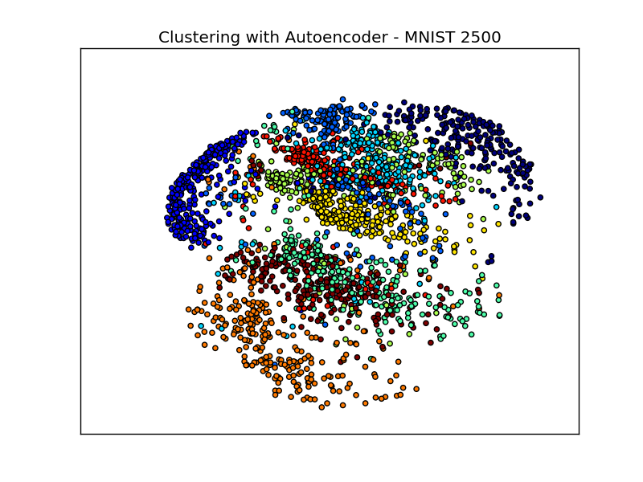
Deep Autoencoder – Clustering application example
MNIST – 2500 examples; digits 0-9
Comparison between data encoded by PCA and Autoencoder with 784-500-2000-2-2000-500-784 topology:
Notes:
It works well. To demonstrate its effectiveness, a clustering example is shown. The autoencoder is used to cluster the MNIST task. MNIST – handwritten digits 0-9. 2500 examples were used from the MNIST corpus and clustered using an Autoencoder – encoded using hidden layers with 2000-500-2 units and PCA. PCA is shown (left), Autoencoder (right). Autoencoder clearly clusters and separates 10 clusters more effectively than PCA.
This demonstrates that we can effectively learn representations from data using deep neural network architectures.

Slide 17
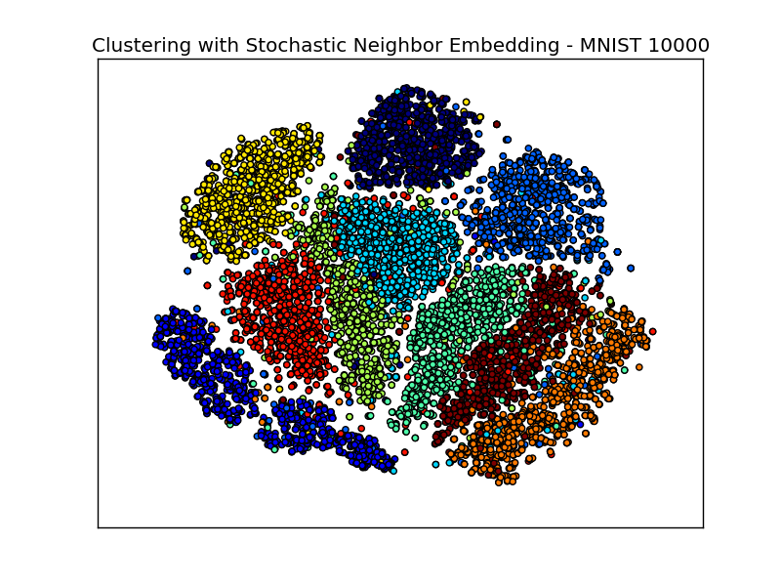
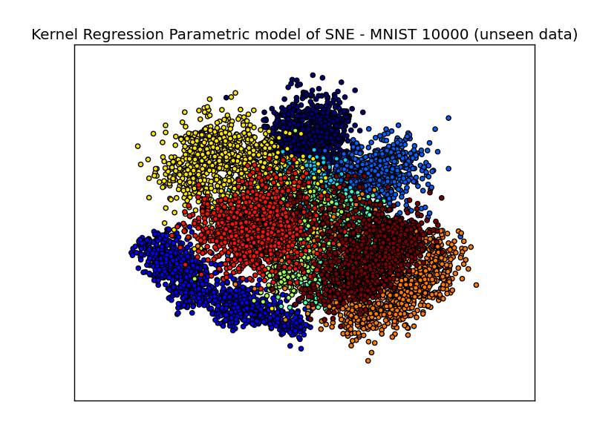
Learned Representations – MNIST Clustering Data Visualization
Stochastic Neighbor Embedding is very effective for data visualization of commonalities within data
This nonparametric method does not lend to unseen data – Soln: use kernel non linear reg.
Notes:
A nonparametric method to uncover commonalities in the data, cluster the data is Stochastic Nearest Neighbors. This is highly effective for data visualization, but can such a model be used with unseen data, as a learned representation? I have used non linear kernel regression, SVM regression to formulate a parametric form of the learned commonalities. This is illustrated in figures at bottom of slide. (left) SNE applied to 10000 examples of MNIST corpus, (right) parametric model inferred from (left) applied to 10000 unseen examples.

Slide 18
Conclusions
Use of vector computer vision image processing enhances corner detection. (example implemented with OpenCV)
Learned representations can be formed from Deep Architectures. They are very effective for inferring meaningful features, extracting features from data. Non parametric data visualization clustering SNE method can be useful for unseen data using parametric model inferred using kernel non linear regression

Slide 19
Conclusions
Thank You!

