Slide 1

Twitter Sentiment
Neil Sahai, Param Mehta, Minal Singh, Aadarsh Krishnan

Slide 2
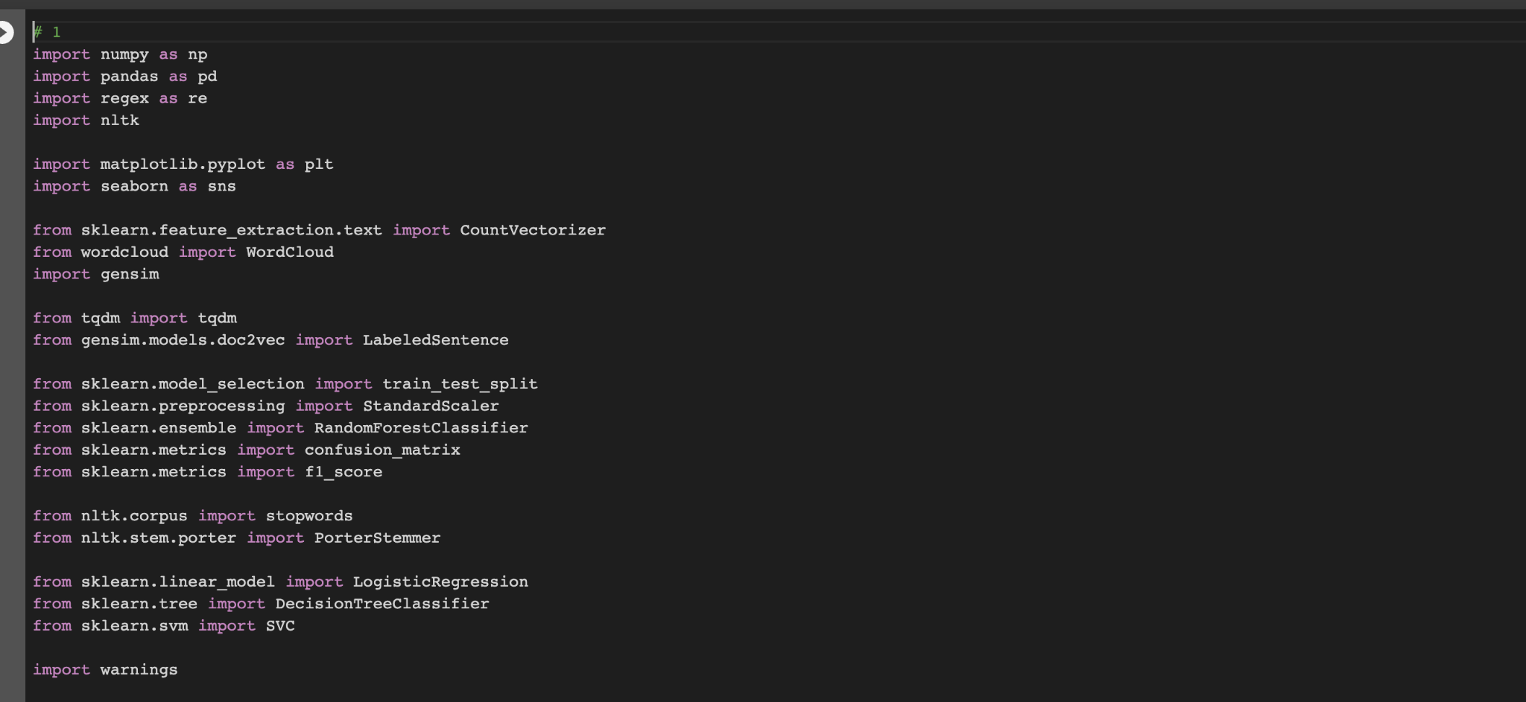
Initial Setup
Login to ‘Google Colab’
No need to install any packages as Google Colab has everything you need.
Import packages in the first cell.
Press ‘Shift+Enter’ to run the cell.

Slide 3

Word Frequency

Slide 4
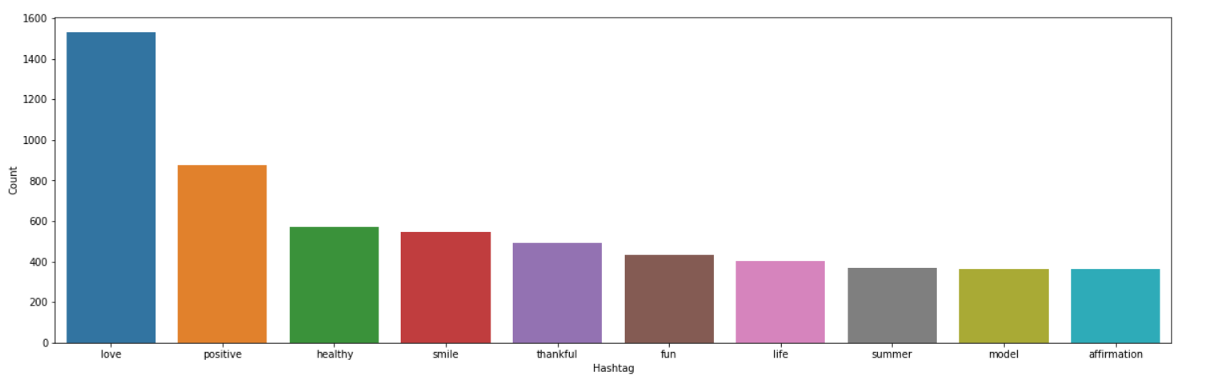
Positive Sentiment

Slide 5
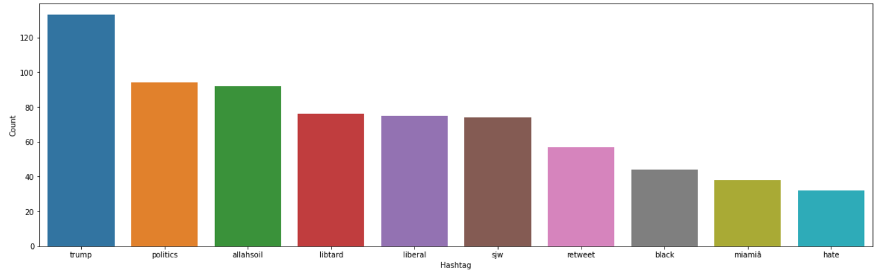
Negative Sentiment

Slide 6
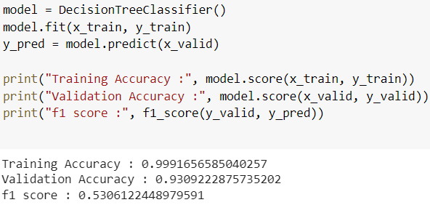
Final Results

