Slide 1
Capstone Project-1
EDA on AIR BNB(NYC) Team Members Naman Veer Pulukuri Neil Samuel Sadanand Nikhileshwar Karamala Sarvana Adithya

Slide 2
INTRODUCTION
AIR BNB(bed and breakfast) is a company which provides lodging facilities especially primary homestays for vacations rentals and tourism activities.
It was founded by three friends Brian Chesky, Nathan Biecharczyk and Joe Gibbia in the year 2008
As in the year 2022 the companies evaluation is 113 billion USD.
Its headquarters are located in San Francisco California.
It has around 6000 employees.

Slide 3
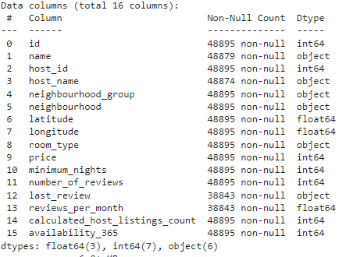
DATA SET DESCRIPTION
The Data set has 48895 rows and 16 columns

Slide 4
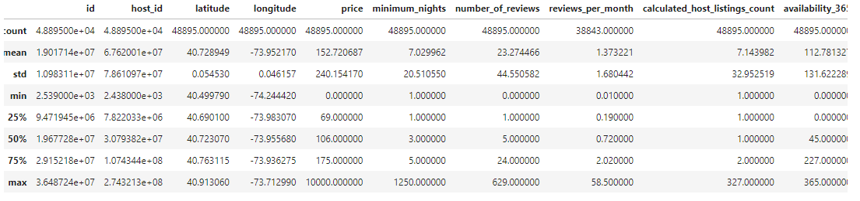
COLUMN DESCIPTION
11.HGH

Slide 5
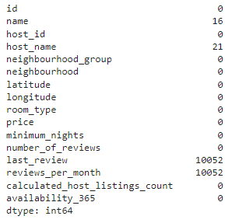
NULL VALUES

Slide 6
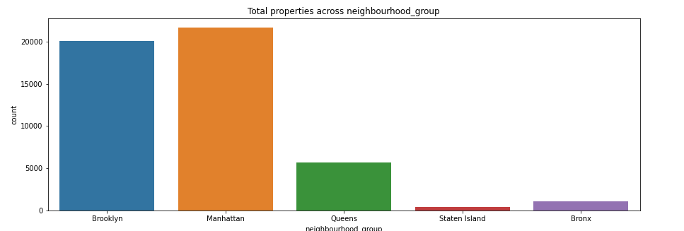
EDA
Overall count of AIR BNB properties in NYC is 48895

Slide 7
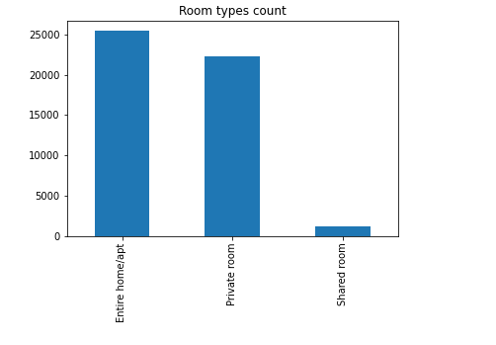
Home apartment types are the most owned room types-25049.

Slide 8
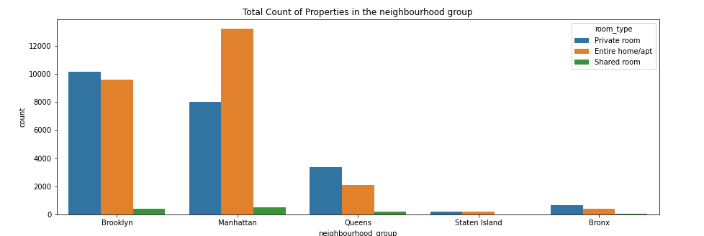
Total Count of properties in neighbourhood_ group
Manhattan has the highest properties amongst the neighbourhood_group - 22000

Slide 9
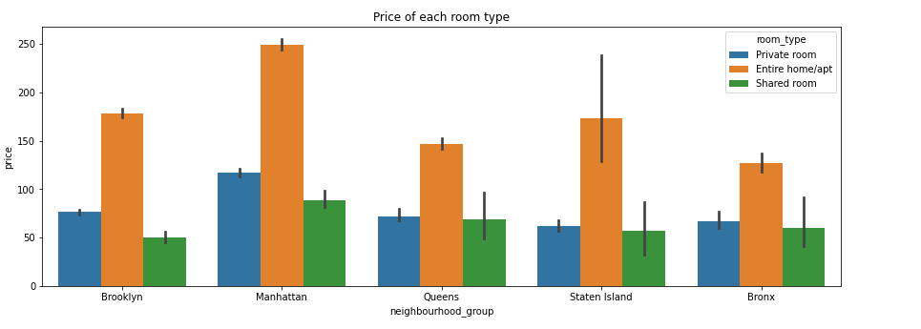
PRICE OF EACH ROOM TYPE
Manhattan is the most expensive area

Slide 10
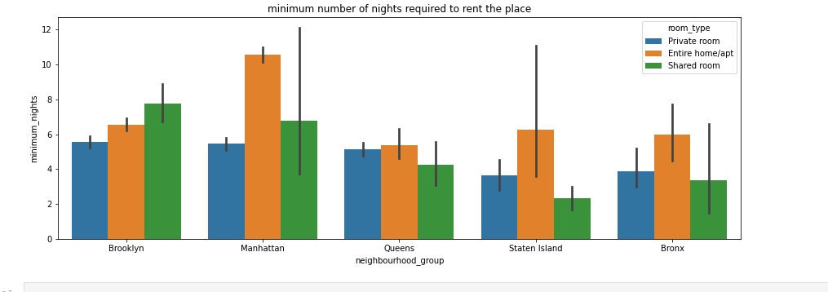
MINIMUM NIGHTS REQUIRED TO RENT THE PLACE
Home apartments are generally based on monthly rentals

Slide 11
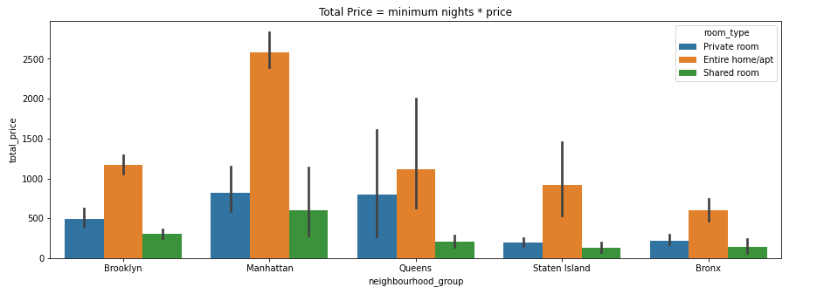
TOTAL PRICE
Bronx is the cheapest amongst groups

Slide 12
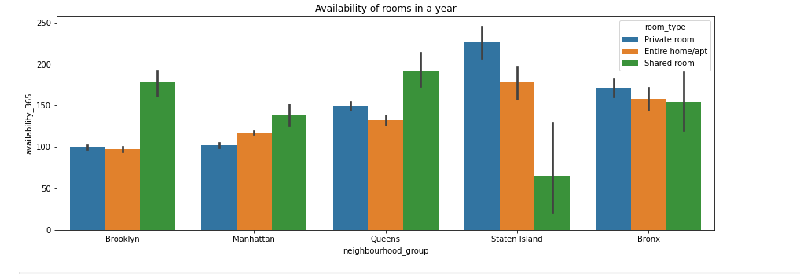
AVAILABILITY OF ROOMS IN A YEAR
Shared rooms are the most available rooms in a calendar year

Slide 13
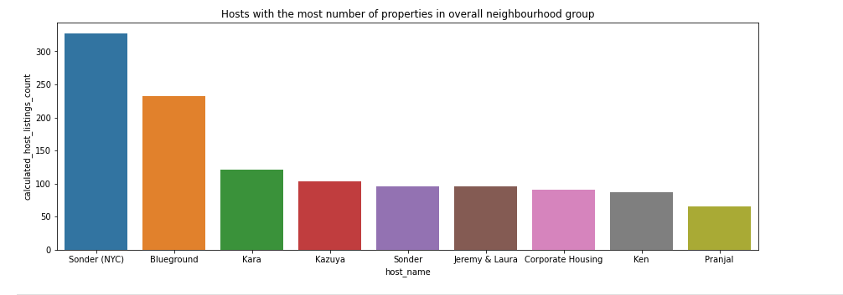
OVERALL NEIGHBOURHOOD GROUPS
Sonder is the host who owns highest properties which is around 347

Slide 14
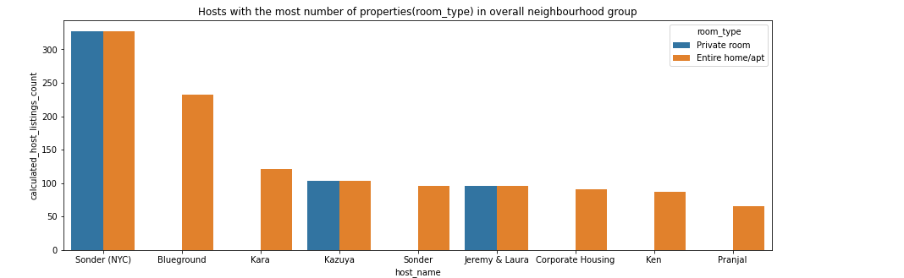
All her rooms are Home apartment and private rooms which are monthly rental(minimum nights is 29 days).
Not the most rated hosts.

Slide 15
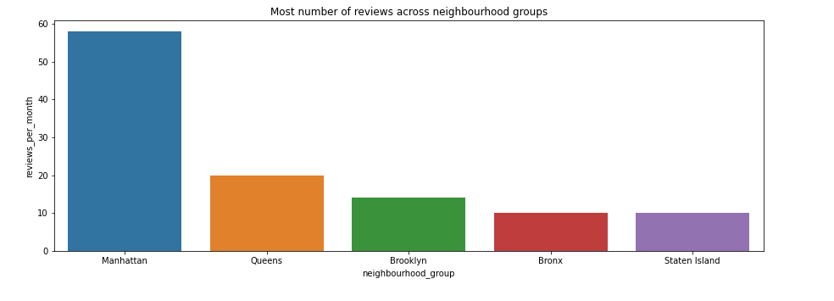
Manhattan is the state which reviews most per month

Slide 16
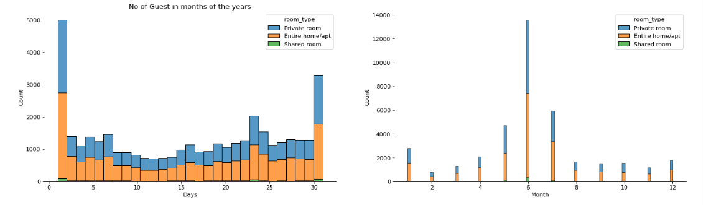
The first and the last day has the most number of guests.
In the middle of the year(JUNE month) there is a surge in the count of guests.

Slide 17
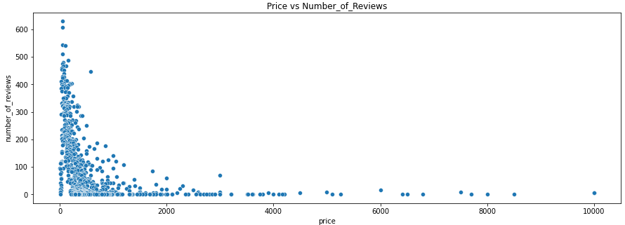
Lesser the price more the reviews

Slide 18
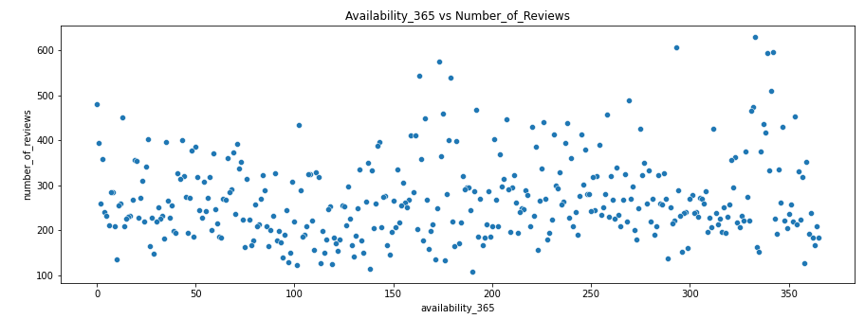
The more the number of availability days of rooms, the more are the reviews

Slide 19
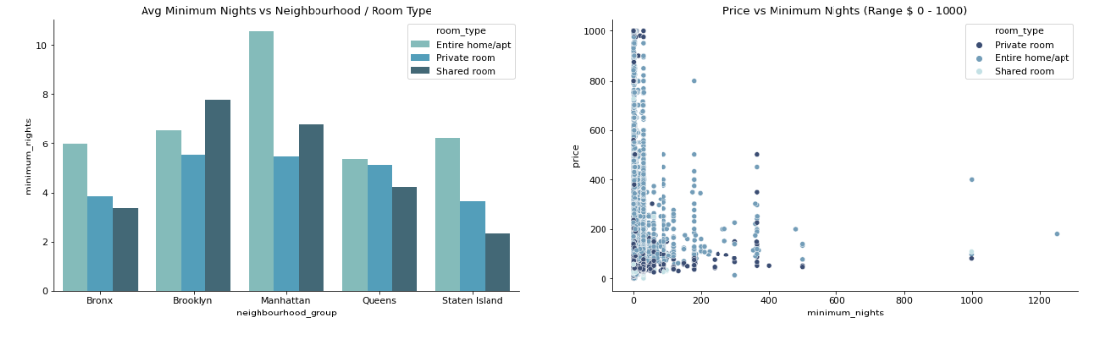
More the cost of property lesser the minimum nights.
Within the price range of 0 – 200 USD , the minimum nights range from 0 – 400.
Within the price range of 600 – 1000 the average minimum nights decreased by 7 nights.
But still, we can say most hosts gives less than 10 nights mandatory stay. As a trivia, Manhattan has highest avg minimum night restriction

Slide 20
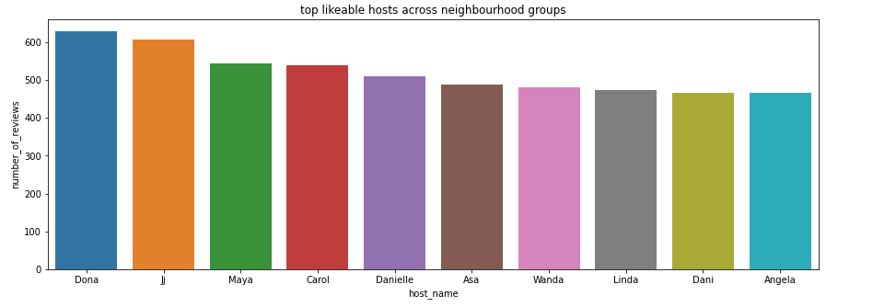
Dona is the most likeable hosts

Slide 21
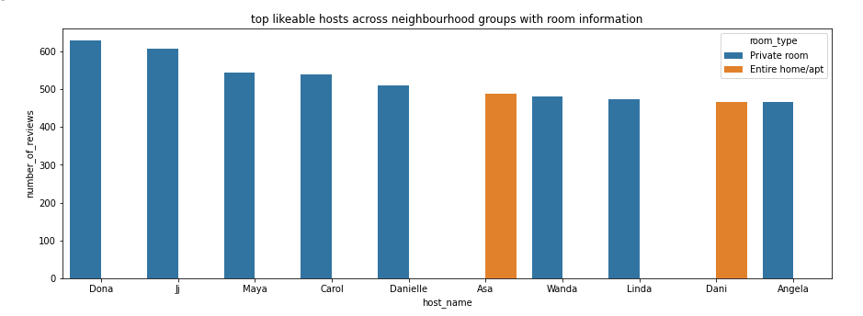
DONA is the most likeable hosts private room costing around 47$ and available for 333 days can be rented per day

Slide 22
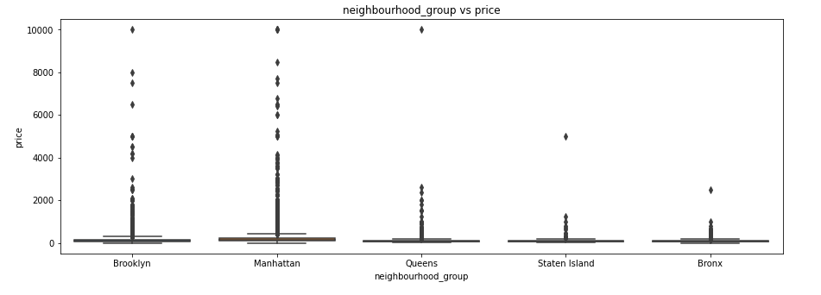
OUTLIERS
Staten and Bronx Islands have outliers if the price is greater than 500$.
Brooklyn and Queens have outliers if the price is greater than 2000$ whereas Manhattan has outliers is price is above 2500$

Slide 23
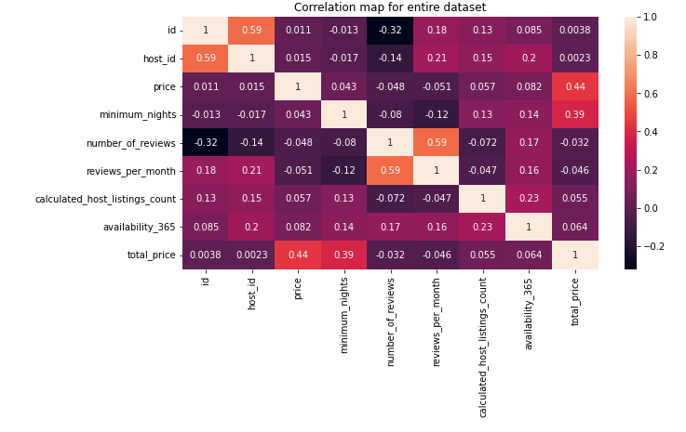
CORRELATION
There is a correlation between availability of rooms and price of rooms

Slide 24
CONCLUSION
Manhattan has the highest properties.
Hosts owns more number of Home apartments compared to Private rooms.
Manhattan is the most expensive area, followed by Brooklyn , Queen ,Staten Island and Bronx.
Price is inversely proportional to reviews.
Availability is correlated(positive correlation) with reviews.
Sonder NYC has the highest properties yet not highly rated because of monthly rentals.
Dona is the hosts who is highly rated because of cost effective room and also highly available throughout the year.
People prefer rooms which price is less than 500$ in Bronx and Staten Islands whereas in Manhattan, Brooklyn and Queen people prefer rooms which price is less than 200$
By using Linear Regression Model we probably can predict the price.

Slide 25
QUERIES

Slide 26
Additional Data Slides

Slide 27
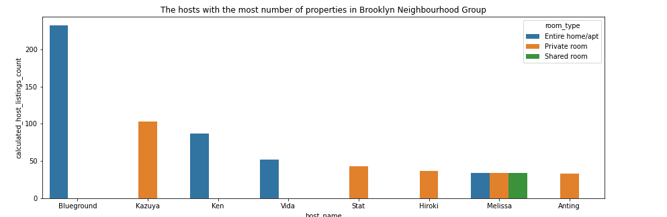
BROOKLYN NEIGHBOURHOOD GROUP

Slide 28
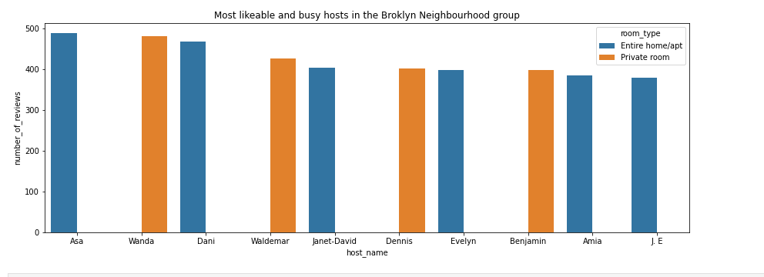
\
2.Axa is the most likable hosts(price is 160$, minimum night =1 and Asa owns only apartments and available for 269 days
Asa is the most likable hosts(price is 160$, minimum night =1 and Asa owns only apartments and available for 269 days

Slide 29
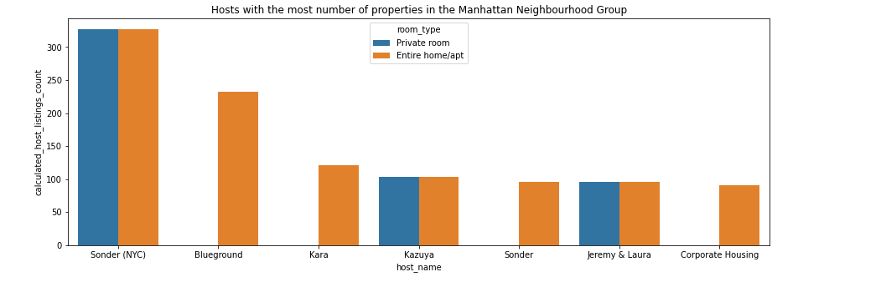
MANHATTAN NEIGHBOURHOOD GROUP

Slide 30
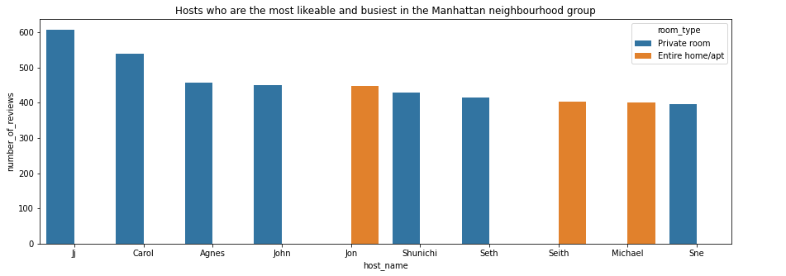
Ji is the most likable hosts (private room and private apartment).His most reviewed is a private room in Harlem district, price of this room is 49,minimum nights for renting a room is 1.

Slide 31
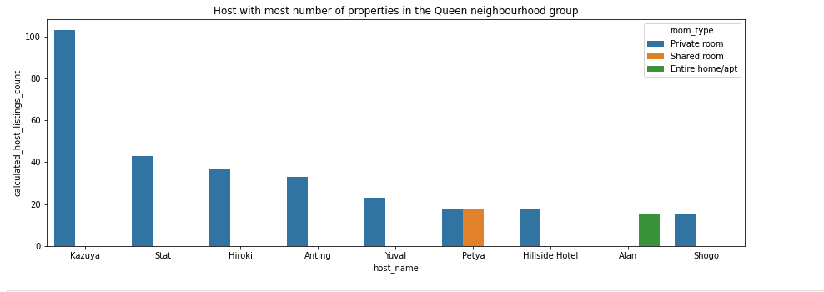
QUEEN NEIGHBOURHOOD GROUP

Slide 32
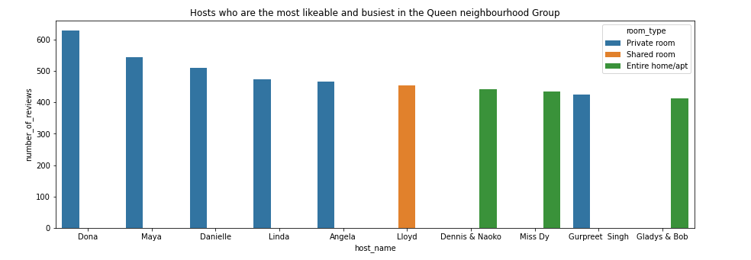
Dona is the most likable hosts(price is 47$, minimum night =1 and Asa owns only privaterooms and available for 333 days

Slide 33
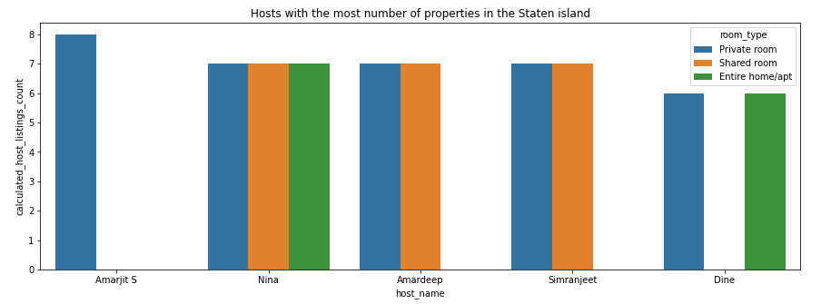
STATEN ISLAND

Slide 34
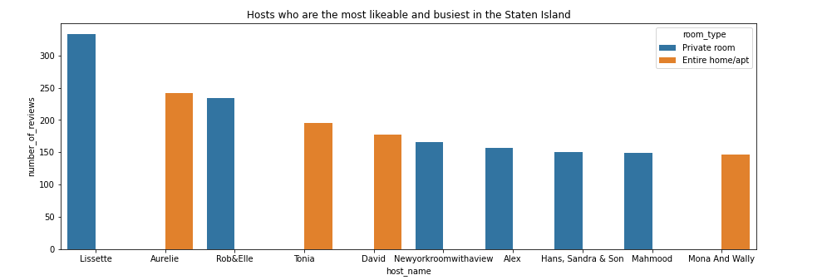
Lissette is the most likable hosts(price is 36$, minimum night =2 and Asa owns only apartments and available for 333 days

Slide 35
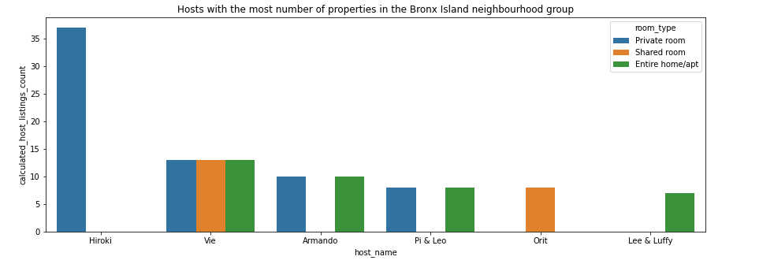
BRONX ISLAND NEIGHBOURHOOD GROUP

Slide 36
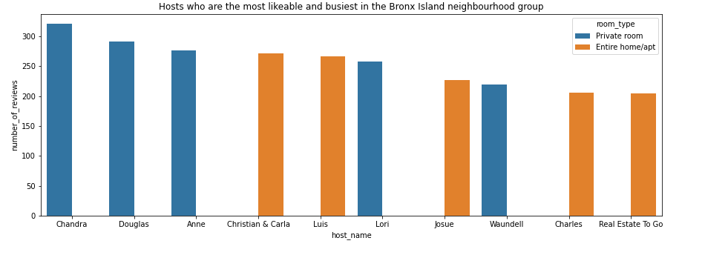
Chandra is the most likable hosts(price is 53$, minimum night =1 and Chandra owns only Privat room and available for 43 days

