Slide 1
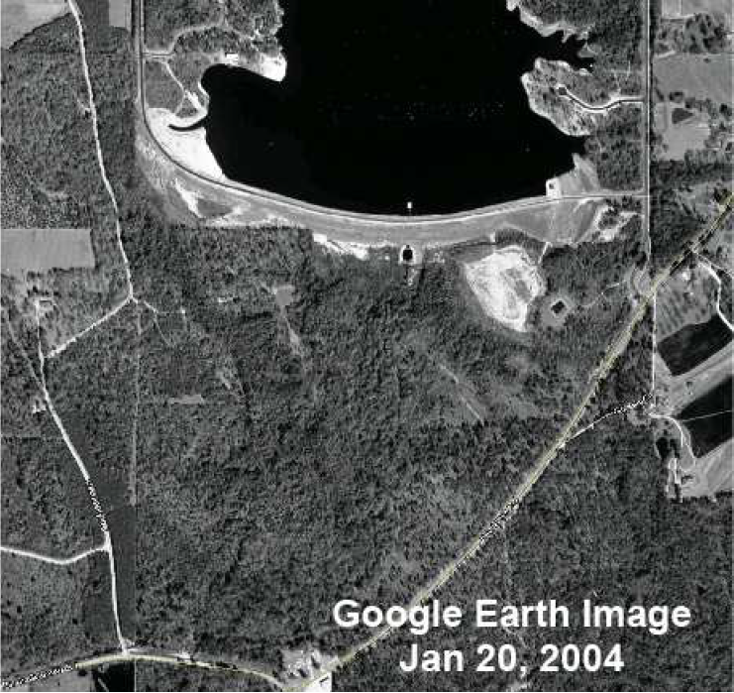



Big Bay Dam Failure Analysis using DLBreach and WinDAM
Mitchell L. Neilsen
Department of Computer Science
Kansas State University, Manhattan, KS
United States Department of Agriculture
Agricultural Research Service
Natural Resources Conservation Service
Notes:
This project involves the development of simulation environment that can be used to evaluate vegetated earth and rock spillways at the watershed scale. Key variables can be specified using probabilistic distributions, and samples for those variables can be generated using either Monte Carlo or Latin Hypercube Sampling. LHS requires fewer samples to achieve the same level of precision.
This project involves a collaborative research effort between KSU, the USDA, and the US Army Corps of Engineers. Spillway erosion is simulated using a three phase erosion model. The first phase is vegetal cover failure, the second phase is concentrated flow erosion, and the third phase is headcut advance. The focus of this paper is on the software architecture. Other recent papers focus on the model and the theoretical basis for the model.

Slide 2
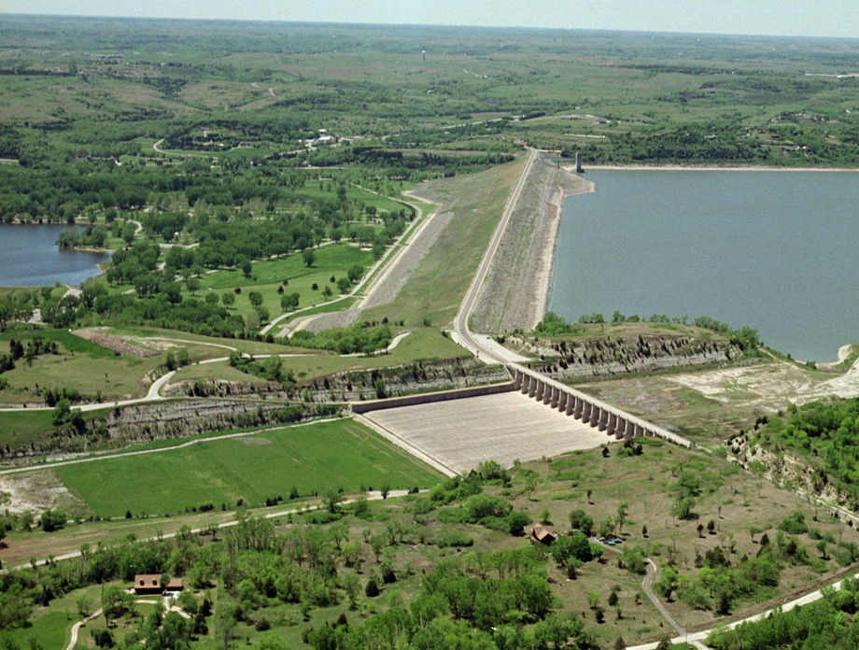
Windows* Dam Analysis Modules (WinDAM)
WinDAM D
Zoned Embankment Erosion Module
WinDAM C
Internal Erosion Module
WinDAM is a modular framework for the design and analysis of water control structures (dams).
WinDAM B
Dam Breach Analysis Module
Embankment Erosion Module
WinDAM A+
SITES Spillway Erosion Analysis with Latin Hypercube Sampling
WinDAM A
Reservoir Routing Module with Dam Overtopping
HEC-RAS
WinTR-20
SITES
Notes:
This paper describes the software components included in the integrated development environment, and a description of the flow of control and data through the environment. The software consists of four different componets, SitesSim is a module derived from Sites to compute the amount of erosion that occurs, an Integrity Checker to verify the syntactic correctness of the input data -- logical correctness is still up to the designer, although some warnings will be generated if some input parameters appear to be out of the normal range, DakotaLHS generates random samples based on the distribution specified by the user for a given variable, and finally the master application that controls overall data and control flow, interaction with the user, and parsing of input and output files to make them meaningful to the various components is the IDE SSEA.exe.

Slide 3


WinDAM Computational Model
WinDAM User Interface
Computational Model (WinDAM)
Random values
for material properties in auxiliary spillways
Probability distribution
defining material properties of auxiliary spillways
Latin Hypercube Sampling (Dakota)

Slide 4
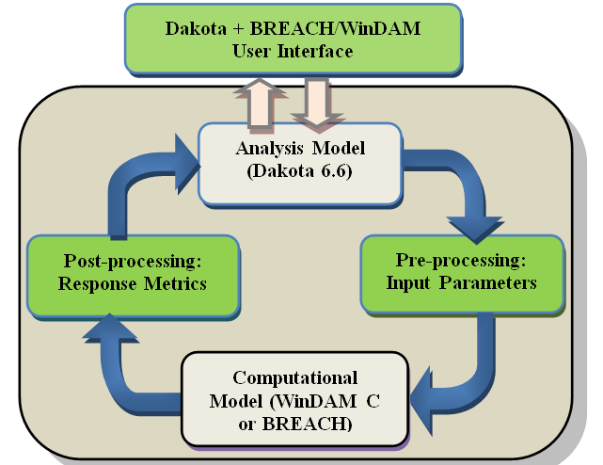
For Dam Analysis: Use Dakota to Drive the Analysis
Dakota User Interface
Computational Model (WinDAM C or DLBreach)

Slide 5
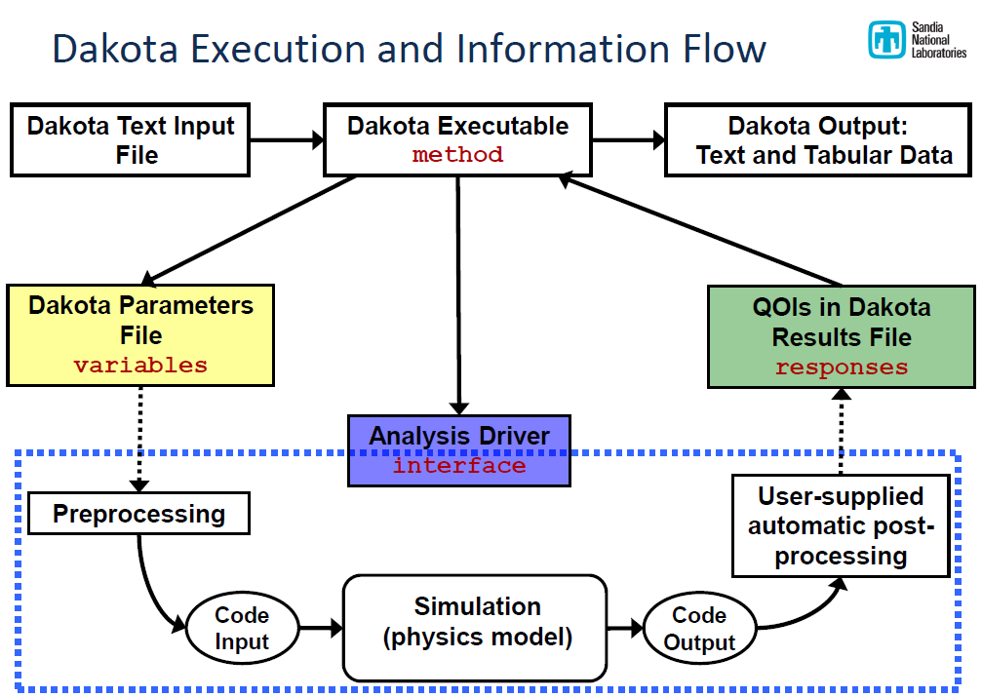

Slide 6
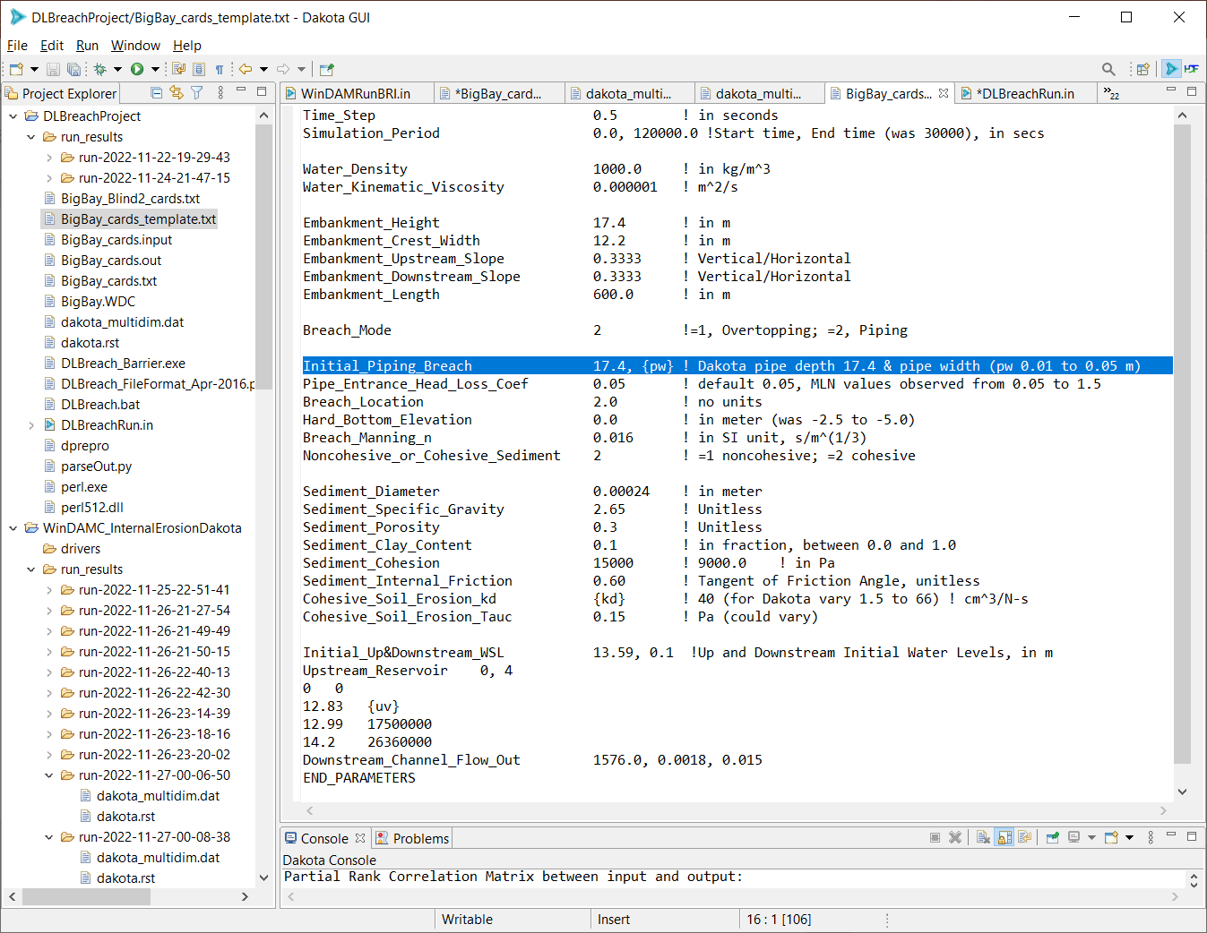
DLBreach Template
Initial_Piping_Breach 17.4, {pw} ! 0.01 to 0.05

Slide 7
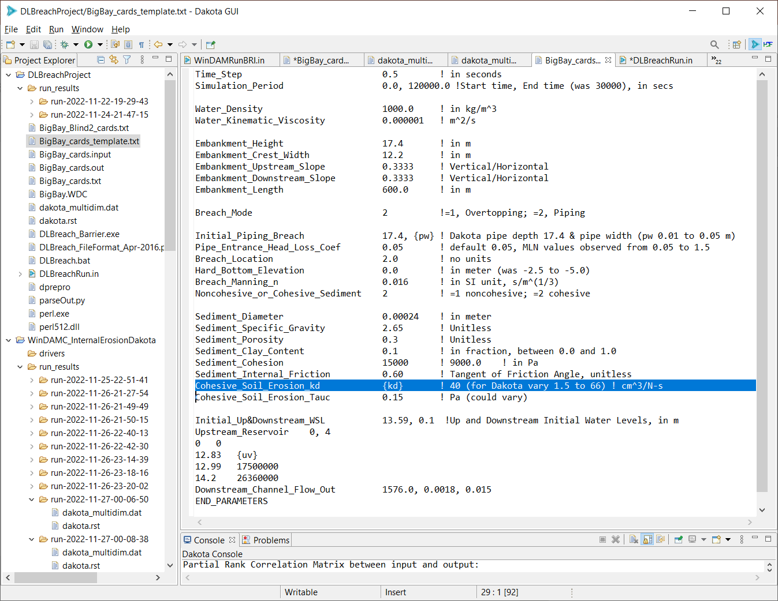
DLBreach
Cohesive_Soil_Erosion_kd {kd} ! 1.5 to 66

Slide 8
Dam Storage

Slide 9
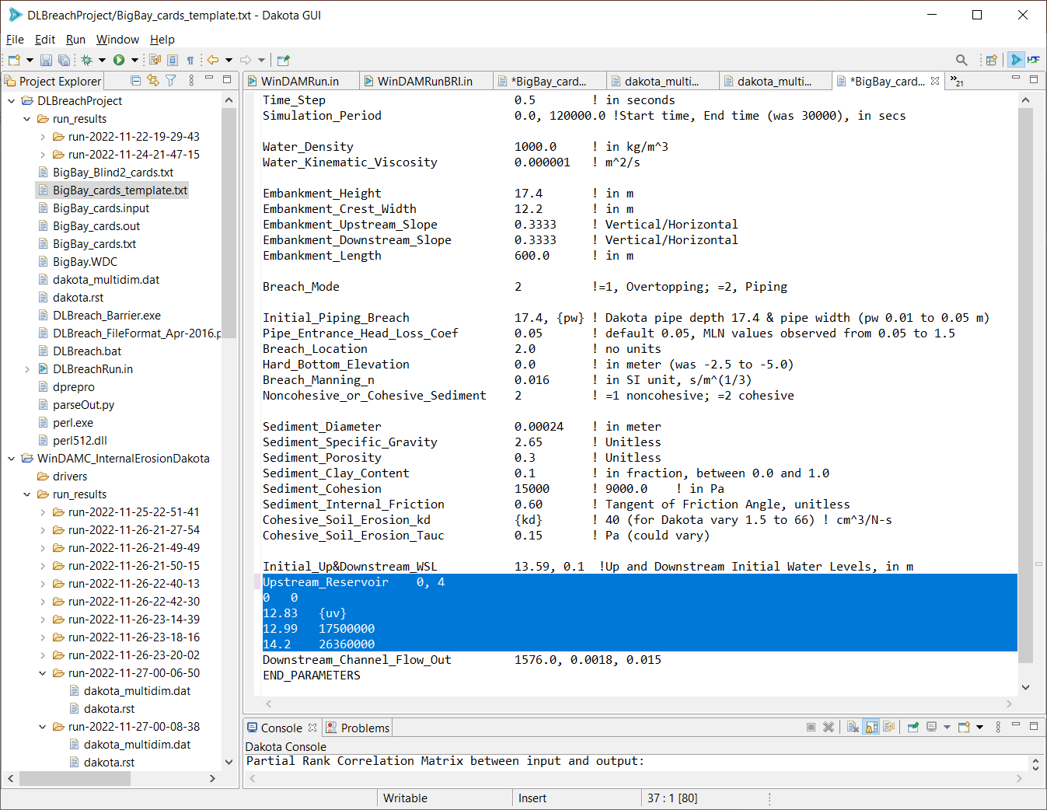
DLBreach
Upstream_Reservoir 0, 4
0 0
12.83 {uv}
12.99 17500000
14.2 26360000

Slide 10
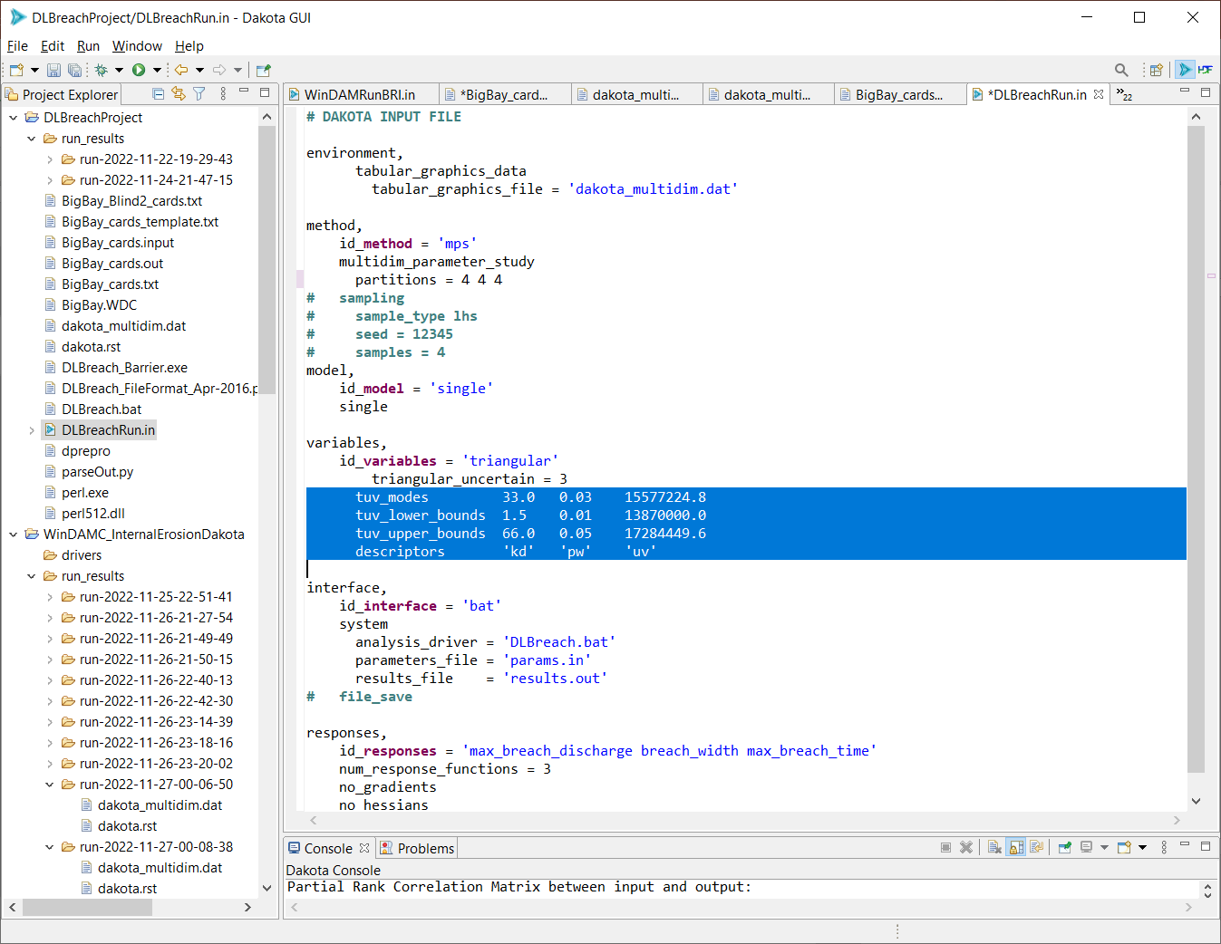
Dakota Driver
DLBreachRun.in

Slide 11
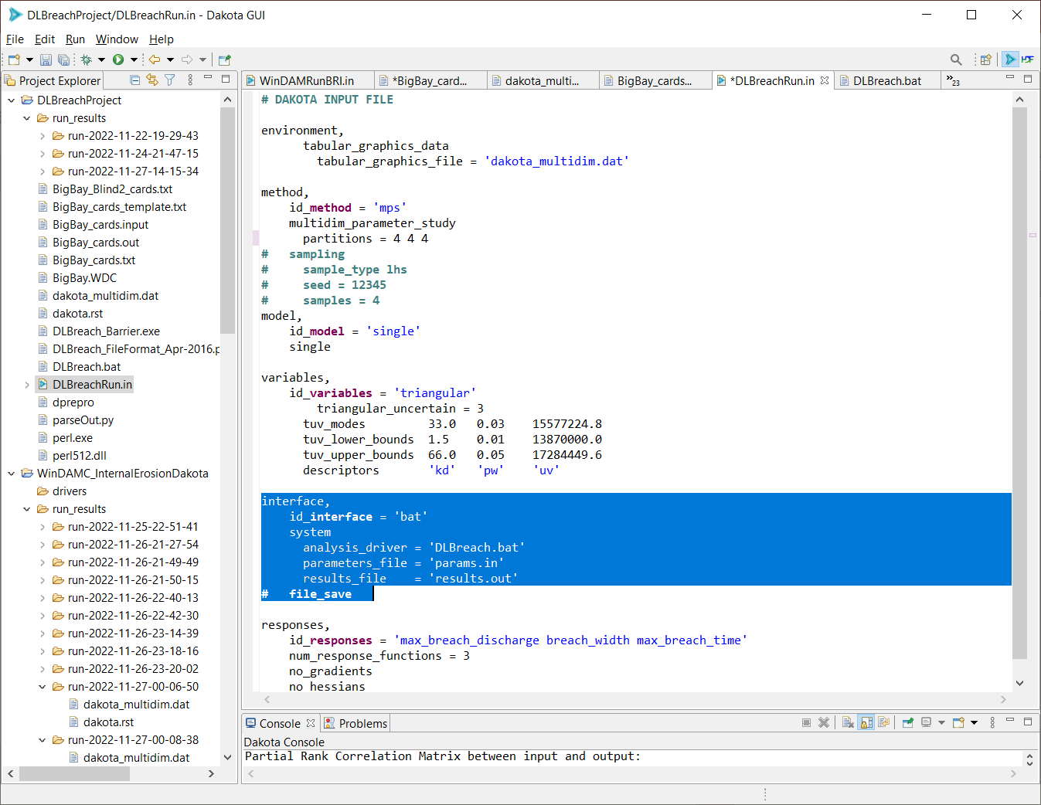
Dakota INTERFACE – analysis DRIVER

Slide 12
params.in
results.out

Slide 13
Dakota ANALYSIS Driver
DLBreach.bat
perl dprepro params.in BigBay_cards_template.txt BigBay_cards.txt
-- insert parameters in template and output BigBay_cards.txt
echo "BigBay_cards" | DLBreach_Barrier.exe
-- invoke DLBreach_Barrier.exe to simulate run
python parseOut.py BigBay_cards.out results.out
-- extract results of interest

Slide 14
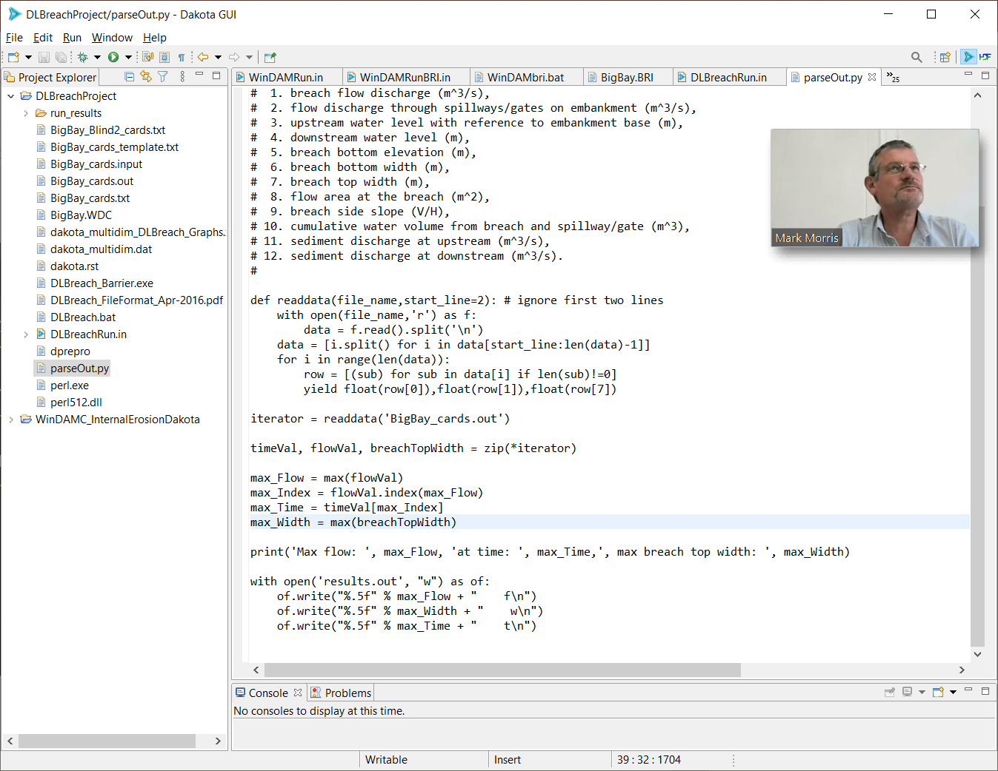

Slide 15
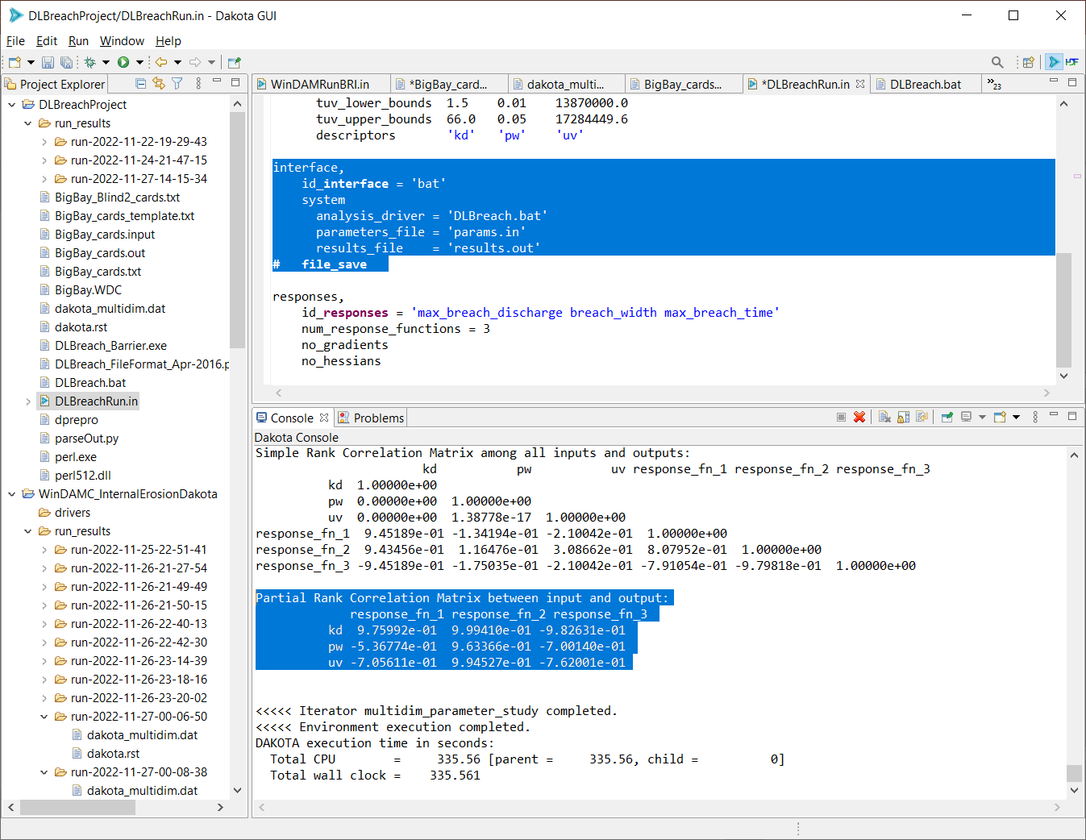
Max discharge, max top width, time

Slide 16
Observed max discharge 4200 cms

Slide 17
Observed max top width 96 m

Slide 18
Observed max discharge time 0.9167 hr

Slide 19
Observed max Q
4200 cms

Slide 20
Observed max discharge 4200 cms

Slide 22
WinDAM C Analysis
Dakota User Interface
Computational Model (WinDAM C or DLBreach)

Slide 23
WinDAM Template (BigBay.WDT)
WINDAM 10/06/2022IE Models Eval - BigBay
OPTION SIMPLE BARESOIL NOPS INTERNAL
IEMODEL 2 120.0 {kd } 100 0.002
HYD 0.1 0 0C
..
0
ENDTABLE
CRESTPRFL
0 57.0866
1968.5 57.0866
ENDTABLE
STROUTE 44.29 0 ELEV
STRUCTURE BigBay
0 0
42.09 {uv}
42.62 14187.5
46.59 21370.4
ENDTABLE
UPSTREAM 3 0.016
DAMCREST 40 0.016
DWNSTREAM 3 0.016
CONDUIT {pw } {pw } 2 984.25
TAILWATER
ENDTABLE
OUTPUT ALL
ENDRUN

Slide 24
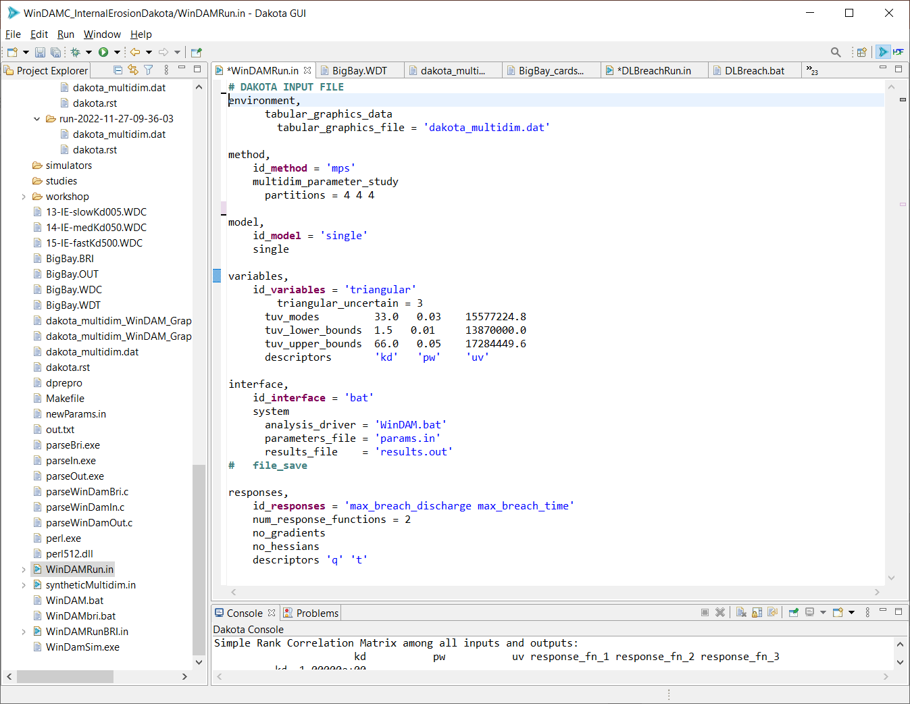
WinDAM C Interface

Slide 25
WinDAM C Analysis
Dakota User Interface
Computational Model (WinDAM C or DLBreach)

Slide 26
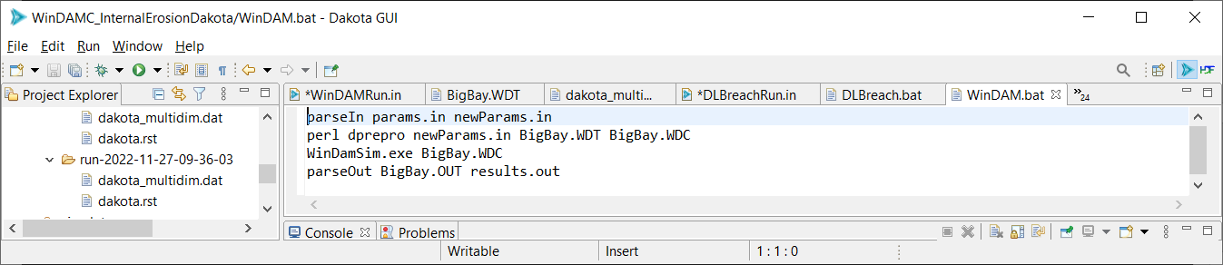
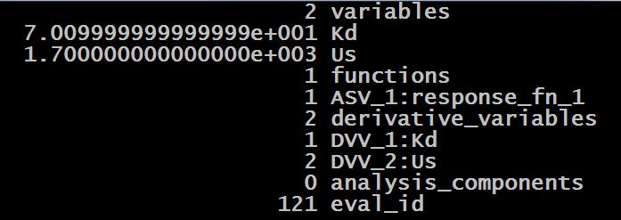
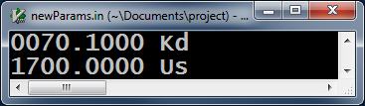
DAKOTA Analysis Driver – WinDAM.bat
params.in
newParams.in
parseIn

Slide 27
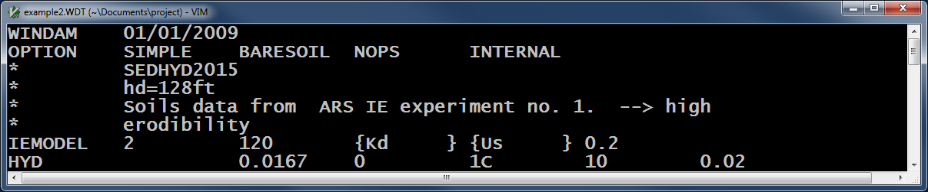

DAKOTA Analysis Driver
Example2.WDT
dprepro
example.WDC

Slide 28
WinDAM C Analysis
Dakota User Interface
Computational Model (WinDAM C or DLBreach)

Slide 29
DAKOTA Analysis Driver
BigBay.WDC
BigBay.OUT
WinDamSim

Slide 30
WinDAM C Analysis
Dakota User Interface
Computational Model (WinDAM C or DLBreach)

Slide 31
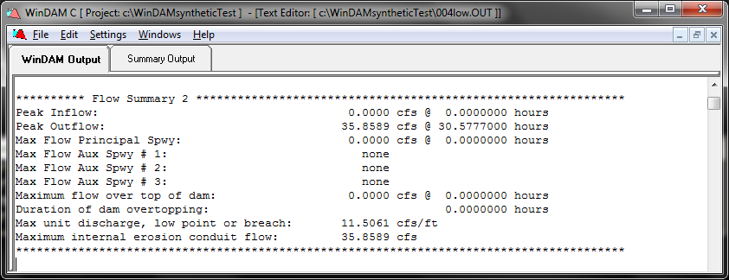
DAKOTA Analysis DriveR

Slide 32
WinDAM C Analysis
Dakota User Interface
Computational Model (WinDAM C or DLBreach)

Slide 33
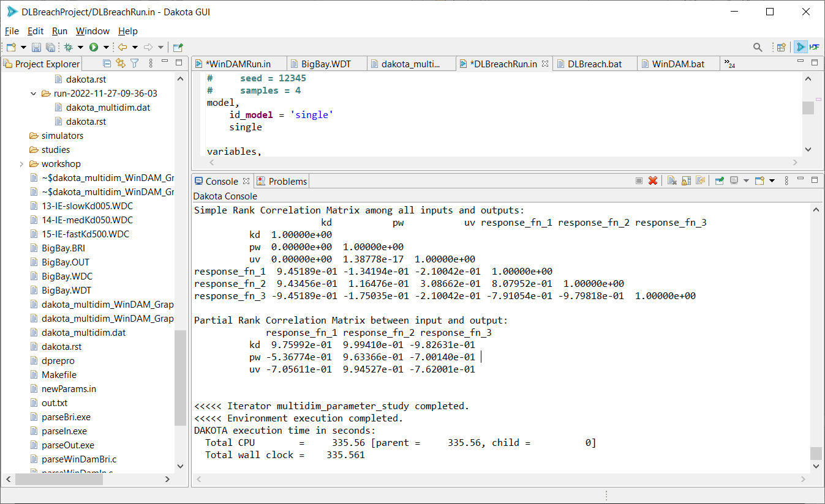

Slide 34
Observed max Q
4200 cms

Slide 35
Observed max Q
4200 cms

Slide 36
Observed max top width 96 m

Slide 37
Obs. max discharge time 0.9167 hr

Slide 39
Observed max Q
4200 cms

Slide 40
Observed max Q
4200 cms
Obs. max discharge time 0.9167 hr

