Slide 1

U.S. Department of Veterans Affairs
Pre-solicitation Notice ID: 36C10X25Q0032
Pre-Decisional

Slide 2
Agenda
VA Transition Assistance
Overview
Scope of Work
VA Benefits and Services Briefing
Curriculum Delivery Modalities
Military Life Cycle Modules
Women's Health Transition Training
VA Benefits Advisors
VA Transition Assistance Program Execution
Supporting VA Transition Assistance Program Customers
Benefits Advisors Training
Curriculum Development
Questions and Answers

Slide 3
Overview
10 U.S.C. § 1142 and 1144
About 200,000 Service members transition to civilian life each year. The Transition Assistance Program (TAP) provides information, resources, and tools to service members and their loved ones to help prepare for the move from military to civilian life. Service members begin TAP one year prior to separation, or two years prior to retiring.
The VA portion of TAP is a one-day, in-person course called VA Benefits and Services. Led by VA Benefits Advisors, the course helps participants understand how to navigate VA and the benefits and services they’ve earned through their military career. The course offers interactive exercises, real examples, and covers topics important to you like family support, disability compensation, education, and health care benefits.

Slide 4
Scope of Work
The agency program office responsible for conducting VA’s contribution to the interagency TAP, Outreach, Transition and Economic Development (OTED) requires contract support services to continue the existing TAP onsite support and associated program management, curriculum development, and training requirements.
This contract support encompasses program management and administration; curriculum development, revision, and validation; onsite support activities at military installations to conduct and report on VA-supported activities; conduct in-person, instructor-led classroom and instructor-led virtual briefings to include virtual off-base transition training workshops; providing information through generalized and one-on-one settings; and conducting evaluations.

Slide 5
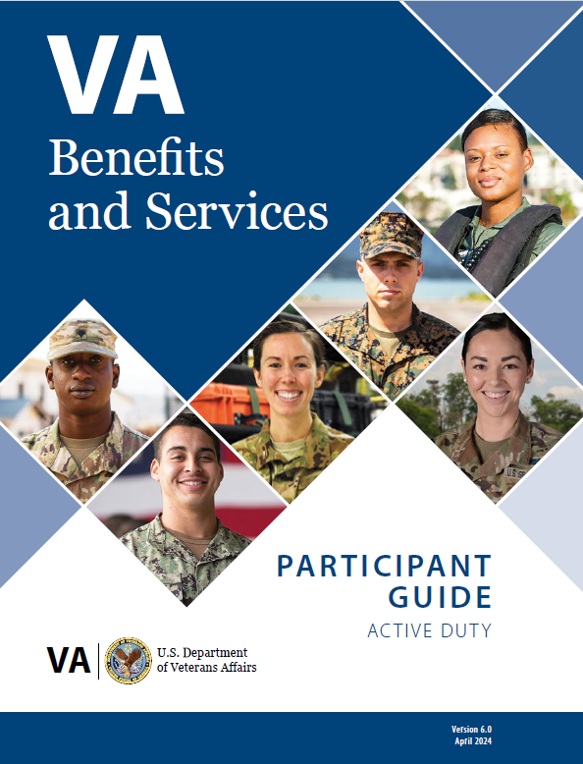
VA Benefits and Services Briefing
Mandatory, one day of instruction on how to navigate resources within VA, including the benefits and services they have earned.
Benefits and Services 6.0 includes 6 modules:
Module 1- Introduction to VA Benefits and Services
Module 2 – Maintaining Your Health
Module 3 – Applying for Disability Compensation
Module 4 – Getting Career Ready
Module 5 – Finding a Place to Live and Community Resources
Module 6 – Course Capstone
Average length of each module is 56 minutes.
Available at: https://www.tapevents.mil/courses/306

Slide 6


Curriculum Delivery Modalities
Live Classroom
Traditional in-person, synchronous format
Live Virtual
Virtual synchronous format hosted on Microsoft Teams
Web-Based
Online, self-paced, asynchronous format

Slide 7
Military Life Cycle Modules
13 Military Life Cycle micro-learning modules focused on the topics most important to Service members and their families and caregivers.
Module Name & Length | Module Overview
VA Education Benefits (45 minutes) | Provides information about Defense Department (DOD) and VA education benefits to include Post-9/11 benefits that may help Service members pay for or offset the cost of tuition, housing, books and supplies.
VA Education and Training Benefits for Spouses and Dependents (45 minutes) | Communicates relevant information about education benefits, including Post-9/11 benefits, that can help eligible family members and caregivers pay for tuition, housing, books and supplies costs through VA education and training benefits available to them.
VA Benefits 101 (45 minutes) | Highlights VA benefits and services, to include education, home loan guaranty, health care and insurance, and memorial benefits.
Social and Emotional Health Resources (45 minutes) | Describes services and provides information on resources for coping with life experiences and stressors that may impact social and emotional health.
Mental Health for Families (45 minutes) | This course explains how to identify local services and community organizations that can provide assistance and aid to Service members and their loved ones.
VA Home Loan Guaranty Program (60 minutes) | Offers a general overview of the VA Home Loan Guaranty Program including eligibility, processes, costs and other available resources.
Module Name & Length | Module Overview
Vet Centers (45 minutes) | Describes how to connect with local Vet Centers and how Service members, Veterans and their loved ones can use Vet Centers as a free resource.
Disability Compensation (60 minutes) | Introduces the VA disability compensation benefit that may be available to eligible transitioning Service members and Veterans and shows where to find key resources.
VA Life Insurance Benefits (60 minutes) | Discusses the different types of VA life insurance benefits to help determine the best choice for Service members and their loved ones based upon interests and needs.
Reserve Component Dual Payments (45 minutes) | Provides an overview on drill pay, compensation eligibility, and options for handling dual payments.
Survivor and Casualty Assistance Resources (45 minutes) | Provides an overview on VA and Department of Defense survivor benefits and eligibility, and what to do in the event of a loss.
Community Integration Resources (60 minutes) | Explores state, local and federal resources that help Service members connect with their community during the transition from active duty to civilian life. Participants will also gain experience with the tools needed to locate and vet online resources.
Other than Honorable (45 minutes) | Provides an overview of VA benefits and services available for former Service members who separated with an Other Than Honorable (OTH) character of discharge.

Slide 8
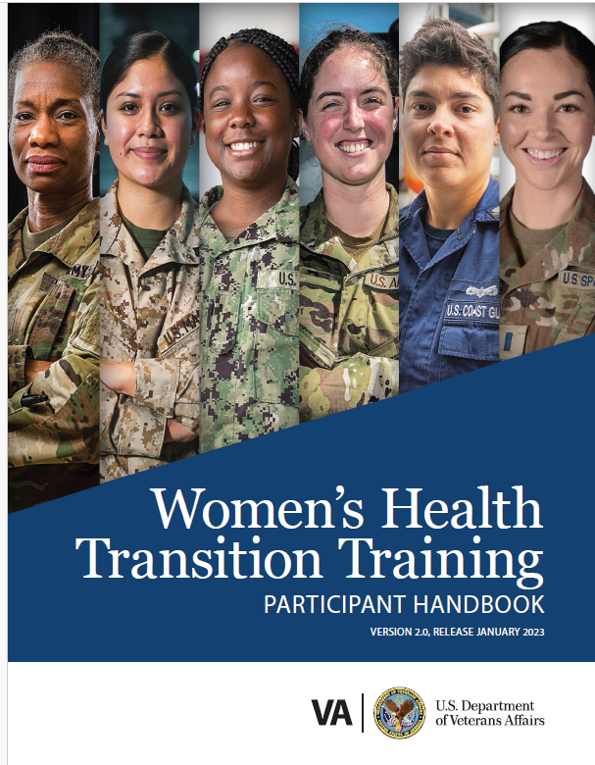
Women’s Health Transition Training
Women’s Health Transition Training is a non-mandatory complement to the VA Benefits and Services course that provides information on women health care services, eligibility, and how to enroll.
Servicewomen at any point in their transition journey, as well as women Veterans can access this e-Learning course anytime, anyplace.
Women’s Health Transition Training consists of five modules with in-depth information on:
Navigating the shift from active duty
Understanding how VA is structured
Available women’s health services
Enrolling in VA health care
Transition assistance resources
Participants can pause and resume as needed, enabling them to complete the course in multiple sittings.
Course is 2.5 hours long. Each module averages 30 minutes each.

Slide 9
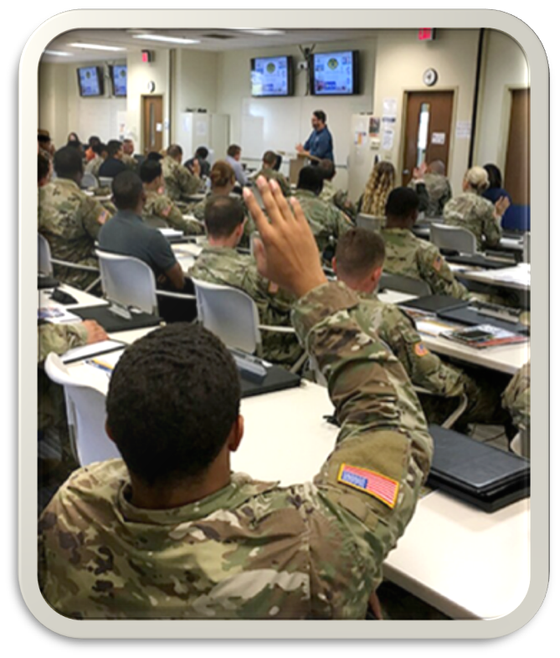
VA Benefits Advisors
Key Role:
Deliver VA Benefits and Services courses
Conduct one-on-one assistance sessions with Service members and their families to explain VA benefits and services and connect them with resources
Provide pre-separation counseling support – as needed/requested by the military service
Support Department of Defense-facilitated Capstone events, to help transitioning Service members meet Career Readiness Standards and make an Individual Transition Plan
Conduct Military Life Cycle micro-learning modules to help Service members better understand benefits, services and resources
Participate in installation engagements (events at the request of installation commanders or other designees such as new arrival events, Yellow Ribbon Reintegration Program, local resource fairs, career-preparedness activities, and spouse events).

Slide 10
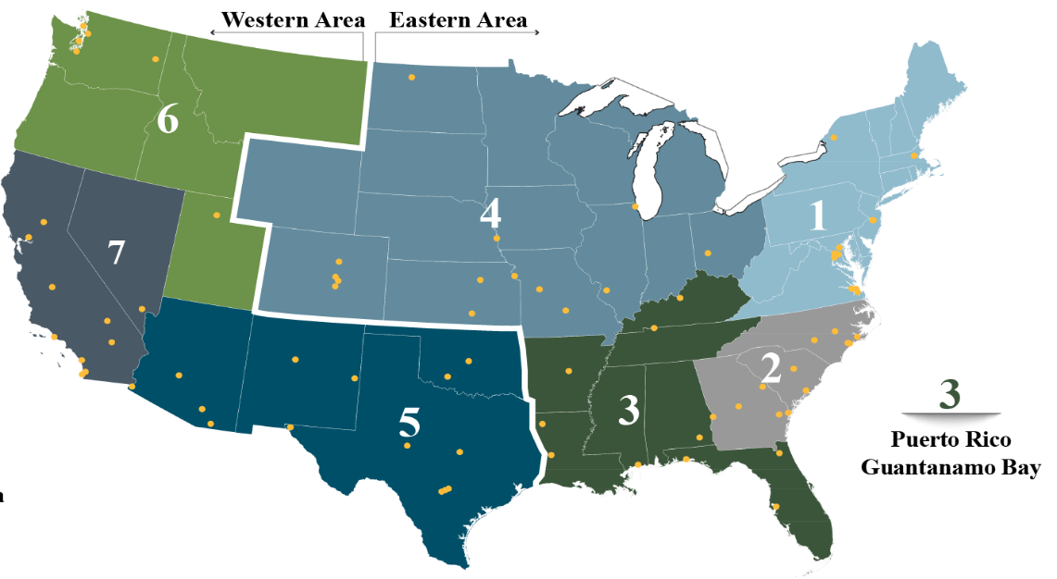
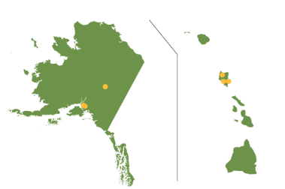
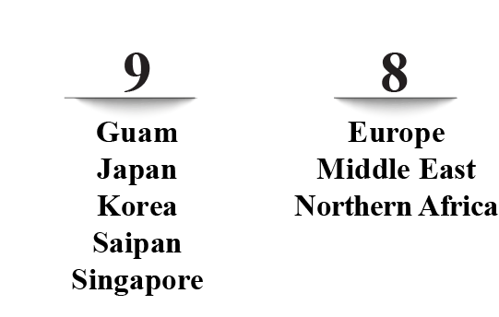
VA TAP Execution
VA currently supports more than 300 installations worldwide organized into nine operational regions.
The Contractor shall implement a support concept which utilizes a regional hub-and-spoke model with regional command and control centers under the direction of VA TAP, providing command and control capabilities.
The Contractor provides physical and permanent onsite support at installations with a high- or medium-demand and provide VA-approved support at installations with low demand.
6
Alaska and Hawaii
Regions 8 and 9 are Western Area
Yellow dots represent permanent (hub) sites

Slide 11





Supporting VA TAP Customers – FY24*
6,039 VA Benefits and Services briefings (in-person and instructor led virtual)
153,107 attendees
54,002 one-on-one appointments
57,294 attendees
1,921 installation engagements (such as Yellow Ribbon, resource fairs, etc.)
67,475 attendees
3,833 in-person and virtual Military Life Cycle Modules
21,282 attendees
Supported 680 Capstone Events
5,561 attendees
*Source: Fiscal Year 2024 Annual Benefits Report: https://www.benefits.va.gov/REPORTS/abr/docs/2024-abr.pdf#

Slide 12
Benefits Advisors Training
New Hire Training – First Step to becoming a Benefits Advisors
Virtual Delivery Training – Designed to replicate on-site VA Benefits and Services course delivery in a virtual environment
Refresher Training – Provides recall and reinforcement to previously acquired knowledge and skills
Master Advisor Training – Develops Master Advisors to execute the Benefits Advisor Training. They must possess facilitator or trainer certification. Must attend New Hire Training and Master Advisor Training.
Other government-provided trainings – Government provides other trainings, as mandated by policy/legislation.

Slide 13
Curriculum Development
Contractor will support the Curriculum Design, Development, Revision and Support Package as defined in the PWS for the following:
VA Benefits and Services Curriculum
Women's Health Transition Training Curriculum
Military Life Cycle Curriculum
New Hire Training Curriculum Development
Benefits Advisor Refresher Training and Virtual Delivery Curriculum Development

Slide 14
Questions and Answers
See attachment provided

