Slide 1
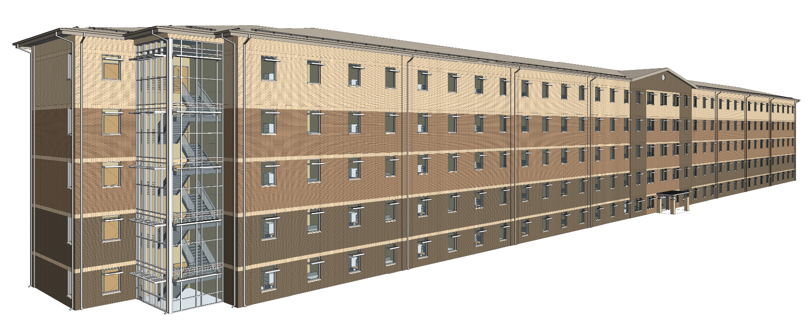
Industry day the Unaccompanied Enlisted Personnel Housing (UEPH) Barracks Fort Campbell, KY
Presenters:
Josh Westgate– Contracting Officer
Crystal Harbin– Deputy for Small Business
Jim MacMillan– Design Team Lead
Date: 23 April 2025
”The views, opinions and findings contained in this report are those of the author(s) and should not be construed as an official Department of the Army position, policy or decision, unless so designated by other official documentation.”

Slide 2
ADMINISTRATIVE ANNOUNCEMENTS
Please ensure that you have signed in
Company Name, POC Name, Email, Phone
Are you interested in being the Prime or Subcontractor
If you’re interested in being a subcontractor, state the type of work you are interested (Electrical, Mechanical, Roofing, etc.)
This briefing and the attendee roster will be posted to SAM
Please be advised that none of the information discussed today is contractually-binding

Slide 3
AGENDA
Procurement Process And Overview
Small Business Participation Plan and Subcontracting Requirements
Overview of the Project
Q&A Session

Slide 4
PROCUREMENT PROCESS and OVERVIEW
Josh Westgate
Contracting Officer
U.S. Army Corps of Engineers
Louisville District
Joshua.K.Westgate@usace.army.mil

Slide 5
HOW TO OBTAIN THE SOLICITATION
System for Award Management (SAM) at www.SAM.gov
UEPH Barracks– Fort Campbell, KY
Solicitation Number is TBD
Solicitations for USACE-Louisville begin with W912QR
View Interested Vendors List and register as an Interested Vendor
Register/Follow to receive notifications and updates / amendments
RFP Technical Information (i.e., Plans and Specs) will be available for download from www.SAM.gov.

Slide 6
OBTAINING THE ISSUE DOCUMENTS
Pre-Solicitation Notice
Posted on www.sam.gov at least 15 days prior to the initial issuance of the Solicitation package.
Advertisement
Minimum 30 days to prepare proposals.
Amendments issued to the RFP will also be posted on www.SAM.gov

Slide 7
OBTAINING THE ISSUE DOCUMENTS
Requirements to download Technical Data Package:
Need to be registered in System for Award Management (SAM) database. You must sign up and sign-in to your account to use many features of SAM.gov (saving searches, viewing solicitations, etc.)
Locate and Access the Solicitation notice in SAM database.
Go to Attachments/Links Section to download the solicitation and all technical documents.
You must register your business entity (you as an individual or your organization) to be able to propose on contracts or apply for federal assistance (grants, loans, etc.) from the federal government.

Slide 8
OBTAINING THE ISSUE DOCUMENTS
Requirements to Submit Proposals:
You must register your business entity (you as an individual or your organization) to be able to propose on contracts or apply for federal assistance (grants, loans, etc.) from the federal government.
All proposals will be submitted through the Procurement Integrated Enterprise Environment (PIEE) Solicitation Module on time. Therefore, offerors must register in advance for a user ID and Password to access this system.
Instructions for submission will be in Section 00 21 00 of the Solicitation Package

Slide 9
THE PROCUREMENT PROCESS
The Unaccompanied Enlisted Personnel Housing (UEPH) Barracks Project is a Design-Bid-Build (D-B-B) Request for Proposals (RFP).
Project award will be made via a Single-Phase “Best Value Trade-off” basis as described in the evaluation criteria.
Proposals must be submitted on time.
The Louisville District is located within the Eastern time zone.
The Source Selection Evaluation Board (SSEB) will evaluate contractors’ proposals based on specific factors which are defined in the RFP Package.

Slide 10
PROPOSAL REQUIREMENTS
Source Selection Criteria for the “Best Value Trade-Off” consists of the following elements:
Volume I
Factor I: Past Performance (Recent projects, similar in size and scope)
Factor II: Management Plan
Factor III: Small Business Participation Plan
Volume II – Price and Pro Forma Information
Standard Form 1442 & Price Breakout Schedule, Subcontracting Plan (Large Businesses Only), Bonding, etc.
Submit your best proposal the 1st time. If we receive an initial proposal that is awardable, discussions may not be opened.

Slide 11
PROPOSAL REQUIREMENTS (cont.)
Instructions for submitting a Request for Information (RFI) is included in the Solicitation
RFIs for this project will be received and answered through the ProjNet system, http://www.ProjNet.org/ProjNet
Any RFIs submitted directly to the project team will not receive a response and will be directed to the ProjNet system.
Each project will have a ProjNet Bidder’s Key, which is used to post your RFIs to the proper project.
The ProjNet Bidder’s Key will be included in the ProjNet Instructions section of the RFP.
Requests for Information and their responses will be available for public review through ProjNet.

Slide 12
PROPOSAL SUBMISSION
We will utilize the Electronic Receipt of Proposal process – Instructions will be in Section 00 21 00 of the solicitation package
Proposals uploaded to and submitted through PIEE Solicitation Module
Don’t wait until the last minute to upload your proposal. Late is Late! No exceptions!

Slide 13
Schedule
Advertise: First Quarter FY 26
Bids Due: Second Quarter FY26
Award: Second/Third Quarter FY 26
Project Complete: Second Quarter FY 29

Slide 14
Crystal Harbin
Deputy for Small Business
Louisville District
SBO-LRL@usace.army.mil

Slide 15
Small Business Participation plan & Subcontracting PLAN
The Small Business Participation Plan is a rated evaluation factor in all unrestricted procurements
Both large and small business offerors must submit a participation plan
The participation plan is based on total contract value
The Small Business Participation Plan must meet the minimum Total Small Business Participation goal. The percentage will be included the solicitation.
Small Business primes self-performance counts as Small Business Participation
Large Business offerors must submit a Small Business Subcontracting Plan
Mandated by FAR 19.702
This is not a rated element as a part of the Source Selection process but the offeror shall submit an acceptable plan prior to award
The subcontracting plan is based on total subcontracted dollars
Failure to comply in good faith is in material breach of the contract

Slide 16
BUILDING YOUR TEAM
Network at Industry Day
Review Sign-In Sheet and Interested Vendors List (https://www.sam.gov/)
SBA’s Dynamic Small Business Search (https://dsbs.sba.gov)
SBA’s SUBNet (https://subnet.sba.gov/client/dsp_Landing.cfm)
FPDS-NG ezSearch (https://www.fpds.gov/ezsearch/)
USASpending (https://www.usaspending.gov/)
APEX Accelerator (https://www.apexaccelerators.us/#/)

Slide 17
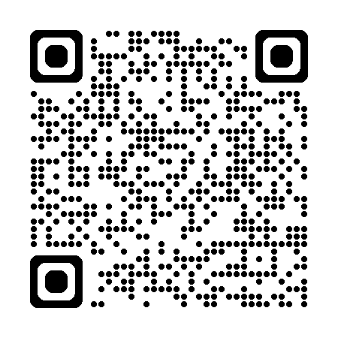
Obtain information
Attend Site Visits, Pre-Proposal Conferences, & Industry Days
Obtain copies of attendee roster for subcontracting opportunities
Attend Workshops and Conferences
Louisville District Open House: February 2026
Construction & IDIQ Forecast is maintained on the Business with Us page of the Great Lakes and Ohio River Division website, https://www.lrd.usace.army.mil/Opportunity-Forecast/

Slide 18
opportunities
We anticipate executing approximately $1.3B in FY25 through both small and large businesses.
Contracting opportunities are posted in the System for Award Management (SAM) website at www.sam.gov. Use “W912QR” to search for Louisville District projects.
Actively Respond to Sources Sought Notices (Market Surveys) posted to SAM
Actively Respond to Competitive Requirements posted to SAM

Slide 19
SUMMARY
Register SAM.gov to obtain and respond to solicitations
Source Selection Evaluation Criteria are basis for selection by source evaluation boards
Unrestricted solicitations require small business participation plan
Fort Campbell UEPH Barracks Project is scheduled for bids due in:
Second Quarter FY 26

Slide 20
What Questions do you have for us?

