Slide 1
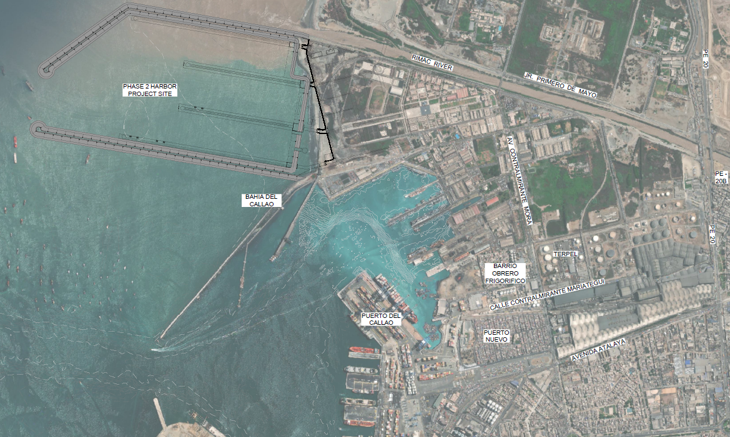
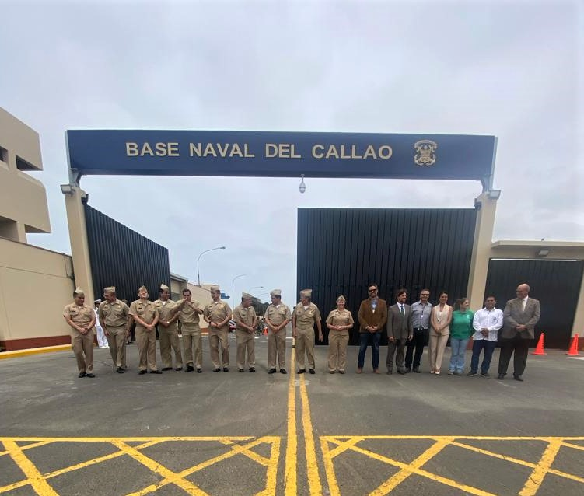
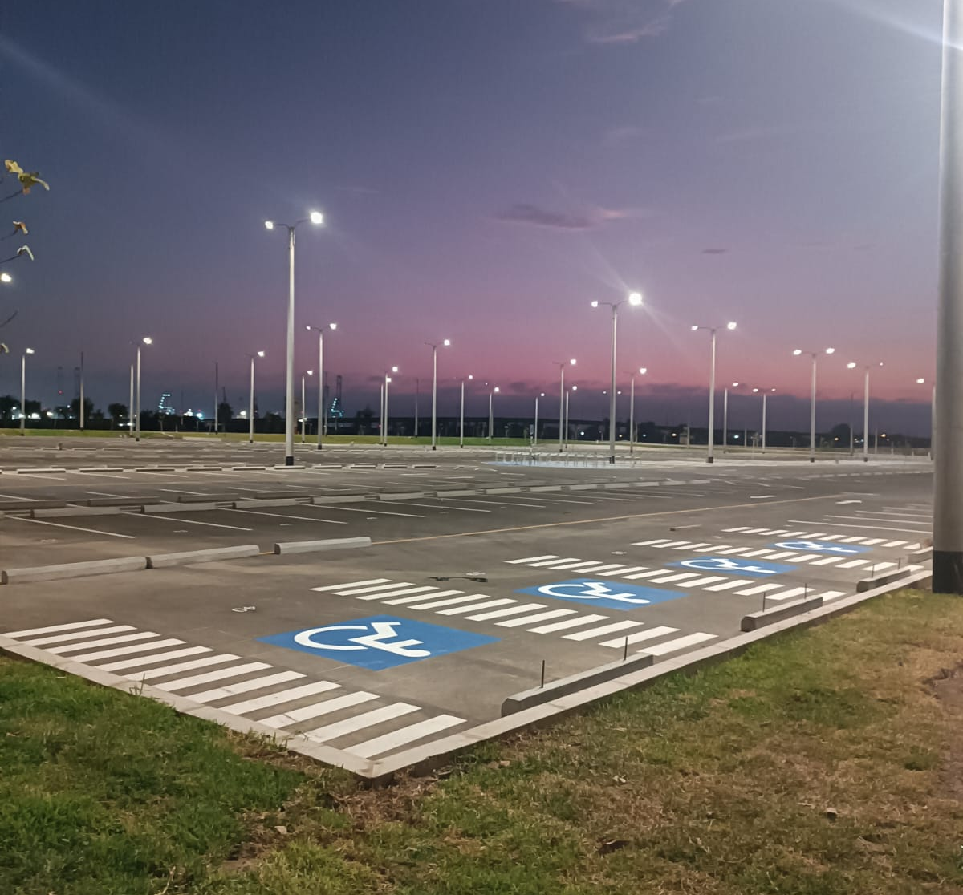
US Army Corps of Engineers’ construction opportunities in support of the Peruvian Navy at the Port of Callao
Industry Day
May 8, 2025

Slide 2
Purpose of this Presentation
Familiarize Contractors with the Peruvian Navy Special Projects Office and the Mobile District, US Army Corps of Engineers (USACE), and its engineering and construction mission in support of the Peruvian Navy at the Port of Callao.
Discuss the purpose of planned solicitations and the resulting contracts.
Familiarize Contractors with the timeframes and submission requirements for planned solicitations.
Request industry feedback on the proposed solicitations and technical requirements.
Disclaimer: This pre-proposal conference is for informational purposes only.
Any remarks or explanations given during this conference (or in the conference notes) will not change the terms and conditions of the solicitation. Offerors are cautioned to carefully read the requirements of the solicitation and comply accordingly. Oral exchanges between offerors and the Government will not be binding unless changes are incorporated by a written amendment.

Slide 3
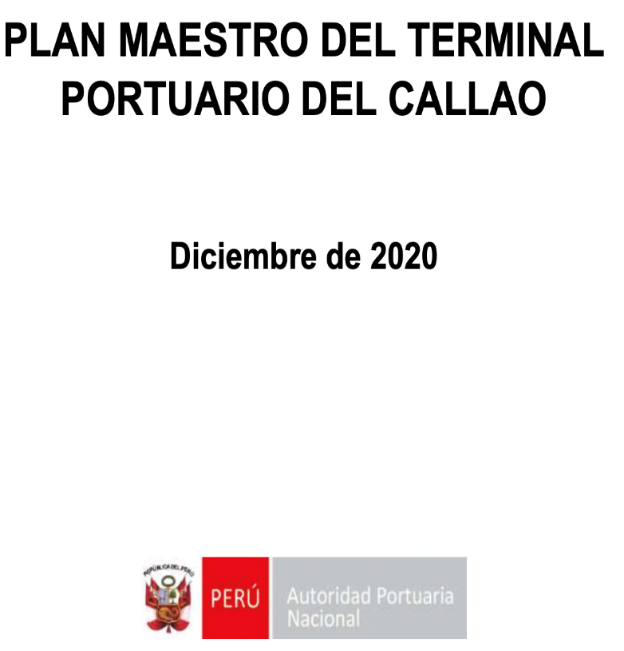
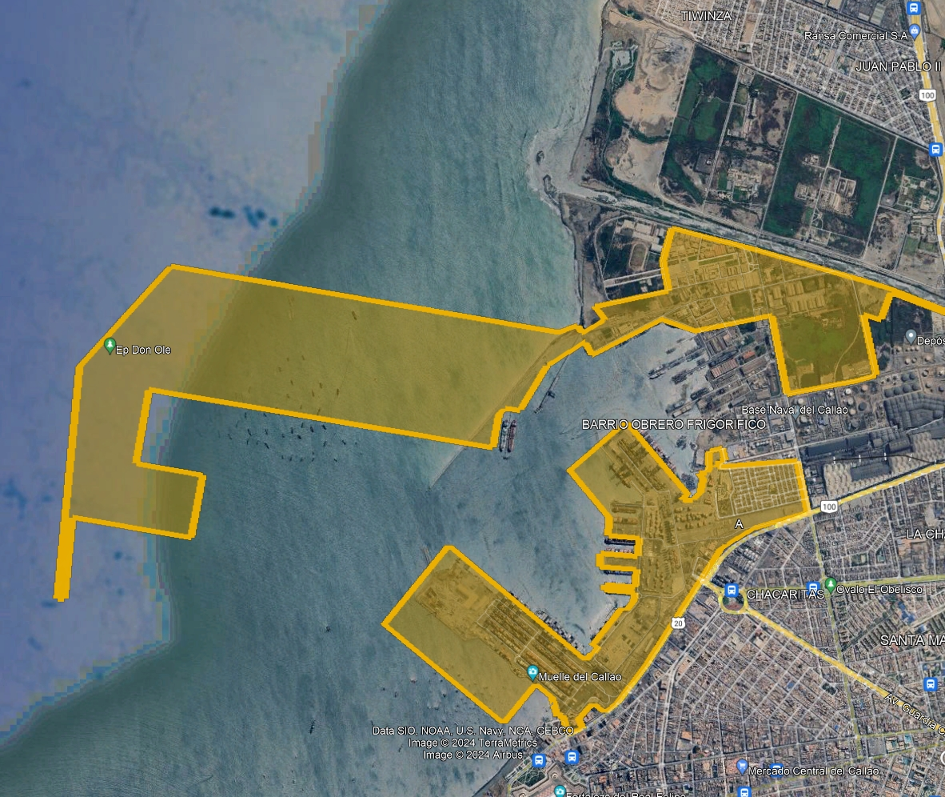
Callao Port Terminal Master Plan
APN – Callao Port Terminal Master Plan. The updated version was approved with the Board of Directors Agreement Resolution N°0070-2020-APN-DIR
(*) Se proyecta el desarrollo potencial del TPC en un horizonte de largo plazo de 30 años que se corresponde con el periodo 2019-2048.
(**) The current requirement is the expansion of Phase 1 - South Pier Terminal (DPW Callao) and the Multipurpose North Terminal (APMT Callao)

Slide 4
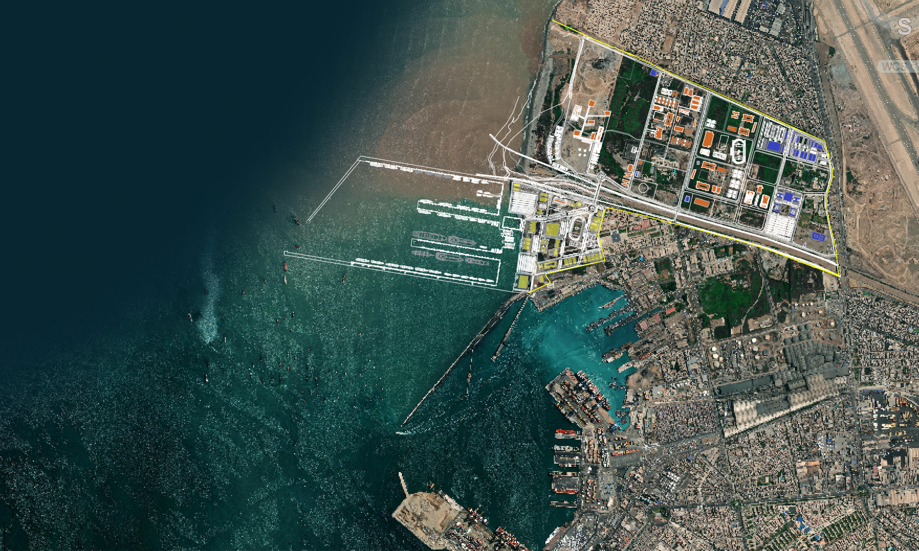
PROYECCION MGP
PROYECCION MTC
PROYECCION APN
Aeropuerto
Jorge Chavez
ARSENAL NAVAL
Base Naval
zona Norte
Av. N. Gambetta
Base Naval zona Sur
PUERTO ha: 25.00
ANTEPUERTO ha: 35.26
Río Rímac
FASE 4
CONSTRUCCIÓN ALINEACIONES DEL DIQUE DE DEFENSA EXTERIOR
FASE 3
ARSENAL NAVAL
FASE 2
VIADUCTO
Av.Calm. Mora
Av. Atalaya
FASE 1
APM TERMINALS
FASE 1
DP WORLD

Slide 5
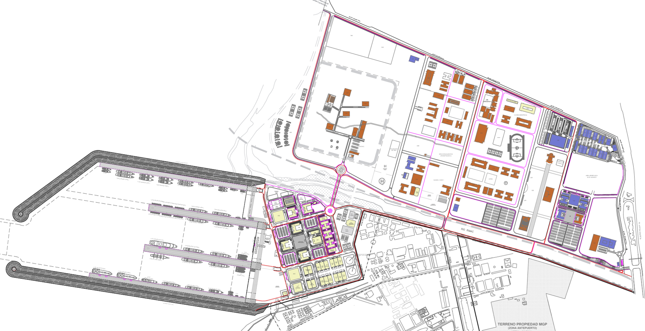
Introducción de la MARINA Del Perú PLAN MAESTRO DE LA BASE NAVAL DEL CALLAO

Slide 6
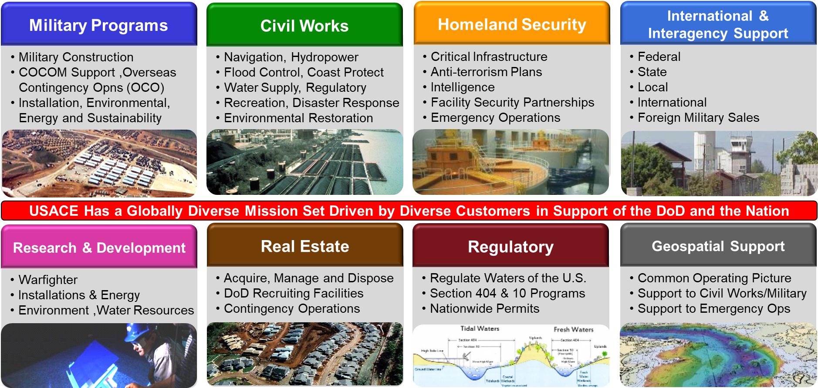
USACE Introduction

Slide 7
General information

Slide 8
To View and Compete
The entity planning to propose (not a parent or subsidiary) must be registered in the following systems to download the solicitation and submit a proposal
Solicitations will ONLY by announced on https://SAM.gov and can ONLY be downloaded from and proposals submitted through https://piee.eb.mil
Steps to Register – must be done in this order
Get an NCAGE Code assigned
https://eportal.nspa.nato.int/Codification/CageTool/request-new-cage
It takes up to 14 calendar days to obtain an NCAGE code.
Create a SAM account and get your Unique Entity Identifier (UEI) Number (formerly known as DUNS) at https://SAM.gov. Allow up to 15 business days after submission before your registration is active in SAM.
For International Registrants, refer to the Quick Start Guide at https://www.fsd.gov/sys_attachment.do?sys_id=c3fbd4771be83898d3ab404fe54bcb19
Obtain PIEE access - https://piee.eb.mil/xhtml/unauth/help/helpvendors.xhtml

Slide 9
General Information
Who Can Submit?
Any responsible, interested, prime construction contractor domiciled in Peru (not the parent company or another branch)
Companies will be required to have or establish a business presence in Peru in accordance with Peruvian law
Who Is Not Eligible to Submit?
Any design firm that participated in preparation of the solicitation in any way
Any firm suspended or debarred in accordance with the US Federal Acquisition Regulation (FAR) or Peruvian law
Some restrictions on participation and access to information related to National Security and Defense will be considered
How Can I Ask Questions?
Once the solicitation is posted, all Requests for Information (RFIs) or questions and clarifications must be submitted by the deadline in the solicitation through the Bidder Inquiry Portal in ProjNet at:
https://www.ProjNet.org/
The Bidder Inquiry Key needed to submit questions will be provided in the solicitation
RFI information is found in solicitation Section 01 00 01
How Will Changes to the Solicitation Requirements be Announced?
Amendment notices will be published on www.SAM.gov
The notice will direct offerors to https://piee.eb.mil where the amendments will be posted

Slide 10
Bonding / insurance Requirements
All bonding requirements are described in the Federal Acquisition Regulation, available on the internet:
https://www.acquisition.gov/far/52.228-15
Bond alternatives will be listed in section 01 00 01 of the solicitation
Bid Guarantee:
FAR 52.228-1
Usually NOT required
Performance Bond:
FAR 52.228-15
10% of awarded amount or approved bond alternative
Payment Bond:
FAR 52.228-15
NOT required
Defense Base Act (DBA) Insurance - https://www.dol.gov/agencies/owcp/dlhwc/lsdba
Required for this procurement
Peruvian requirements must also be met - SCTR and trained personnel per SSOMA

Slide 11
Miscellaneous item Requirements
Safety & Health Requirements must comply with USACE safety manual - EM 385-1-1: http://www.publications.usace.army.mil/Portals/76/Publications/EngineerManuals/EM_385-1-1.pdf
Proposals to be in English & in US Dollars
All construction data to be in metric units
Work to comply with applicable host nation laws and standards, to include either payment of or completion of process for exemption or reimbursement of host nation taxes
Check all amendments (SF 30) for any new information and acknowledge all amendments

Slide 12
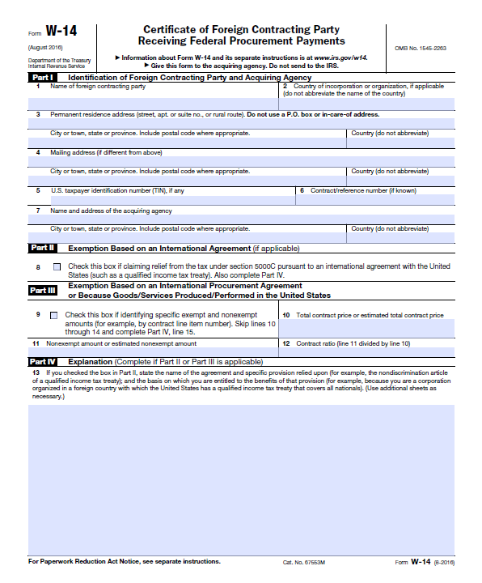
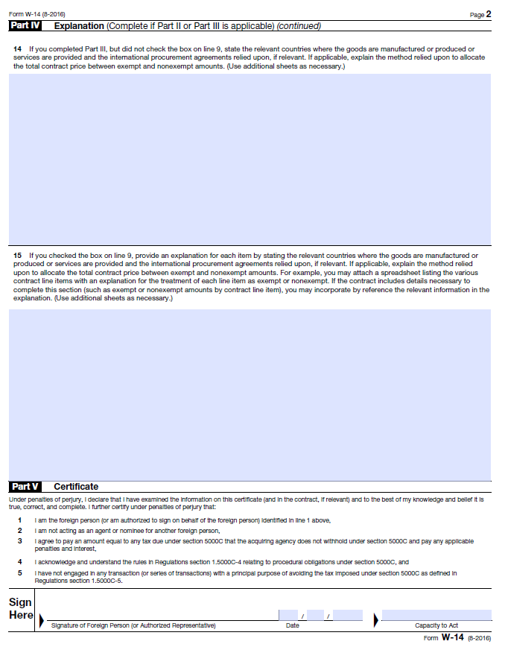
Tax on Certain Foreign Procurements
Provision 52.229-11 – Section 00 45 00
Are you not a US citizen?
Clause 52.229-12 – Section 00 70 00
Exemptions:
Part II – Based on International Tax Agreement (Appendix A and B)
Part III – Based on International Bilateral/Trade Agreement
Part III – Imports from US or Exempted Countries

Slide 13
FUTURE Requirements – BUILDINGS & Infrastructure

Slide 14
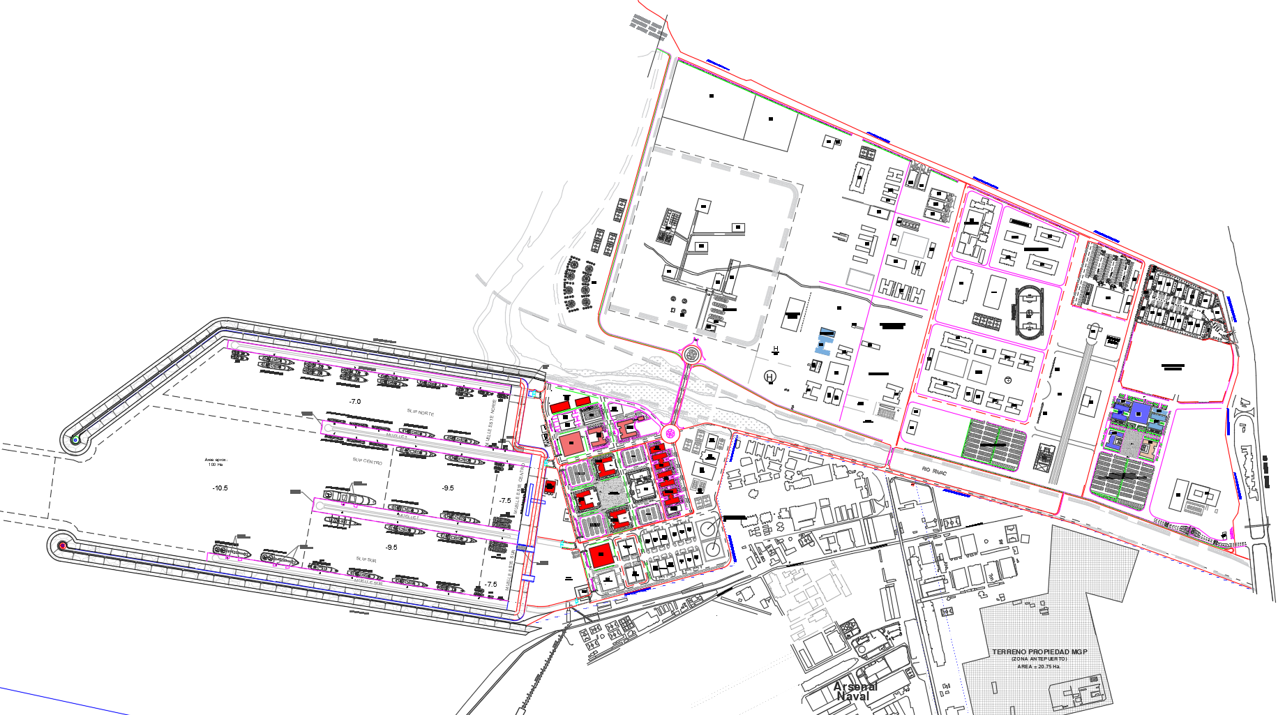
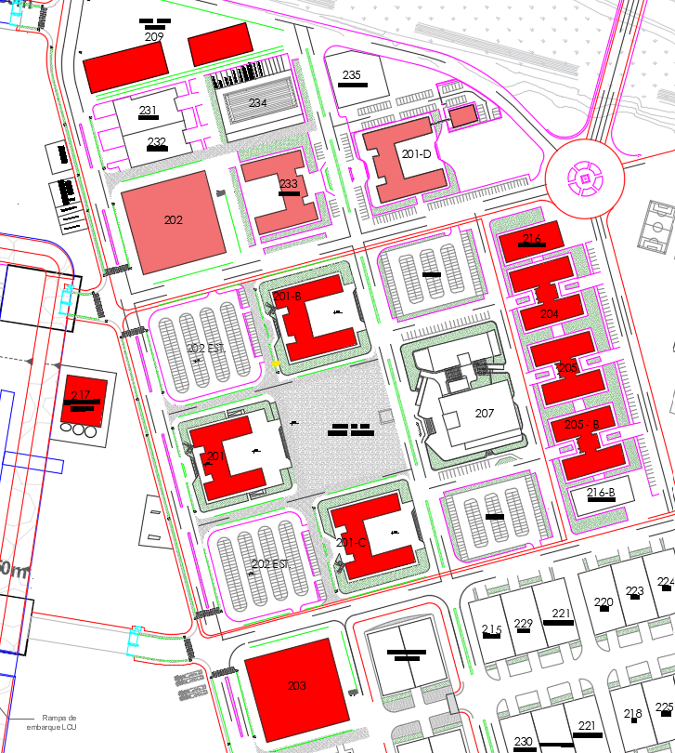
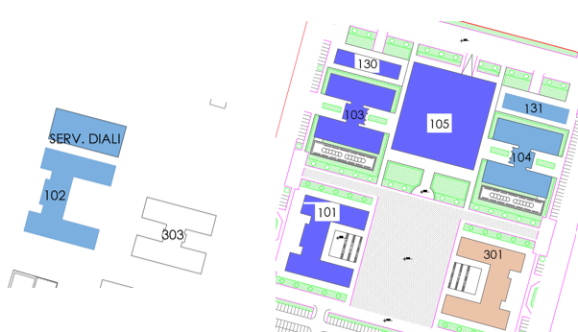
DISEÑO Y CONSTRUCCION DE EDIFICACIONES

Slide 15
Planning and Design Shoreside Requirements
Architect-Engineer contract suite for studies and design
Multiple Award Task Order Contract (MATOC) – Indefinite Delivery, Indefinite Quantity
Covers assessment, planning, and design of facilities (administrative buildings, barracks, dining facilities), roads, utilities, and other infrastructure at the Port of Callao
Contract capacity (to be determined) will be shared among the pool over five years
Will be advertised per U.S. Federal Acquisition Regulation requirements following the “Selection of Architect and Engineers” process – pre-proposal conference will be held prior to issuance of solicitation
FAR Part 36.6 - https://www.acquisition.gov/far/subpart-36.6
EP 715-1-7 - https://www.publications.usace.army.mil/Portals/76/Publications/EngineerPamphlets/EP_715-1-7.pdf
Anticipate that competition may be restricted to Peruvian firms
Firms involved in the development of solicitation documents (such as Request for Proposal packages) will not be eligible to participate in the competition for construction activities resulting from their work
NAICS 541330 – Engineering Services: https://www.naics.com/search/

Slide 16
Construction - Shoreside Requirements
Multiple Award Task Order Contract (MATOC) – Indefinite Delivery, Indefinite Quantity
Covers construction of facilities (administrative buildings, barracks, dining facilities), roads, utilities, and other infrastructure at the Port of Callao
Contract capacity (to be determined) will be shared among the pool over five years
Design-Build Capabilities
Will be advertised as a two phase process
Unrestricted “Best Value” Procurement
Both price and non-price factors will be considered
Proposal representing the overall best value will be selected
The lowest price proposal will not necessarily be selected
NAICS 236220 – Commercial and Institutional Building Construction: https://www.naics.com/search/

Slide 17
QUESTIONS?
Answers provided during the Industry Day are not official.
Once a solicitation has been issued, official answers will only be provided to questions submitted through the RFI process described in the solicitation. Prior to issuance of a solicitation, you may contact the Contracting Officer: Jillian Saffle, jillian.e.saffle@usace.army.mil.

Slide 18
Current Requirements – HARBOR PROJECT

Slide 19
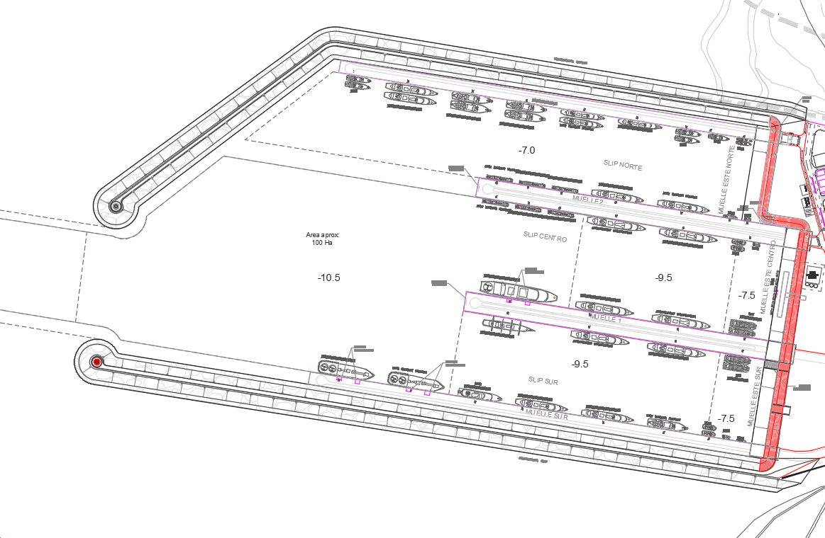
PRIMERA LICITACION: Construcción de revestimiento y rampas para embarcaciones

Slide 20
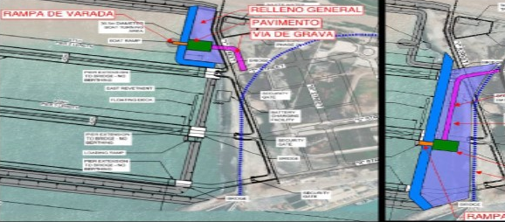
Revetment and Boat Ramp Construction
Solicitation Number: W9127825RA023
Construction of new Revetment/Shore Stabilization and Boat Ramp at the planned Peruvian Navy harbor location immediately north of the commercial port and south of the Rimac River
Design-Bid-Build procurement (full design provided)
Unrestricted, Stand-alone, “Best Value” Procurement
Both price and non-price factors will be considered
Proposal representing the overall best value will be selected
The lowest price proposal will not necessarily be selected
Single, Firm Fixed-Price Contract Award
Anticipate issuance of solicitation in September 2025
NAICS 237990 – Marine Construction: https://www.naics.com/search/

Slide 21
Single Phase (or Step) Stand-alone Solicitation Process
Any company which meets the requirements of the solicitation (see general information slide above) is eligible to submit a proposal
A technical board will evaluate “non-price” proposals, and a separate team will determine if the proposal is complete and if the proposed pricing is fair and reasonable.
The Selecting Official will conduct a price/technical trade-off, and will select the one company which will receive the contract for the specific construction requirement
All evaluations and decisions will be reviewed by independent reviewers and/or committees
USACE intends to award without discussions, but may open discussions with any or all offerors
Proposals with a deficiency will not be considered for award

Slide 22
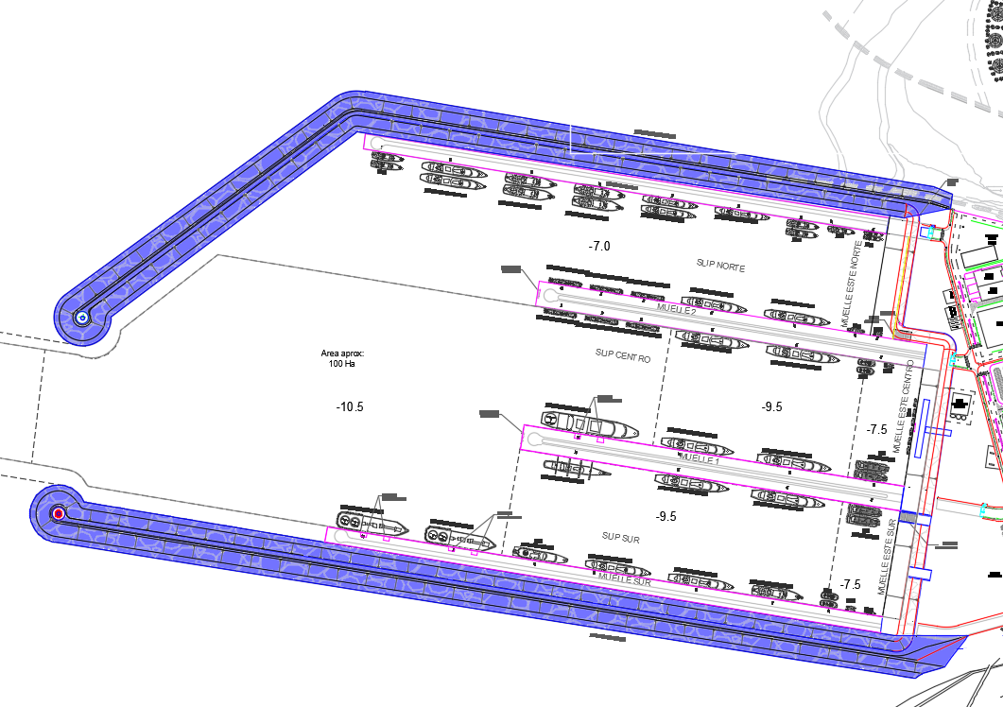
SEGUNDA LICITACION (PROYECTO SEMILLA-MATOC): DISEÑO Y CONSTRUCCION DE ROMPEOLAS

Slide 23
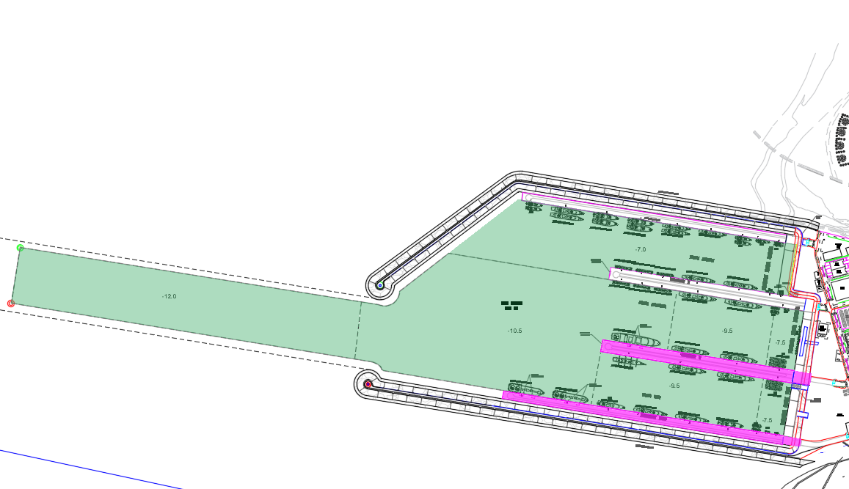
TERCERA LICITACION (MATOC): DRAGADO, DISEÑO Y CONSTRUCCION DE MUELLE SUR Y MUELLE I

Slide 24
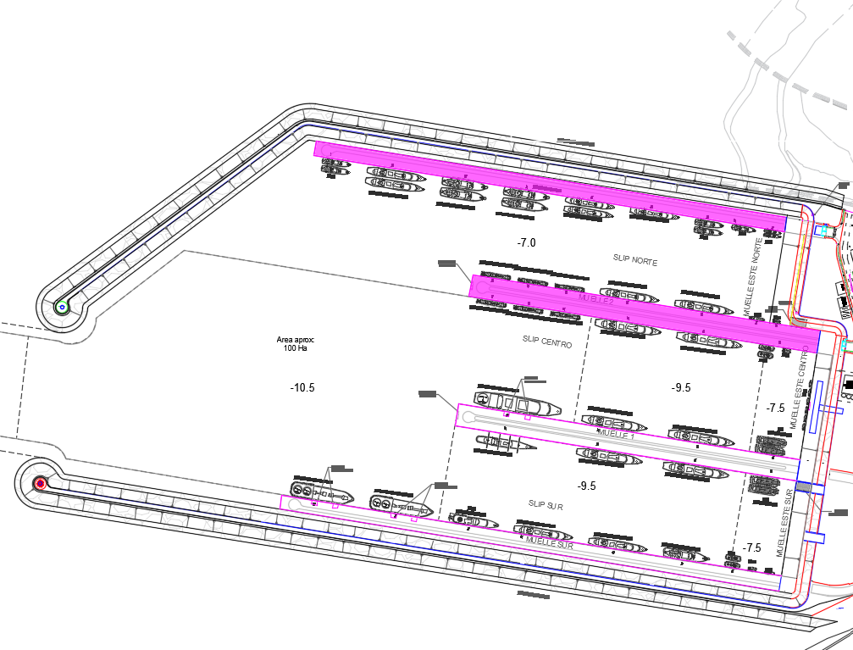
CUARTA LICITACION (MATOC): DISEÑO Y CONSTRUCCION DE MUELLE NORTE Y MUELLE II

Slide 25
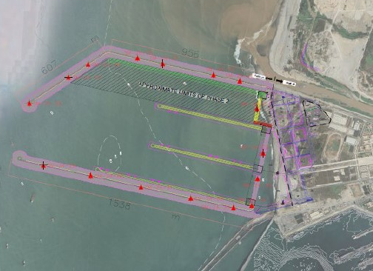
Construction - Harbor Requirements
Multiple Award Task Order Contract (MATOC) – Indefinite Delivery, Indefinite Quantity
Covers construction of harbor infrastructure at the Port of Callao
$950,000,000 USD in total shared capacity over five years
Design-Build Capabilities
Unrestricted “Best Value” Procurement
Both price and non-price factors will be considered
Proposal representing the overall best value will be selected
The lowest price proposal will not necessarily be selected
Will be advertised as a two-phase process
Anticipate issuance of the Phase 1 solicitation in December 2025
NAICS 237990 – Marine Construction: https://www.naics.com/search/

Slide 26
Solicitation Requirements for construction and repair MATOC – Harbor Construction

Slide 27
Two Phase (or Step) MATOC Process
Any company which meets the requirements of the solicitation (see general information slide above) is eligible to submit a proposal in Phase 1
A technical board will evaluate Phase One proposals, and the Selecting Official will determine which companies are invited to participate in the Phase Two competition (anticipate the goal will be to invite 5 companies for Phase Two)
All companies will be advised if they will or will not be included in Phase Two
Separate technical and pricing boards will evaluate Phase Two proposals, and the Selecting Official will select the companies which will receive contracts
All evaluations and decisions will be reviewed by independent reviewers and/or committees
USACE intends to award without discussions, but may open discussions with any or all offerors during Phase One and/or Phase Two
Proposals with a deficiency will not be considered for award
Today’s presentation will be based on a Two Phase process

Slide 28
MATOC Process for individual requirements
The selection process for the MATOC will result in both award of “basic contracts” to a pool of contractors, and award of the seed project to one member of that pool
Contractors receiving a “basic contract” award will be eligible to compete against other contractors in the pool for award of future projects (awarded as task orders) under the terms of the signed basic contract
Only companies holding a basic contract will be allowed to compete for these future requirements
Being awarded a basic contract does not guarantee the award of future work – it only enables participation in the competition for future work
Each task order Request for Proposal will provide instructions on what items are required for the competition, but they will generally include price and a technical/management discussion specific to that project
USACE does not pay in advance, so the winning contractor for each project must be prepared to start actions and mobilize prior to their first payment – payments will only be made for work completed and verified by the USACE Contracting Officer’s Representative

Slide 29
Section 00 11 00: phase (or step) one
Factor 1 - Past Performance of Prime in Peru
Factor 2 - Past Performance of Prime with Harbor Related Construction
Factor 3 – Past Performance of the Lead Design Firm
In order of importance
A separate response is required for each factor
Two components for each factor:
Relevant Company Effort:
Recent (as defined in solicitation)
Relevant (as defined in solicitation)
Quality of Past Performance
Federal Gov’t Projects: CPARS (Interim or Final) when available; otherwise, use provided Past Performance Questionnaire (PPQ) format
Other Projects: only PPQs (Attachment in solicitation section)
Maximum of 5 examples per factor (Attachment in solicitation section)
Past Performance of Offeror = Offeror’s name in SF1442 (form in solicitation) except as described in solicitation

Slide 30
Section 00 11 00: phase (or step) one
Factor 1 - Past Performance of Prime in Peru
Factor 2 - Past Performance of Prime with Harbor Related Construction
Factor 3 – Past Performance of the Lead Design Firm
Evaluation for each factor:
Step 1 - Determine if projects submitted are recent and relevant
Step 2 - Assign ratings to each project based on level of relevancy
Step 3 - Assess how well the Prime or Lead Design Firm performed on these projects
Step 4 - Determine overall Performance Confidence Assessment Rating
The Performance Confidence Assessment Rating reflects the degree of probability the Offeror or Lead Design Firm will be able to meet the solicitation’s requirements.
Offerors’ proposals with little or no relevant past performance will be rated neutral confidence.

Slide 31
Section 00 11 00: phase (or step) one
Factor 4 – Overall Management Approach
4th in Relative Importance
Narrative to include information regarding:
Home office organizational structure
Type of work the Offeror intends to self-perform
Offeror’s business method for selecting and managing subcontractors
Evaluation:
Step 1 – Evaluate each aspect of the narrative to assess offeror’s understanding of the requirements
Step 2 - Determine strengths, weaknesses, and deficiencies
Step 3 – Assign an overall combined Technical/Risk Rating
The Technical/Risk Rating reflects the degree to which the proposed approach meets or does not meet the minimum technical requirements.

Slide 32
Section 00 12 00: phase (or step) TWO
Evaluation Process
Components:
Proposal Compliance Review
Phase Two Non-Price Factor Evaluation
Price Analysis
fair, reasonable, unbalancing of bids
Non-Price/Price Trade-off Analysis
based on relative advantages and disadvantages of proposals and prices
Non-price factors are evaluated independently from price by a technical team
Price is not rated but will be analyzed for fairness and reasonableness, and for appearance of unbalanced pricing by a separate team
2 separate bid schedules will be required
Contract rates (labor rates, mark-ups)
Seed Project proposed pricing
Award to be made to the proposal that offers the best value to the Government (combined factor ratings & price)

Slide 33
Section 00 12 00: phase (or step) TWO
Factor 5 – Overall Technical Approach
1st in Relative Importance
Narrative to explain the Offeror’s capabilities to execute the project
Project Approach
Preliminary Schedule
Project Self-Performance
Factor 6 – Key Management Personnel Experience & Qualifications
2nd in Relative Importance
Provide key construction and design personnel resumes with emphasis on projects in which the personnel have performed duties for their assigned role on this contract
Evaluation per factor:
Step 1 – Determine if proposal meets the solicitation requirements
Step 2 – Determine strengths, weaknesses and deficiencies
Step 3 – Assign an overall combined Technical/Risk Rating for each factor
The Technical/Risk Ratings reflect the degree to which the offeror demonstrates the necessary capabilities and approach to effectively perform the project.

Slide 34
Industry Discussion and feedback

Slide 35
Discussion Topics
Any potential concerns with including multiple types of projects under a single “task order” contract (dredging, breakwaters, piers, etc)
Capabilities
Need for teaming with other contractors
Experience or concerns with installation of wick drains and geotextiles if they were to be used in a project
Critical risk items for performance of harbor construction

Slide 36
Final Reminders
Each solicitation discussed today will be posted individually. Ensure your company is registered in all required systems as soon as possible.
Solicitations will be posted via the Procurement Integrated Enterprise Environment (PIEE) website
(https://piee.eb.mil/xhtml/unauth/home/login.xhtml -OR- https://piee.eb.mil).
Instructions for offerors can be found in Section 00 11 00.
Submit Questions via Bidder Inquiry Portal in ProjNet at https://www.ProjNet.org/. The “Bidder Key” required for submitting questions will be provided in the solicitation posting information.

Slide 37
QUESTIONS?
Answers provided during the Industry Day are not official.
Once a solicitation has been issued, official answers will only be provided to questions submitted through the RFI process described in the solicitation. Prior to issuance of a solicitation, you may contact the Contracting Officer: Jillian Saffle, jillian.e.saffle@usace.army.mil.

