Slide 1

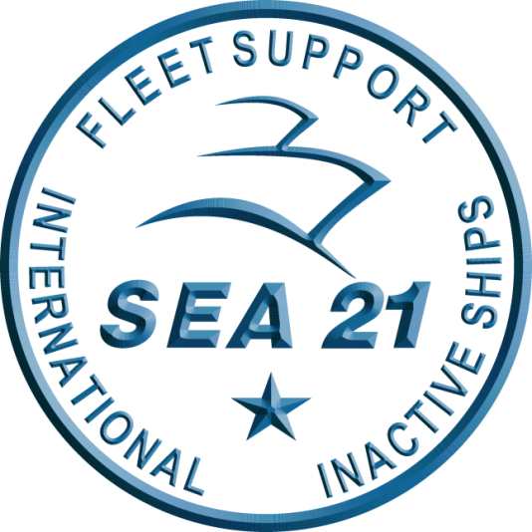
Domestic Private Sector Workload Estimate FY24 - FY27 Workload as of 01 DEC 2023 Industry Version FY24 Q1 M3
“Intent of this information is to provide U.S. DoD industry contractors a general schedule for information and planning purposes for upcoming surface ship maintenance periods- It does not constitute any request for information or request for proposals or any commitment to contract for work in accordance with this plan. This information is to assist U.S. DoD industry contractors by providing a broad overview of frequently changing (driven by U.S. Navy operations) maintenance schedules and is not a guarantee of workload or exact ship schedules”
“Distribution Statement A: Approved for Public Release; Distribution is unlimited.”

Slide 2
Notes
Data contained in this report reflects the Navy program of record as of 01 DECEMBER 2023.
The next bi-monthly workload projections are targeted for release no later than 29 FEBRUARY 2024.
Industry manning impacts, results of ongoing availability duration and schedule review, tailored acquisition strategies and ongoing budget negotiations may refine out-year projections.
Please note, as of August 2023, we have incorporated the use of new software, which automates the generation of the workload charts. SEA21 is aware of the label legibility issues within the workload charts for some ports and is working to correct those issues. The supporting availability data tables following each workload chart should provide required insight. If there is any confusion, please do not hesitate to reach out to Minh Ly (minh.t.ly.civ@us.navy.mil).
“Intent of this information is to provide U.S. DoD industry contractors a general schedule for information and planning purposes for upcoming surface ship maintenance periods- It does not constitute any request for information or request for proposals or any commitment to contract for work in accordance with this plan. This information is to assist U.S. DoD industry contractors by providing a broad overview of frequently changing (driven by U.S. Navy operations) maintenance schedules and is not a guarantee of workload or exact ship schedules”
“Distribution Statement A: Approved for Public Release; Distribution is unlimited.”

Slide 3
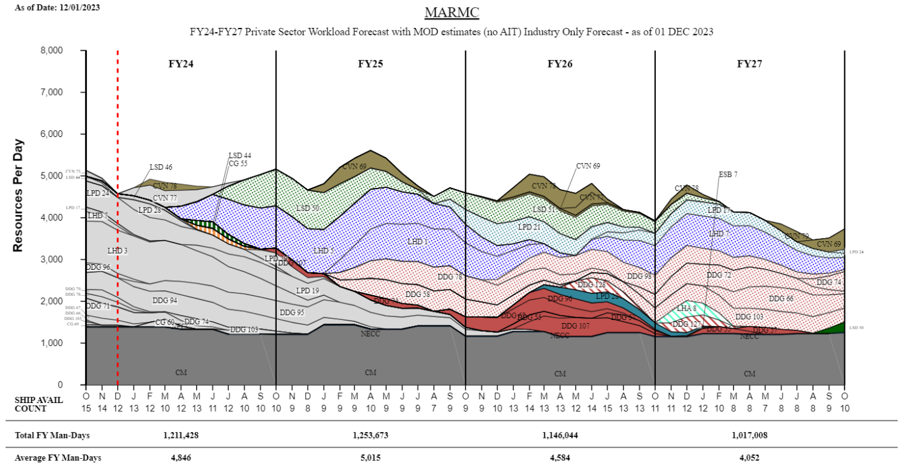
MARMC Private Sector
TIME NOW
“Intent of this information is to provide U.S. DoD industry contractors a general schedule for information and planning purposes for upcoming surface ship maintenance periods- It does not constitute any request for information or request for proposals or any commitment to contract for work in accordance with this plan. This information is to assist U.S. DoD industry contractors by providing a broad overview of frequently changing (driven by U.S. Navy operations) maintenance schedules and is not a guarantee of workload or exact ship schedules”
“Distribution Statement A: Approved for Public Release; Distribution is unlimited.”

Slide 4
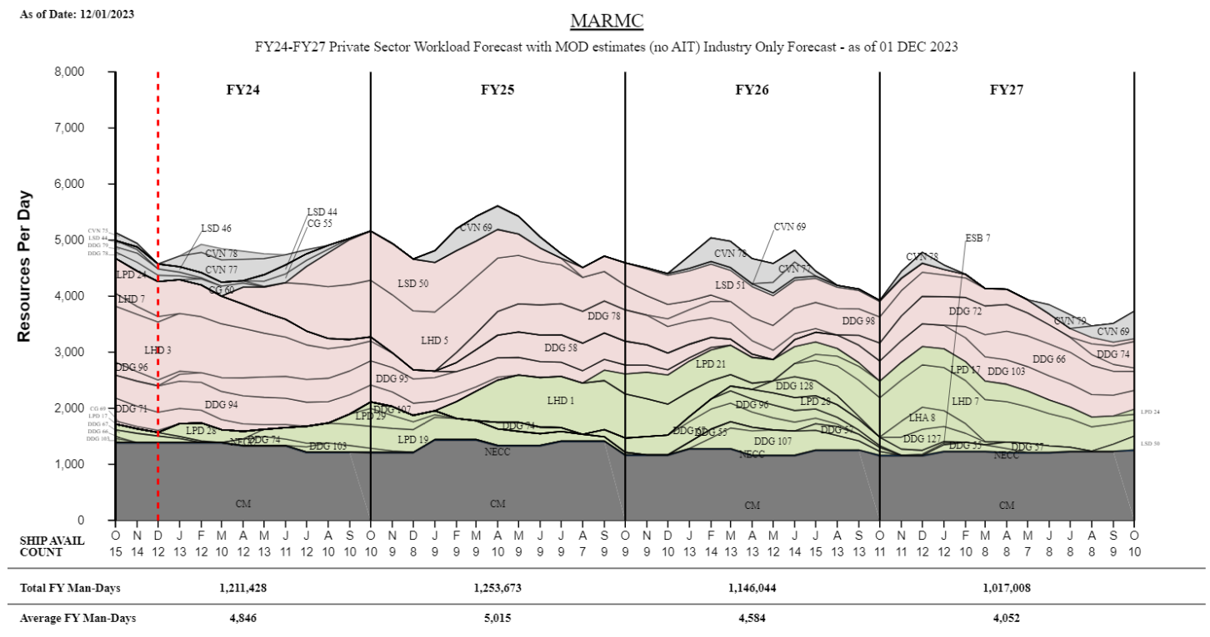
MARMC Private Sector
TIME NOW
“Intent of this information is to provide U.S. DoD industry contractors a general schedule for information and planning purposes for upcoming surface ship maintenance periods- It does not constitute any request for information or request for proposals or any commitment to contract for work in accordance with this plan. This information is to assist U.S. DoD industry contractors by providing a broad overview of frequently changing (driven by U.S. Navy operations) maintenance schedules and is not a guarantee of workload or exact ship schedules”
“Distribution Statement A: Approved for Public Release; Distribution is unlimited.”

Slide 5
MARMC Private Sector Workload Forecast with MOD estimates (no AIT) FY24 - FY25 Industry Forecast - as of 01 DEC 2023
“Intent of this information is to provide U.S. DoD industry contractors a general schedule for information and planning purposes for upcoming surface ship maintenance periods- It does not constitute any request for information or request for proposals or any commitment to contract for work in accordance with this plan. This information is to assist U.S. DoD industry contractors by providing a broad overview of frequently changing (driven by U.S. Navy operations) maintenance schedules and is not a guarantee of workload or exact ship schedules”
“Distribution Statement A: Approved for Public Release; Distribution is unlimited.”

Slide 6
MARMC Private Sector Workload Forecast with MOD estimates (no AIT) FY26 - FY27 Industry Forecast - as of 01 DEC 2023
“Intent of this information is to provide U.S. DoD industry contractors a general schedule for information and planning purposes for upcoming surface ship maintenance periods- It does not constitute any request for information or request for proposals or any commitment to contract for work in accordance with this plan. This information is to assist U.S. DoD industry contractors by providing a broad overview of frequently changing (driven by U.S. Navy operations) maintenance schedules and is not a guarantee of workload or exact ship schedules”
“Distribution Statement A: Approved for Public Release; Distribution is unlimited.”

Slide 7
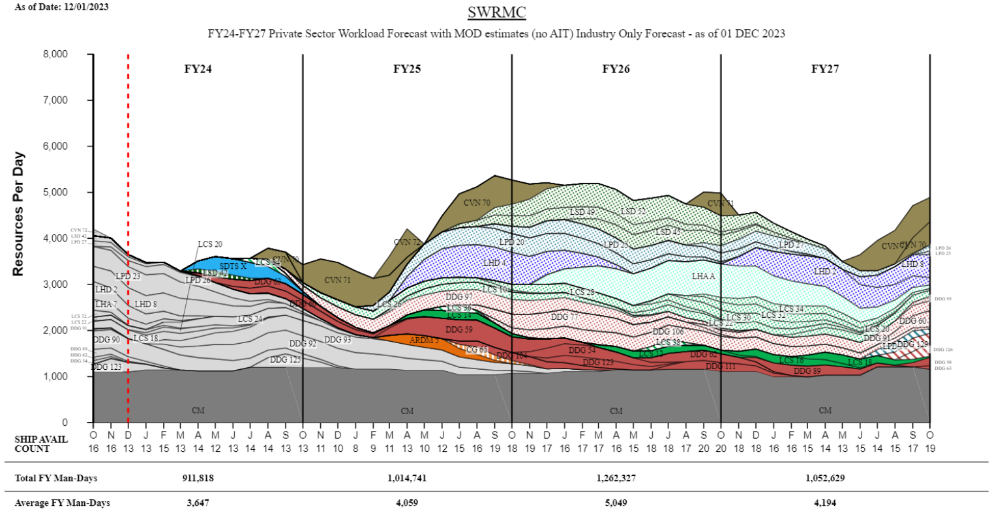
SWRMC Private Sector
TIME NOW
“Intent of this information is to provide U.S. DoD industry contractors a general schedule for information and planning purposes for upcoming surface ship maintenance periods- It does not constitute any request for information or request for proposals or any commitment to contract for work in accordance with this plan. This information is to assist U.S. DoD industry contractors by providing a broad overview of frequently changing (driven by U.S. Navy operations) maintenance schedules and is not a guarantee of workload or exact ship schedules”
“Distribution Statement A: Approved for Public Release; Distribution is unlimited.”

Slide 8
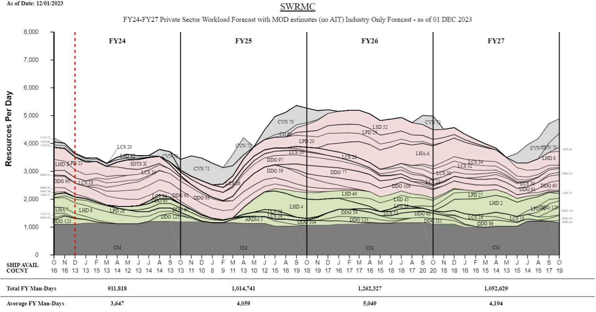
SWRMC Private Sector
TIME NOW
“Intent of this information is to provide U.S. DoD industry contractors a general schedule for information and planning purposes for upcoming surface ship maintenance periods- It does not constitute any request for information or request for proposals or any commitment to contract for work in accordance with this plan. This information is to assist U.S. DoD industry contractors by providing a broad overview of frequently changing (driven by U.S. Navy operations) maintenance schedules and is not a guarantee of workload or exact ship schedules”
“Distribution Statement A: Approved for Public Release; Distribution is unlimited.”

Slide 9
SWRMC Private Sector Workload Forecast with MOD estimates (no AIT) FY24 - FY25 Industry Forecast - as of 01 DEC 2023
“Intent of this information is to provide U.S. DoD industry contractors a general schedule for information and planning purposes for upcoming surface ship maintenance periods- It does not constitute any request for information or request for proposals or any commitment to contract for work in accordance with this plan. This information is to assist U.S. DoD industry contractors by providing a broad overview of frequently changing (driven by U.S. Navy operations) maintenance schedules and is not a guarantee of workload or exact ship schedules”
“Distribution Statement A: Approved for Public Release; Distribution is unlimited.”

Slide 10
SWRMC Private Sector Workload Forecast with MOD estimates (no AIT) FY26 - FY27 Industry Forecast - as of 01 DEC 2023
“Intent of this information is to provide U.S. DoD industry contractors a general schedule for information and planning purposes for upcoming surface ship maintenance periods- It does not constitute any request for information or request for proposals or any commitment to contract for work in accordance with this plan. This information is to assist U.S. DoD industry contractors by providing a broad overview of frequently changing (driven by U.S. Navy operations) maintenance schedules and is not a guarantee of workload or exact ship schedules”
“Distribution Statement A: Approved for Public Release; Distribution is unlimited.”

Slide 11
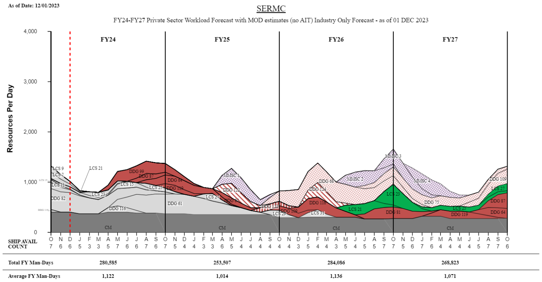
SERMC Private Sector
TIME NOW
“Intent of this information is to provide U.S. DoD industry contractors a general schedule for information and planning purposes for upcoming surface ship maintenance periods- It does not constitute any request for information or request for proposals or any commitment to contract for work in accordance with this plan. This information is to assist U.S. DoD industry contractors by providing a broad overview of frequently changing (driven by U.S. Navy operations) maintenance schedules and is not a guarantee of workload or exact ship schedules”
“Distribution Statement A: Approved for Public Release; Distribution is unlimited.”

Slide 12
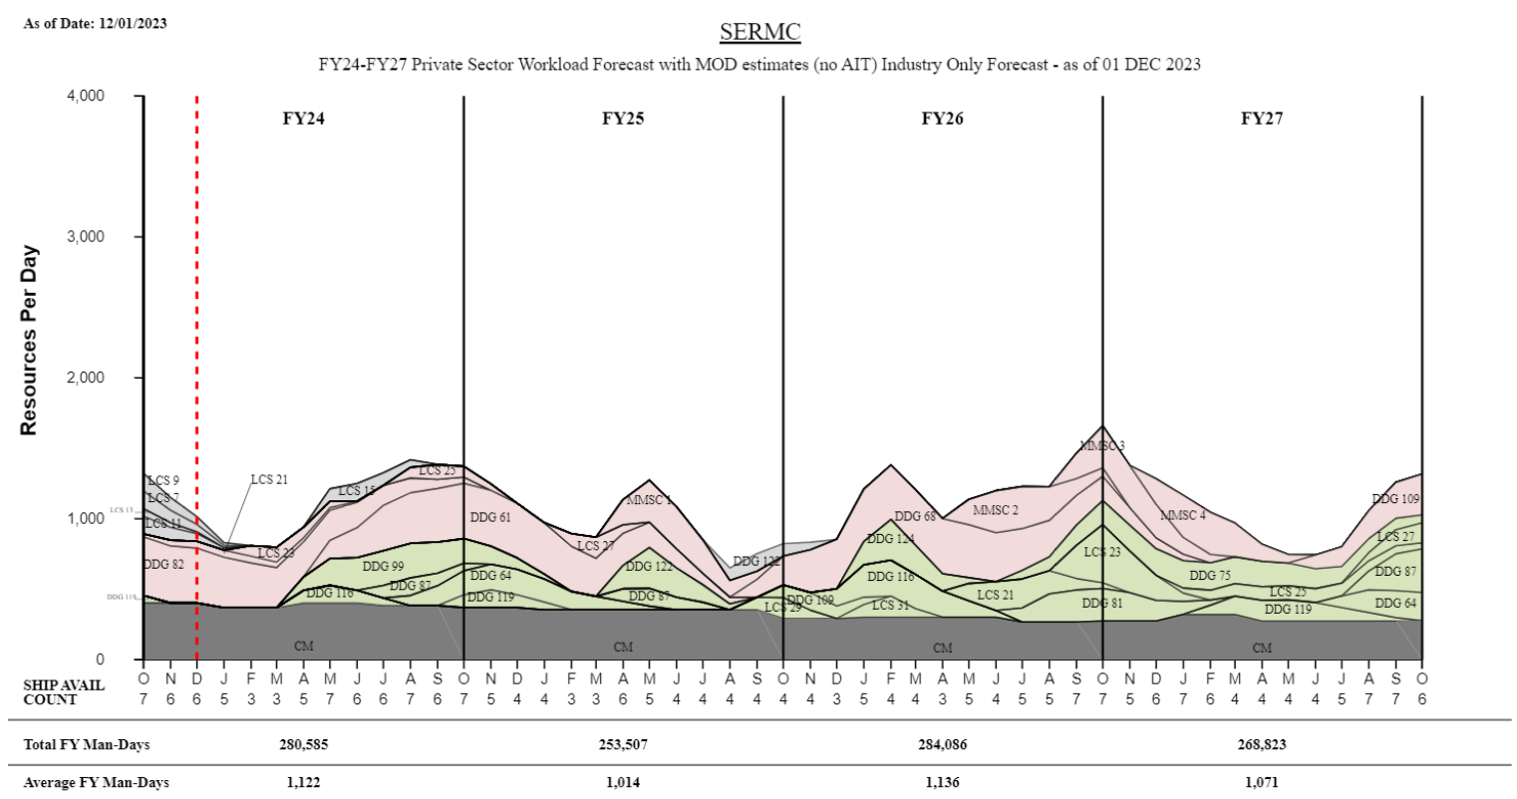
SERMC Private Sector
TIME NOW
“Intent of this information is to provide U.S. DoD industry contractors a general schedule for information and planning purposes for upcoming surface ship maintenance periods- It does not constitute any request for information or request for proposals or any commitment to contract for work in accordance with this plan. This information is to assist U.S. DoD industry contractors by providing a broad overview of frequently changing (driven by U.S. Navy operations) maintenance schedules and is not a guarantee of workload or exact ship schedules”
“Distribution Statement A: Approved for Public Release; Distribution is unlimited.”

Slide 13
SERMC Private Sector Workload Forecast with MOD estimates (no AIT) FY24 - FY25 Industry Forecast - as of 01 DEC 2023
“Intent of this information is to provide U.S. DoD industry contractors a general schedule for information and planning purposes for upcoming surface ship maintenance periods- It does not constitute any request for information or request for proposals or any commitment to contract for work in accordance with this plan. This information is to assist U.S. DoD industry contractors by providing a broad overview of frequently changing (driven by U.S. Navy operations) maintenance schedules and is not a guarantee of workload or exact ship schedules”
“Distribution Statement A: Approved for Public Release; Distribution is unlimited.”

Slide 14
SERMC Private Sector Workload Forecast with MOD estimates (no AIT) FY26 - FY27 Industry Forecast - as of 01 DEC 2023
“Intent of this information is to provide U.S. DoD industry contractors a general schedule for information and planning purposes for upcoming surface ship maintenance periods- It does not constitute any request for information or request for proposals or any commitment to contract for work in accordance with this plan. This information is to assist U.S. DoD industry contractors by providing a broad overview of frequently changing (driven by U.S. Navy operations) maintenance schedules and is not a guarantee of workload or exact ship schedules”
“Distribution Statement A: Approved for Public Release; Distribution is unlimited.”

Slide 15
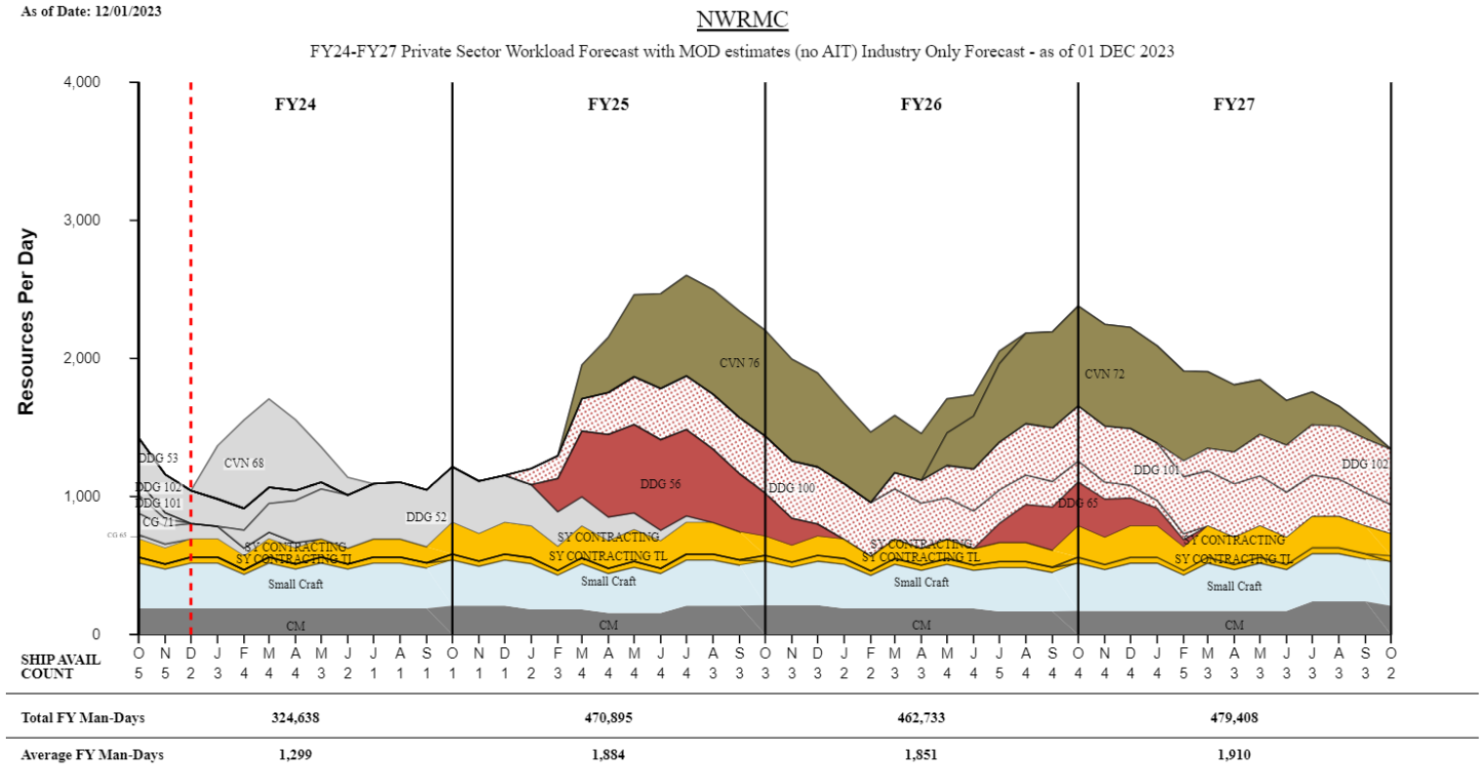
NWRMC Private Sector
TIME NOW
“Intent of this information is to provide U.S. DoD industry contractors a general schedule for information and planning purposes for upcoming surface ship maintenance periods- It does not constitute any request for information or request for proposals or any commitment to contract for work in accordance with this plan. This information is to assist U.S. DoD industry contractors by providing a broad overview of frequently changing (driven by U.S. Navy operations) maintenance schedules and is not a guarantee of workload or exact ship schedules”
“Distribution Statement A: Approved for Public Release; Distribution is unlimited.”

Slide 16
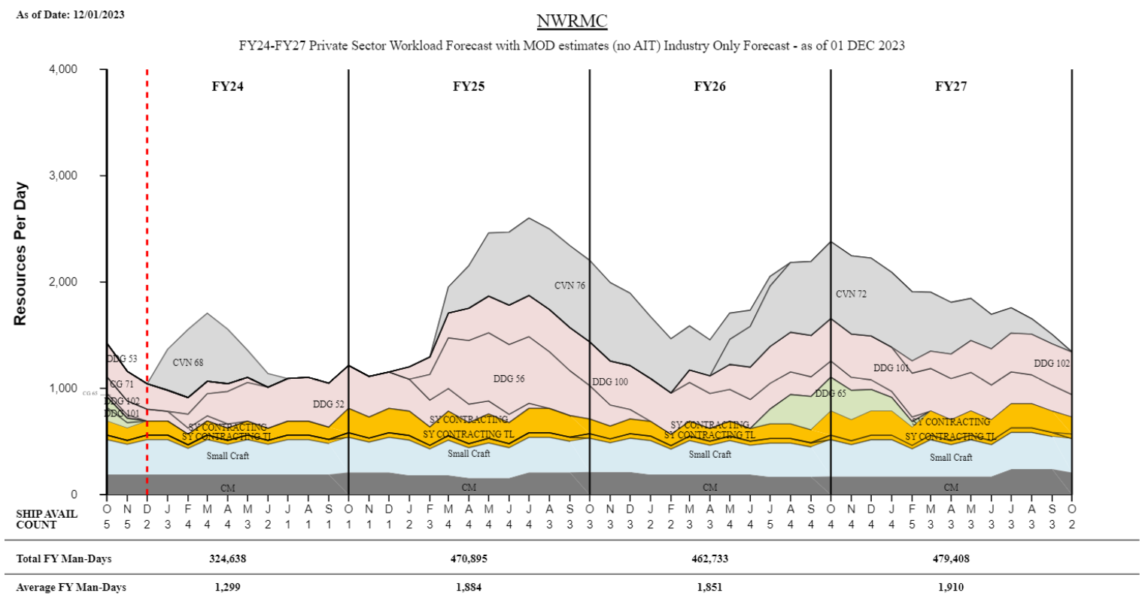
NWRMC Private Sector
TIME NOW
“Intent of this information is to provide U.S. DoD industry contractors a general schedule for information and planning purposes for upcoming surface ship maintenance periods- It does not constitute any request for information or request for proposals or any commitment to contract for work in accordance with this plan. This information is to assist U.S. DoD industry contractors by providing a broad overview of frequently changing (driven by U.S. Navy operations) maintenance schedules and is not a guarantee of workload or exact ship schedules”
“Distribution Statement A: Approved for Public Release; Distribution is unlimited.”

Slide 17
NWRMC Private Sector Workload Forecast with MOD estimates (no AIT) FY24 - FY27 Industry Forecast - as of 01 DEC 2023
“Intent of this information is to provide U.S. DoD industry contractors a general schedule for information and planning purposes for upcoming surface ship maintenance periods- It does not constitute any request for information or request for proposals or any commitment to contract for work in accordance with this plan. This information is to assist U.S. DoD industry contractors by providing a broad overview of frequently changing (driven by U.S. Navy operations) maintenance schedules and is not a guarantee of workload or exact ship schedules”
“Distribution Statement A: Approved for Public Release; Distribution is unlimited.”

Slide 18
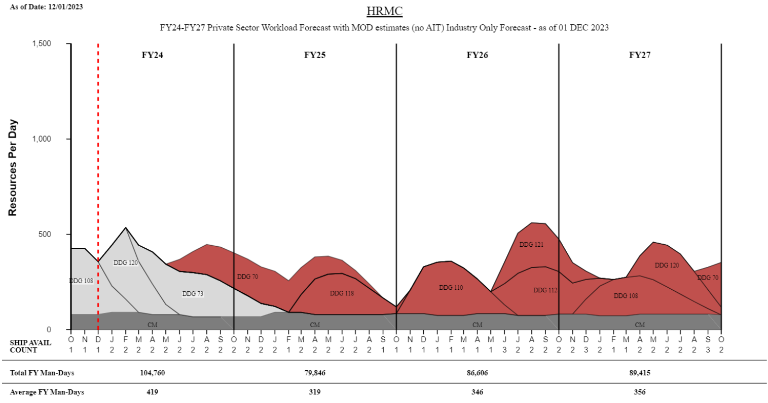
HRMC Private Sector
TIME NOW
“Intent of this information is to provide U.S. DoD industry contractors a general schedule for information and planning purposes for upcoming surface ship maintenance periods- It does not constitute any request for information or request for proposals or any commitment to contract for work in accordance with this plan. This information is to assist U.S. DoD industry contractors by providing a broad overview of frequently changing (driven by U.S. Navy operations) maintenance schedules and is not a guarantee of workload or exact ship schedules”
“Distribution Statement A: Approved for Public Release; Distribution is unlimited.”

Slide 19
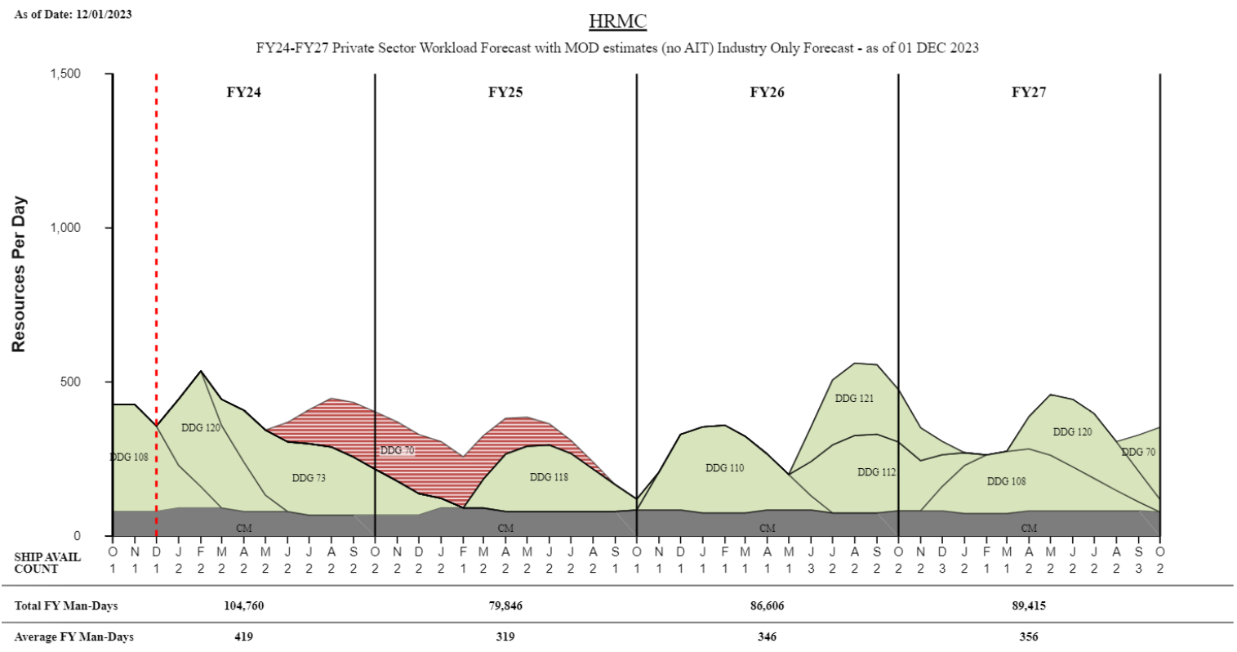
HRMC Private Sector
TIME NOW
“Intent of this information is to provide U.S. DoD industry contractors a general schedule for information and planning purposes for upcoming surface ship maintenance periods- It does not constitute any request for information or request for proposals or any commitment to contract for work in accordance with this plan. This information is to assist U.S. DoD industry contractors by providing a broad overview of frequently changing (driven by U.S. Navy operations) maintenance schedules and is not a guarantee of workload or exact ship schedules”
“Distribution Statement A: Approved for Public Release; Distribution is unlimited.”

Slide 20
HRMC Private Sector Workload Forecast with MOD estimates (no AIT) FY24 - FY27 Industry Forecast - as of 01 DEC 2023
“Intent of this information is to provide U.S. DoD industry contractors a general schedule for information and planning purposes for upcoming surface ship maintenance periods- It does not constitute any request for information or request for proposals or any commitment to contract for work in accordance with this plan. This information is to assist U.S. DoD industry contractors by providing a broad overview of frequently changing (driven by U.S. Navy operations) maintenance schedules and is not a guarantee of workload or exact ship schedules”
“Distribution Statement A: Approved for Public Release; Distribution is unlimited.”

