Slide 1

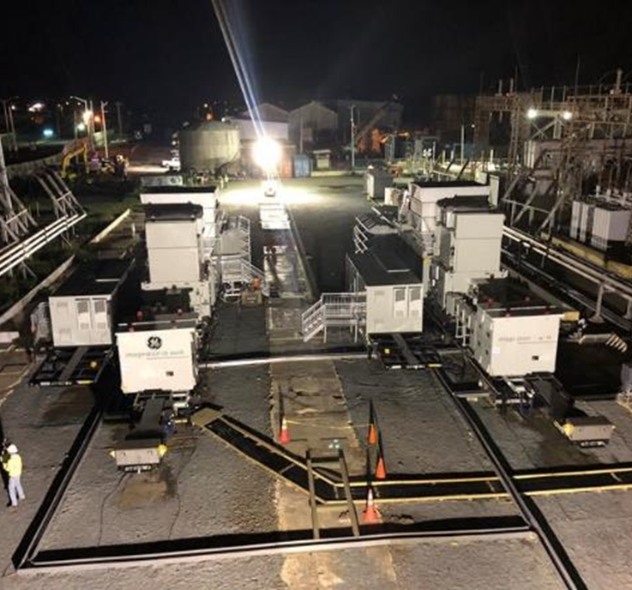
U.S. Army Corps of Engineers ENTERPRISE ENVIRONMENTAL Acquisition STRATEGY “EEAS”

Slide 2
EEAS Mission
Mission – To build an enterprise strategic approach for executing programs for our environmental Stakeholders
Provide tools to meet our Mission Requirements
Eliminate redundancy – Reduce overall cost of doing business – encourage sharing of best practices
Demonstrate commitment to small business
Provide the Enterprise maximum flexibility to meet Stakeholder’s needs and reduces the time requirement for acquisition

Slide 3
EEAS Overview
Required Contract Services
Environmental Remediation Services (NAICS 562910)
Military Munitions Response Program (NAICS 562910)
Pre-Placed Remedial Action Contracts (NAICS 562910)
A-E Services (NAICS 541330)
Environmental Consulting Services (NAICS 541620)

Slide 4
EEAS Overview
EEAS capacity amount will be based on projected future (5-Year) workload
Solicitations and contract awards will be staggered over a 5-year period from approval of the Acquisition Strategy
Contracts will have a 5-7 year Period of Performance this includes base period and options (if any)
Mix of Firm Fixed Price/Cost Reimbursable Performance Based contracts
Work to be performed in the CONUS, Alaska, Hawaii, and outlying areas in support of the USACE Enterprise
Set-asides for Small Business

Slide 5

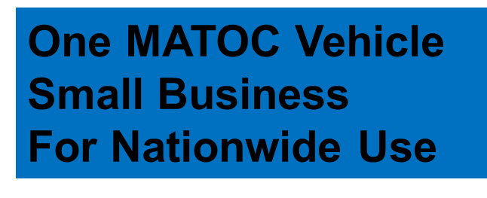
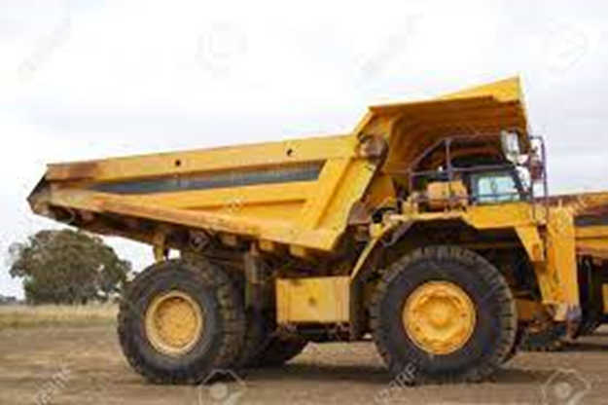


Eeas misconceptions

Slide 6
Eeas summary
EEAS
Provides necessary capabilities to meet USACE Environmental mission requirements
Reduces award times by having an approved acquisition strategy
Achieves efficiencies across the Enterprise
Provides a wide variety of opportunities for small business
ProjNet will be open until 24 APR for additional inquires; see SAM.gov posting for additional information

