Slide 1


Decision Advantage Sprint for Human-machine-teaming DASH 1 - Perceive Actionable Entities (PAE) Information Briefing and “Ask Me Anything” Advanced Battle Management System Cross-Functional Team 711th Human Performance Wing
UNCLASSIFIED
Department of the Air Force
This briefing is
UNCLASSIFIED

Slide 2
Topics
UNCLASSIFIED
DASH Basics
Milestones and Schedule
Location
Deliverables and Desired Outcomes
Transformational Model for Decision Advantage Introduction
Ask Me Anything

Slide 3
DASH Basics Enriching C2 Decision Advantage Software Requirements
UNCLASSIFIED
Problem: Our C2 systems will not give us decision advantage. All decision-making is still left to the humans without any help from the machines
Collaboration between 711 Human Performance Wing, ABMS CFT, and 805 CTS
Battle management warfighters and software developers collaborate over two-weeks to:
Use the Transformational Model (TM) to define, derive, and enrich software functional and technical requirements for implementing decision advantage via microservices
Develop or improve microservice human-machine interfaces
Produce prototype/MVP-like microservices
Validate TM decision function decomposition for microservice development
Week 1: TM deep dive, battle management scenario, software coding, operator feedback
Week 2: Progress check, more software coding, final battle management scenario
Post-event: Push DASH insights to C2 requirement developers for software acquisitions
Bottom line: TM-framed DASH events will help us build machine teammates that arm our C2 enterprise with decision advantage capabilities.

Slide 4
DASH 1 Milestones and Draft Schedule
UNCLASSIFIED
You are here
21 February: AMA ; RFI released in Sam.gov
7 March: RFI abstracts due; DTS cross-org information pushed to warfighters
14 March: Government invites selected software development teams
21 March: Software development team RSVPs due
24 March: Deep dive briefing with selected teams
31 March – 11 April: DASH 1 event

Slide 5
Location: Howard Hughes Operations Center (H2O) 3773 Howard Hughes Parkway Suite 300, Las Vegas, NV 89169
UNCLASSIFIED
Logistics
No visit access request req’d
Names of participants needed
Ample lodging, food, parking
H2O Facility
Unclassified environment
Commercial Wi-Fi available
No classified discussions
H2O Software Dev Environment
Hardware will be for scenario and software testing only
Exploring routes of software transfer (External hard drive/GitHub)
Expect further details after participation selection
H2O
N

Slide 6
Deliverables and Outcomes
UNCLASSIFIED
Abstracts (not to exceed 5 pages)
Reflect an understanding of the PAE decision function
Describe proposed microservice solution
Address coverage of requirements as described by the PAE function
Unclassified military use case/vignette demonstrating decision function understanding
DASH
Software developers:
Produce a prototype PAE microservice that outputs a stream of effects (BattleEffects) that map a change state onto an entity and includes applicable operational limits (e.g., rules of engagement) and the time window associated with the state change
Demonstrate microservice performance when used by humans in a battle management scenario
Furnish software performance and technical integration insights for government consumption
Number of decision opportunities recognized/missed; decision speed; decision accuracy; human confidence in decision
ABMS CFT:
Detail functional and technical requirements to enable software microservice acquisition

Slide 7
UNCLASSIFIED
Transformational Model for Decision Advantage Introduction

Slide 8
Military Advantages
What Advantages can Coalition & Joint Forces Secure?
UNCLASSIFIED
Alliance
Unity
Advantage
-----------------------
Integrated
Deterrence
Decision
Advantage
---------------------------------
Make better
decisions faster
Home Court
Advantage
Home Court
Advantage
First Move
Advantage
First Move
Advantage
Information
Advantage
---------------------------------
Live & train in the OE
Field robust, resilient networks
Minimize loss between
plausible, available,
accessible, & usable
information
Information
Advantage
---------------------------------
Live & train in the OE
Field robust, resilient networks
Minimize loss between
plausible, available,
accessible, & usable
information
Maneuver
(Agility)
Advantage
---------------------------------
Choose favorable trajectories
Rapidly shift position
& force posture for
unpredictability
Maneuver
(Agility)
Advantage
---------------------------------
Choose favorable trajectories
Rapidly shift position
& force posture for
unpredictability
Geographic
Advantage
blue
red
blue
OE
Geographic
Advantage
Logistics
Sustainment
Advantage
Logistics
Sustainment
Advantage
Stick
Advantage
---------------------------------
Field longer-range kill chains
Choose & orchestrate
engagements to have
favorable employment
ranges
Decision
Advantage
---------------------------------
Make better decisions faster
Stick
Advantage
---------------------------------
Field longer-range kill chains
Choose & orchestrate
engagements to have
favorable employment
ranges
Numerical
Advantage
---------------------------------
Outpace Adversary Industrial
& Human Capital Output
Mass forces at optimal
place & time
Numerical
Advantage
---------------------------------
Outpace Adversary Industrial
& Human Capital Output
Mass forces at optimal
place & time
+
to-be
as-is
Notes:
Slide Notes:
The Operational Environment Decision Domain incorporates all remaining Decision Functions after the other Decision Domains have been abstracted out. For example, the Operational Environment Decision Domain includes Decision Functions including, but not limited to, political, cultural, economic, familial, romantic, etc.). The Operational Environment Decision Domain is also unique in that it incorporates all other activities beyond just military decision-making. Therefore, the Operational Environment Decision Domain encompasses and accounts for the physical/material world.
Additional Information:

Slide 9
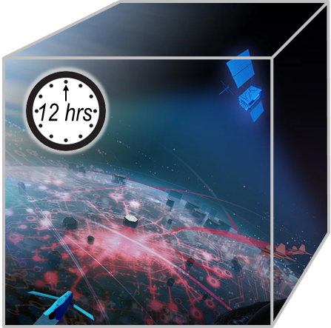
Decision Advantage Capabilities
A capability gap that underwrites all others
UNCLASSIFIED
Capability Gap
Connect & Compute capabilities reduce friction
They can have, but do not guarantee, knock-on benefits to Decision Advantage, in that less friction may allow a higher percentage of a decision-maker’s total cognitive capacity to be available for decision-making.
However, these capabilities do not directly improve speed or quality of individual decision performance.
Decision Advantage
In a Pacing Challenge fight,
how many
C2 & Military Intelligence decisions
will there be?…
…in just the first 12 hours…
You
are
here
More
Workflow
Automations
Workflow Automations
Speech-to-Text
Replace J-Series
Data & Network Modernizations
Resilient Comms
Notes:
Slide Notes:
The Operational Environment Decision Domain incorporates all remaining Decision Functions after the other Decision Domains have been abstracted out. For example, the Operational Environment Decision Domain includes Decision Functions including, but not limited to, political, cultural, economic, familial, romantic, etc.). The Operational Environment Decision Domain is also unique in that it incorporates all other activities beyond just military decision-making. Therefore, the Operational Environment Decision Domain encompasses and accounts for the physical/material world.
Additional Information:

Slide 10
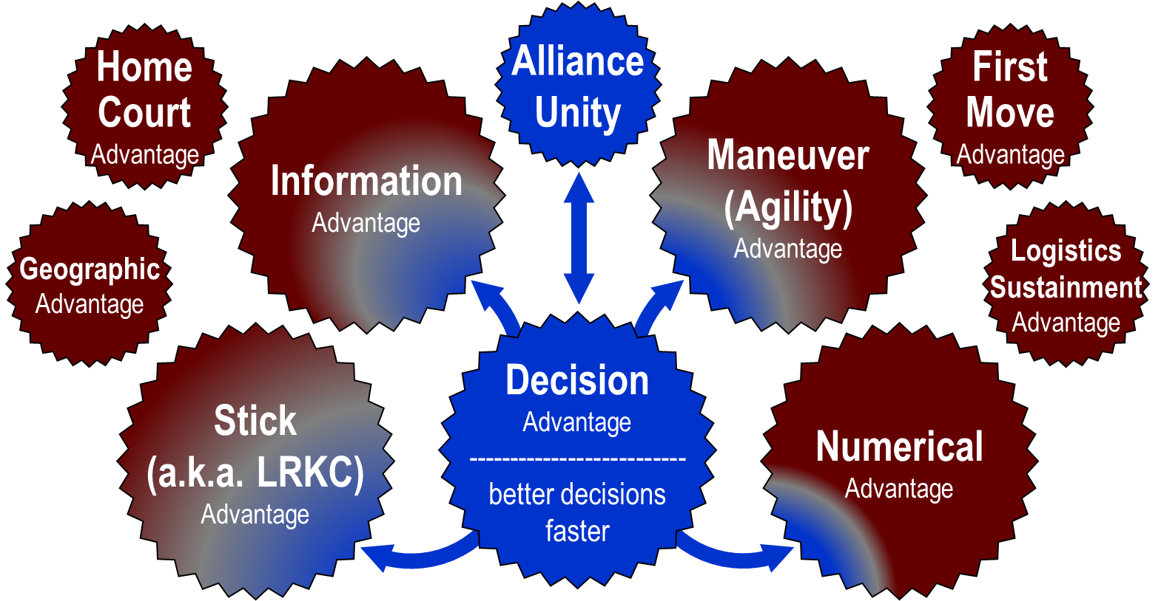
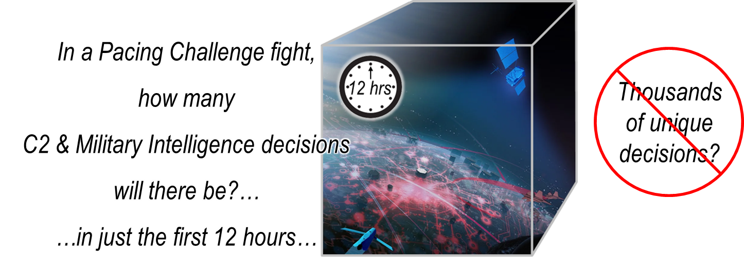
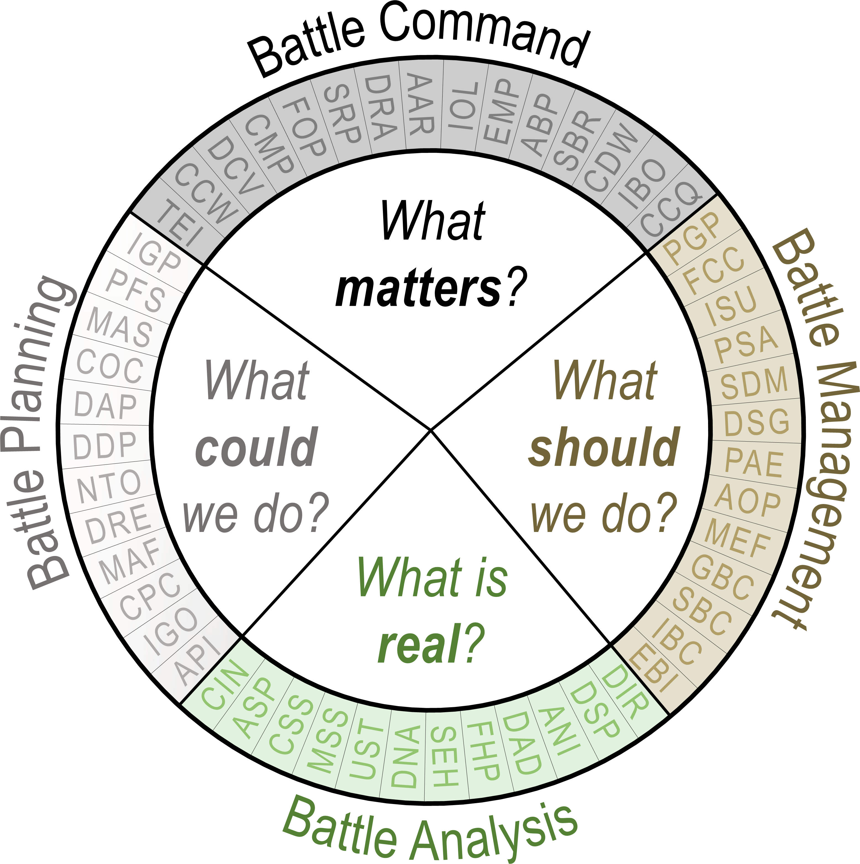
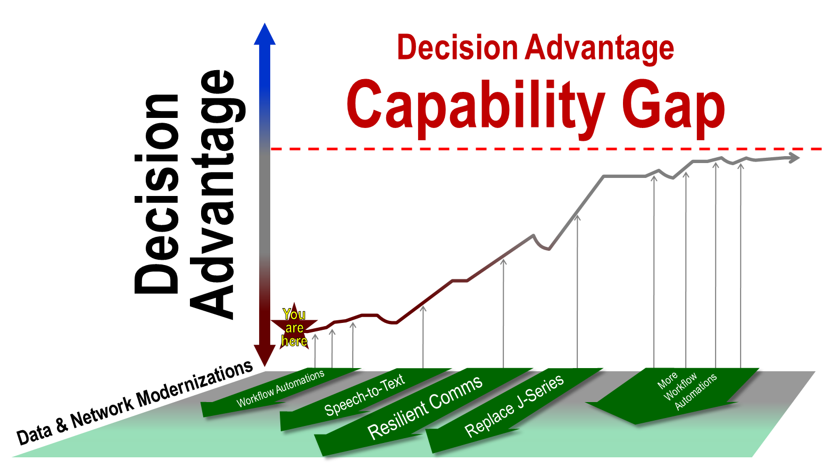
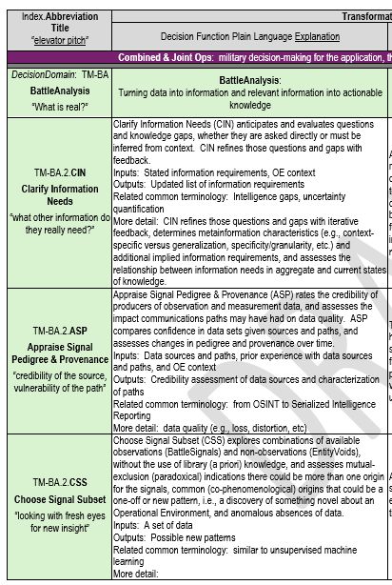
Decision Advantage Capabilities
A capability gap whose solutions underwrite other capabilities
UNCLASSIFIED

Slide 11
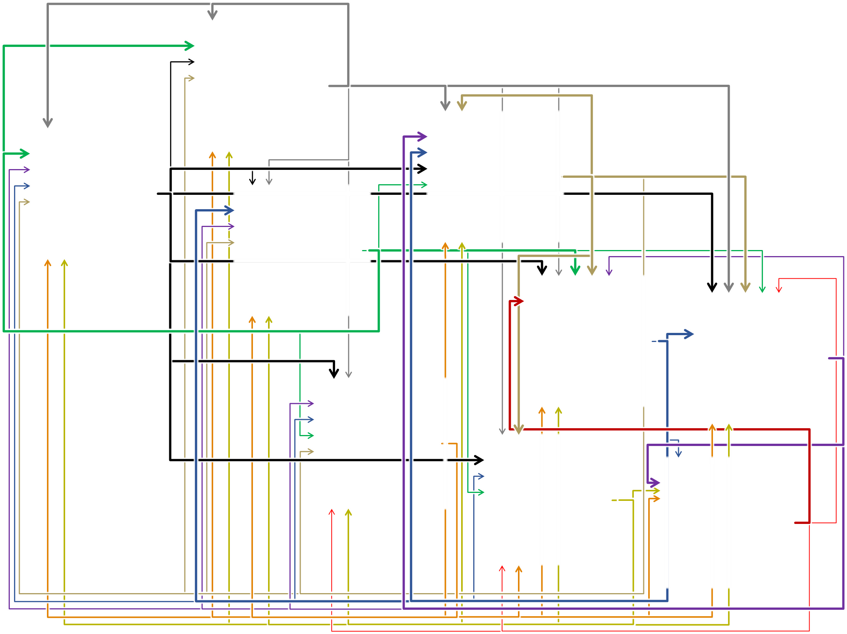
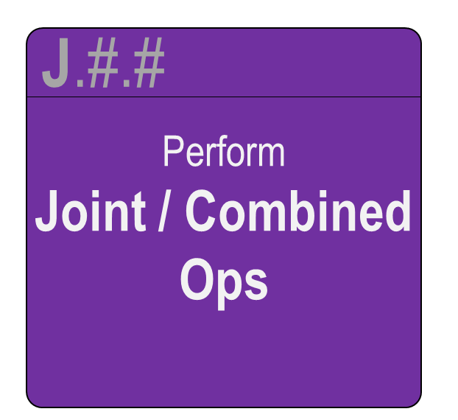
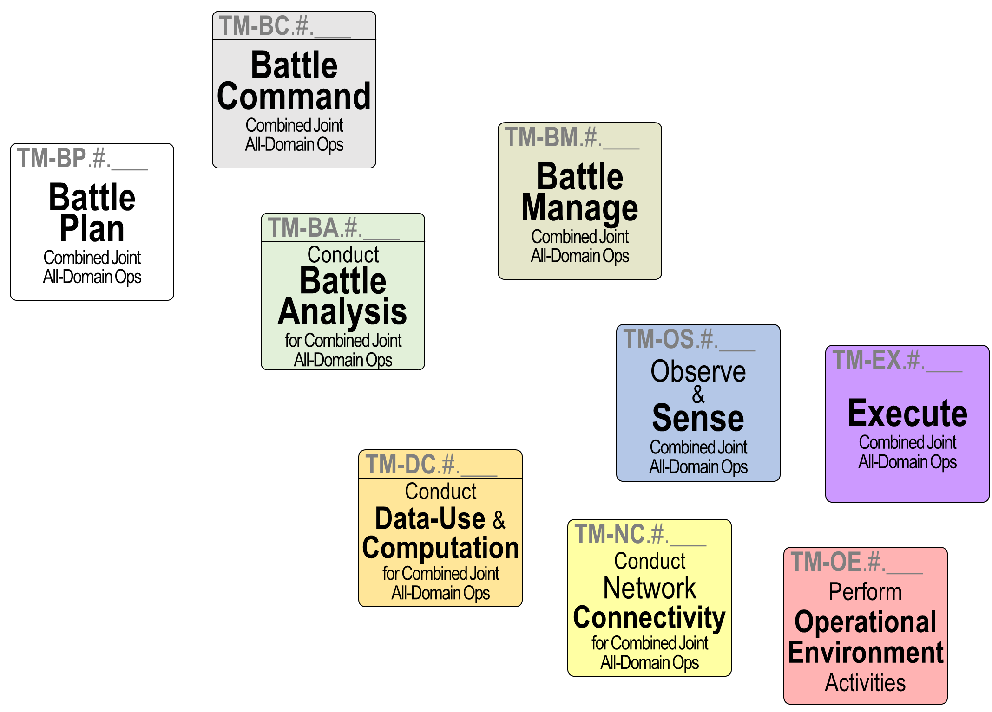

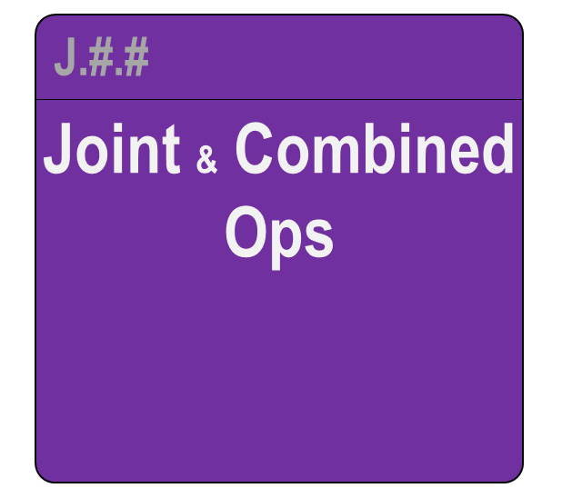
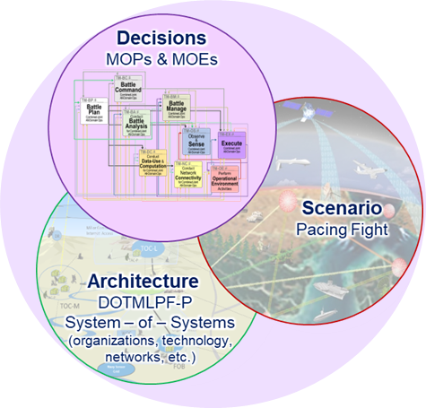
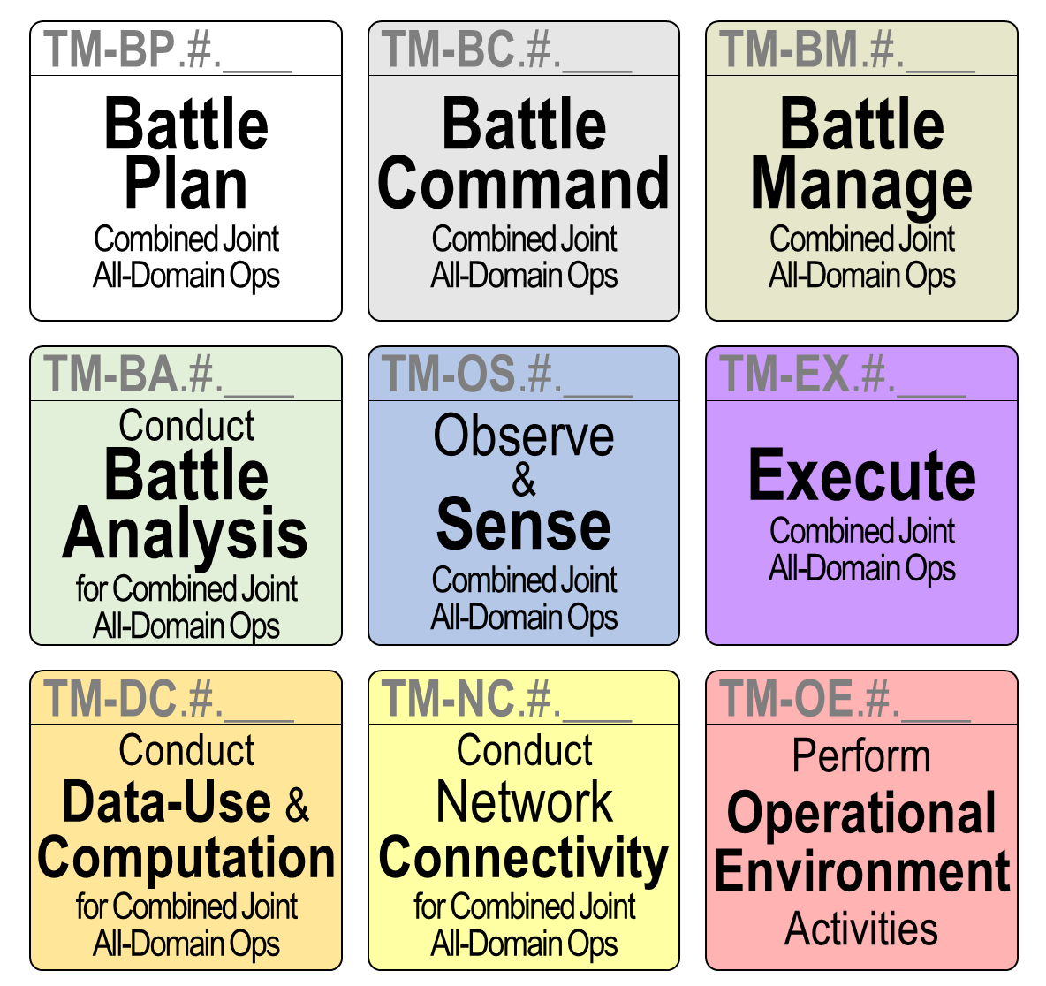
Transformational Model Methodology
Defining Decision Domains for CJADC2 Decision Advantage
UNCLASSIFIED
The TMs can be nested within the instruments of national power
Decision Domains view → IDEF0 – Joint & Combined Ops *
D
I
M
E
The TM Methodology defines 9 Decision Domains:
8 x Abstracted Decision Domains
1 x Operational Environment Decision Domain ¹
M.#.#
Perform
Military Activities
Building the Forces we need
C2 Capability (“Purpose”) Requirements
Fighting with the Forces we have
F.#.#
Design–Develop–Sustain
Joint & Combined
Forces
Perform
Joint & Combined
Ops
Perform
Joint & Combined
Ops
* All models are wrong, some models are useful. -- George Box
Notes:
Slide Notes:
The Operational Environment Decision Domain incorporates all remaining Decision Functions after the other Decision Domains have been abstracted out. For example, the Operational Environment Decision Domain includes Decision Functions including, but not limited to, political, cultural, economic, familial, romantic, etc.). The Operational Environment Decision Domain is also unique in that it incorporates all other activities beyond just military decision-making. Therefore, the Operational Environment Decision Domain encompasses and accounts for the physical/material world.
Additional Information:

Slide 12
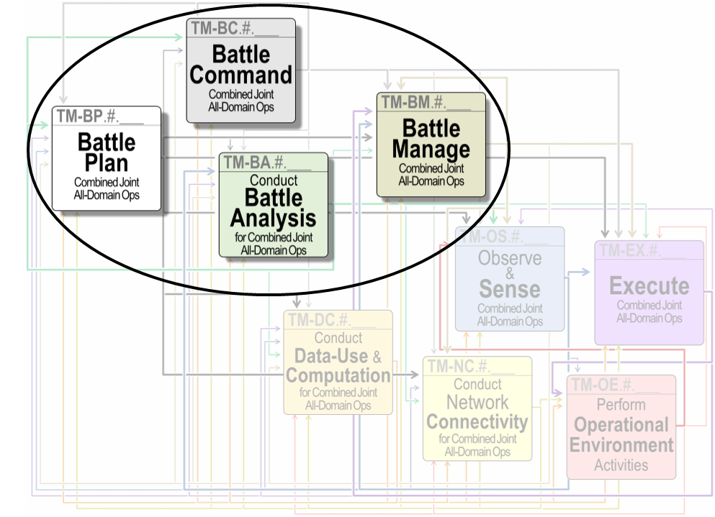

The Transformational Model’s
Next Step toward Decision Advantage:
UNCLASSIFIED
52 discrete Decision Functions (DFs)
(each 3-letter acronym represents one DF)
Opportunities to leverage
existing & emerging technologies
to optimize human-machine teaming
for collaborative decision-making
(not just workflow automations or data movement / presentation)
= Match Effectors, one of the thirteen Decision Functions (DFs) of Battle Management
Unclassified

Slide 13
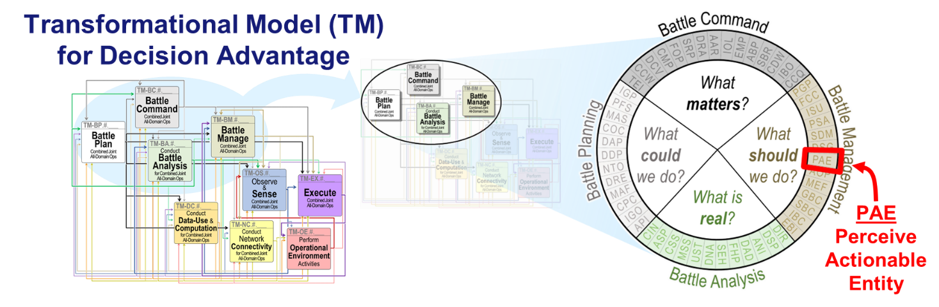
UNCLASSIFIED
Transformational Model – Battle Management (TM-BM) Overview
Perceive Actionable Entity (PAE):
Determines possible, desirable, and permissible actions to take on something in the Operational Environment—whether it is a target (e.g., to investigate or prosecute) or a task objective (e.g., to rescue, refuel, resupply, etc.)—to achieve a specific effect, calculates the window of opportunity for those actions, and highlights conflicts between desired effects.

Slide 14
UNCLASSIFIED
Ask Me Anything

