Slide 1

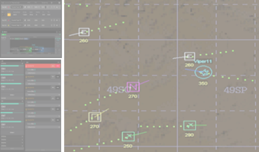
H2O Center
White Force
Your PAE Microservice:
Web-based?
Running on OS?
Machine vs Human Ratio?
SIM Driver
MACE
DIS
Chat & Voice
Teams or …
or
BM “Scope”
(map & track display/interaction)
BC3 or NGTS
Your PAE Microservice
Input Sources:
Text Documents
(Objectives, Plans & Tasks, Ops Limits)
Tactical Picture
(Entities of Interest, Current Situation)
Chat & Voice Comms
(Entities of Interest, Current Situation)
Outputs: BattleEffects (𝕖 )
“ê ffectOperator ” (e.g., F-Kill)
+
“𝔸 ctionable ” (e.g., Target X)
+
“𝕥 imeWindow ” (e.g., in next 5 min)
x4
Driver
Chat & Voice
Teams or …
BM “Scope”
BC3 or NGTS
x4
Crew
DIS + Data Link Processor
Chat & Voice
Teams or …
x4+
JREAP-C or…
Database
(Text documents for plans, objectives, & operational limits)
Agency
Scenario:
The Crew is a mid-echelon all-domain Battle Management agency supporting lower-echelon & theater/national BM units, as well as Battle Managing their own Area of Operations
Text Scraper?
Chat + Voice Transcript

Slide 2
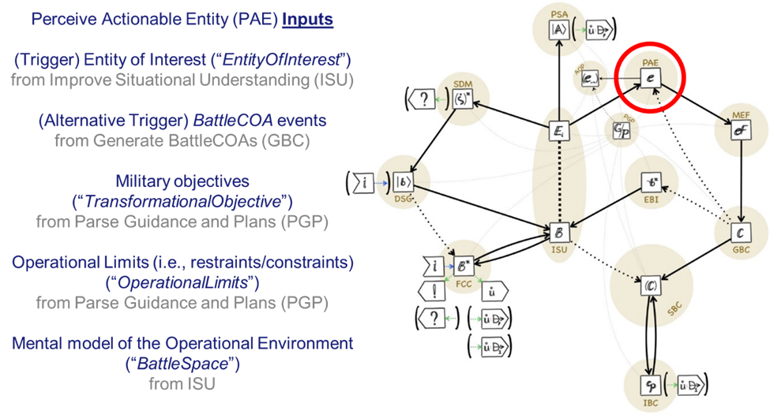
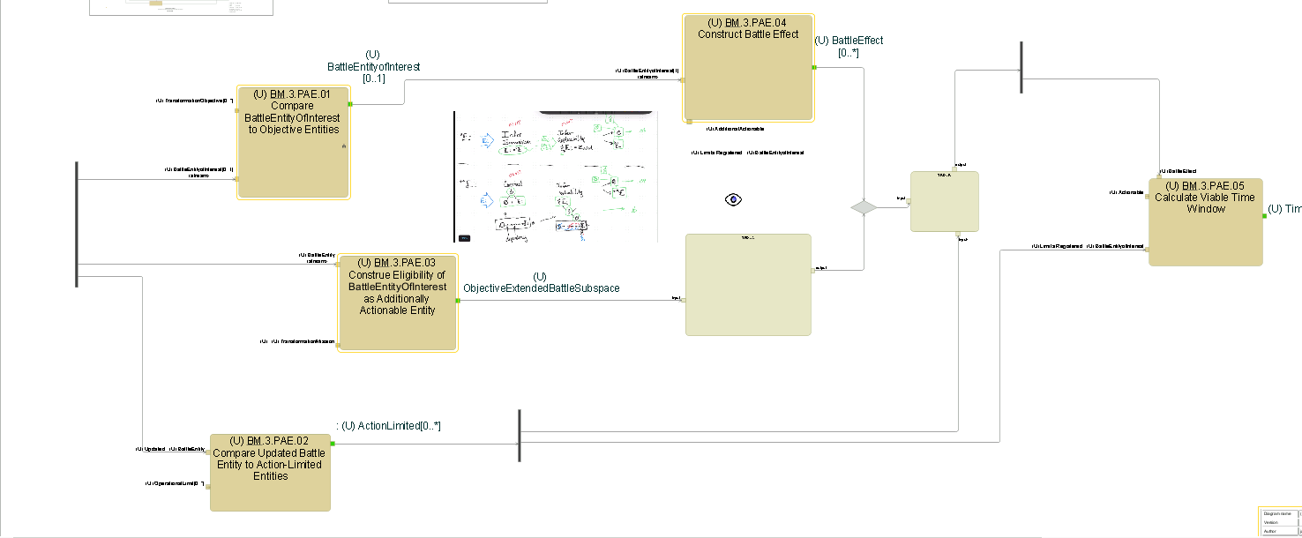
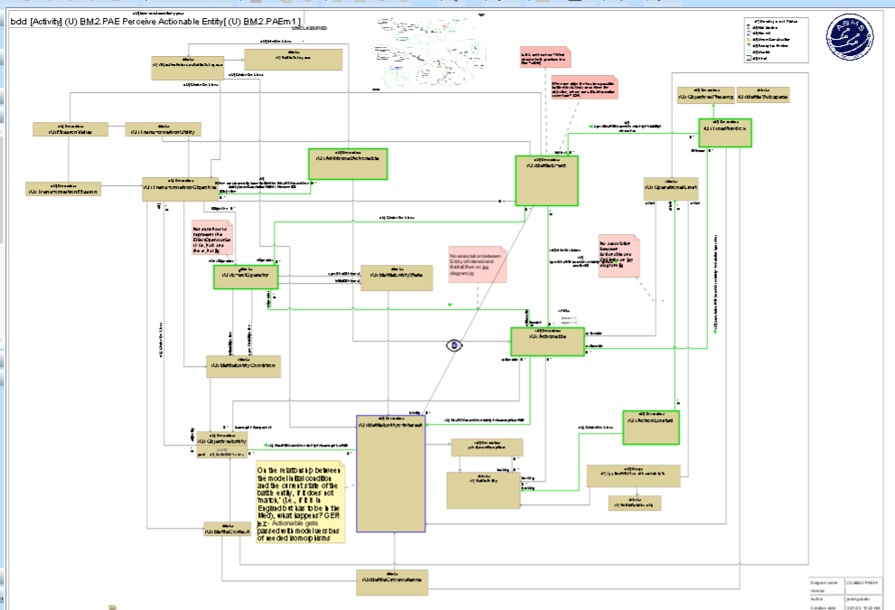
Tier-3 Subfunctions of PAE:
Infer plausible Effect Operators that can be applied to the Entity of Interest
Correlating the Entity of Interest to an Objective Entity
Infer that the Entity of Interest may impact an Objective Entity, or Mission Entity, or Command Value
Mapping Operational Limits (constraints and restraints) to the Entity of Interest
Calculating a Time Window for a given Battle Effect
Triggers for PAE:
Battle Objects
Battle Events
Battle Relationships
&
BattleCOAs
The beginning of the BattleCOA story…

