Slide 1
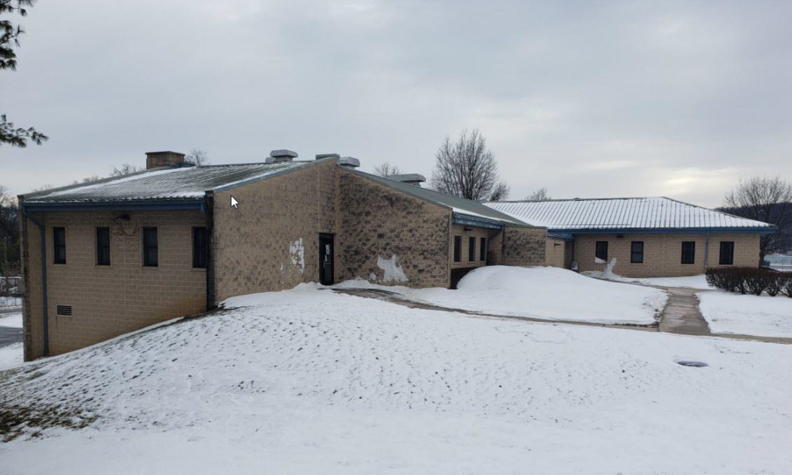
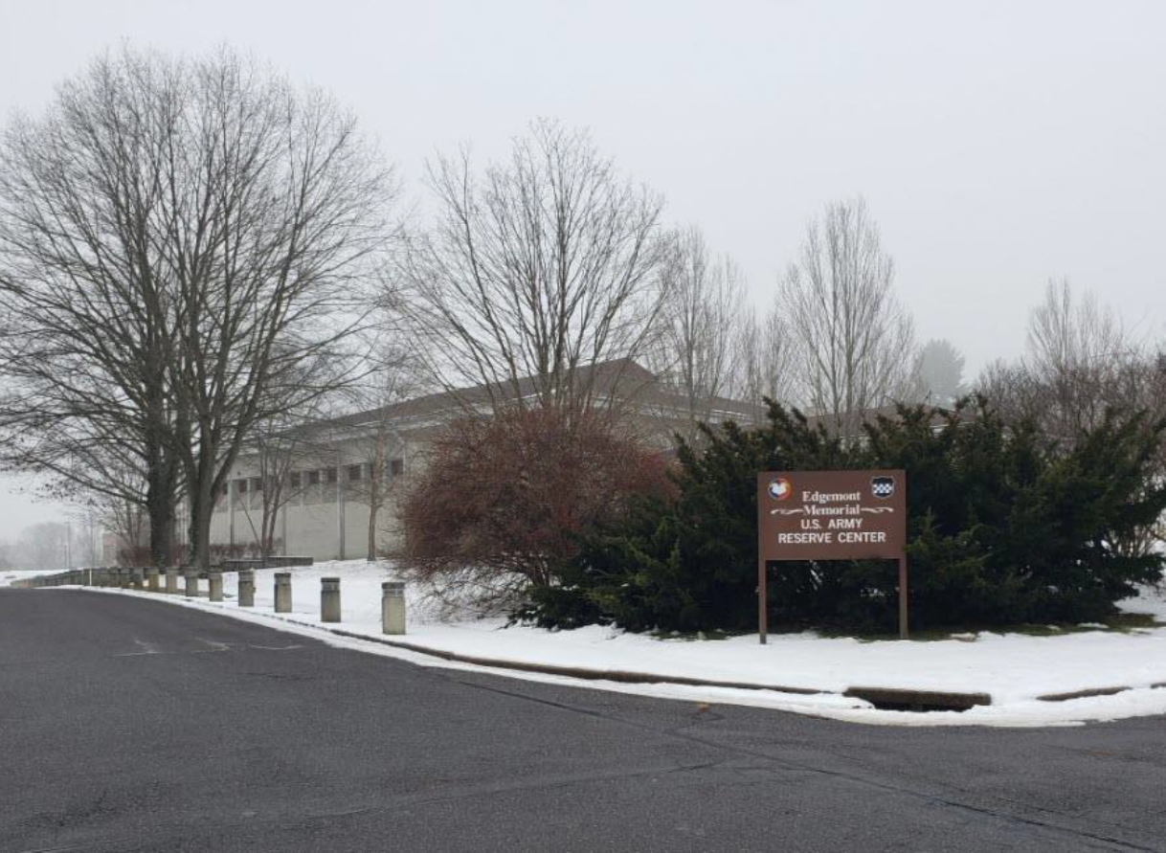
INDUSTRY DAY FORUM New Cumberland and Newtown square ARC
Presenters:
Jonathan Cowen – Project Manager
Felix Carrion-Viera – Project Engineer
Eliot Lincoln – Project Engineer
Ryan King – Contract Specialist
Crystal Harbin – Deputy for Small Business
Date: 04 March 2025
Training Center Two, Newtown Square Army Reserve Center (ARC)
”The views, opinions and findings contained in this report are those of the author(s) and should not be construed as an official Department of the Army position, policy or decision, unless so designated by other official documentation.”

Slide 2
ADMINISTRATIVE ANNOUNCEMENTS
Please ensure that you have signed in (Send in chat for remote participants)
Company Name, POC Name, Email, Phone
Are you interested in being the Prime or Subcontractor
If you’re interested in being a subcontractor, state the type of work you are interested (Electrical, Mechanical, Roofing, etc.)
Please turn off all mobile devices
No recording
This briefing and the attendee roster will be posted to SAM
Please be advised that none of the information discussed today is contractually-binding

Slide 3
AGENDA
Introduction of Team Members
Army Reserve Overview
USACE Procurement Process Overview
Overview of the New Cumberland ARC Project
Overview of the Newtown Square ARC Project
Q&A Session

Slide 4
US Army Reserve OVERVIEW
Jonathan A. Cowen
Program Manager
U.S. Army Corps of Engineers
Louisville District

Slide 5
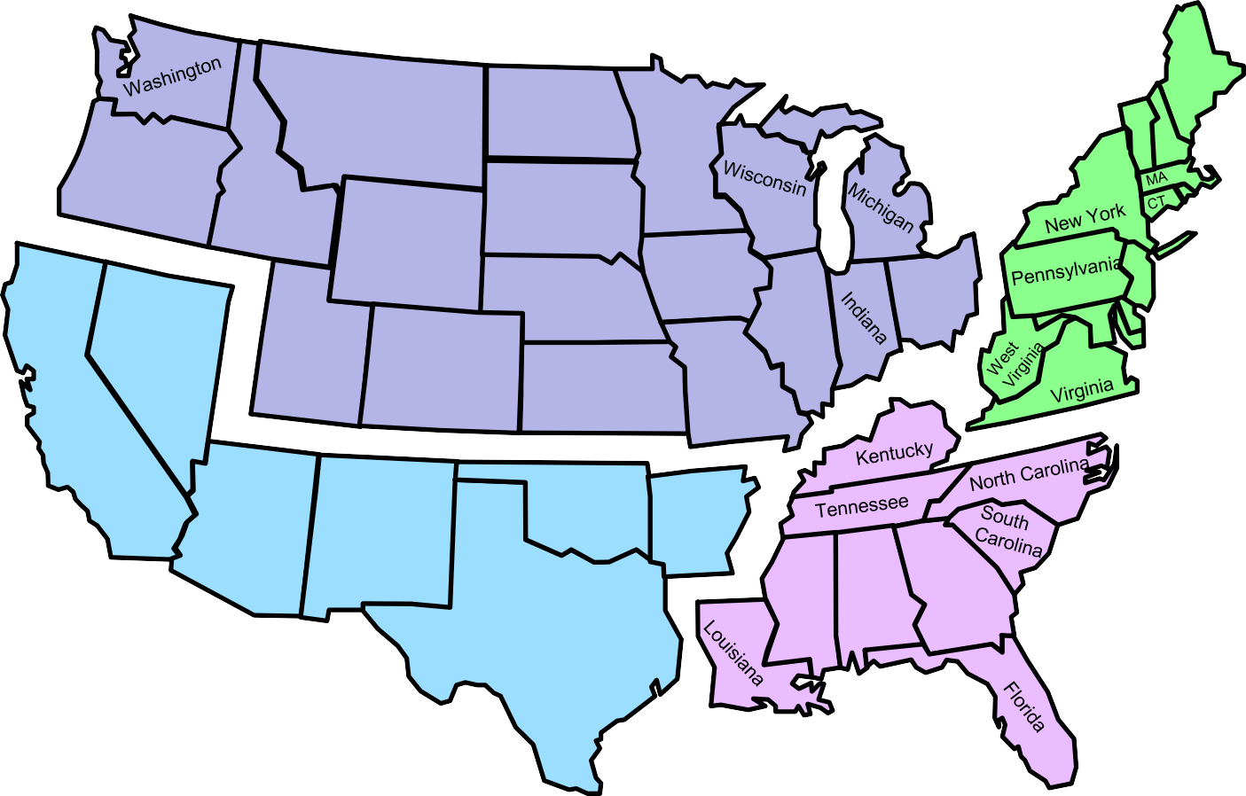




Army reserve program
88th Readiness Division
Ft McCoy, WI
Maine
Montana
North Dakota
Minnesota
VT
NH
99th Readiness Division
Ft Dix, NJ
Oregon
Idaho
South Dakota
RI
Wyoming
OCAR – Fort Belvoir, VA
Iowa
OCAR - Fort Belvoir, VA
Nebraska
Ohio
Illinois
MD
DC
DE
Nevada
Utah
Colorado
Kansas
Missouri
USARC –
Fort Liberty, NC
USARC - Fort Bragg, NC
California
Arizona
Oklahoma
Arkansas
New Mexico
Mississippi
Georgia
81st Readiness Division
Ft Jackson, SC
63rd Readiness Division
Mountain View, CA
Texas
Alabama
Puerto Rico
Notes:
Fort Hunter Liggett – CA
-Parks Reserve Forces Training Area – CA
JBMDL
Fort Buchanan, PR

Slide 6
Army reserve MILCON program management
The AR MILCON program has been centrally managed by the Louisville District since 1995
AR MILCON Opportunities thru LRL
Military Construction Army Reserve (MCAR)
Unspecified Minor Military Construction (UMMCR)
Maintenance & Repair, Army Reserve (MRAR)
LRL partners with Geographic Districts for construction oversight and local expertise
Louisville District (LRL) + Roadrunner Resident Office (CESPL)
Daniel Netherton, Administrative Contracting Officer (ACO)
Stephanie Kenett, Contracting Officer’s Representative (COR)
Local District Construction Management Team (TBD)
Administrative Contracting Officer (ACO) – Jeff Owens
Contracting Officer’s Representative (COR) – Elvis Garay

Slide 7
Army reserves milcon communication plan

Slide 8
USACE PROCUREMENT PROCESS OVERVIEW
Newtown Square Project
Ryan King
Contract Specialist
U.S. Army Corps of Engineers
Louisville District
Jesse Scharlow
Contracting Officer
U.S. Army Corps of Engineers
Louisville District
New Cumberland Project
Adam Brooks
Contract Specialist
U.S. Army Corps of Engineers
Louisville District
Adam Wantland
Contracting Officer
U.S. Army Corps of Engineers
Louisville District

Slide 9
HOW TO OBTAIN THE SOLICITATION
System for Award Management (SAM) – www.SAM.gov
New Cumberland Solicitation will beW912QR25NEWCUMBERLAND
Newtown Square Solicitation will be W912QR-25-R-A019
Search by keyword (Select “Any Words” or “All
Words”): “Newtown, New Cumberland”
View Interested Vendors List and register as an Interested Vendor.
Register to receive notifications and updates / amendments.
RFP Technical Information (i.e., Plans and Specs) will be available for download from www.SAM.gov
Notes:
A list of general contractors bidding the project is not maintained. The Government does not know who is bidding the project until a proposal is received. SAM.gov does contain an Interested Vendors List to which you may add your firm’s name.

Slide 10
OBTAINING THE ISSUE DOCUMENTS
Pre-Solicitation Notice – will be posted on www.sam.gov at least 15 days prior to the initial issuance of the Solicitation package.
Advertisement – Minimum 30 days to prepare proposals for Each Phase.
Amendments issued to the RFP will also be posted on www.sam.gov

Slide 11
OBTAINING THE ISSUE DOCUMENTS
Requirements to download Technical Data Package:
Locate and access the Solicitation notice in the SAM database.
- Go to the “Attachments/Links” section to download the
solicitation and all technical documents.
Sign-Up and Sign-In to your SAM account to:
- “Follow” to receive email notifications (i.e., amendments)
- View Interested Vendors List
- Sign up as an Interested Vendor

Slide 12
OBTAINING THE ISSUE DOCUMENTS
Requirements to Submit Proposals:
Register your business entity (you as an individual or your organization) to be able to propose on contracts as the Prime.
All proposals will be submitted through the PIEE Solicitation Module on time. Therefore, offerors must register in advance for a user ID and Password to access this system.

Slide 13
THE PROCUREMENT PROCESS
The projects will be Design-Build (D-B) Request for Proposals (RFP).
The solicitations are Total Small Business Set-Aside procurements
Project award will be made via a Two-Phase “Best Value Trade-off” basis as described in the evaluation criteria.
Proposals must be submitted on time.
The Louisville District is located within the Eastern time zone.
The Source Selection Evaluation Board (SSEB) will evaluate offerors’ proposals based on specific factors which are defined in the RFP Package.
New Cumberland Solicitation will be W912QR25NEWCUMBERLAND
Newtown Square Solicitation will be W912QR25RA019

Slide 14
PROPOSAL REQUIREMENTS
Source Selection Evaluation Criteria for the “Best Value Trade-Off”
consists of the following elements for Phase I:
1) Volume I – Factor I: Past Performance Evaluation
Project(s) submitted for both Prime Contractor and A/E Designer of Record
(maximum 3 each)
Relevancy - Recent projects, similar in size, scope, magnitude of effort & complexities
Quality of performance on submitted projects
Other sources of relevant past performance information (i.e., CPARS, FAPIIS,
eSRS)
Volume I – Factor II: Technical Approach for Design-Build
(i.e., Collaboration, Organization, Quality Control)
Technical
Evaluation
Factors

Slide 15
PROPOSAL REQUIREMENTS
Source Selection Evaluation Criteria for a “Best Value Trade-Off” consists of the following elements Phase I:
3) Volume II – Pro Forma & Price Information
Tab A: Standard Form 1442 (Price is not included in Phase I)
Tab B: Joint Venture Agreements (if applicable)
Tab C: Evidence of Ability to Obtain Bonding & Proof of Financial Ability
Tab D: Pre-Award Information
(i.e., Reps & Certs, offeror information, etc.)

Slide 16
PROPOSAL REQUIREMENTS
Offerors selected as among the most highly qualified will be invited to participate in Phase II.
Phase II will be issued as an Amendment.
Submission Requirements and Source Selection Evaluation Criteria will be issued as a DRAFT during Phase I, subject to change w/the Phase II Amendment.
Information for an Optional Site Visit provided.

Slide 17
PROPOSAL REQUIREMENTS
Source Selection Evaluation Criteria for the “Best Value Trade-Off” consists of the following elements for Phase II (subject to change):
1) Volume I – Factor I: Design Narrative
Volume I – Factor II: Management Plan
Volume I – Factor III: Schedule Narrative
Technical
Evaluation
Factors

Slide 18
PROPOSAL REQUIREMENTS
Source Selection Evaluation Criteria for a “Best Value Trade-Off”
consists of the following element(s) for Phase II:
4) Volume II – Pro Forma & Price Information
Tab A: Standard Form 1442 & Price

Slide 19
PROPOSAL REQUIREMENTS
Technical Factors listed in relative order of importance for
Phase I:
Volume I – Factor I: Past Performance 1st
Prime Contractor Equal to A/E (DOR)
A/E Designer of Record (DOR) Equal to Prime
Volume I – Factor II: Technical Approach for D/B 2nd
The ratings from Phase I will not be considered in Phase II for the final selection.

Slide 20
PROPOSAL REQUIREMENTS
Technical Factors listed in relative order of importance for
Phase II:
Volume I – Factor I: Design Narrative Equal to Factors II & III
Volume I – Factor II: Management Plan Equal to Factors I & III
Volume I – Factor III: Schedule Narrative Equal to Factors I & II
All Technical Evaluation Factors, other than Price, when combined are considered approximately equal to Price.
Submit your best proposal the 1st time. If we receive an initial proposal that is awardable, discussions may not be opened.

Slide 21
PROPOSAL REQUIREMENTS
Instructions for submitting a Request for Information (RFI) will be
included in the Solicitation.
RFIs for these projects will be received and answered through the ProjNet system: www.ProjNet.org
Any RFIs submitted/emailed directly to the Project Team will NOT receive a response, and offerors will be directed to the ProjNet system.
A ProjNet Bidder’s Key included in the solicitation’s Project Instructions section of the RFP, which is used to post your RFIs/questions.
RFIs and their responses will be available for public review through ProjNet.
Optional Site Visit held to familiarize Offerors with the jobsite and conditions, not for the purposes of answering questions.

Slide 22
Proposal submission
We will utilize the Electronic Receipt of Proposal process – Instructions will be in Section 00 21 00 of the solicitation package
Proposals are uploaded to and submitted through PIEE Solicitation Module
Recommend performing a test run well in advance
Don’t wait until the last minute to upload your proposal. Late is Late! No exceptions!

Slide 23
PROCUREMENT SCHEDULE Dates are approximate AND SUBJECT TO CHANGE
ISSUE SOLICIATION (PHASE I) March/April 2025
PHASE I – SOLICITATION CLOSES April/May 2025
PHASE I – EVALUATION BOARD May 2025
PHASE II – AMENDMENT ISSUED JULY 2025
PHASE II – SOLICITATION CLOSES AUGUST 2025
PHASE II – EVALUATION BOARD SEPTEMBER 2025
AWARD SEPTEMBER 2025

Slide 24
Crystal Harbin
Deputy for Small Business
Louisville District
Courtney Luckett
Small Business Professional
Louisville District
SBO-LRL@usace.army.mil

Slide 25
Small Business Participation plan & Subcontracting PLAN
The Small Business Participation Plan is a rated evaluation factor in all unrestricted procurements
Both large and small business offerors must submit a participation plan.
The participation plan is based on total contract value.
The Small Business Participation Plan must meet the minimum Total Small Business Participation goal. The percentage will be included the solicitation.
Small Business prime self-performance counts as Small Business Participation.
Large Business offerors must submit a Small Business Subcontracting Plan
Mandated by FAR 19.702
This is not a rated element as a part of the Source Selection process but the offeror shall submit an acceptable plan prior to award
The subcontracting plan is based on total subcontracted dollars
Failure to comply in good faith is in material breach of the contract

Slide 26
Obtain information
Attend Site Visits, Pre-Proposal Conferences, & Industry Days
Obtain copies of attendee roster for subcontracting opportunities
Register as an Interested Vendor on SAM
Attend Workshops and Conferences
Louisville District Networking: Tentatively 29 July 2025
Construction & IDIQ Forecast is maintained on the Business with Us page of the Great Lakes and Ohio River Division website, https://www.lrd.usace.army.mil/Opportunity-Forecast/

Slide 27
opportunities
We anticipate executing approximately $1.3B in FY25 through both small and large businesses.
Contracting opportunities are posted in the System for Award Management (SAM) website at www.sam.gov. Use “W912QR” to search for Louisville District projects.
Actively Respond to Sources Sought Notices (Market Surveys) posted to SAM
Actively Respond to Competitive Requirements posted to SAM

Slide 28
New Cumberland Arc Overview
Jonathan Cowen
Project Manager
Felix Carrion-Viera Project Engineer
U.S. Army Corps of Engineers - Louisville District

Slide 29
New Cumberland ARC
Project Information:
Description-This project will repair an existing 28,989 square feet Army Reserve Center, Training Building 315, that is in a failed or failing condition. Constructed in July 1992, building 315 provides mission essential functional areas in support of USAR units. The repairs will provide the necessary operational building functional areas for the training and mission support of these commands. The mechanical, plumbing and electrical systems are beyond serviceable life. A
technical review will be conducted, work classification verified, and other facility alternatives were visited but the most expedient and best option was to repair the listed facility. This project is required right now, because the present condition of the facility has extensive Life Safety issues and inadequate power and cooling which has a
negative impact on the operations mission and the health of Soldiers.
Project Delivery Method - Design/Bid/Build
Procurement Method- Best Value Trade Off SSEB
Estimated Construction Duration - 1100 days
Stakeholder- 99th Readiness Division and ARIMD
Scheduled Milestones (estimates for planning):
Advertise Period – JUN-JUL 2025
Source Selection Evaluation Board – JUL 2025
Discussions (if needed) – AUG 2025
Contract Award – AUG 2025
Admin NTP – SEP 2025
Construction NTP – OCT 2025
Construction Completion – APR 2028

Slide 30
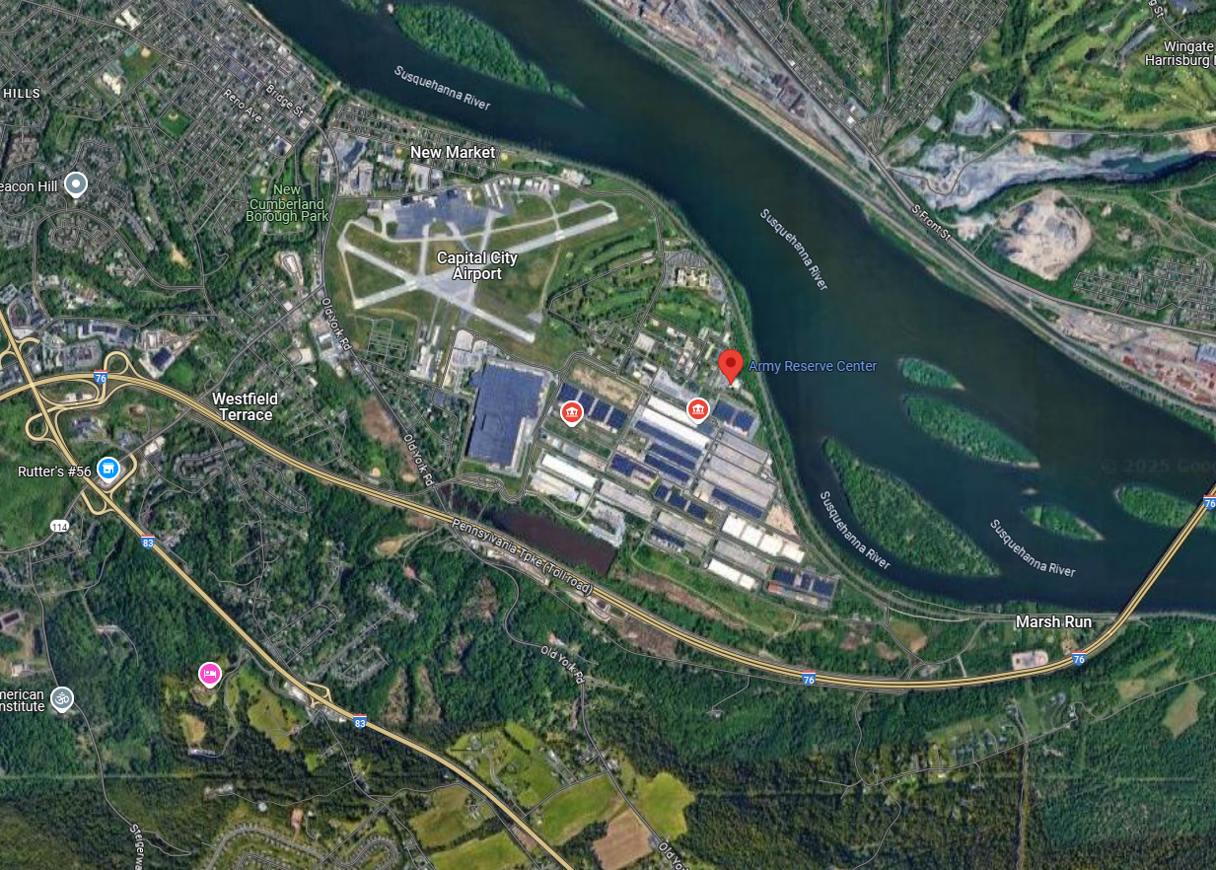
New Cumberland arc
DLA Distribution Center Susquehanna, PA
40.21182364094431, -76.83435547365774

Slide 31
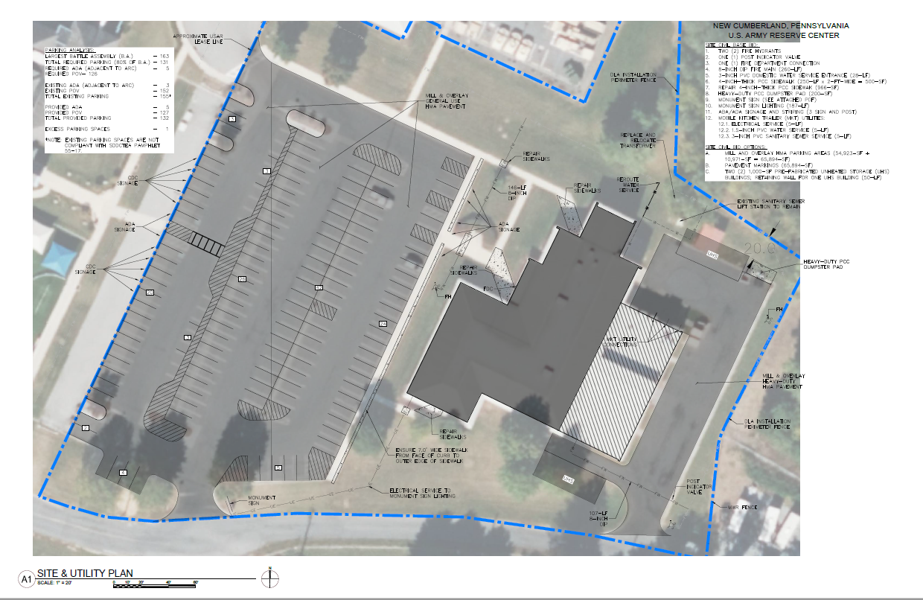
New Cumberland site plan

Slide 32
New Cumberland Army reserve Center

Slide 33
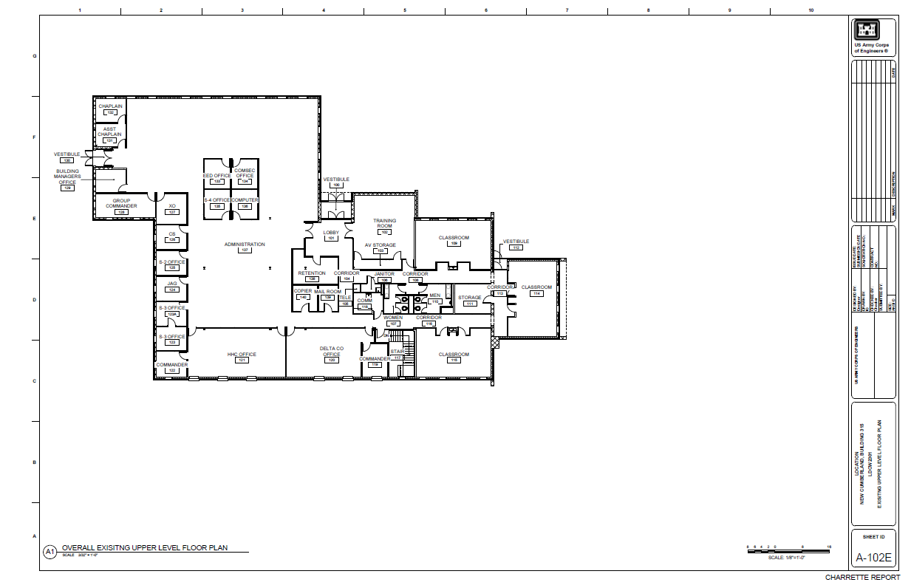
New Cumberland main floor

Slide 34
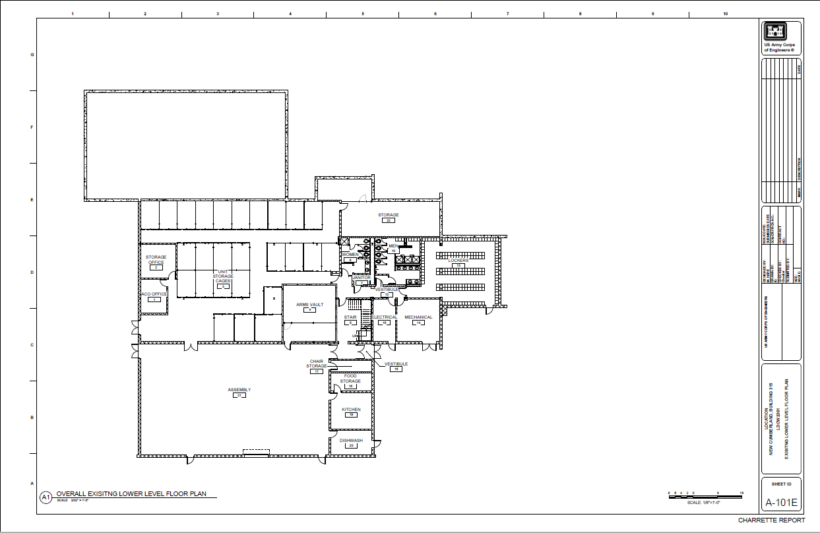
New Cumberland lower floor

Slide 35
Newtown square ARC
Project Information:
Description- This project will repair the failing 38,987 square feet Edgemont Army Reserve Center (ARC) Building 92001 located on approximately 45 acres in Newtown Square, PA. This facility was constructed in 1976 to provide mission essential training and operational capabilities supporting USAR units. This project is required now due to the present conditions of the facility which include extensive life safety issues and inadequate power and
cooling which has a negative impact on the health and mission of assigned personnel. Much of the infrastructure is over 46 years old and requires replacement to ensure continuous mission operation. If not corrected in this project, temporary repairs will continue to be costly and conditions in the facility will continue to degrade.
Project Delivery Method - Design/Bid/Build
Procurement Method- Best Value Trade Off SSEB
Estimated Construction Duration - 1100 days
Stakeholder- 99th Readiness Division and ARIMD
Scheduled Milestones (estimates for planning):
Advertise Period – JUN-JUL 2025
Source Selection Evaluation Board – JUL 2025
Discussions (if needed) – AUG 2025
Contract Award – AUG 2025
Admin NTP – SEP 2025
Construction NTP – OCT 2025
Construction Completion – APR 2028

Slide 36
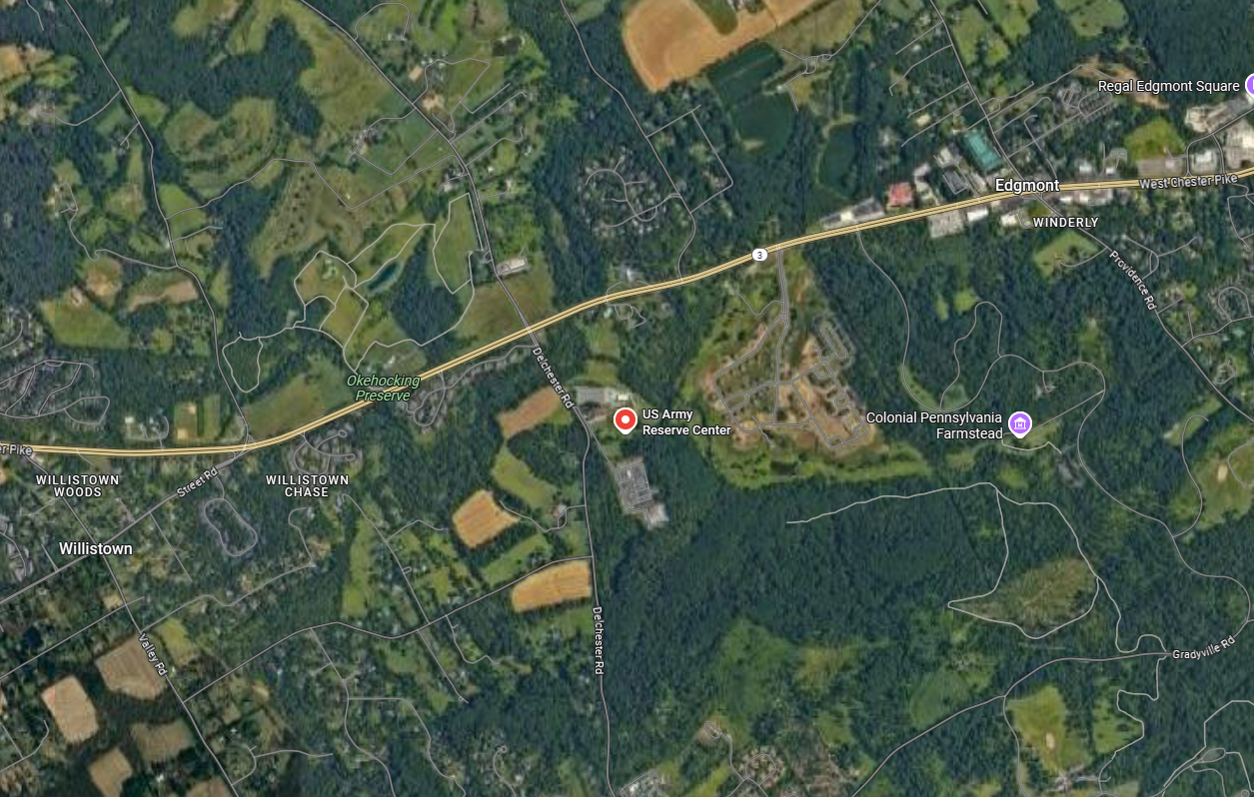
Newtown square arc
2101 Delchester Rd. Newtown Square PA 19073

Slide 37
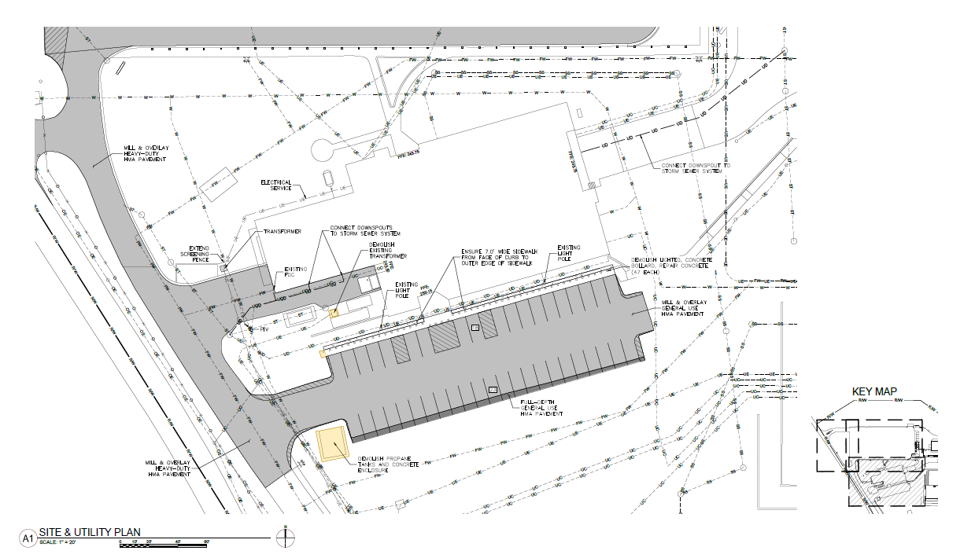
Newtown square site plan

Slide 38
Newtown square Army reserve Center

Slide 39
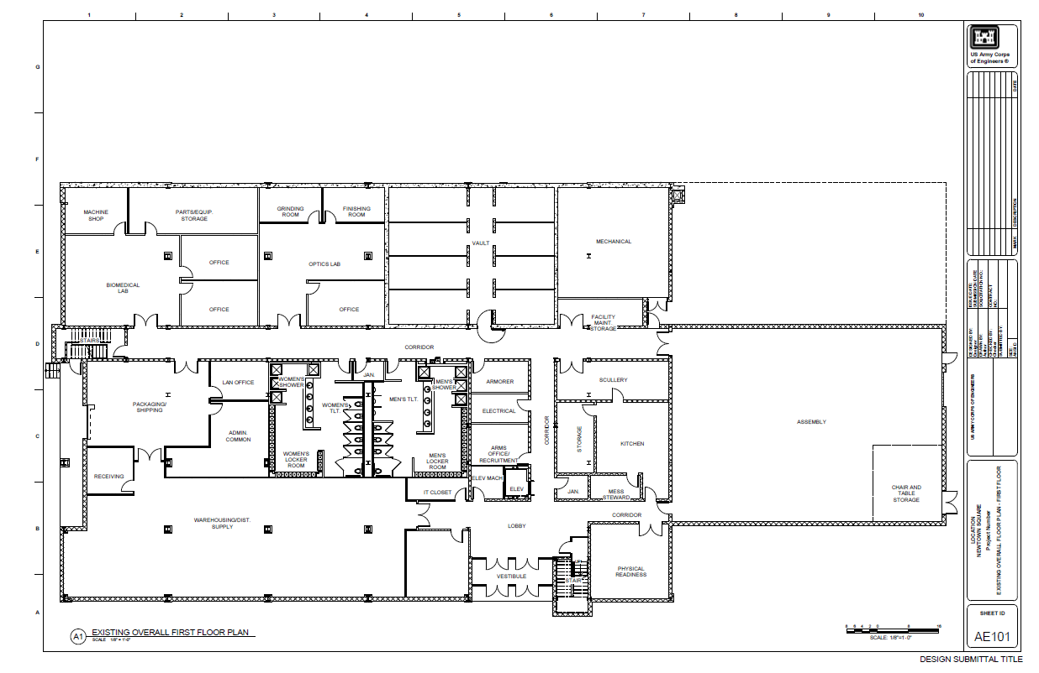
Newtown square 1st floor

Slide 40
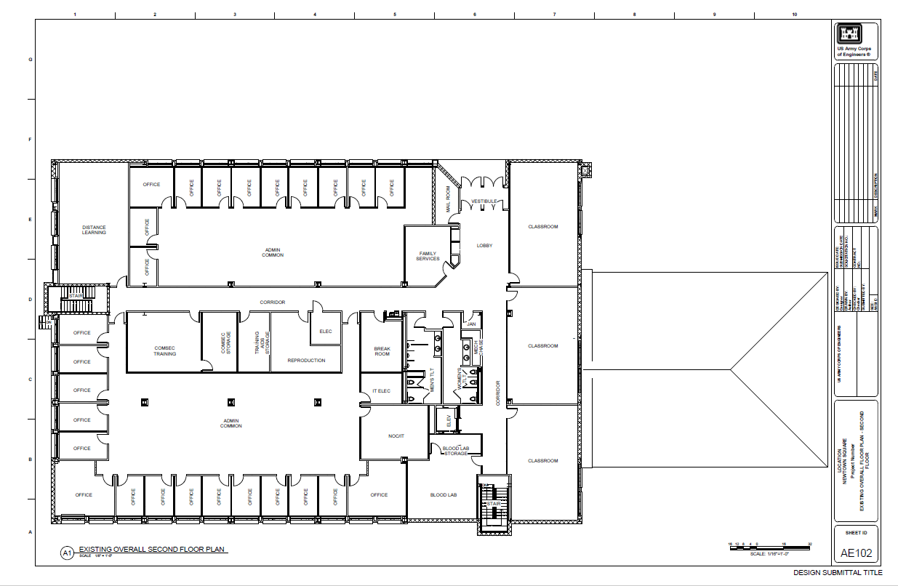
Newtown square 2nd floor

Slide 41
SUMMARY
Register SAM.gov to obtain and respond to solicitations
Source Selection Evaluation Criteria are basis for selection by source evaluation boards
Unrestricted solicitations require small business participation plan
New Cumberland project is scheduled for bids due in:
November 2024 via Solicitation W912QR-24-R-0077
Newtown Square project is scheduled for bids due in:
November 2024 via Solicitation W912QR-24-R-0077

Slide 42
What Questions do you have for us?
Notes:
This power point presentation will be posted to FBO and will be linked to the industry day announcement. It will be available for download for 15 days.

