Slide 1


Los Angeles district Corps of engineers (SPL)
Business Opportunities Open House (BOOH)
COL Andrew Baker
Commander
March 6th, 2025

Slide 2
BOOH Agenda
Welcoming Remarks by COL Baker @ 8:30AM
SPL Overview: Sean Sackett @8:45AM
Discussion of Los Angeles Fire Recovery @ 9:15AM
-Debris Cleanup Progress: T’Destynee Hives-McCray
-FEMA/USACE Partnership: Christine Davis
-Potential Business Opportunities: Christine Davis/Roger Minami
-ECC: Prashant Khanna
-Q&A
Networking @ 10:15AM (Networking Closes at 12:30PM)
This slide deck will be posted in the System for Award Management (SAM) upon conclusion
Notes:
-Good AM and Welcome to the BOOH
-We will start off with an overview of SPL’s procurement program by Sean Sackett, the SPL, Chief of Contracting
-Next, we will have a presentation by Task Force Phoenix on the Los Angeles Fire Recovery efforts
-The first presentation will focus on the progress of the debris cleanup. The fire debris team focuses on: managing the response to the debris cleanup-create/implements best practices-manages contractors-assists the public affairs ofc/PAO and Leadership in developing answers to questions and reporting
-The second presentation will discuss the relationship between FEMA and USACE in carrying out the fire recovery mission
-Next, there will be a presentation by Christine Davis and Roger Minami to discuss potential small business opportunities among the fire recovery efforts
-Finally, ECC will discuss their role in the fire recovery efforts and potential business opportunities
-After the fire recovery presentation, you are encouraged to network among SPL personnel to discuss forecasted and other SPL business opportunities.

Slide 3
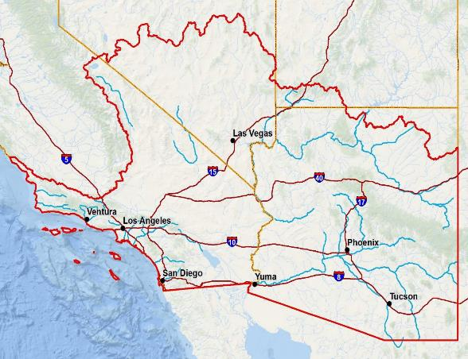
LOS aNGELES DISTRICT overview
Over 720 Team members serving a population of 33 million people
Actively supporting Southern California Wildfires
During TS Hilary: ~19,000 acre-feet of water from Prado and Whittier Narrows Dams (Worth ~$19M)
Support to 8 million acres of military installations
(Army, Navy, Air Force, Space Force, Marine Corps – 15 total bases)
15 Construction Offices
6 Regulatory Offices
Operate & Maintain 17 dams and 61 miles of levee across AZ, NV, CA
Operate & Maintain 14 harbors along Southern California
Maintain 5 River basins across AZ, NV, and Southern California
Maintain 420 miles of shoreline
California VA Medical Centers in San Diego and Long Beach
Sustain Critical Habitats (300+ Threatened / Endangered Species)
Ports of LA/Long Beach = 5th Busiest Port Complex in the World!
67 Federally-recognized Tribes (27 Non-Federal)
8 Senators / 4 Governors / 44 House Representatives
Small Business Program inducted into the AZ Million Dollar Circle of Excellence
Utah
Nevada
California
Creech AFB
Nellis AFB
Fort Irwin NTC
Vandenberg AFB
Edwards AFB
Arizona
Los Angeles AFB
Luke AFB
Yuma Proving Ground
Davis-Monthan AFB
Fort Huachuca
SPL Area of Operations
Harbor
Military Customer

Slide 4
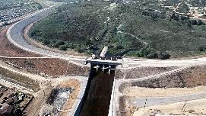
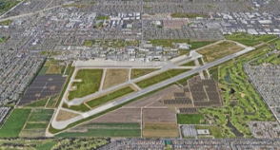
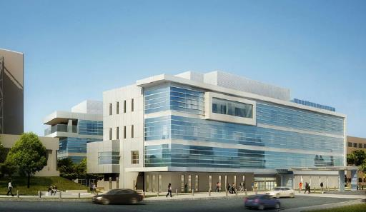








SPL Missions
Civil Works
Military Programs
International and Interagency
Whittier Narrows Dam
JFTB-Los Alamitos Energy Resilience Project
San Diego VA, Spinal Cord Injury Center
Flood Risk Management
Operations & Maintenance
Project Planning
∙∙∙∙∙∙∙∙∙∙∙∙∙∙∙∙∙∙∙∙∙∙∙∙∙∙∙∙∙∙∙∙∙∙∙∙∙∙∙∙∙∙∙∙∙∙∙∙∙∙
16 Dams and 61 Miles of Levees
5 River Basins Across AZ, NV and SOCAL
∙∙∙∙∙∙∙∙∙∙∙∙∙∙∙∙∙∙∙∙∙∙∙∙∙∙∙∙∙∙∙∙∙∙∙∙∙∙∙∙∙∙∙∙∙∙∙∙∙∙
Regulatory Program & Permitting / Section 408 / Real Estate / Environmental Justice / Water Projects & Studies
595 Program / Levee and Dam Safety
Reservoir Regulation / Hydraulics and Hydrology / Tribal Nations
Support to DoD Agencies (Army, Navy, Air Force, Space Force, Marine Corps)
∙∙∙∙∙∙∙∙∙∙∙∙∙∙∙∙∙∙∙∙∙∙∙∙∙∙∙∙∙∙∙∙∙∙∙∙∙∙∙∙∙∙∙∙∙∙∙∙∙∙
FUDS (Formerly Used Defense Sites), EQ (Environmental Quality), IRP (Installation Restoration Program), MILCON (Military Construction), SRM (Sustainment Restoration, Maintenance), UXO (Unexploded Ordnance), Sustainability
∙∙∙∙∙∙∙∙∙∙∙∙∙∙∙∙∙∙∙∙∙∙∙∙∙∙∙∙∙∙∙∙∙∙∙∙∙∙∙∙∙∙∙∙∙∙∙∙∙∙
Programming & Project Management / Environmental EQ / IRP / FUDS
Assists Non-DoD Federal, State and Local Agencies via Economy in Government Act
∙∙∙∙∙∙∙∙∙∙∙∙∙∙∙∙∙∙∙∙∙∙∙∙∙∙∙∙∙∙∙∙∙∙∙∙∙∙∙∙∙∙∙∙∙∙∙∙∙∙
Full Range of Engineering and Construction Expertise and Support to our IIS Customers
∙∙∙∙∙∙∙∙∙∙∙∙∙∙∙∙∙∙∙∙∙∙∙∙∙∙∙∙∙∙∙∙∙∙∙∙∙∙∙∙∙∙∙∙∙∙∙∙∙∙
Programming / Engineering / Construction
Real Estate Acquisition / Contracting Management
Construction Management
Flight Test Complex, Edwards AFB
Dam Safety
Regulatory Program / Section 408 Permitting
595 Program
Planning
Water Projects
Prado Dam Modification
Creech AFB Disaster Resiliency Program

Slide 5
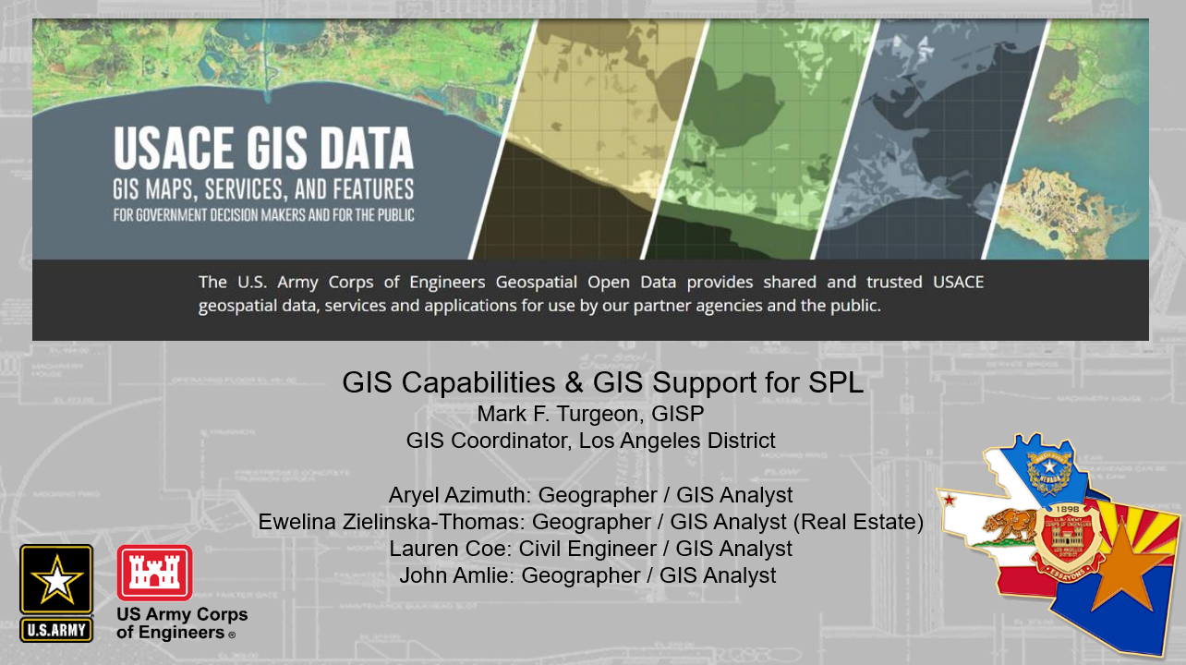
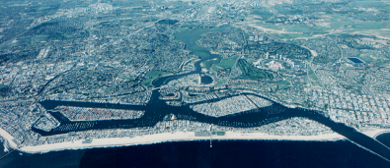
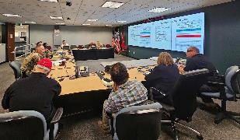
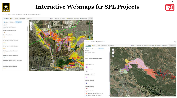
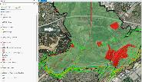
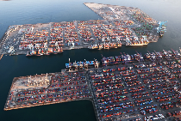


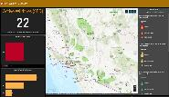
SPL Missions
Geospatial Support
Navigation/Coastal
Emergency Management
Newport Bay Harbor Dredging Project
Tropical Storm Hilary AAR
Connect Geography with Data Resulting In: Cost Savings, Better Decision Making
Improved Record Keeping and Communication
Safe, Reliable, Efficient, Effective and Environmentally Sustainable Waterborne Transportation Systems
∙∙∙∙∙∙∙∙∙∙∙∙∙∙∙∙∙∙∙∙∙∙∙∙∙∙∙∙∙∙∙∙∙∙∙∙∙∙∙∙∙∙∙∙∙∙∙∙∙∙
14 Harbors Along SOCAL for Movement of Commerce, National Security Needs, Recreation
Plan/Construct Navigation Channels, Ports, Harbors, Maintain Channel Depths
∙∙∙∙∙∙∙∙∙∙∙∙∙∙∙∙∙∙∙∙∙∙∙∙∙∙∙∙∙∙∙∙∙∙∙∙∙∙∙∙∙∙∙∙∙∙∙∙∙∙
Ports of Long Beach and Los Angeles Account for $420B in Annual Cargo
*Together, Make Up the 5th Busiest Port Complex in the World!
Marina del Rey Harbor Accounts for 5,300 Slips (AKA Parking Spaces for a Boat)
*One of the Largest Recreational Harbors in the USA!
Engineering Services to Respond to National and Natural Disasters
∙∙∙∙∙∙∙∙∙∙∙∙∙∙∙∙∙∙∙∙∙∙∙∙∙∙∙∙∙∙∙∙∙∙∙∙∙∙∙∙∙∙∙∙∙∙∙∙∙∙
Public Law 93-288 (Stafford Act)
National Response Framework
ESF #3
Public Law 84-99
∙∙∙∙∙∙∙∙∙∙∙∙∙∙∙∙∙∙∙∙∙∙∙∙∙∙∙∙∙∙∙∙∙∙∙∙∙∙∙∙∙∙∙∙∙∙∙∙∙∙
Rehab and Inspection Program / EM Planning
Engineering and Construction Support
Disaster Preparation
SPL Continuity of Operations Planning
USACE Reach-Back Operations Center (UROC)
Web maps for SPL Projects
Whittier Narrows Dam
TS Hilary – Whittier Narrows Dam
Duncan, AZ Flood Response
Port of Los Angeles
Ports of Long Beach & LA Account for 40% of ALL shipping containers entering USA
Active Wildfires Dashboard
Temporary
Power
Debris
Management
Temporary
Housing
Critical Public
Facilities
Temporary Roofing
“Blue Roofs”
Response
“Short-Term” Recovery
Notes:
Emergency/Disaster/Contingency “Support to Others” (Generic Comments Already Developed)
Falling under Civil Works is Contingency Operations or Emergency Response – USACE is FEMAs Engineer.
In the event of natural or manmade disasters, USACE is prepared and ready to respond as part of the federal government’s unified national response to disasters and emergencies in support of State, Territorial, and Tribal Governments. In any disaster, USACE’s top priorities are to 1) save lives and protect property; and 2) support immediate emergency response priorities for USACE, DoD, FEMA and the Federal Government.
During natural disasters and other emergencies, the Corps can respond under Public Law 84-99 (Flood Control and Coastal Emergencies); as a component of the Department of Defense; and as the designated lead agency in support of FEMA for ESF #3, Public Works and Engineering.
You can see here the types of services we provide under our public law mandates.
The Corps is the lead agency for ESF #3, Public Works and Engineering. As such, we’re responsible for several critical missions, including Temporary Emergency Power, Debris Removal and Clearance, Infrastructure Assessment, Temporary Housing and Critical Public Facilities, and Temporary Roofing. The Corps also lends trained personnel to support other ESFs, such as ESF #9, Search and Rescue, when activated.
All USACE emergency response work is performed in concert with other federal agencies, states and local governments, contractors, and affected industries working together as ONE TEAM.

Slide 6
Corps of engineers Attendees
SPL Leadership -COL Andrew Baker: District Commander -Justin Gay: Deputy for Programs and Project Management -LTC Stephen Brooks: Deputy Commander | Operations Division -Mark Cohen (Chief): Mark.D.Cohen@usace.army.mil -Michael Turanitza: Michael.Turanitza@usace.army.mil -Trevor Snyder: Trevor.R.Snyder@usace.army.mil -Mylene Guron: Mylene.M.Guron@usace.army.mil -Julio Ramos: Julio.E.Ramos@usace.army.mil
Military Branch -Eric Negrete: Eric.A.Negrete@usace.army.mil -John Oshima: John.D.Oshima@usace.army.mil -Grace Parnell: Grace.R.Parnell@usace.army.mil | Construction Division -Shaun Frost (Chief): Shaun.R.Frost2@usace.army.mil -John Stephens: John.W.Stephens@usace.army.mil -Thad Fukushige: Thad.T.Fukushige@usace.army.mil
Fire Recovery/Small Business -Christine Davis: Christine Davis: Christine.Davis@usace.army.mil -Roger Minami: kinya.r.Minami@usace.army.mil | Sacramento and Albuquerque District Representatives -Vernon Simpkins: Vernon.A.Simpkins@usace.army.mil -Stephanie Parra: Stephanie.N.Parra@usace.army.mil
Contracting Division -Sean Sackett (Chief): Sean.P.Sackett@usace.army.mil -Pat Bonilla: Patricia.B.Bonilla@usace.army.mil | DVA (Department of Veteran Affairs) Project Execution Office: -David Van Dorpe (Chief): David.M.Vandorpe@usace.army.mil
Workforce Management: Emily Wang, Emily.I.Wang@usace.army.mil | Engineering Division -Paul Underwood (Chief): Paul.W.Underwood@usace.army.mil -Vincent Andrada: Vincent.G.Andrada@usace.army.mil
IIS (International & Interagency) Branch -Dina Aman: Dina.Aman@usace.army.mil -Claudia Garcia: Claudia.Garcia@usace.army.mil -John Drake: John.E.Drake@usace.army.mil | Mega Projects Division -Priyanka Wadhawan, Priyanka.Wadhawan@usace.army.mil
Navigation Branch -Steve Dwyer, Charles.S.Dwyer@usace.army.mil
Notes:
Here is a list and contact information of USACE personnel taking part in today’s BOOH

Slide 7
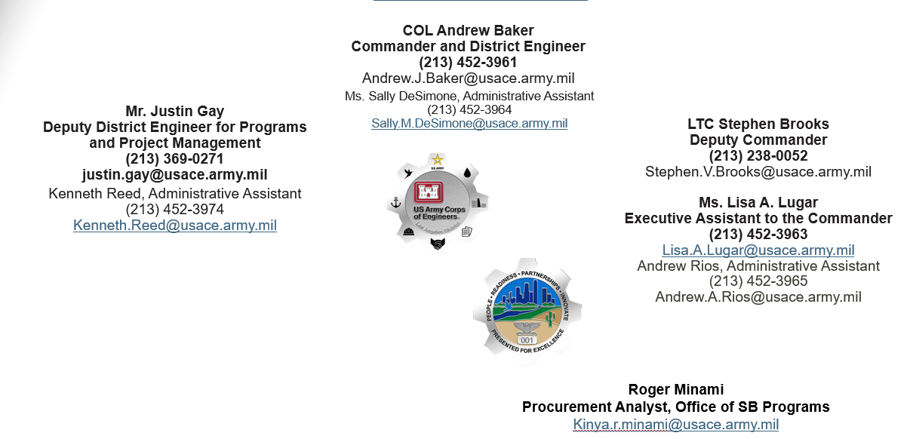
U.S. Army Corps of Engineers Los Angeles District
www.spl.usace.army.mil
COL Andrew Baker
Commander and District Engineer
(213) 452-3961
Andrew.J.Baker@usace.army.mil
Ms. Sally DeSimone, Administrative Assistant
(213) 452-3964
Sally.M.DeSimone@usace.army.mil
Mr. Justin Gay
Deputy District Engineer for Programs
and Project Management
(213) 369-0271
justin.gay@usace.army.mil
Ms. Lisa A. Lugar
Executive Assistant to the Commander
(213) 452-3963
Lisa.A.Lugar@usace.army.mil
Andrew Rios, Administrative Assistant
(213) 452-3965
Andrew.A.Rios@usace.army.mil
Kenneth Reed, Administrative Assistant
(213) 452-3974
Kenneth.Reed@usace.army.mil
Ms. Jennie Ayala
Outreach Coordinator
213-452-4018
Jennie.Ayala@usace.army.mil
Roger Minami
Procurement Analyst, Office of SB Programs
Kinya.r.Minami@usace.army.mil

Slide 8
Prime Contracting Opportunities: IIS Interagency & international Services (Subject to Change)
Project | Description | Advertise on SAM.GOV | Range
Modernize and Upgrade New Pumphouse and Substation Long Beach VA | (W912PL24B0005 in SAM), New combined pumphouse and substation, followed by demolition of the building 125 pumphouse and substation 12A (Dina Aman) | Q3-4, FY25 SBSA | $10M-$25M
Upgrade Central Chiller Plant and DDC Controls Long Beach VA | (W912PL24B0004 in SAM), Replace the existing chillers, upgrade/refurbish existing cooling towers, upgrade/replace the primary, secondary chilled water pumps and condenser water pumps (Dina Aman) | Q3-4, FY25 SDVOSB | $5M-$10M
Environmental Services Dewey-Humboldt, AZ | Iron-King Mine-Humboldt Smelter (IKM-HS). (MATOC or SATOC: TBD)(Claudia Garcia) (W912PL25S0007-Design) (W912PL25S0008-Remediation) (W912PL25S0009-Construction) | Q4, FY25 0007-UNR 0008-SBSA 009-SBSA | Design: $49M Construction: $249M Remediation: $100M
Notes:
-W912PLB0005: DBB/This project will construct a new combined pumphouse and substation. The existing pumphouse at building 125 at Long Beach VA will be operational in its current location during construction. Temporary power will be provided to the Fisher House on-campus hotel during construction. The construction will be performed in phases to allow continuous operation of the existing pumphouse. This requirement will include, but will not be limited to, preparation and/or performance for, submittals, field investigations, site visits, meetings and providing construction meeting minutes to the COR, staff interviews, phasing/scheduling, utility shutdowns, infection control measures and other related information and services. The PM is Dina Aman
-W912PL24B0004: DBB/This project entails the provision of all material and labor required to upgrade the central chiller plant and DDC controls in Building 5A of the Long Beach VA campus, to comply with the latest codes and VA standards. All construction shall be performed in accordance with drawings and specifications provided by the VA. This project intends to replace the existing chillers, upgrade/refurbish existing cooling towers, upgrade/replace the primary and secondary chilled water pumps, condenser water pumps, related piping and controls, pressure differential Delta P valves in main chilled water lines entering each of the buildings and interface with existing Johnson Controls Metasys System. The PM is Dina Aman
-Iron King Mine-Humboldt Smelter: The former operations of the Iron King Mine and the Humboldt Smelter led to wastes and contamination in soils, sediments, and surface drainages within the town of Dewey-Humboldt, Arizona. SPL anticipates the award of three IDIQ contracts in support of cleanup efforts in accordance with the Record of Decision – Iron King Mine-Humboldt Smelter (USEPA, 2023) the Residential Design Plan (Weston-TechLaw, 2024). These IDIQs will be in the areas of: (Design)(Remediation)(Construction). The PM is Claudia Garcia

Slide 9
Prime Contracting Opportunities: Military program (Subject to Change)
Project | Description | Advertise on SAM.GOV | Range
Child Development Center Luke AFB, AZ | Construct a 3,394-SM building, steel-framed, concrete slab and foundation system, masonry block exterior, and standing seam metal roof (Bill Prout) (DB)(Market Research Underway) (No SAM Posting Yet) | 4th QTR, FY25-1st QTR, FY26 | $25M-$50M
DB Construction MATOC-East Branch Nevada includes Clark County, Lincoln and Nye Counties and Arizona include Maricopa and Pima counties. | Three but no more than five firm-fixed price (FFP) individual Indefinite Delivery Contracts (IDCs) and subsequent FFP Task Orders (TOs) (James Elsberry/John Oshima) | 4th QTR, FY25 | Up to $99M
Training Support Center Ft. Irwin, CA | Construction of a 60K-SF TSC to be part of the National Training Center (Eric Negrete) (SB Set-Aside)(DBB) (W912PL25R0005 & W912PL25S0001) | 4th QTR, FY25-1st QTR, FY26 | $25M-$50M
Disaster Resiliency Program Phase 2 Creech AFB, NV | 79,335-SF Aircraft Maintenance Facility (AMF) hangar, a 4,429-SF covered Aerospace Ground Equipment (AGE) storage yard, and 100,167-SF of airfield pavements (James Elsberry/John Oshima) (DB)(W912PL25S0003) | 3rd QTR, FY25 | $100M-$250M
Notes:
-Child Development Center: This project is a Design and Construction of a one-story (3,394-SM)(36,533-SF), Child Development Center (CDC) facility for 252 dependent children, aged 6 weeks through 5 years of age. The facility includes age-appropriate child activity rooms, administrative offices, a staff break room, storage space, kitchen facilities, laundry, outdoor activity areas, and all other required operational capabilities. Additionally, there are the typical building support functions including: mechanical, electrical, fire protection and communications equipment rooms. The PM is Bill Prout. Bill is unable to attend. Please speak with John Oshima
-DB MATOC: SPL anticipates issuing two DB contracts that will be for a period of five years and/or $99,000,000, whichever occurs first. The intent is to issue one contract for each of the two geographical areas covered by SPL. These being the east (NV/AZ) and the west (CA). Accordingly, SPL proposes to award at least three but no more than five firm-fixed price (FFP) individual Indefinite Delivery Contracts (IDCs) in each area and subsequent FFP Task Orders (TOs). The PM is James Elsberry. James is unable to attend, please see John Oshima
-Training Support Center: This project involves construction of a single-story, 60,000 SF TSC to be part of the National Training Center (NTC) at Ft. Irwin, California. This TSC will support the Program of Instruction for the NTC Home Station, and Rotational Training Units (RTUs) training requirements. Please see John Oshima or Eric Negrete
-Disaster Resiliency Program: This isa design-build project to design and construct a 79,335 square foot Aircraft Maintenance Facility (AMF) hangar, a 4,429 square foot covered Aerospace Ground
Equipment (AGE) storage yard, 204 square foot hazardous material storage, and 100,167
square feet of airfield pavements to accommodate the Disaster Resiliency Program (DRP)
mission sets. SPL has conducted market research of subcontracting opportunities for this project to ensure maximum/local small business participation. The PM is James Elsberry. James was unable to attend. Please see John Oshima

Slide 10
Prime Contracting Opportunities: CIVIL WORKS, AE and Navigation (SUBJECT TO CHANGE)
Civil Works Current Projects | Description | ADV | Range | Anticipated Set Aside
Murrieta Creek, CA | Phase 2B-Buried riprap bank protection and ecosystem restoration (Damien Lariviere) | Q3-Q4, FY25 | $25M-$50M | SBSA
LA County, San Bernardino, Orange County, Arizona and Nevada | FY26 Channel Levee Maintenance Services (Trevor Snyder) | Q4, FY25 | $25M-$50M | SBSA
Navigation Current Projects | Description | ADV | Range | Anticipated Set-Aside
Lower Newport Harbor Maintenance Dredging Newport Beach, CA | Dredge approx 800K CY. Dredged materials will be transported and placed at the LA-3 Ocean Dredged Material Disposal Site. Dredge approx 125K CY that are unsuitable for open ocean disposal and place at the Port of Long Beach. (Chris Romero/Steve Dwyer) | Q4, FY25 | $10M-$25M | UNR
Dana Point Harbor Breakwater Repair Orange County, CA | Structural maintenance at the West Breakwater. Replace displaced armor stone from the crest to the toe of the slope, and resetting existing stone to interlock with the new stone. (Chris Romero/Steve Dwyer) | Q4, FY25 | $5M-$10M | UNR
Prime Contracting Opportunities: AE Program (subject to change)
Current Projects | Description | ADV | Range | Anticipated Set Aside
Civil Works MATOC | (5-Year Base)(Civil Works Plus Vertical Design) (No SAM Posting Yet) (Vincent Andrada/Paul Underwood) | TBD | $48M Capacity | UNR and SB
Hydrology and Hydraulics SATOC | (5-Year Base)(Hydrology, Hydraulics, Sediment Engineering)(No SAM Posting Yet) (Vincent Andrada/Paul Underwood) | TBD | $5M Capacity | SB
Notes:
Murrieta Creek: This is a Multi-purpose flood risk management, ecosystem restoration and restoration project This is a channel widening project. The invert of the channel consists of a maintained channel area and riparian vegetation corridor. Some scopes include: (overbank aesthetics landscaping, right of way), (buried riprap), (grouted riprap slopes at confluences), (replacing existing concrete slopes), (maintenance road/trail, riparian vegetation corridor). Please see Damian Lariviere
SPL seeks a small business contractor in providing a minimum 5-years experience in providing flood risk management/channel levee maintenance services to the gov. Services may include: (graffiti abatement)(vegetation management)(sediment, concrete and cobble stone debris management)(trash removal) and other services in the LA County Drainage Area, San Bernardino County Drainage Area, Orange County Drainage Area, Santa Ana River Mainstem and the States of AZ and NV
2. Newport Harbor: This is a dredging project of approximately 800,000 cubic yards of material from the federal navigation channels at Newport Bay Harbor. The dredged materials will be transported and placed at the LA-3 Ocean Dredged Material Disposal Site. Services will also include dredging approximately 125,000 cubic yards of material from the federal navigation channels that are unsuitable for open ocean disposal and transport and placement of that material in the Pier G slip at the Port of Long Beach. The PM is Chris Romero. Chris is not able to attend. Please see Steve Dwyer
3. Dana Point: The project involves replacing displaced armor stone from the crest to the toe of the slope, both on the seaward and harbor sides, and resetting existing stone to interlock with the new stone. It is expected that a small number of individual stones during repair will be larger than 20 tons with a maximum of 24 tons (8.25 ft in diameter). It is expected that no more than 6,000 tons of new stone will be required. The PM is Chris Romero. Chris is not able to attend. Please see Steve Dwyer
4. Civil Works MATOC: This is a 5-year IDIQ for civil works plus vertical design projects. SPL is expecting both a unreserved and a small business pool of contractors. SPL expects market research to begin soon. Please contact Roger Minami if you are interested in this project.
5. Hydrology and Hydraulics SATOC: This is a 5-year IDIQ for hydrology, hydraulics and sediment engineering. SPL expects market research to begin soon. SPL expects this project to be set-aside for small business participation. Please contact Roger Minami if you are interested in this project

Slide 11
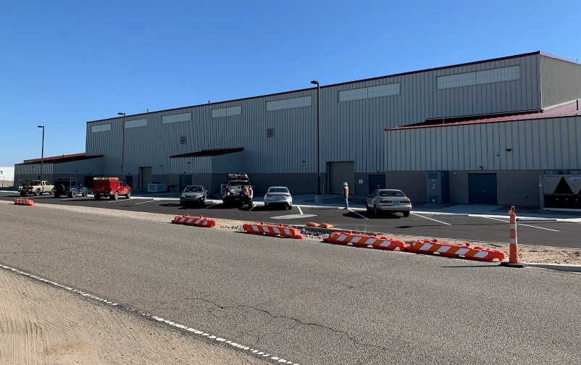
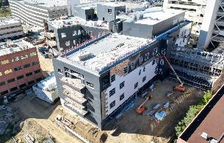
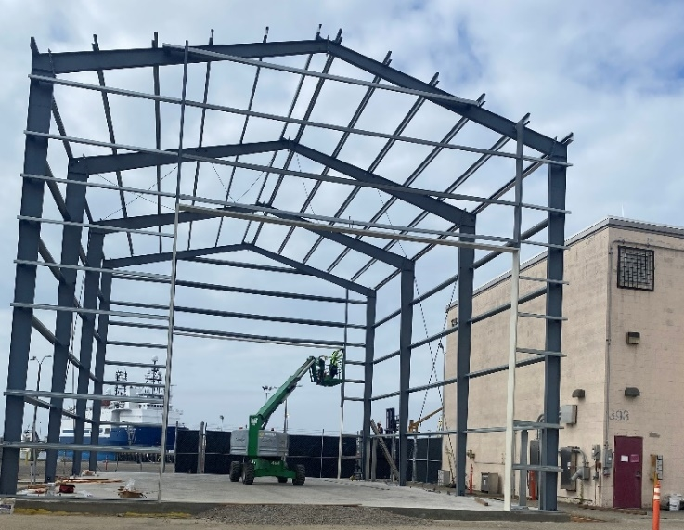
Contact information
Edwards AFB Resident Office Resident Engineer Robby Smith, P.E.
(760) 256-4527
DVA Long Beach Resident Office
Resident Engineer
Kevin Thomas, P.E.
(760) 708-6084
DVA San Diego Resident Office
Resident Engineer
Roberto Paredes, P.E.
(858) 379-1920
San Andreas Resident Office
Resident Engineer
Jose Rocha
(626) 401-4084
Environmental &Tech Support Branch
Thad Fukushige P.E.
(626) 401-4048
CONSTRUCTION DIVISION INFORMATION
Los Angeles District Website
www.spl.usace.army.mil
Construction Quality Assurance Training
email CESPL.CQM.Training@usace.army.mil
Resident Management System & QCS
Contact Area or Resident Offices
Questions Concerning Contract Types
Area and Resident Engineers and District
Contracting Office
(213) 452-3424
Questions concerning Small Business Opportunities
Resident or Area Engineers and our Small Business Advocate, Prisco "Eric" Ravelli
(213)452-39
Southern California Area Office
Area Engineer
Tom Weber, P.E.
(760) 920-0526
Santa Ana Dams Resident Office Resident Engineer
Pete Gauer, P.E.
(951) 898-6153
Ft Irwin Resident Office
Resident Engineer Robby Smith, P.E.
(760) 256-4527
San Diego Resident Office
Resident Engineer Jared Rowley
(858) 430-2805
High Desert Area Office
Area Engineer
John Stephens, P.E.
(661) 265-7222x1236
AREA AND RESIDENT OFFICES
Vandenberg AFB Resident Office
Resident Engineer
David Jorgenson, P.E. (805) 734-4670
Arizona Nevada Area Office
Area Engineer
Richard Fontanilla, P.E.
(602) 230-6851
Road Runner Resident Office
Resident Engineer
Jeff Owens, P.E.
(602) 230-6870
Las Vegas Resident Office
Resident Engineer
Teryl Stacey, P.E.
(702) 852-3544
Tucson Resident Office Resident Engineer
Bill Crockett, P.E.
(520) 584-1673
Notes:
Here is the current list of construction contacts

