Slide 1
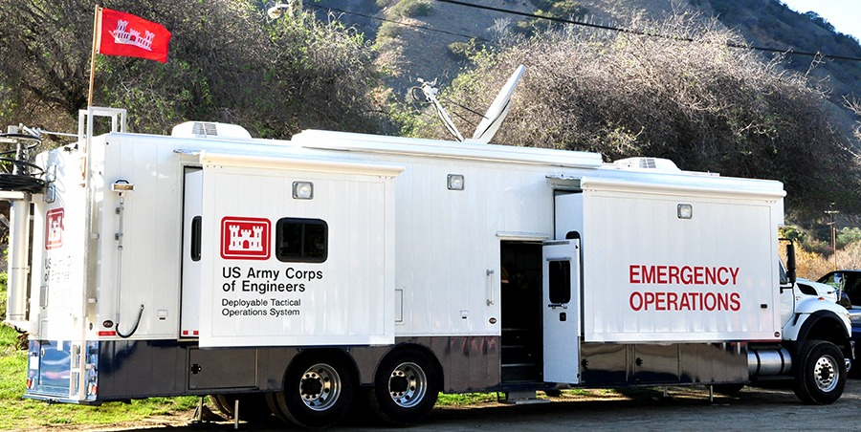
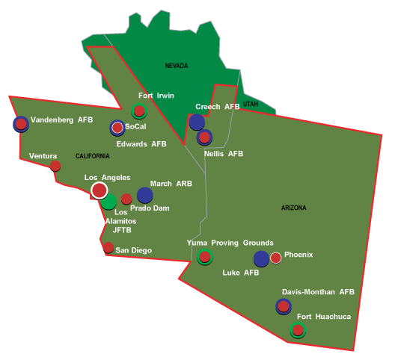

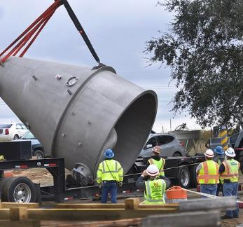
Los Angeles District (SPL) Overview 6 Mar 2025
US Army Corps of Engineers
Los Angeles District
Sean Sackett
Chief, Contracting Division

Slide 2
Agenda

Slide 3

Agenda
Los Angeles District (SPL) Overview
Rules for Industry Day
SPL Overview
Area of Operations
Historical Workload
Tips for New Firms Seeking
Work with the Government
Timeline
08:45 – 08:50
08:50 – 08:55
08:55 – 09:00
09:00 – 09:10
09:10 – 09:15

Slide 4
Rules for industry day

Slide 5
Rules for the Industry day
Unofficial and non-binding. If you have follow-on questions, please submit them to us in writing. E-mail: kinya.r.minami@usace.army.mil and christine.davis@usace.army.mil.
No recording devices permitted.
Please hold your questions until the end of the presentation during the Q&A portion.

Slide 6
SPL Overview

Slide 7
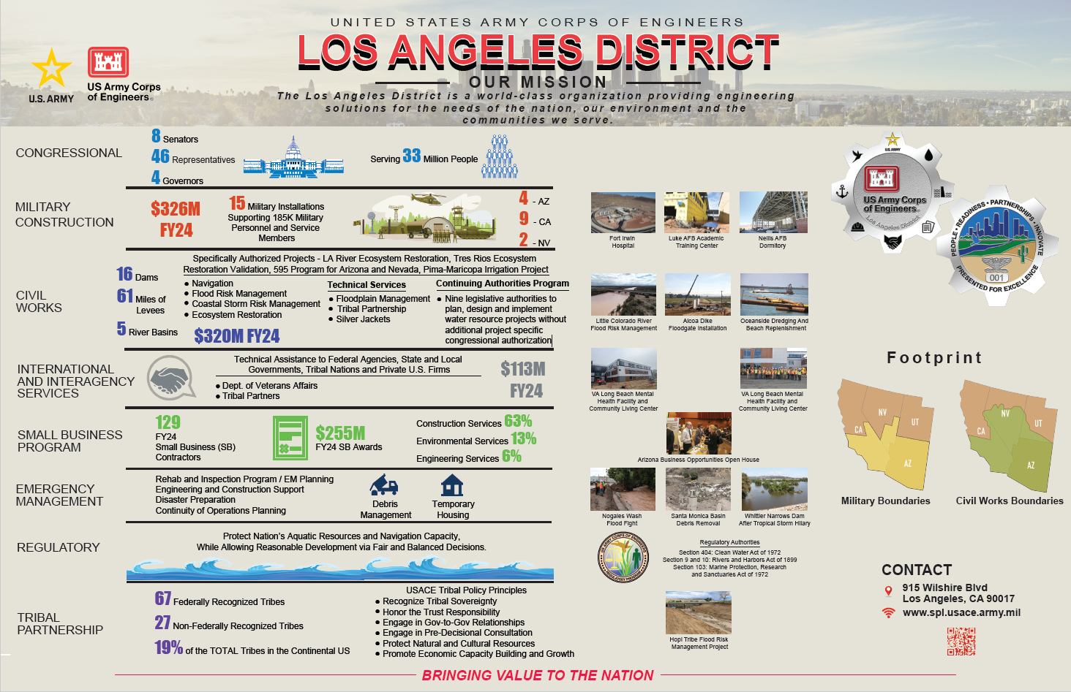

Slide 8
Area of operations

Slide 9
Los Angeles District’s Area of Responsibility
The boundaries of the Los Angeles District
touch the four western states of California,
Nevada, Arizona, and Utah. The 226,000
Square mile area includes 420 miles of
coastline,14 harbors, and the highest, lowest,
and hottest spots in the contiguous 48 states

Slide 10
FY20 – FY24 Historical workload

Slide 11
5 Year history – Obligations by Dollar value

Slide 12
5 Year history - Contract Awards by Volume

Slide 13
5-year History – Contract Analysis
Average Number of Actions: 832
Average Number of Obligations: $726,922,241

Slide 14
Architect-Engineer Awards

Slide 15
5 Year history – Obligations by Contract Awards

Slide 16
5 Year history – Obligations by Dollar value

Slide 17
5-year History – AE Analysis
Average Number of AE Actions: 26
Average Number of AE Obligations: $10,654,288
$249M AE Vertical Design MATOC Awarded in Oct 2024

Slide 18
Construction Awards

Slide 19
5 Year history – Obligations by Contract Awards

Slide 20
5 Year history – Obligations by Dollar value

Slide 21
5-year History – Construction Analysis
Average Number of Construction Actions: 147
Average Number of POCAs ($2M IDIQ each): 34
Average Number of Construction Obligations: $517,123,227
Evaluating Increase to POCA Limit Thresholds
Exploring Design-Build MATOC Acquisition Tools

Slide 22
Environmental Awards

Slide 23
5 Year history – Obligations by Contract Awards

Slide 24
5 Year history – Obligations by Dollar value

Slide 25
5-year History – Environmental Analysis
Average Number of Environmental Actions: 36
Average Number of Environmental Obligations: $45,575,808

Slide 26
Service and Supply Awards

Slide 27
5 Year history – Obligations by Contract Awards

Slide 28
5 Year history – Obligations by Dollar value

Slide 29
5-year History – Service and Supplies
Average Number of Actions by categories
Services: 33
Supplies: 10
Average Number of Dollars by categories
Services: $6,351,537
Supplies: $301,869

Slide 30
Tips for new firms seeking government contracts

Slide 31
Contractor Required Information
System for Award Management (SAM) and Procurement Integrated Enterprise Environment (PIEE) Solicitation Module
Contractors must be registered in SAM (www.sam.gov) and PIEE (https://cac.piee.eb.mil/xhtml/unauth/home/login.xhtml?logout=Y)
Certifications & Representations
Search W912PL

Slide 32
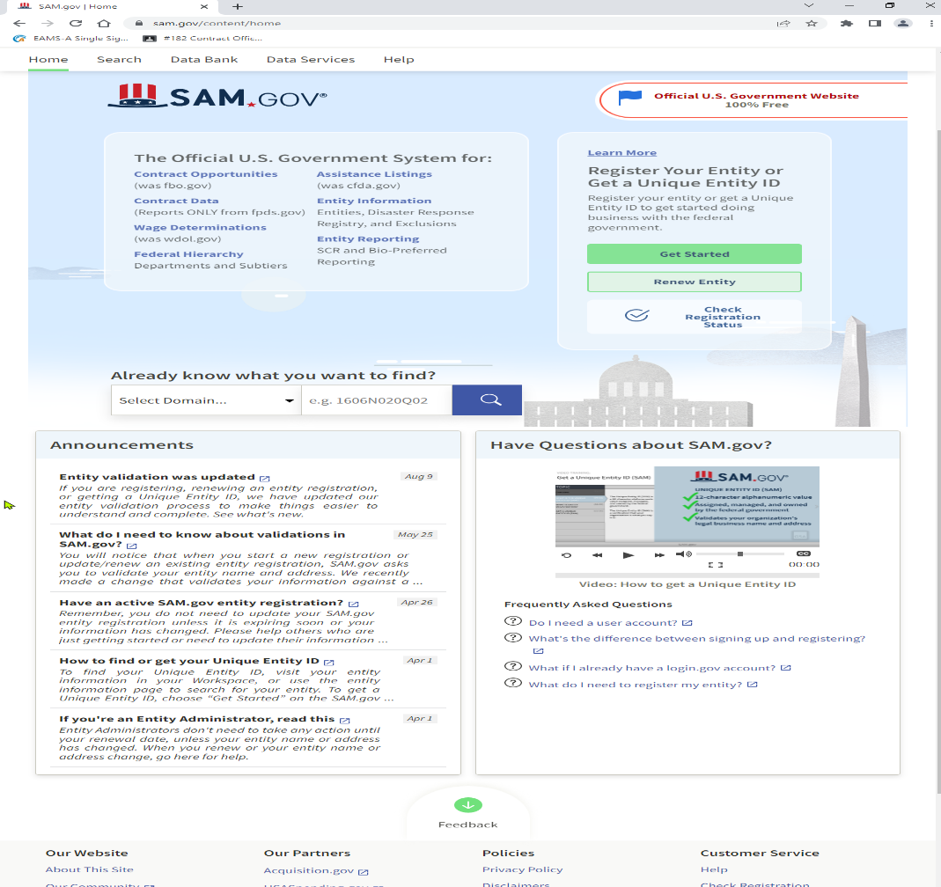
SAM.GOV

Slide 33
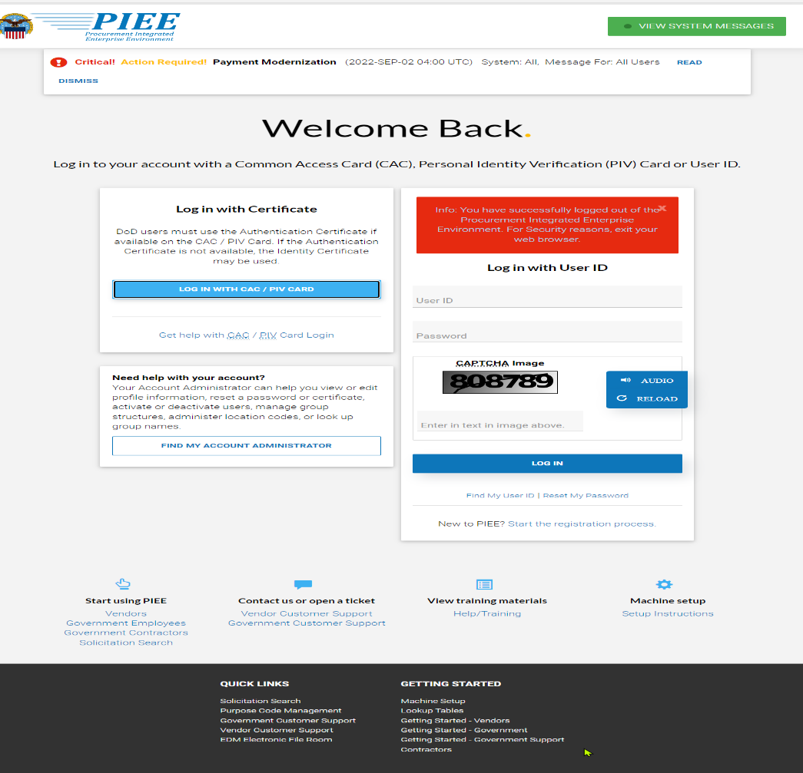
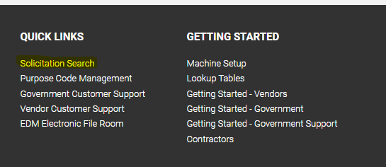
Procurement Integrated Enterprise Environment (PIEE)

Slide 34
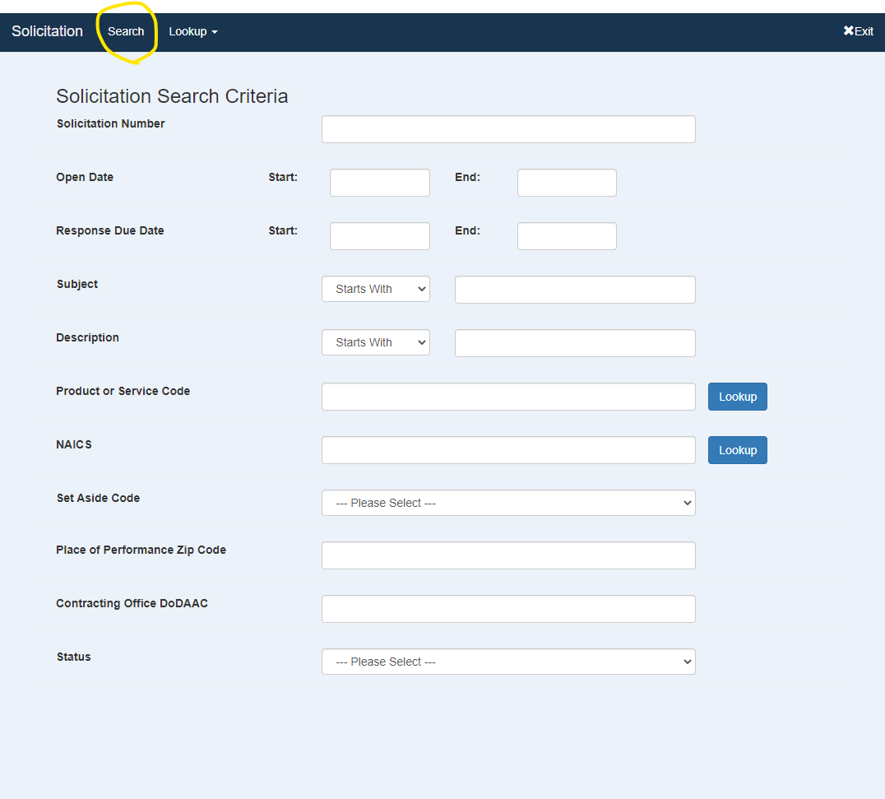
Solicitation Search
W912PL

Slide 35
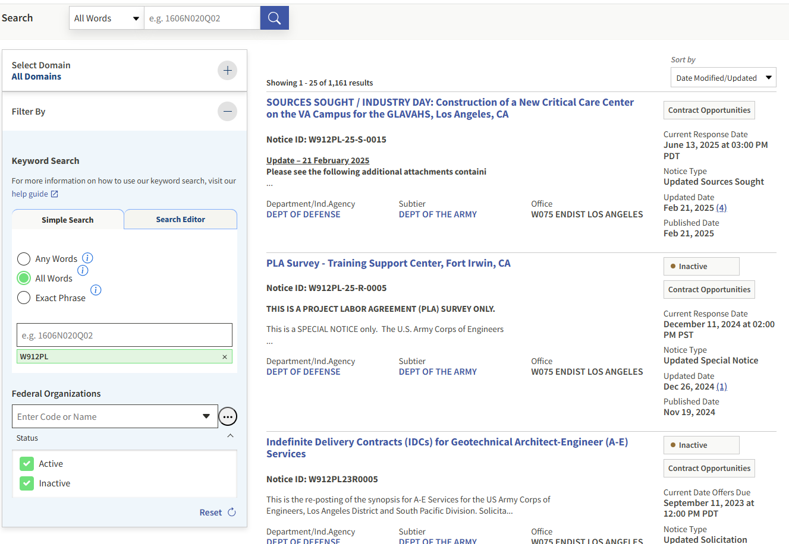
Solicitation Search

Slide 36


Thank you Come and visit the contracting booth!

