Slide 1



Los Angeles district (SPL) usace
Task Force Phoenix
Southern California Wildfires Recovery Efforts
March 6th, 2025
This slide deck will be posted in SAM upon conclusion of BOOH

Slide 2
BOOH Agenda
Welcoming Remarks by COL Baker @ 8:30AM
SPL Overview: Sean Sackett @8:45AM
Discussion of Los Angeles Fire Recovery @ 9:15AM
-Debris Cleanup Progress
-FEMA/USACE Partnership
-Potential Business Opportunities
-ECC
-Q&A
By: (T’Destynee Hives-McCray)(Christine Davis)(Prashant Khanna)(Roger Minami)
Networking @ 10:15AM (Networking Closes at 12:30PM)
This slide deck will be posted in the System for Award Management (SAM) upon conclusion

Slide 3
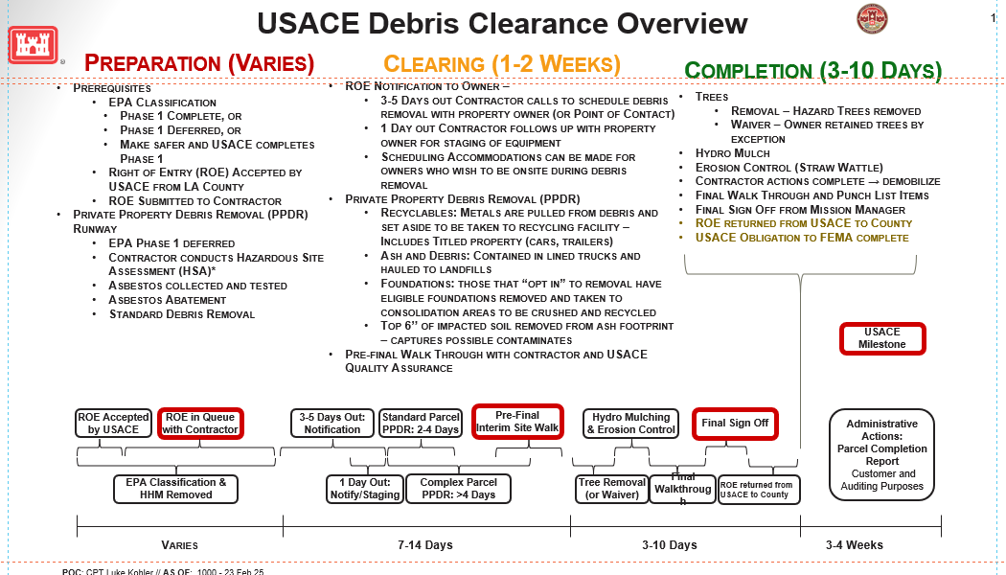
Debris Cleanup Progress: T’Destynee Hives-McCray and Christine Davis

Slide 4
USACE Involvement in disaster response
Under the National Response Framework, when asked, USACE assists FEMA to prevent, prepare for, respond to, and/or recover from incidents.
Committed to executing Phase 2 of wildfire debris removal safely, efficiently, and in partnership with the community
Assist communities across LA County lay the groundwork for rebuilding in a way that protects public health and the environment.
This is a “whole of government” effort.
Our mission is complex and includes methodical debris removal operations.

Slide 5
Current contract information
USACE has negotiated contracts for emergency response.
Competitively awarded Source Selection process
Firm-Fixed-Price IDIQ 5-year contract
Expires 28 Jan 28
South Pacific Division Advanced Contract Initiative – ECC LLC
Stafford Act Funding

Slide 6
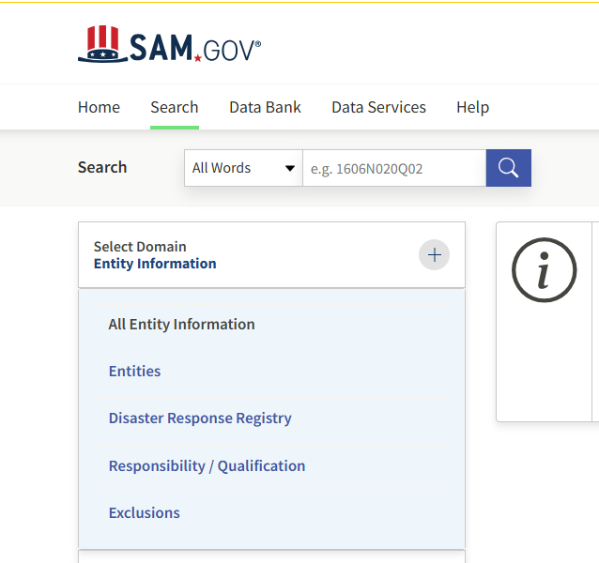
SMALL BUSINESS PARTICIPATION
To participate in federal contracts – contractors MUST be registered in www.SAM.GOV.
If you need assistance with SAM registration, contact the APEX Accelerator (a free Government Organization)
at https://www.apexaccelerators.us/#/contact
Within SAM.GOV there is a national disaster
registry. Optional to include yourself in this
registry.

Slide 7
Current Sources sought
W912PL25S0011 - ­ Capability to perform environmental remediation/environmental assessment services that will be needed for these recovery efforts.
There is currently no close date for these requests. Submissions are reviewed weekly.

Slide 8
Sources SOUGHT RESPONSE
Be brief but complete – READ THE SOURCES SOUGHT DOCUMENT
Government Focus FIRE DEBRIS REMOVAL
Past Performance
CPARS is preferred but others are acceptable
Don’t tell us ‘available upon request’ – WE ARE REQUESTING
Include past performance for team members
Emphasize past performance for the work requested
Describe your team so we know you can perform the entire scope
If 8(a) – Provide your SBA/8(a) contacts to expedite offering letters

Slide 9
POTENTIAL STAND-ALONE CONTRACTS
Non-residential properties as requested by FEMA – example: schools, churches
Complex properties – properties likely to require an engineered demolition plan

Slide 10
Create a team
Stafford Act Considerations
Limitations on Subcontracting
Sole Source limitations - $4.5M/$100M for super 8(a)
Expedited awards
Can complete Hazardous Site Assessments be performed?
Make safe
Archaeological/tribal monitor are on-site as necessary.
Hazardous Site Assessments Team
Site Assessment Team Lead (TL)
Certified Asbestos Consultant
Arborist or Registered Professional Forester (RPF)
Key Personnel:
Project Manager
Operations Manager
Operations Planner
Safety and Health Manager (SHM)
Site Safety and Health Officer (SSHO)
Certified Asbestos Consultant (CAC)
Biological Monitor (Optional CLIN)

Slide 11

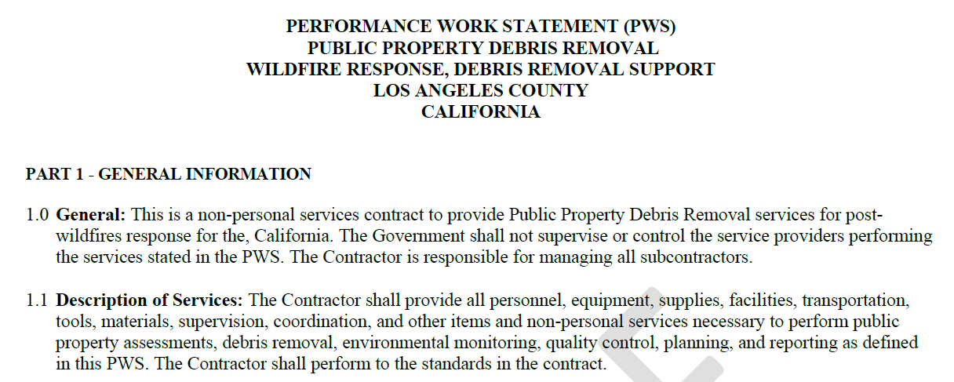
Sample PWS to be published in SAM

Slide 12
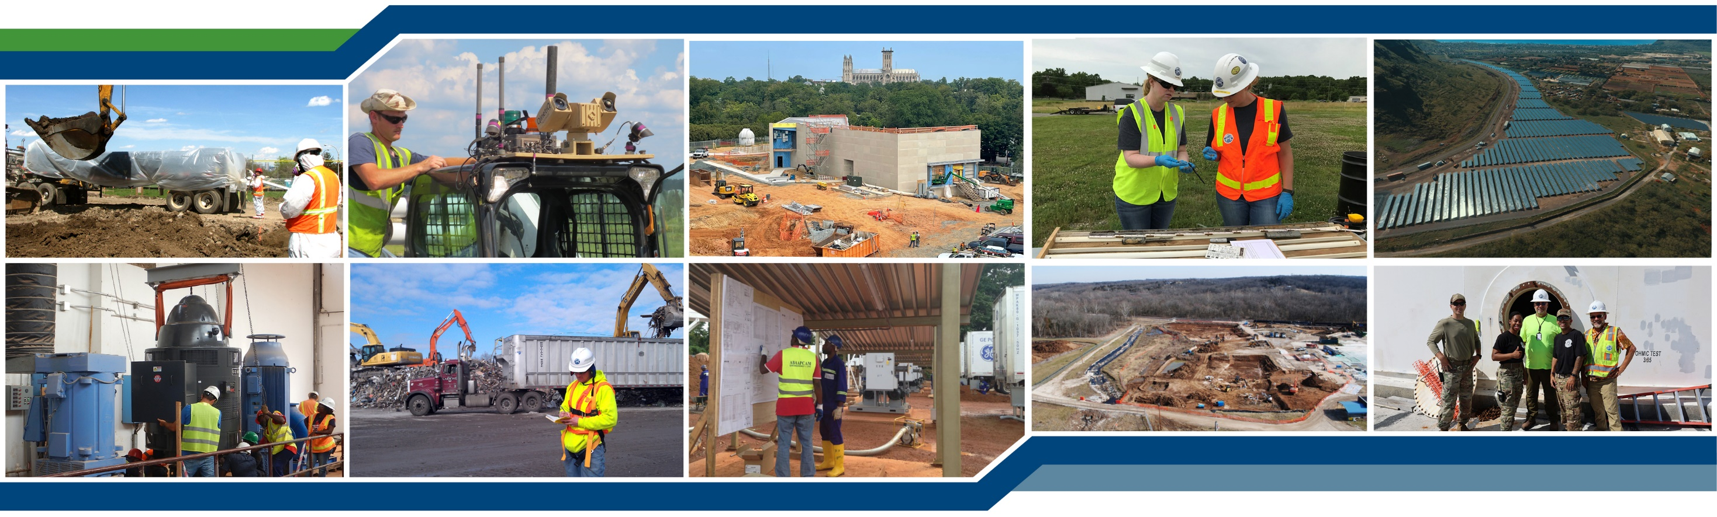
Usace los angeles district business opportunities open house 06 March 2025
Los angeles county wildfire debris removal mission
Prashant Khanna, PE, PMP
Vice President
ECC
06 March 2025

Slide 13
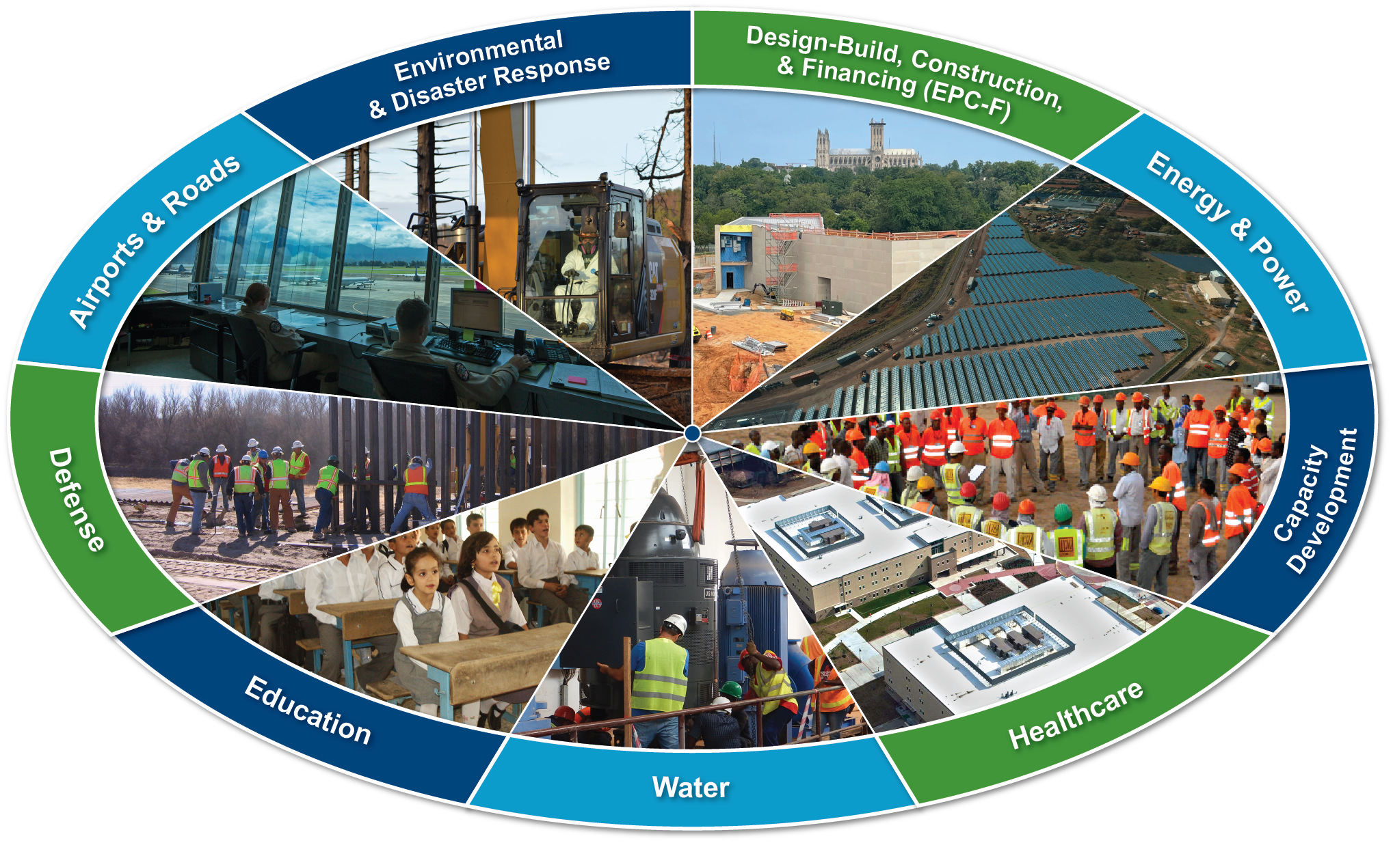
A Little History ….
ECC was formed in 1985
Entered the 8(a) program in July 1989
Graduated in July 1998
Became an ESOP company in 2005
Currently working in 20 countries/territories
Core capabilities:
Environmental Remediation
Design-Build Construction
Munitions Response
Renewable Energy Development
Emergency/Contingency Response

Slide 14
Usace - ecc fire recovery mission
SCOPE OF WORK (SOW):
Planning
Hazard Site Assessments
Private Property Debris Removal – Residential and Schools
Household Hazardous Waste
Asbestos Abatement & Disposal
Debris Removal
Temporary Reduction Sites Management
Transportation & Disposal
NOT INCLUDED IN SOW:
Property Improvements
Reconstruction/Rebuilding
Temporary & Permanent Utilities
Temporary Sheltering/Feeding/Life Support

Slide 15
Subcontracting opportunities
SCOPE ELEMENTS:
Certified asbestos consultants
Archeological Support
Biological support
Engineering services for demolition plans
Household Hazardous Material removal services
Certified arborists
Street sweepers/Water Trucks
Fencing installation
Tree cutting services
Traffic control
Debris removal and Make Safe crews
Staffing including administrative support, field supervisors, quality control & safety management

Slide 16
Utilization of local small businesses
ECC has successfully implemented a subcontracting approach to local small businesses during mission responses:
Initial emphasis to get the mission moving; execution may involve LBs or non-local resources that are teamed with ECC with demonstrated past performance
Outreach efforts through our website and social media
Review and compile list from pre-qualification data base
Transition to local resources expeditiously
Host local subcontractor outreach efforts
Connect with local agencies to obtain a list of qualified resources with the appropriate socio-economic status

Slide 17
Utilization of local small businesses
ECC has successfully implemented a successful approach for subcontracting to local small businesses during mission responses:
On the current Los Angeles mission – ECC is working closely with the small business office of USACE LA District; they are connecting ECC with their suite of small business prime contractors with proven past performance
Currently, ECC has 40 subcontractors working in the field
60% are Greater LA Area based small businesses: 8(a), SDB, WOSB, HubZone, VOSB, SDVOSB
Similar approach successfully implemented on Maui – ECC predominantly hired subcontractors based/registered in Maui, Hawaii

Slide 18
Utilization of local small businesses
Initial efforts include:
Establishing call centers
Website links for registration
Subcontractors submit basic pre-qualification information
Share T&Cs ahead of time to identify any major barriers
In-person meetings with selected subcontractors to ensure mutual understanding
Los Angeles Fire Mission Response
Efforts focused on local small businesses based in the region
Local – from impacted/adjacent communities in Southern California
Expand footprint only if there are unfilled resource gaps
We do not foresee footprint expansion outside of California

Slide 19
Pre-qualification screening
Capability & resources to perform within timeframe required
Demonstrated past performance on similar work
Safety practices and EMR rate
Established business entities
SAM registration (highly recommended)
Other project-specific requirements:
HAZWOPER Training
Asbestos certifications
State of California licensure

Slide 20
