Slide 1
Industry Days Coatings & Sealants Customer Overview
Justin Spencer – AMXG/EN

Slide 2
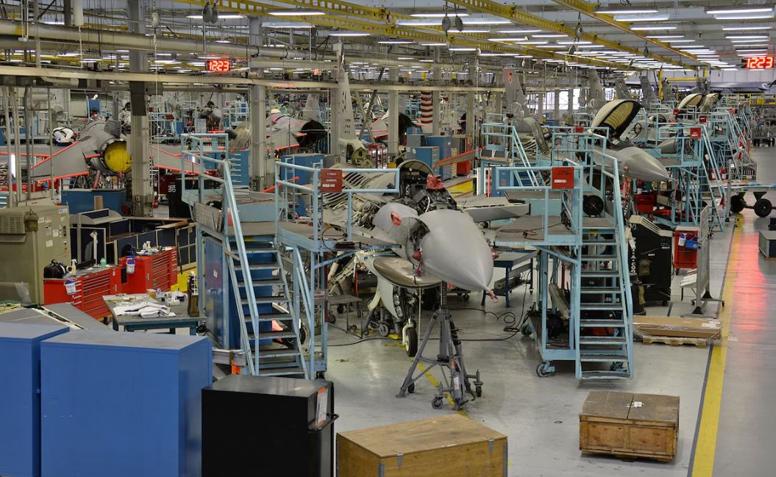
AMXG Mission Support
Maintenance, Repair, and Overhaul (MRO) of military aircraft
F-35
F-22
F-16
Mission: warfighter support, mission readiness
C-130
T-38
A-10

Slide 3
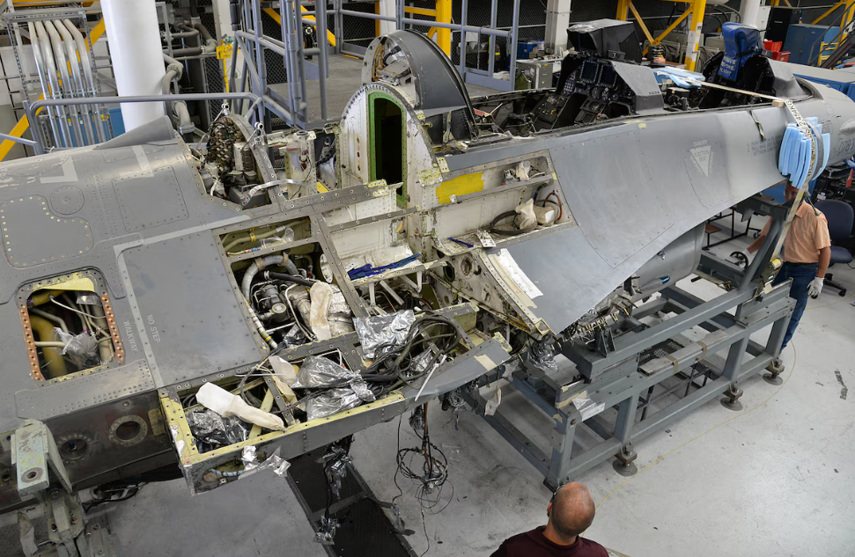
AMXG Major Workloads
Paint
Full or scuff refresh
Depaint
Plastic Media Blast (PMB)
Robotic Laser
F-16 SLEP
F-16 PSSR
A-10 ATTACK

Slide 4
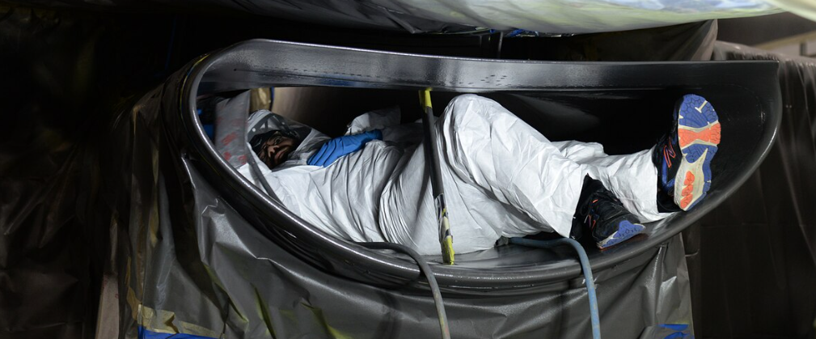
Maintenance Process Flow
Induction
Inspection
Depaint
Scheduled Maintenance
Paint
Flight Test
Return to Unit
Traditional Maintenance
Induction
Inspection
Depaint
Paint
Flight Test
Return to Unit
“Speedline” (<5%)
Other Processes
Scuff/refresh
F-16 intake

Slide 5
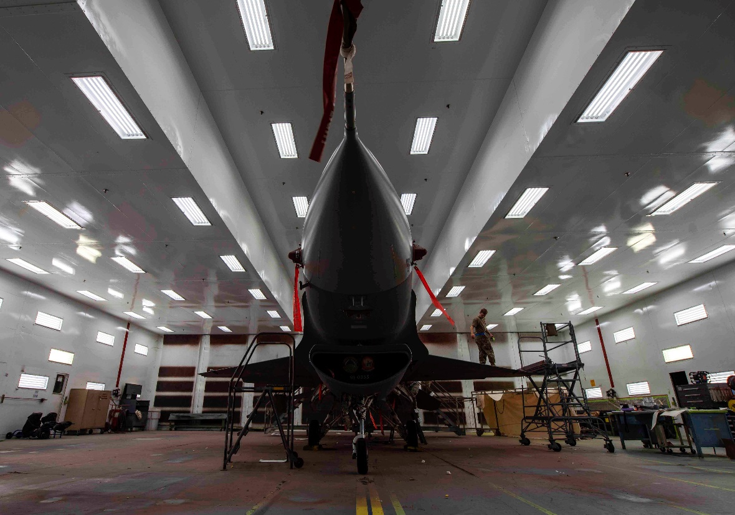
Paint Facilities - AMXG
Paint
(6) F-16 Paint Bays
(1) A-10 Paint Booth
(1) C-130 Paint Booth
(1) Small Parts Bay
Depaint
(3) Wash/Prep Bays
(2) F-16 Blast Booths
(2) A-10 Blast Booths
(1) F-16 Laser System

Slide 6
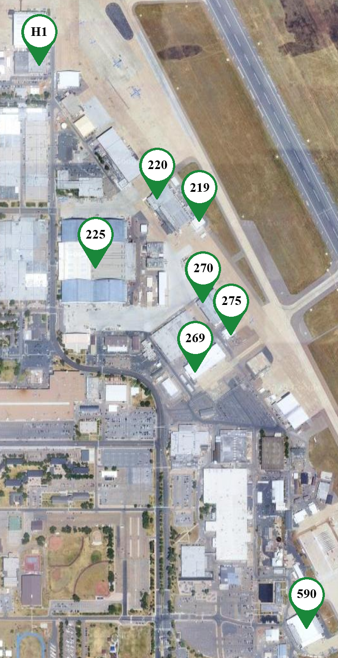
Facilities - AMXG
Hangar 1: A-10 MRO Hangar
220: F-16 Paint/Depaint
219: A-10 Depaint
225: F-16/C-130 MRO Hangar
270: A-10 Paint
275: A-10 Depaint
269: C-130 Paint
590: A-10 MRO Hangar

Slide 7
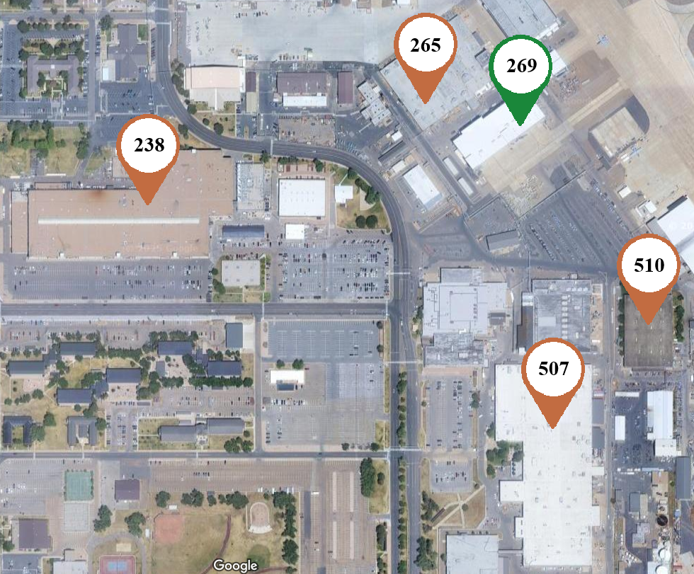
Facilities - CMXG
265: Landing Gear
238: Drop-off
510: Drop-off
507: Plating

Slide 8
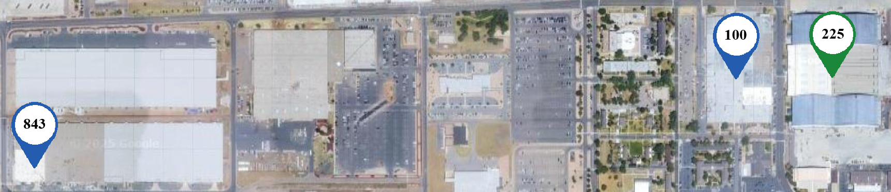
Facilities - EMXG
100 Bay J: Drop-off
843 Bay L: Drop-off

Slide 9

Security Badging
Security Layers
Base Access: CAC/DBIDS
Flightline: AMXG Badge
Renewed every 1-3 years
Vindicator Card: specific building access

Slide 10
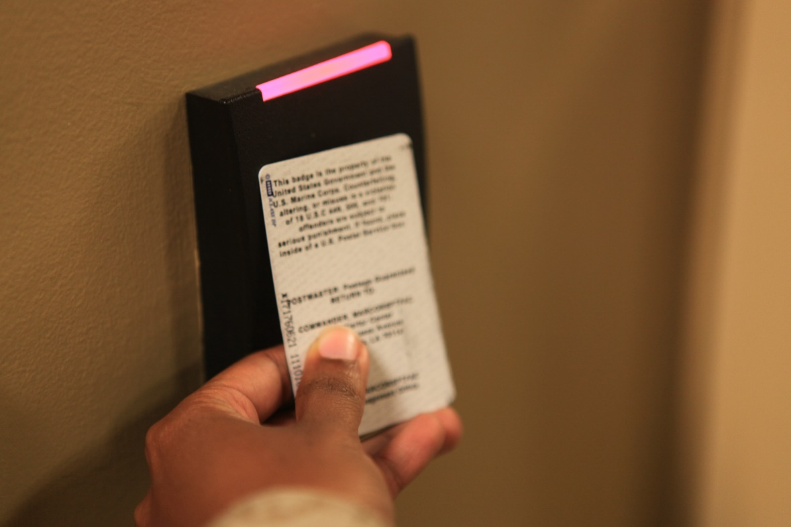
Security Protocols
Non-badged individuals must be escorted onto the base
Coordinated ahead of time with AMXG & Base Security
No unauthorized photography
You must be escorted into buildings you don’t have vindicator access to

Slide 11
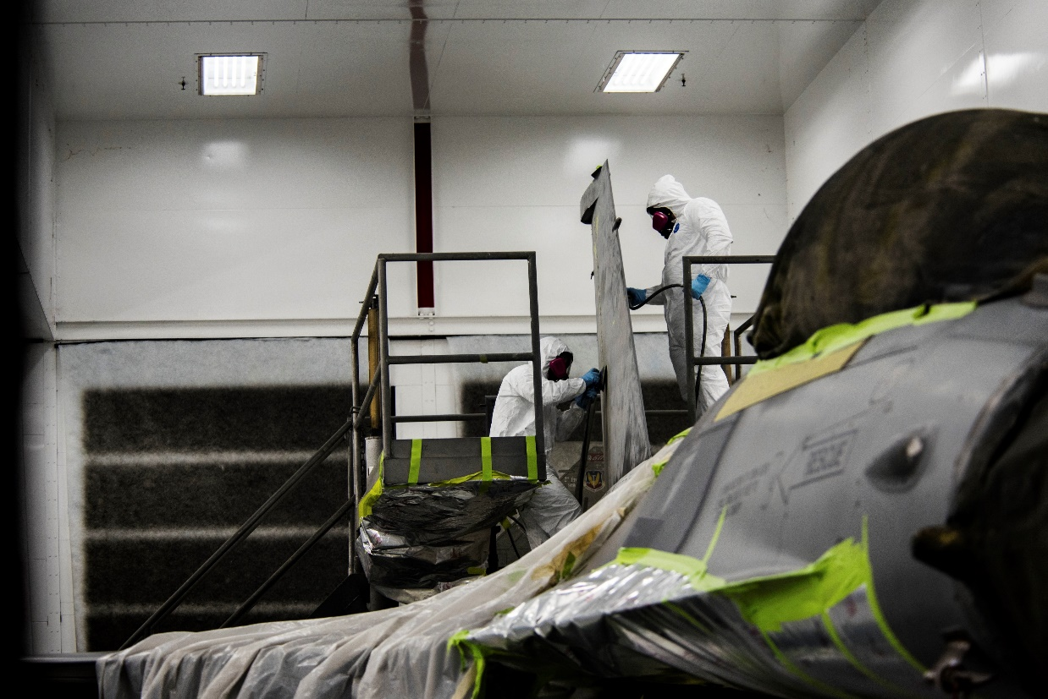
Paint Processes
Masking
Aircraft Wash
Wet Processes
B&A or PreKote
Additional Masking
Primer & Topcoat
Decals & Stenciling

Slide 12
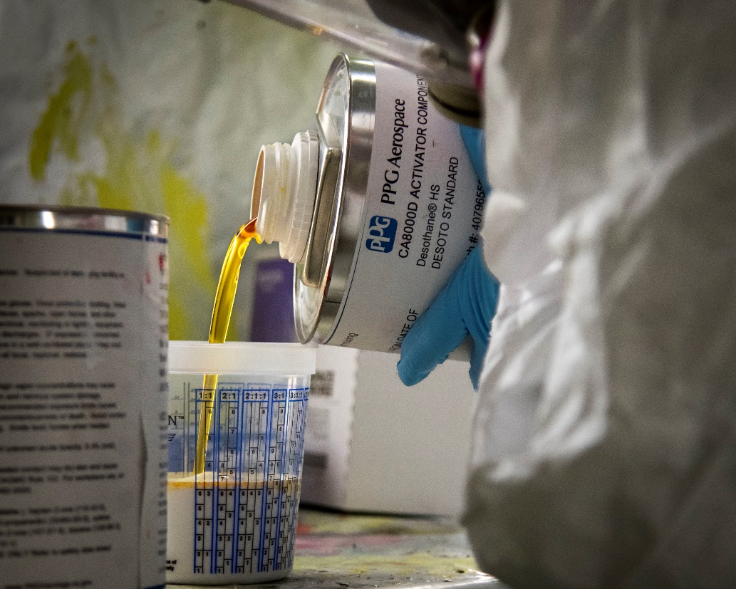
Contract Motivation
Defense Logistics Agency (DLA) limits product selection
Many products per spec
MIL-PRF-85285: 122
MIL-PRF-23377: 38
MIL-PRF-81706: 85
MIL-PRF-81733: 24
Significant lead time

Slide 13
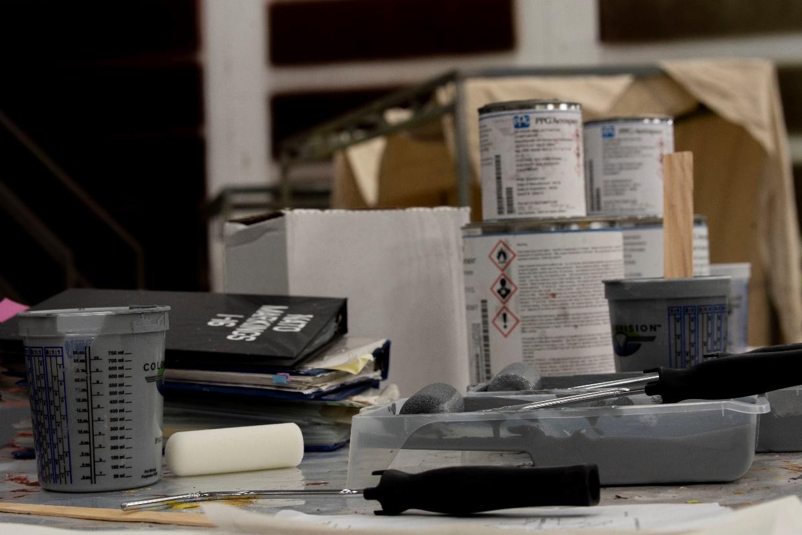
Contractual Obligations
Quality products
Product inventory
Maintain threshold product levels
Shelf-life validation
“Just-in-time” product delivery
FMS 3600 Product
Online ordering and tracking system
Technical support

Slide 14
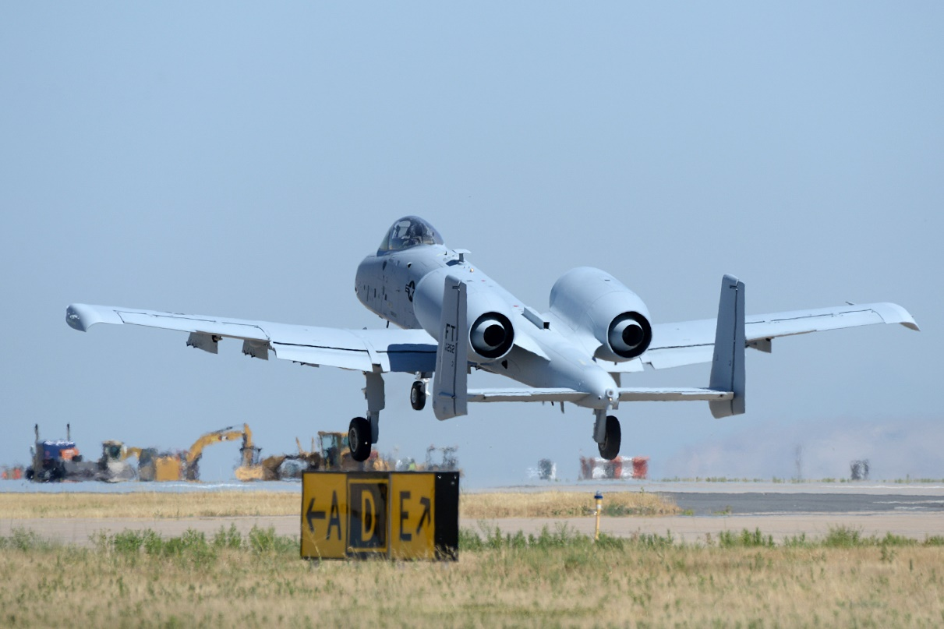
Additional Expectations
Continuous coordination with local leadership
Product volume projection
Process updates
Product changes
Product expertise
Liaison to industry

Slide 15
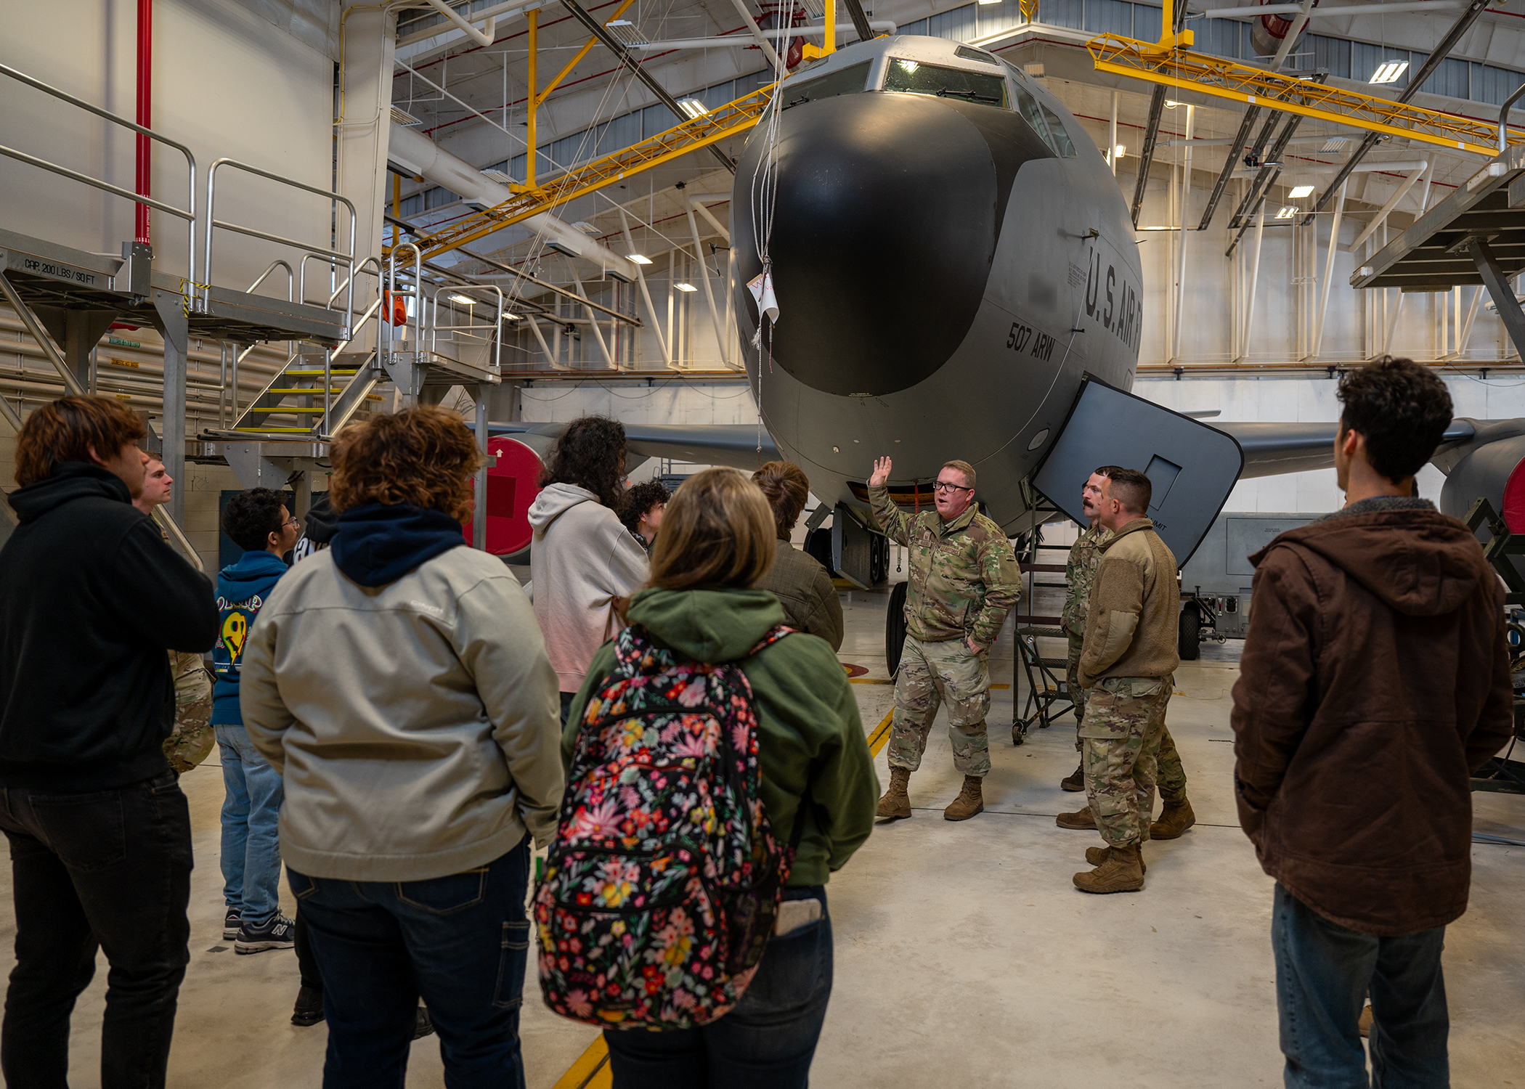
Next Steps: Site Visits
Hangar tour
Familiarization with supported workloads
Product storage and distribution facilities
Interact with leadership and personnel

Slide 16


Slide 17

Contract Timeline and Expectations
Estimated Timeline
Solicitation posting Nov 2025
Proposal due January 2025
Contract award July 2026
Contract start date May 2027
FFP contract for 5 years.
Anticipated to be a competed effort among small businesses under NAICS 325510.
Lowest priced technically acceptable source selection but may change to a tradeoff approach.

Slide 18

Q&A Questions
All questions and answers will be recorded and posted under the industry days announcement page on SAM.gov within the next couple of weeks.

