Slide 1


JOC Pre-Proposal Conference - 26 March 2026
414th Contracting Support Brigade
Contracting Officer: Cappello, Sebastiana
Contract Specialist: SSG Anglin, Lew
26MAR2026
1
Notes:
Welcome everyone to todays Pre-Proposal Conference I am your presenter SSG Anglin.

Slide 2
Ground Rules and Procedures
Keep side conversations to a minimum.
Take notes and save question(s) until called upon.
3. No technical discussions will be held in this conference.
4. All question(s) will need to be in accordance with:
L.1.7* Questions and Answers (Q&A): Offerors may submit questions as part of the Q&A period to the primary POCs (see section L.1.5) no later 01 April 2026, 11:00 AM Central European Time (CET). In accordance with the RFO's goal of streamlined communication, the Government will provide responses via the "Addendum/Notice" feature on https://sam.gov.
*Refer to selection L.1.7 can be found in Amendment W912PF26RA002 001 for additional instruction.
Prepared by: SSG Anglin, Lew
Notes:
Lets start off going over a few rules for todays Conference. Read Slide
Refer to selection L.1.7 can be found in Amendment W912PF26RA002 001 for additional instruction.

Slide 3
Pre-Proposal Conference Agenda
Team Introductions
Job Order Contract (JOC) Scope
Italy Price Schedule and Bidding Coefficients
JOC Task Order Process Overview
JOC Sample Task Order
JOC Sample TOPR Proposal
Doing Business with the 414th CSB
JOC Solicitation
QUESTIONS?
Prepared by: SSG Anglin, Lew
Notes:
Here is the agenda for today. Read slide

Slide 4
Team Introductions
414th Contracting Support Brigade
US Army Garrison – Italy
Sebastiana Cappello
Contracting Officer
Tausha Beins
Chief, Construction Management Branch
Directorate of Public Works, USAG Italy
SSG Anglin, Lew
Contract Specialist
Massimiliano Bozzolan
JOC – Contract Specialist Support
Matthew McNease
Office of Counsel
Prepared by: SSG Anglin, Lew
Notes:
Let me interduce the requirement team from the 414th Read Slide
And from US Army Garrison we have Read Slide

Slide 5
Disclaimer
Any comments or explanations shared during today’s presentation are intended for general informational purposes only and do not modify or override the terms and conditions of any resulting solicitation or subsequent contract.
Prepared by: SSG Anglin, Lew
Notes:
Read Slide

Slide 6

Job Order Contract (JOC) Scope
The JOC will be used to fulfill repair, maintenance, demolition and minor construction
requirements on a variety of projects ranging from Sustainment, Restoration, and
Modernization (SRM), simplified acquisition of base repair requirements, civil works
operations and maintenance, small renovations, real property repair and maintenance
with an estimated value more than the micro-purchase threshold (MPT) for acquisitions
of construction. At the time of this revision the MPT is $15,000.00 in accordance with
Federal Acquisition Regulation (FAR) 2.101 Definitions.
Prepared by: SSG Anglin, Lew
Notes:
The JOC addresses various repair, maintenance, demolition, and minor construction needs.
Project Types Include:
Sustainment, Restoration, and Modernization (SRM)
Simplified base repair requirements
Civil works operations and maintenance
Small renovations
Real property repair and maintenance
Financial Scope:
For construction acquisitions, projects must exceed the Micro-Purchase Threshold (MPT).
Currently, the MPT for construction acquisitions is $15,000.
(In accordance with FAR 2.101 Definitions)
Need to add in Credentials

Slide 7
414th CSB – JOC Award Intent / Overview
Indefinite-Delivery, Indefinite-Quantity (IDIQ), Single Award Task Order Contract (SATOC) Contract Award
Total Contract Value: Not to exceed $40 Million
Contract Term: 5-year base ordering period, with one 6-month option to extend the term of the contract
Ordering Period: 15 May 2026 through 14 May 2031
Types of Work: A project fundamentally for building renovations (e.g., roof repairs), repair replacement of major building systems (electrical, mechanical, HVAC), civil works (concrete asphalt roads, pavements, earthwork, drainage structures), or environmental project.
Task Order Range: Minimum $5,000 / Maximum $2,000,000
Prepared by: SSG Anglin, Lew
Notes:
Read Slide

Slide 8
JOC Benefits
Reduced procurement lead times
Fast and timely delivery of projects
Low overhead cost of construction, procurement, and delivery
Transparency with itemized unit pricing
Reduced number of change orders
Standard pricing and specifications utilizing a published Unit Price Book Europe - Attachment 2
Low risk to the Government
Prepared by: SSG Anglin, Lew
Notes:
Read Slide

Slide 9
JOC Limitations
JOC CANNOT be used for:
Fuels
Utilities (Contractor will perform incidental work to connection point of primary utilities)
Construction / Administrative Equipment
Furnishings
Construction materials only (lumber, concrete, etc.), for other than valid JOC projects
A-E Services (Brooks Act)
Administrative services such as typing, transportation, reproduction, graphics, and interior design services not part of a JOC Contractor construction proposal
Maintenance, overhaul, or repair of equipment
Housekeeping Services
Purchase of supplies
No Design (Contractor will produce shop drawings incidental to the job, reflecting the plan of action and the completed project)
For the sole purpose of abatement of lead-based paint and/or asbestos
Prepared by: SSG Anglin, Lew
Notes:
Here are a few items that con not be used with the JOC.

Slide 10
JOC Pricing
Factor 4 - Price (Coefficients)
Factor 4 - Price (Coefficients): Price proposals will be evaluated for completeness,
reasonableness, realism, and balance. The proposed coefficient(s) will be reviewed to
determine whether they reflect a fair and reasonable price to the Government.
Analysis will be performed by one or more of the following techniques to ensure a fair and
reasonable price.
Comparison of proposed coefficients received in response to the Solicitation.
Comparison of proposed coefficients with the Government Estimate.
Comparison of proposed coefficients with available historical information.
Comparison of proposed coefficients with market average.
Normal Regular Hours Coefficient: A single coefficient applicable to work performed during Regular Hours as defined in Section J, Attachment 3.
Other Than Regular Working Hours Coefficient: A separate coefficient applicable to work performed other than Regular Hours, as defined in Section J, Attachment 3.
Non Pre-Priced Items: A separate coefficient applicable to work performed Non-Pre Priced Items as defined in Section J, Attachment 3.
The Government reserves the right to conduct a price realism analysis of proposed prices to determine risk of unreasonable low proposed prices when compared to Offeror-proposed prices submitted in response to the solicitation or in comparison with the IGE.
Prepared by: SSG Anglin, Lew
Notes:
Nella will talk this slide.

Slide 11
JOC Pricing Continued
Non-Pre-Priced (NPP) Items: Tasks not included in the Unit Price Book Europe 2025 but within the intent and general scope of the contract. NPP work may also include items that are included in the Unit Price Book Europe 2025 but require adjustments because of unusual site conditions differing from those contemplated in the contract. NPP work is discussed separately from tasks included in the Unit Price Book Europe 2025. The coefficient developed for a Pre-Priced task or item must not be applied to a NPP task or item.
Non-Pre-Priced Work: A unique item not easily defined within the Unit Price Book Europe 2025 for which the Pre-Priced cost data will not be used in Task Order pricing. If the NPP portion of a project > 10% of the total cost, the project is not appropriate for JOC and an order will not be issued for that particular project.
Non-Standard Hours Coefficient: This is an optional coefficient that shall be used only when the Government specifies the requirement to complete a project during nonstandard hours.
Solicitation (W912PF26RA002) Reference: Attachment 1, Statement of Work (SOW)
Prepared by: SSG Anglin, Lew
Notes:
Nella will talk this slide.

Slide 12
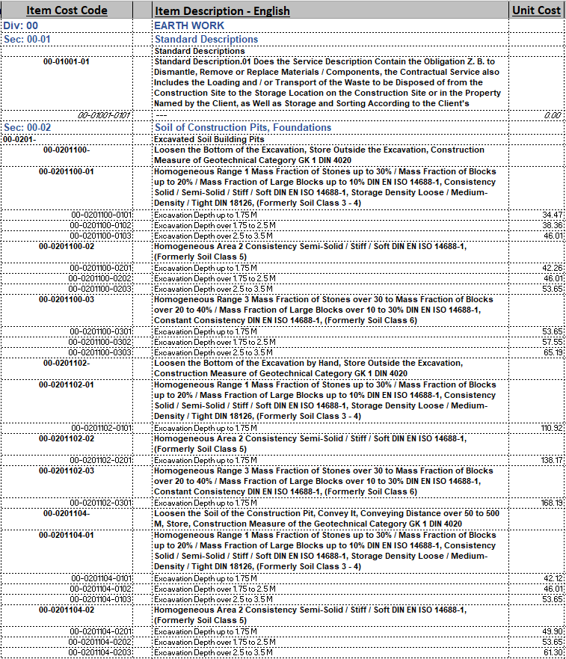
JOC Unit Price Book (UPB)
A compilation of real property repair, maintenance, minor construction related tasks, etc.
Integral part of contract
Thousands of items
Sections by trade
Each item has item number, description, unit cost & unit of measure
All UPB costs and their respective coefficients are established at the award of contract.
Prepared by: SSG Anglin, Lew
Notes:
Nella will talk this slide.

Slide 13
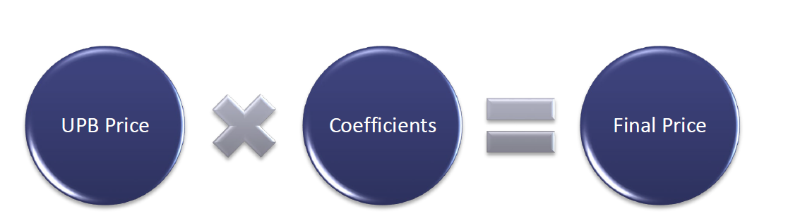
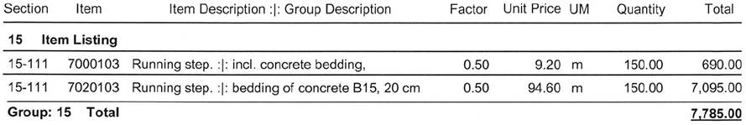
JOC Coefficients
Coefficient Factor or Coefficient: Coefficient means a numerical factor that represents costs (generally indirect costs) not considered to be included in the Unit Price Book Europe 2025 prices such as general, administrative, other overhead costs, insurance, alternative payment protection, protective clothing, sales tax, and compliance with tax laws. Coefficients proposed by offerors are multiplied times the unit prices in the Unit Price Book to price a job or project on individual orders. The coefficient(s) proposed by the Offeror and accepted by the Government are incorporated in the JOC. (7.6 of SOW Attachment 1)
Prepared by: SSG Anglin, Lew
Notes:
Nella will talk this slide.

Slide 14
JOC Coefficients Include:
Project-Related Costs
• Project management and project supervision.
• Contractor adjustments to Government Unit Prices.
• Price quotations.
• Submittal preparation.
• Quality Control.
• Collaboration/face-to-face meetings with all Program/Project stakeholders (i.e. progress reviews, negotiations, etc.)
• Services required to complete project filings and obtain permits.
• Preparation and modification of sketches, drawings, submittals, as-built drawings, and other project records. 13
• Incidental engineering and architectural services.
• Permits, licenses, and fees.
• Project trailer, equipment and supplies, and portable toilets for Contractor’s use.
• Gang boxes and storage containers for Contractor's tools, equipment and materials.
• Basic safety and warning signage, traffic signage, minor barricades (e.g., construction tape, etc.) and personnel safety equipment (e.g., hard hats, safety harnesses with lifeline or cabling, protective clothing, safety glasses, face shields, etc.).
• Meeting Government’s security requirements.
• Protection of Government property
• Removing and returning Government's furniture and furnishings (e.g. chairs, tables, pictures, etc. but excluding modular furniture, furnishings fastened to the wall or floor, safes and other furniture requiring disassembly).
• Sealing windows doors, and other openings with plastic to contain construction dust and debris within the work area, or to protect existing surfaces.
• Compliance with protection and safety laws (i.e., safety rails, face and clothing
• protection, etc.) • Working in extreme temperatures (below or above normal) or adverse conditions such as rain, wind, sleet or snow. Costs resulting from inadequate supply of building materials, fuel, electricity, or skilled labor.
• Daily clean-up.
• Final professional clean-up.
• O&M Manual.
• O&M Training.
Prepared by: SSG Anglin, Lew
Notes:
Nella will talk this slide.

Slide 15
JOC Coefficients Include:
Business-Related Costs
• Corporate, Regional, and Site offices (i.e. Office buildings, office spaces, office trailers, office management, office equipment and supplies, etc)
• Contractor’s overhead and profit.
• Subcontractor’s overhead and profit.
• All associated costs with Performance and Payment Bonds (per Army Federal Regulation Supplement 17.94 2(h))
• Business taxes, contributions, memberships, corporate headquarters support (legal, financial, etc.)
• Employee payroll taxes, insurances, and fringe benefits
• Other insurances.
• Compliance with environmental laws (overhead {indirect} cost associated with performing work in compliance with EPA/OSHA regulations including local Government requirements, including obtaining any necessary licenses and permits, reporting requirements, etc.)
Job Orders, poor Subcontractor performance, currency exchange, and inflation or material cost fluctuations.
• Job Order development services, Government meetings, and other administrative services required by the Contract Documents.
• Cost of financing the work.
• All taxes for which a waiver is not available including material sales tax and equipment rental.
• Business risks such as the risk of a lower-than-expected volume of work, smaller than anticipated
Prepared by: SSG Anglin, Lew
Notes:
Nella will talk this slide.

Slide 16
Italy Price Schedule and Bidding Coefficients
Unit Price Book (UPB) Coefficients
Offerors are required to price all Proposed Coefficients for all items.
Coefficients will be contractually binging.
Prices proposed will be analyzed to determine if prices are unbalanced.
Prepared by: SSG Anglin, Lew
Notes:
Nella will talk this slide.

Slide 17
JOC Task Order Process Overview
JOC Project
Stakeholder End User
Contractor
KO
PM
COR
Others
Project Identification
Joint Site Visit & Scoping
Task Order Proposal Request (TOPR) Issued
Contractor Prepares Cost Estimate/Proposal via Professional Cost-estimating software and JOCPB
DPW – 414th Proposal Reviews
Negotiate (as necessary)
Finalize Pricing (as necessary)
Contracting Officer Issues Task Order (DD 1155)
Project Execution (Construction - COR) – CMB Oversight
Task Order Close-out
Prepared by: SSG Anglin, Lew
Notes:
The key takeaway is this: for any listed construction-related tasks valued over $15,000, the JOC is our go-to contracting method. For anything under that amount, we would use other micro-purchase procedures.

Slide 18
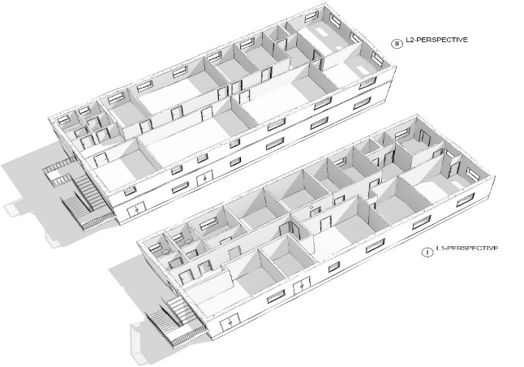
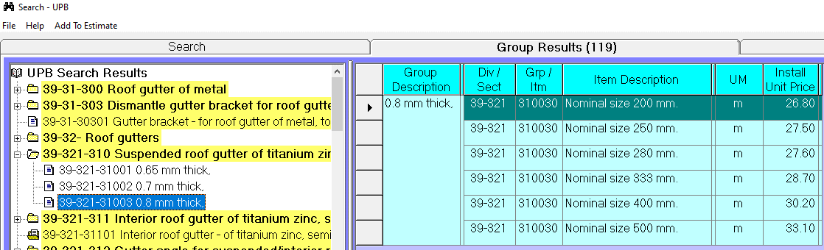
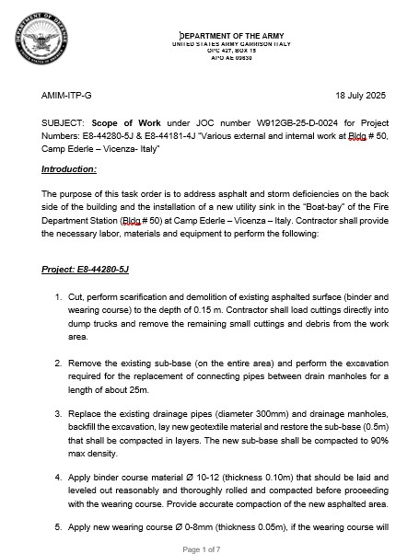
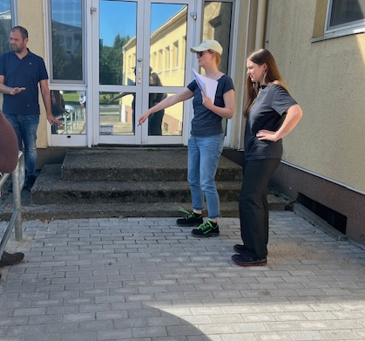
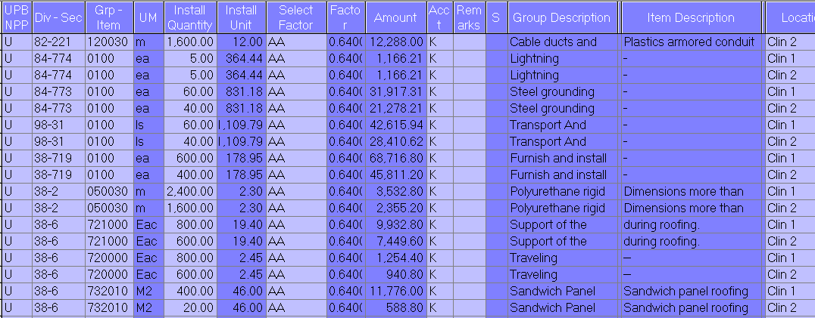
JOC Sample Task Order
The Sample Task Order is intended to be used as an EXAMPLE ONLY.
Unit costs and coefficients do NOT represent actual award pricing.
Prepared by: SSG Anglin, Lew
Notes:
Sample of a Task Order.

Slide 19
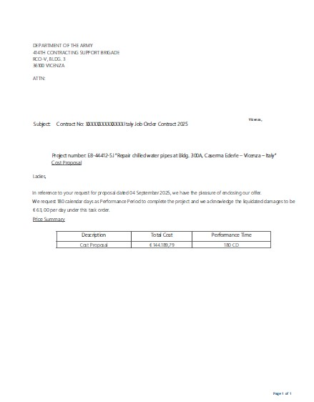
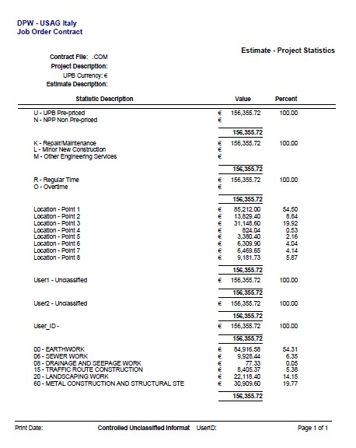
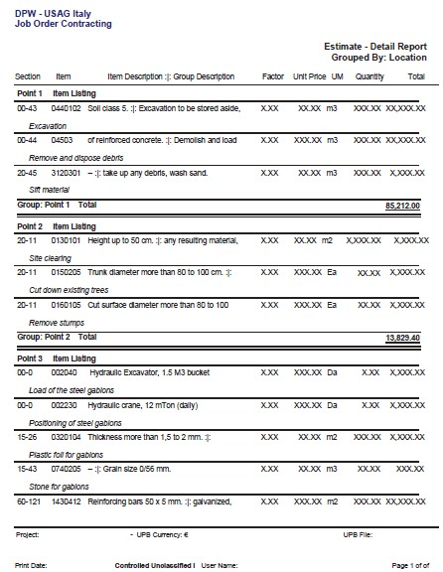
JOC Sample TOPR Proposal – Euros
CLINs or Features of Work
Summary Statistics
Detailed Statistics
Prepared by: SSG Anglin, Lew
Notes:
Sample of a TOPR Proposal

Slide 20

Doing Business with the 414th CSB
Prepared by: SSG Anglin, Lew
Notes:
Let cover some basic business practices that will help you.

Slide 21
Doing Business with the 414th CSB Part 1 (Pt. 1): Overview
Registration & ID Numbers
Unique Entity ID (UEI)
CAGE / NCAGE Codes*
SAM Registration
Source Selection Process
Understanding the Solicitation
Preparing your Proposal
Section K of Solicitation
*Commercial and Government Entity (CAGE) / NATO Commercial and Government Entity (NCAGE)
Prepared by: SSG Anglin, Lew
Notes:
Read Slide

Slide 22
Doing Business with the 414th CSB (Pt. 1) Registrations & ID Numbers
System | Description | Website | General Timeline
Unique Entity Identifier (UEI) | Unique nine-digit identification number for each physical location of your business | https://www.sam.gov/ | 7-10 business days
CAGE / NCAGE | Commercial and Government Entity (CAGE) Code NATO Commercial and Government Entity (NCAGE) Code | https://cage.dla.mil/Home/UsageAgree https://eportal.nspa.nato.int/AC135Public/default.aspx | 7-10 business days
SAM | System for Award Management (SAM) is a registration database required for all US Federal Government Contracts and where you will find opportunities. | https://www.sam.gov/ | 2 weeks to go active
Prepared by: SSG Anglin, Lew
Notes:
Read Slide

Slide 23

Doing Business with the 414th CSB (Pt. 1) System for Award Management (SAM) Entity Registration
SAM registration is required for all Offerors, including JVs. A copy of their current "entity registration" shall be available in the SAM website, at www.sam.gov. Offerors not registered and active, at time of proposal submission and through contract award, may be determined ineligible for contract award.
Offerors shall ensure complete, current, and accurate information under the "FAR & DFARS Report," which demonstrates current and complete representations and certifications on the SAM Website.
Non-U.S. (foreign, including Italian) Offerors ONLY: Non-U.S. offerors must obtain a NATO CAGE (NCAGE) Code instead of a CAGE Code prior to registering in the SAM database. NCAGE codes may be obtained at the NCAGE website http://www.dlis.dla.mil/Forms/Form_AC135.asp.
Prepared by: SSG Anglin, Lew
Notes:
SAM Registration Requirements
Mandatory for All Offerors:
Registration in SAM (System for Award Management) is required for everyone, including Joint Ventures (JVs).
Your registration must be active from the time you submit your proposal through the final contract award.
Warning: Inactive or missing registration may lead to disqualification.
Keep Your Information Current:
You are responsible for ensuring your "FAR & DFARS Report" in SAM is complete and accurate.
This includes all your representations and certifications.
Special Rule for Non-U.S. Offerors:
All foreign companies (including Italian firms) must first obtain a NATO CAGE (NCAGE) Code.
You cannot register in SAM without an NCAGE code.
Obtain your NCAGE code from the official NCAGE website.

Slide 24
Doing Business with the 414th CSB (Pt. 1) Source Selection Process Overview
Develop Requirement & Conduct Market Research
Develop Acquisition Strategy/Plan
Government Issues Solicitation (via SAM.GOV & PIEE) – 09 March 2026
Pre-Proposal Conference / Site Visits may be held – 26 March 2026
Offerors submit questions – DUE by 01 APRIL 2026
Offerors Submit Proposals – DUE by 20 APRIL 2026
Government Evaluates Proposals
If Necessary, Establish Competitive Range, Hold Discussions, & Request & Receive Final Proposal Revisions
Evaluate Final Proposals & Make Source Selection Decision
Contract Award
Debriefings
Prepared by: SSG Anglin, Lew
Notes:
Read Slide

Slide 25
JOC Solicitation
Go to SOLICITATION DOCUMENT via SAM.GOV
Prepared by: SSG Anglin, Lew
Notes:
Nella will talk this slide.

Slide 26
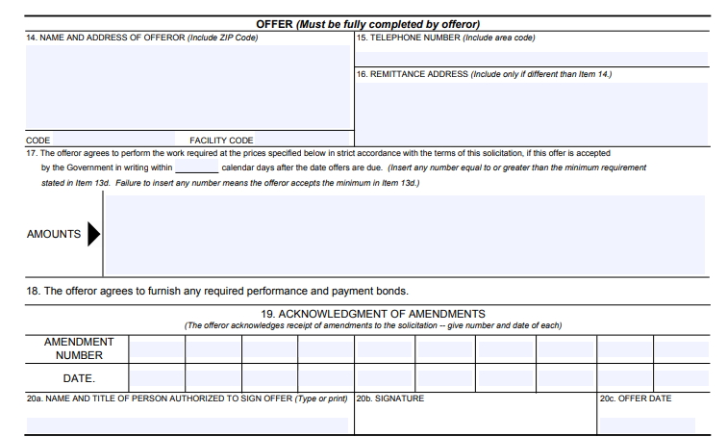
JOC Solicitation
Prepared by: SSG Anglin, Lew
Notes:
Nella will talk this slide.

Slide 27
JOC Solicitation Understanding the Solicitation Package and Preparing the Proposal
The typical Request for Proposal (RFP), or Solicitation W912PF26RA002, is a significantly long document and has very specific requirements. Make sure you thoroughly read and understand the proposal submission requirements and process.
You may be disqualified or determined ineligible for award by submitting a proposal that does not meet all of the RFP requirements.
Offerors are advised to provide their BEST PROPOSAL in the first submission.
Prepared by: SSG Anglin, Lew
Notes:
Nella will talk this slide.

Slide 28
JOC Solicitation
FY 26 JOC Solicitation W912PF26RA002
Prepared by: SSG Anglin, Lew
Notes:
BRIEFED BY CIV DEPUTY

Slide 29
JOC Solicitation General Solicitation Information
A.1 The U.S. Army, 414th Contracting Support Brigade (CSB) Regional Contracting Office-Vicenza (RCO-V), Italy intends to award a contract to provide a Job Order contract (JOC) for various minor construction requirements under an Indefinite Delivery Indefinite Quantity (IDIQ) Single Award Task Order Contract (SATOC) in support of the US Army Garrison Italy (USAG-I) Directorate of Public Works (DPW).
A.2 This Request for Proposal (RFP) is a competitive acquisition to establish the RCO-V, Construction JOC IDIQ SATOC contract Firm Fixed Price (FFP) Task Orders requirements.
A.3 This JOC shall be awarded using the Trade Off Approach in accordance with FAR 15.103-1, utilizing the DoD Source Selection Procedures to meet the Government's requirement.
A.4 The Government shall issue a Task Order Proposal Request (TOPR) for individual construction requirements subject to the JOC/SATOC terms and conditions. Construction requirements will be issued in accordance with the Order Placement Procedures established in Section H herein.
A.5 The total value of all orders awarded shall not exceed $40 Million.
A.6 Funding for construction efforts shall be made available for each Task Order requirement. The minimum guarantee is established at Section B herein.
A.7 The contract includes a base ordering period of five (5) years. The Government may extend the term of the contract by one six-month period in accordance with FAR 52.217-8, Option to Extend Services.
A.8 The word "Offeror" as used throughout this RFP or solicitation, as used interchangeably herein, means a company seeking to do business with the Department of War (DOW) Government by submitting a proposal in response to this RFP. "Government" may describe the contracting activity, RCO-V, or the primary customer for resulting task orders, the U.S. Army Garrison (USAG) Italy, Department of Public Works (DPW), located at the USAG Vicenza, Italy.
Prepared by: SSG Anglin, Lew
Notes:
Nella will talk this slide.

Slide 30
JOC Solicitation Source Selection Approach
The Government will award a contract to the responsible offeror whose proposal represents the best value to the government using a tradeoff process.
Evaluation Factors:
Factor 1: Corporate Experience
Factor 2: Management Approach
Factor 3: Past Performance
Factor 4: Price (Coefficients)
Relative Importance:
The factors will be weighted in the following order of importance:
Factor 1 - Corporate Experience and Factor 2 - Management Approach: These are equal in importance
Factor 3 - Past Performance: This is less important than Factors 1 and 2.
Factor 4 - Price (Coefficient): This is the least important factor.
Prepared by: SSG Anglin, Lew
Notes:
Nella will talk this slide.

Slide 31
JOC Solicitation Joint Venture Agreements
Joint Venture (JV) Agreements
A JV refers to a formal Legal Entity in the nature of a Partnership comprised of two or more persons or companies. As a JV, in order to be eligible for contract award, each Joint Venture must provide the following:
One (1) CAGE/NCAGE Code;
One (1) Unique Entity Identifier (UEI), and;
One (1) active registration in the Chamber of Commerce Registration (CCR), at https://italianbusinessregister.it/en/chambers-of-commerce, all of which use the same name of the Joint Venture.
JV Offerors shall provide, with their proposal, a notarized legal document that establishes the JV. The JV shall be formed and valid at the time of submission of the proposal.
Submission of the notarized legal document that establishes the JV shall be furnished with the proposal in its original language version along with a certified English translation of the document.
Note: The notarized legal document shall include language that each member of the JV will be jointly and irrevocably liable for the performance of the whole contract and will be incorporated into the contract award if award is made to the JV.
Prepared by: SSG Anglin, Lew

Slide 32
JOC Solicitation Joint Venture Agreements (Continued)
The Joint Venture Agreement shall include, at a minimum, the following:
Name of firms that form the JV and the name of the JV
Name and title of the corporate officials signing on behalf of each party
Solicitation number
Description of the responsibilities in terms of work category for each member (for example: Firm A performing 100% of C-2-d.)
The statement "The composition and structure of the JV will remain unchanged from award to one (1) year after contract completion.“
Date of issuance of the agreement and notarized signature of the corporate officials signing in behalf of each party.
Statement under oath stating that the JV is in compliance at the time of proposal submission with all applicable laws, rules, and regulations. This statement must be signed under oath by all members comprising the JV.
Note: The JV Agreement shall take effect upon the submission of the Offeror's proposal and shall remain irrevocable until one (1) year after the expiration of the Contract performance period.
The U.S. Government reserves the right to review the actual JV Agreement to determine its basis and compliance with the applicable laws. Any internal agreement(s) affecting the internal composition of the existing JV Agreement and its potential liabilities in relation to the contract (performance guarantee, insurance, etc.) shall be sent to the Contracting Officer at time of the JV Agreement review.
Any change(s) in the composition of the JV will require the JV to formally request a Novation
Agreement in accordance with FAR 42.12, which will be approved/disapproved at the
discretion of the Contracting Officer.
Prepared by: SSG Anglin, Lew
Notes:
Nella will talk this slide.

Slide 33
JOC Solicitation
QUESTIONS?
Prepared by: SSG Anglin, Lew
Notes:
ANY QUESTION not of a technical nature and pertaining to this presentation?

Slide 34

414th CSB - U.S. Procurement Law & Overseas Contracting
U.S. Procurement Regulations and Important Clauses
U.S. Contracting Officers (KO)
Defense Base Act Insurance
Taxes and VAT
Questions
Prepared by: McNease, Matthew
Notes:
Our next speaker will be Mr. McNease legal counsel.

Slide 35

414th CSB - U.S. Procurement Law and Regulations
Contracts are awarded and executed under
United States procurement laws and regulations.
Federal Acquisition Regulation (FAR) Overhaul (RFO)
http://acquisition.gov
Defense FAR Supplement (DFARS)
http://acquisition.gov
Army FAR Supplement (AFARS)
http://acquisition.gov
Prepared by: McNease, Matthew

Slide 36
414th CSB - DISPUTES AND CLAIMS REGULATIONS
Title 41 United States Code (U.S.C.) Chapt. 71 - Contract Disputes
RFO FAR Subpart 33.2, Disputes and Appeals
FAR 52.233-1, Disputes
Prepared by: McNease, Matthew

Slide 37
414th CSB - Compliance with local labor laws
The U.S. Government is committed to ensuring that laborers on our projects receive working conditions and wages in accordance with Host Nation laws and regulations.
“Compliance With Local Labor Laws,” provides that contractors must comply with all host nation labor laws and regulations including laws and regulations relating to hours of work and compensation.
Be aware that this applies to subcontractors as well as the prime contractor – the prime contractor is responsible for ensuring that all workers on the project are properly paid, regardless of whether the workers are employed directly by the prime contractor, principal subcontractor or subcontractors at any tier.
Prepared by: McNease, Matthew
Notes:
BRIEFED BY CIV DEPUTY

Slide 38
414th CSB - Defense Base Act (DBA) Insurance
What is the Defense Base Act?
-The DBA is a U.S. federal law requiring workers' compensation insurance for civilian employees working overseas on contracts with the U.S. government.
-The primary purpose is to provide medical benefits, disability compensation, and death benefits to covered employees who are injured, or to their dependents if they are killed, in the course of employment.
Application to U.S. Government Contracts in Italy
-Mandatory Coverage: All contractors and subcontractors with U.S. government-funded contracts performing public works or national defense-related activities outside the United States must secure DBA insurance for their employees.
-This includes construction projects in Italy.
-For Italy, a waiver exists, but it's crucial to understand that this waiver does not apply to U.S. citizens, U.S. residents, or any employee hired within the United States. Therefore, for those employees, DBA insurance remains mandatory.
Prepared by: McNease, Matthew

Slide 39
414th CSB - Defense Base Act (DBA) Insurance
Key Vendor Responsibilities
-Secure DBA Insurance: Before starting any work on the contract, you must obtain DBA insurance from an authorized insurance carrier.
-Major authorized carriers include companies like CNA, AIG, and ACE-USA.
-Proof of Coverage: You will be required to provide proof of DBA insurance before a Notice to Proceed (NTP) can be issued.
-Subcontractor Compliance: Prime contractors are responsible for ensuring that all of their subcontractors also have the required DBA insurance coverage. If a subcontractor fails to secure it, the prime contractor becomes liable.
-Consequences of Non-Compliance: Failure to secure and maintain DBA insurance can result in severe penalties, including fines of up to $10,000, imprisonment, and personal liability for corporate officers to pay any benefits owed to an injured employee.
Prepared by: McNease, Matthew

Slide 40
414th CSB - Tax and Tax Exemptions
Generally, United States contractors when working solely for the purpose of supporting the U.S. Government should not be subject to any form of income or profits tax by a foreign government.
Importation of articles by any contractors acting on behalf of the U.S. should be free of any import duties or taxes.
Articles and services acquired by contractors acting on behalf of the U.S. should not be subject to direct or indirect taxation, to include value added taxes, excise taxes, sales taxes or similar taxes.
Prepared by: McNease, Matthew

Slide 41
414th CSB
QUESTIONS?
Prepared by: McNease, Matthew
Notes:
ANY QUESTION not of a technical nature and pertaining to this presentation?

